Slide 1
The Opioid Epidemic:
Our National Public Health Crisis
Jeremy Adler, M.D.
Family Physician, Unity Healthcare
Health Officer, Tippecanoe County Health Department

Slide 2
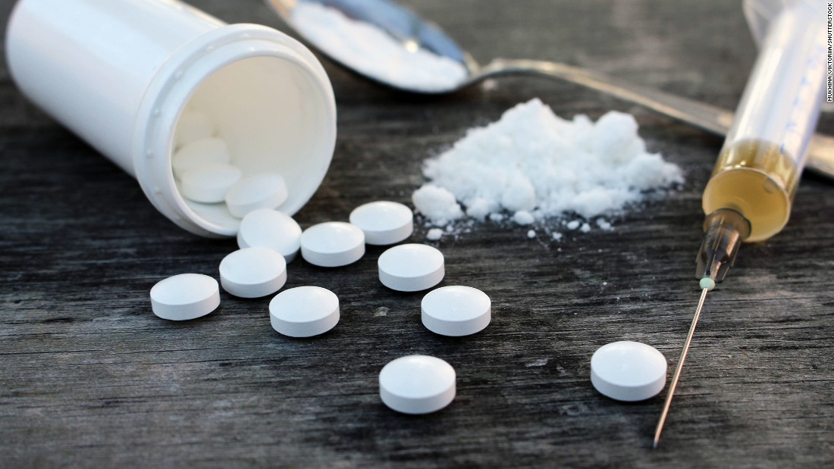

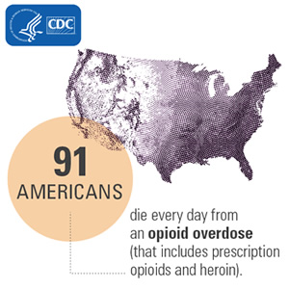



Slide 3
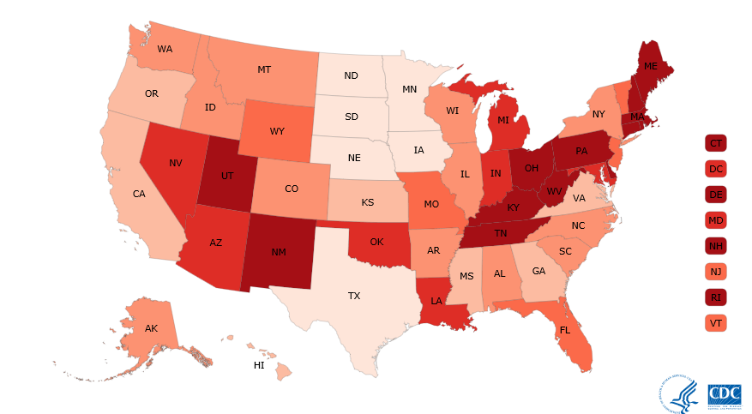
Drug Overdose Death Rates (2015)
2015 age-adjusted rate
(per 100,000 people)
2.8 to 11.0
11.1 to 13.5
13.6 to 16.0
16.1 to 18.5
18.6 to 21.0
21.0 to 41.5
Indiana: 19.5 drug overdose deaths per 100,000 people (1,245 deaths)

Slide 4
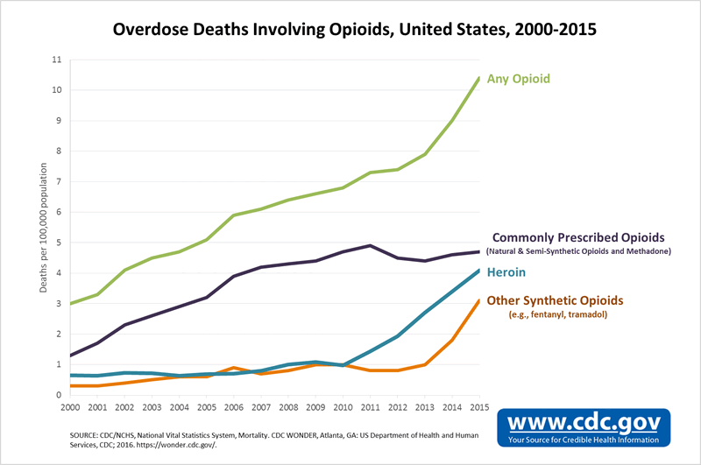

Slide 5
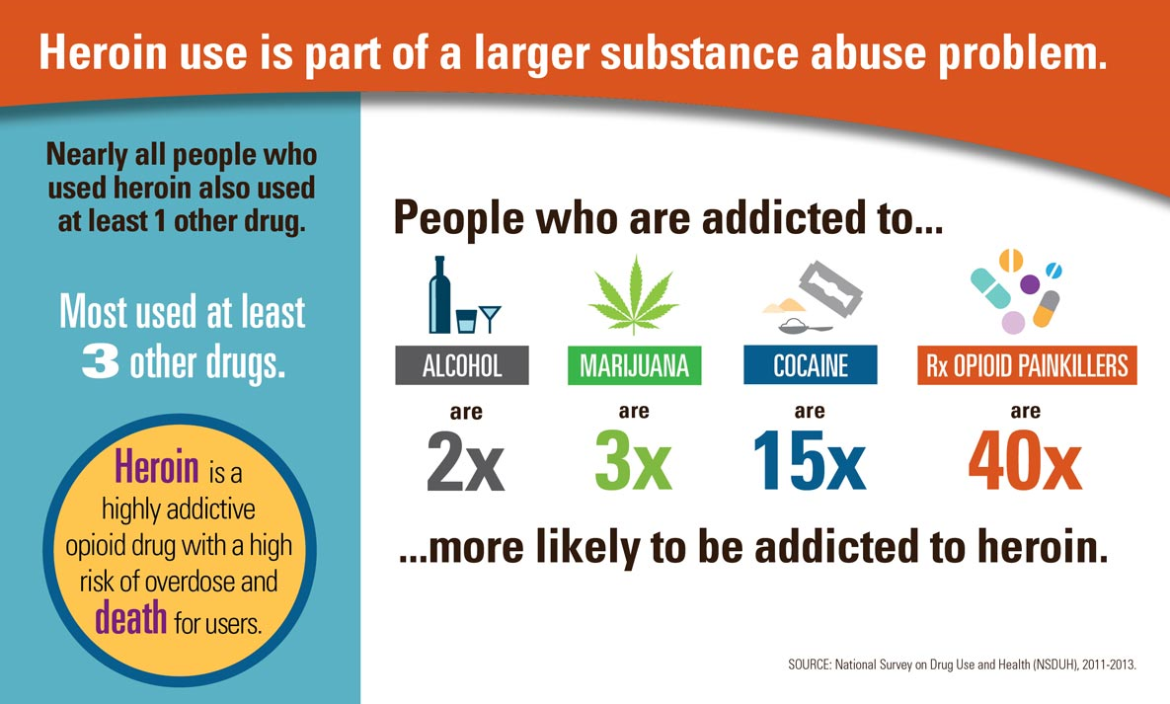

Slide 6
World Population vs.
Opioid Prescriptions
U.S.A. = 4% of world population
U.S.A. = 80% of opioid prescriptions

Slide 7
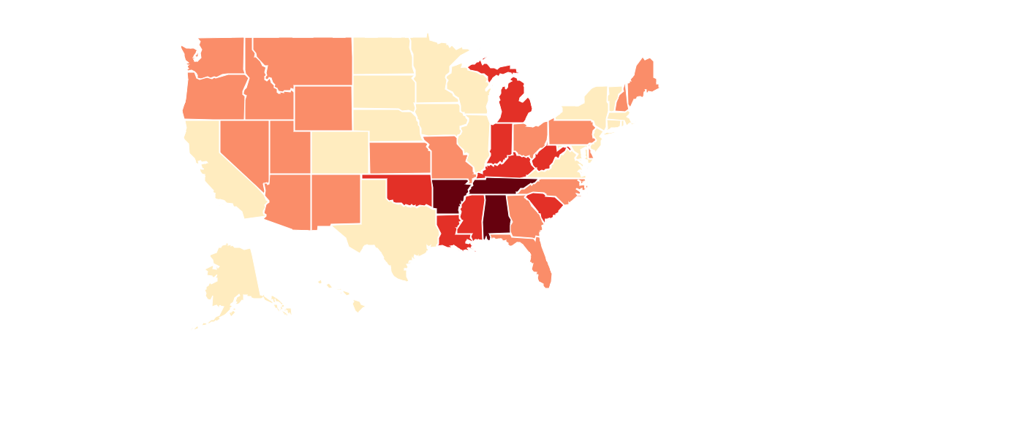
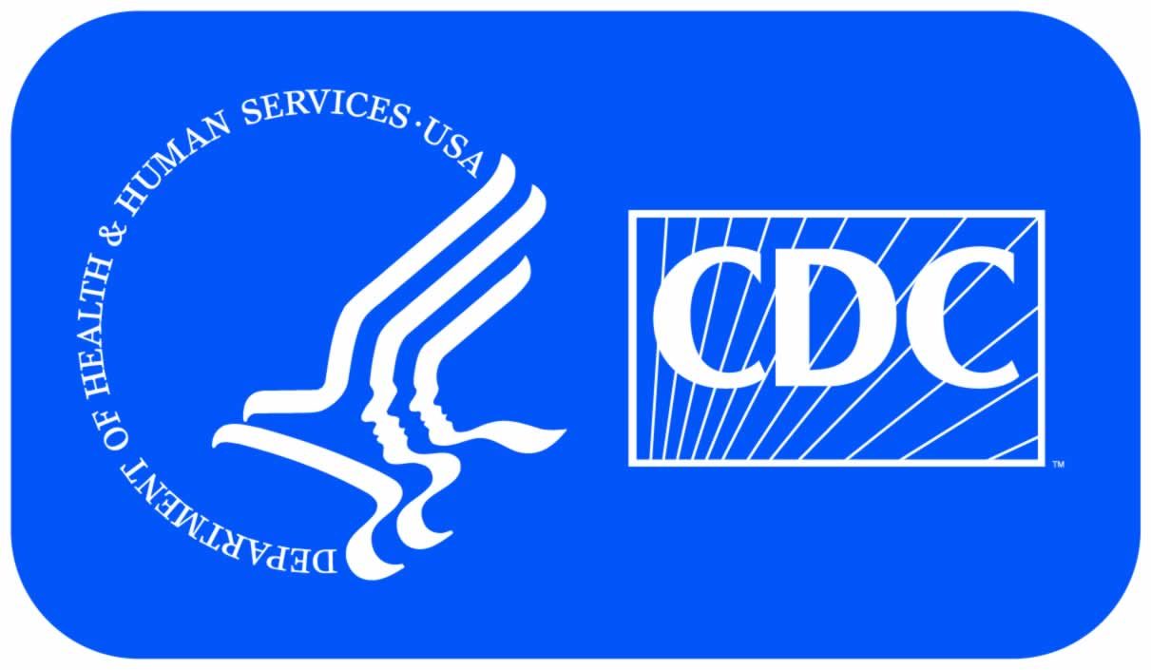
Opioid Prescriptions per 100 Residents
 | < 64.1
 | 64.1 - 82.9
 | 83.0 - 107.1
 | > 107.1
Indiana: 83.9 opioid prescriptions per 100 residents

Slide 8


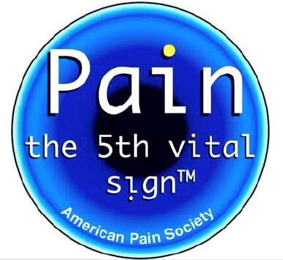

The Perfect Storm

Slide 9
People who abuse prescription painkillers get the drugs from a variety of sources
7.1%
Other
4.4%
Drug dealer or stranger
16.2%
Bought or stole from friend or relative
17.3% Prescription
Source: 2010 National Survey on Drug Use and Health
Tennessee Substance Abuse and Mental Health Services Administration

Slide 10

Fighting the Epidemic: Medical Providers
Improve understanding of chronic pain and its management
Expand use of non-opioid alternatives to manage pain
  Non-opioid pain relievers
  Topical analgesics
  Heat/ice/compression
  Exercise/stretching/physical therapy/massage
  Electrical stimulation (TENS unit)
  Therapeutic ultrasound
  Joint/trigger point injections
  Accupuncture
  Biofeedback
Expand substance abuse and addiction treatment services

Slide 11
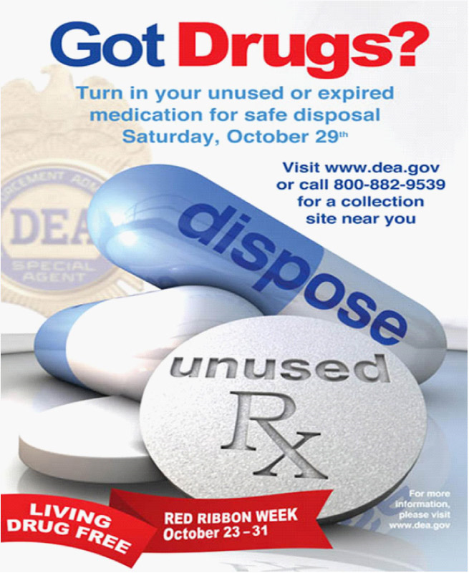
Fighting the Epidemic: Our Communities
Education
Drug disposal/take-back programs
Narcan
Collaboration

Slide 12
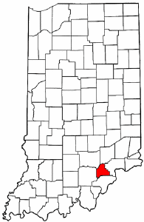

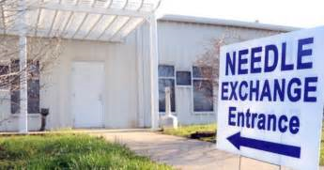
Scott County, Indiana (2014 - 2015)
210 people infected with HIV because of sharing needles
95% also infected with hepatitis C virus
"People often ask me what's unique about Scott County. I tell them, 'Absolutely nothing.’“ -- Dr. Jerome Adams, U.S. Surgeon General

Slide 13
U.S. Syringe Services Programs (April 2017)
Source: American Foundation for AIDS Research/NASEN

Slide 14
Syringe Exchange Programs: Proven Benefits
Harm reduction: reduce transmission of HIV and hepatitis C virus
Save money – every $1 spent saves $3 in treatment costs
Encourage safe disposal of syringes
Reduce risk of needlestick injury to law enforcement officials, EMS personnel, and public
Serve as link to drug treatment, healthcare, and social services
-- The American Foundation for AIDS Research

