Slide 1
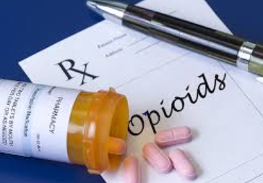
Opioids: Pain, Use and Patient Management
Dr. Pamela Aaltonen aaltonen@purdue.edu

Slide 2
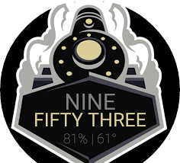
What Using
How Did We Get Here?
Prescribing Practices
Unintended Consequences
Indiana’s Plan
Good Samaritan Coverage
Why Needed … Indiana Stats
Drug Disposal
Harm Reduction Strategies vs. Criminal Approach
Legal Action Against Opioid Manufacturers
Illegal Opioid Marketplace (use of USPS)
Extra Data
Where Going?

Slide 3
What are we using in healthcare …
Natural (from opium/poppy flower)
Morphine
Codeine
Semi-Synthetic (chemical modification of natural opiates)
Oxycodone
Hydrocodone
Meperidine
Hydromorphone HCL
Fully Synthetic
Fentanyl
Methadone
Buprenorphine
Street names: footballs, pink footballs, yellow footballs, 65’s, Ns juice, dillies, drug street heroin, demmies, pain killer, Oxy 80s, oxycotton, oxycet, hillbilly heroin, percs perks, pain killer, vikes, hydros and pinks
Notes:
Approach of treatment: relief from drug craving and withdrawal symptoms without providing patients with intense high. Methadone and Buprenorphine have been proven to be effective in reducing heroin use, maintaining prolonged periods of abstinence, increasing retention in drug treatment and reducing risk of overdose-related death.

Slide 4
So have Medical vs Non-medical opioid users
Medical users: take opioids exactly as prescribed for pain relief with no extra doses for pain relief or pleasurable effect
Concern: risk of dependence goes up with amount and length of treatment
Non-medical opioid users: illicit, prescription drugs used in manner other than directed by provider (physician, nurse practitioner, physician assistant)
Given by or stolen from family or friends
Doctor shopping
Buy from friends, family members, drug dealers
Switch to heroin (may be cheaper, readily available); now increasingly cut with fentanyl
Start with heroin

Slide 5
How did we get here … contributing factors:
Health care system tagged with failing to appreciate & treat pain appropriately
1996 OxyContin [Purdue Pharma] approved as a “minimally addictive” time-released pain reliever
Launch of aggressive public campaign
Cultural shift in expectations for both health providers (improve assessment and management of pain) and general public (be pain free)
2001 Joint Commission (accreditation body) issued pain standards (pain = 5th vital sign)
2007 Purdue Pharma pleads guilty to federal criminal charge of misleading regulators, doctors and patients … $600 M fines & litigation)
1999 to 2015 prescription rate for opioids triples
Alternative therapies not as well reimbursed as opioid prescriptions
Efficacy? Timetable? Measuring pain?
Notes:
Purdue Pharma launched campaign in 1996: new safe drug, OxyContin, to treat pain beyond that caused by surgery, trauma, or cancer.
Touted as being safe because slow release of ingredients, making it unlikely to become addictive

Slide 6
Number Opioid Prescriptions per 100 residents in top 10 States, 2016
IN 9th highest rate

Slide 7
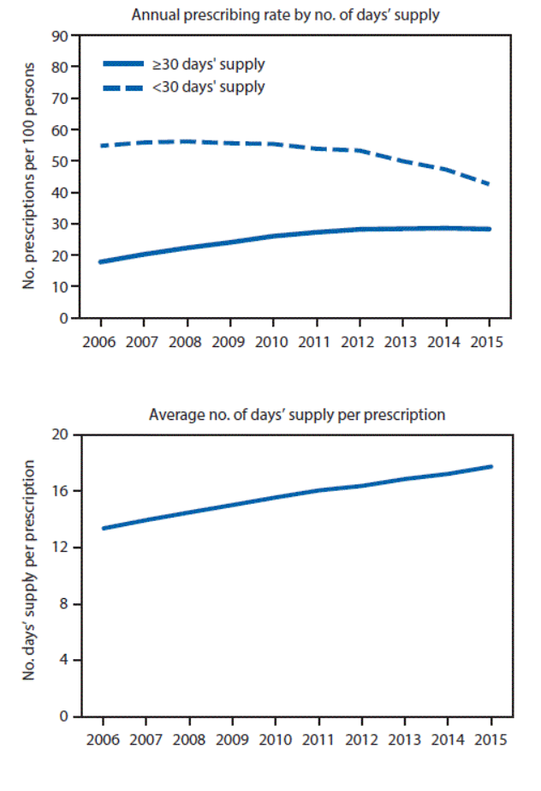
Prescribing Practices
Top-prescribing counties 6 X ↑ than low-prescribing counties
While # of prescriptions ↓, amount per Rx ↑
2nd opioid prescription doubles risk of opioid use 1 year later
1 in 4 prescription users struggle with addiction
Suggests:
Inconsistent practice patterns
Not differentiating among types of pain
Lack of consensus re: appropriate use (CDC data … ideal duration for Rx is < 3 days)
Potential point of contention between patient and practitioner
Need for alternatives
Source: CDC, 2017, MMWR, 66(26). Changes in Opioid Prescribing in the United States, 2006-2015

Slide 8
Epidemiology informs us that higher amounts of opioids prescribed …
In micropolitan areas (10,000-50,000 population)
For non-Hispanic whites
Among uninsured & those enrolled in Medicaid
For those with lower educational attainment
Among those with higher rates of unemployment
In communities with more dentists and physicians per capita
Where prevalence of diagnosed diabetes, arthritis, disability is higher
In communities with higher suicide rates
Meaning?
Missed significance of ↓ life expectancy in white males in several states
Source: CDC, 2017, MMWR, 66(26). Changes in Opioid Prescribing in the United States, 2006-2015

Slide 9
Prescribers … treating pain
Balance benefits against serious potential adverse outcomes (addiction, overdose, misuse/abuse, and death)
Assess patient situation carefully (types of pain)
Be knowledgeable about drugs, actions, drug interactions, limitations of use
Be familiar with how to initiate, modify, and discontinue use
Know how to counsel patients and caregivers on safe use, including proper storage and disposal
Be familiar with & advocate for alternative approaches to treating pain
Know when to refer to specialists
Identify and use community resources

Slide 10
Recommendations for nurse practitioner’s approach … chronic, nonmalignant pain
Perform pain assessment -- determine if opioid therapy indicated
Apply risk stratification tools -- risk for adverse outcomes to opioids
Obtain informed consent from patient to receive opioid therapy
Construct mutually developed treatment agreement
urine toxicology screening
opioid taper plan
naloxone rescue education
nonpharmacological and behavioral interventions
Limit administration & management of opioid therapy to a single primary provider
Ongoing evaluation of response to opioid therapy (pain, functioning, adherence)
Involve addiction specialist if at risk for substance abuse disorders
Abuse-deterrent opioid formulations (difficult to extract active opioid component)

Slide 11
Unintended Consequence of Crackdown on Prescribing Practices
Crackdown
Decrease in “doctor-shopping”
Restrictions in amounts and timetable of prescriptions
Increase in pharmacy robberies (DEA statistics)
Between 2009 and 2016, Indiana = 651 robberies (second highest, California with 597 … 6 X the population of Indiana)
Indianapolis drug dealers recruiting juveniles to rob pharmacies
Pharmacy Actions
Time-release safes (wait to get drugs)
Armed guards
Height markers
Prohibition of hats, sunglasses, hoods at counters
Eye-level cameras

Slide 12
Indiana’s Integrated Response Plan, 2017
Best Practice | Indiana Response
Improving opioid prescribing practices (INSPECT) | Dispensing data must be submitted to Prescription Drug Monitoring Program (PDMP) within 24 hours Prescribers not required to consult PDMP Program allows public health to track trend Needs to be integrated with EHR
Expanding use and distribution of naloxone | Bills passed to broaden access
Expanding [medication-assisted] treatment to reduce opioid use disorders and overdose | Elimination of approval for methadone tx for Medicaid recipients Use of telemedicine (Project ECHO) ↑ ER/ED referral to treatment ↑ access to buprenorphine
Environmental Prevention Expansion | Increase education through use of social media platforms, etc.

Slide 13
Good Samaritan Overdose Prevention Laws
Laws in all states but AZ, IA, ID, KS, MO, ME, OK, SC, TX, WY
Naloxone (brand name: Narcan) can reverse opioid overdose
Injectable (been in use for 40+ years by emergency response personnel)
Auto-injector (EVZIO) thru clothing if necessary
Nasal spray (Narcan Nasal Spray)
Would one recognize an opioid emergency?
Extreme sleepiness/unresponsiveness; unable to awaken
Small or “pinpoint” pupils
Slow heartbeat (average 60-100/min, adult)
Breathing slow or shallow to not breathing at all (average 12-18/min, adult)
Fingernails or lips turning blue/purple

Slide 14
A bit more about Naloxone
Antidote binds to opioid receptors in brain preventing drugs from doing its work; temporarily reversing overdose within 2-5 minutes post administration
If give to someone NOT overdosing, will have no effect
Immunity for calling 911 (good faith reporting)
Indiana school districts allowed to stock naloxone as an “emergency medicine” (like albuterol for asthma and EpiPens for allergies)
Bartholomew Schools saved a life (nonstudent)
Starting in 2017 must report to State when drug used on school property
Cost ~ $37.50 per dose (18 month shelf live); going up

Slide 15
Naloxone access via Pharmacy Chains
Nacan Nasal Spray without prescription available at Walgreens other than North Dakota (no Walgreens), Puerto Rico and US Virgin Islands by end of 2017 (previously 33 states)
CVS currently offers prescription-free naloxone in 43 states
Demo devices in pharmacies
Education when individual dispensed drug which places at risk for accidental overdose
Cost may be an increasing factor; as demand increases, costs up
One fire department $6 in 2010; $30 in 2016
Evzio (auto-injector $288 in 2014; $2,000 in 2017; up to $4,500 in some markets)
Talking device

Slide 16
Non-Fatal Hospitalizations Due to Opioid Overdose, Indiana 2015
County | # | County | # | County | # | County | #
Adams | 5 | Hamilton | 27 | Lawrence | 7 | Sullivan | 5
Allen | 99 | Hancock | 10 | Madison | 48 | Tippecanoe | 32
Bartholomew | 11 | Hendricks | 17 | Marion | 224 | Vanderburgh | 59
Boone | 12 | Henry | 12 | Marshall | 14 | Vermillion | 14
Clark | 13 | Howard | 21 | Monroe | 15 | Vigo | 26
Clinton | 10 | Huntington | 14 | Montgomery | 9 | Wabash | 10
Dearborn | 16 | Jackson | 6 | Morgan | 18 | Warrick | 8
Decatur | 5 | Jasper | 9 | Noble | 8 | Washington | 5
DeKalb | 5 | Jefferson | 6 | Owen | 6 | Wayne | 39
Delaware | 54 | Jennings | 5 | Porter | 53 | Wells | 8
Dubois | 5 | Johnson | 22 | Randolph | 9 | White | 5
Elkhart | 36 | Knox | 9 | St. Joseph | 81 | Whitney | 8
Fayette | 10 | Kosciusko | 15 | Shelby | 9 | IN Total | 1430
Floyd | 17 | Lake | 94 | Starke | 7
Grant | 12 | LaPorte | 30 | Steuben | 8
Counties not on list had < 5; data suppressed
Source: ISDH Epidemiology Report 2016, Table 7

Slide 17
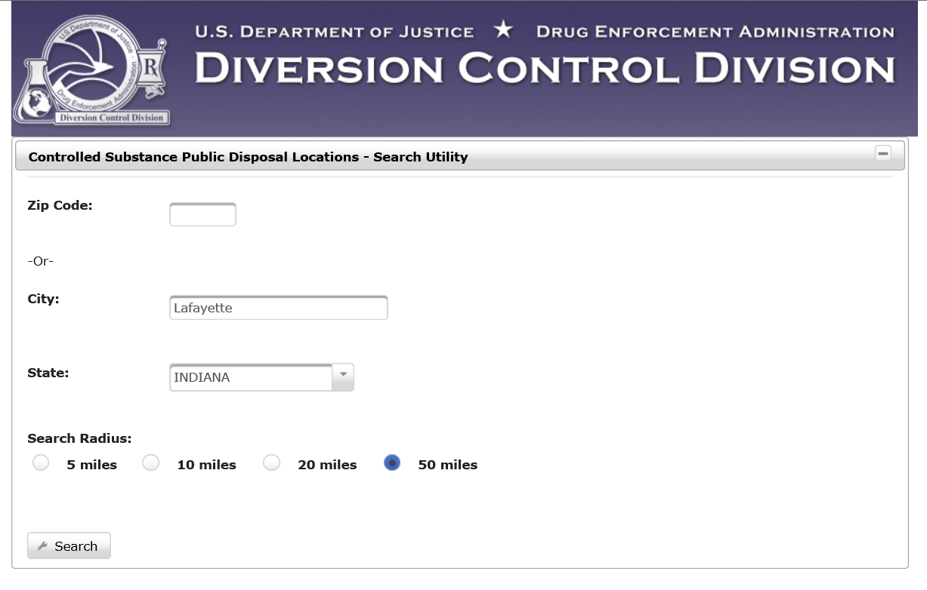
Database of public drug disposal locations
Medication disposal program also key
Prescription drugs, including opioids
Over-the-counter medications
Not accepted
Illegal drugs, needles, lotions or liquids, inhalers, thermometers, hydrogen peroxide, aerosol cans

Slide 18
Harm Reduction Strategies vs. Criminal Approach… best strategies?
Philosophy: not endorse drug use, but accepts drug use as a reality and focuses on reducing harmful consequences (death, HIV, Hepatitis C, dysfunction, criminal activity, incarceration)
Harm reduction strategies
Syringe exchange
Possession of syringes is not illegal under federal law
Bloodborne disease transmission
Opioid agonist therapy
Methadone: treatment clinics
Buprenorphine: prescribed and dispensed since 2002 in physician offices
Challenges: access to clinics, insurance coverage, access if incarcerated
Overdose prevention
Federal funds may be used to purchase & distribute naloxone (Comprehensive Addiction and Recovery Act, 2016)
Supervised consumption sites (Europe, Canada, Australia)
Seattle, WA pilot consumption sites
Heroin-assisted treatment (some European countries and Canada)
Law-Enforcement Assisted Diversion
Diverted from criminal system to community-based support services
Seattle, Santa Fe, Atlanta, Louisville, Fayetteville, etc.
Cannabis as substitute drug
Needs more research; marijuana surprisingly minimally researched

Slide 19
Legal Action Against Opioid Manufactures
2015
West Virginia, New Hampshire, and Kentucky civil lawsuit against Purdue Pharma
2017 (November) Indiana cities join many cities across country
Indianapolis
Hammond
Basis
Racketeering, negligence … deceptive marketing practices to promote use beyond effective short-term use
Failure to identify, report, and stop suspicious orders of medications

Slide 20
Illegal Market for opioids (coming in from black market)
Senate Government Oversight and Homeland Security Committee meeting now with focus on Preventing Drug Trafficking through International Mail
Internet Pharmacy and Health Product Sector … USPS “carrier of choice for illegal online pharmacies”
In one study, 29/29 test purchases reached intended destination
Illicit drugs website, Silk Road, the “dark net” initiated in 2011
Why?
USPS paper tracking system is challenging
Customs and Border Protection; 2,000 officers short of full enforcement capacity so minimal inspections
UPS and other private carriers typically have sophisticated tracking systems so know what carrying
Notes:
TOR: The Onion Router ..protocol to hide web browsing (obscured by many layers of an onion) developed in collaboration with US Military Intelligence; launched 2004

Slide 21
Resources
US Department of Justice, Drug Enforcement Administration (2017). Drugs of Abuse. Available at: https://www.dea.gov/pr/multimedia-library/publications/drug_of_abuse.pdf
Indiana’s Integrated Response to the Opioid Epidemic, 2017,
https://in.gov/recovery/files/2017%20Indiana%20Integrated%20Response%20Opioid%20PNF.PDF
Quinones, S. (2015). Dreamland: The True Tail of America’s Opiate Epidemic (focus West Virginia, Ohio, and Indiana)
Christie, C. (President’s Commission) Draft Report, 2017
https://www.whitehouse.gov/sites/whitehouse.gov/files/ondcp/commission-interim-report.pdf

Slide 22
Extra Slides
Death (mortality) statistics
Heroin

Slide 23
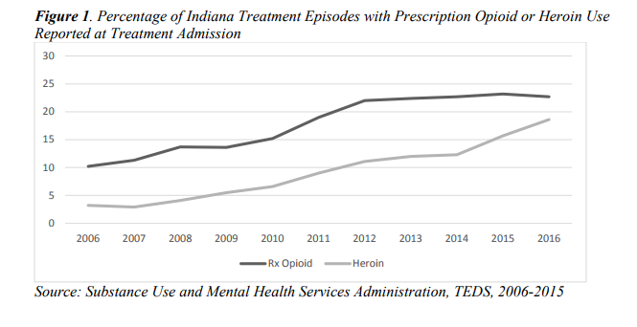
2016, Persons Receiving Substance Abuse Treatment
23% using prescription opioids at time of admission
36% using heroin or prescription opioids (or both)

Slide 24
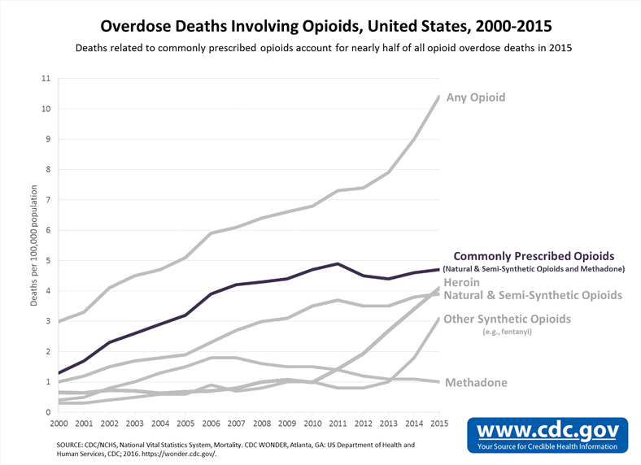
US Mortality Trend Lines

Slide 25
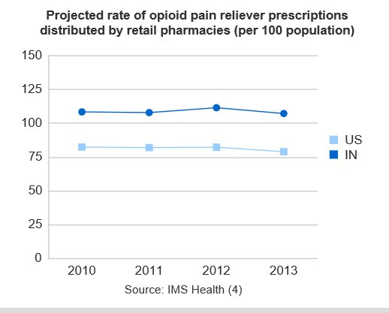
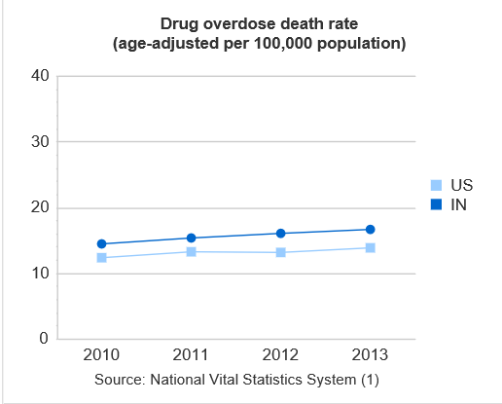
Indiana Mortality Data
Overdose death rate in 2013 16.6 per 100,000 population, above national rate of 13.8

Slide 26
2015 US Drug Overdose Deaths
 | Synthetic Opioids/Heroin/Methadone Rate per 100,000 population | Minus Heroin and Methadone Rate per 100,000 population
Overall | 3.9 | 3.1
Gender
Male | 4.8 | 4.2
Female | 3.0 | 1.9
Age
15-24 | 1.6 | 2.3
25-34 | 5.3 | 6.6
35-44 | 6.9 | 5.6
45-54 | 8.1 | 4.6
55-64 | 6.4 | 2.9
> 65 | 1.5 | 0.5
 | Synthetic Opioids/Heroin/Methadone Rate per 100,000 population | Minus Heroin and Methadone Rate per 100,000 population
Race/Ethnicity
White | 5.3 | 4.2
Black | 2.1 | 2.1
Hispanic | 1.5 | 0.9
Region
Northeast | 3.6 | 5.6
Midwest | 3.4 | 3.9
South | 4.4 | 2.8
West | 3.8 | 0.9
Synthetic = oxycodone, hydrocodone, fentanyl
Source: CDC, 12/30/16, MMWR, 65(50-51)

Slide 27
Indiana Drug Overdose Deaths
Year | Heroin | Opioid Pain Relievers | Total Drug Overdoses (includes cocaine, stimulants, unspecified, etc.)
2000 | < 5 | 24 | 203
2005 | 13 | 118 | 609
2010 | 54 | 229 | 923
2015 | 239 | 274 | 1236
Source: ISDH Epidemiology Resource Center, Table 2, 2016

Slide 29
National Safety Council

Slide 30
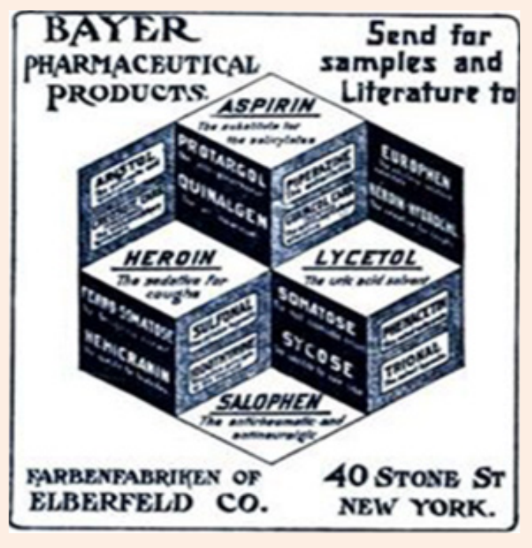
Sources of Heroin
Afghanistan (63-75% globally)
Mexico (most of US market)
China (fentanyl)
But marketplace is the USA
$70 B annual industry (~ 32.4 M users globally)
Historical note: sold commercially by Bayer from 1898-1913 (focus on weaning soldiers off of morphine)
Common cutting agents also include powdered sugar, baking soda, starch, talcum powder, laundry detergent, powdered milk, rat poison
Cheaper often than cigarettes

