Slide 1
State Response to Minimize Spread and Promote Business Continuity
Bret D. Marsh, DVM
Indiana State Veterinarian

Slide 2
Indiana’s 2016 HPAI Incident
Jan. 15: H7 in commercial turkey flock
NVSL: HPAI H7N8
Depopulation started by owner
Area testing of commercial flocks started
Jan. 16: H7 in 9 more nearby flocks
8: LPAI H7N8; 9th: ultimately not isolated

Slide 3
Control Area
10 km Control Area
20 km Surveillance Zone

Slide 4
Plan For the Biggest Job
Negative Flocks: Free Area
Business as usual
Negative Flocks:
Control
Area
Premises Identification
Sampling
Testing
Reporting & Records
Issuing Permits for Movements
Infected
Sites
Quarantined
Depopulation & Disposal

Slide 5
Plan for Permitted Movements
Identifying premises in Control Area
Commercial: 65 flocks
Backyard: 1,945 residences: 105 flocks
Issuing permits
738 permits in 38 days
55 types of permits
Surveillance Testing
4500+ tests

Slide 6
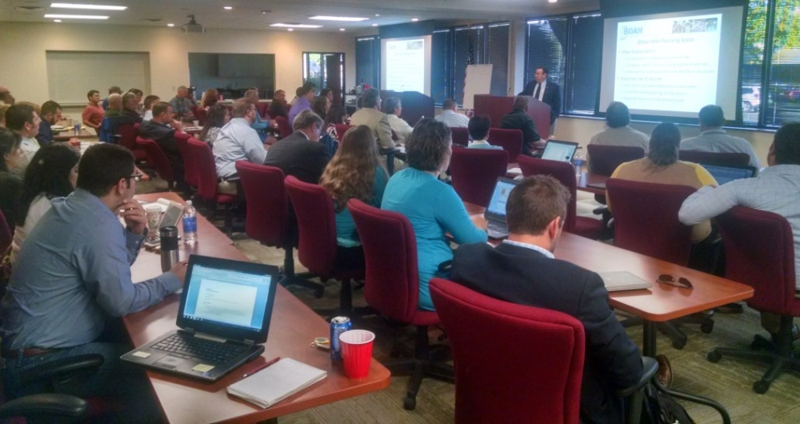
Partner With Industry to Plan
Verified premID/location of flocks, processing
NPIP Authorized Testers
Training:
Sample submission process (bar codes!)
PPE use
Biosecurity audits
Electronic permits

Slide 7
Respond Quickly
USDA paying for live birds only
Inventory records
Rapid laboratory testing
DUNS and SAMS numbers in advance
Identify flocks in 10-km Control Area
All associated sites listed w/ BOAH
Commence testing and notification
Began on preliminary NAHLN result

Slide 8
What Can You Do Now?
USDA/State resources may be limited
Limited number of national response teams
May have to “get in line”
Take pro-active steps to minimize loss
Growers shut off vents: avoid spread

Slide 9
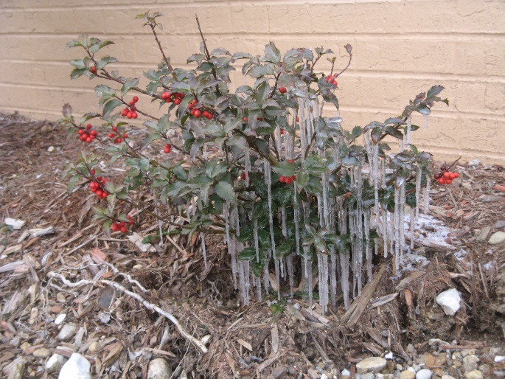
Have Your Own Depop Plan(s)
Don’t get locked into one solution
Alternative methods for euthanasia, disposal
Back-up option for every site
Weather
Equipment failure

Slide 10
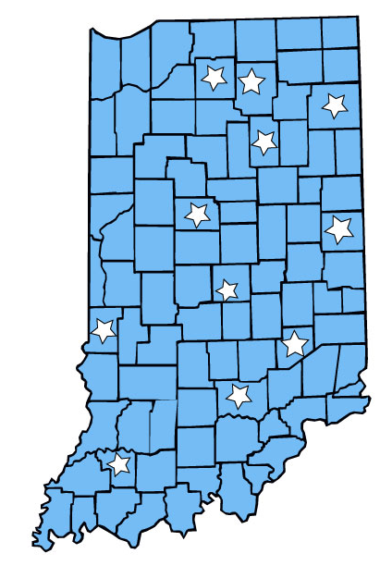
Preplan Disposal Options
Work with state environmental agency
11 landfills pre-identified
Pre-identify viable options
Burial, composting, incineration
Communicate to industries
Solid waste handlers

Slide 11
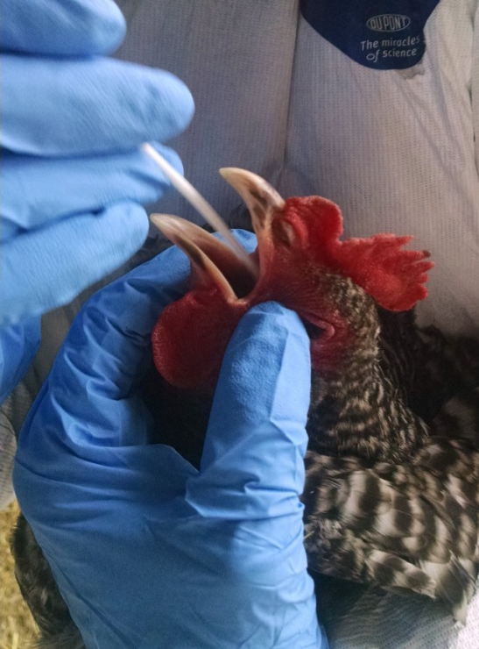
Coordinate with the Laboratory
Electronic reporting
Bar codes for speed, accuracy
Proper equipment, training
Surge capacity
Processing schedule
For permit timing

Slide 12
Other Details
Epidemiology
USDA team analyzed surveys
Determine possible source, spread
Surveillance
BOAH responding to Healthy Birds Hotline
Wild bird sampling by DNR/WS
Financial Settlements
USDA handling paperwork

Slide 13
New Ideas=New Solutions
Department of Correction
Depopulation crews
Local firefighters: Foaming experts!
State Police: Sample transport

Slide 14
Future Opportunities
Depopulation/Mass Depopulation
Whole House CO2, VSD, novel methods
Secure Food Plans
Modify to meet real-life operations
Disposal Methods
Landfill leachate, waste to energy, etc.

Slide 15
Future Opportunities
Environmental Sampling
Integrated methods, e.g., waterers/drinkers
Other species
Algorithms for Testing
All species: swine, milk, etc.
Laboratory Messaging
Reporting back to states in NAHLN system

Slide 16
5 Steps for Pork Producers
Validated Premises
Biosecurity Plan (SPS)
Sampling Plan (Certified Samplers)
Exercise Requesting a Permit
Face to Face Meeting

Slide 17
More Information
www.boah.in.gov
animalhealth@boah.in.gov
@INBOAH
www.facebook.com/INBOAH

