Slide 1
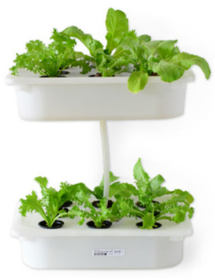
Design STEM : High School
Hydroponics:
Putting it All Together

Slide 2
Overarching Hydroponic Challenge
You are working as an engineer for a company that manufactures irrigation systems for hydroponic farmers that live in remote locations including in regions of the Arctic.
You and your interdisciplinary team are tasked with the challenge to design a hydroponic system that would work in such conditions. Your design should include plans for providing appropriate conditions for growing the hydroponic plants including light, water, and nutrients.

Slide 3
Overarching Hydroponic Challenge
Biology
Chemistry
Physics

Slide 4
Overarching Hydroponic Challenge
Your plans should include designs for …
lighting system,
water distribution system, and
recipe for appropriate nutrition for the plants.
Work with your team and report back with a visualization and a verbal report

Slide 5
Thank You
Power Point slides will be posted on the Blackboard website for the course.
If you have any questions, please feel free to contact us
Hui-Hui Wang (huiwang@purdue.edu)
Minjung Ryu (mryu@purdue.edu)
Sanjay Rebello (rebellos@purdue.edu)

