Slide 1
How do we tell the story of agriculture ?
Linda J. Pfeiffer PhD.
Agricultural Sciences Education and Communication

Slide 2
Overview:
Telling the Story
Current Trends in Public Perceptions of Agriculture
The Communication Process
  Factors Influencing Public Perceptions
  A Case Study of Fair Oaks Farms

Slide 3
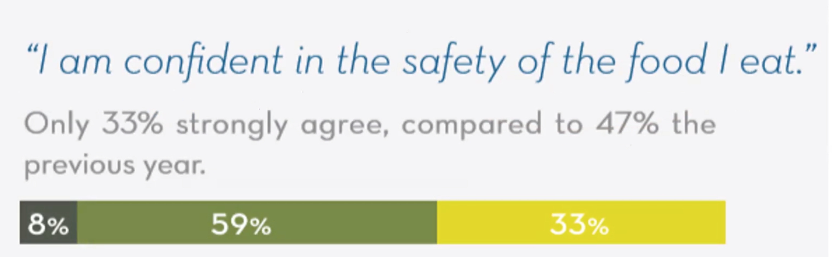
Declining Trust
THE CENTER FOR FOOD INTEGRITY, NOV. 2018 GENE EDITING, ENGAGE IN THE CONVERSATION

Slide 4
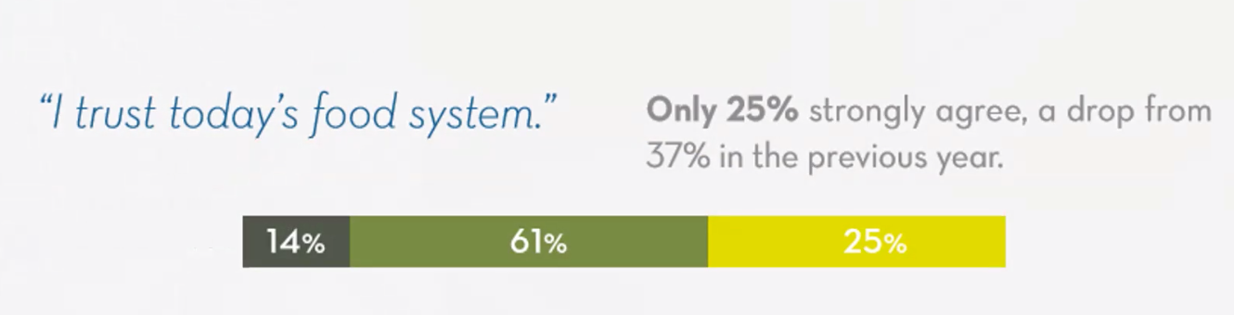
Declining Trust
THE CENTER FOR FOOD INTEGRITY, NOV. 2018 GENE EDITING, ENGAGE IN THE CONVERSATION

Slide 5
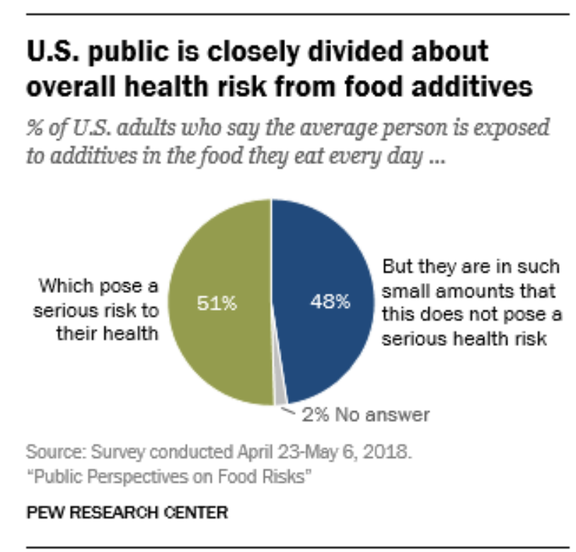
Skepticism: Food Additives
Food Additives
Animals given hormones/
antibiotics
Produce grown with pesticides
Foods with artificial
ingredients.
Notes:
MAJORITIES SEE AT LEAST SOME RISK FROM EATING FOOD PRODUCED WITH COMMON AGRICULTURAL AND PROCESSING PRACTICES, INCLUDING MEAT
https://www.pewresearch.org/science/2018/11/19/public-perspectives-on-food-risks/

Slide 6
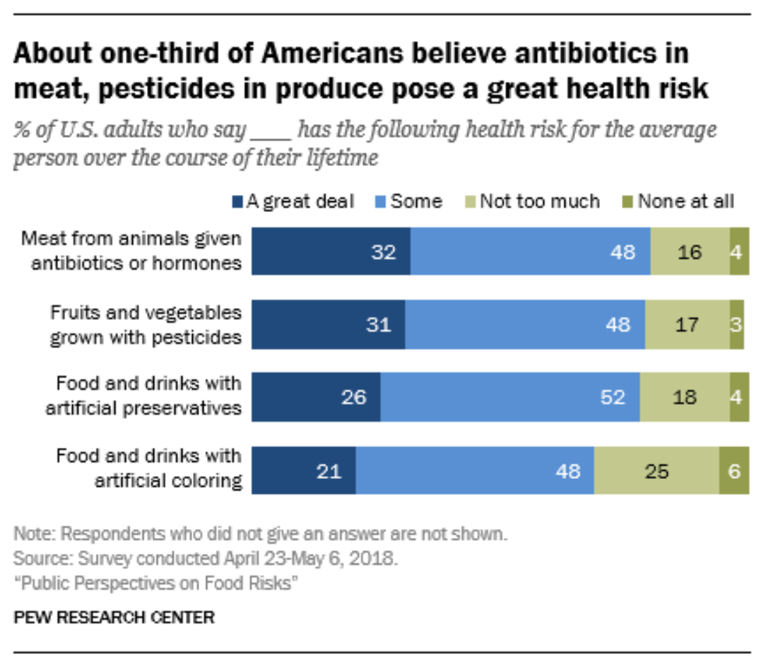
Risk Perceptions : Additives

Slide 7
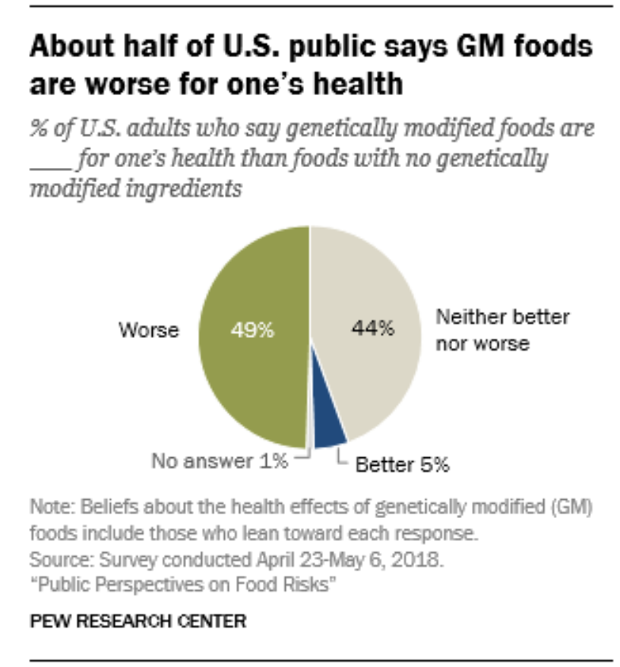
Skepticism : GM Foods
Notes:
https://www.pewresearch.org/science/2018/11/19/public-perspectives-on-food-risks/

Slide 8
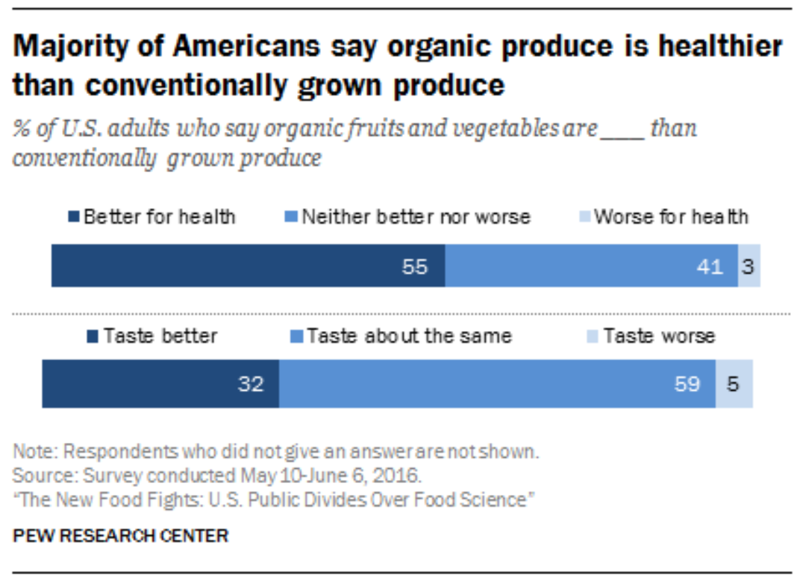
Move towards: Conventional vs. Organics
Notes:
https://www.pewresearch.org/science/2018/11/19/public-perspectives-on-food-risks/

Slide 9
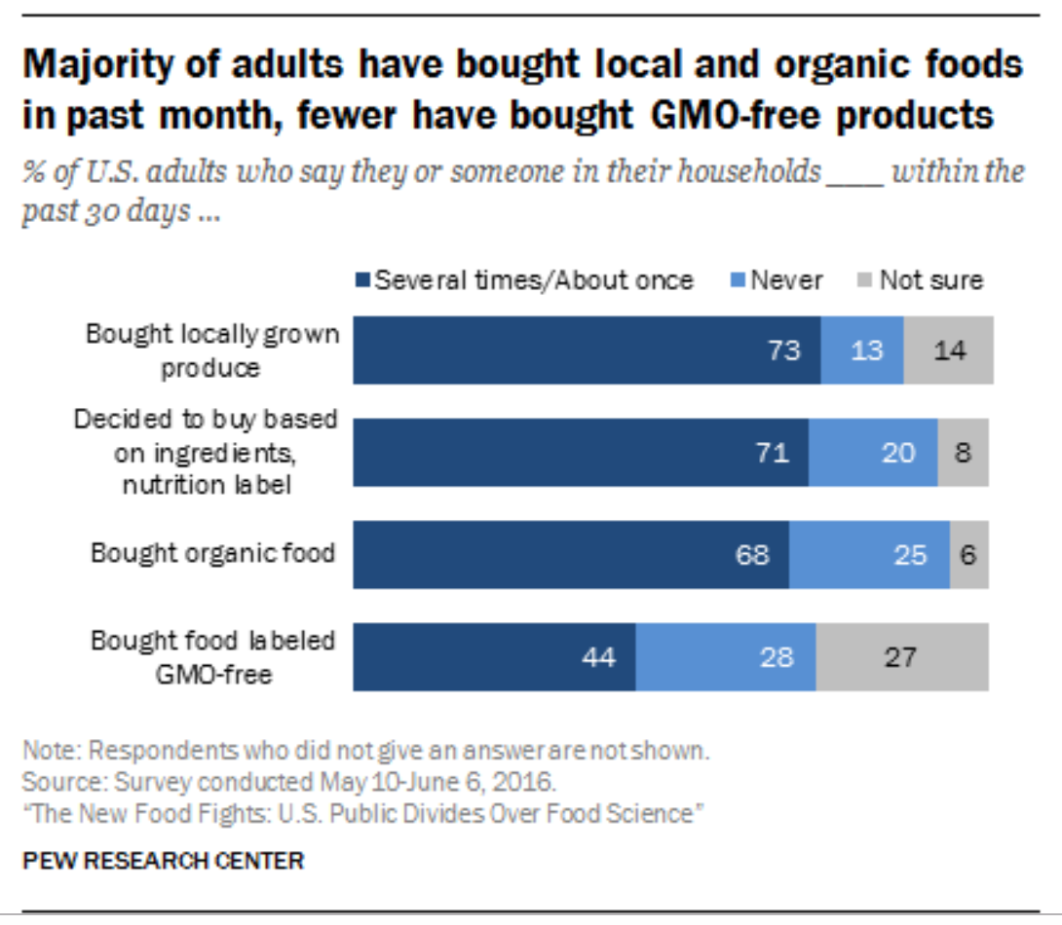
Changing Public Behaviors:
Notes:
https://www.pewresearch.org/science/2018/11/19/public-perspectives-on-food-risks/

Slide 10
The Communication Process
Know your communication goals & the science
& where your audience gets their information from
Factors that Influence How the Audience
Perceives: The Food System
Trust/Credibility
Knowledge -or Misinformation
  Past Experiences/ Emotion
  Social Acceptance/ Social Norms
3. Design & test your message
Design a Communication Campaign
Notes:
Content Analysis (local media), interviews (depth), opinion polling

Slide 11
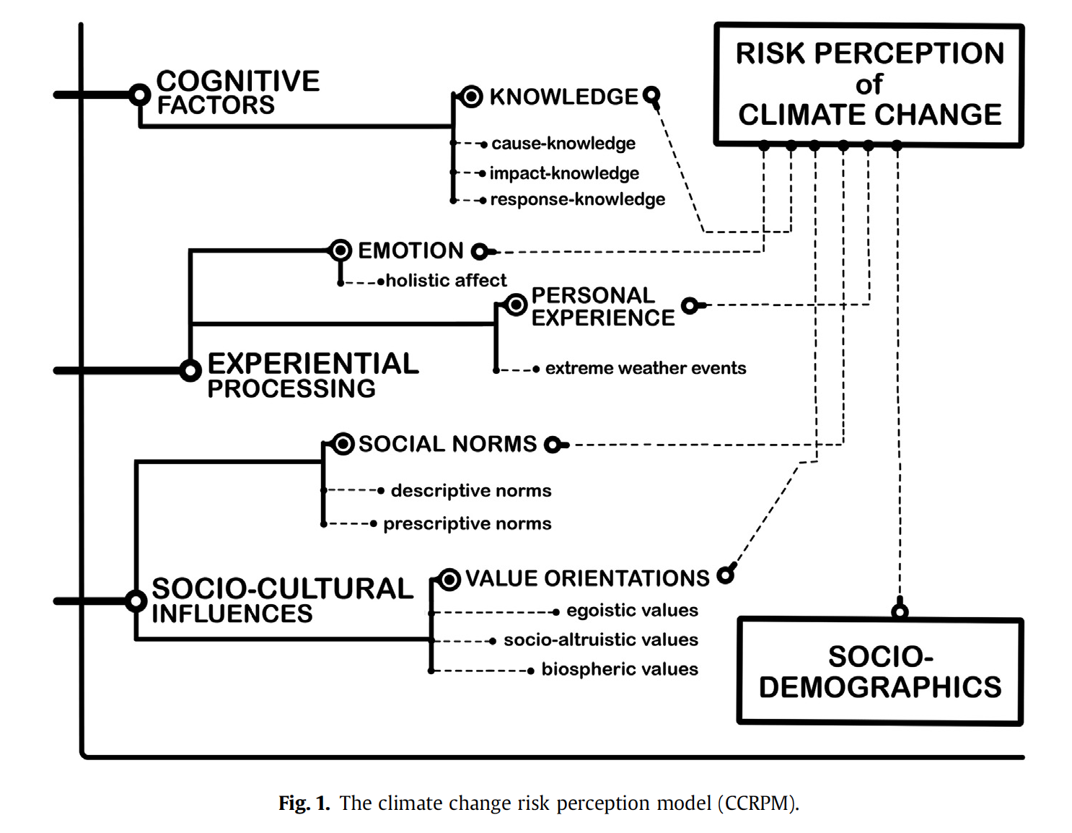
Factors affecting public perception of science
Knowledge
Emotion &
Personal Experience
Values &
Social Expectations
Van der Linden 2016
Notes:
Hierarchical regression model
Descriptive Norms: the extent referent others are taking action to prevent climate change (electric cars)
Prescriptive Norms: the extent one feels socially pressured to take action on climate change

Slide 12
Factors affecting public perception
Notes:
TRUST

Slide 13
Key Elements in Public Perception: Agriculture
Trust
Social Acceptance/ Social Norms
Experiences/ Emotion
Knowledge/ Information
THE CENTER FOR FOOD INTEGRITY, NOV. 2018 GENE EDITING, ENGAGE IN THE CONVERSATION

Slide 14
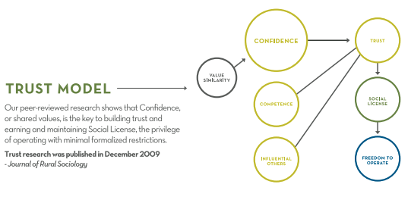
Key Elements in Public Perception: Trust
THE CENTER FOR FOOD INTEGRITY, NOV. 2018
Notes:
THE CENTER FOR FOOD INTEGRITY, NOV. 2018 GENE EDITING, ENGAGE IN THE CONVERSATION

Slide 15
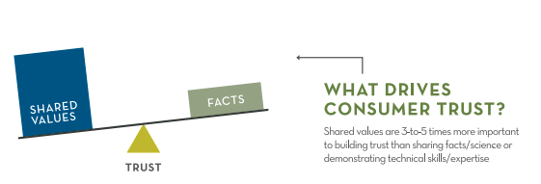
Key Elements in Public Perception: Trust
THE CENTER FOR FOOD INTEGRITY, NOV. 2018
Notes:
VALUES ARE 3-5X MORE IMPORTANT THAN FACTS

Slide 16
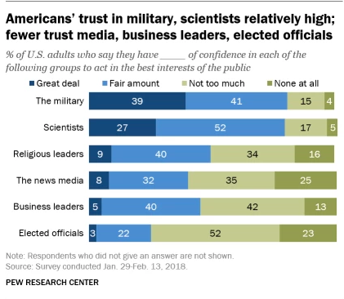
Key Elements in Public Perception: Trust in Experts
THE CENTER FOR FOOD INTEGRITY, NOV. 2018
Notes:
IN GENERAL - TRUST THAT GROUPS ACT IN BEST INTEREST OF THE PUBLIC

Slide 17
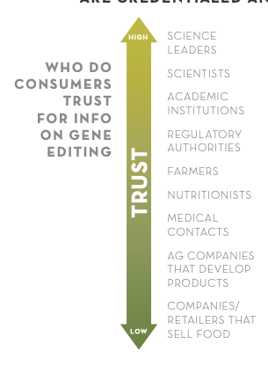
Key Elements in Public Perception: Trust in Farmers
Photo Credit: Bowmanstudio.com
THE CENTER FOR FOOD INTEGRITY, NOV. 2018
Notes:
SPECIFICALLY – WHEN WE LOOK AT A SPECIFIC ISSUE

Slide 18
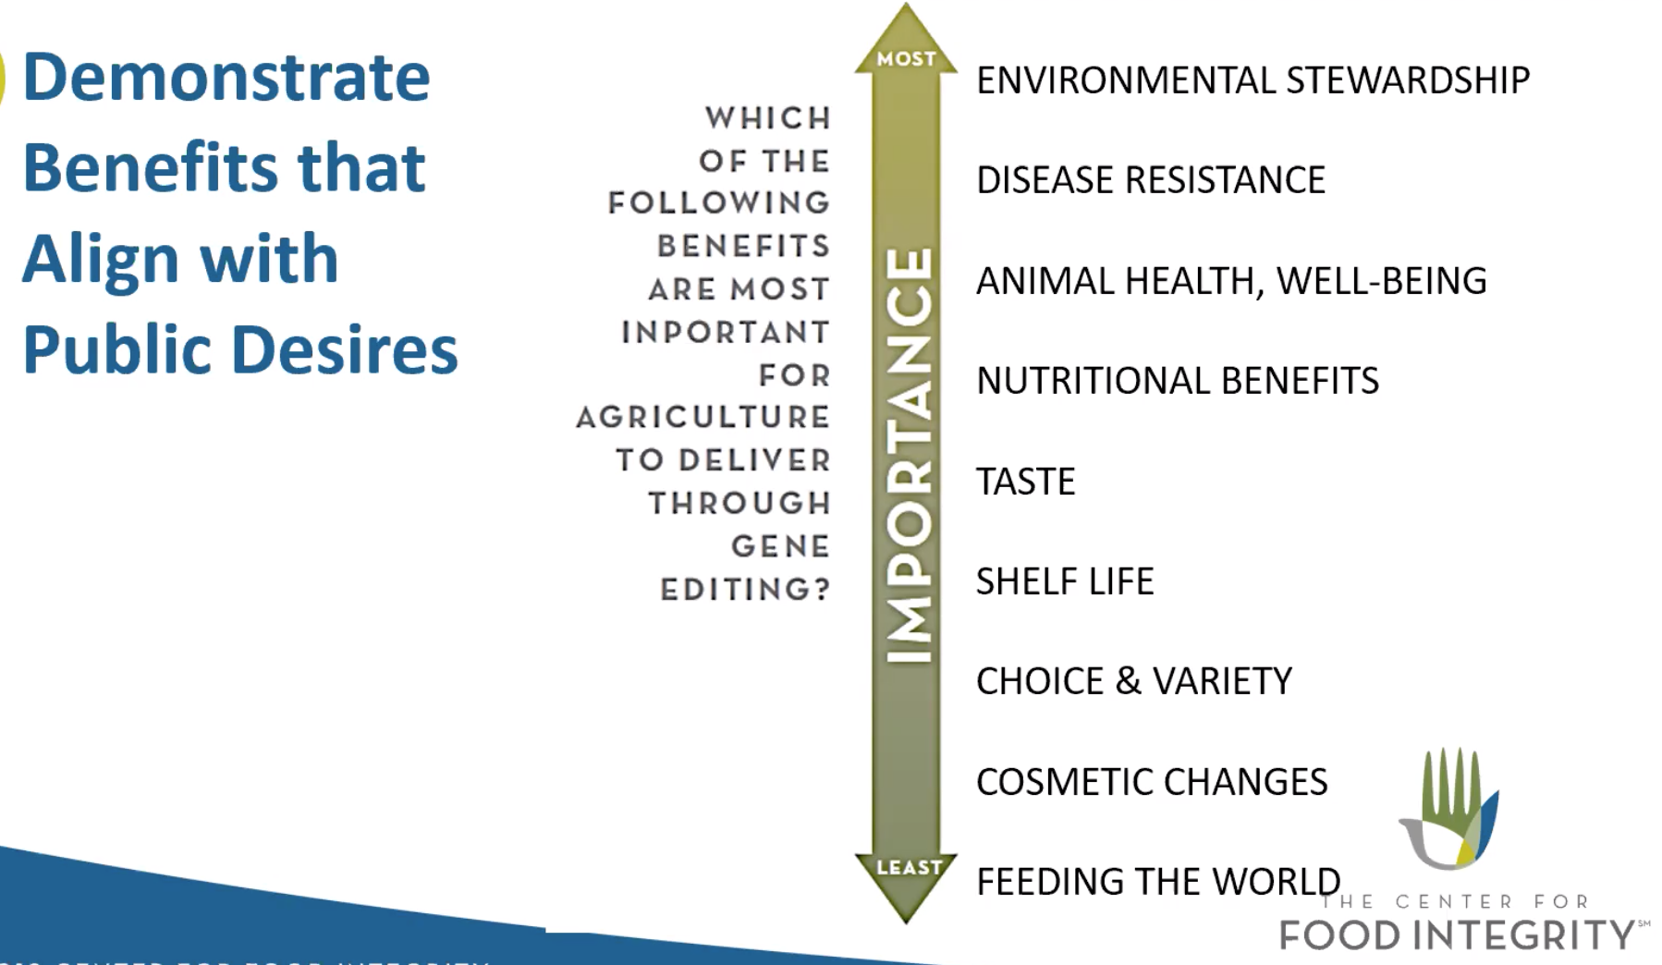
Key Elements in Public Perception: Social Acceptance/ Norms
THE CENTER FOR FOOD INTEGRITY, NOV. 2018
Notes:
SOCIAL NORMS IN YOUR AUDIENCE’S COMMUNITY
Assessments of food risk from additives vary by gender, degree of concern about the issue of GM foods and levels of science knowledge

Slide 19
Key Elements in Public Perception: Prior Experiences/Emotion
Emotional Appeal
Photo credit: Business insider
Notes:
Assessments of food risk from additives vary by gender, degree of concern about the issue of GM foods and levels of science knowledge

Slide 20
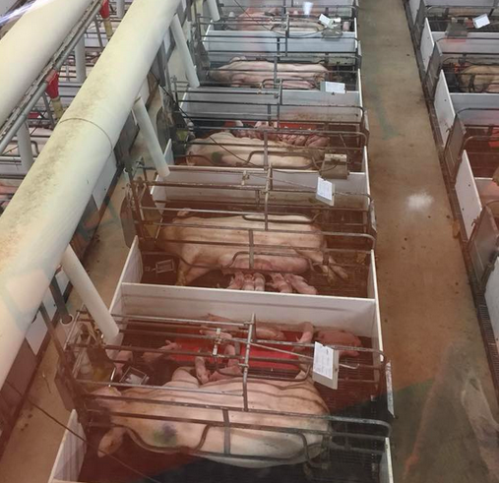
Case Study: Fair Oaks Farms
Indiana Animal Rights Alliance
…one method of disposing of these runts is for farm workers to hold the piglets by their back legs and slam their heads against the concrete floor. …Of course, this is often done in full few of the mothers. It’s unclear whether Fair Oaks allows its visitors to witness how they dispose of these low-value animals.
All for cheese and bacon.

Slide 21
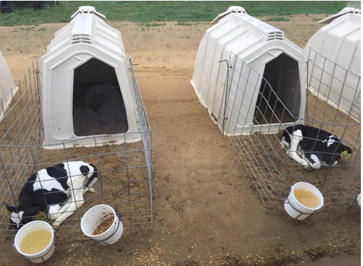
Case Study: Fair Oaks Farms
Indiana Animal Rights Alliance
The females are quickly moved to a dirty patch of ground and are fed a milk replacement instead of their own mothers’ milk.
If they’re cold, they can go inside the hutch. If they’re hot, they can come out. That’s about it.

Slide 22
Telling the Story of Agriculture
Trust: Credible sources, transparency, honesty,
institutional integrity
Social Acceptance/ Social Norms: Norms of care and
protection, environmental responsibility
Experiences/ Emotion: Sharing heartfelt care/ concern
Knowledge/ Information: Proactive farming practices,
why we do what we do…

Slide 23
Case Study: Fair Oaks Farms
Pre-emptive Public Relations
Animal Abuse Video
Response Video
3:10
4:11
6:58

Slide 24
Telling the Story of Agriculture
Trust: Credible sources, transparency, honesty,
institutional integrity
Social Acceptance/ Social Norms: Norms of care and
protection, environmental responsibility
Experiences/ Emotion: Sharing heartfelt care/ concern
Knowledge/ Information: Proactive farming practices,
why we do what we do…

Slide 25
Questions?

Slide 26
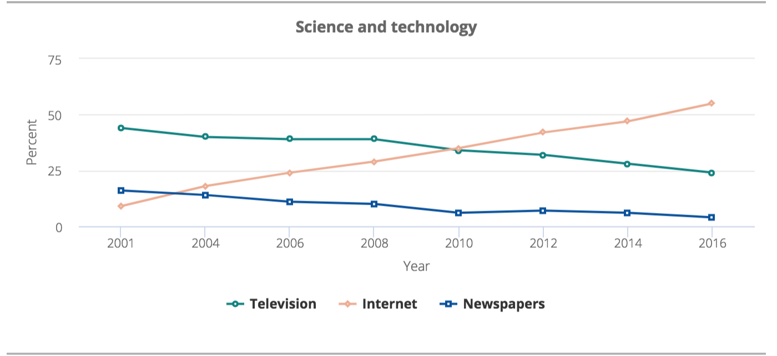
Science information comes from the media!

Slide 27
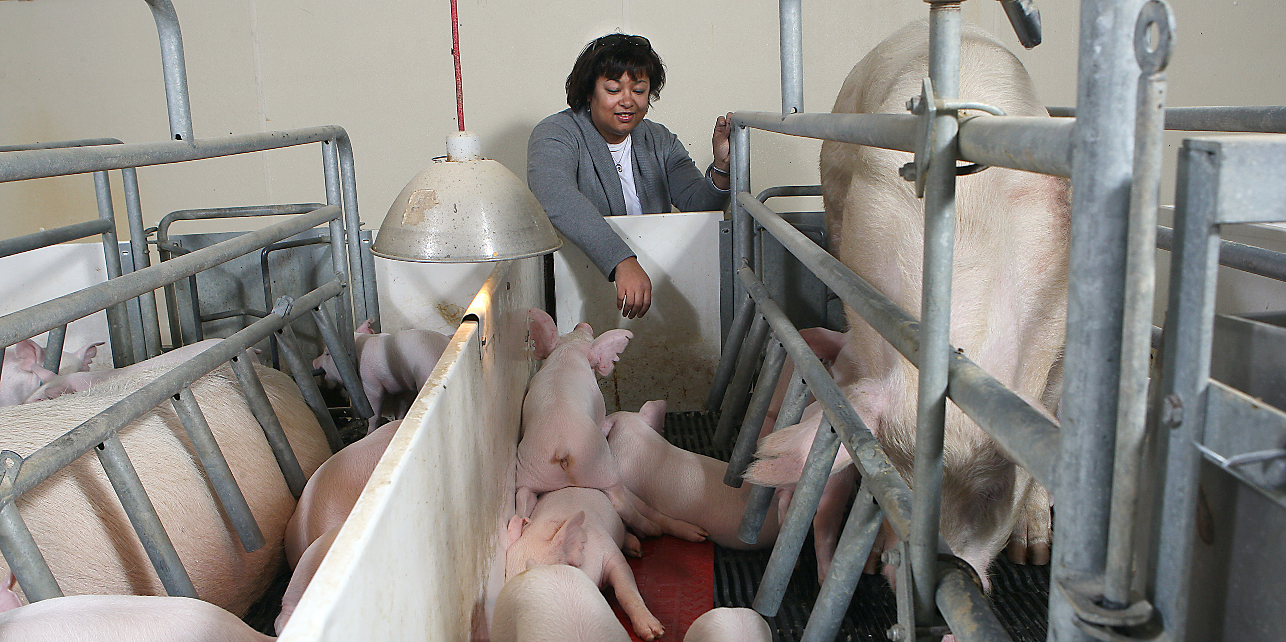
Tell a story!
People prefer a “narrative” approach for understanding science
Notes:
Naturalness and humane treatment were central to what was considered good welfare.

Slide 28
Case Study: Fair Oaks Farms
Fair Oaks Messaging Strategy
Indiana Animal Rights Alliance
Fair Oaks Farm

Slide 29
Strategy for media communication
Problem
In one sentence, identify the main issue/ problem this communication will address?
Relevance
To
Audience
How does this topic intersect with the day-to-day lives of your audience? Why do they care about it?
Key Messages
Solutions
Describe solutions that address audience concerns
What is the main point(s)
you want to make?
(use memorable language,
an analogy if possible)

Slide 30
Communication template
Problem
In one sentence, identify the main issue/ problem this communication will address?
Relevance
How does this topic intersect with the day-to-day lives of your audience? Why do they care about it?
Key Message
Proposed Solutions
What are the proposed solutions to this problem?
What are your key points
For this audience
(is it memorable, can you use
an analogy)

