Slide 1
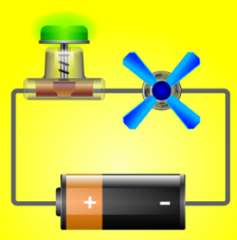
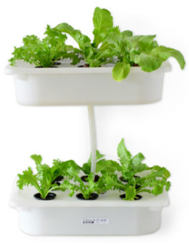
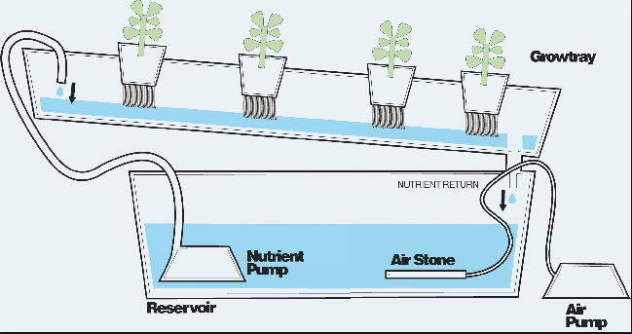
Design STEM High School Physics
Simple Circuits:
Engineering Irrigation Systems for Hydroponic Enthusiasts

Slide 2
Agenda For Today
8:30 AM Introduction
Lesson 1 : What is a Water Pump?
Lesson 2 : Series & Parallel Circuits
Break
Lesson 3 (Optional): Voltage, Current, and Resistance in Series & Parallel Circuits
12:00 PM Lunch
Lesson 4 : What is a Variable Resistor?
Lesson 5 : Design Challenge – Creating a Water Pump Circuit
3:15 PM Wrap up

Slide 3
Before We Begin
Prerequisites (if used in HS Physics class):
Understand what a complete circuit is,
Know how to light a bulb with one battery and wire,
Be able to identify simple circuit elements, and
Be familiar with Ohm’s law.

Slide 4
Before We Begin
Indiana State Content Standards

Slide 5
Before We Begin
Also…
What is Engineering Design?
What is Inquiry?
What, if any, is the interplay between Engineering Design and Inquiry?

Slide 6
Hydroponic Systems
https://www.youtube.com/watch?v=6kUm_I7bLYw
https://www.youtube.com/watch?v=Rj4MzjxjGck
https://www.youtube.com/watch?v=EJjAWF2DfWY
https://www.youtube.com/watch?v=aJorITEWCWk

Slide 7
The Challenge
You are working as an engineer for a company that manufactures irrigation systems for hydroponic farmers. Recently, your company has begun to meet the specific needs of home hydroponic enthusiasts that are remotely located i.e. they are not accessible to any electrical power grid.
You and your team are tasked with the challenge to produce an electrical pumping system i.e. the pump along with the electrical circuit and power source that drives the pump to serve the needs of such hydroponic enthusiasts. Further, you are also asked to produce a user’s manual for hydroponic enthusiasts that would enable them to use the system for their specific criteria and constraints, such that the water flow rate and height of water delivery can be adjustable for multiple hydroponic plan configurations.

Slide 8
Lesson 1 : What is a Water Pump?
Questions for Guiding Engineering Design
What is the problem?
Who is your end-user in this story?
What are the needs of your end-user?
What info do you need to solve this problem?
What are possible design considerations?
Others?

Slide 9
Lesson 1 : What is a Water Pump?
Questions for Guiding Inquiry
Have you ever wondered how to move water up to a certain height? Have you ever wondered how water can be removed from flooded basements?
What is a water pump?
How do you think a water pump works?
What might you need to get a water pump to work?
Can you find a way to run a water pump using a battery and be able to adjust its flow rate?

Slide 10
Lesson 1 : What is a Water Pump?
Examples of Water Pumps
https://www.youtube.com/watch?v=2hP5ZKZfO1Q
https://www.youtube.com/watch?v=OBp8-WWhxJU
https://www.youtube.com/watch?v=mP8_RAt75bQ
https://www.youtube.com/watch?v=BaEHVpKc-1Q

Slide 11
Lesson 1 : What is a Water Pump?
Where are pumps used?
https://www.youtube.com/watch?v=x21kClCjkW0
https://www.youtube.com/watch?v=D9Ukbklc6gc
https://www.youtube.com/watch?v=48jNBQboYt4

Slide 12
Lesson 2 : Simple Circuits
Questions for Guiding Inquiry
Can you find a way to connect the battery, light bulbs, and wires to make the bulbs appear dim when lit?
Can you find a way to connect the battery, light bulbs, and wires, to make the bulbs appear bright when lit?

Slide 13
Lesson 2 : Simple Circuits
Questions for Guiding Design
Why do the light bulbs appear to be bright in some ways and dim in others?
How could you use this feedback to inform your design of connecting a water pump to a battery in Lesson 1?

Slide 14
Lesson 2 : Simple Circuits
Useful Interactive Simulations
https://phet.colorado.edu/en/simulation/legacy/circuit-construction-kit-dc
https://phet.colorado.edu/en/simulation/legacy/circuit-construction-kit-dc-virtual-lab

Slide 15
Lesson 3 : Current & Voltage in Simple Circuits
Questions for Guiding Inquiry
How do the current and voltage compare across different resistors that are in series? In parallel?
How does the combined resistance change when two resistors are added in series? in parallel?
OPTIONAL

Slide 16
Lesson 4 : What is a Variable Resistor?
Questions for Guiding Inquiry
What is a variable resistor and how can you change its resistance?
What happens when a variable resistor is used in a series circuit? In a parallel circuit?

Slide 17
Lesson 4 : What is a Variable Resistor?
Questions for Guiding Inquiry
What is a variable resistor and how can you change its resistance?
What happens when a variable resistor is used in a series circuit? In a parallel circuit?

Slide 18
Lesson 4 : What is a Variable Resistor?
Question for Guiding Design
How can a variable resistor be used to control the brightness of a bulb in a circuit? Think of more than one way to do this.
What ideas that you had learned from series and parallel circuits can be used in your design process?

Slide 19
Lesson 5 : Design Challenge Creating a Water Pump Circuit
Questions for Guiding Inquiry
How can you measure the flow rate and head of the pump using the materials provided?
How can you measure the relationship between the flow rate and the head?

Slide 20
Lesson 5 : Design Challenge Creating a Water Pump Circuit
Questions for Guiding Design
How can you control the flow rate and head of the pump using the materials provided? Think of more than one way to do this.
What ideas that you learned from controlling the brightness of the resistor can be used in your design process?

Slide 21
Lesson 5 : Design Challenge Creating a Water Pump Circuit
A Manual for Hydroponic Farmer to Use your Design
A diagram showing the submerged pump and how it supplies water to the plant bed above it. The head and flow rate should be labeled and defined for the end user as two important parameters.
Circuit schematics showing how the variable resistor, battery and pump are connected together.
A paragraph explaining the circuit schematics and how it works to control the flow rate and head by changing the variable resistor.
A paragraph explaining the graph of flow rate vs. head for different settings of the variable resistor. The paragraph should also explain to the end user, with a concrete example of how they should fine tune the electrical circuit to achieve a particular desired flow rate and head based on the graph.

Slide 22
Thank You
Power Point slides will be posted on the Blackboard website for the course.
If you have any questions regarding this unit, please feel free to contact Sanjay Rebello (rebellos@purdue.edu )

