Slide 1
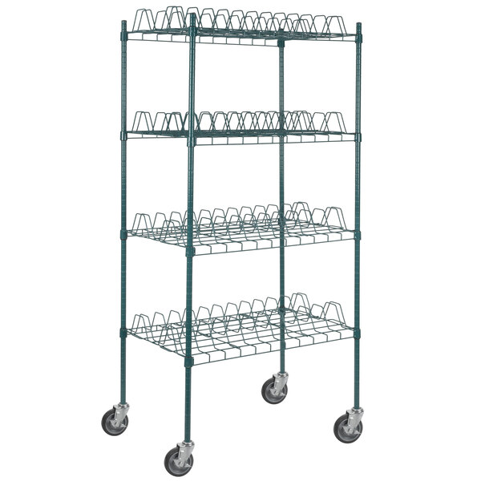
Drying Rack 4-shelf kit (Skidmore)
Price: $315
Application: It features (4) 24" x 36" drying rack shelves with 3" slots, accommodating 10 sheet pans per shelf for a total of 40.
https://www.webstaurantstore.com/regency-24-x-36-green-epoxy-drying-rack-shelf-kit-with-64-posts-and-casters-3-slots/460EG2436D3C.html

Slide 2
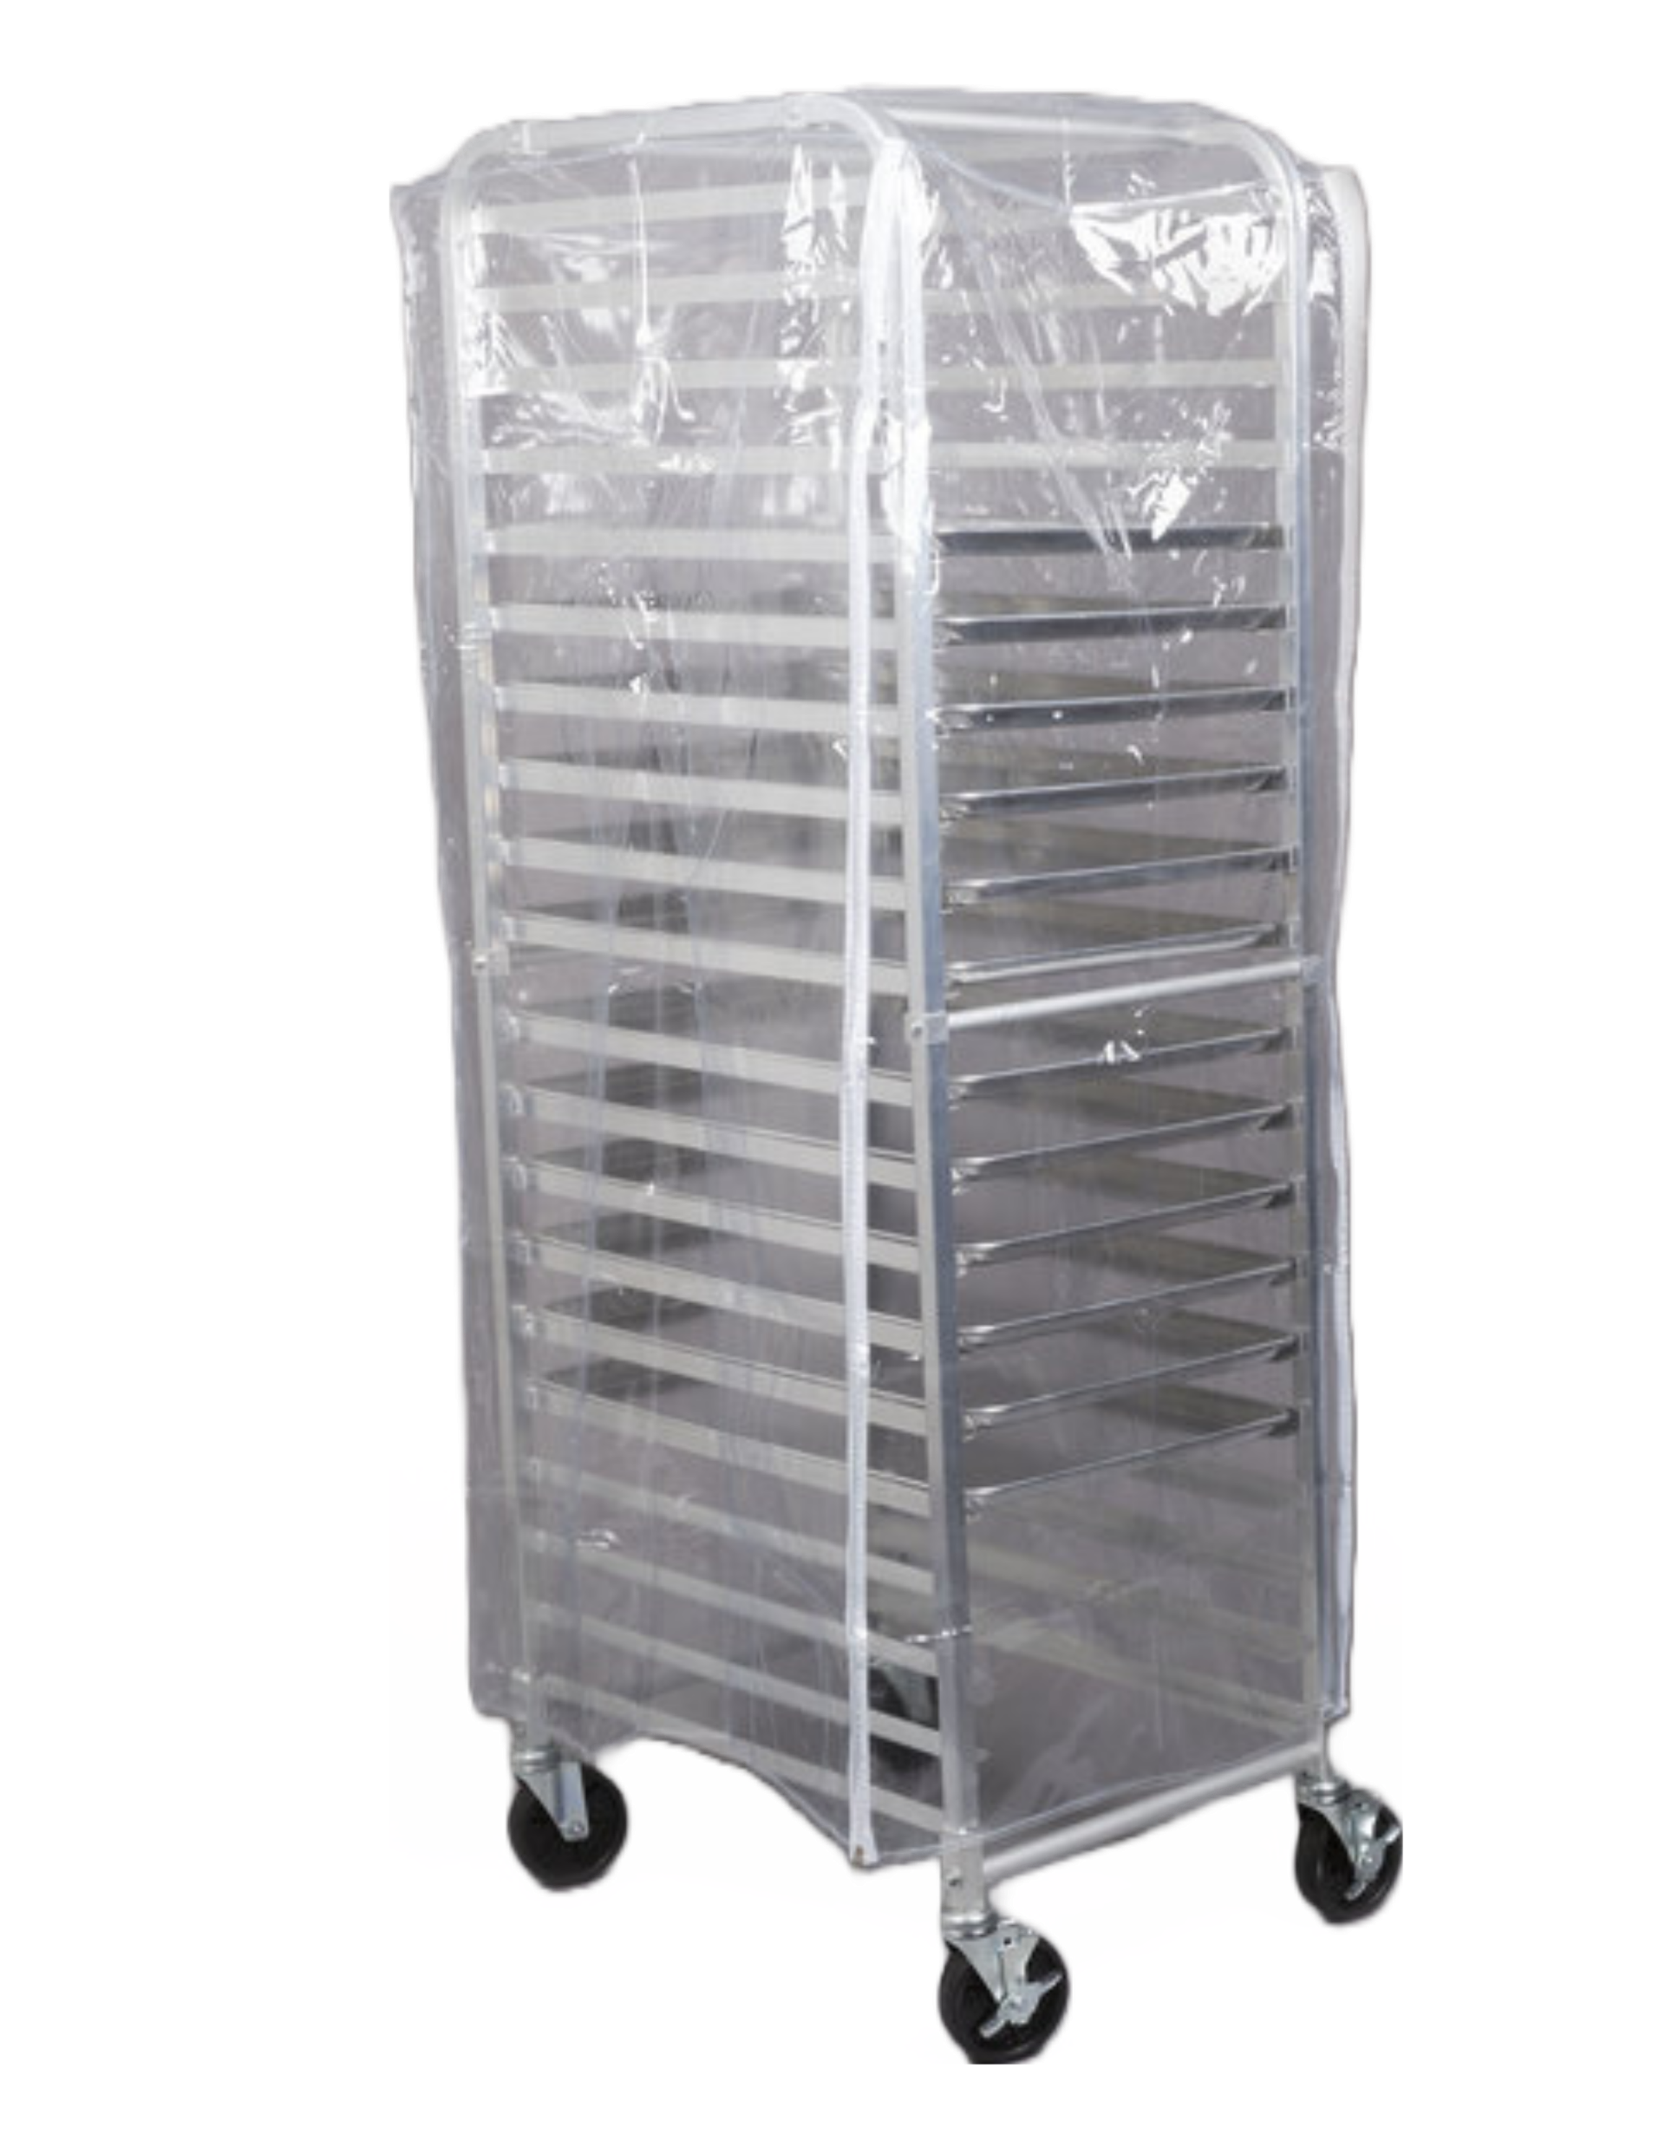
Speed rack with cover—3 total (Skidmore)
Price: $825
Application: Regency's 20 pan end load full height bun pan rack with cover and 12 pans provides you with everything you need to effectively store and transport baked goods in your facility. This rack will save valuable space for your restaurant, bakery, cafe, supermarket, or catering business and provides chefs with the space to store multiple sheet pans in one convenient location. Because this rack is end loading, it is also perfect for properly and evenly cooling baked goods or meats.
https://www.webstaurantstore.com/regency-20-pan-end-load-full-height-bun-sheet-pan-rack-with-cover-and-12-pans-unassembled/407RKKITFULL.html

Slide 3
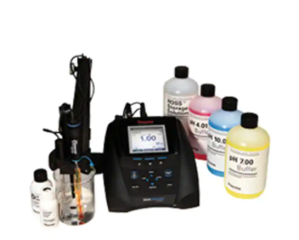
pH meter (QC lab)
Price: $3,500
Application: Record accurate and reliable pH, ion concentration, mV, ORP and temperature measurements with the Thermo Scientific™ Orion Star™ A214 pH and ISE Benchtop Meter. This meter is ideal for a wide range of applications and advanced pH or ion analysis in the lab. Perform up to 5 point pH and ISE calibrations, log up to 2000 data point sets with time/date stamp and easily transfer calibration and data logs via USB or RS232 to a printer or computer with free downloadable Orion Star™ Com software. Use the included electrode stand to easily place sensors in samples and simplify storage to minimize breakage.
Orion Star™ A214 pH/ISE Benchtop Meter (thermofisher.com)

Slide 4
Viscometer (QC lab)
Price: $7,000
Application: The DV2T Viscometer offers powerful programming capabilities and result analysis, including data averaging and QC limits with alarms. Using the new Program Generator Software, you can create user instructions with multi-step test protocols.
The 5-inch color display guides you through test creation and data gathering for fast and easy laboratory viscosity measurements. Test data can be recorded directly on a local printer or sent to a PC. Additional automated control and data collection can be achieved with optional RheocalcT software.
DV2T Viscometer - AMETEK Brookfield North America (brookfieldengineering.com)

Slide 5
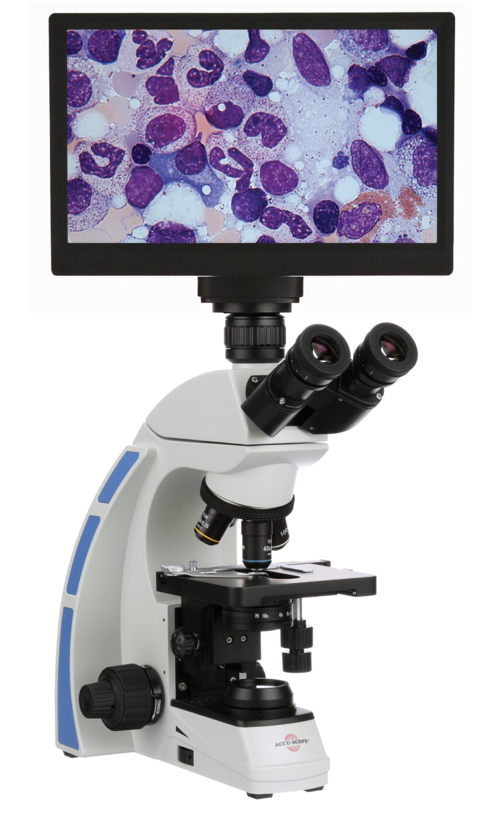
Accu-scope 3000 Digital Microscope (QC lab)
Price: $2,326
Application: Accu-Scope 3000 is our best selling all around laboratory microscope and can now be paired with your choice of digital camera. This package includes all necessary adapters and software for capturing digital video and images, annotations, measurements, and more! The microscope comes complete with trinocular head and c-mount adapter.
https://microscopecentral.com/products/accu-scope-3001-digital-microscope-package

Slide 6
At-line NIR instrument (Pilot Plant, QC lab)
Price: $40,000
Application: The DA 7250 NIR analyzer is the third generation diode array NIR instrument from PerkinElmer, designed specifically for analysis in the food and agri industries. It combines outstanding analytical accuracy with speed, ease of use, ruggedness, and versatility. DA 7250™ calibrations are available for a wide range of applications, and measures moisture, protein, fat, fiber, starch and many other parameters in all types of samples – powders, pellets, grains, pastes, cakes, meal, and slurries.
https://www.perkinelmer.com/product/da-7250-at-line-nir-instrument-perdab

Slide 7
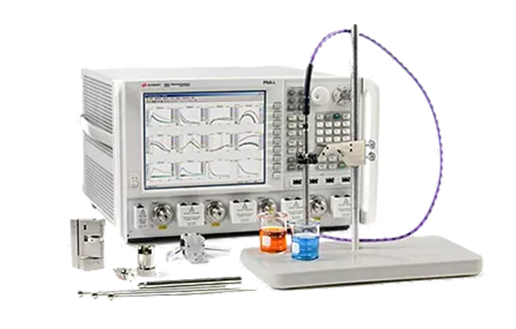
Dielectric probe kit for microwave (Pilot Plant)
Price: $10,000
Application: The Keysight N1501A dielectric probe kit with N1500A materials measurement software suite with Option 004 and a Keysight network analyzer determines the intrinsic electromagnetic properties of many dielectric materials…N1501A has a frequency range of 200 MHz to 50 GHz and is useful in all stages of a product's lifecycle: design, incoming inspection, process monitoring, and quality assurance.
https://www.keysight.com/us/en/product/N1501A/dielectric-probe-kit.html

Slide 8
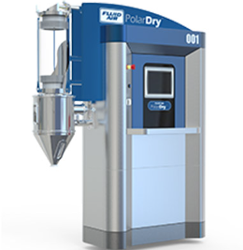
PolarDry Model 001 Electrostatic Spray Dryer (Pilot Plant)
Price: $250,000
Application: Designed for a laboratory environment, this portable, PLC-controlled, once-through design is the choice for feasibility checks. cGMP design assures full features in a compact footprint.
https://www.fluidairinc.com/products/electrostatic-spray-dryers#section-2

Slide 9
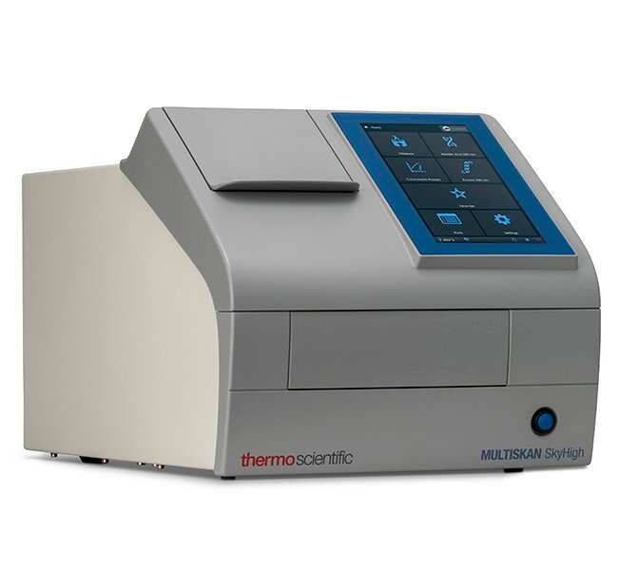
Multiskan SkyHigh Microplate Spectrophotometer (QC lab)
Price: $18,000
Application: Multiskan SkyHigh Microplate Spectrophotometer is a UV/Vis microplate reader designed to be convenient and easy to use for any photometric absorbtion or turbidimetric research applications and especially DNA, RNA and protein analysis.
https://www.thermofisher.com/order/catalog/product/A51119600C

Slide 10
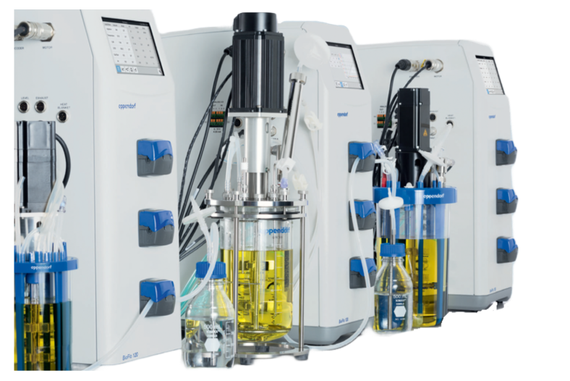
Bioreactor system – two bioreactors (Fermentation Science)
Price: $70,000
Application:
Bacterial, yeast, and fungal fermentation
https://online-shop.eppendorf.us/US-en/Bioprocess-44559/Bioprocess-Systems-60767/BioFlo-120-PF-176595.html

Slide 11
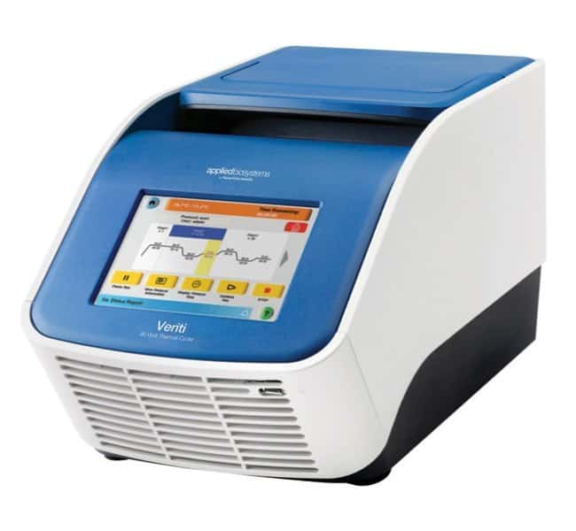
Thermal cyclers – two units (Fermentation Science)
Price: $9,910 each
Application: The Veriti™ 96-Well Thermal Cycler features innovative VeriFlex™ Blocks for enhanced PCR functionality. Six separate peltier blocks provide maximal versatility and flexibility and offer two key benefits: 1) PCR Optimization: each block can be set with a specific temperature which is ideal for precise control over PCR optimization 2) Run more experiments: the six peltier blocks can also be used to run up to six different annealing temperatures in the same run.
https://www.thermofisher.com/order/catalog/product/4375305

Slide 12
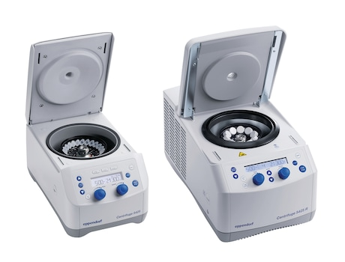
Two Eppendorf 5425 microcentrifuges-one refrigerated, one not (Fermentation Science)
Price: $7,999 refrigerated
Price: $3,608 non-refrigerated
Application: Eppendorf microcentrifuges 5425 and 5425 R are true laboratory standards. These whisper quiet 24-place microcentrifuges offer an outstanding set of features for a broad range of molecular and cell biology applications in Eppendorf and PCR tubes from 0.2 to 5 mL. The refrigerated Centrifuge 5425 R provides precise temperature control for processing temperature-sensitive samples with its advanced cooling system.
https://online-shop.eppendorf.us/US-en/Centrifugation-44533/Microcentrifuges-1007183/Centrifuge-5425-5425R-PF-934144.html#epService

Slide 13
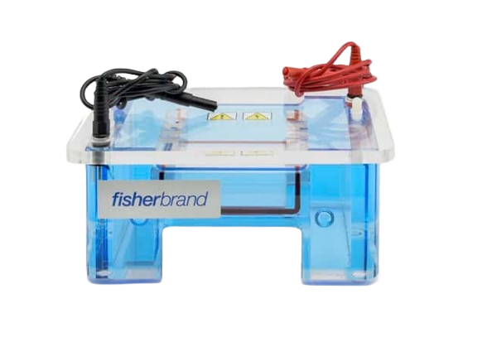
Three agarose gel electrophoresis units (Fermentation Science)
Price: $546.00 each
Application: Allows the user to choose from Minigel, Midigel, Large Gel, or Wide-Format System as needed.
https://www.fishersci.com/shop/products/fisherbiotech-horizontal-electrophoresis-systems-6/FBSB710

Slide 14
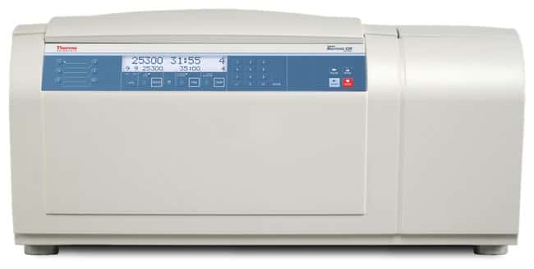
Benchtop centrifuge (Fermentation Science)
Price: $17,930
Application: Ensures accurate control of the sample temperature during the run featuring a BIOLiner rotor, BIOLiner buckets, and 8 conical adapters.
https://www.fishersci.com/shop/products/thermo-scientific-sorvall-legend-xt-xf-centrifuge-rotor-packages-23/p-4383149#?keyword=legend%20xtr

Slide 15
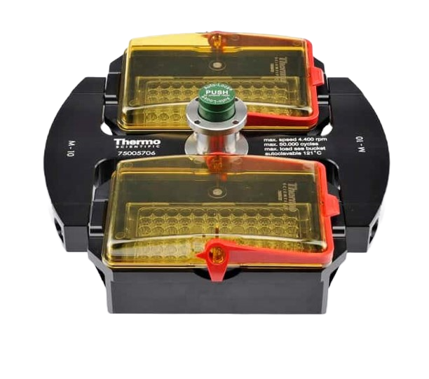
Microplate rotor (Fermentation Science)
Price: $2,750
Application: Used for spinning up to 4 standard or 2 midi-deepwell microplates in transportable carriers.
https://www.fishersci.com/shop/products/sorvall-st8-ventilated-package-tx-150-highconic-rotor-package/75200709#?keyword=st8

Slide 16
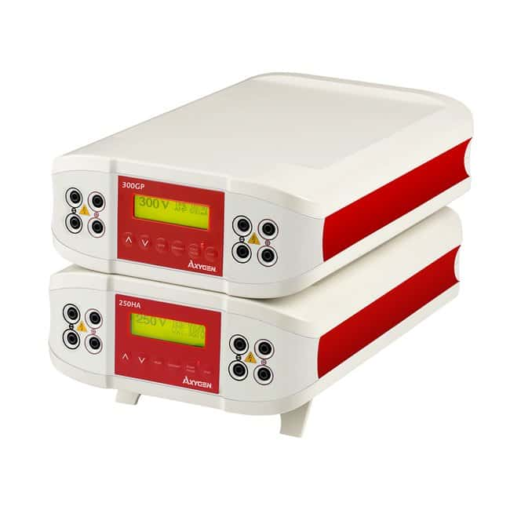
One general purpose and one high amperage power supply (Fermentation Science)
Price: $1307 high amperage
Price: $676.50 general purpose
Application: Used for up to 4 gel boxes simultaneously, with color-coded terminals.
https://www.fishersci.com/shop/products/general-purpose-high-amperage-power-supplies-2/p-7201187#?keyword=western%20blot%20power%20power%20supply

Slide 17
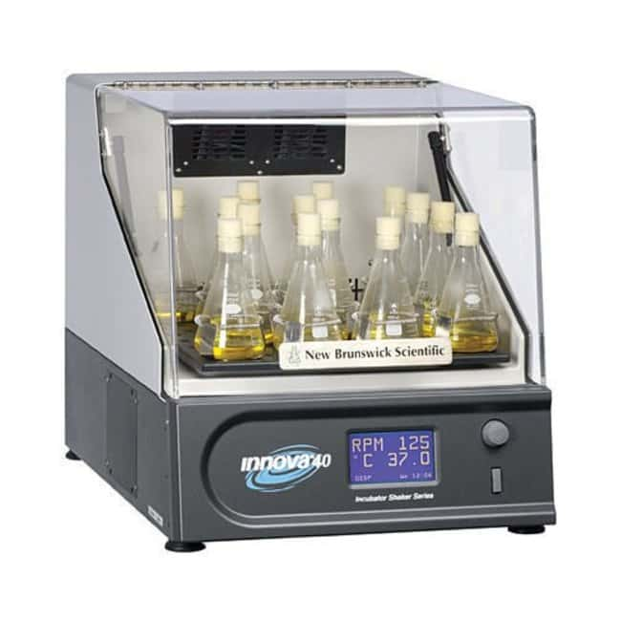
Incubated shaker (Fermentation Science)
Price: $11,064
Application: The New Brunswick™ Innova™ 40/40R (refrigerated) Benchtop Incubator Shaker can take flasks up to 3 L in a compact footprint. The user interface allows easy programming of speed, temperature, and time. Samples can be observed at all times through the self-supporting transparent lid.
https://www.fishersci.com/shop/products/new-brunswick-innova-40-40r-benchtop-incubator-shaker-8/p-7237446#?keyword=incubated%20shaker

Slide 18
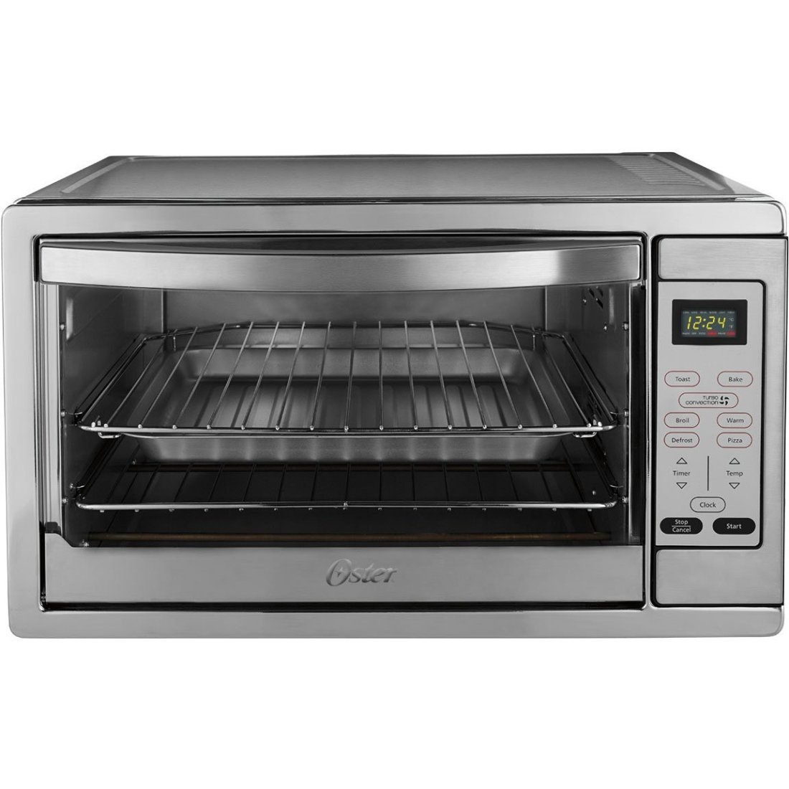
Two Oster Extra Large Digital Countertop Convection Ovens
(Lab 1254/Teaching Lab)
Price $204.89 each
Oster® Extra Large Digital Oven - Walmart.com

Slide 19
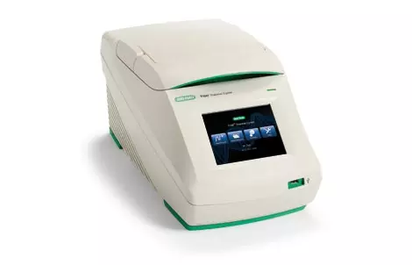
Bio rad T100 Thermal Cycler (Lab 1254/Teaching Lab)
Price : 5,743.00
Application: The T100 thermal cycler is a small thermal cycler offering a comprehensive set of convenient features in a small footprint. This compact thermal cycler features an intuitive touch-screen user interface to make running PCR easy. Thermal gradient technology allows you to quickly optimize your reaction in a single run.
https://www.bio-rad.com/en-us/product/t100-thermal-cycler?ID=LGTWGIE8Z

Slide 20
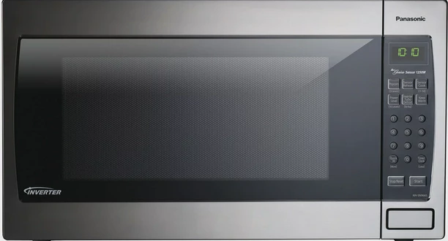
Panasonic Genius Sensor 2.2 Cu. Ft. 1250W Microwave Oven with Inverter Technology (Lab 1254/Teaching Lab)
Price : $355.24
https://www.walmart.com/ip/Panasonic-Genius-Sensor-2-2-Cu-Ft-1250W-Microwave-Oven-with-Inverter-Technology

Slide 21
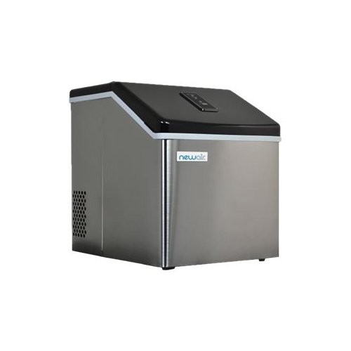
NewAir - 40-lb Clear Ice Maker - Stainless steel (Lab 1254/Teaching Lab)
Price : $230.99
https://www.bestbuy.com/site/newair-40-lb-clear-ice-maker-stainless-steel/6185215.p?skuId=6185215&ref=NS&loc=101

Slide 22
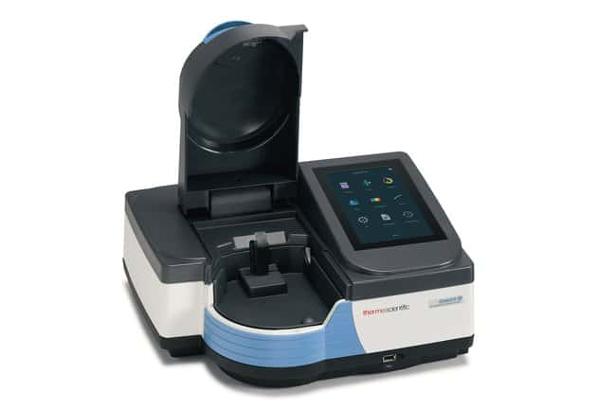
GENESYS 50 UV-Vis Spectrophotometer (Lab 1254/Teaching Lab)
Price : $7,444
Application: Performing routine measurements for quality control.
https://www.fishersci.com/shop/products/genesys-50-uv-vis-spectrophotometer-promo-6/14385351PMO#?keyword=14-385-351

Slide 23
The Rapid Visco Analyser
( Pilot Plant QC Lab)
Price: $60,000
Application: Ingredient Performance Analyzer
The Rapid Visco Analyser is a unique tool for product development, quality and process control and quality assurance. It's a cooking, stirring viscometer with ramped temperature and variable shear capability optimized for testing the viscous properties of starch, grain, dairy products and other foods. The instrument will analyze as little as two or three grams of sample using international standard methods or your own tailor-made test routines of mixing, measuring, heating and cooling.
https://www.perkinelmer.com/category/rva

Slide 24
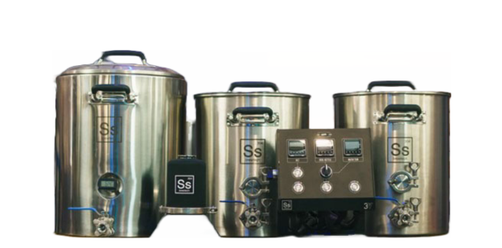
3 vessel eBrewing System 20 gallon kettles
(Brewing Lab)
Price: $3,359.00
Application: The 3V eBrewing system combines an eController 3V along with a pair of eKettles and an InfuSsion Mashtun paired with an RIMS, allowing for control, flexibility, and high performance in brewing.
https://www.ssbrewtech.com/collections/ebrewing-3v/products/ebrewing-3v-system?variant=17240039227463

Slide 25
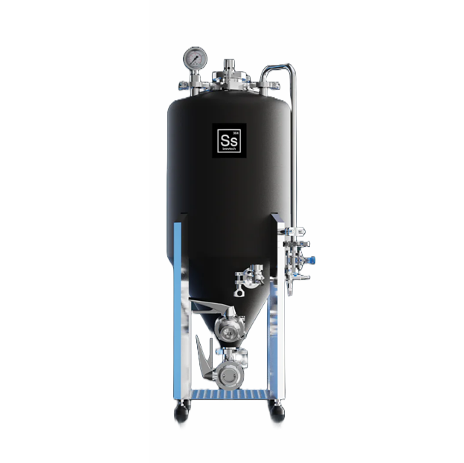
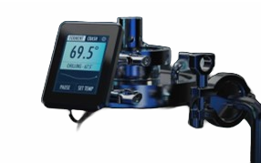
Unitank 2.0 - 14 gal with FTSS Touch Temp Control, FTSS Touch Heating Pad, and Essential Kit/Unitank Accessories
(Brewing Lab)
Price: $1,645
https://www.ssbrewtech.com/products/unitank-2-0

Slide 26
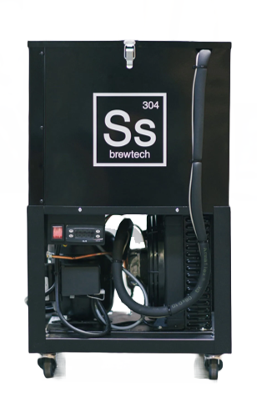
Glycol Chiller / 3/8 hp
(Brewing Lab)
Price: $1,499
Application: Maintains lager temperatures and enables crash cooling for up to 6 vessels. Compatible with FTSS kits.
https://www.ssbrewtech.com/products/glycol-chiller-3-8hp

Slide 27
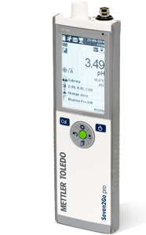
Seven2Go portable pH meter
(Brewing Lab)
Price: $1,495
Application: Measuring pH in brewing
https://www.mt.com/us/en/home/products/Laboratory_Analytics_Browse/pH-meter/pH-meters/portable-pH-meter/seven2go/S8-Meter.html#documents

Slide 28
pH electrode inLab Expert Go-ISM (Brewing Lab)
Price: $580
Application: pH eltrode with integrated temperature probe, designed for portability
https://www.mt.com/us/en/home/products/Laboratory_Analytics_Browse/pH-meter/sensor/pH-sensor/InLab-Expert-Go-ISM.html

Slide 29
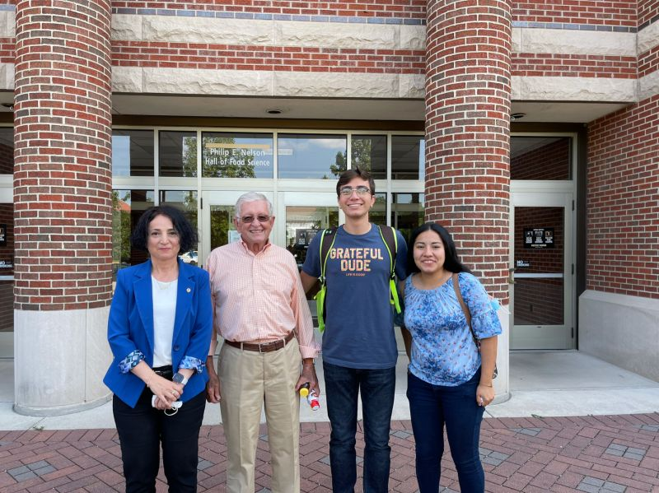
Questions?
Social Media
https://www.linkedin.com/company/purdue-food-science/
@PurdueFoodSci
@purduefoodscience
https://www.facebook.com/PurdueFoodScience
Thank You

