Slide 1
Broadband 101
Roberto Gallardo, Ph.D.
Purdue Center for Regional Development / Extension
robertoge

Slide 2
Digital Inclusion
Affordable & robust broadband
Internet-enabled devices that meet needs of user
Digital Literacy training
Quality technical support
Applications & online content that encourage self-sufficiency, participation, & collaboration
Source: National Digital Inclusion Alliance

Slide 3
Digital Parity
Mindset
Infrastructure
Literacy/Skills
#Rural2pt0

Slide 4
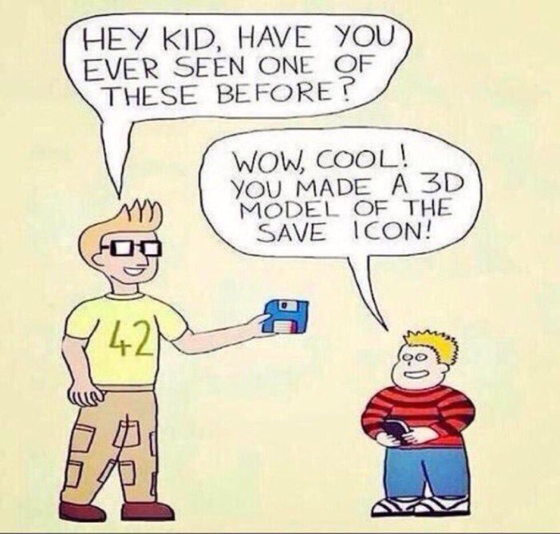
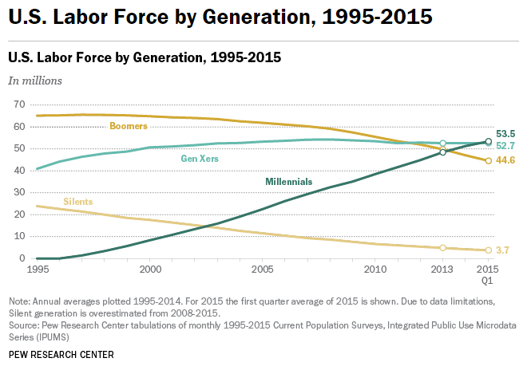
Changing workforce
Worldwide by 2025, 1 billion digital natives will join the workforce
Source: Deloitte

Slide 5
Middle & Digital Skills
Occupations that typically don’t require a bachelor’s degree and pay above the national living wage.
Source: Capital One; Burning Glass

Slide 6
Digital Readiness (2016)
52%
Source: Pew Research Internet

Slide 7
Precision Agriculture
UAVs
Self-guided equipment
Soil and moisture sensors
Farmbot Genesis: grows food in your backyard
Swagbot: cattle herding
Rowbot: fertilize soil, mulch weeds, sow crops

Slide 8
Broadband Key Terms
Bits: 1s & 0s; basic unit of information
Kilobit (Kbps): 1,000 bits per second
Megabit (Mbps): 1,000,000 bits per second
Gigabit: (Gbps): 1,000,000,000 bits per second
Download: speed measured in bits → receive data
Upload: speed measured in bits → send data
Symmetric: comparable upload/download speeds

Slide 9
Broadband Key Terms (cont’d)
Middle mile: network section that connects last mile networks to the backbone of the internet
Last mile: connection between network and home subscriber
FTTH: fiber-to-the-home
WISPs: wireless internet service providers
Open access: separates physical network from the services
Two-layer: municipality builds/owns/operates; ISPs provide service
Three-layer: municipality builds/owns; independent party operates; ISPs provide service
Dark fiber: laid but not “lit”; left as unused until needed or desired

Slide 10
Defining Broadband
Internet access that is always on and faster than dial-up
Different technologies, different speeds
Download: 25 Mbps
Upload: 3 Mbps
1 Mbps = 1 mph

Slide 11
Broadband Technologies
Digital Subscriber Line (DSL)
Cable Modem
Fiber-optic
Fixed Wireless
Satellite
Broadband over Power Line (BPL)
Fixed Versus Mobile

Slide 12
Broadband Deployment Models
Private sector
Large providers; WISPs; Telephone/Cable
Public-private partnership (P3)
Ammon, Idaho
South Bend, Indiana
Municipal
Nashville, Tennessee
Co-operatives
Minnesota

Slide 13
Open access arrangement
Source: Community Networks

Slide 14
Infrastructure Barriers
Lack of density
ROI inexistent
Right-of-ways
Easements
Topography

Slide 15
Funding Options
USDA – Community Connect Grants
USDA – Distance Learning and Telemedicine Grants
USDA – Rural Broadband Access Loan and Loan Guarantees
USDA – Telecommunications Infrastructure Loans and Guarantees
USDA – e-Connectivity ($600 million)
Indiana – Rural Broadband ($100 million)

Slide 16
In summary …
Community Economic Development
Access & Affordability
Adoption
& Use
Digital Inclusion

