Slide 1
African Swine Fever - update
Harm HogenEsch, DVM, PhD, DACVP

Slide 2
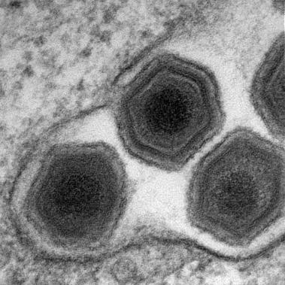
African swine fever virus
Sole member of Asfarviridae family
Enveloped DNA virus
DNA encodes for over 150 proteins
Virus replicates in monocytes and macrophages
> 20 genotypes, vary in virulence
https://www.pirbright.ac.uk/our-science/african-swine-fever-vaccinology
Andres G, et al., J Biol Chem 2019

Slide 3
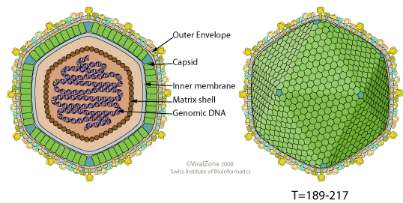
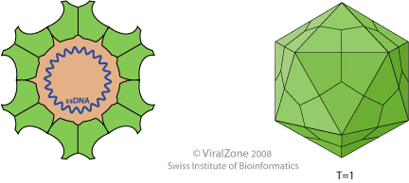
Comparing ASFV and PCV-2
Virus | Size | Genome | Nucleotides | ORFs
ASFV | 175 – 215 nm | dsDNA | 170 – 190 kB | > 160
PCV-2 | 12 – 23 nm | ssDNA | 1,768 B | 11
https://viralzone.expasy.org

Slide 4
Clinical Disease
Incubation period
  5-21 days
Forms of disease
  Peracute – sudden death
  Acute
  Subacute
  Chronic
Center for Food Security and Public Health, Iowa State University, 2018

Slide 5
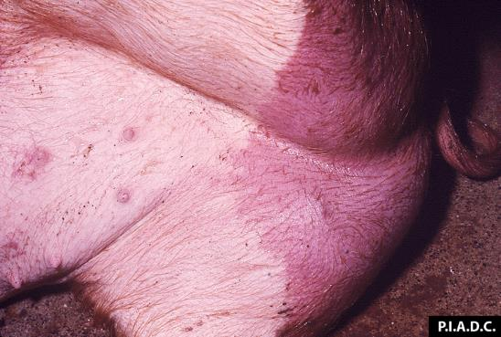
Acute disease
High fever
Anorexia, anorexia, weakness
Erythema, cyanosis
Hemorrhages
  Skin, snout
Diarrhea
Abortion
Respiratory
  Dyspnea
  Nasal discharge
Death
  7-10 days
Center for Food Security and Public Health, Iowa State University, 2018

Slide 6
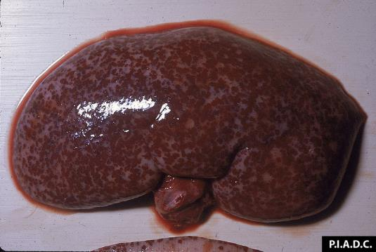
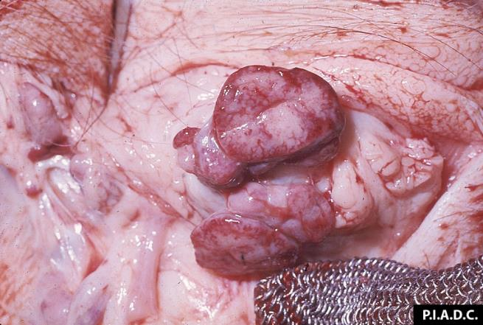
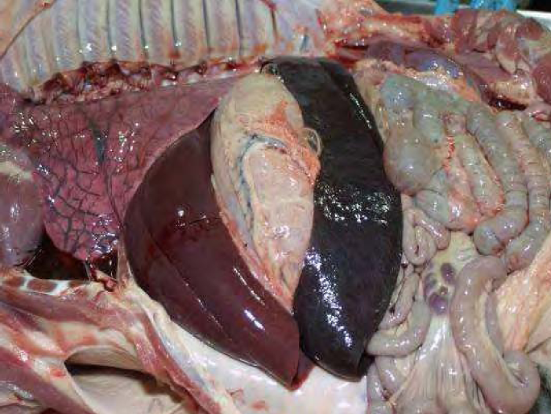
Pathology
Hemorrhages – skin, kidneys
Swollen spleen
Hemorrhagic lymph nodes
Center for Food Security and Public Health, Iowa State University, 2018

Slide 7
Subacute disease
Abortion
Fever
Erythema, cyanosis
Hemorrhages
may occur
Thrombocytopenia
Leukopenia
Death or recovery within 3-4 weeks
Center for Food Security and Public Health, Iowa State University, 2018

Slide 8
Chronic disease
Intermittent, low fever
Anorexia, depression
Emaciation, stunting
Respiratory: coughing
Joint swelling
Diarrhea
Occasional vomiting
Skin lesions
May be fatal
Center for Food Security and Public Health, Iowa State University, 2018

Slide 9
Spread of African Swine Fever
2015
2018
2018
1970-1990s
Caribbean
Brazil
1921
2007
1957, 1960
Dixon et al. Antiviral Res. 2019
Notes:
ASFV was first described in 1921 in Kenya.

Slide 10
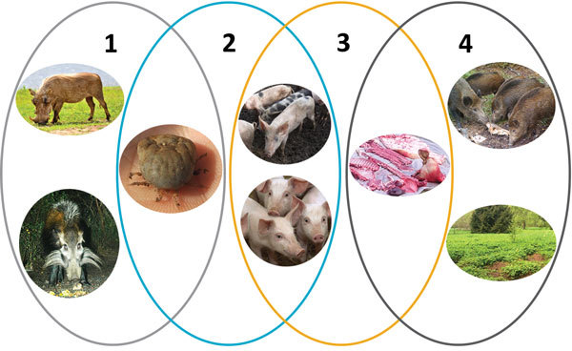
Epidemiology of ASFV
Domestic cycle
Tick-pig cycle
Sylvatic cycle
Wild boar-habitat cycle
Chenais, E. et al., Emerg Inf Dis 2018
Notes:
Sylvatic cycle – no disease; Africa (warthog, bushpig); probable origin of ASFV in domestic pigs
Tick-pig cycle – Subsaharan Africa and Iberian peninsula
Domestic cycle – Europe, Asia; high levels of viremia; oral-fecal route
Wild boar habitat cycle – wild boar equally susceptible as domestic pigs.

Slide 11
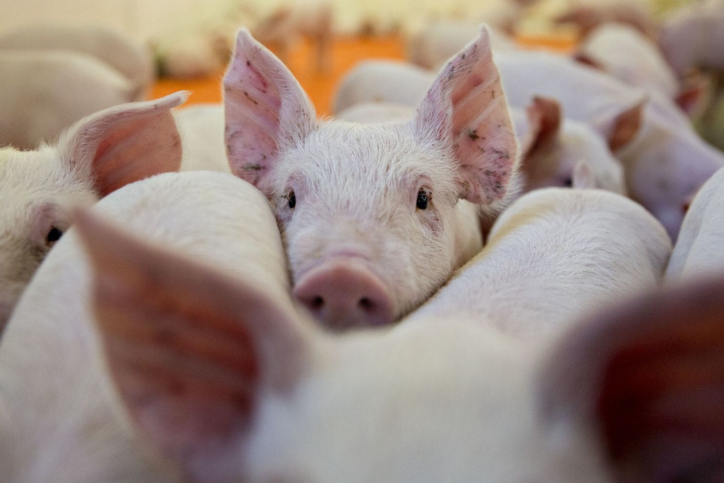
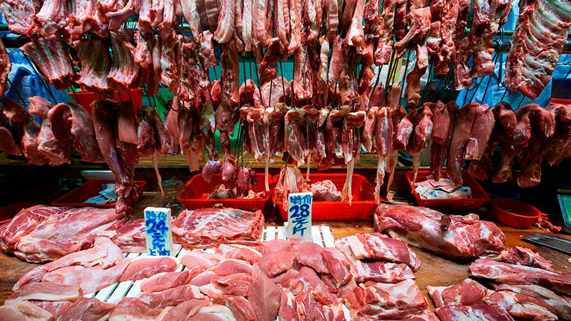
Domestic cycle –
Europe/Asia/Africa
High levels of viremia
High virus levels in urine, saliva, feces
Oral-fecal transmission
Limited role for aerosol transmission
Raw/undercooked meat products
Clothes, boots, vehicles, hunting knives

Slide 12
OIE– biweekly information
OIE/Nov 22 – Dec 5, 2019

Slide 13
African Swine Fever is a reportable disease
If ASF suspected, IMMEDIATELY notify animal health authorities
  In the U.S.
    USDA Assistant Director (AD)
    State Animal Health Official
Isolate/quarantine animals until
definitive diagnosis received
Center for Food Security and Public Health, Iowa State University, 2018

Slide 14
Diagnosis
Virus isolation
  Blood
  Tissues
PCR
  Blood
  Tissues (tonsil)
Serology
  ELISA
  IFA
  Immunoblotting
Center for Food Security and Public Health, Iowa State University, 2018

Slide 15
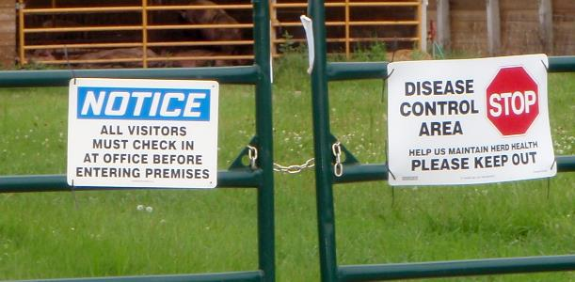
Treatment
No treatment available
  No treatment should be attempted
No vaccine available
Response should be directed by animal health authorities
Depopulation
Restrictions on pig movements
Center for Food Security and Public Health, Iowa State University, 2018

Slide 16
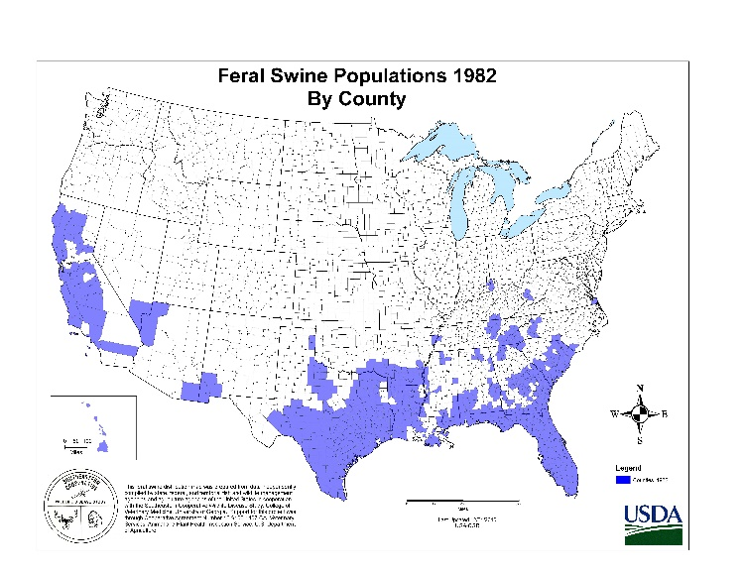
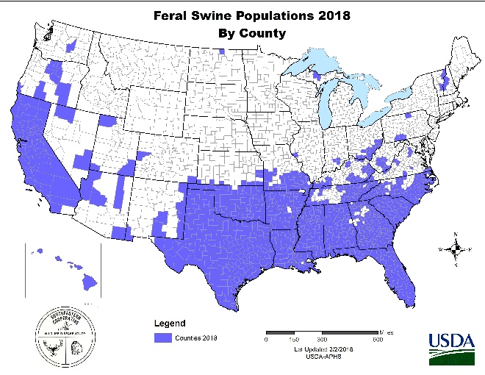
Prevention
Prevent direct transmission between infected and susceptible swine
  Isolate ill pigs
  Prevent contact with feral or wild hogs; when possible house pigs indoors
  Keep newly acquired pigs separate from the herd for at least 30 days to assure health
Prevent indirect transmission
  Do not feed uncooked pork products to pigs
    Swill, garbage, waste
  Disinfection
    Vehicles, equipment, footwear, clothing
  Appropriate disposal of manure and carcasses
  Avoid hunting wild hogs prior to contact with domestic pigs
Control tick vectors
Center for Food Security and Public Health, Iowa State University, 2018

Slide 17
Disinfection
Many disinfectants ineffective
  Use an product approved for the virus
  Feces and organic debris can increase resistance of virus
Disinfectants on nonporous surfaces
  Sodium hypochlorite, citric acid, some iodine and quats
Disinfect premises, equipment, vehicles, footwear
Center for Food Security and Public Health, Iowa State University, 2018

Slide 18
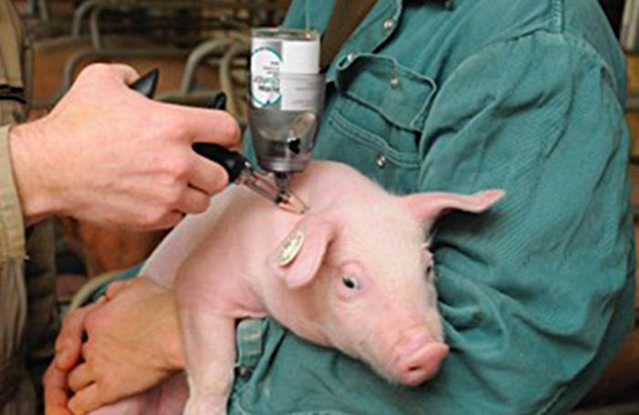
Vaccines
Considerations:
  Swine develop immunity following natural infection
  Differentiation of infected from vaccinated animals (DIVA)
  Safety
Types of vaccines:
  Live attenuated
  Killed:
    Challenging to neutralize virus and preserve immunogenicity
  Subunit:
    One or more viral protein candidates
    Combined with adjuvant
  DNA/vector
    Pox-, adeno-, alpha-viruses

Slide 19
