Slide 1
The Economic Outlook for 2021
December 8, 2020
Larry DeBoer
Department of Agricultural Economics
Purdue University

Slide 2
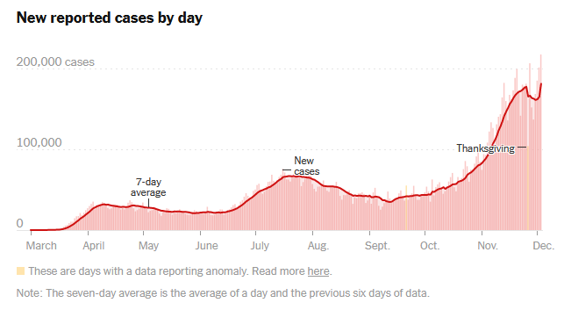
COVID Pandemic
7-day average, Dec. 3: 180,000

Slide 3
The Outlook for the U.S. Economy

Slide 4
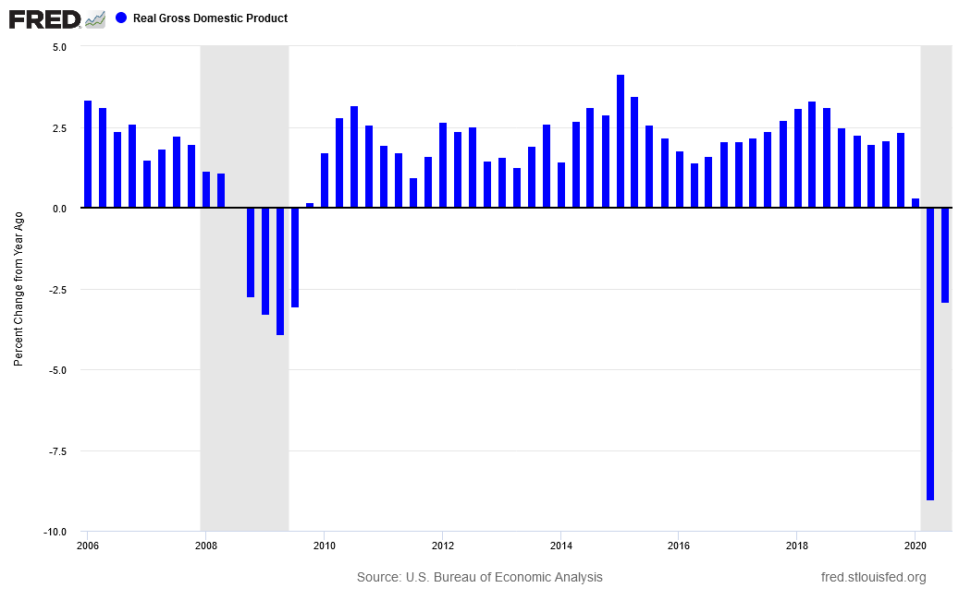
Real GDP Growth
(Percent change from previous year)
-2.9%
-3.9%
-9.0%

Slide 5
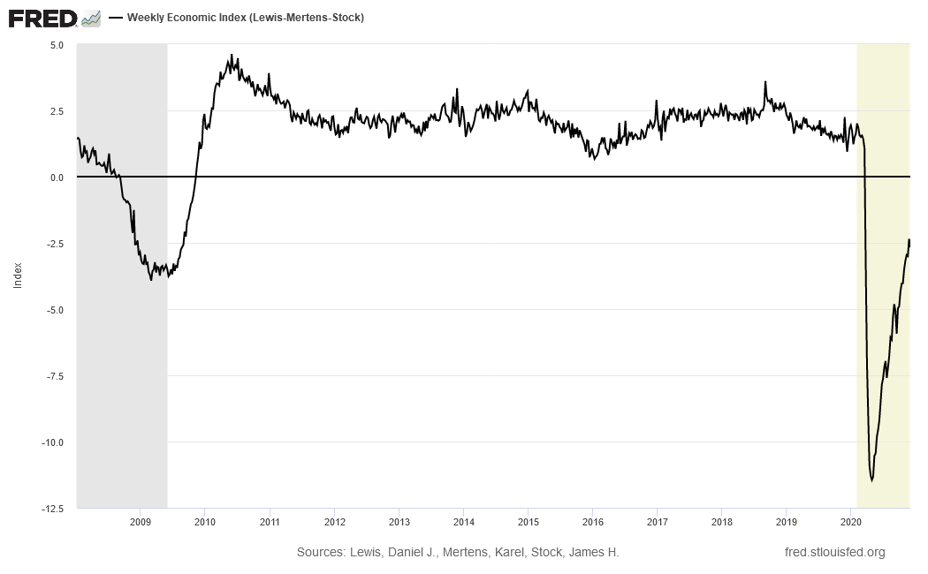
Weekly Economic Index, Jan 2018 to Oct 2020
(NY Fed, calibrated to percent change in GDP from year ago)
3/14/20
+1.1%
11/28/20
-2.7%
Index of 10 weekly data series
Like retail sales, unemp. insurance, railroad traffic,
gasoline sales, tax withholdings, etc.
4/25/20
-11.5%

Slide 6
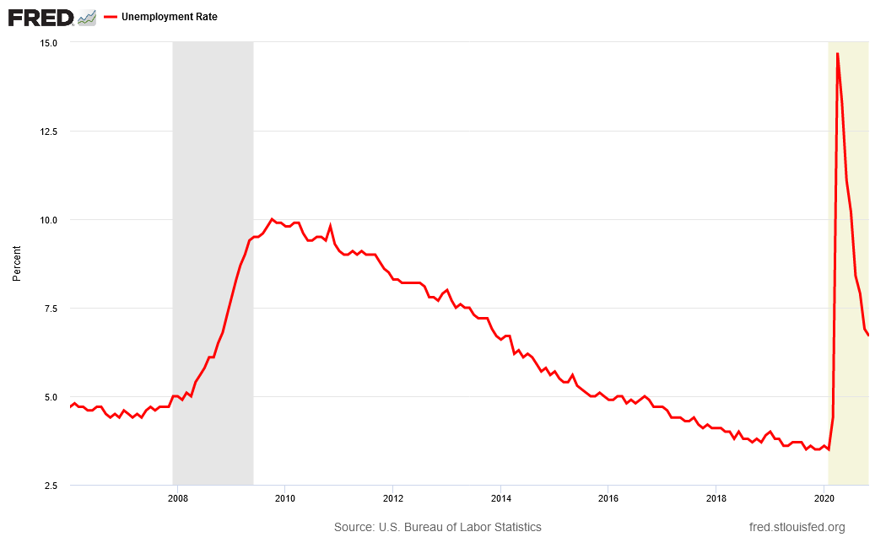
Unemployment Rate
April
14.7%
Oct 09
10.0%
Oct.
6.9%
Nov.
6.7%
May 07
4.4%
Feb 3.5%

Slide 8
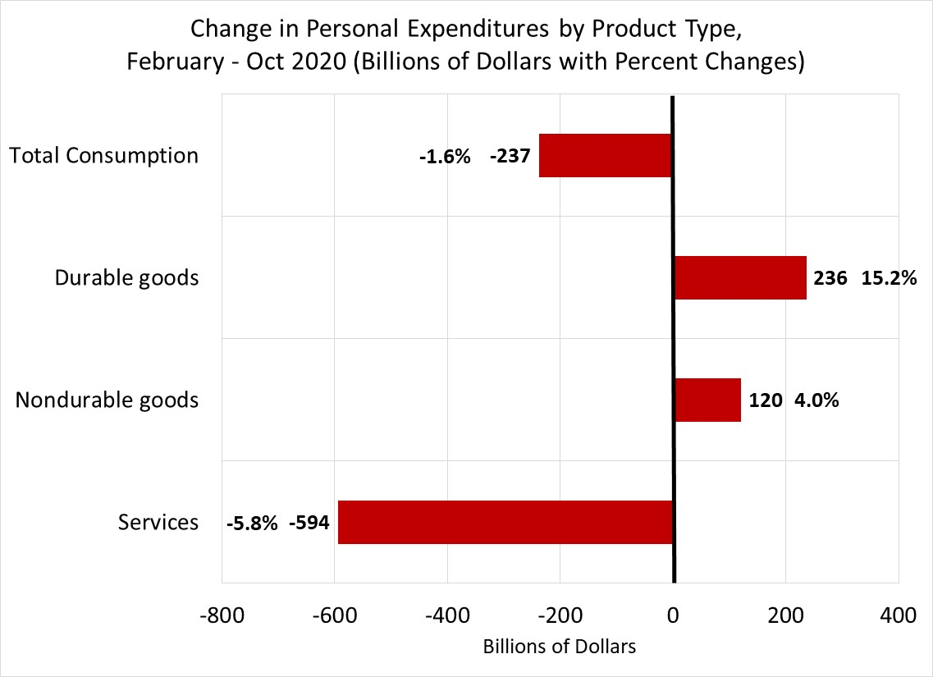

Slide 9
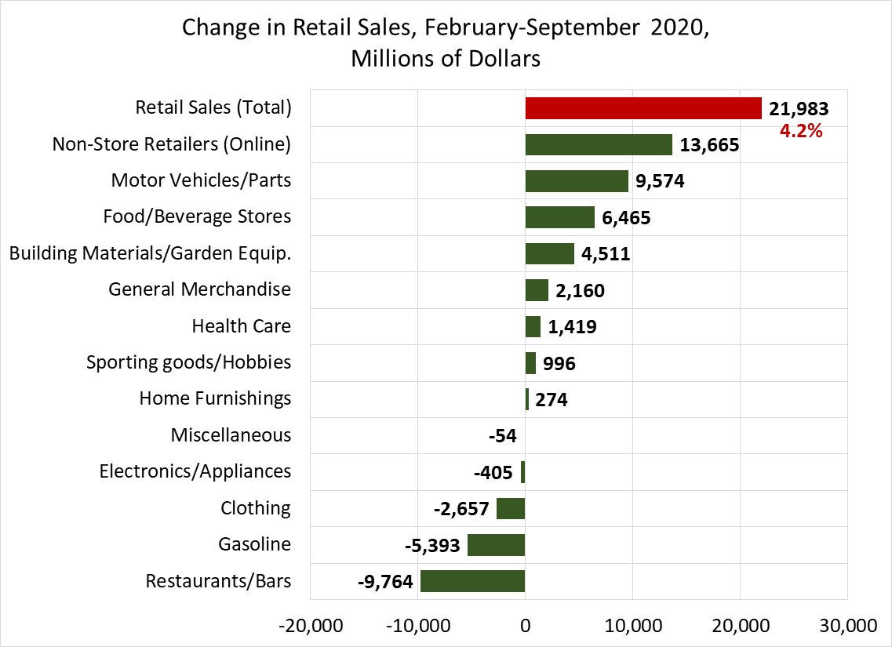
Goods only,
No services

Slide 10
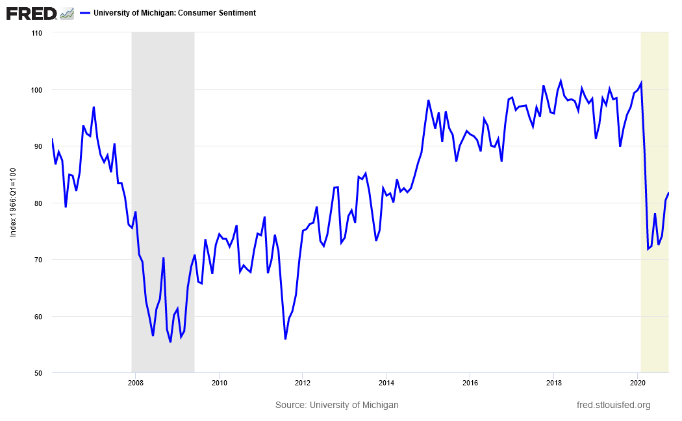
Consumer Confidence
University of Michigan Consumer Sentiment Index

Slide 11
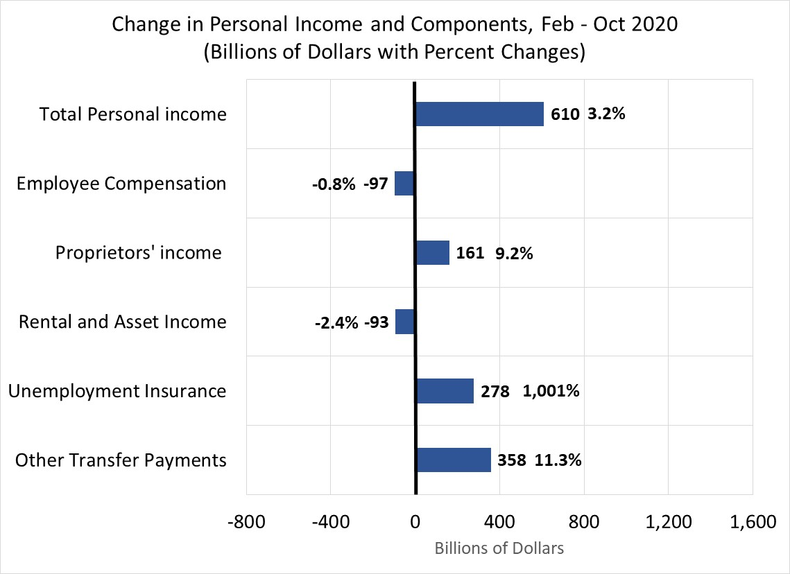

Slide 12
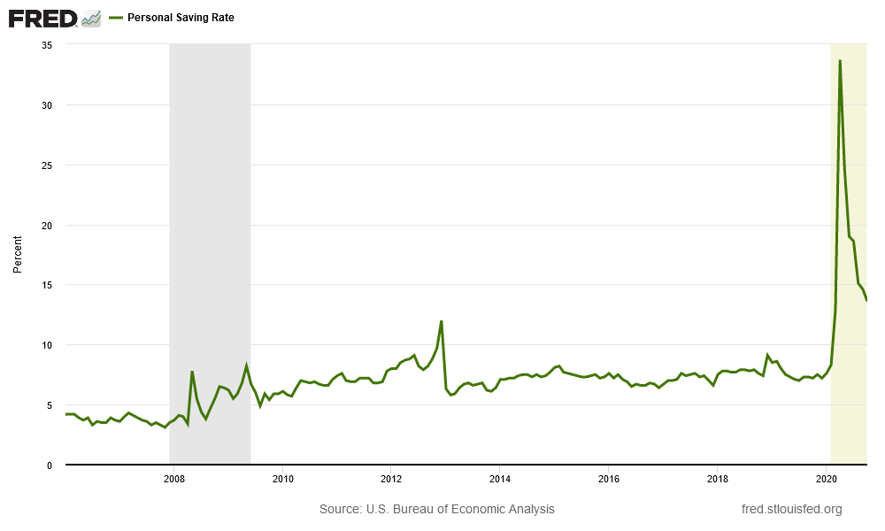
Personal Savings Rate, Monthly
April
33.6%
Oct
13.6%
Feb
8.3%

Slide 13
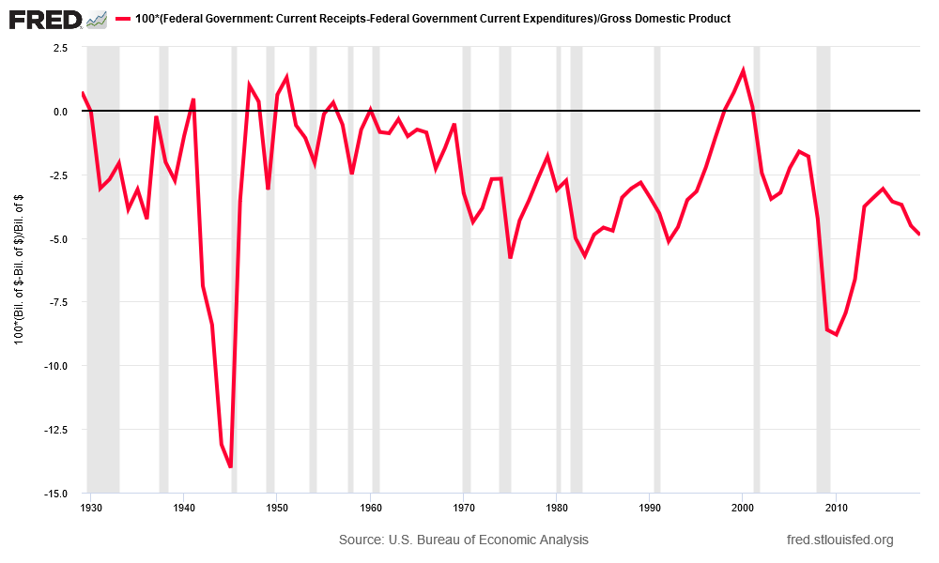
Federal Budget Balance, Percent of GDP, 1929-2019 and 2020 3rd Quarter
Q3 2020 deficit: $3.5 trillion
3rd Q GDP (ann. rate): $21.2 trillion
1945:
-14.0%
-16.5%

Slide 14
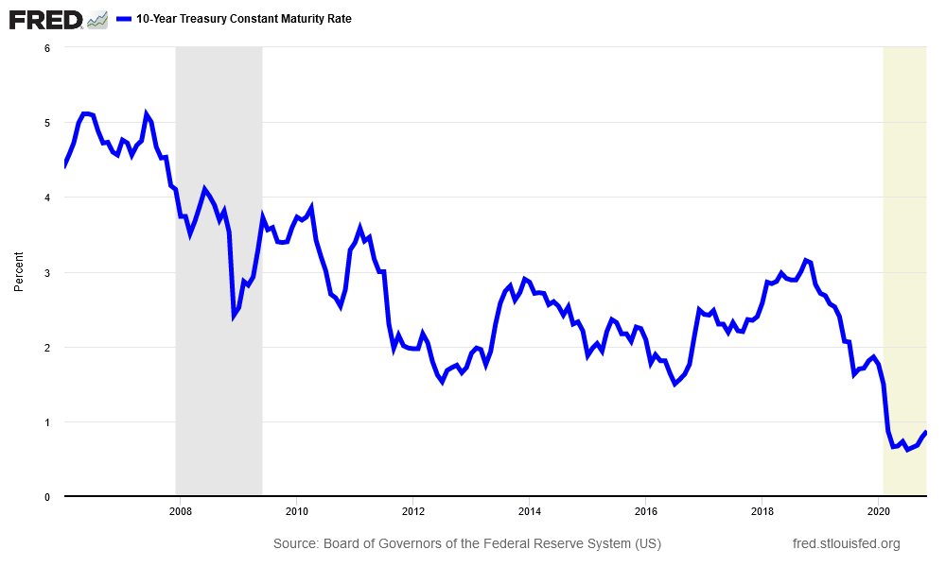
Treasury 10-Year Bond Yield

Slide 15
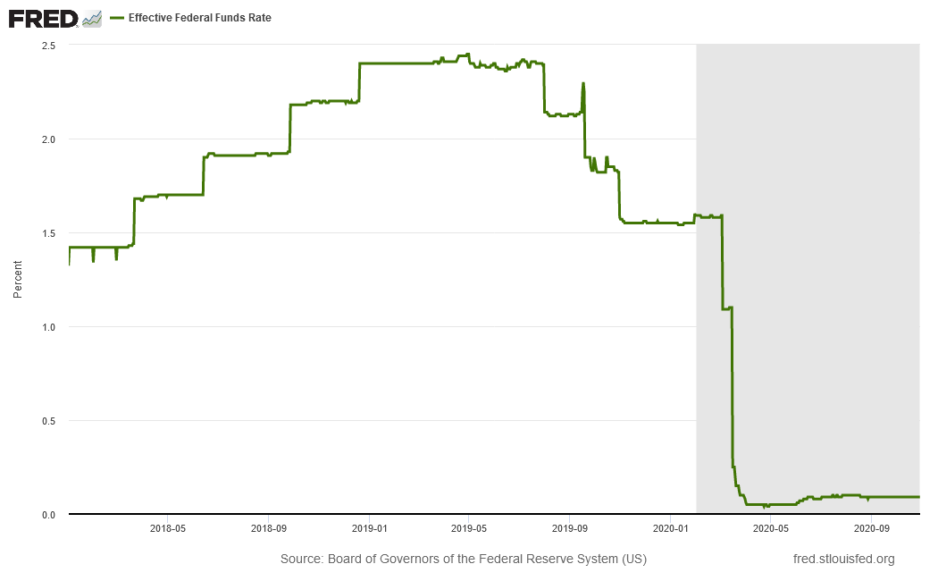
Federal Funds Rate, Daily
-0.5%
March 4
-1.0%
March 16

Slide 16
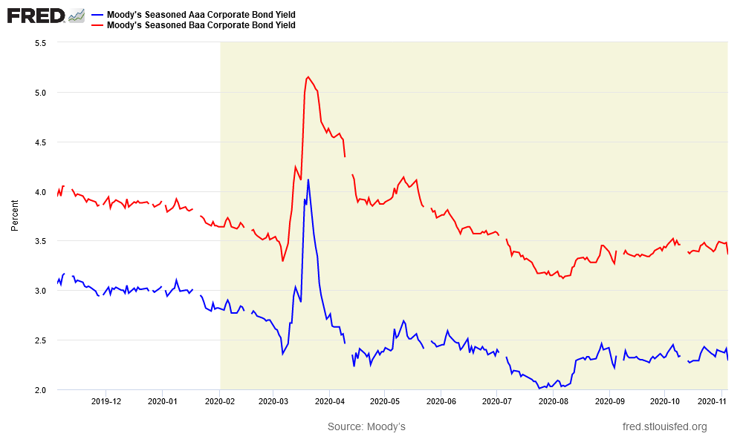
Corporate AAA and BAA Bond Yields
Daily, Oct 2019 – Oct 2020
Spread
4/7
1.99
Spread
2/28
0.81
BAA
Spread
8/26
0.95
Spread
11/4
1.07
AAA

Slide 17
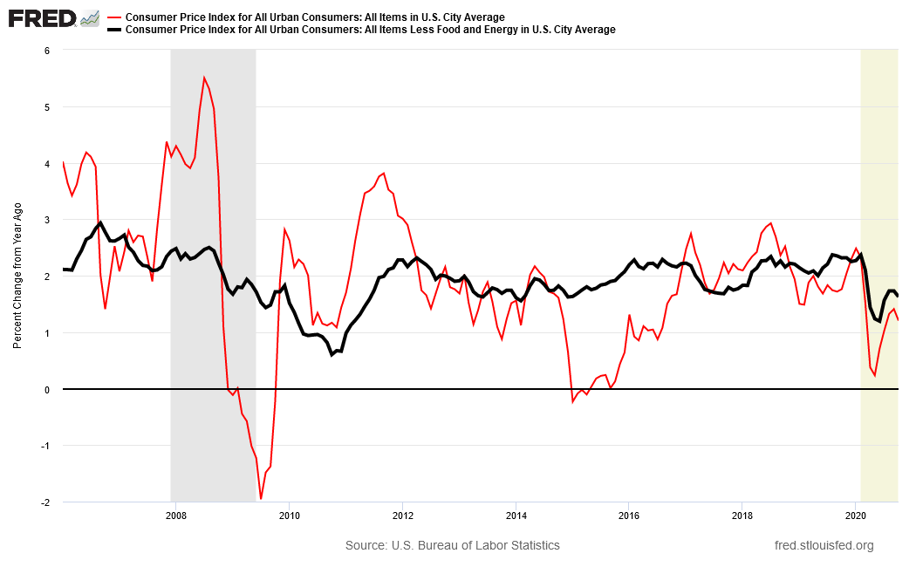
Inflation Rates, All-Items and Core
All Items
Core
(less food
and energy)
Feb.
2.4%
Oct
1.6%

Slide 18
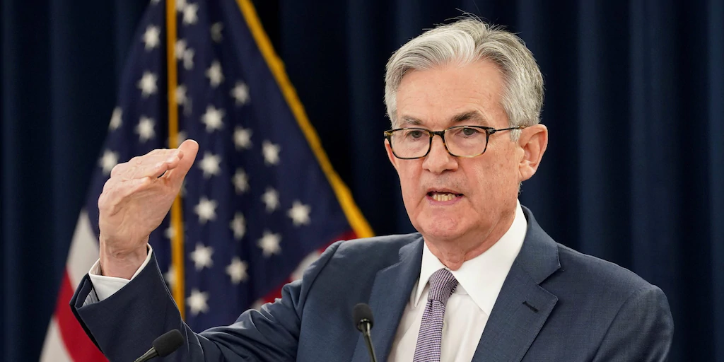
The Fed’s New Policy Framework
. . . The Committee's policy decisions must be informed by assessments of the shortfalls of employment from its maximum level . . . . The Committee seeks to achieve inflation that averages 2 percent over time, and therefore judges that, following periods when inflation has been running persistently below 2 percent, appropriate monetary policy will likely aim to achieve inflation moderately above 2 percent for some time.
The Fed will not raise
rates before employment
reaches its maximum.
The Fed will allow inflation above 2% for a time, before raising rates.
Fed Chair Jerome Powell

Slide 19
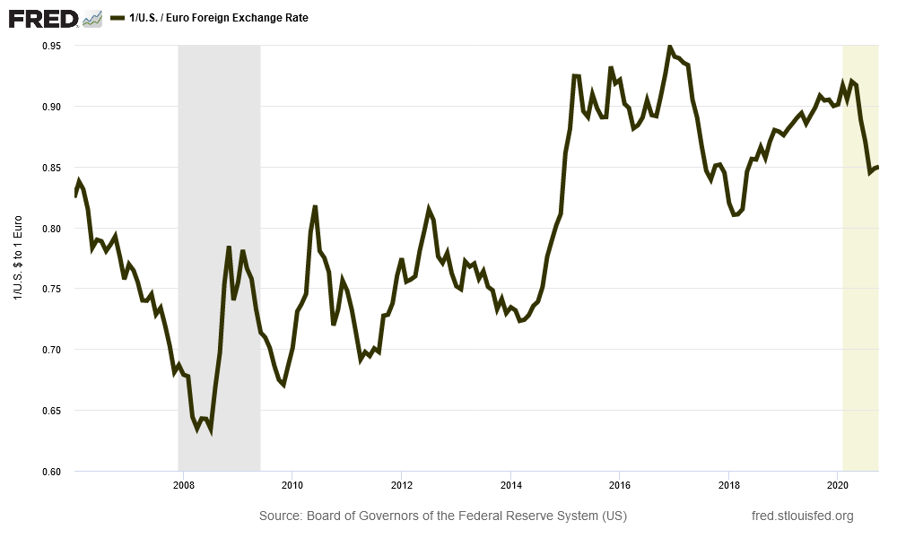
Exchange Rate: Euros per Dollar
No safe haven in the U.S.
Europe had more success against COVID

Slide 20
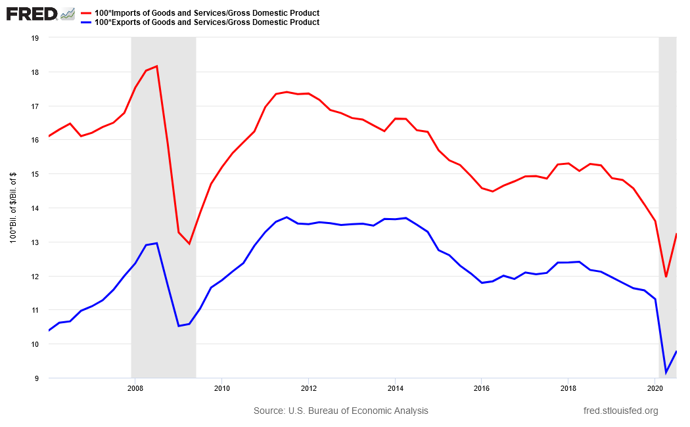
Exports and Imports,
Percent of GDP
Imports
Exports
Exports have fallen more than imports.

Slide 21
The Outlook for Indiana and its State and Local Governments

Slide 22
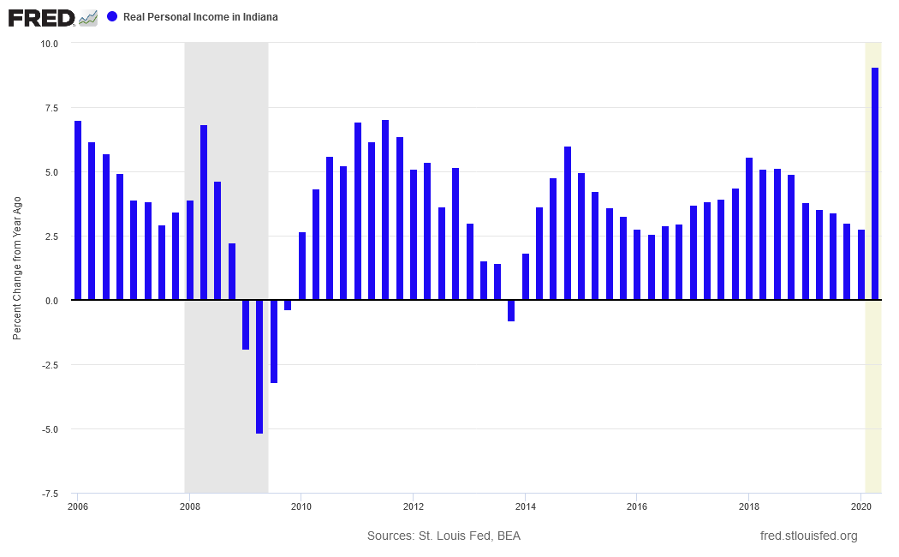
Real Personal Income in Indiana
(Percent change from year ago)

Slide 23
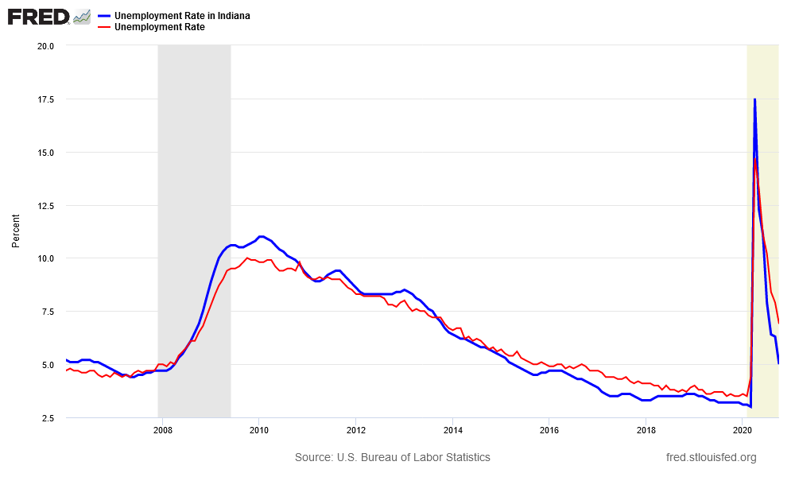
Unemployment Rate, Indiana and U.S.
April
Indiana
17.5%
U.S.
14.7%
2015-2019
Indiana < U.S.
Oct.
U.S.
6.9%
Indiana
5.0%
Aug ‘08 – Sep ’10
Indiana > U.S.

Slide 24
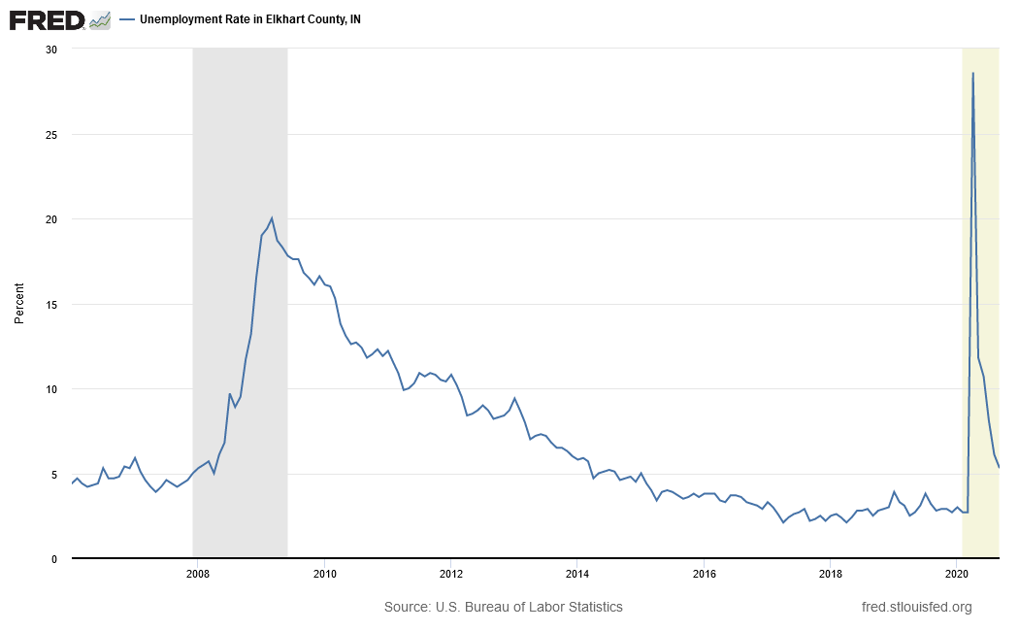
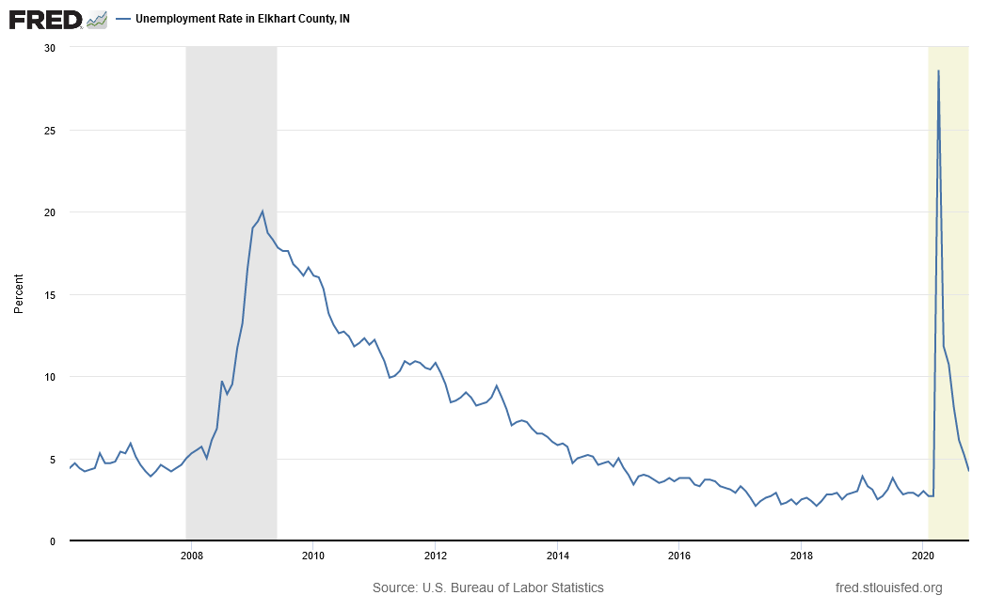
Elkhart County Unemployment Rate
April
28.6%
March
2.7%
Oct.
4.2%

Slide 25
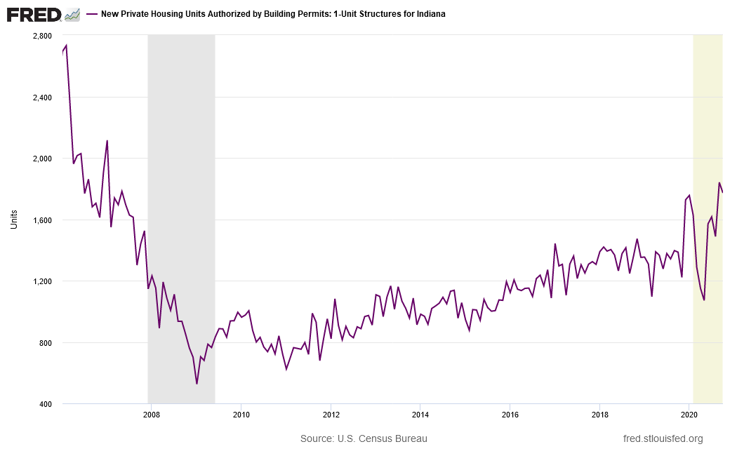
Indiana Home Building Permits
(Monthly, Seasonally Adjusted)
Oct.
1,771

Slide 26
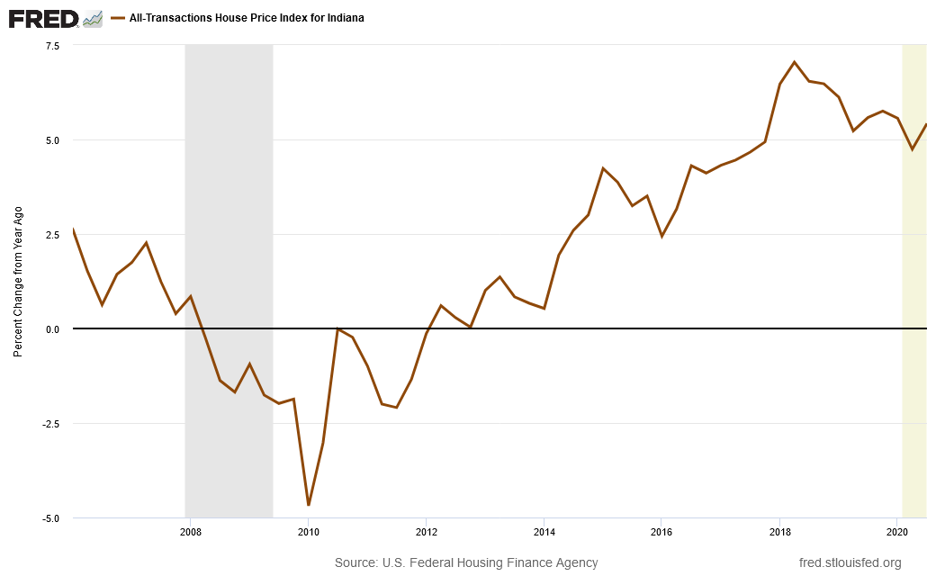
Indiana House Price Index
(Percent Change from Year Ago)

Slide 27
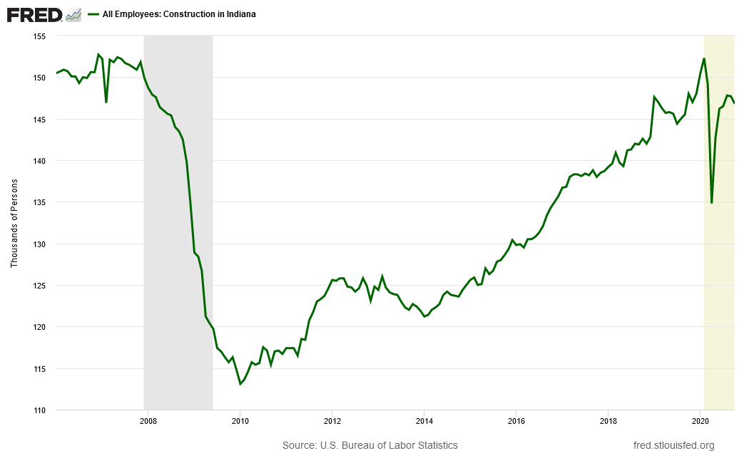
Indiana Construction Employment

Slide 28
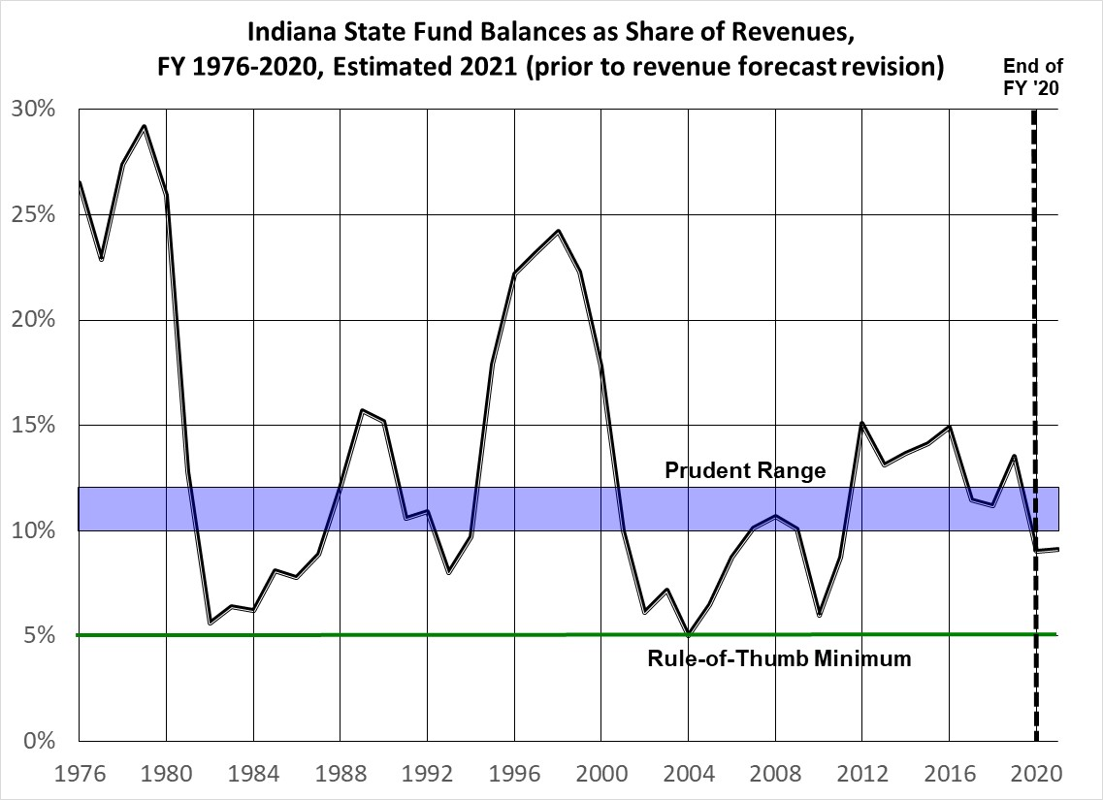

Slide 29
The Indiana Property Tax

Slide 30
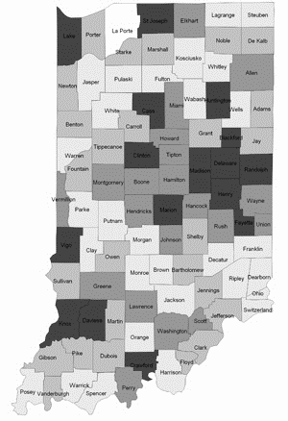
Recession and the
Indiana Property Tax
Recession in 2020 reduces property prices, new construction and equipment purchases.
Assessed Values in 2021 grow slowly or fall.
Slower income growth in 2020 enters the Maximum Levy Growth Quotient for 2022 budgets; levy growth slows.
Tax rates increase if levies grow more than assessed value.
Higher tax rates raise Tax Cap Credits, so the share of tax levy received decreases.

Slide 31
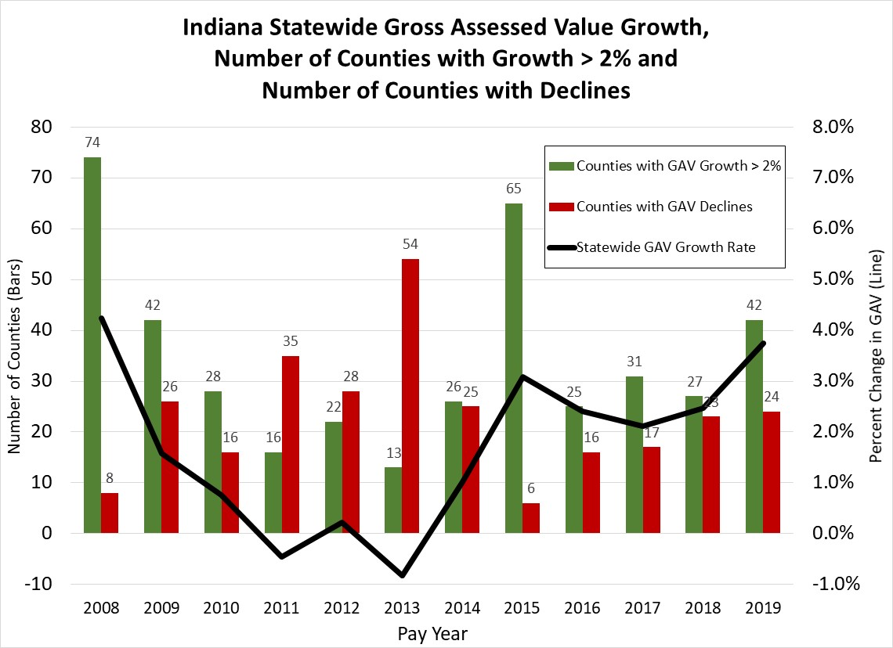
Market value in use, with trending
Assessed value declined
In most counties after the
Great Recession.

Slide 33
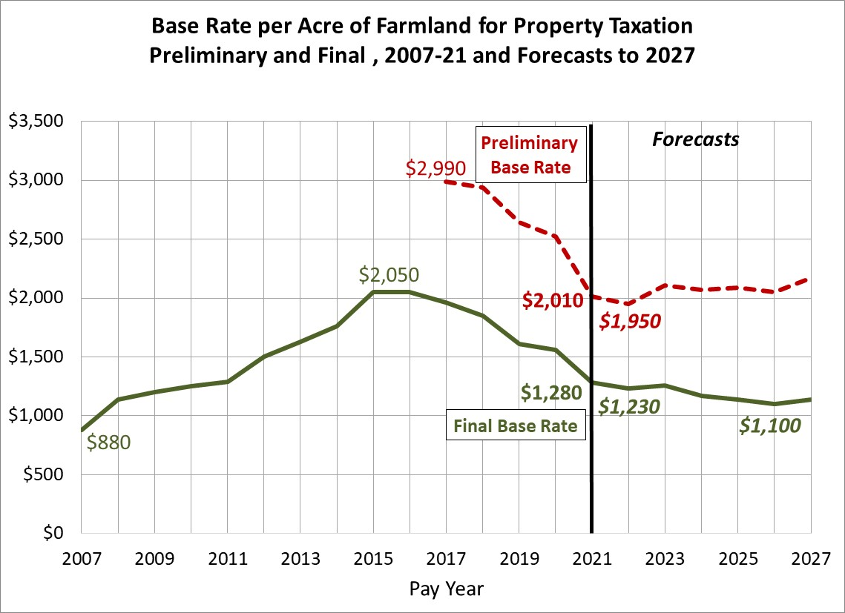
$1,560

Slide 34
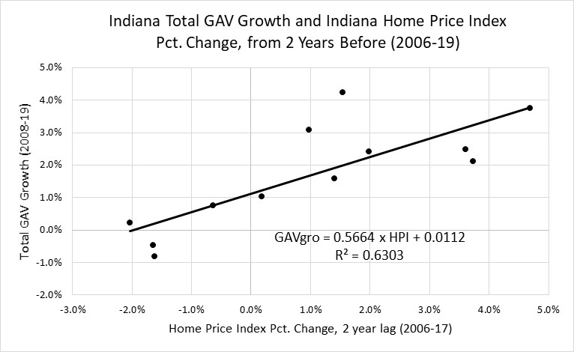
State and county home price index
have been a leading indicator of assessed
value growth, with a 2-year lag.

Slide 35
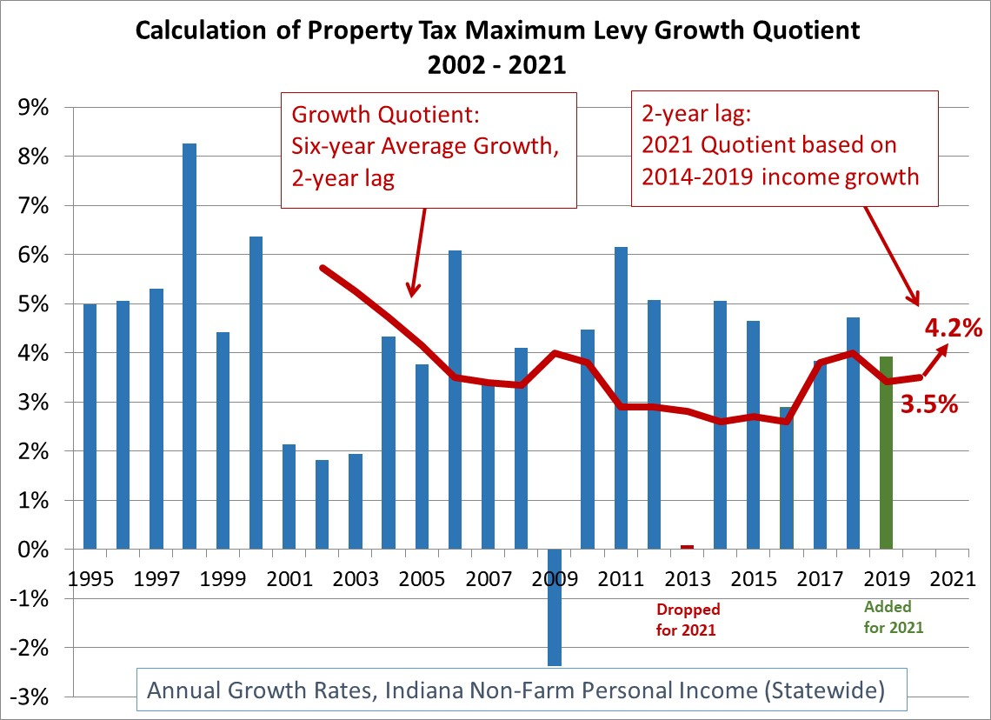

Slide 36
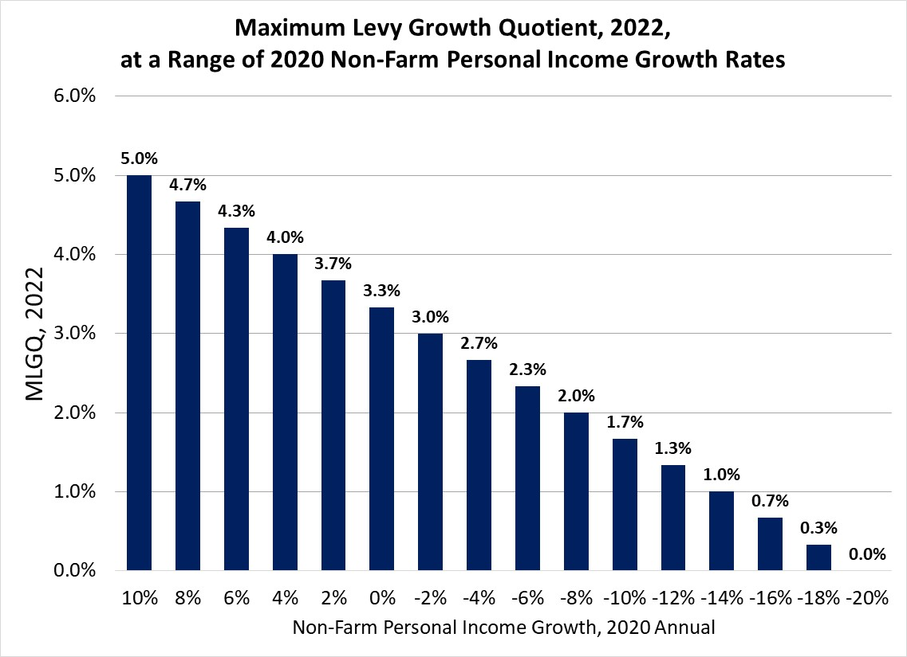
A personal income drop like in 2009
would put the MLGQ between 2.7% and 3%. 2Q ‘19-’20 Indiana Personal Income is UP 9% due to CARES act benefits. Annual 2020 income change range: -3% to +2%.

Slide 37
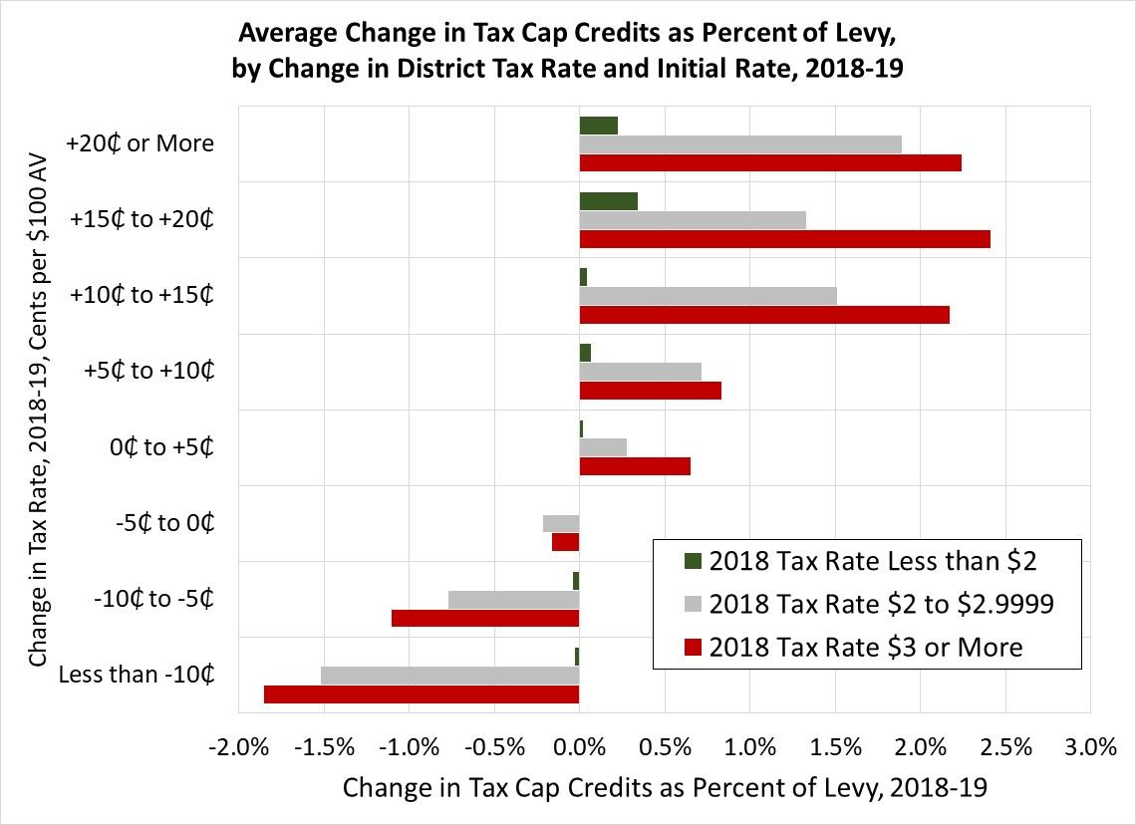
Tax rates rise if levies grow more than AV. Local governments with district rates above $2 are most vulnerable to tax cap credits.

Slide 38
The Outlook for 2021

Slide 39
The Outlook: What about the Virus?
Can consumer spending recover as long as the virus continues?
7-day average, Dec. 2: 218,000

Slide 40

Recovery from the COVID Recession
The virus calls the shots
  Consumer spending on services and social retailing will not fully recover until the virus is controlled. (Consumers are 2/3’s of GDP)
Can the President and Congress pass new aid for the unemployed and state/local governments? Will we repeat the stalemate of the post-Great Recession years?
Home building, vehicle sales and equipment investment likely to continue to grow
The Fed will hold the federal funds rate near zero well into the 2020’s
Neither fiscal nor monetary policy is likely to cause rising inflation or rising interest rates
Can we avoid more permanent job loss this winter?
“Check-shaped” recession/recovery, with the virus and fiscal policy determining how long a tail

Slide 41
Indiana Government Budgets in Recession
Cautious Pessimism
  What will the State Revenue forecast tell us for the next biennium?
  Assessment growth could slow for taxes in 2022, commercial property values could decline.
  Farmland assessments will fall in rural taxing districts.
  Higher tax rates will increase tax cap credit losses for city taxing districts.
  Local income taxes may fall in 2022 due to lower incomes in 2020

Slide 42
Indiana Government Budgets in Recession
Cautious Optimism:
  Vaccine may be in wide distribution by the time the next biennium starts in July
  Some CARES act benefits are taxable as income
  Housing construction continues, prices are rising, so assessed values may not fall in 2021 pay 2022.
  MLGQ may not fall much.
  Tax rates may not rise very much, so tax cap credits may not increase.

Slide 43
Long Term Effects of COVID Recession?
Telecommuting
  Exodus from high-rent cities to suburbs and rural areas
  Lower demand for commercial office space
  Lower demand for business travel (airlines?)
  Further investments in broadband infrastructure (private and public)
Accelerated shift to online retailing
  More trouble for malls and department stores
Further concentration of sales with largest firms
  Big chains with resources to survive vs. small businesses
Larger Federal budget deficits for several years
Low interest rates for even more years
  Revised Fed policy

Slide 44
The Economic Outlook for 2021
December 8, 2020
Larry DeBoer
Department of Agricultural Economics
Purdue University

