Slide 1
Climate Change Impacts on Crop Performance
Jeff Volenec and Sylvie Brouder
Department of Agronomy
Purdue University
jvolenec@purdue.edu

Slide 2
Climate-related Factors That Impact Crop Production
Carbon Dioxide (CO₂): Increasing at 1-2 ppm per year
Temperature: Increasing; More Variable
Growing Season: Longer; Variable Start and Finish
Water: Variable. Higher Intensity Rain. Higher Temps will Increase Crop Water Use

Slide 3
Not All Crops Respond to High CO₂: Plants with C₃ Photosynthesis Are Expected to Respond; Photosynthesis of C₄ Plants is Not Expected to Increase with High CO₂
10 to 30% Yield Increase
No Tangible Yield Increase
C₃ Crops: Soybean, Alfalfa, Wheat,..
C₄ Crops: Corn, Sorghum, Sugarcane,....
90-95% of Crop Biomass is Derived From Photosynthesis
Peterson. 2019. Impact of climate change on twenty-first century crop yields in the U.S. Climate 7:40-57. doi:10.3390/cli7030040

Slide 4
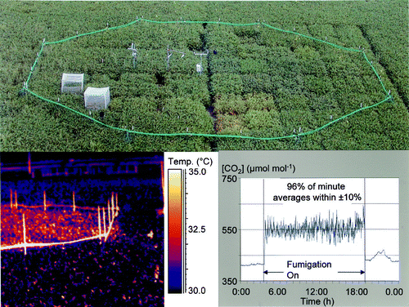
Free Air CO₂ Exchange Experiments
IL FACE
Five Locations World-wide
Focused on Major Crops
Duration of 3 to 8 Years
Elevated Daytime CO₂ to ca. 500-600 ppm
Partial Stomatal Closure-Heat Stress

Slide 5
Meta-Analysis of Adaptation of Crops to Climate Change (FACE): Grain Yield
Species/Trt | Number of Studies | [CO₂] ambient CO₂ | 90% Confidence Interval | Comments
Maize | 1 | 1.01 | n/a | No Impact (C4)
Sorghum | 3 | 0.99 | 0.92-1.06 | No impact (C4)
Soybean | 2 | 1.15 | 0.99-1.33 | No impact
Rice | 8 | 1.12 | 1.04-1.21
Wheat | 7 | 1.13 | 1.10-1.16
Low N | 4 | 1.09 | 1.00-1.18 | No impact
Medium N | 2 | 1.15 | 0.93-1.42 | No impact
High N | 4 | 1.15 | 1.08-1.23
(Adapted from Long et al., 2006)

Slide 6
Cornbelt Temperatures in Summer will Increase by 3 to 8˚C (5 to 14˚F) with More Frequent Heat Waves
29C=84F
33C=91F
38C=100F
Heat Wave: three consecutive days where the daytime high is in the upper 90% percentile of high temps recorded for that day
Peterson. 2019. Impact of climate change on twenty-first century crop yields in the U.S. Climate 7:40-57. doi:10.3390/cli7030040

Slide 7
Temperature Effects on Photosynthesis (Ps) or Dark Respiration (Rd)
100
Ps: Rate Inc. Slowly With Temp.
Rd>Ps
Plants Lose Weight!!
75
Ps=Rd; No Net Dry Wt Gain
50
Rd: Rate Inc. Rapidly with Temp.
25
At “Normal” Temps ~45% of CHO Created Daily by Ps is Lost via Rd
0
55 60 65 70 75 80 85 90 95 100 105 ˚F

Slide 8
Model Predictions Indicate Little Change in Soybean Yield: Positive Effect of CO₂ on Yield Will Offset the Negative Impact of High Temps.
Peterson. 2019. Impact of climate change on twenty-first century crop yields in the U.S. Climate 7:40-57. doi:10.3390/cli7030040

Slide 9
Model Predictions Indicate a Large Reduction in Corn (C₄) Yield: No Positive Effect of CO₂ on Yield to Offset the Negative Impact of High Temps.
Peterson. 2019. Impact of climate change on twenty-first century crop yields in the U.S. Climate 7:40-57. doi:10.3390/cli7030040

Slide 10
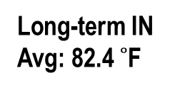
Average July Maximum (~daytime) Temperatures Have Impacted Corn Yields in IN, MO, IL and IA Over the Last Decade.
Long-term IN
Avg: 82.4 $˚$F

Slide 11
Why Temperature Impacts Corn Yield and What it Costs (hidden yield reductions)
High daytime temperatures reduces photosynthesis (Ps)
Hot nights increase respiration rates (Rd)
Net daily CHO (Ps – Rd) for growth/grain yield is reduced
Climate change impact on yield and gross income in IN
  Predict a 5°C (9°F; 82.4 to 91.4) increase in temp. by 2100
    82.4 (avg) to 87.2 (tip. pt.): Δ4.8F x 0.69%/F=3.3% x 175 bu/a=5.8 bu
    87.2 (tip. pt.) to 91.4: Δ4.2F x 4.95%/F=20.8% x 175 bu/a =36.4 bu
    Total yield reduction: 5.8 +36.4 bu/a=42.2 bu/a
  This 42.2 bu/a loss, at $4.92/bu (Tate & Lyle)=$208/a
  5.2 M acres of corn in IN in 2018; $1.08 Billion loss for IN
Huge disclaimer: This is an agronomist doing an economic analysis!!!

Slide 12
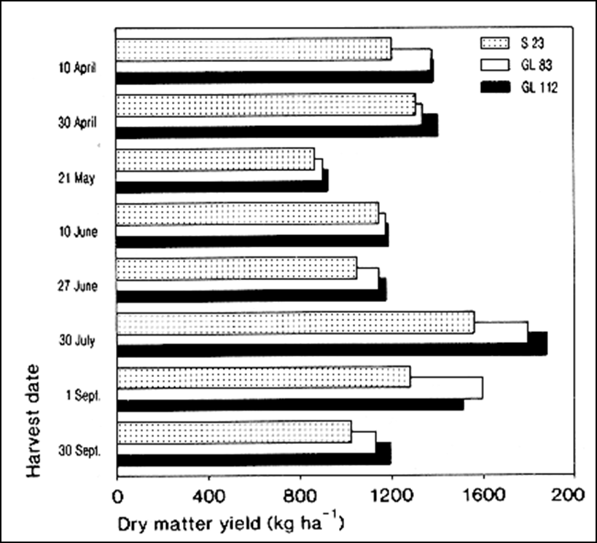
Adaptation/Resilience: Selection for Low Leaf Dark Respiration (Rd) Resulted in Higher Yield of Ryegrass
If photosynthesis is the same, reducing Rd increases net CHO available for growth
Benefits of low Rd most evident in summer-hot
Date: 1982 (37 years ago).
Wilson, D. and Jones, J.G., 1982. Effect of selection for dark respiration rate of mature leaves on crop yields of Lolium perenne cv. S23. Annals of Botany, 49(3), pp.313-320.

Slide 13
Wheat Grain Yield is Negatively Associated with Leaf Respiration at 30 and 35 C in 12 Spring Wheat Lines Grown Under Heat Stress in the Yaqui Valley, Mexico. (Date: 2017)
Pinto, R.S., Molero, G. and Reynolds, M.P., 2017. Identification of heat tolerant wheat lines showing genetic variation in leaf respiration and other physiological traits. Euphytica, 213:76.

Slide 14
Climate Change Will Also Impact the Forage-Livestock Industry-Direct vs Indirect Effects (Izaurralde et al. 2011)
Characteristic | Annual Change | Comment
Yield | No change* (extra cutting?) | Response to high CO₂ may be temp.-, water- and N-limited
Species Composition | C₃ plants and legumes may be favored in high CO₂ | Interaction of species with nutrients, water, temperature and CO₂ will determine this
Forage Protein | Decreased concentration | Unless soil N is ample, high CO₂ will increase forage C and dilute N lowering protein
Forage Fiber | Increased concentration | Higher C increases cellulose, hemicellulose, lignin and reduces forage intake and digestibility
*does not take into account climate impact on persistence of perennials nor the direct effects of heat on livestock (fans, open-sided barns, misting sytems,…): Increase feed and management costs!

Slide 15
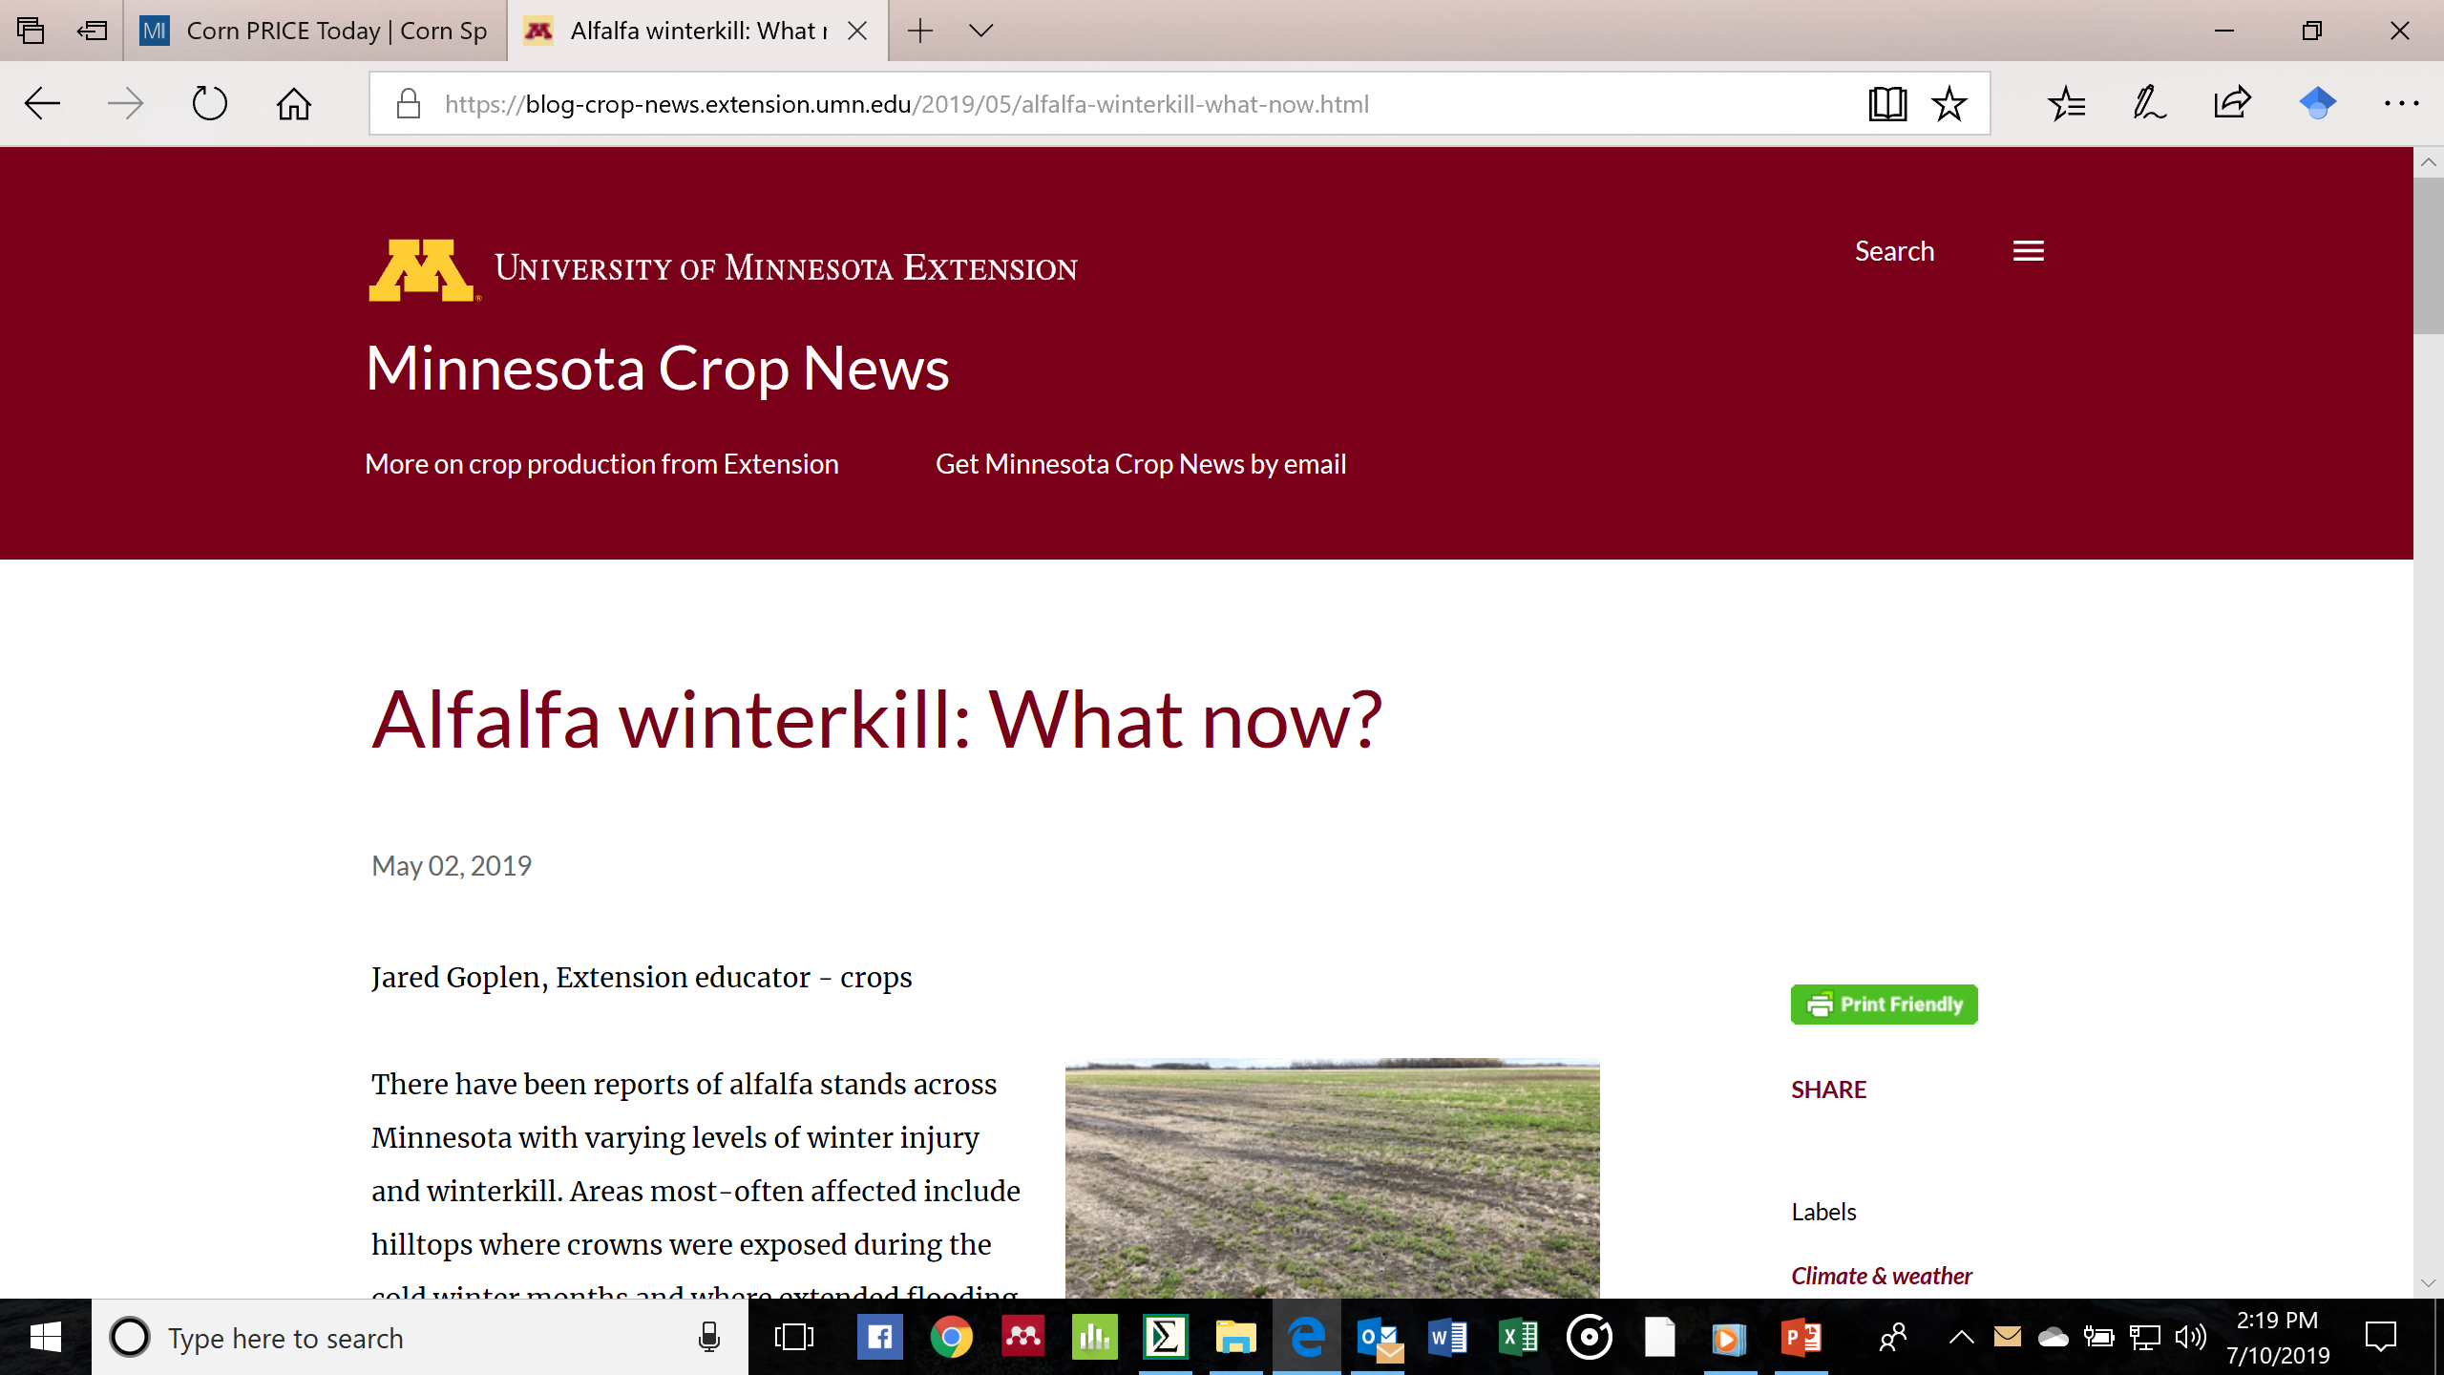
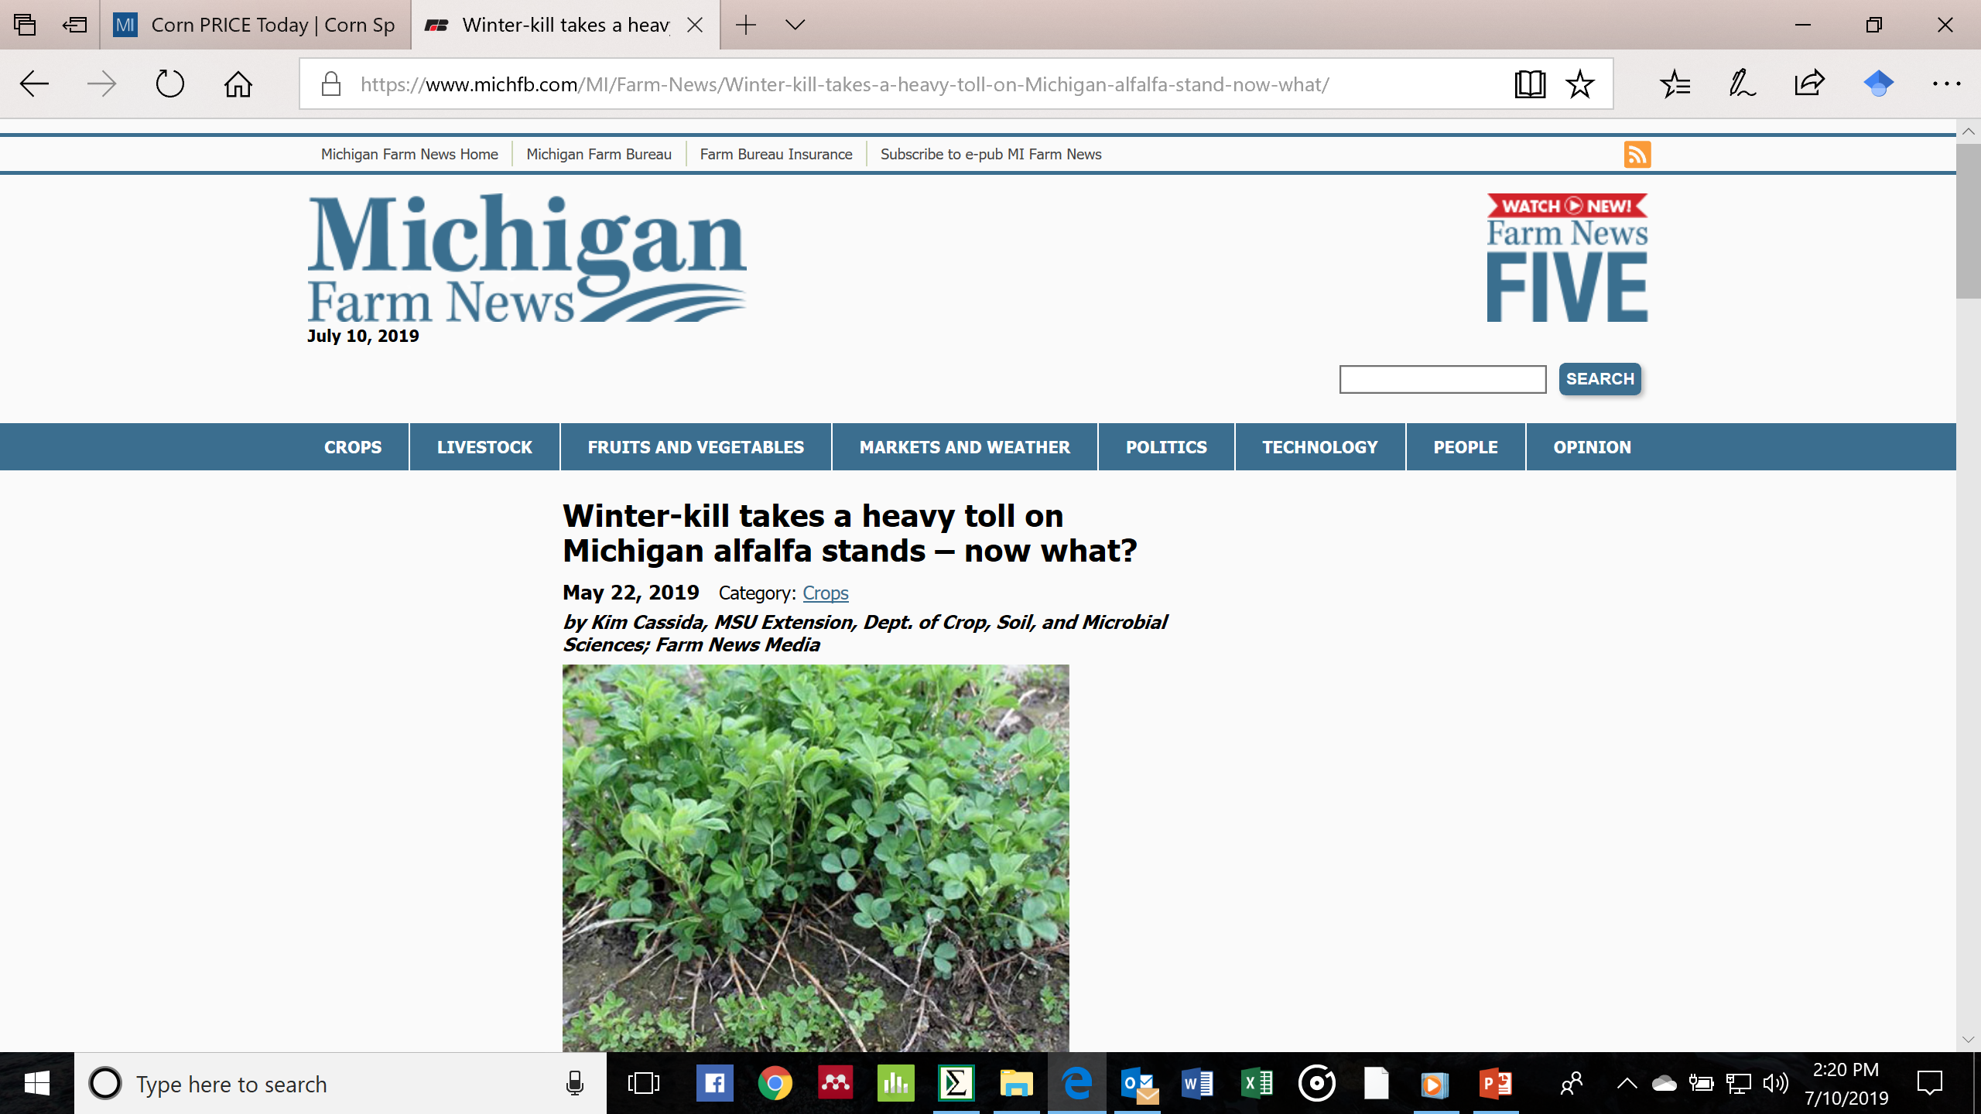
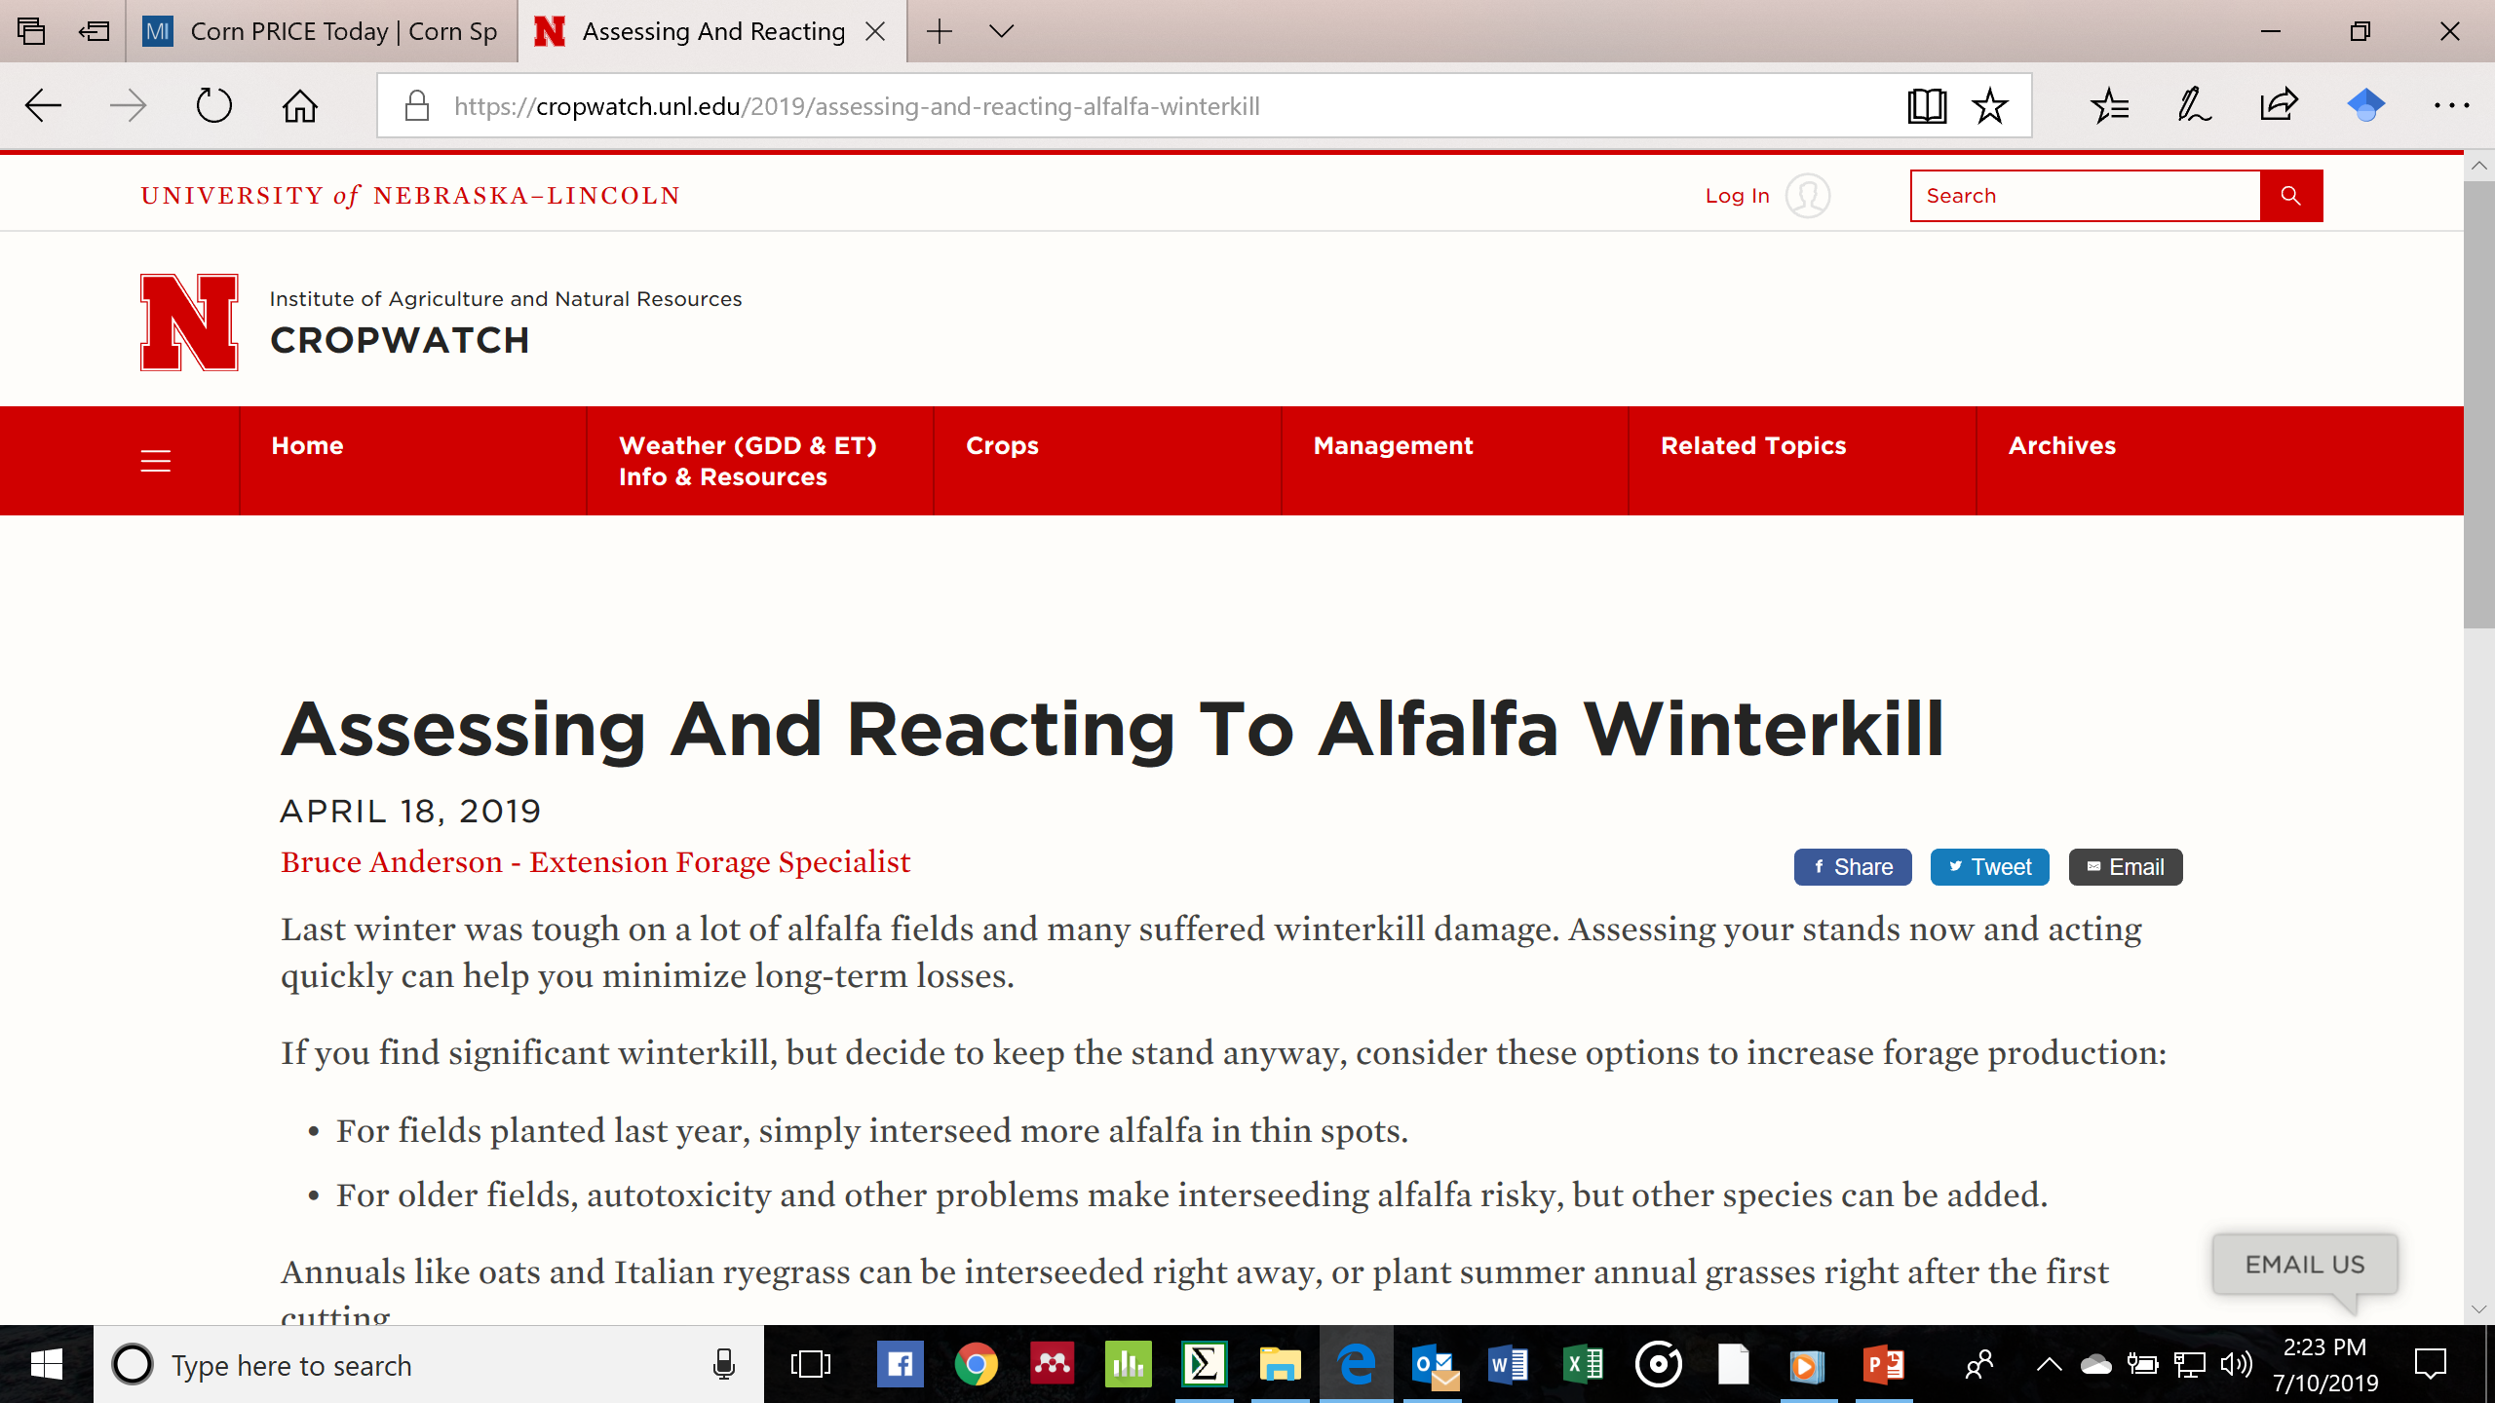
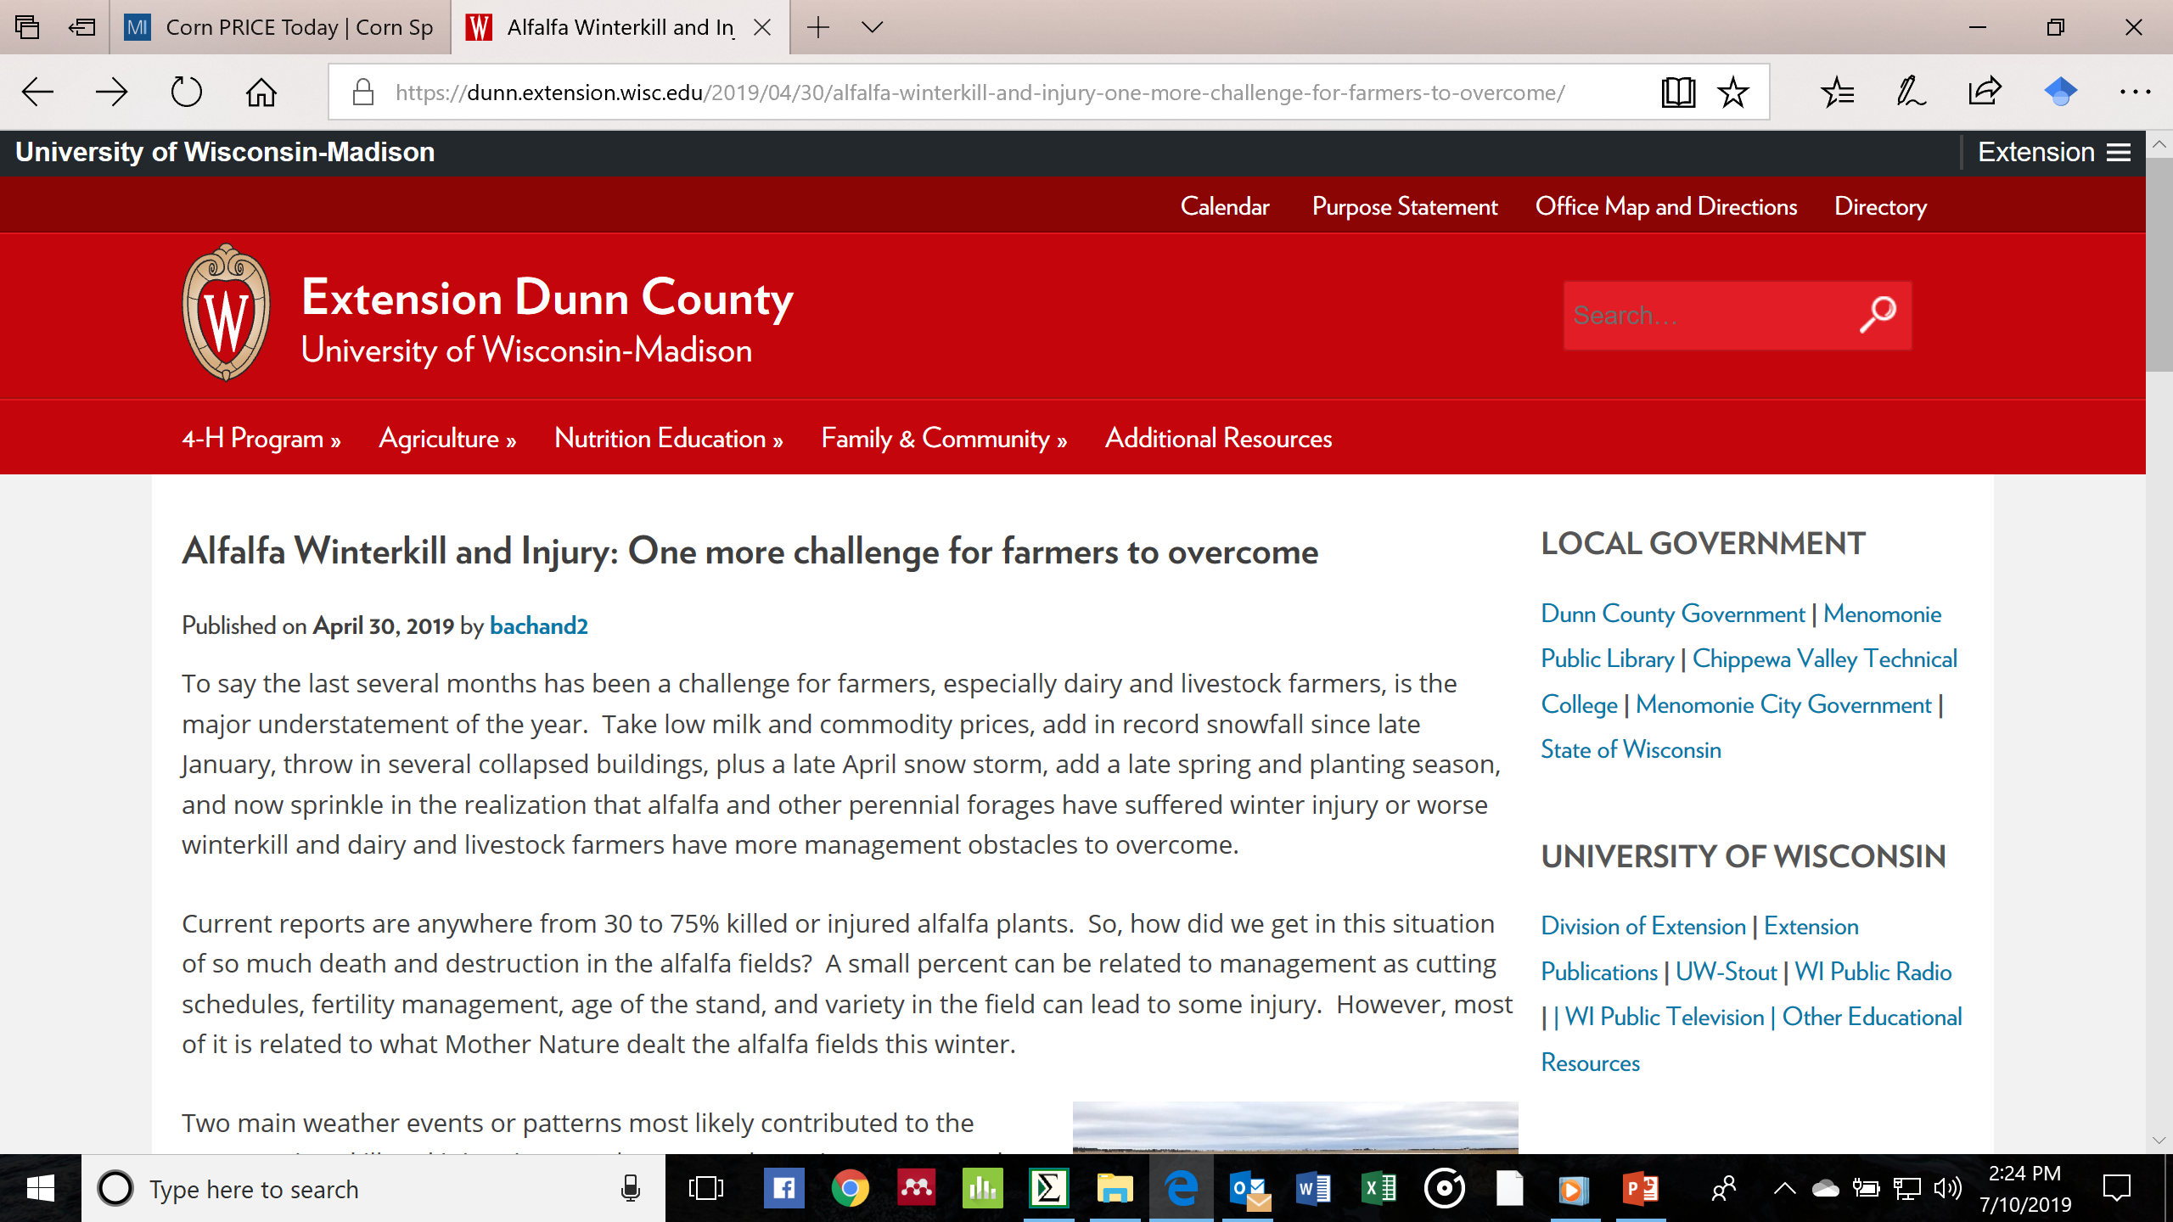

The 2018-19 winter was hard on perennials and winter annuals in much of the Midwest

Slide 16
What is the Problem-Winters are Getting Warmer??
Elias et al. 2018. County-level climate change information to support decision-making on working lands. Climatic Change148:355-369.

Slide 17
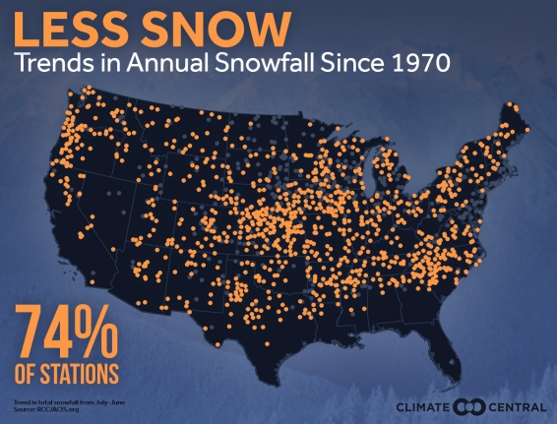
Winterkill of Alfalfa is Reduced With Snow Cover – Snow Insulates Plants/Soil from Extremely Low Temperatures (Leep et al., 2001).
https://www.climatecentral.org/gallery/maps/these-us-cities-are-getting-more-and-less-snow
 | Snow Depth, Inches
Alfalfa Variety | 0 | 4 | 8
Hardy (MN/WI/MI) | 29 | 1 | 5
Interm. Hardy (IN/IL) | 36 | 20 | 16
Not Hardy (AZ/NM) | 97 | 72 | 61

Slide 18
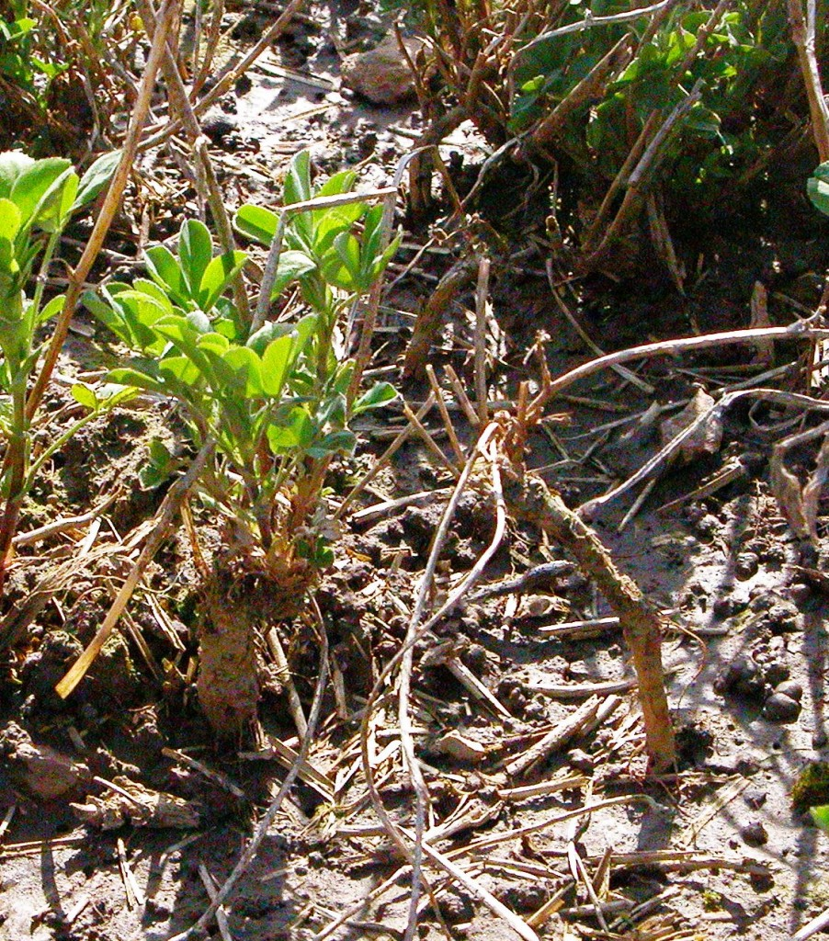
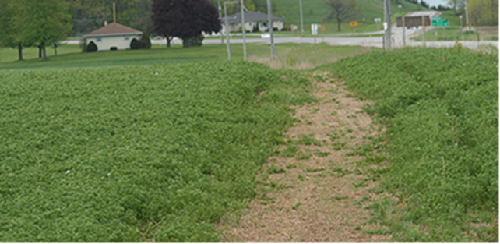
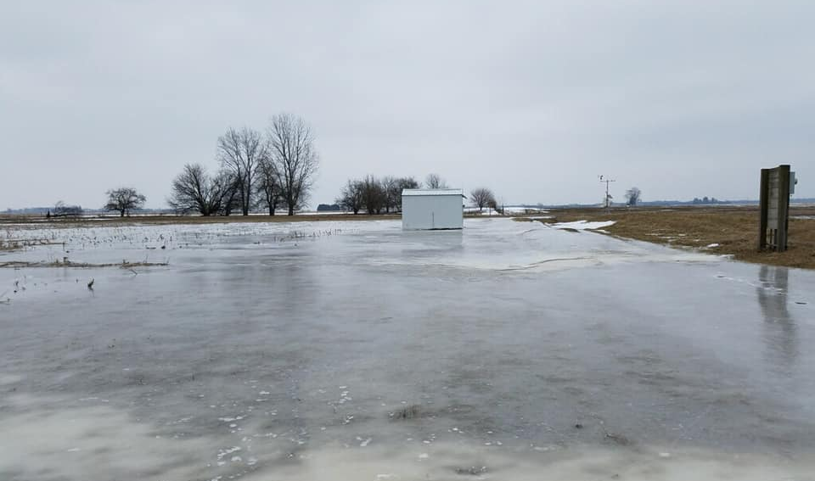
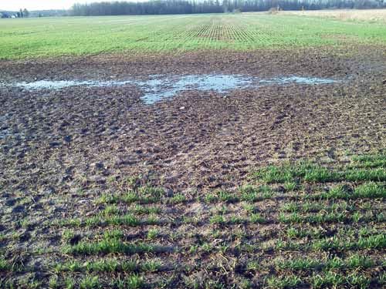
Warmer Winters: Freeze-Thaw-Freeze Cycles-Ice Sheet Formation; Few Plants Survive Extensive Ice Encasement-Also Causes Heaving
February 3, 2019-Water Quality Field Station

Slide 19
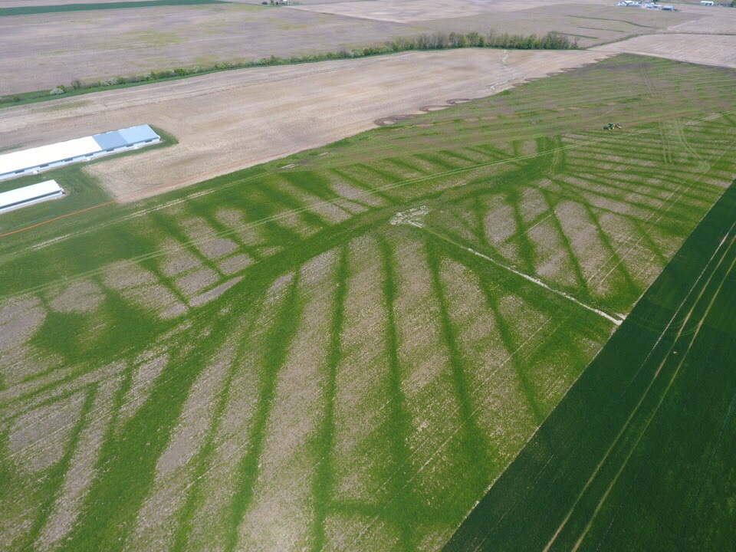
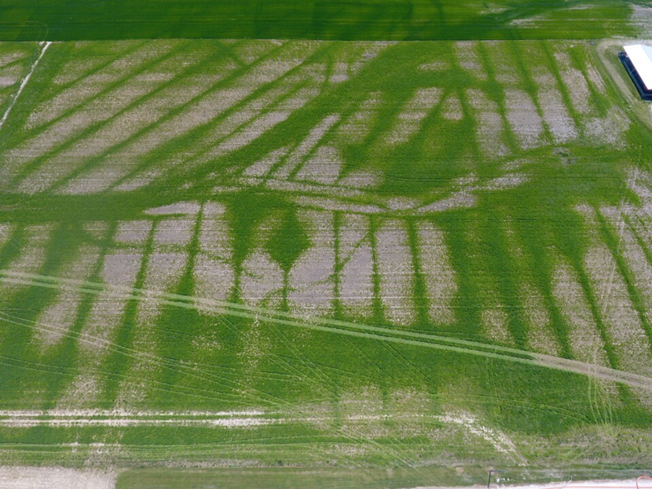
Water Retained on Alfalfa Fields in Winter 2018-19 Resulted in Essentially Total Stand Loss
Images courtesy of Sam Custer, OSU Extension , Jacob Wuebker of Wuebker Farms

Slide 20
Variable Weather in Late Winter and Early Spring Can Injure Perennial and Winter Annual Crops
Lianhong et al. 2008. The 2007 Eastern US Spring Freeze: Increased Cold Damage in a Warming World?, BioScience, 58:253–262, https://doi.org/10.1641/B580311

Slide 21
Thanks for Listening!!
Questions???
Email: jvolenec@purdue.edu
Phone: 765-494-8071
Dept. of Agronomy, Purdue University
915 West State St. West Lafayette, IN 47907-2054

Slide 22
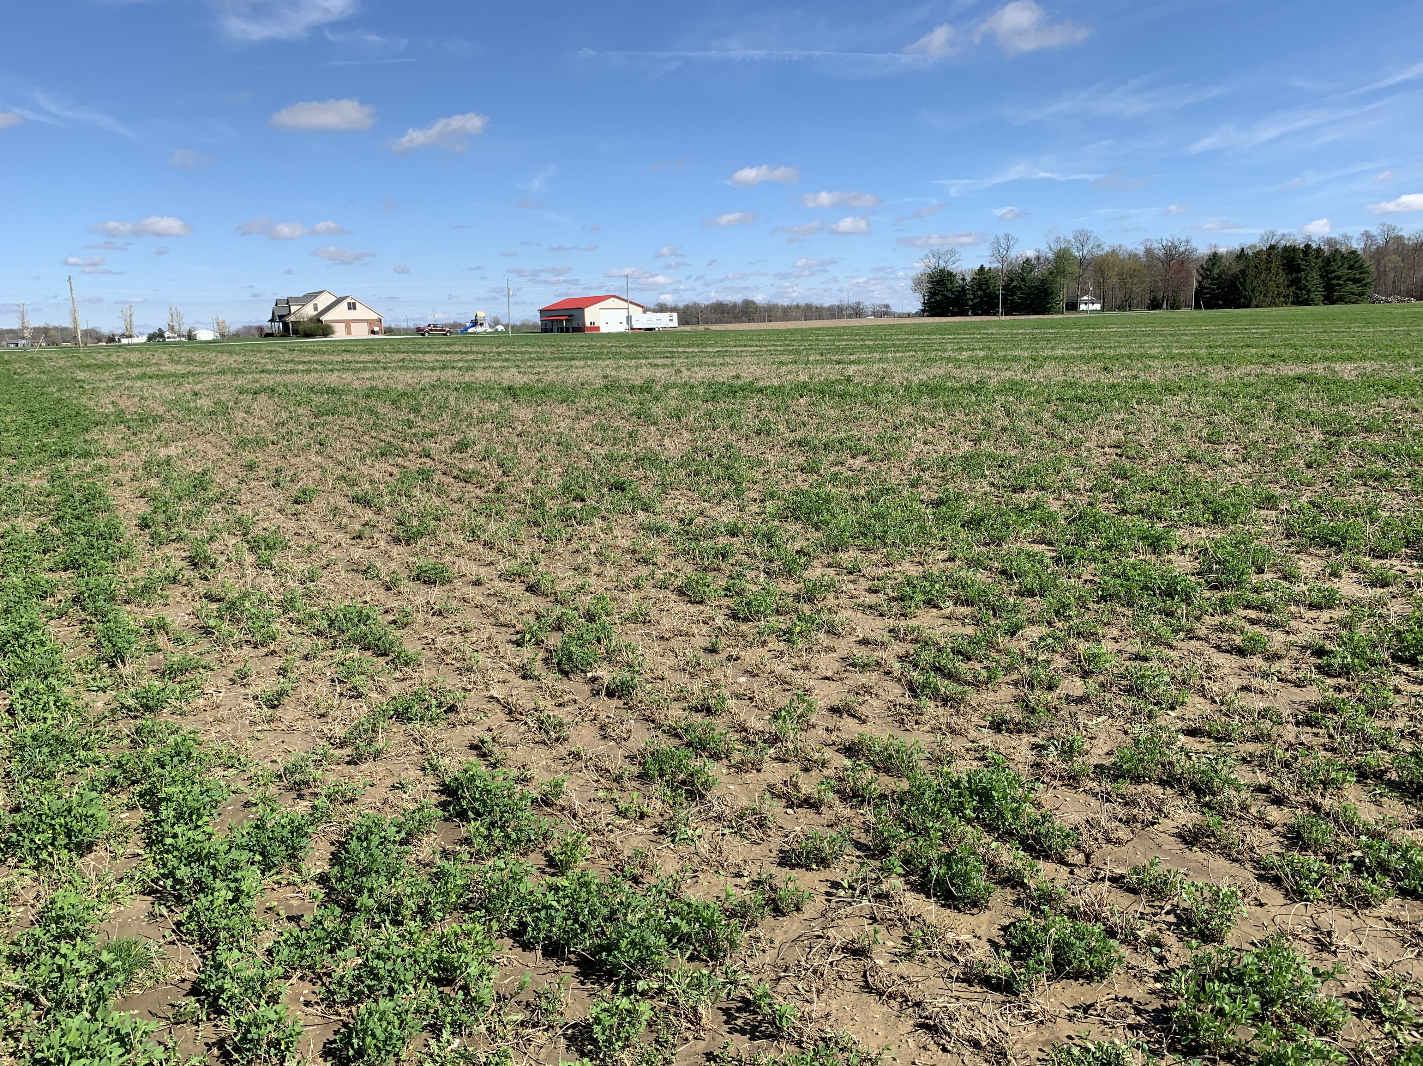
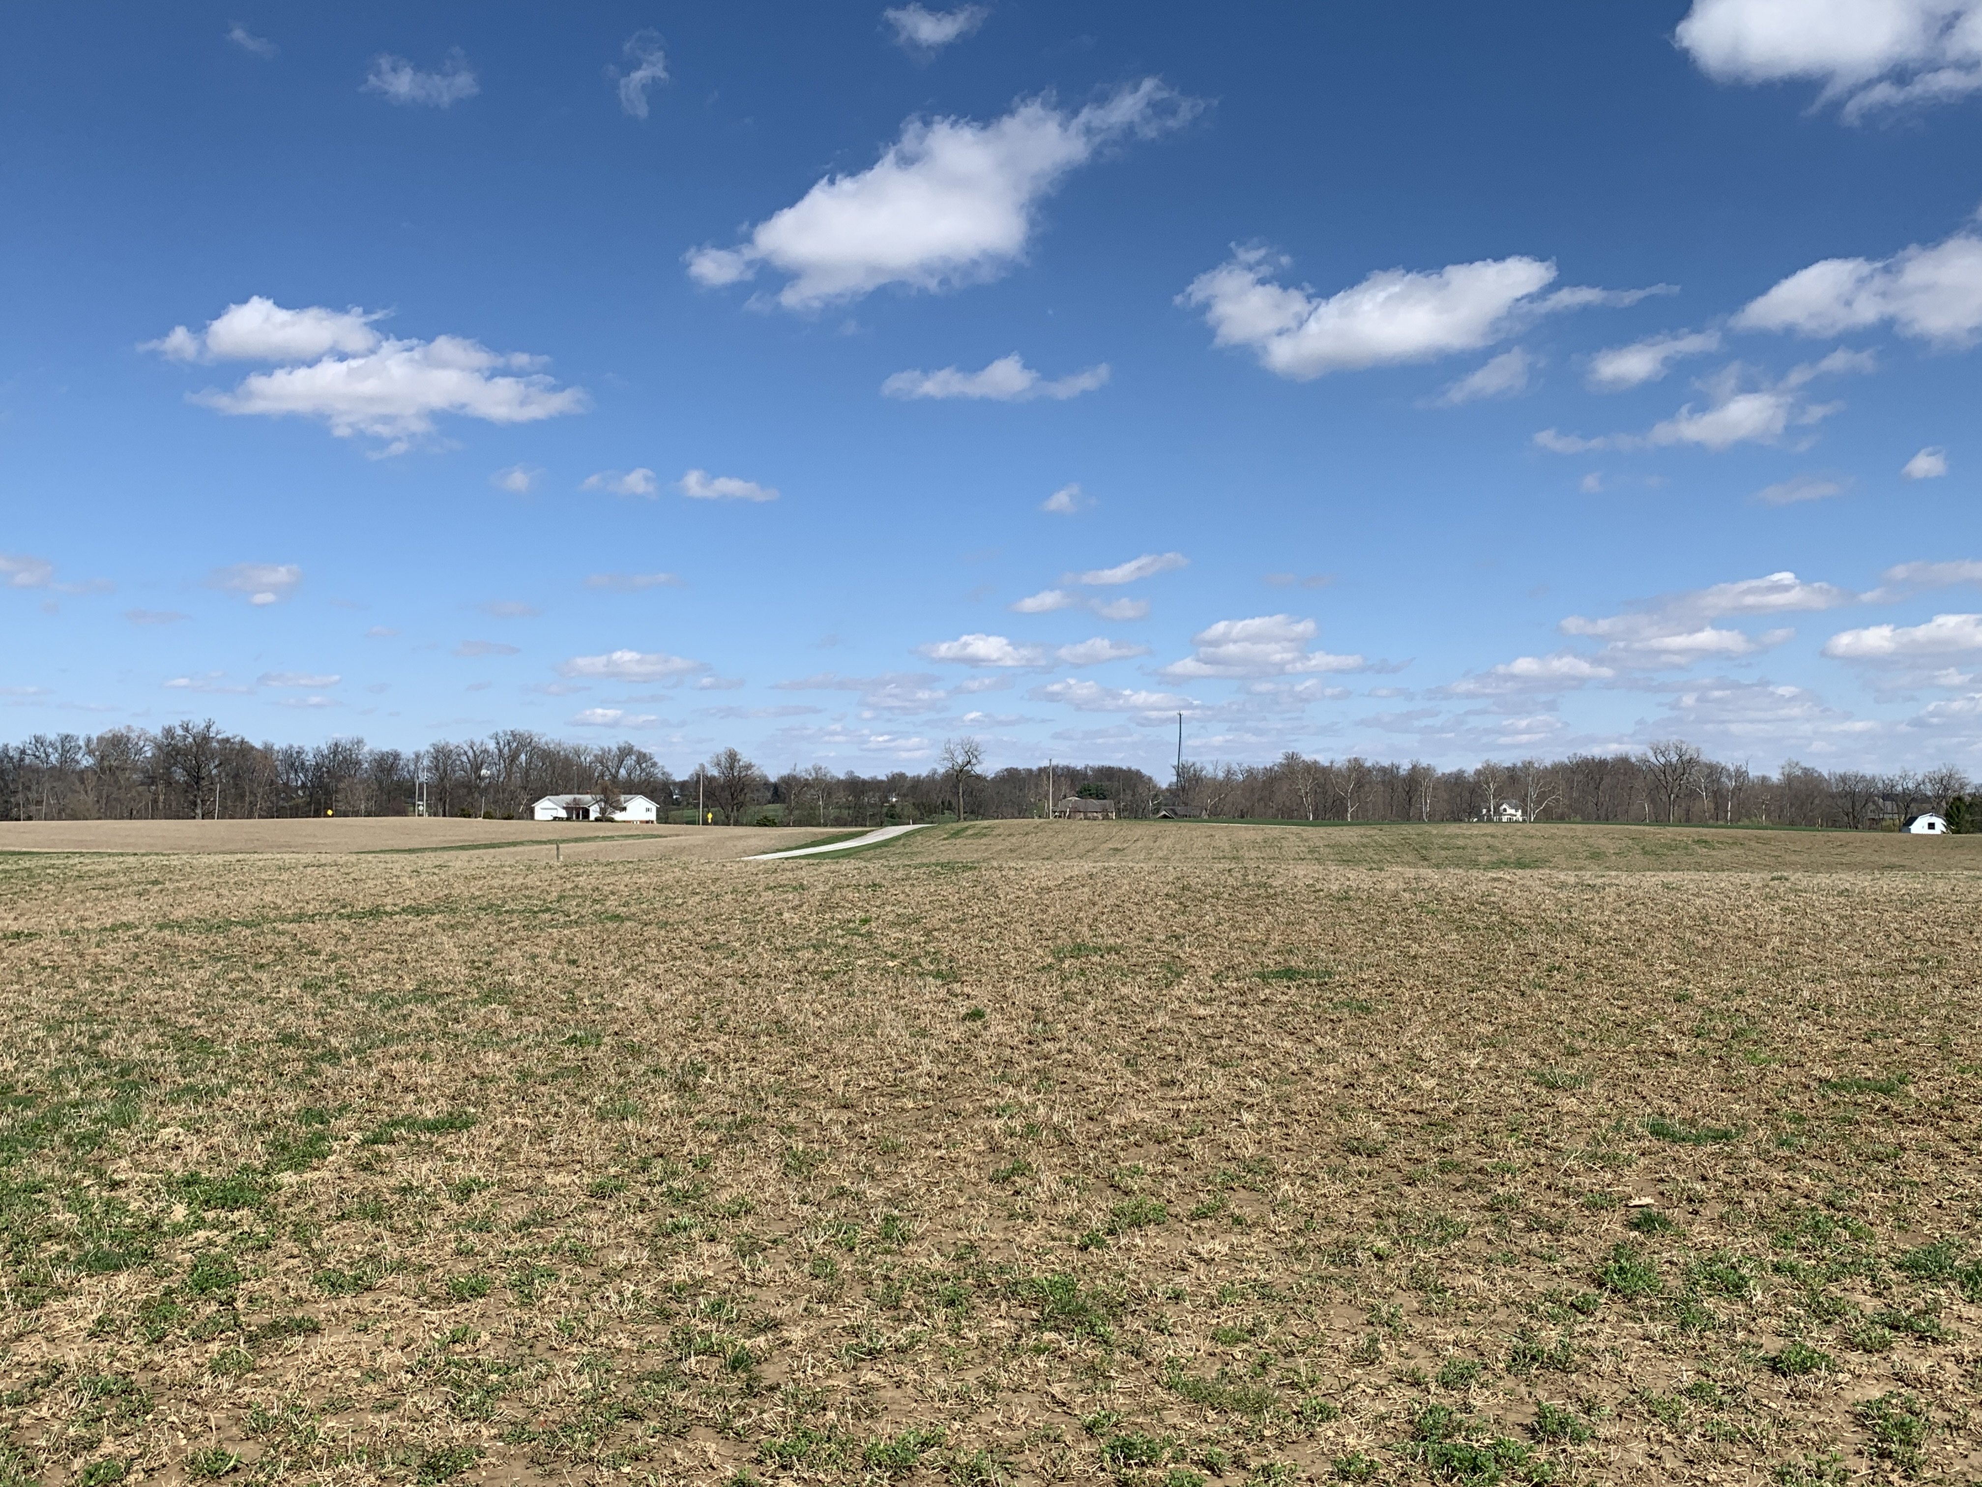
Severe forage stand losses
Images courtesy of Jeff Stachler
OSU Extension

Slide 23

Severe forage stand losses
Images courtesy of Sam Custer, OSU Extension
and Jacob Wuebker of Wuebker Farms

Slide 24
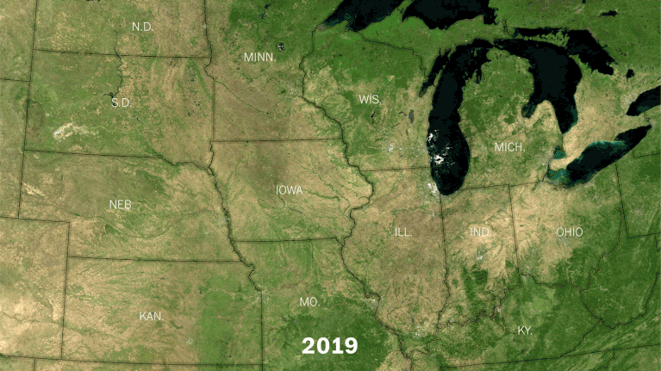
Crops from Space

