Slide 1
Small Modular Reactor (SMR)
July 7th, 2026
Opportunities and Impacts for Indiana
Indraneel Kumar, PhD, AICP (ikumar@purdue.edu)
Kara Salazar, PhD, AICP (salazark@purdue.edu)

Slide 2
Team
Sponsored by Indiana Office of Energy Development
Purdue University
School of Nuclear Engineering
Chatzidakis, Stylianos;
Kim, Seungjin
Administrative Operations
Gallagher, Ryan
Purdue Center for
Regional Development
Kumar, Indraneel
Purdue Extension Community Development
Salazar, Kara A.; Ogle, Tamara;
Wilcox Jr., Michael D.
Purdue Polytechnic Institute
Lucietto, Anne
Argonne National Laboratory
Kim, Taek K.
Energy Systems Network
Gillespie, Becca; Mitchell, Paul
Ivy Tech Community College of Indiana
Burton, Brooklyn; Eaton, Bryce; Ely, David; Hall, Ilicia

Slide 3
Study Summary, Handout, and Technical Report
www.purdue.edu/operations/nuclear/home/ioed
Chapters
Summary of Study on SMR Technology and Its Impact for Indiana
SMR Technology Overview
Economic Impact
Repurposing Coal Sites to Nuclear
Workforce Needs
Environmental and Safety Considerations
Community Engagement
Conclusion

Slide 4
Overview
What are SMRs?
Legislations and definitions
Economic opportunities
Coal to nuclear conversion
Community Engagement Study

Slide 5
What are SMRs?
SMRs are compact nuclear reactors that typically have generation capacity at less than 500 MWe (< 500 MW of electric power).
An SMR of 300 MWe delivers 300 MW of power to the electric grid. It produces 300 MWh of electrical energy if it runs at full capacity for 1 hour. SMRs can run nonstop 24/7 for several months before maintenance.
SMRs produce two types of energy: thermal and electric. The thermal or heat from nuclear reaction is generally three times larger than electric power.
SMRs have scalable solutions with modular construction opportunities.
SMRs have reduced land use footprint and smaller emergency zone planning requirements than the traditional nuclear power plant.
Source: IOED SMR Final Report 2024

Slide 6
SMR Legislations (2022-2026)
Indiana has introduced new policies for SMRs:
    Senate Bill 271 allows SMR development in retired coal sites
    Senate Enrolled Acts 423, 424, and 425 allows to develop SMR pilot program; recover planning costs; and establish energy production zones to facilitate transition from coal-based power plants to natural gas or SMR sites.
    House Enrolled Act 1007 allows 80% of the costs to be recovered from large load customers such as AI data centers.
    House Enrolled Act 1222 limits state-level hearings to construction of nuclear power generating facilities. Safety and siting need to evaluated by federal agencies.
    Executive Order 25-48 establishes Nuclear Indiana Coalition to “advance, practical, affordable, and reliable pathways for nuclear development” in Indiana.
Source: IOED SMR Final Report 2024; https://www.in.gov/oed/files/NIC2_12.11.25_slides.pdf

Slide 7
SMR Definitions
Indiana Code §8-1-8.5-12.1 (b)
    Defines an SMR as a nuclear power generating facility with rated capacity no more than 470 MWe
    Operates alone or in combination with similar reactors.
    Licensed by the U.S. Nuclear Regulatory Commission (NRC).
    Indiana’s definition can accommodate new generation SMR design.
    Generally, SMRs are defined as having 300 MWe or less capacity. For example, International Atomic Energy Agency specifically mentions 300 MWe capacity for SMRs.
    World Nuclear Association also defines SMRs as 300 Mwe or less capacity.
Source: https://law.justia.com/codes/indiana/title-8/article-1/chapter-8-5/section-8-1-8-5-12-1/?__cf_chl_f_tk=nrvN58V4mh1kuAHeOiTy4lgndWL72cRvDIRKHRS92pY-1782847496-1.0.1.1-9ejMzvJgOX6Cw4UFEBqio2PPcFqii7LBAStINXBpZrU
Notes:
Source links: https://www.iaea.org/newscenter/news/what-are-small-modular-reactors-smrs
https://world-nuclear.org/information-library/nuclear-power-reactors/small-modular-reactors/small-modular-reactors

Slide 8
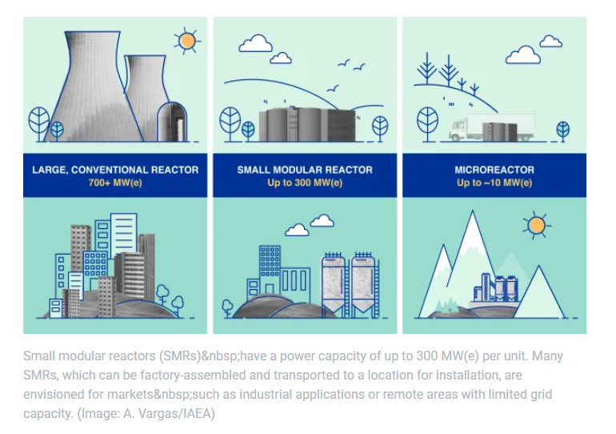
Types of Nuclear Reactors
SMRs can be one-third of the traditional nuclear power plant.
Modular design option can increase the capacity
Image source: IAEA (https://www.iaea.org/newscenter/news/what-are-small-modular-reactors-smrs)

Slide 9
Economic opportunities (part 1 of 4)
Economic opportunities
Nuclear electric power generation industry is a highly capital intensive industry with extended supply chains and requires a highly skilled workforce. Hence, the economic impact multipliers could be comparable or larger than other sources of power generation.
The economic multipliers can vary based on maturity of the electric power generation industry and share of suppliers from within the region.
Capital and construction costs of SMRs can vary based on the capacity and if it is First-of-a -Kind (FOAK) or later generation units that are Nth-of-a-Kind (NOAK). Site constraints can increase construction cost.
Overnight estimated capital cost of SMRs can vary from $4,500/KW to $5,350/KW; a 300 Mwe capacity SMR could cost from $1.4 to $ 1.61 billions (Alonso et al. 2016).
U.S. based FOAK estimate for 300 MWe SMR is $3.9 billions (IOED SMR Final Report, p. 84).
Alonso, G., Bilbao, S., & Valle, E. d. 2016. Economic competitiveness of small modular reactors versus coal and combined cycle plants. Energy. 116, 1, pp. 867-879.

Slide 10
Economic opportunities (part 2 of 4)
Economic opportunities
Indiana's Economic Multipliers 2024 (Type Lightcast Model)
Electric Power Generation | Employment 2024 | Earnings/ Labor Income 2024 | Sales/Output 2024 | Value Added/GRP
Biomass | 1.59 | 2.34 | 1.55 | 1.43
Fossil Fuel | 4.52 | 2.31 | 1.54 | 1.42
Geothermal
Hydro | 3.52 | 2.27 | 1.52 | 1.41
Nuclear
Solar | 4.17 | 2.34 | 1.56 | 1.45
Wind | 4.12 | 2.25 | 1.51 | 1.4
Source: Author using the Lightcast Model, July 2026
A simulation of +100 jobs in different electric power generation sectors reveal that matured industry sectors have higher jobs multiplier.
Type Lightcast Model uses Type II Model (Type I plus household spending) and assumes long-term investments and government spending.

Slide 11
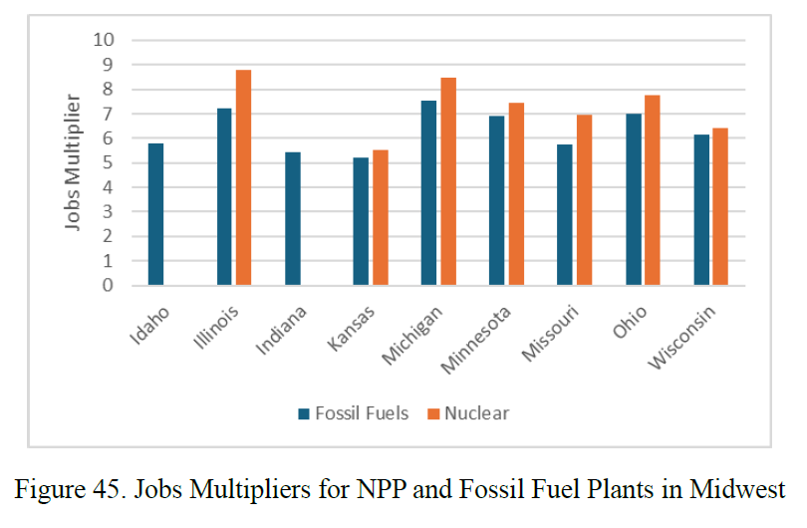
Economic opportunities (part 3 of 4)
Economic opportunities
Comparison of jobs multipliers between traditional nuclear and fossil fuels based electric power generation in Midwestern states in 2022.
Comparable jobs multiplier between nuclear and fossil fuels.
Source: IOED Final Report, Figure 45, p. 106
Source: IOED SMR Final Report 2024

Slide 12
Economic opportunities (part 4 of 4)
Economic opportunities
Idaho National Lab (INL) study as reported in IOED study, on average a 300 Mwe SMR can create 100 direct jobs and 252 indirect and induced jobs during operations. The jobs multiplier will be 3.52. The study further revealed economic output of $212 million per year.
A 500 Mwe SMR can employ around 2,000 workers over 4-year construction period.
However, the economic impacts will depend on the SMR technology type (water cooled, gas cooled, liquid metal cooled, or molten salt cooled).
Supply chain linkages and suppliers present in the state/region. Domesticating the supply chain for SMR manufacturing and construction is a major opportunity for economic development.
Overall, a nuclear plant creates twice the number of jobs compared to a similar sized fossil-fuel based plant. Workers earn much higher wages. The revenues are much higher because the capacity factor is high.
Source: IOED SMR Final Report 2024

Slide 13
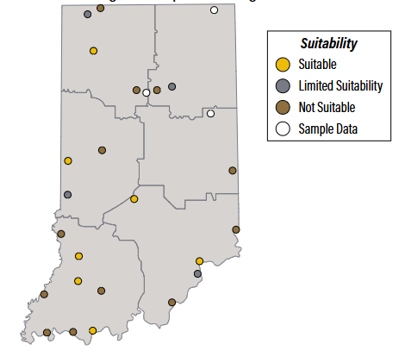
Coal to nuclear conversion
SMR has certain advantages such as shorter construction timelines, one of the highest capacity factor, large revenue generation, and more importantly opportunity to convert existing or abandoned coal sites.
IOED study found that Indiana has eight existing and former coal plant sites suitable for repurposing to nuclear plant. Six existing sites and two are recently retired sites.
Only Texas has more suitable coal power plant sites than Indiana.
Image Source: IOED SMR Summary Report 2024
Source: IOED SMR Final Report 2024

