Slide 1
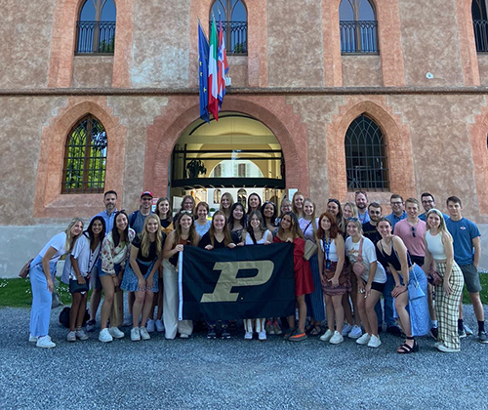
Agricultural Economics Welcomes You to Purdue 101 Summer 2024

Slide 2
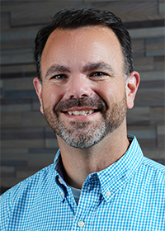
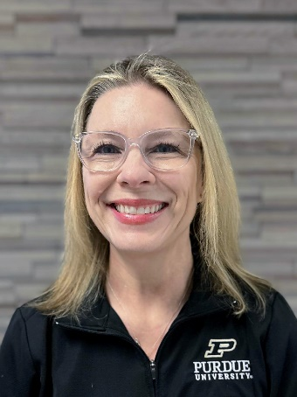
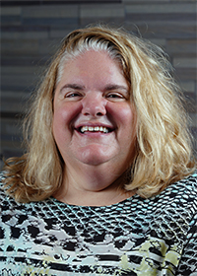
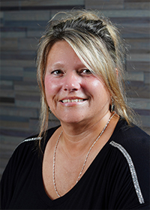
Undergraduate Advising Team
Andy Oppy
Asst. Director of Advising
& Student Services
Christine Strong
Academic Advisor
LeeAnn Williams
Director of Advising
& Student Services
Malissa Allen
Undergraduate Office Coordinator

Slide 3
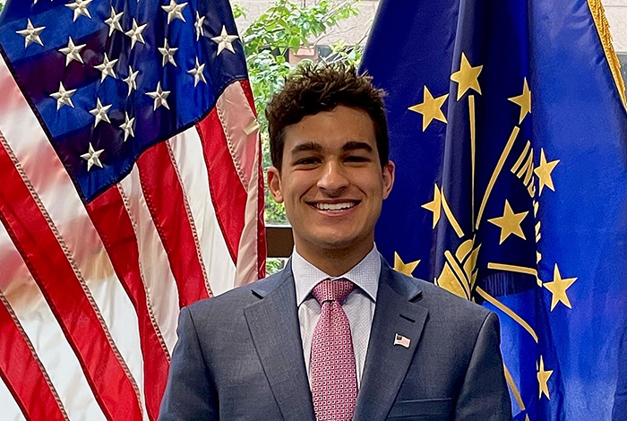
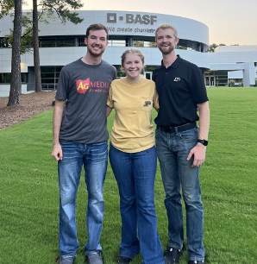
Academic Majors
Agribusiness
5 Concentrations
Agribusiness Management
Finance
Marketing
Food Marketing
Commodity Marketing
Agricultural Economics
3 Concentrations
Applied Agricultural Economics
Quantitative Data Analytics
Policy and Pre-Law
Farm Management
Sales and Marketing

Slide 4
Purdue 101 Advising Appointment Preparation
On New Student Tab (my Purdue)
Complete Student Information Form
Complete ALEKS Math Placement Test
Dual Credit and AP Courses
Dual Credits – Have Credit-Granting University send transcript to admissions@purdue.edu
Have List Ready for Advising Meeting

Slide 5
What To Expect In Your advisor Meeting
Be Ready To Share a Little About You!
High School Experience, Hobbies Interests
What are Your Current Career Goals or Plans?
We Want to Develop a Relationship With You!
Review Credits You Plan to Use at Purdue – Dual or AP
Discuss Purdue Plan
Are you Already Considering a Dual Major? Minor?
Athletics, Greek or Co-Op Living, ROTC, Part-Time Job
Graduation TimeLine
Select Classes & Submit Your Course Requests Form (CRF)
Goal is to get You Registered for 15-17 Credits
Review Key Purdue Dates Between Appointment and Start of Classes
Questions!

Slide 6
First Semester Curriculum
1. Learning Community Courses (not Everyone Will Have This)
2. Science Option (BIOL – 4 cr. & CHM – 3 cr.)
Chemistry & Biology Both Required For Graduation
Will Only Take One Science Per Semester Freshmen and Sophomore Year
3. Written or Oral Communication –
Do You Have Dual Credits for These?
4. Math (Based on ALEKS, SAT or ACT Score or Dual Credit) – See Next Slide
5. AGEC 20300 (3 cr.) – Intro Microeconomics
6. AGEC 29800 (1 cr.) – Careers in Agribusiness
7. AGR 10100 (.5 cr.) – College of Ag Freshmen Seminar
Once/Week – First Eight Weeks; All Freshmen in College of Agriculture
8. AGR 11200 (.5 cr.) – Department Freshmen Seminar
Once/Week – First Eight Weeks – Peer Mentor

Slide 7
First Semester Curriculum
Math Placement Information
Class – Number & Title | Prereq | Comment
MA 16010 – Required Applied Calculus I | ALEKS Score 75+ SATR 620/ACT Math 26 MA 15800 0r 15400 (dual credit) with grade of C- | Only need one semester of Calculus to meet graduation requirements!
MA 15800 PreCalculus | ALEKS Score 60+ SATR 570/ACT Math 24 MA 15300 (dual credit) with grade of C- | The course would count as free electives and would be taken to meet prereq for MA 16010 if didn’t have high enough ALEKS, SAT, or ACT
MA 15300 Algebra & Trigonometry I | ALEKS Score 45+ SATR 530/ACT Math 21 | The course would count as a free elective and then need to be followed by MA 15800 and 16010 (required course to graduate). Student with scores below the prereq may want to consider “holding” on math and take math requirements elsewhere during a future summer. Students could also study ALEKS learning modules and have 5 ALEKS attempts.

Slide 8
First Semester Curriculum
9. Goal: Pre-Register for 15-17 Credits
Free Electives
Agronomy 10500 – Crop Production
Ag Systems Management 10400 – Introduction to Agricultural Systems
Animal Sciences 24000 – Principles of Animal Production
Animal Sciences 25500 – Introduction to Animal Products
Horticulture 10100 – Fundamentals of Horticulture
CSR 10300 – Intro to Personal Finance (Online Only)
Humanities & Social Science Electives
international Understanding
Multicultural Awareness Requirement
Agribusiness Selectives
TLI 11200 – Foundations of Organizational Leadership
TLI 15200 – Business Principles for Organizational Leadership
IET 21400 – Introduction to Supply Chain Management Technology
CSR 28200 – Customer Relations Management

Slide 9
Distinguish Yourself Transformational Experiences
99% Job Placement & $52,400 Avg. Starting Salary
Summer Internships
Study Abroad – Spring Break, Summer, Semester
Student Organizations & Leadership
Entrepreneurship Certificate
Honors, Dean’s Scholars, Undergraduate Research
Academic Minors
Student Competition Teams – NAMA & Quiz Bowl

Slide 10
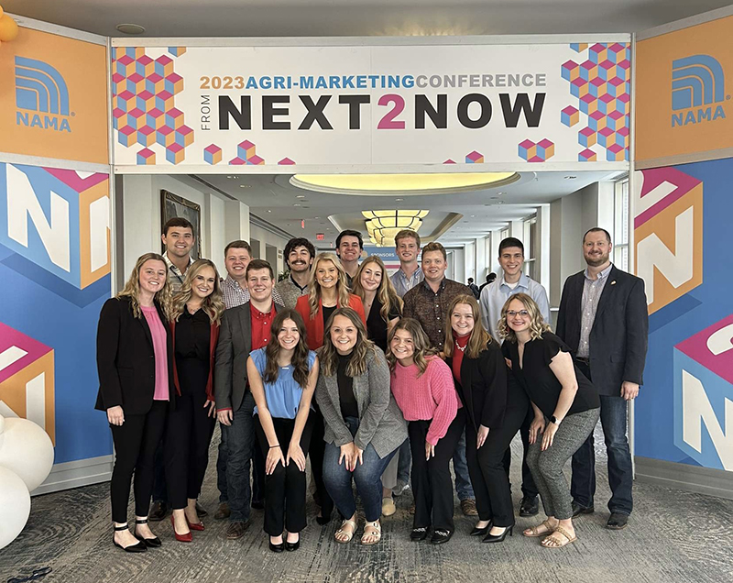
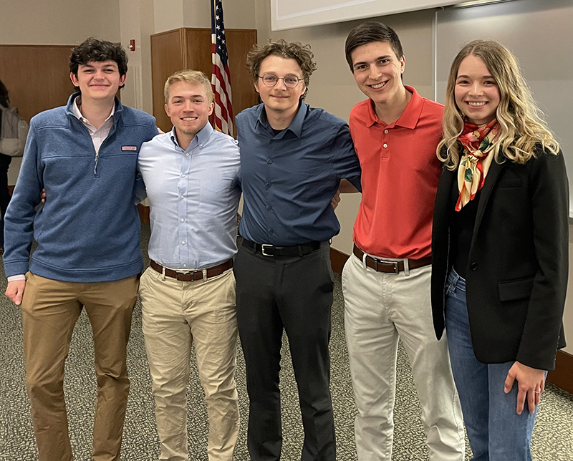
Follow-Up – Summer 2024
Check Purdue E-mails Weekly During Summer
July 18 – Students will have schedule @ 5:00 p.m.
July 22 – Make Changes to Schedule, but BE CAUTIOUS
Boiler Gold Rush
August 13 - 17
Classes Begin – August 19

Slide 11
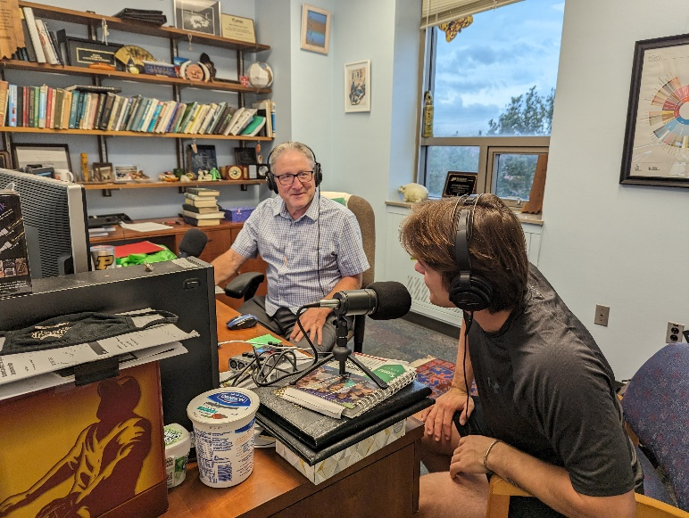
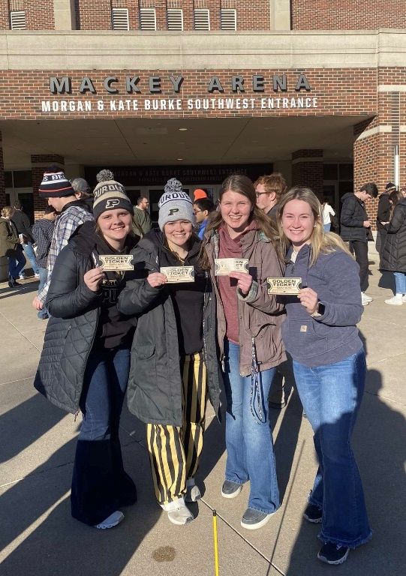
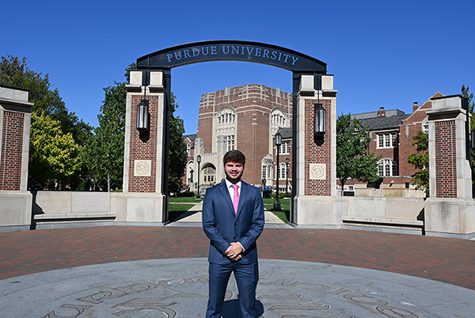
Have Questions? Contact Us!
E-mail
malissa@purdue.edu
Call
(765) 494-4201

Slide 12
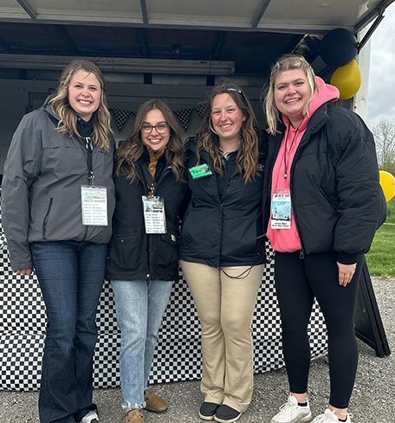
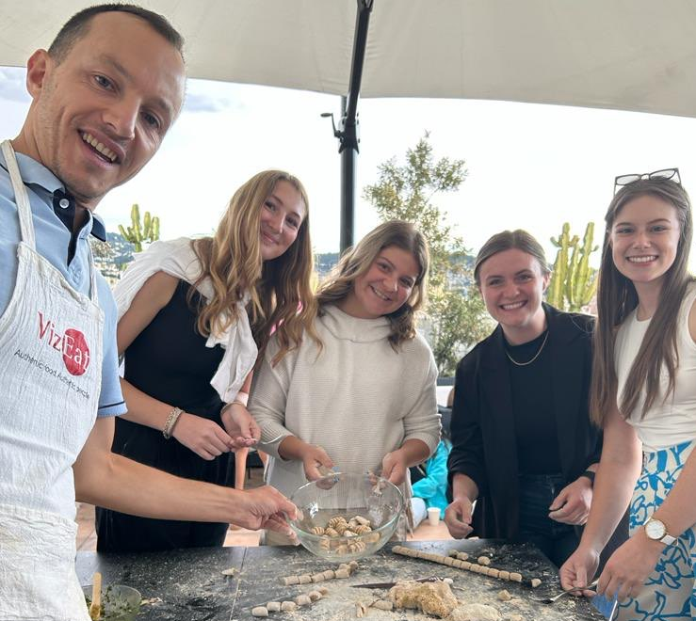
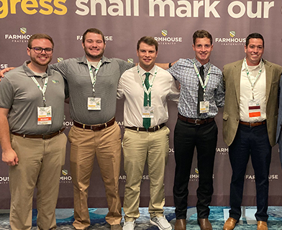
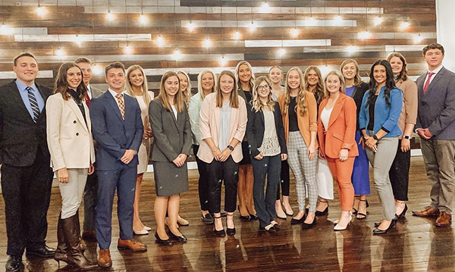
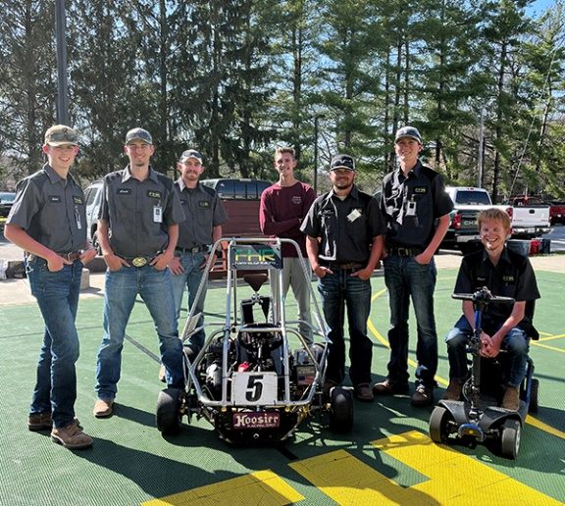
Boilermaker Experiences! – Can’t Wait for YOU to Experience It!

