Slide 1
Indiana State Dairy Association
Elizabeth Straw – Executive Secretary
270 South Russell St
West Lafayette, IN 47907
(765) 494-8025
Efarrow@purdue.edu

Slide 2
Register For DHIR With Your Breed Association
For most breed associations the date to register for DHIR does not apply to new herds
Ex. The January 31st deadline for ADGA is for renewing herds not new herds
ISDA currently works with ADGA, MDGA, AGS, and Kinder Goat Breeders Association
You do not need to be registered with a breed association in order to milk test

Slide 3
If Registering For DHIR With ADGA
Name of DHIA - Indiana State Dairy Association
DPRC - DRMS (Raleigh)
Herd Code # - Assigned By ISDA Once Membership Agreement is submitted

Slide 4
Most Popular Supervised Test Types
DHIR 20 – Supervisor weights and samples both milkings on test day. Verification Test required for Top Ten Awards.
DHIR 22 – Supervisor collects both test day weights. Supervisor also collects component samples alternating AM and PM samples each month. Annual herd Verification Test and minimum DCR of 93 required for Top Ten Awards.

Slide 5
Owner Sampler Test Types
DHIR 40 O/S – Owner/Sampler weighs and samples each month and is responsible for sending in samples and paperwork.
For Star Recognition – A minimum DCR of 75 is required plus a herd verification test when the herd is 60-150 Days in Milk.
For Advanced Registry – Requirements for Star recognition. In addition the animals must have 240 days in milk, 8 tests and the owner must provide documentation to ADGA regarding training. This is for those interested in 10 months of testing each year.

Slide 6
DHIR Certification With ISDA
Certification Is Valid For 2 Years
Certification Costs $30
Confirmation Of Certification Will Be Emailed To ADGA And Mailed To Individual

Slide 7
Herdcode Information
32185500
First Two Digits Are The State
32 – Indiana
Second Two Digits Are The County
18 – Delaware
Fifth Digit is 5 For Goat Herds
Last Three Digits Are Random
Assigned By DHIA Service Affiliate

Slide 8
Required Testing Information
Doe Registration Number & Breed
Index/Tag Number For Doe
Date of Birth
Dam & Sire Registration Numbers
Kidding Date
Often herds will send in photos of their registration pages

Slide 9
Transfer Does
Does that come from another herd
If doe was not tested previously, the standard registration information is required
If does is transferring from a herd that is on test only the information below is needed
Registration Number and Breed
Previous Herdcode
Previous Index Number

Slide 10
Approved Scales
Scales Must Be Calibrated Annually
Scale Calibration Is $5 Plus Shipment Back
Approved Scales: http://www.quality-certification.com/approved_devices.asp#scales
ISDA Sells Calibrated AWS SR-20 Scales For $25 Plus Shipping

Slide 11
When to Test?
Does must be at least 5 days in milk before testing
Under 5 days the milk has residual colostrum
Does must have their first test before 90 days in milk
Under 30 days is strongly recommended
Test days must be at least 15 days apart

Slide 12
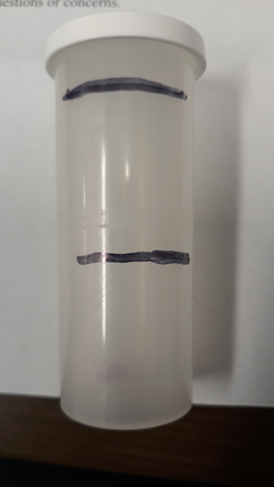
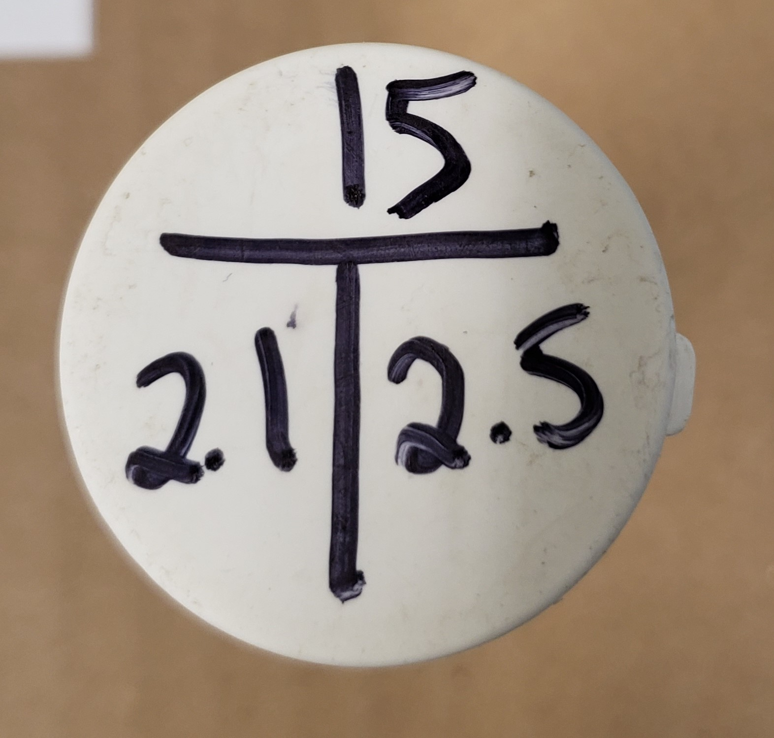
Weighing & Sampling Milk
Tare Scale To Bucket Or Record Weight Of Bucket
Weigh And Record Milk Weights
Easiest Is To Write Weights And Sample Or Index Number On Vial Then Transfer To Paperwork After Milking (Example Below)
Agitate Milk Sample By Stirring
Fill Vial Halfway with Agitated Milk
Repeat During Second Milking - Keeping The Sample Volume Below Maximum Fill Line

Slide 13
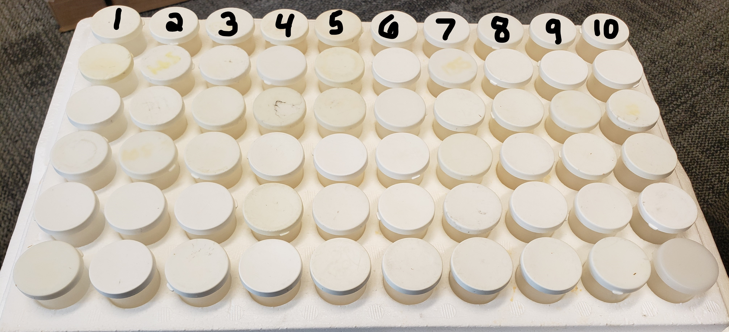
Agitating and Storing Samples
After Sampling, Gently Invert Vial To Mix Preservative
Sample Should Turn Orange In Color
Place Samples In Sample Order From Left To Right, Top To Bottom
Top Row Of Samples Will Be 1-10
Store Samples In Cool Environment (70˚ Or Below Is Ideal)

Slide 14
Sending Test Paperwork
What materials does ISDA need?
201 barn sheet completed with sample numbers listed
Milking Times
For Verification tests all original paperwork must be submitted to the ISDA office
Send Test Day Papers To ISDA
Email Them To efarrow@purdue.edu Or Mail To ISDA At The Address Below
Indiana State Dairy Association
270 S Russell Street Rm 1088
West Lafayette, IN 47907

Slide 15
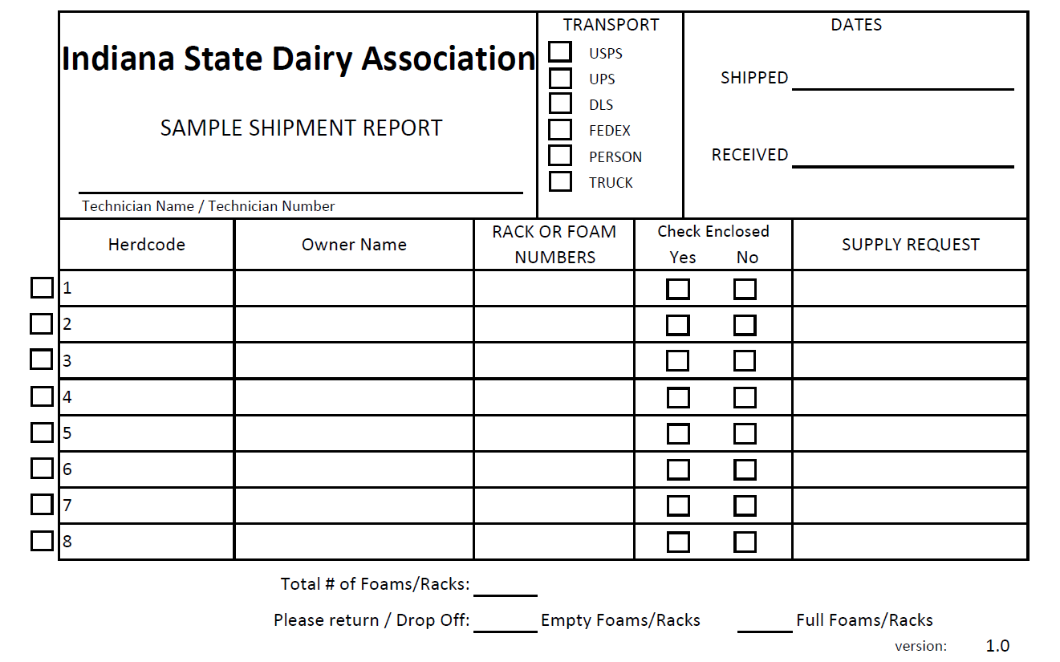
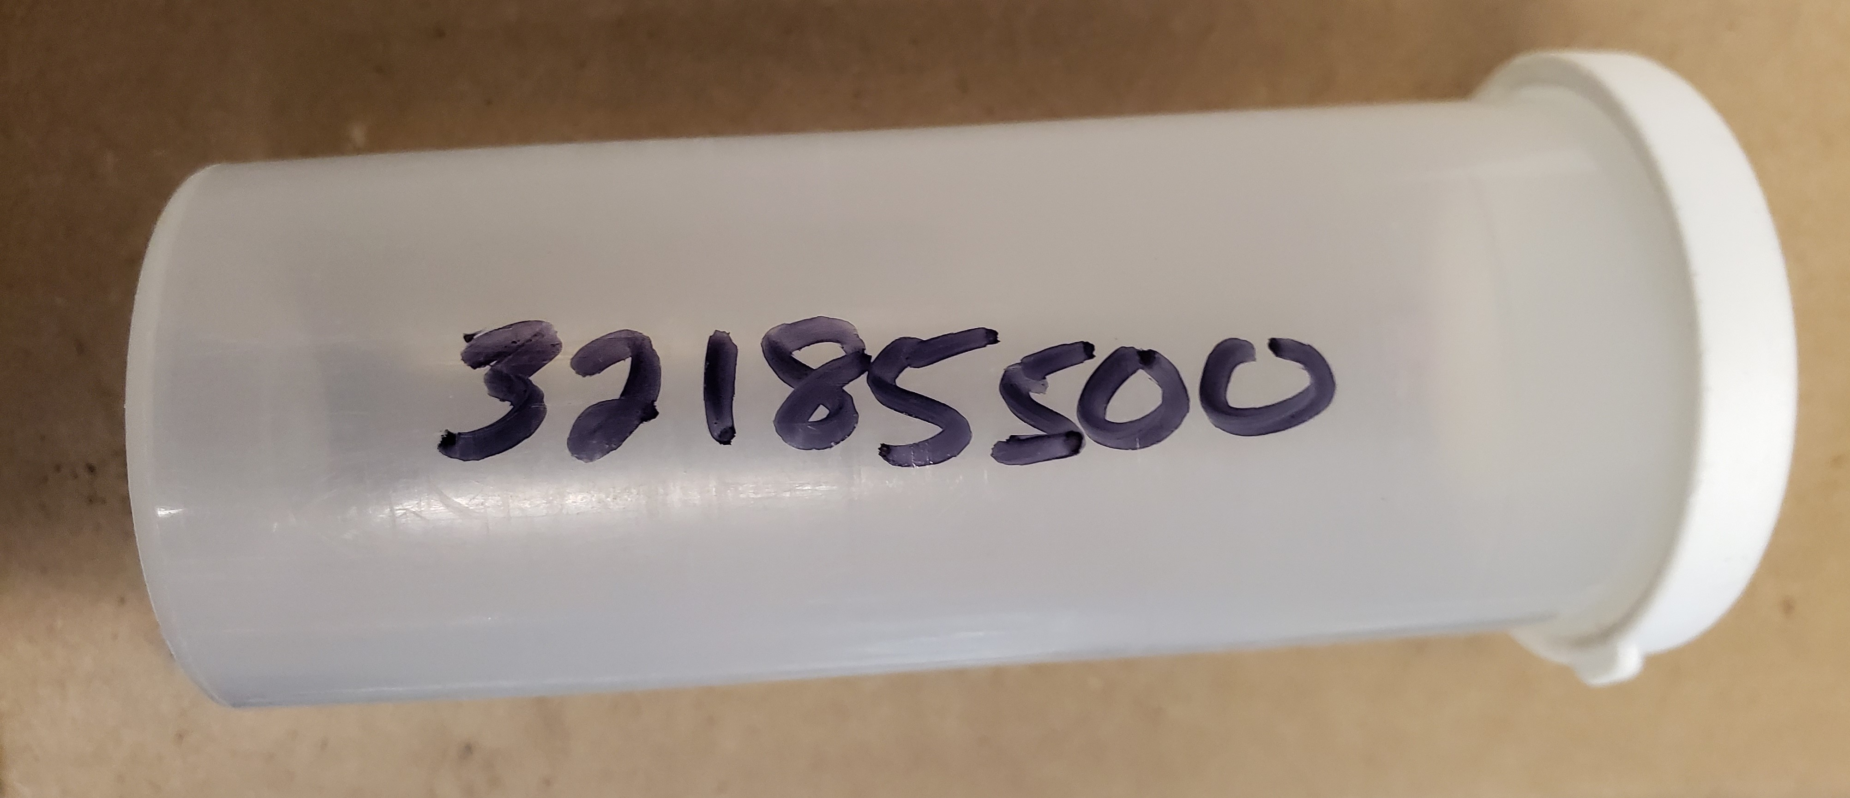
Sending Test Day Samples
Before Shipping Samples, Write Herdcode On The Side Of First Vial
Ship With Sample Shipment Report or with a piece of paper with your herdcode and name

Slide 16
Shipping Samples
Ship Samples To DHI Coop
If Shipping Via UPS
1224 Alton-Darby Creek Rd
Columbus, OH 43228
If Shipping Via USPS
P.O. Box 28168, Columbus, OH 43228

Slide 17
Post-Test Date
Sample Box Should Come Back From The lab
Large Packet From The Processing Center (DRMS) Should Arrive With Your Results And Lactation Records
On First Test Be Sure To Check Registration Numbers And Lactation Number
Standard Envelope From ISDA With Invoice, UPS Label, And Additional Reports Should Arrive

Slide 18
Verification Test
Required For Most Test Plans
Between 60 and 150 Days In Milk
Must Be Performed By A Supervisor That Is Not The Regular Supervisor
If on a supervised test plan, the 1st milking may be the VT supervisor with the 2nd and 3rd milkings the standard tester
If Owner Sampler plan, all milkings must be observed by the VT supervisor
Supervisor must verify identification (normally tattoos) on all animals during the first test and ensure that each animal is milked out

Slide 19
Verification Test
Supervisor Must Attend 3 Consecutive Milkings
If the herd is a 3x milking herd, 4 consecutive milkings are required
The verification paperwork requires that something be recorded for all milkings.
For the pre-milking/milk out - a checkmark or X is sufficient. All other milkings need a weight
All Completed Verification Forms Must Be Mailed To ISDA
We recommend making a copy before mailing

Slide 20
Verification Test
ISDA will email a copy to the appropriate breed association and will keep a copy on file
Owner will receive a copy in the mail
Or emailed upon request

Slide 21
Dry Off Test
This test is the final test for the season and marks the end of lactation for all animals
Some breed associations may require lactation summaries to be submitted
AGS and MDGA require doe pages, 210, or 202 be sent

Slide 22
Round Robin
Requires At Least Three DHIR Certified Supervisors
A Tests B, B Tests C, C Tests A
Verification Tests Require Supervisor Outside Of Circle (For Groups Of 3)
For Groups Larger Than 3, A Supervisor Other Than The Regular Supervisor Can Perform VT
Owners Are Eligible For Test Types 20 & 22

Slide 23
One Day Milking Competition
Should be registered with your breed association in advance.
Contact ISDA prior to the event to obtain supplies
Supervisor Must Attend 3 Consecutive Milkings
Supervisor must verify identification (normally tattoos) on all animals during the first test and ensure that each animal is milked out and provide contestant/sample number

Slide 24
One Day Milking Competition
The ODMC paperwork requires that something be recorded for all milkings.
For the pre-milking/milk out - a checkmark or X is sufficient. All other milkings need a weight
Samples should be shipped to the lab
All Completed Verification Forms Must Be Mailed To ISDA
We recommend making a copy before mailing

Slide 25
One Day Milking Competition
ISDA will email a copy to the appropriate breed association and will keep a copy on file
If the ODMC is a single herd, the owner will receive a printed copy
If the ODMC consists of multiple farms, results will be sent to the supervisor upon request

Slide 26
ADGA Star Recognition Standard Breeds
Standard breeds 18+ points to earn star
For each pound of milk, 1 point figured to the tenth decimal point
9.9 lbs milk would be 9.9 points
For each 10 days in milk since last kidding .1 point
Maximum of 3.6 points
For each .05 pounds of butterfat yielded, 1 point

Slide 27
ADGA Star Recognition Miniature Breeds
Miniature breeds 7+ points to earn star
For each pound of milk, 1 point figured to the tenth decimal point
3.5 lbs milk would be 3.5 points
For each 10 days in milk since last kidding .04 point
Maximum of 1.44 points
For each .05 pounds of butterfat yielded, 1 point

Slide 28
Diagnostic/Additional Testing
Tests that can be run with your component sample
Johnes Milk Samples $6
Pregnancy Milk Samples $4.5
MUN Tank Sample $5.00
MUN Individual $.25
Mastitis Panel – Call Elizabeth For Pricing
Additional tests through DHI Cooperative
Blood Pregnancy $3 – Kits available through DHI Cooperative website
CAE Blood Sample – Call DHI Cooperative for pricing

Slide 29
Questions?
Elizabeth Straw – Executive Secretary
270 South Russell St
West Lafayette, IN 47907
(765) 494-8025
Efarrow@purdue.edu

