Slide 1
4-H Natural Resource Club
Why? What? Where? When?

Slide 2
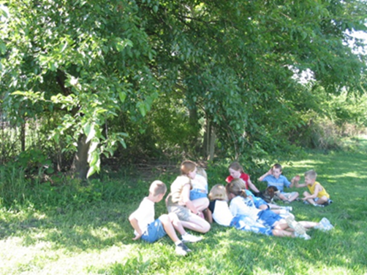
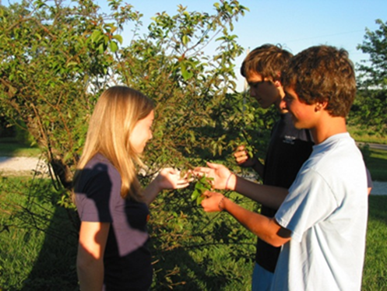
4-H Natural Resource Clubs
Why a 4-H Natural Resource Club?
What resources are available?
How do I run the club?

Slide 3
Why have a Natural Resource Club?
2010 Survey by Extension Educator Julia Miller
Participants:
4-H members in grades 9-12 who participated in Forestry, Soil & Water Conservation, Weather, or Wildlife projects for at least three years
Purdue Extension County-based staff
Natural Resource Professionals

Slide 4
Responses – Youth
Note! 37% of youth participating in 4-H natural resource projects hope to have a career related to the area of 4-H project work
Question – “What motivates you to continue to participate in one of these projects?”
Enjoyment/interest, 59%
Family member, 10%
Pursuing a career in a related field, 7%
Question – “What are the barriers to participation?”
Low interest by other youth, 32.0%
Lack of a knowledgeable volunteer, 22.0 %
Lack of information, 21.3%
n = 69

Slide 5
Responses – Extension Educators (Youth & ANR)
Barriers to participation:
Low interest by youth, 39.2%
Lack of a knowledgeable volunteer, 24.5%
Challenges faced when identifying volunteers to help with natural resource projects
Time required by volunteer, 39.8%
Lack of project experts, 26.3%
Difficulty finding people willing to work with youth, 20.5%
Comfort level in asking volunteers to help with the NR projects:
None, 14% Somewhat, 62% Very, 24%
n = 105

Slide 6
Responses – Natural Resource Professionals
What resources could 4-H use to increase participation?
Natural resource organizations and associations (SWCD, IDNR, NRCS, and others), 37.7%
Natural resource literature – Historical Maps; Indiana Community Tree Selection Guide; Field Guides; Native Trees of Indiana; 50 Trees of Indiana; lists of forests, nature centers, and wildlife preserves, tools and equipment for activities; storm water Enviroscape module;
Informative brochures from various agencies (ex. DNR brochures), 14.4%
106 respondents: SWCD (59%), IDNR (34%), Weather Service (2%), Foresters (2%), Other (4%)

Slide 7
Suggestions from Natural Resource Professionals
It may be beneficial to have a project leader for the natural resource projects.
Natural resource clubs would benefit the kids, they can learn about NR, be outdoors, and perhaps this could get more children out of doors and involved with caring for their NR for the future.
Involve the students about the importance of water quality and conservation, as hands on.... field trips, workshops, etc.
Organize a job shadow day or field day with IDNR
Actual visits to forest
Work with SWCD's, DNR-Forestry, DNR-Fish & Wildlife to promote the projects in each county.
Focus group discussion: Wish to be invited speakers but not to run a club

Slide 8
Earthcare 4-H Club, Elkhart County
Leader: Janeen Bertsche-Johnson
What is the Earthcare club?
I started the Earthcare 4-H Club to integrate environmental education with the 4-H program. Our club does not have traditional meetings, but does hands-on activities to increase the youth participants' knowledge of forestry, soil and water conservation, wildlife, recycling, and weather. We are also intentional about doing activities that benefit our community and the environment. The club had 8 members in its first year, and has grown to 25 participants. We welcome parents and younger siblings to join our activities, so that the older youth learn leadership.
See page 8 for a list of activities Janeen did with the club

Slide 9
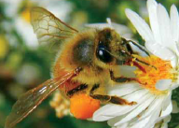
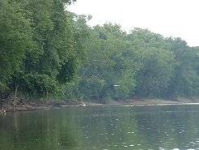
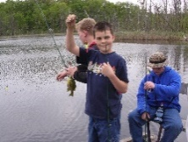
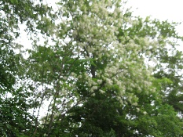
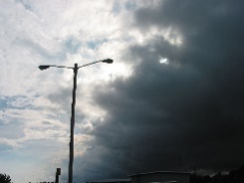
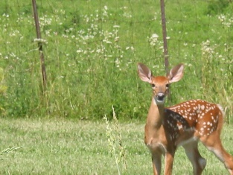
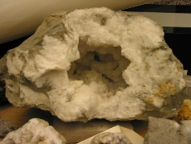
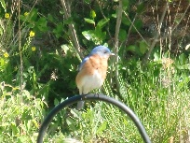
What is in the NR Club Resource Kit?
Beekeeping
Entomology
Forestry
Geology
Soil & Water Science
Sportfishing
Weather & Climate Science
Wildlife Science

Slide 10
What are the NR Club Kits?
Geared at the Level 1 age group – grades 3-5
Goals:
To introduce more youth to the 4-H natural resource
Provide adult volunteers with resources for the club
Increase natural resource project participation and knowledge

Slide 11
What is in the Natural Resource Kit?
An introduction to the NR club and curriculum
Subject matter folders
Invited speaker suggestions
Resources and other opportunities in 4-H
Selected activities and answers or facilitation help
The same information is in your spiral notebook and online at http://www.ydae.purdue.edu/NR,Club/Indiana,4-H,NR,Club.html

Slide 12
How Can I Use the NR Club Kit?
Topic introduction – how you wish:
1 topic each year
2-3 topics
All 8 topics
Utilize Junior Leaders and/or older youth who participate in these projects to teach/mentor
Outdoor activities – walks, talks, visit woods, streams, wetlands, and other areas of local interest
Timing: It’s up to you

Slide 13
www.ydae.purdue.edu/natural_resources/

Slide 15
Explore: Plan a NR Club Meeting
Include:
Target 4-H member age(s)
Meeting length
Materials needed
When and where
Agenda
Topic/topics
Activity/activities (from the NR club kit; review and describe)
Invited speaker
Reflections (experiential learning)
Application
Sources for more information on the topic(s)

Slide 16
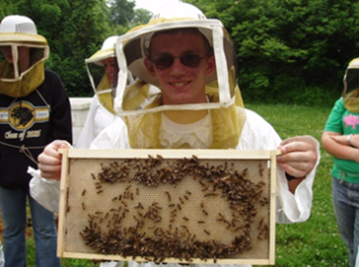
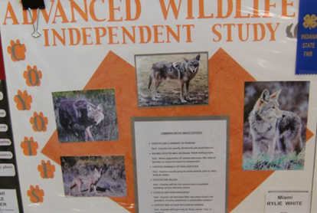
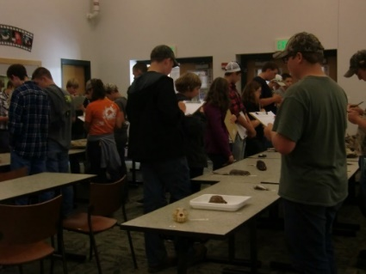
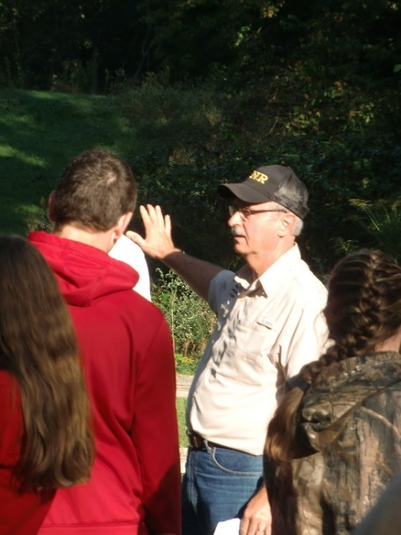
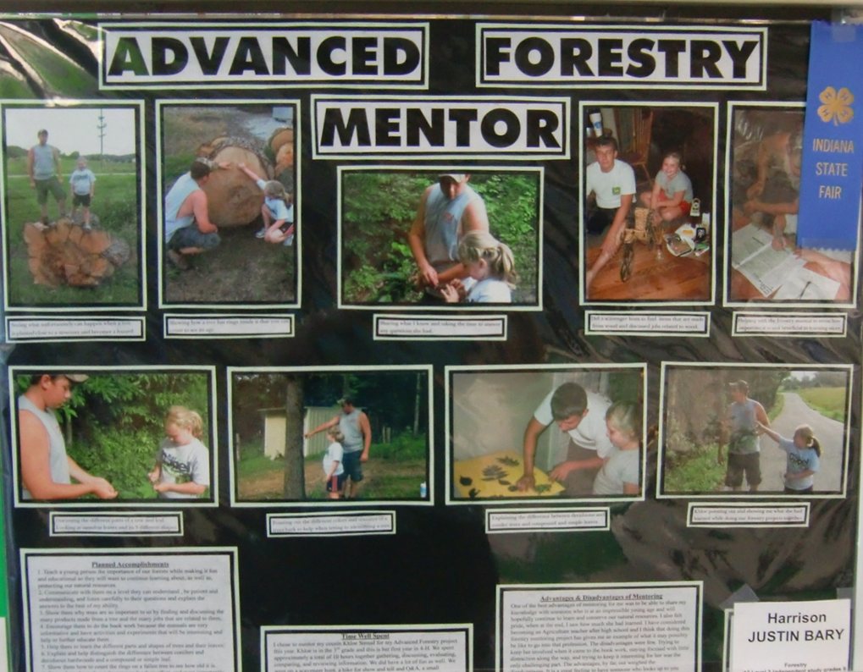
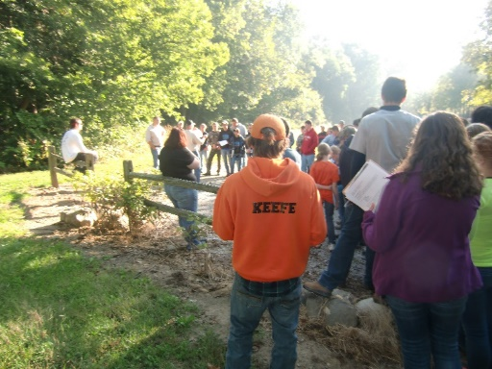
Any Questions?
Thank you for your interest and attention!

Slide 17
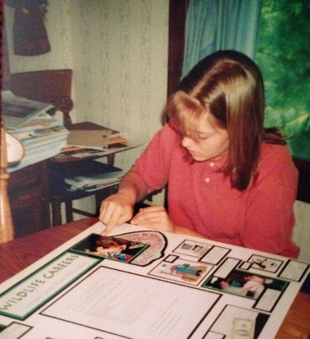
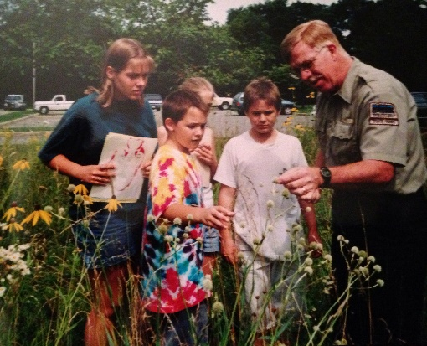
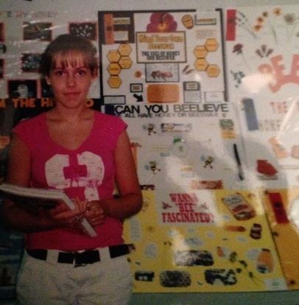
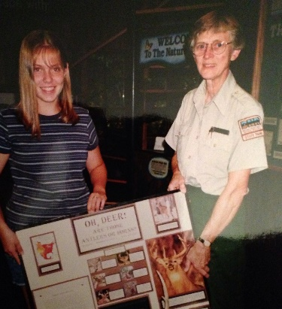
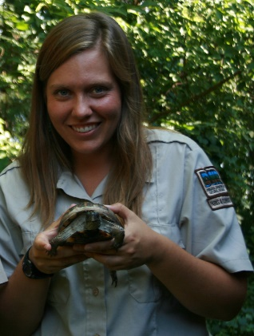
Natural Resource Club Blog for Indiana 4-H Volunteers
DOCUMENT TITLE
Marie Laudeman
Purdue YDAE Master’s Degree Student

