Slide 1
Welcome to Biochemistry!

Slide 2
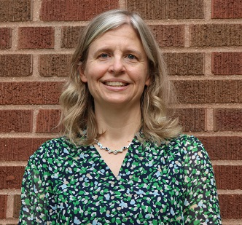
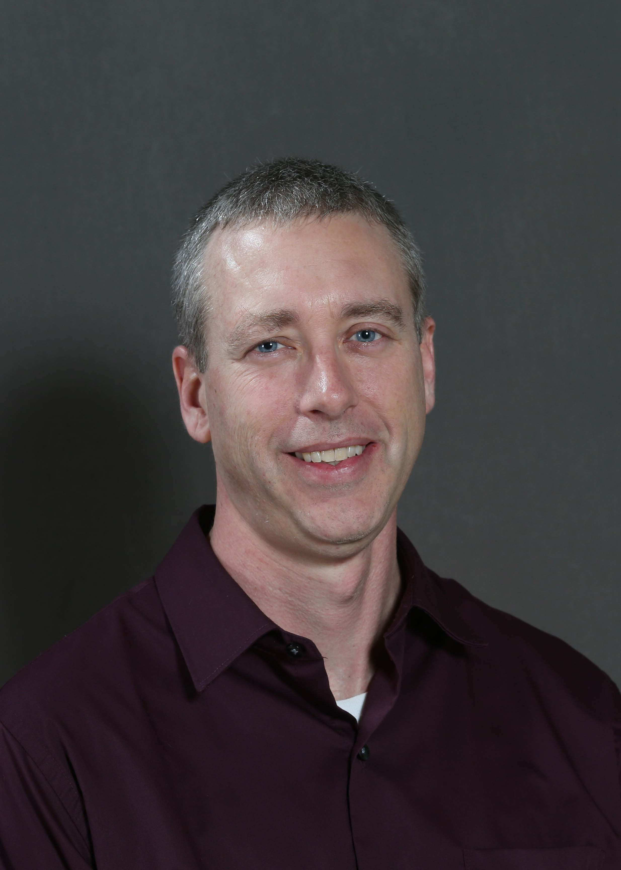
Your Biochemistry Advising Team
Heidi Fornes
  Academic Advisor, Principal
  hfornes@purdue.edu
Dr. Mark Hall
  Professor and Associate Department Head
  mchall@purdue.edu

Slide 3
Presentation Outline
Biochemistry Department Overview
Foreign Language Placement
Math Placement
High School vs. College
BCHM – A challenging major
Typical Fall Schedule
Advising appointment
Next Steps

Slide 4

Biochemistry Department
Basic information you should know…
  22 faculty
    Teach, do research, mentor graduate and undergraduate students
    Located in Biochemistry Building
      also Hansen, Whistler and Hockmeyer Research Buildings
  About 170 undergraduates (~40 per class)
    student to faculty ratio = 8:1
  All students participate in undergraduate research
  Undergraduate program is accredited by the ASBMB (American Society of Biochemistry and Molecular Biology)

Slide 5
Foreign Language Placement
The College of Agriculture does NOT have a Foreign Language requirement; however, there is a 9-credit International Understanding requirement which may be met by language classes or cultural classes
IF you have previously studied a language in high school (2 years or more), you MUST take a placement test before registering for a Purdue class in that language
Information about the online placement exam:
https://cla.purdue.edu/academic/slc/placement/index.html

Slide 6
Math Placement
You must complete 2 semesters of calculus in the curriculum (MA 16010 and MA 16020)
Ways to complete calculus:
  AP test score in Calculus AB 4 or 5 to test out of 1 semester
  AP test score in Calculus BC 4 or 5 to test out of 2 semesters
  Dual credit
Enrolling in calculus:
  Need Math SAT score 620 or
  ACT Score 26 or
  MA 158 and C- grade of better
  ALEKS score 75 (you must take the ALEKS test if you do not have these scores)
Information about the ALEKS test: https://www.math.purdue.edu/academic/undergrad/placement.html

Slide 7
High School vs. College
College is different from high school
You will have a lot of “free” time between classes
Much more is expected of you as an independent learner
General rule: for every 1 hour in class, spend 2 hours studying on your own
For 17 credit hours = 51 hrs per week to academics
  Sounds like a lot?
  168 hrs per week -56 hrs for sleeping -51 hrs studying = still have 61 hrs “free” time

Slide 8
A Challenging Major
SAT scores | HS GPA | Average BCHM 100 grade | Average 1st semester GPA | Stayed in BCHM | Changed major | Left Purdue
1290-1590 | 3.94-4.00 | 3.52 | 3.62 | 71% | 28% | 2%
1200-1280 | 3.76-3.93 | 2.70 | 3.00 | 50% | 39% | 12%
1110-1190 | 3.49-3.75 | 1.96 | 2.50 | 36% | 41% | 23%
880-1100 | 2.70-3.48 | 1.57 | 1.96 | 11% | 78% | 11%
n=507 freshmen in biochemistry, 2006-2022

Slide 9
Typical Fall Schedule*
AGR 10100/11500 (1 credit) – Orientation to College of Ag and Biochemistry Department (1st 8 weeks only)
BCHM 10000 (2) – Introduction to Biochemistry
BIOL 11000 (4) or 12100 (2) – Biology I
CHM 11500 (4) or 12901 (5) – General Chemistry
MA 16010 (3) – Calculus I (ALEKS score 75+ or SAT 620/ACT Math 26 or MA15800 or MA15400 (dual credit) grade of C-)
Optional: Social sciences/humanities course (3)
Total = 14-17 credits
*This will look different if students have AP or dual credit in any of these subjects!

Slide 10
Advising Meeting
Schedule an appointment in Boiler Connect when you receive a request to do so (this will be after you have completed Purdue 101).
Be prepared to share a little about yourself (hobbies, interests, career goals, involvement/activities at Purdue, graduation timeline, etc)
Review any transfer, AP, IB or dual credit you may have
You will have the opportunity to ask individual questions
Dr. Hall will discuss courses with you and make recommendations for the fall semester
Heidi will help you plan a schedule and walk you through the course request process

Slide 11
Next Steps
Check your Purdue email often!!!
You will receive an email when your fall schedule is ready on July 18
  Please do not make any changes without contacting us first!!!
  If you drop a course that is full, we cannot help you get back in!
E-invoice will appear on your myPurdue page in late July
  You must arrange a payment plan by August 28
Boiler Gold Rush (BGR)
  Sign up by July 31
  Attend August 13-17
Expect to hear from a “Biochem Buddy” (peer mentor)
Classes start August 19, 2024

Slide 12
Have a great summer!
Welcome Pizza Party with your biochemistry buddy– TBA in August
We look forward to getting to know you better this fall!
Questions?
  Heidi Fornes
    hfornes@purdue.edu
    765-494-1612

