Slide 1
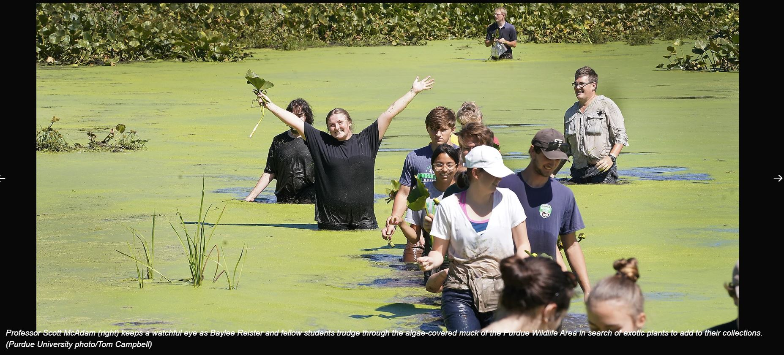
Welcome Plant Science students!
Department of Botany
& Plant Pathology
All Aboard

Slide 2
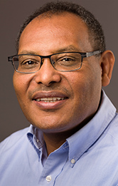
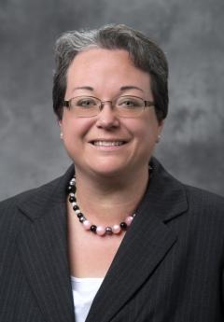
Meet Your Botany & Plant Pathology Team
Dr. Tesfaye Mengiste
Department Head
Research Professor
mengiste@purdue.edu
LILY 1-446D
Lisa Klein
Senior Academic Advisor
klein85@purdue.edu
LILY 1-446C

Slide 3
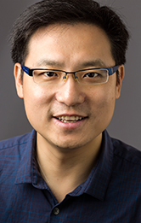
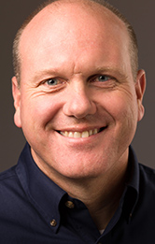
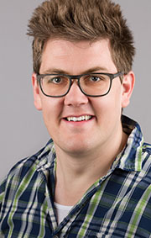
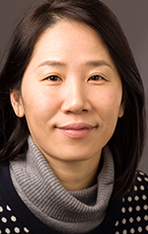
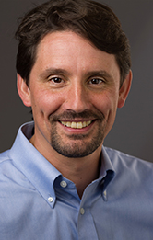
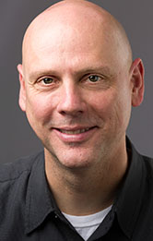
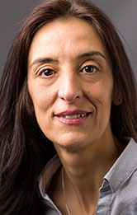
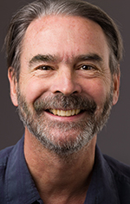
Botany & Plant Pathology Faculty Mentors
Each Plant Science student is assigned a faculty mentor. In addition to your Academic Advisor, Lisa Klein, each semester you will also meet with your faculty mentor. These faculty members serve as mentors for the research and professional development side of your Purdue education.
DR. YUN ZHOU
LILY B-472
zhouyun@purdue.edu
DR. BRYAN YOUNG
LILY 1-347
bryanyoung@purdue.edu
DR. SCOTT MCADAM
*On Sabbatical Fall 2024
LILY B-338
smcadam@purdue.edu
DR. GYEONG MEE YOON
LILY B-474
YOONG@purdue.edu
DR. CHRIS OAKLEY
LILY 1-329
oakleyc@purdue.edu
DR. MIKE MICKELBART
WSLR B-024
mickelbart@purdue.edu
DR. LEONOR BOAVIDA
WSLR 232
lboavida@purdue.edu
DR. DAMON LISCH
WSLR B-032
dlisch@purdue.edu

Slide 4
Your major is Plant Science
The Botany & Plant Pathology Department offers one major and three minors:
Major:
Plant Science, BS
Minors:
Plant Biology (not available to Plant Science majors)
Plant Pathology
Weed Science
All Plant Science degree requirements are available at catalog.purdue.edu.
2024-2025 Academic Year Requirements Coming after June 1st
On left-side menu: Undergraduate Colleges > Department of Botany and Plant Pathology > Programs >Plant Science, BS
Course recommendations for your first semester*:
AGR 10100 Introduction To The College Of Agriculture And Purdue University
AGR 12500 Introduction to Plant Science
BTNY 12000 Principles of Plant Biology I
CHM 11100 General Chemistry
ENGL 10800/SCLA 10100 First Year Composition
MA 16010 Applied Calculus I
*You will work with your advisor to plan for your specific first semester courses. If you have any dual credits, AP credits, etc. please let your advisor know when you meet to preregister

Slide 5
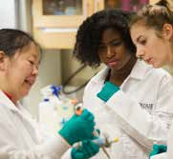
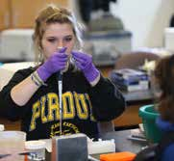
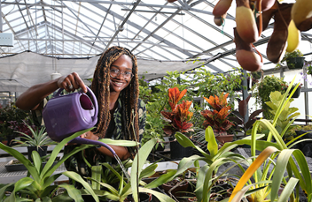
Botany & Plant Pathology Research and Careers
All B&PP Faculty have an area of focus within Plant Science:
Plant Biology - Plant Pathology - Weed Science
All Plant Science undergraduate students are required to complete 3 credit hours of research. Information about faculty research focus areas is available so you can start to think about what you might like to research.
Where do you want your Plant Science degree to take you?
Research will help you find out
More information about Careers in Plant Science

Slide 6
Additional Opportunities and Resources
Be Informed, Get Involved, Boiler UP
Keys to Academic Success:
Get engaged in learning from the start
Talk to your instructors, Academic Advisor, and classmates
Read your course syllabi and Purdue emails
Responsibilities for Academic Success:
Ultimate responsibility for academic progress lies with YOU
Become familiar with your degree requirements (myPurdue Plan)
Work with your Academic Advisor and Faculty Mentor for guidance
The Botany & Plant Pathology Undergraduate Advising Website contains a lot of information about your Plant Science major and the department, as well as opportunities for student engagement, such as the Botany Club, the Ambassador program and more. Please review it here before your advising meeting.

Slide 7
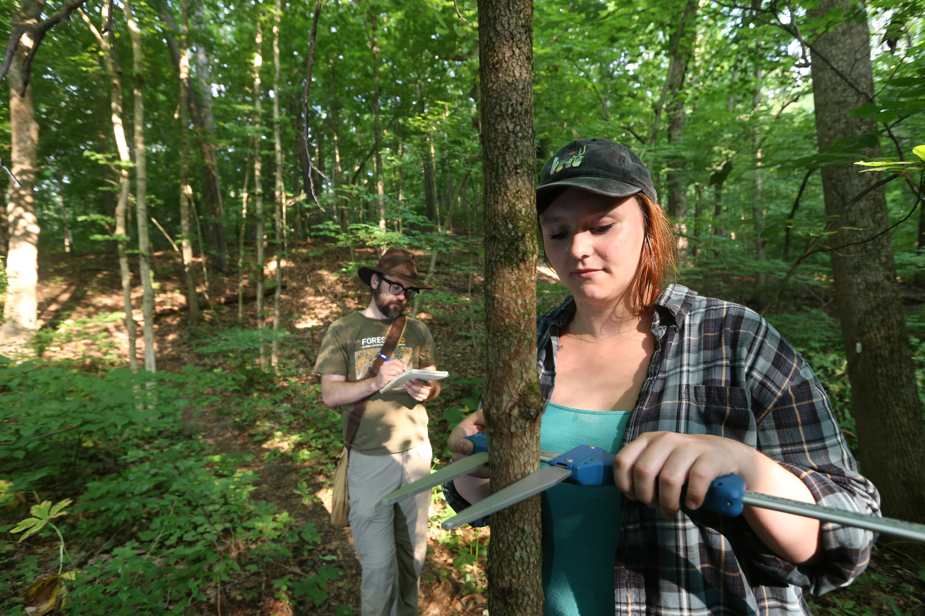
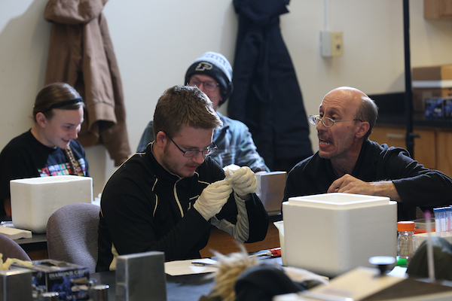
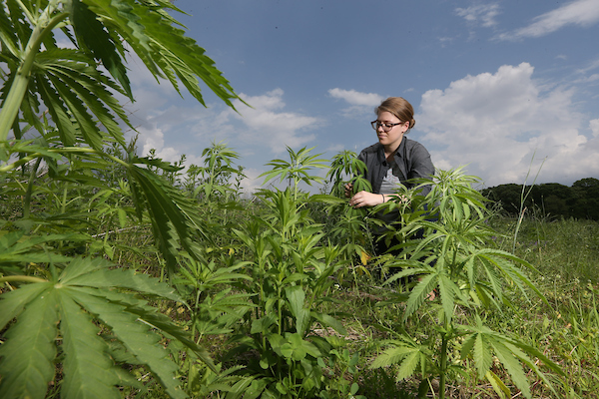
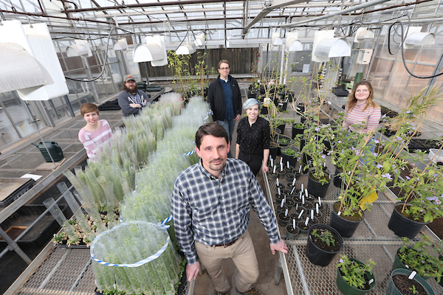
Our Hope For You
Collaborate
Turn Ideas into Reality
Ask Questions
Explore
Become a Boilermaker
Build a Foundation
Seek Knowledge
Have Adventures
Push your limits
Grow

Slide 8
Academic Advising Overview
Next Steps:
You’re almost done!
Please complete the New Student Intake Form and email it to your Academic Advisor, Lisa Klein, at klein85@purdue.edu.
Next, Lisa will send an invitation through BoilerConnect for you to schedule a meeting to complete the preregistration process for Fall 2024 courses, beginning June 1st. Please check your Purdue email regularly.
In myPurdue, review your myPurdue Plan worksheet to see all degree requirements to prepare for the meeting.

Slide 9
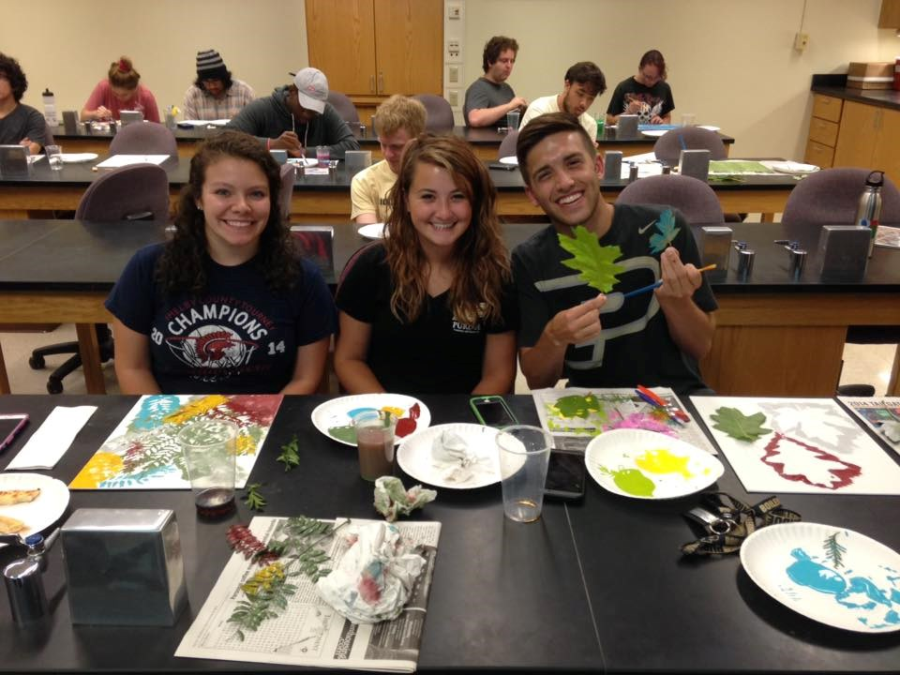
Thank You
We look forward to working with you!
-The Botany & Plant Pathology Undergraduate team
Boiler up!
Purdue Botany and Plant Pathology

