Slide 1
Notes:
FieldWatch is the not-for-profit parent organization that helps administer driftwatch, beecheck, cropcheck, and FieldCheck through out the US and Canada. FieldWatch was formed in 2012 by Purdue University and interested agriculture stakeholder groups.
SENSITIVE CROPS, BEE HIVES, AND ROW CROPS CAN ALL BE SEEN ON https://in.driftwatch.org
Want to register bees- go to driftwatch or beecheck
Want to register row crops- need to go to cropcheck
Want to register sensitive crops- driftwatch
Are you an applicator and want to see what's around you- fieldcheck or driftwatch

Slide 2
Presentation Overview
What is DriftWatch?
What is new?
How do I register as an applicator?
How do I register my specialty crop?
How do I get signs?
Notes:
Presenter is encouraged to pull up the website and navigate around, if access to internet.

Slide 3
Mission
To develop and provide easy-to-use, reliable, accurate and secure on-line mapping tools intended to enhance communications that promote awareness and stewardship activities between producers of specialty crops, beekeepers and pesticide applicators.
Notes:
Driftwatch is a sensitive crop registry tool administered through FieldWatch. It is meant to help pesticide applicators and specialty crop growers communicate more effectively to promote awareness and to help prevent and manage drift effects. Producers plot their fields on satellite images (Google Earth), and pesticide applicators can then view the sensitive sites. Pesticide applicators can also sign up to be notified when new fields in their area get registered. The web address is https://in.driftwatch.org/map Presenter is encouraged to pull up the website and navigate around, if access to internet.
Only commercial producers are allowed, no home gardens. Bee hobbyists are the one exception to the rule (You don’t need to be commercial beekeeper.) New this year will be cropcheck, which will allow certain kinds of row crops.

Slide 4
Why DriftWatch?
Drift is expensive!!
2019 EEE outbreak in northwest Indiana, Driftwatch producers were protected.
Some labels REQUIRE applicators to check DriftWatch before making pesticide applications.
Some crops cost more than $10,000 an acre to replace.
What are you neighbors growing?? (bees or organics)
Wider variety of applicators (aerial, turf, mosquito control, and right of way) use driftwatch every time they apply
Notes:
Driftwatch is a free tool that saves everyone time, money, and frustration. We don’t always know all the crops that are around our fields, so driftwatch can bridge the gap. Plus as a registered producer, you can potentially avoid an aerial or ROW drift by registering.
In 2019, We had an EEE outbreak that required county wide spraying of mosquitos in NW Indiana. EEE is Eastern equine encephalitis commonly called Triple E or sleeping sickness caused by certain types of mosquitos. EEE can be fatal to horses and humans.
When they had county wide aerial applications, the aerial applicator loaded the DriftWatch map data into his flight software and was able to avoid certain sensitive crop producers and bee keepers when it came spray time. Get registered ahead of time!

Slide 5
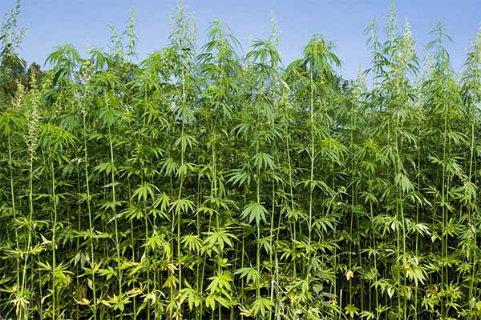
What is New in 2020
Select protected sites from DNR will be added to Map
Must be owned and/or managed by the State (DNR)
Must have a shared border with an agricultural area
Approximately 33 sites have been added
Hemp allowed on Map
Dropdown listed as
“Industrial Hemp”
Notes:
Very selective on what can be added to these protected DNR sites.
A “shared border” means that at least one boundary of the Preserve is adjacent to, contiguous with, or across the road from known farmland.
Presenter: review the Hemp FAQ which addresses licenses, number of acres, fertilizer and pesticides, etc. https://www.oisc.purdue.edu/hemp/index.html

Slide 6
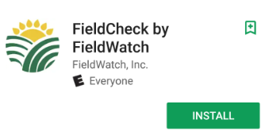
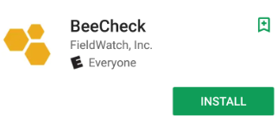
What is New
2 new apps for mobile use- FieldCheck (applicators) and BeeCheck (beekeepers)
Notes:
The new mobile apps (FieldCheck and BeeCheck) have been released for iOS and Android operating systems. These would be helpful especially for pesticide applicators ‘on the fly’ and for commercial bee keepers who routinely move hives. There is no size restriction when defining “Alert Area” Could be the entire state.
Different ‘Bee Icons’ defined: Red=beekeeper registered with the state. Striped=mulitpe hives at the location. B=single hive. Seasonal hives are bees that are used only for a pollination season such as for orchards. Seasonal hives are not used much in Indiana.

Slide 7
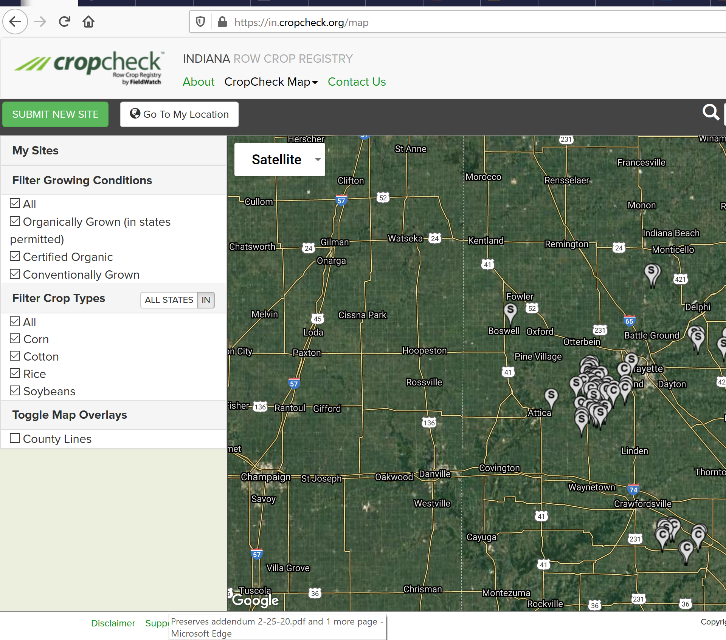
What is New
Cropcheck - New in 2019! Row crop registry program www.cropcheck.org
Notes:
Cropcheck is the new registry that will allow row crop producers (like non-dicamba beans) to map crops that may be sensitive to off target movement of pesticides. It is similar to driftwatch and beecheck today. All cropcheck data will flow into the same database as driftwatch and beecheck. This will allow applicators to continue to have a simple and streamlined process for accessing all FieldWatch data. The crop types allowed in cropcheck are: rice, beans (soybeans), cotton and corn. AS AN APPLICATOR, YOU CAN GO TO DRIFTWATCH TO SEE SENSITIVE SITES (INCLUDING ROW CROPS) AROUND YOU. If you want to register your row crops you should go to www.cropcheck.org . Please don’t register in other category of DriftWatch site. You use same login as DriftWatch but when you go to CropCheck there are additional items to select like pesticide tolerance.

Slide 8
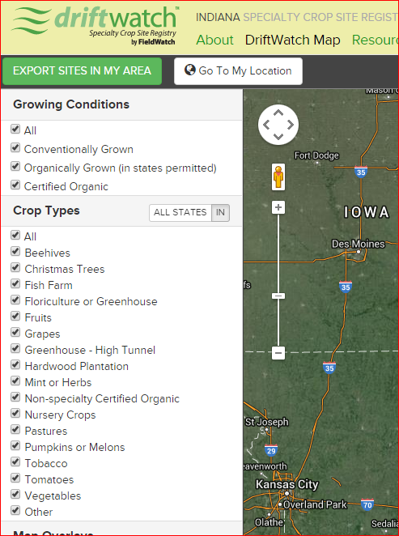
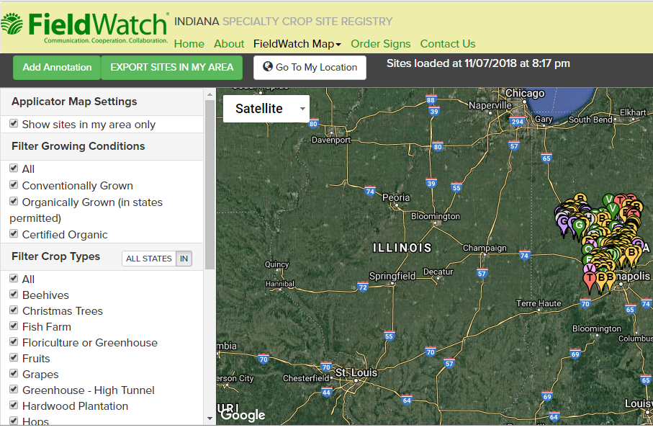
What is New
Membership with FieldWatch can allow organization to download or live stream.
Annotations for applicators
Notes:
For larger organizations who are members, data can be downloaded or streamed. This is especially helpful for companies that do extensive spraying and can be integrated with their current spray software. Fees apply.
Brand new for 2019 is annotations. This will allow applicators to ‘personalize’ ONLY their map. For instance, it would allow the applicator to add a variety of ‘sensitive areas’ such as an unregistered sensitive site, a school, or a past complainant. Farmers can use the annotations to note areas that may not registered with DriftWatch, such as home gardens or personal fruit trees. These annotations will only show on their profile not on the public database.

Slide 9
DriftWatch-State View
Notes:
Overview of site. Don’t need login to view. Can zoom in on area or search by address

Slide 10
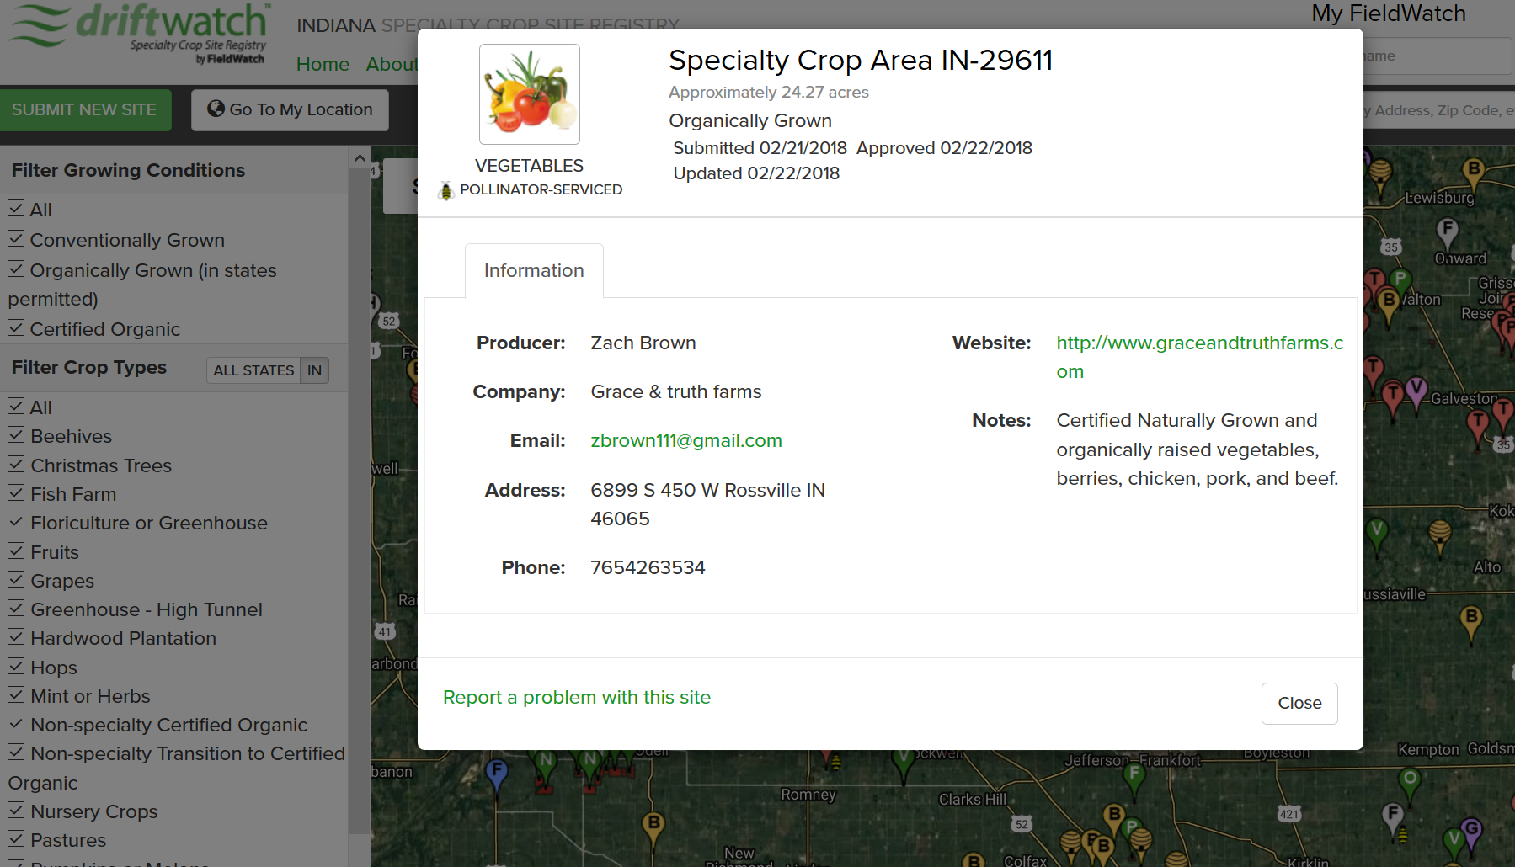
Zoomed in view
Notes:
If you click on balloon, more information about sensitive site can be seen including contact info, website, and notes. Pollinator serviced is a new feature.

Slide 11
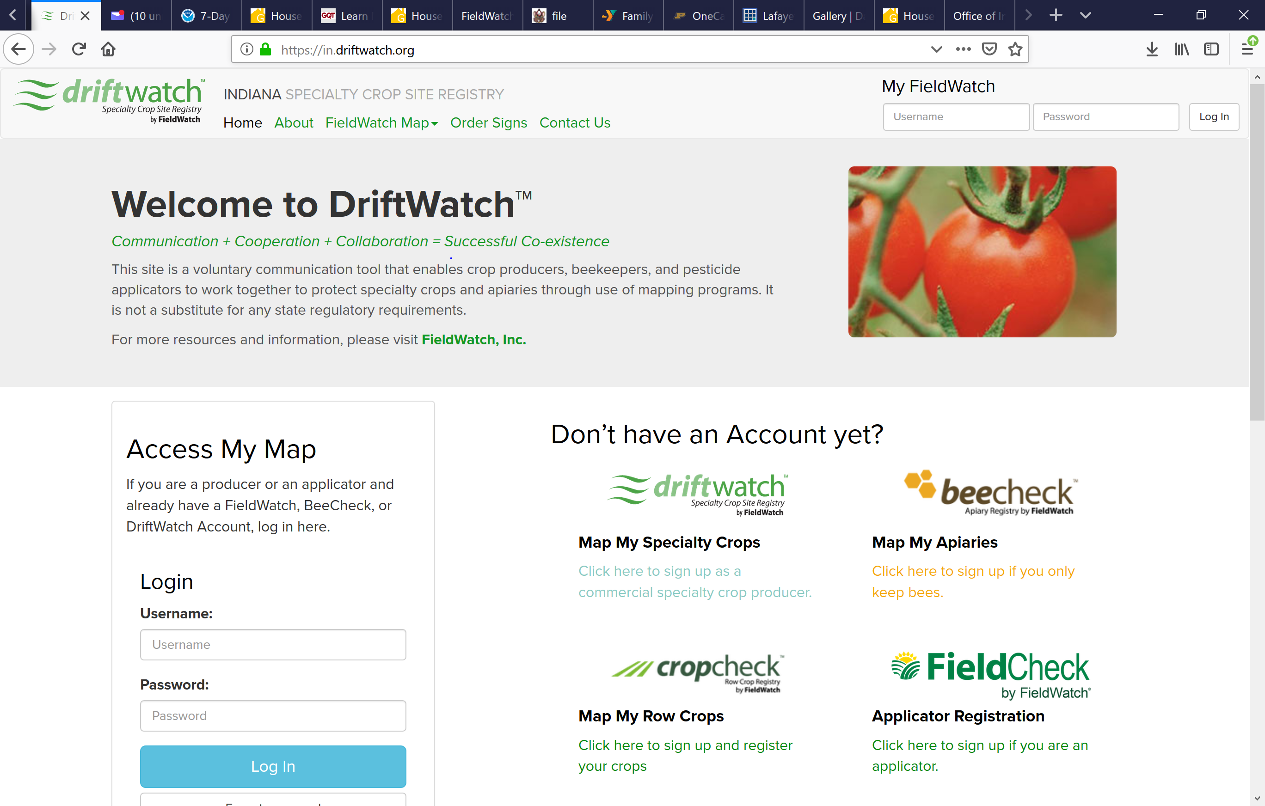
How to sign up?
It’s free!
Notes:
This is how to sign up/ login. Go to website https://in.driftwatch.org. Click on top right corner. Signing up is free. Make sure you select the correct area: Driftwatch: producer, beecheck: beekeeper, Cropcheck- row crops, and FieldCheck- applicator

Slide 12
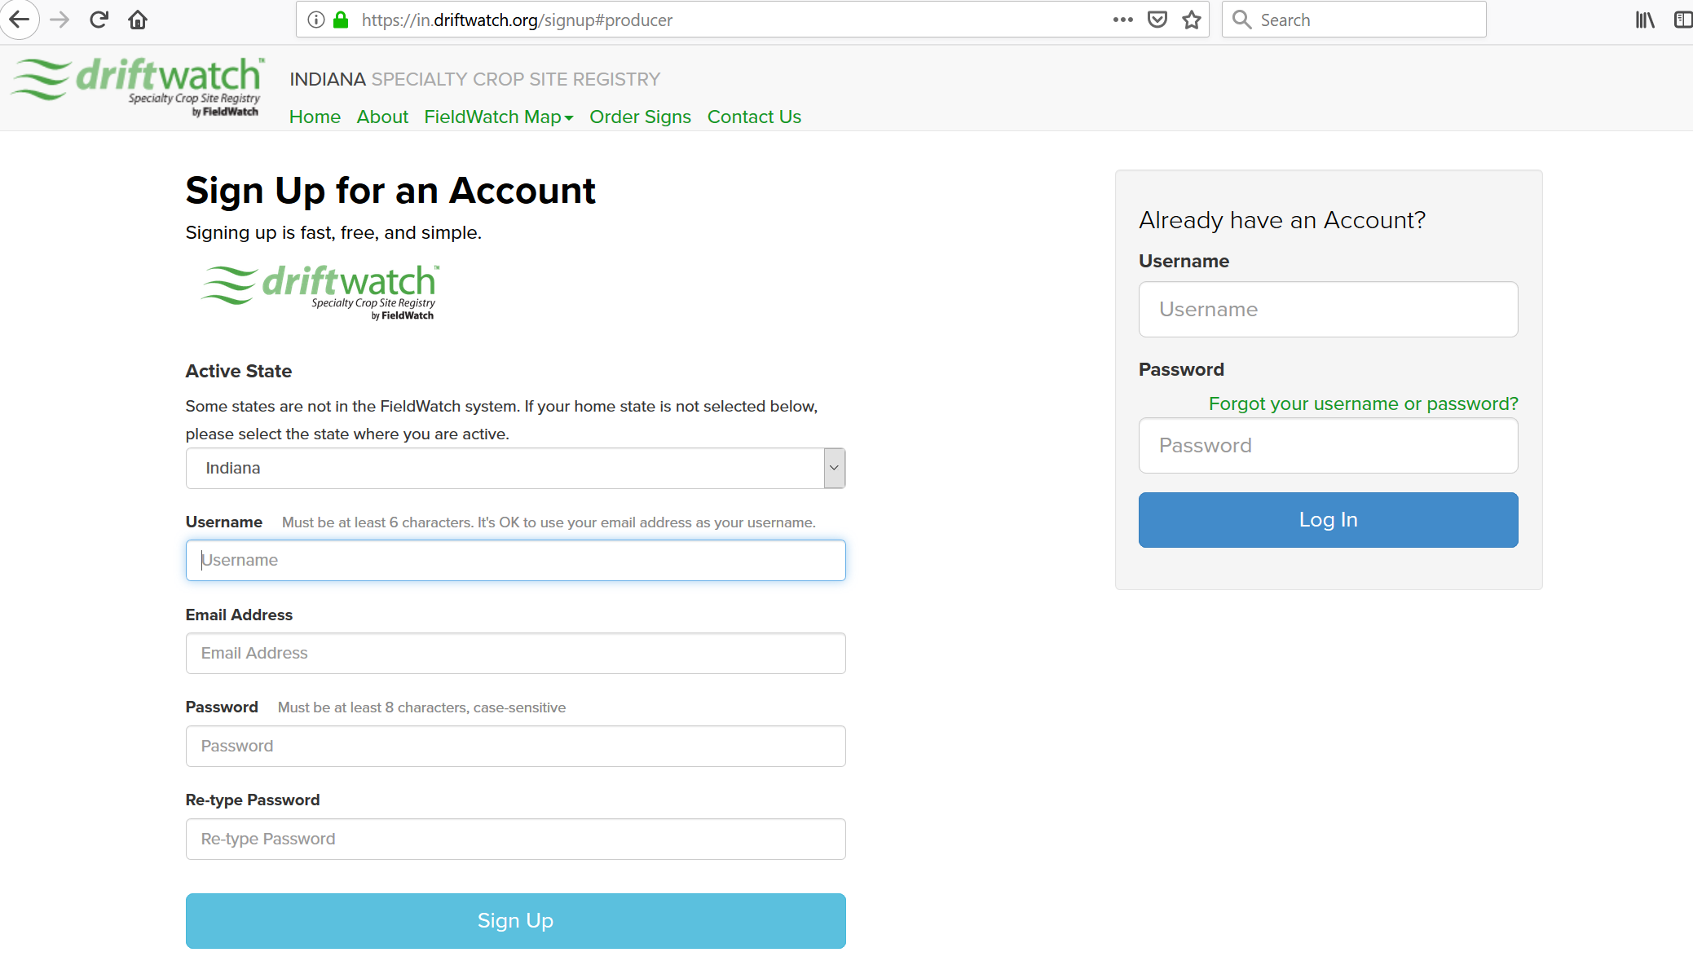
Login information
Does your producer have no email: use no.email@driftwatch.org
This really help us at renewal time!
No email address?: no.email@driftwatch.org
Notes:
Need to choose a login and password. If you don’t have an email address, please use no.email@driftwatch.org.

Slide 13
User Contact Information
Same for producers & applicators
Notes:
Need to provide contact info. Please make sure info is correct.

Slide 14
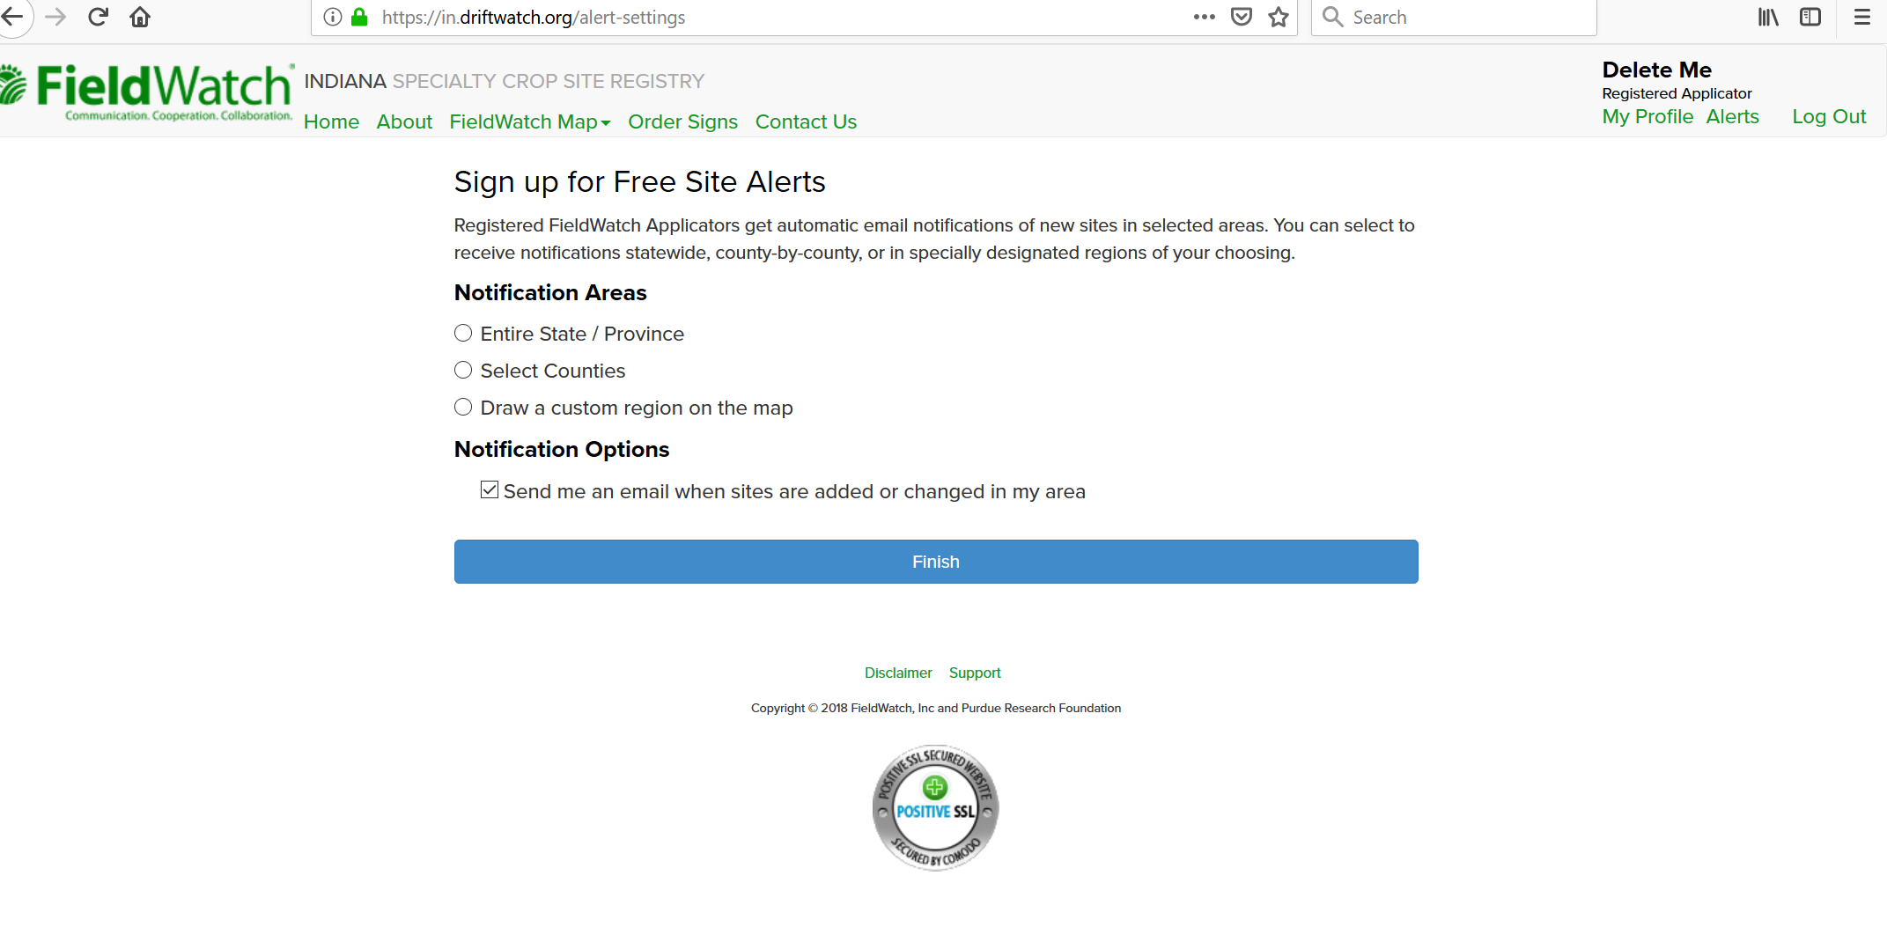
Signing up as an Applicator: Notification options
Notes:
You can register to receive notifications for the entire state, certain counties, or select a custom area.

Slide 15
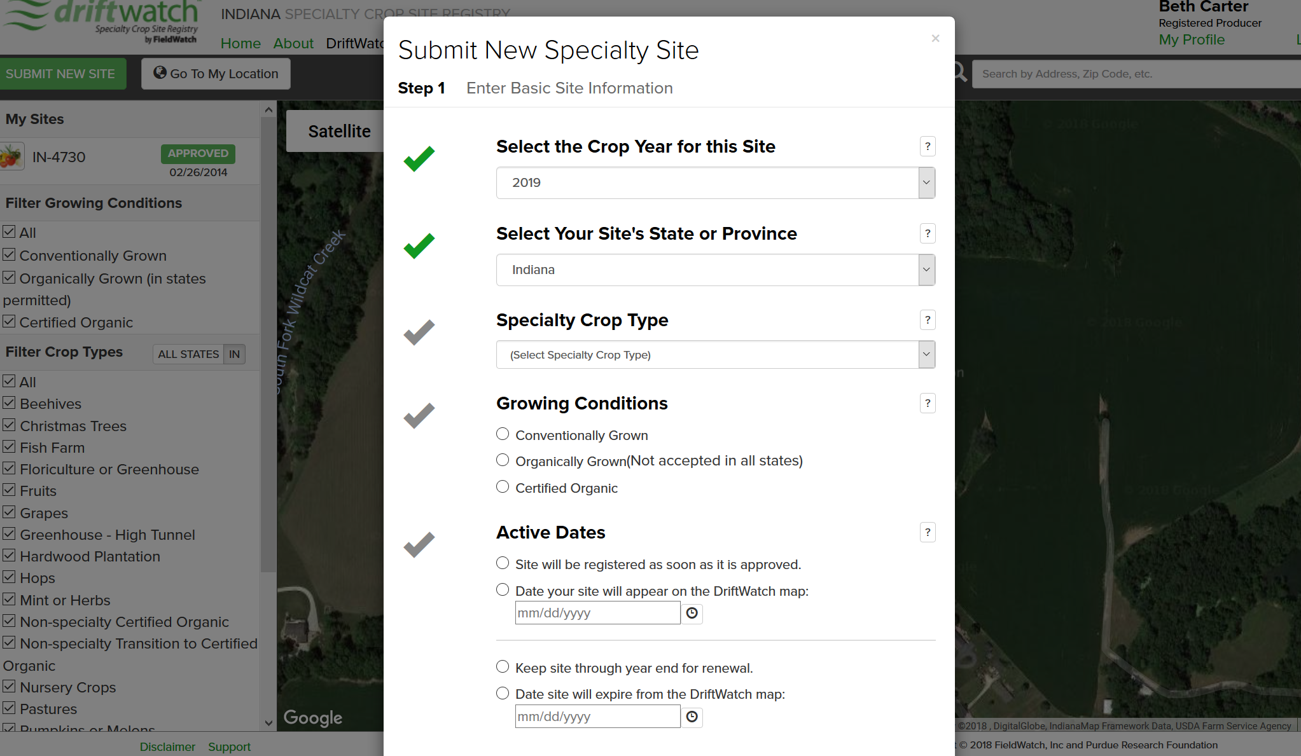
Registering Your Site as a Producer
2) Submit new site button
3) Fill out crop info
1) Login
Notes:
Registering your site on DriftWatch. From this screen you can register any sensitive site or bees. Review items 1, 2 & 3. Crop info has a series of questions and dropdowns.

Slide 16
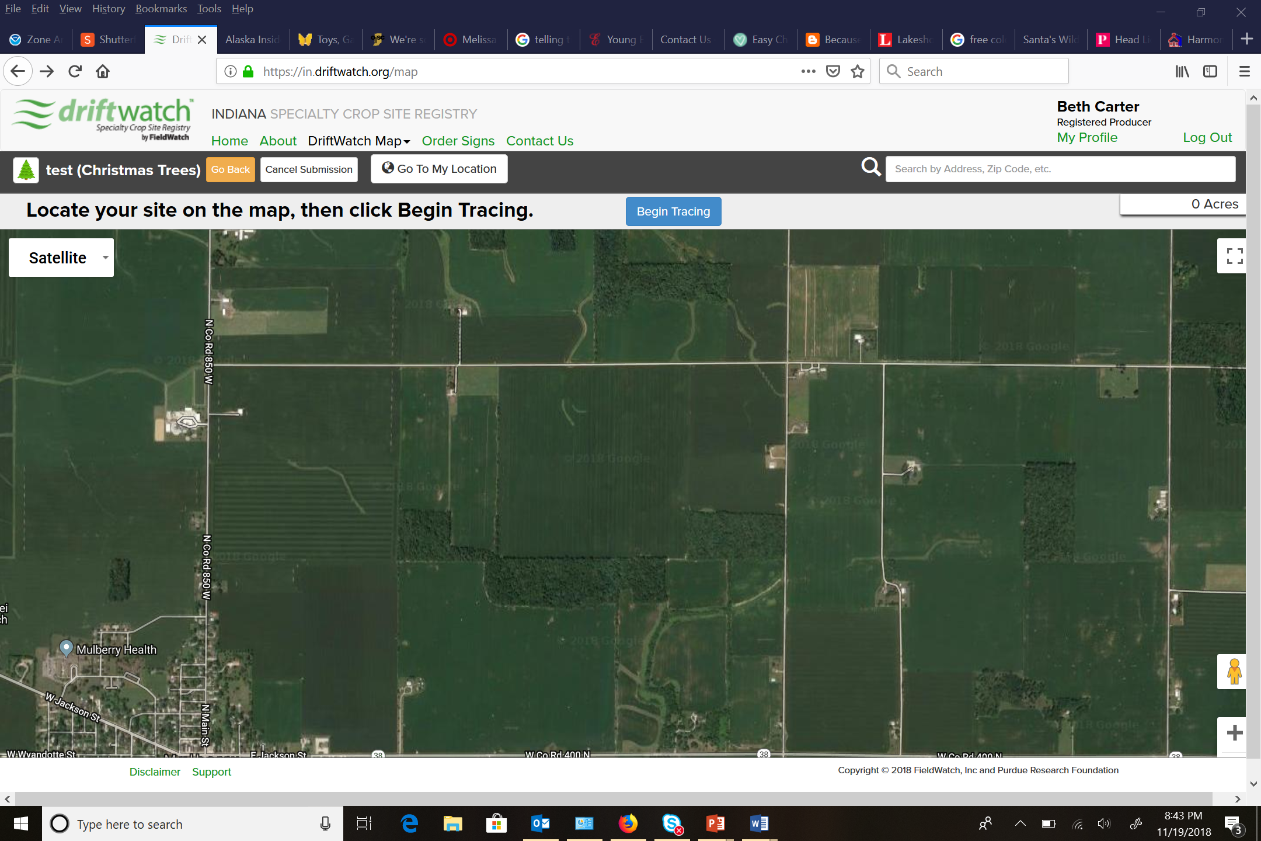
Registering your Site as a Producer- Continued
4) Begin tracing button
Notes:
Review step 4
If you are a beekeeper, the area will automatically be a half acre circle. IF you wanted to register YOUR PROPERTY as bee forage that would be in the “other category” and you need to list “bee forage” in the notes.

Slide 17
Registering your Site as a Producer- Continued
5) Draw
6) Submit
Notes:
Use mouse clicks to draw the polygon. There is also the option to clear drawing if you are having trouble. Finally, submit site. Site needs to be reviewed by the data steward. Once it has been approved, an automated email will be sent. You can see the status of your submission when you login on the left side of the screen under ‘my sites.’

Slide 18
Need more help?
https://fieldwatch.com/resources/
Notes:
Go to FieldWatch for even more detailed instructions… but I promise it is not that hard!
https://fieldwatch.com/resources

Slide 19
Field signs
Notes:
These are the driftwatch field signs. You are required to have a registered and approved field to purchase the signs.
2-Sided Print on plastic corrugated board 24"x18" (H stake included) 1st Sign = $12.00+shipping Additional Signs = $10.00 each
The bee flags 1-Sided Print on Yellow Nylon Flag 14"x20" (3 grommets w/ zip ties included) Flag = $9.00+shipping

Slide 20
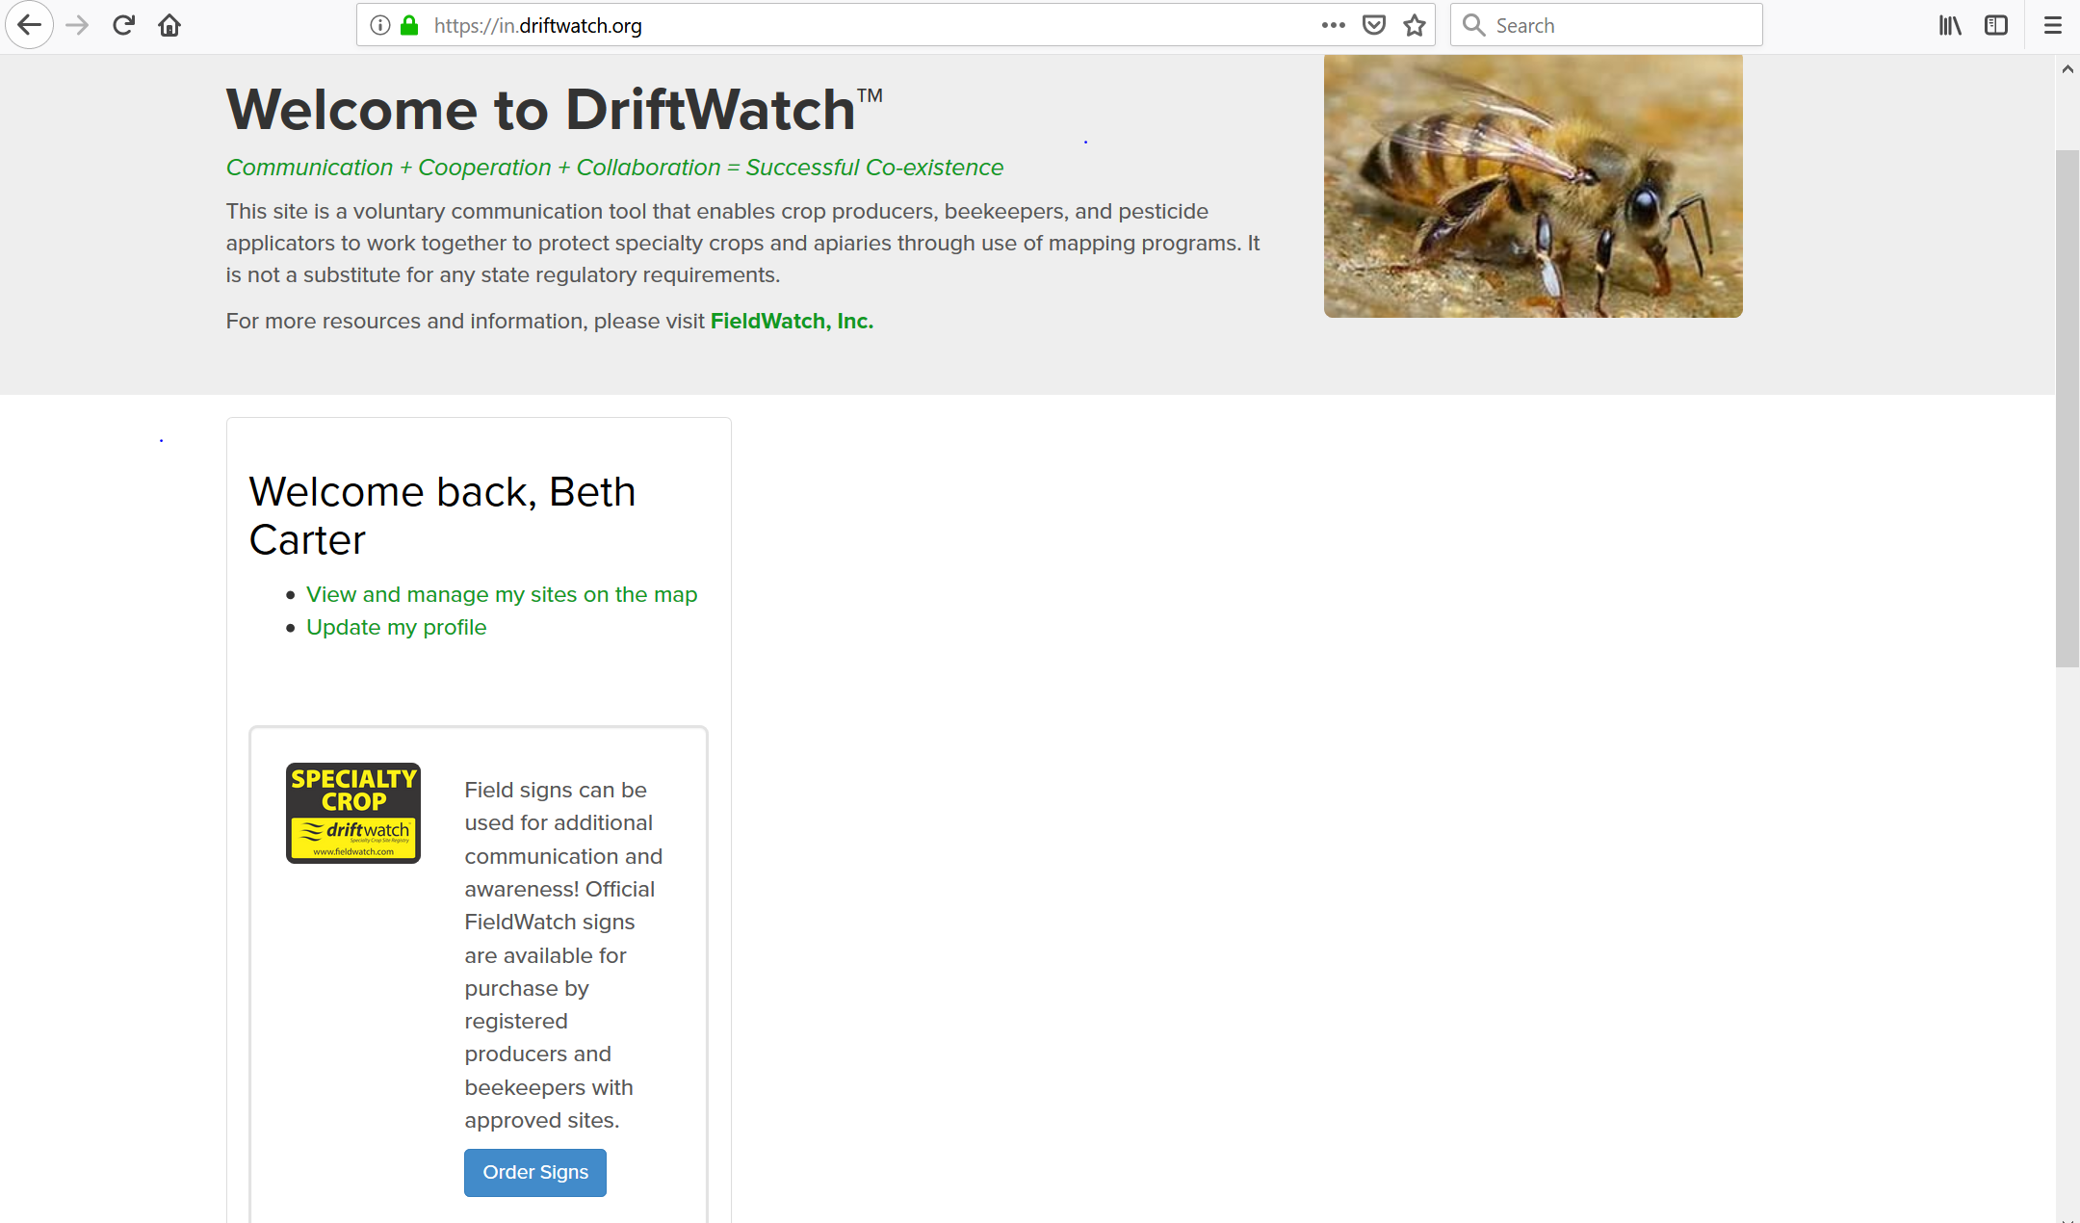
Ordering signs
Notes:
You need to be logged in to order signs. It can be done from the “welcome page” or by clicking on your sites

Slide 21
Thank You!
Mailing address:
PO Box 221610
St. Louis, MO 63122
877-443-4353
Notes:
Contact info

