Slide 1

Pesticide
Jeopardy
Created By: Purdue Pesticide Program
Revised By: Crystal Van Pelt, Purdue Extension-Steuben County
Special Thanks to Matt Hamlyn for permission to use the game board frame (University of Arizona Cooperative Extension)

Slide 2

Movement Off-Site

Slide 3
Pesticide Handling

Slide 4
The Label

Slide 5
Ground Water Contamination

Slide 6
Health Issues

Slide 7
Show & Tell

Slide 8
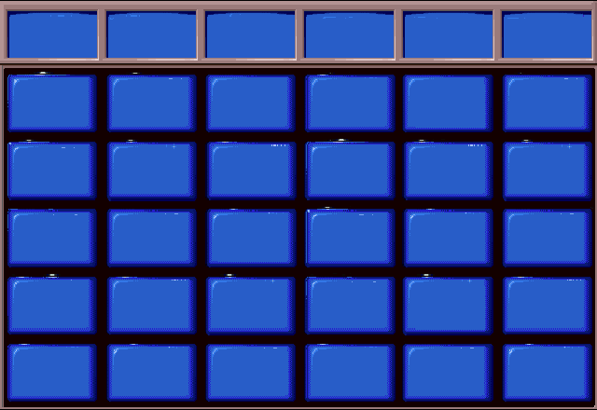
Movement Off-Site
Pesticide Handling
Ground Water Contamination
The Label
Health Issues
Show & Tell
$100
$100
$100
$100
$100
$100
$200
$200
$200
$200
$200
$200
$300
$300
$300
$300
$300
$300
$400
$400
$400
$400
$400
$400
$500
$500
$500
$500
$500
$500

Slide 9
1-100
Off-Site Movement $100
Applicators can prevent volatility (vapor drift) of pesticide by using...

Slide 10
1-100A
What are non-volatile pesticides?
(especially during hot weather)
1 - 100
$100

Slide 11
1-200
Off-Site Movement $200
How can pesticide residues affect
non-target areas or objects.

Slide 12
1-200A
What is contaminating plants
and animals
and
pitting or staining nearby surfaces
1 - 100
$200

Slide 13
1-300
Off-Site Movement $300
What are considered “sensitive areas” when applying pesticides near people?

Slide 14
1-300A
What are homes, schools, hospitals, playgrounds?
1 - 100
$300

Slide 15
1-400
Off-Site Movement $400
What are 3 ways an applicator can avoid wind drift?

Slide 16
1-400A
What are
Wind speeds less than 10mph
Wind blowing away from sensitive areas
Low pressure application
Coarse spray/large droplets
Apply close to target?
1 - 100
$400

Slide 17
1-500
Off-Site Movement $500
What 3 things can contribute to ground water contamination?

Slide 18
1-500A
What are:
Use of soluble/leachable chemicals
Getting to close to waterways
Carelessness when mixing/loading
Spills
Leaking equipment and containers?
1 - 100
$500

Slide 19
2-100
Pesticide Handling $100
The very first thing that must be done in a pesticide program.
1 - 100

Slide 20
2-100A
What is correctly identify the pest?
1 - 100
$100

Slide 21
2-200
Pesticide Handling $200
Pesticide labels often give ranges of pesticide rates that can be used. When would an applicator use the low rate? Why?

Slide 22
2-200A
What is on sandy soil, low CEC?
1 - 100
$200

Slide 23
2-300
Pesticide Handling $300
How can an insecticide and target insect activity be affected by cold temperatures?

Slide 24
2-300A
What are low volatility and low pest activity?
1 - 100
$300

Slide 25
2-400
Pesticide Handling $400
What type of herbicide will best control deep-rooted, perennial weeds?

Slide 26
2-400A
What are systemic herbicides?
1 - 100
$400

Slide 27
2-500
Pesticide Handling $500
After the carrier, what is generally the first pesticide formula that should be added to the tank?

Slide 28
2-500A
What are WPs or Wettable Powders?
1 - 100
$500

Slide 29
3-100
The Label $100
The Federal Agency that registers pesticides
1 - 100

Slide 30
3-100A
What is the Environmental Protection Agency (EPA)?
1 - 100
$100

Slide 31
3-200
The Label $200
Indiana’s state pesticide regulatory agency

Slide 32
3-200A
What is the Office of the Indiana State Chemist (OISC)?
1 - 100
$200

Slide 33
3-300
The Label $300
What statement appears on every pesticide label?

Slide 34
3-300A
What is “Keep out of reach of children”?
1 - 100
$300

Slide 35
3-400
The Label $400
There are three words that describe pesticide toxicity known as signal words. What are they in order of least to most toxic?

Slide 36
3-400A
What are caution, warning, and danger?
1 - 100
$400

Slide 37
3-500
The Label $500
Who can purchase and use Restricted Use Pesticides (RUPs)?

Slide 38
3-500A
Who are certified pesticide applicators or someone under their direct supervision?
1 - 100
$500

Slide 39
4-100
Ground Water Contamination $100
What is the first factor to consider when trying to reduce ground water contamination?
1 - 100

Slide 40
4-100A
What is the location?
1 - 100
$100

Slide 41
4-200
Ground Water Contamination $200
What event can cause pesticides to move off target?

Slide 42
4-200A
What is rain (or irrigation)?
1 - 100
$200

Slide 43
4-300
Ground Water Contamination $300
Name 2 chemical characteristics that influence ground water contamination.

Slide 44
4-300A
What are:
Solubility (in water)
Adsorption (to soil particles)
Persistance (breakdown of the chemical)?
1 - 100
$300

Slide 45
4-400
Ground Water Contamination $400
Name 2 soil characteristics affecting pesticide movement into ground water.

Slide 46
4-400A
What are
Soil texture- sand, silt, clay
Permeability/compaction (H2O movement)
Organic matter (carbon content)?
1 - 100
$400

Slide 47
4-500
Ground Water Contamination $500
The movement of pesticides down through the soil profile is called what?

Slide 48
4-500A
What is leaching?
1 - 100
$500

Slide 49
5-100
Health Issues $100
Generally, does mixing or applying pesticides require more Personal Protective Equipment (PPE)?
1 - 100

Slide 50
5-100A
What is mixing?
1 - 100
$100

Slide 51
5-200
Health Issues $200
What is the most common method of pesticide exposure?

Slide 52
5-200A
What is dermal exposure?
1 - 100
$200

Slide 53
5-300
Health Issues $300
Would cancer be an acute or chronic toxic effect?

Slide 54
5-300A
What is a chronic toxic effect?
1 - 100
$300

Slide 55
5-400
Health Issues $400
Vomiting, chest pain, and difficulty breathing are all symptoms of what?

Slide 56
5-400A
What is pesticide poisoning?
1 - 100
$400

Slide 57
5-500
Health Issues $500
What should you do in case of dermal pesticide poisoning?

Slide 58
5-500A
What is drench skin/clothes with water and wash skin with soap and water?
1 - 100
$500

Slide 59
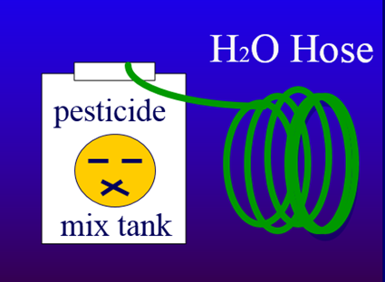
6-100
Show & Tell $100
What is wrong with this photo? What are two ways to fix it?
1 - 100

Slide 60
6-100A
What is the hose is in the tank?
What is an air gap or back flow preventor?
1 - 100
$100

Slide 61
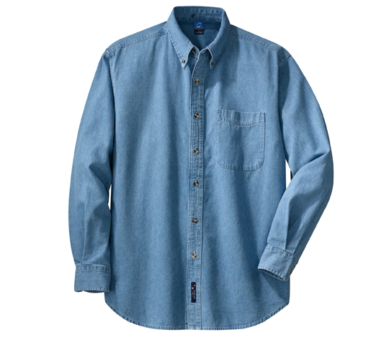
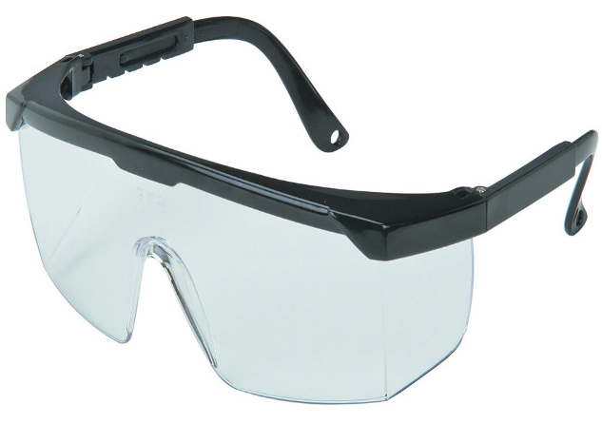
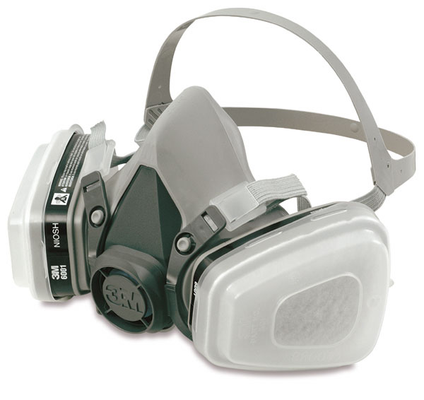
6-200
Show & Tell $200
What basic PPE items are missing?

Slide 62
6-200A
What are a hat and gloves?
1 - 100
$200

Slide 63
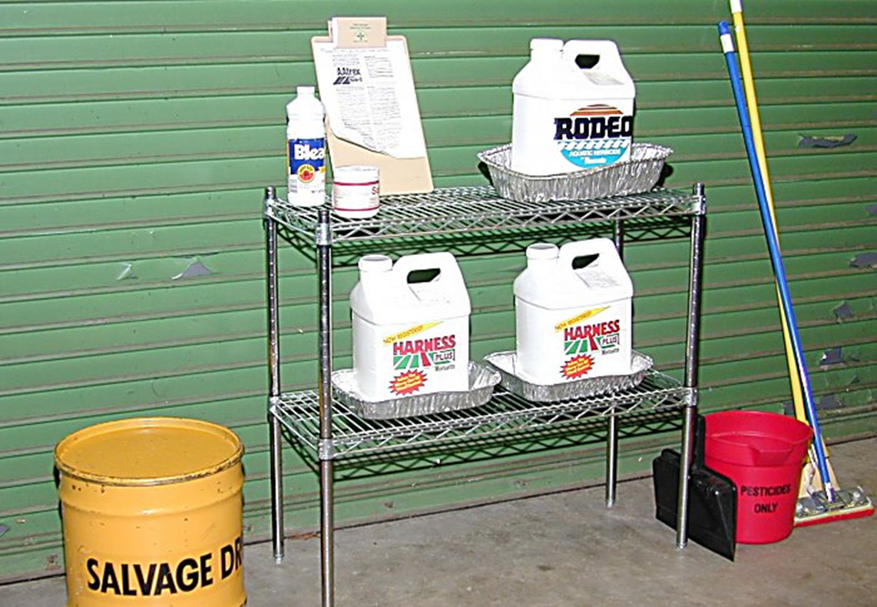
6-300
Show & Tell $300
What are 3 good practices in this photo?

Slide 64
6-300A
What are:
Stainless steel shelves
Spill kit
Secondary chemical containment
Sealed concrete floor
Waste drum for broken items?
1 - 100
$300

Slide 65
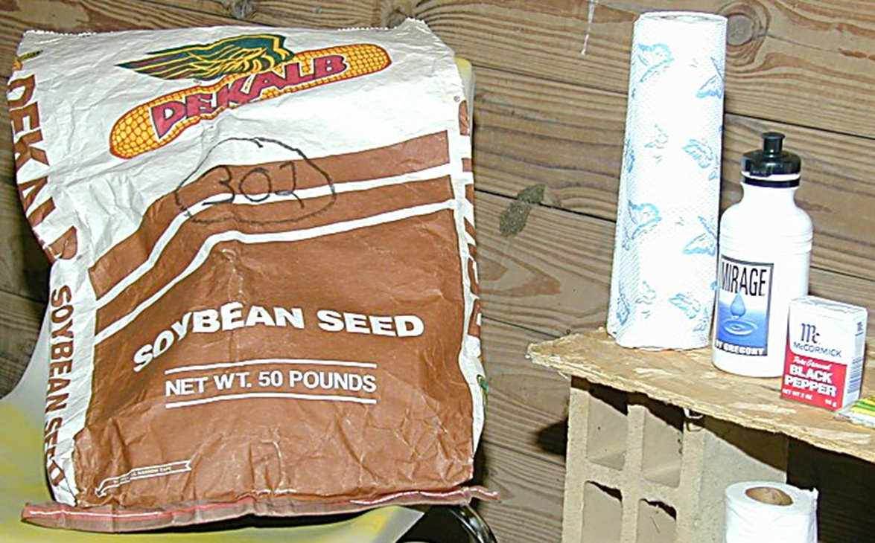
6-400
Show & Tell $400
What are two problems with this photo?

Slide 66
6-400A
What are:
Do not store pesticides with seed or feed
Keep pesticides in original containers
Wood absorbs pesticide spills?
1 - 100
$400

Slide 67
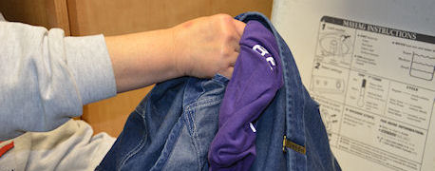
6-500
Show & Tell $500
What are 3 things that should be done with clothes warn when mixing and applying pesticides?

Slide 68
6-500A
What are:
Keep separate from family clothes
Wash a couple garments with plenty of hot water
Launder daily between uses
Rewash 2-3x, if needed
Line dry, if possible?
1 - 100
$500

