Slide 1
How can we use Precision Application for Herbicides and Fertilizer Setbacks?
ANR Educator County

Slide 2
Atrazine Setbacks

Slide 3
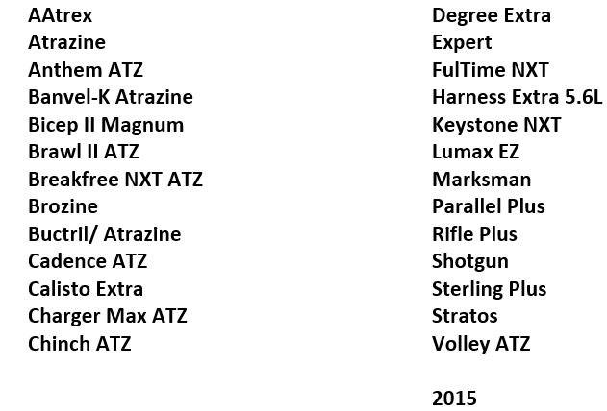
Some Products that contain Atrazine
Notes:
Atrazine is a restricted-use pesticide. Any product containing atrazine--no matter the amount—will be a restricted-use pesticide

Slide 4
Indiana Totals of Atrazine Used 2021
6,322,000 #
1.152 # / Acre
74% of corn Acres
From NASS survey

Slide 5
U.S. Totals of Atrazine Used 2021
59,180,000 #
1.054 # / Acre
65% of corn Acres
From NASS survey

Slide 6
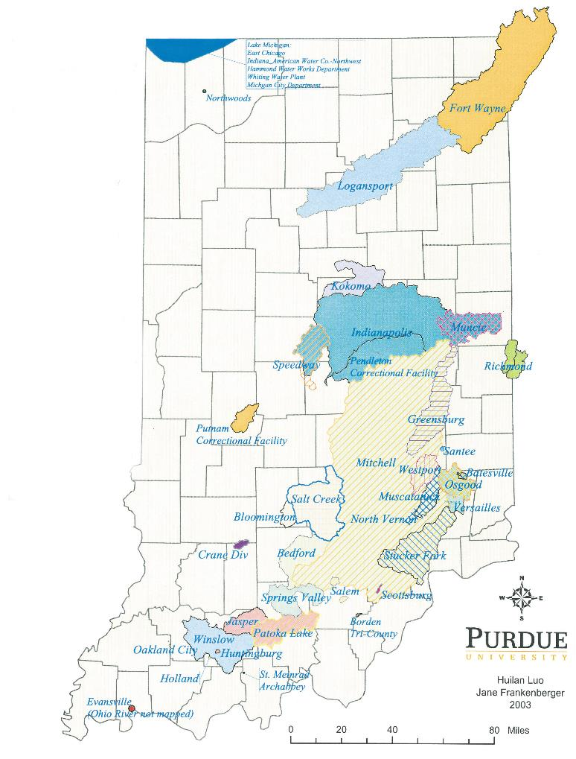
Indiana watersheds in atrazine monitoring program
Indianapolis (Eagle Creek)
Batesville Santee Utilities
Bedford Stucker Fork
Fort Wayne Versailles
Jasper Westport
Logansport Winslow
Notes:
Community water supplies whose source of drinking water comes from surface water supply. These 11 watersheds are in the atrazine monitoring program.

Slide 7
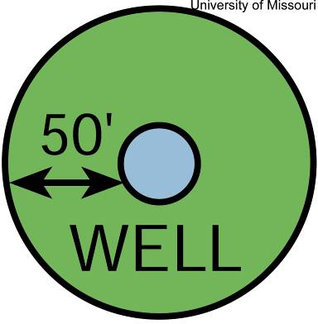
Atrazine Label Setback Requirements – Wells, Sinkholes
You cannot Mix, Load or Use Atrazine within 50 feet of Well heads
(Active or Abandoned),
Sinkholes or Tile Inlets.
Notes:
Can distribute copies of the atrazine label to audience as presenter reviews. Any product containing atrazine will have setback listed.
EPA has perception that farmers are not following setback distances on label.

Slide 8
Atrazine Label Setback Requirements – Standpipe
Do not apply atrazine within 66 feet of any standpipe in a terraced field if the tile outlet is within 66 feet of a point where surface water
runoff from the field
through the outlet
enters a stream or river
unless . . .
Setback zone
Inlet
Outlet
Notes:
Green semicircles is the 66 ft setback distance. Vertical line is standpipe.

Slide 9
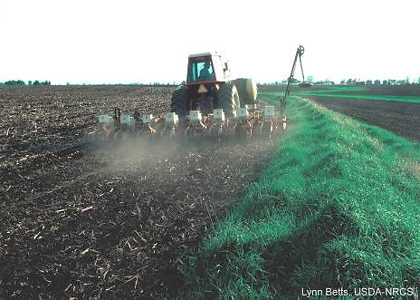
Standpipe setback
  You may apply atrazine to an entire terraced field with tile outlets if
    Immediate incorporation to a
    2-3″depth
    No-till or other
    high residue crop
    management
    practices are used
Notes:
Label indicates 30% residue.

Slide 10
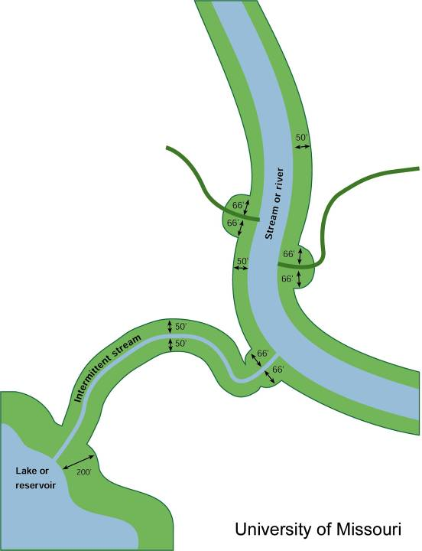
Atrazine Label Setback Requirements – Surface water
Do not mix or load within 50′ of stream or river
Do not apply within 66′ where runoff enters
a stream or river
Do not apply
200′ of lake or reservoir
Notes:
Office of Indiana State Chemist will be monitoring compliance of setback distance more aggressively. Label is Law.
Mix & Load distance less than application, perception that more in control of atrazine while handling it. Less controllable factors come into play (rainfall, etc.) when application made to field.
When setback distances first determined, 66 ft. was boom length. Now have larger (100 ft.) sprayers. Can turn off portions of sprayers to meet setback distances.
Farm ponds are exempt if they meet all of the following requirements
The pond is entirely on the farmers property
It is not used for human drinking water
It does not discharge directly to a stream or river through a clearly traceable, concentrated water course

Slide 11
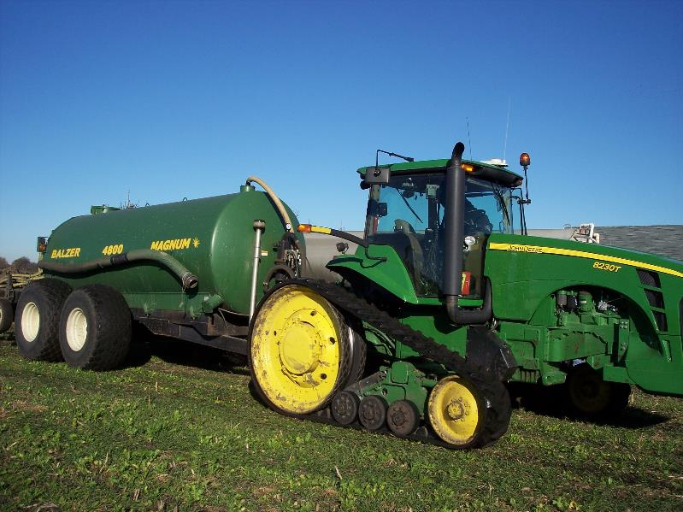
Manure set backs

Slide 13
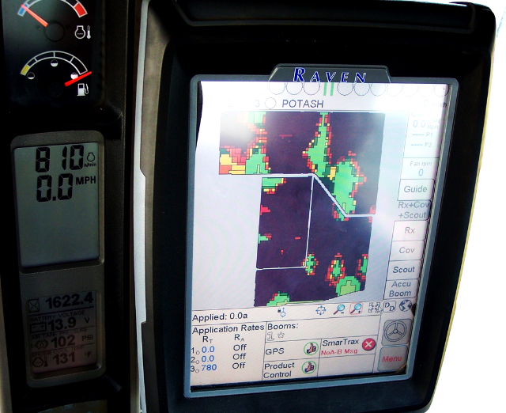
Precision mapping

Slide 14
Lime and fertilizer have been applied by variable rates with assistance of GPS for several years.

Slide 15
Why not use the same technology for setbacks?

Slide 16
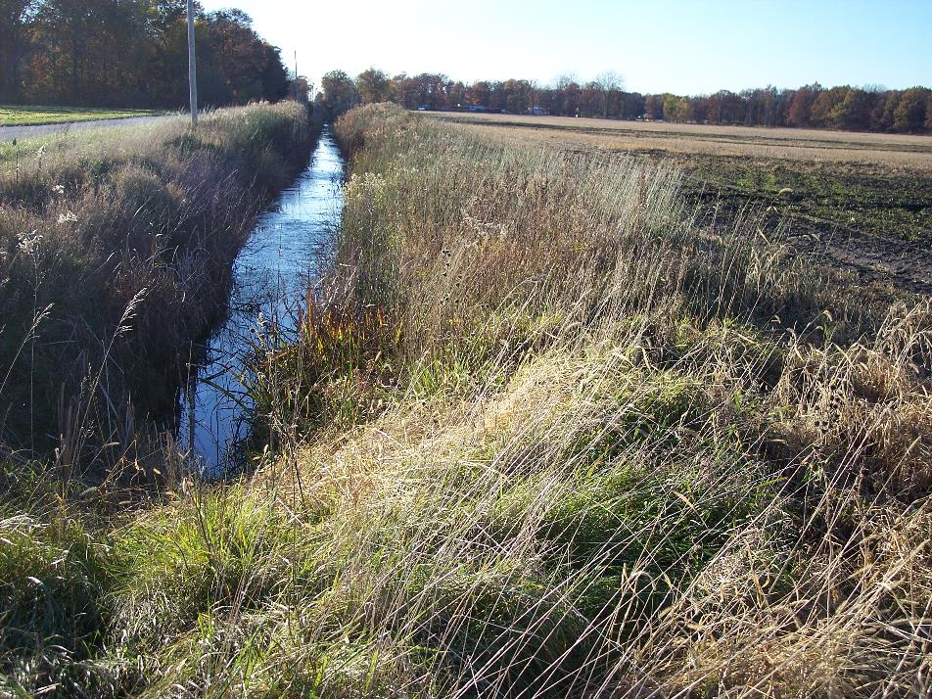
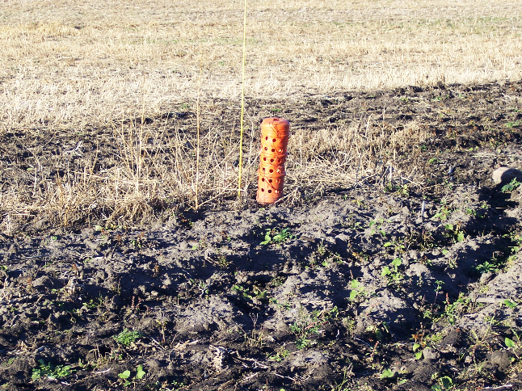
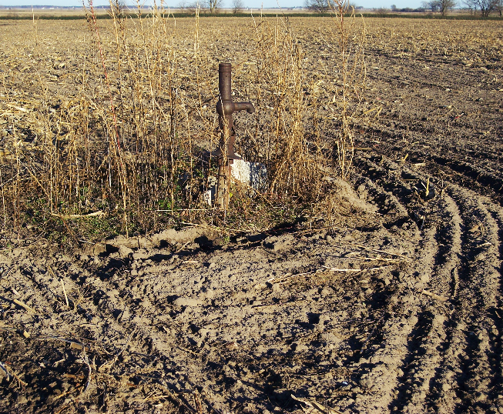
Notes:
Some of the common things we will set backs for are Streams or Ditches, Well heads , and stand pipes.

Slide 17
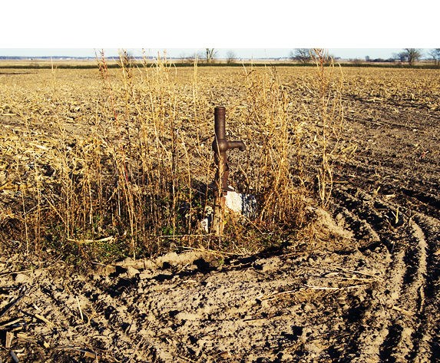
Well Point
Notes:
We still find this still way to often in fields across Indiana where an old well from a homestead long ago was plowed under but the well is still present.
We will also need to look if a house near a field may have their well near the field edge.

Slide 18
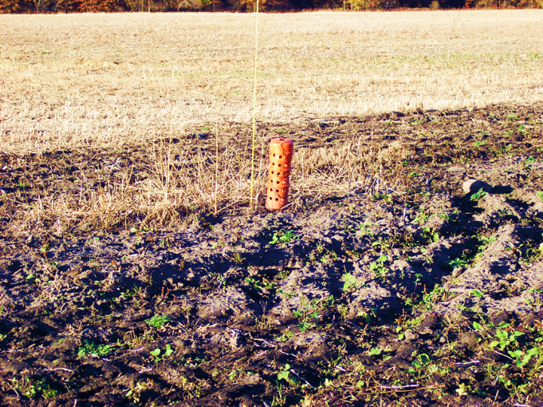
Catch Basin or Stand pipe

Slide 19
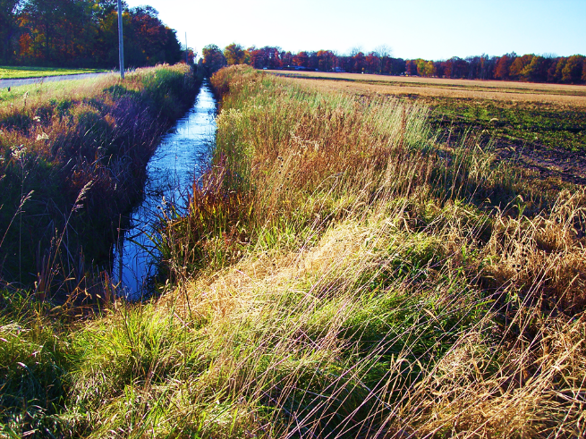
Stream And Ditches
Notes:
Many farmers plant right up the edge of Ditches and streams. The point of where the water may flow into the stream or ditch is where the set back need to be. If the water can flow any where along the stream the set back needs to be all along the stream. If it only has one entry point that is where the set back needs to be.

Slide 20
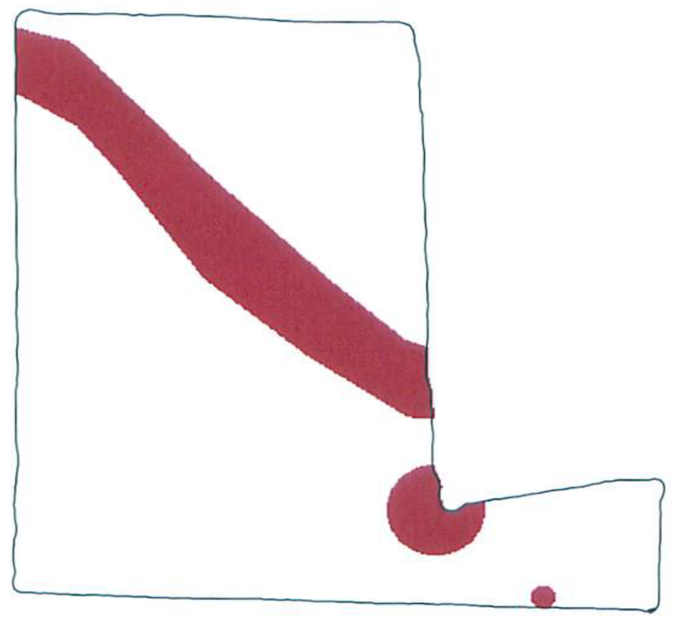
Buffer area
Notes:
Here we have set up the buffer areas where the set backs need to be in this field.

Slide 21
With controllers connected to GPS we can control where the application is allowed.
Green is applied and
Red is shut off.

Slide 22
Application Map
Notes:
The green is where the manure will be applied and the machine will shut off when it is in the red zone.

Slide 23
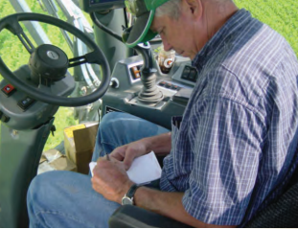
Record Keeping

Slide 24
The maps are also a record of what has been applied and where that can be kept in the farms records.

Slide 25
Private applicator record requirements
Records kept for 2 years.
Recorded within 30 days of application.
No specific form required.
Notes:
Record keeping requirements are straightforward. Records must be kept for two years, but not on any specific form. You can make your own. Past private applicator handbook have examples. Any form can be used as long as all the required information is included. Records must be written within 30 days of the application.
You are responsible for the records of all RUPs applied on your farm, whether you made the application or had it applied commercially. Now in saying that, in Indiana you can have an agreement with the local pesticide dealer that they will keep records of what they apply for you. You will have to keep records of what you apply, such as corn rootworm insecticides. If the State Chemist would need to access your records they would go to the retailer where you do business. However it’s done it’s you, the private applicator’s, responsibility to see that the required records for RUPs are kept.
At your pesticide retailer you can expect to show your private applicator permit, and they likely will make a copy of it.
They may ask for the names of people who can pick up pesticides for you. You might have to sign a form stating the information is correct, etc. Pesticide dealers are under the same regulations for selling and applying Restricted-Use Pesticides. If the pesticide dealer sells to a non-certified person they will be fined as well as the non-certified applicator. EACH PURCHASE will be fined.
If the worst case happens and you become involved in a lawsuit, it may take longer than two years. So you may want to keep pesticide records longer as you do financial records.

Slide 26
RUP required information
Location
Applicator name and permit number
Date of application
Crop
Pest
Acres treated
Rate
Total amount used
Brand name and formulation
Manufacturer
EPA registration number
Fertilizer & Manure required information
Location
Applicator+ Cert. no.
Date
Fertilizer Type
Nutrient value
Rate/acre
Application Method
Notes:
11 required items for RUP record. You can designate the RUP records from other pesticide records with a *, asterisk; or ‘RUP’, etc. It’s to your benefit to record all pesticide applications you make.
Most make sense, like where applied and when, the rate, number of acres.
What’s not so obvious is why you need brand name, EPA registration number, manufacturer name. Reason is that there can be a variety of products under the same name, such as Atrazine. Pesticides are regulated based on the label, and the EPA number is what makes the label. How pesticide records are reviewed is by what the label states.
The location is anything that identifies that location to you. It can be the Muck Field, the Back 40, Grandpa’s Place, or the USDA identification. Whatever identifies that field to you.
If a non-certified person applies pesticides under your supervision, your name and permit number are recorded. The private applicator is accountable for that application. And if you allow someone else to use your name and permit number to make a RUP application, it’s your name that is on the line.
Pest can be listed as generally as Weeds, Insects, Disease. Or as specific as European Corn Borer, Canada Thistle, Japanese Beetle. In terms of records, the more specific the better. It will help you manage the pest problems in that field over the long-term.
These are the 11 items of required information for RUP records and you have 30 days following an application to record it. Later will share some ideas to make this easier.

Slide 27


Thank you to Ceres Solutions –
Pleasant Ridge,
View Point,
Nick Held, ANR Educator
Leo Reed, OISC
Cheri Janssen, Purdue Pesticide Programs

