Slide 1

Useful to Usable (U2U):
Corn Split Nitrogen Application Decision Support Tool
Linda S. Prokopy
Associate Professor, FNR
Hans Schmitz
Gibson County Extension
Melissa Widhalm
U2U Project Manager
Insert Date and Event Here

Slide 2
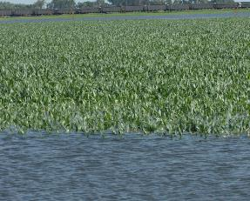
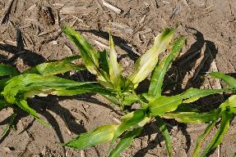
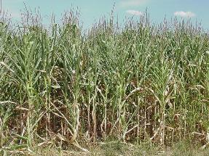
Corn Belt Agriculture and Climate
Successful crop production relies on favorable weather and climate patterns
Limited seasonal climate predictability can increase farm vulnerability
Current tools and models are not widely used, may not be meeting corn farmers’/advisors’ needs

Slide 3
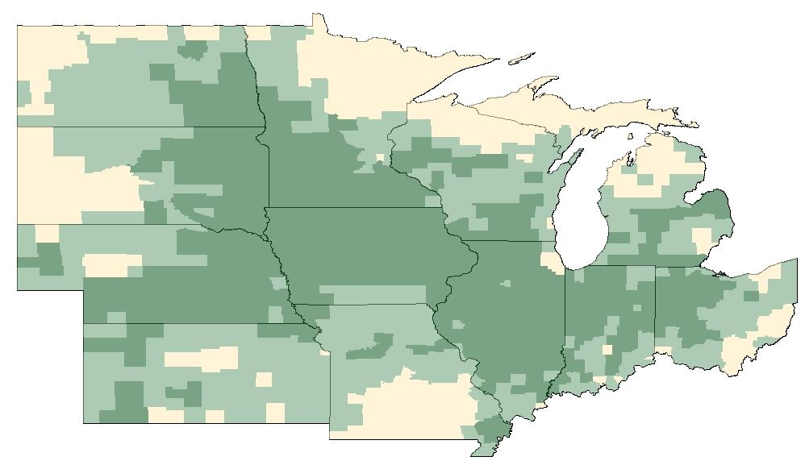

About U2U
Our Vision
Transform existing climate information into usable knowledge for agricultural decision making
Give farmers the resources and training to more effectively manage variable climate conditions
Increase Extension’s capacity to address agro-climate issues
More resilient and profitable farms
in a variable and changing climate

Slide 4











U2U Team
climatologists, crop modelers, agronomists,
IT specialists, economists, sociologists, Extension, and more

Slide 5
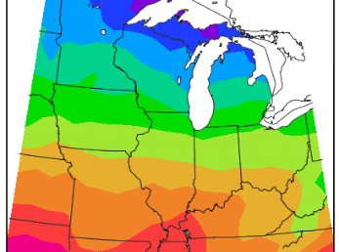
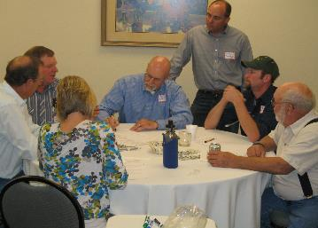
Project Objectives
Decision Support Tools
Models and Data
Stakeholder Input

Slide 6

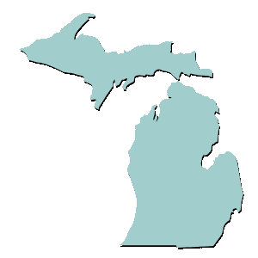
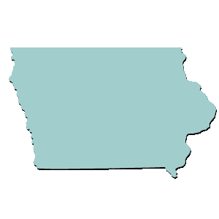

Project Objectives
Decision Support Tools
Models and Data
Stakeholder Input
NE
Pilot test tools, methods, and outreach
MI
IA
IN
Disseminate across 12 state region

Slide 7
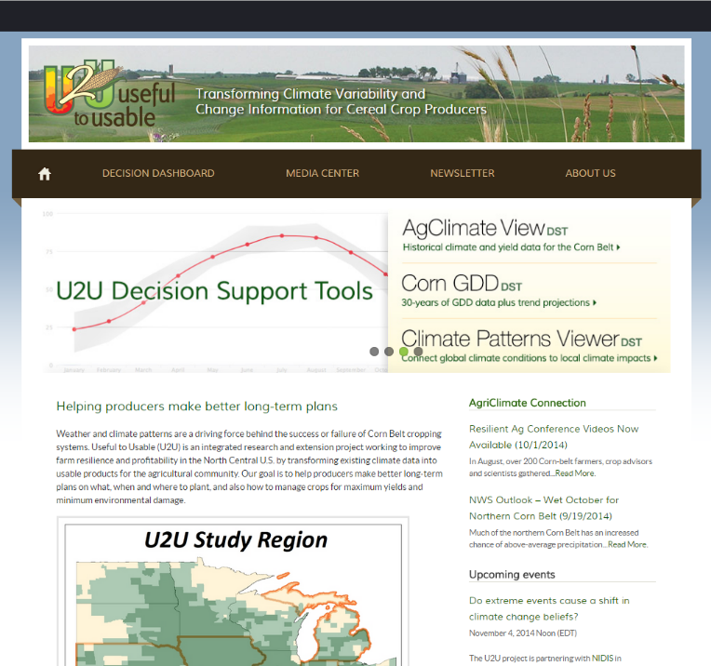
A Look at the Website
Multiple Other Tools Currently Available:
Climate Patterns Viewer
AgClimate View
Corn GDD Decision Support
Probable Field Work Days Decision Support

Slide 8
Corn Split Nitrogen Application Decision Support Tool
Considering possible benefits of side dress applied N?
This tool allows producers to consider:
Time required to side dress
Economic analysis of the savings with timely N application
Potential risk associated with weather preventing N side dress
Notes:
This product is designed to help farmers and farm advisors understand the risks and benefits of using post-planting nitrogen (N) application for corn production. The Corn Split N tool combines historical weather and fieldwork data with economic considerations to determine the feasibility and profitability of completing a second (split) N application within a user-specified time period. This tool may help you with decisions that:
Increase corn yields
Reduce nitrogen costs
Reduce nitrogen losses to the environment
Affect the likelihood of completing in season fieldwork
With the Corn Split N tool you can quantify the costs and benefits of post-planting nitrogen applications for your farming operation to help your bottom line and the environment.

Slide 9
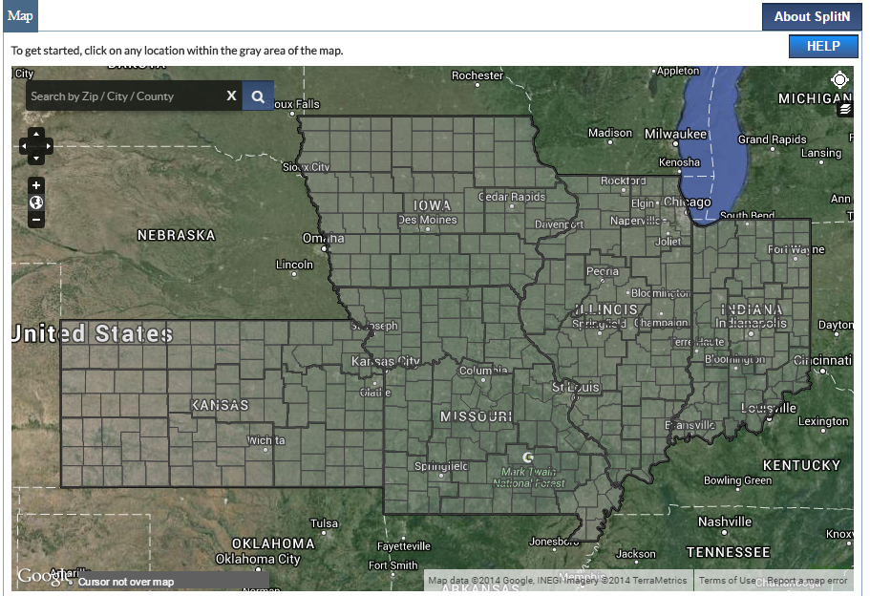
Corn Split Nitrogen Application Decision Support Tool
County and crop reporting district specific information.
Incorporates Fieldwork Days as reported from 1981 to the last reporting year.

Slide 10
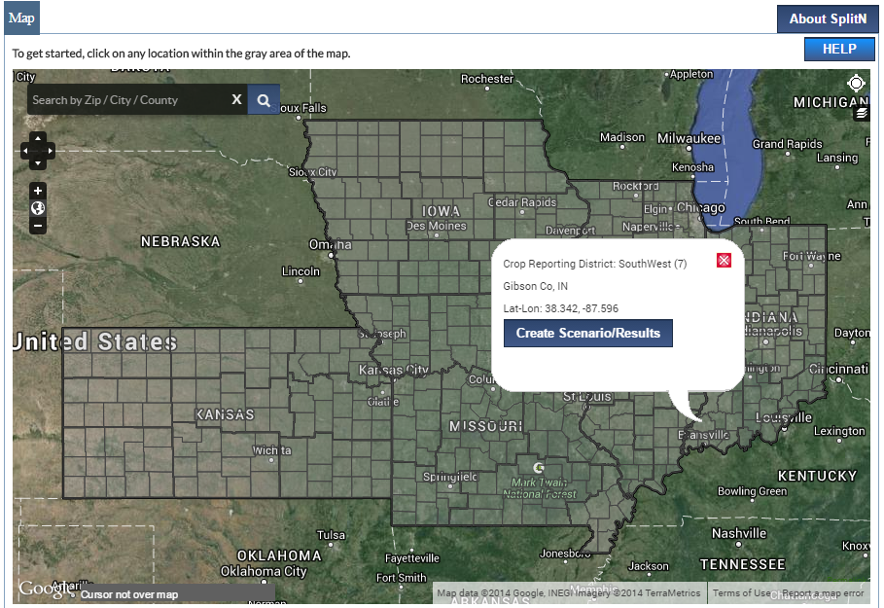
Corn Split Nitrogen Application Decision Support Tool
Notes:
Click on your county in the map and a box will pop up allowing you to input additional information.

Slide 11
Input Customization

Slide 12
Set Planting Date and Plant Growth Stage by Which to Apply

Slide 13
Set Risks and Rewards
Defaults exist based on Iowa State Research.

Slide 14
Pricing Information
The user definitely needs to define these costs. These defaults will be unrealistic in most cases.

Slide 15
Set the Working Window
Note that the tool will alert you when logical errors occur.

Slide 16
Input Application Equipment and Acres to Cover

Slide 17
Set Work Dates and Time
Tool allows one to schedule days off and normal working hours.

Slide 18
Confirming the Time Available
Using the Field Work Day history, tool assesses whether applicator has the number of hours needed to coverage defined acreage.

Slide 19
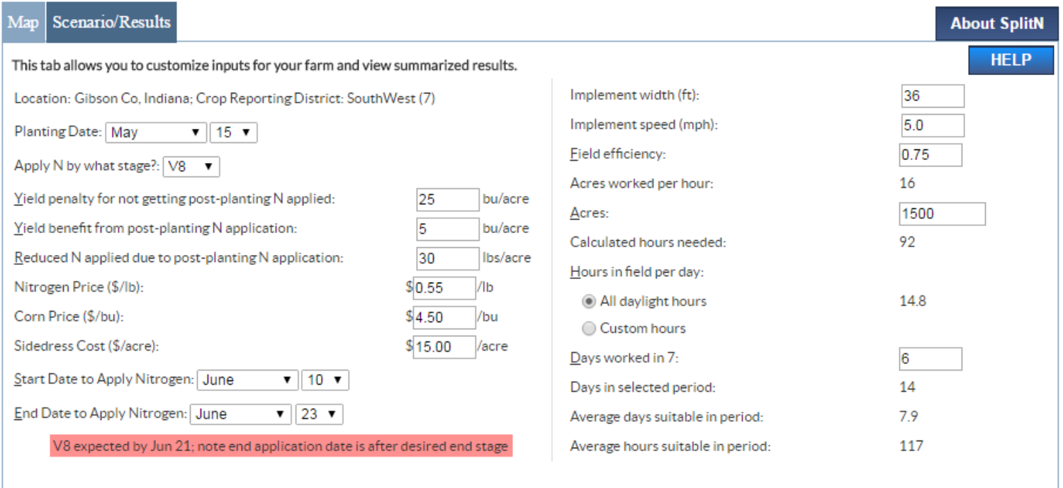
Inputs Complete

Slide 20
Economic Data

Slide 21
Economic Data
Notes:
In this scenario, all acres were able to be side dressed.

Slide 22
Economic Data
Notes:
These variables were directly input above.

Slide 23
Economic Data
Notes:
In this scenario, the net benefit or reducing total N application rate and yield benefit associated with timely application offsets the cost of application.

Slide 24
Average Savings

Slide 25
Murphy’s Law
This corresponds to the least productive year on record in Field Work Days history from 1981-on.

Slide 26
Additional Information

Slide 27
Additional Graphical Information

Slide 28
Tabular Data

Slide 29
Graphical Data

Slide 30
Savable Options

Slide 31
Growing Degree Day Check
Notes:
Dates are based on previously input planting date.

Slide 32
Questions?
This tool and others available at:
Agclimate4u.org

