Slide 1
The endangered Species Act: Navigating the New Pesticide Labels
Purdue University is an Equal Access / Equal Opportunity institution.

Slide 2

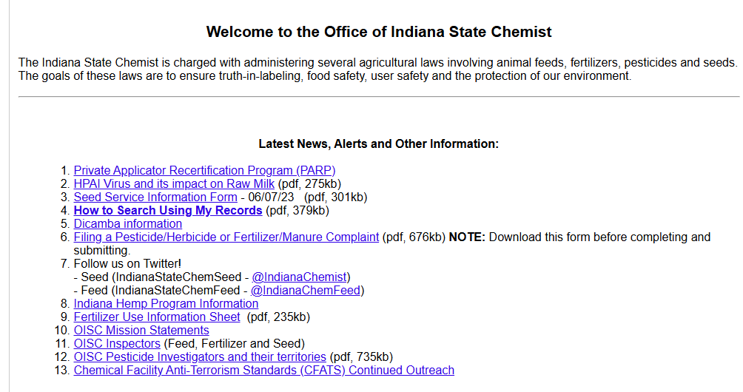
Office of the Indiana State Chemist
Mitch Trimble
jmtrimbl@purdue.edu
Nate Davis Manager of Certification and Licensing davi1280@purdue.edu
765-494-7108
Located at Purdue University
175 S University St.
W. Lafayette, IN 47907
www.oisc.purdue.edu
765-494-1492
Notes:
https://myplate-prod.azureedge.us/sites/default/files/2024-04/MyPlatePoster-White20x16.pdf
https://extension.purdue.edu/news/county/elkhart/2023/03/how-to-build-a-balanced-breakfast.html

Slide 3
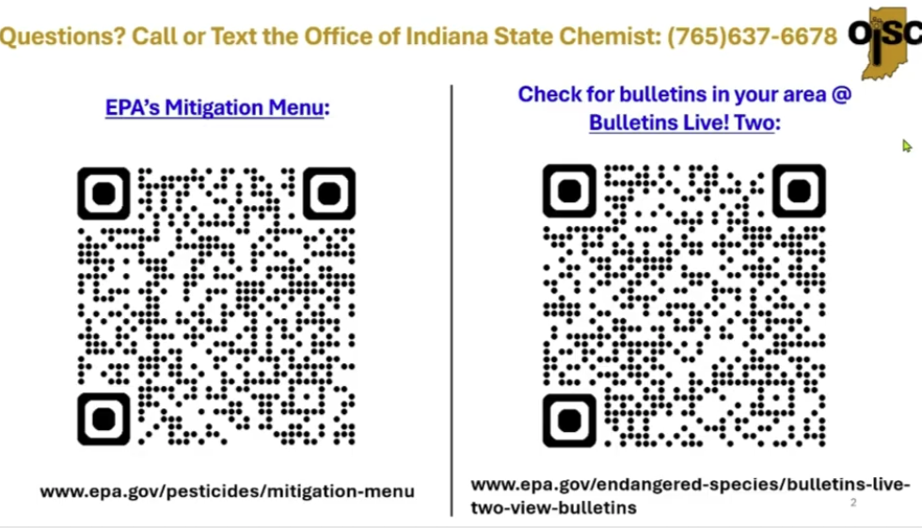
Questions? Can also call or text here!

Slide 4
Labels will be transitioning
Updates will continue as pesticides are added and updated.
Process for pesticide approval has changed so the new labels reflect these changes.
Labels have the new ESA (Endangered Species Act) required elements.
Two specific changes
Physical changes within the label
New web-based requirements outside of the physical label that will need to be addressed.
Notes:
https://myplate-prod.azureedge.us/sites/default/files/2024-04/MyPlatePoster-White20x16.pdf
https://extension.purdue.edu/news/county/elkhart/2023/03/how-to-build-a-balanced-breakfast.html

Slide 5
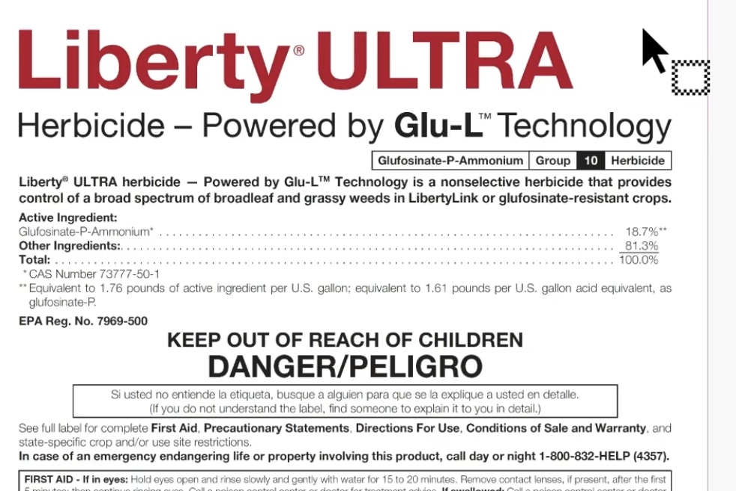
Label Example- Looking into the new changes
All new products will have the new label.
As products are reregistered, the label will be updated.
The products you already have may not have the newest label.

Slide 6
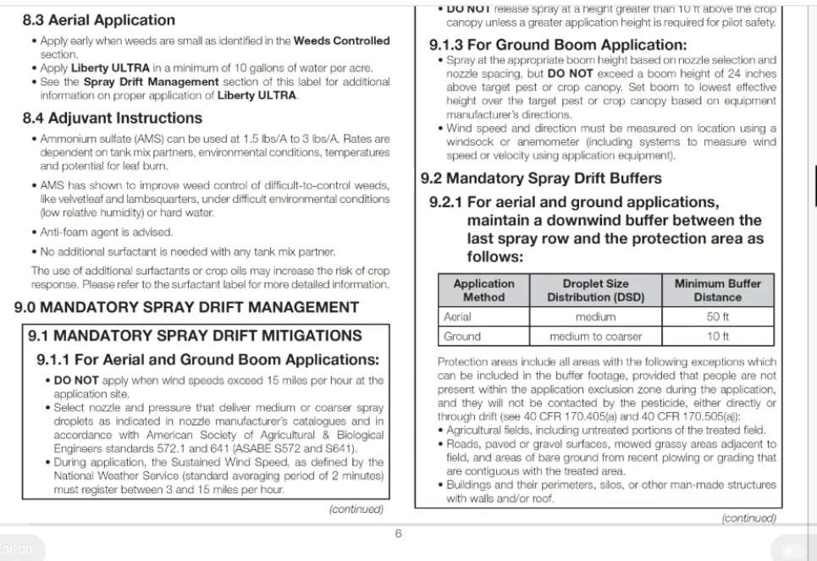
Label Example- Mandatory Spray Drift Buffers
Mandatory Spray Drift Buffers
Section 9
Not a new section to the label, but it has changed.
Biggest change:
Downwind buffer will be on every label.
Have the option to mitigate (reduce) the buffer.

Slide 7
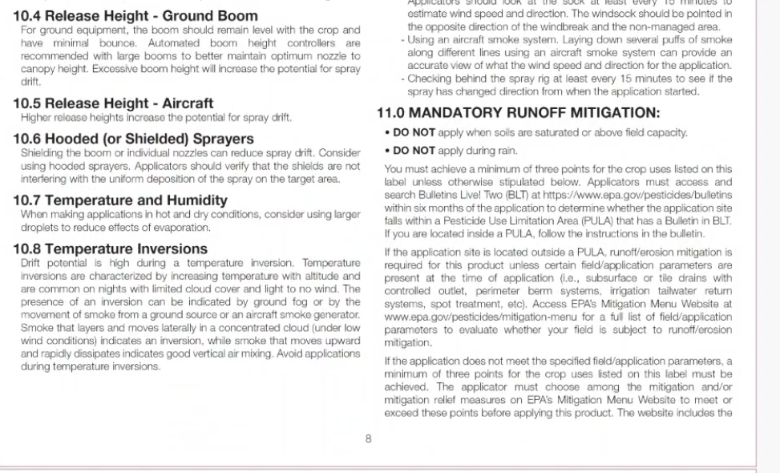
Label Example- Mandatory Runoff Mitigation
Mandatory Runoff Mitigation
Section 11
Not a new section to the label, but it has changed.

Slide 8
Label Example- Mandatory Runoff Mitigation Cont.
Biggest change:
“You must achieve a minimum _____ points for crop listed on this label unless otherwise stipulated below.”
Each pesticide will have a value of 0-9 points
Generally easy to achieve
3 points most common
Must check PULA (Pesticide Use Limitation Area) within 6 months of application
Check if target field is in a PULA. It could make stricter regulations on your specific pesticide.
If your target area and application pesticide fall within a PULA, you will need to read the Bulletin in the BLT (Bulletins Live! Two) website. More information on how to do that!
https://www.epa.gov/pesicides/bulletins
EPA mitigation Menu Website: https://www.epa.gov/pesticides/mitigation-menu

Slide 9
Label Example- Mandatory Runoff Mitigation Cont.
This web based content is an extension of the label and YOU MUST FOLLOW THEM. This will be the new format of the label.

Slide 10
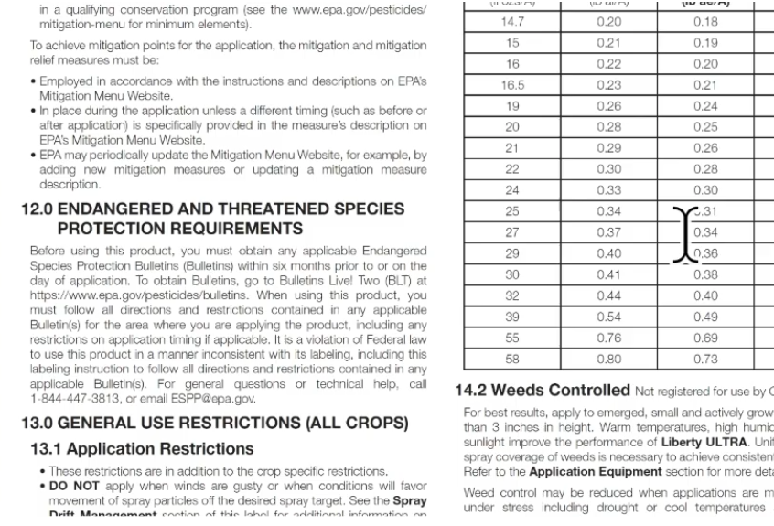
Label Example- Endangered and Threatened Species Protection Requirements
Endangered and Threatened Species Protection Requirements
Section 12
“You must obtain any applicable Endangered Species Protection Bulletins (Bulletins) within 6 months prior to or on the day of application.”
https://www.epa.gov/pesticides/bulletins
Can call and leave a voicemail. They will call you back.
1-844-477-3813
Or Email ESPP@epa.gov

Slide 11
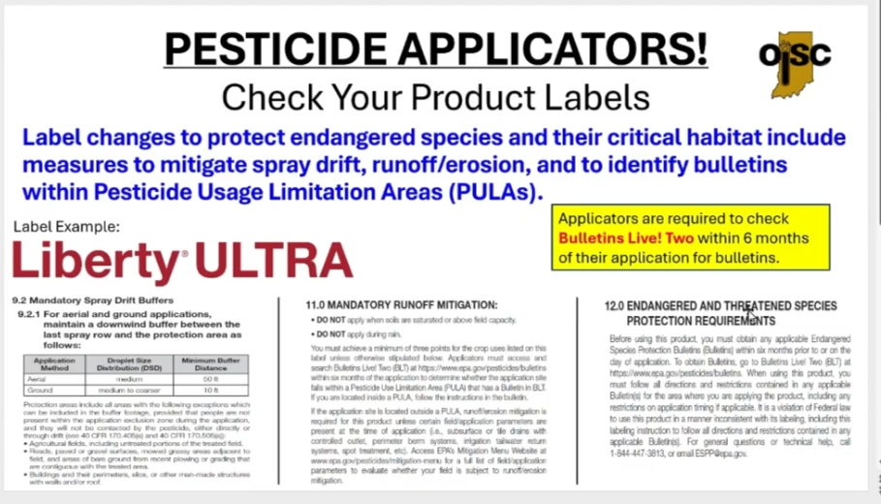
Summary of New Label Section Requirements to Look For

Slide 12
PULAs and Bulletins

Slide 13
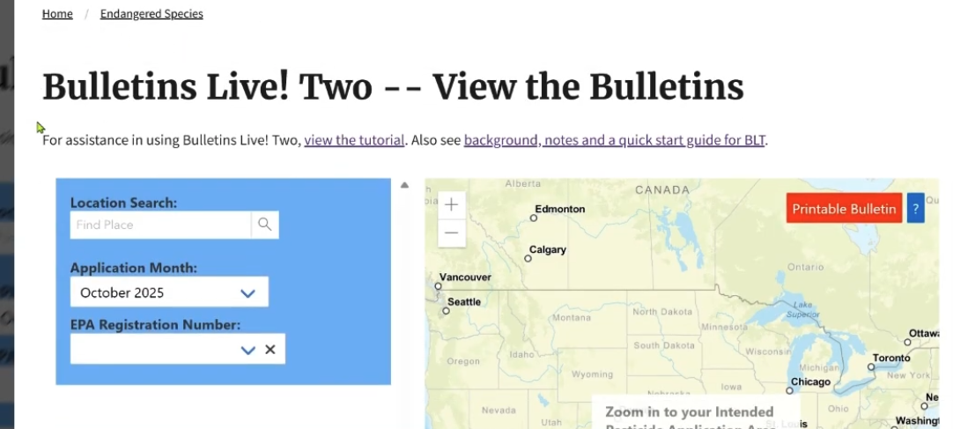
Bulletin Live! Two Website
Endangered and Threatened Species Protection Requirements
“You must obtain any applicable Endangered Species Protection Bulletins (Bulletins) within 6 months prior to or on the day of application.”
Let’s check to see if we need to add any point (have stricter requirements) to use this pesticide(s).
Add your location address
Add application month
Add the EPA Registration number of the pesticide from the label.
Website does have tutorial to help!
Map can zoom in and out. And can change to 3D map to see field boundaries.
https://www.epa.gov/pesticides/bulletins

Slide 14
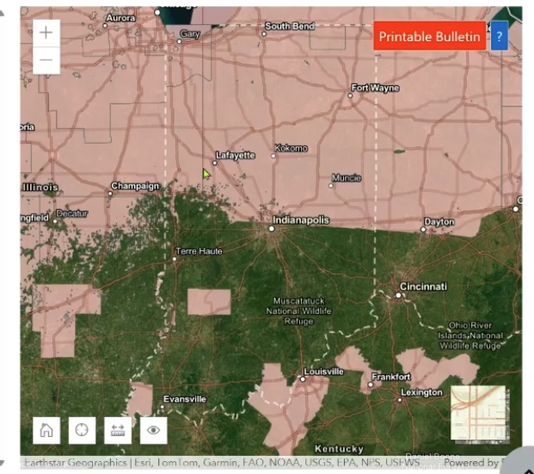
Bulletin Live! Two Website
Endangered and Threatened Species Protection Requirements
You are searching for the areas in PINK. Those are the PULAs (Pesticide Use Limitation Areas).
PULAs are areas that have additions restrictions on the pesticide(s) that are being looked up.
Area will change as different pesticides are searched.
https://www.epa.gov/pesticides/bulletins

Slide 15
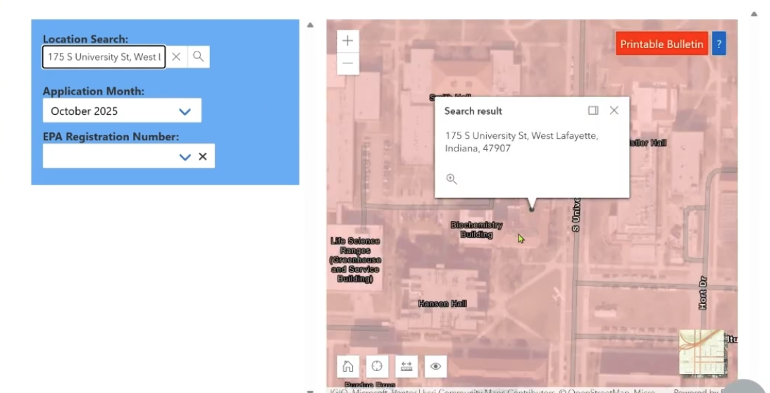
Bulletin Live! Two Website
Endangered and Threatened Species Protection Requirements
Add target Field or location
https://www.epa.gov/pesticides/bulletins

Slide 16
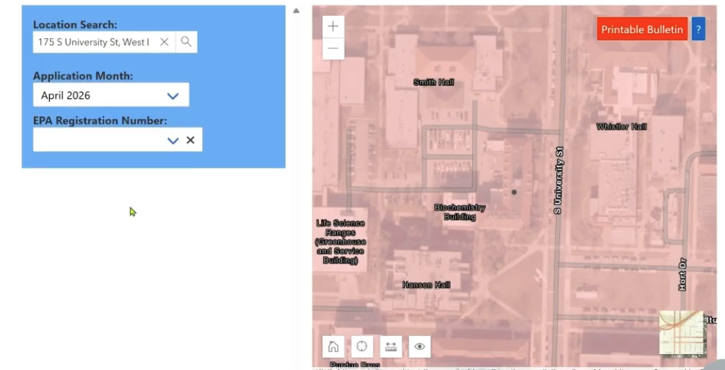
Bulletin Live! Two Website
Endangered and Threatened Species Protection Requirements
Change Application Month
Per the label, you can look up within 6 months of application.
You will have to do this for every target field.
Can do this on rainy days or off season.
Just selects MONTH, not the day.
https://www.epa.gov/pesticides/bulletins

Slide 17
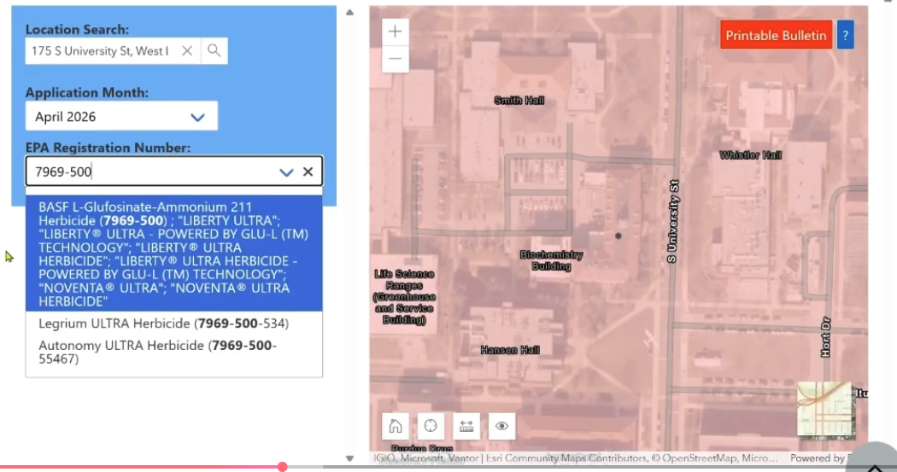
Bulletin Live! Two Website
Endangered and Threatened Species Protection Requirements
Add EPA Registration Number
MUST search by Reg Number, not name.
Found on first page of product information.
https://www.epa.gov/pesticides/bulletins

Slide 18
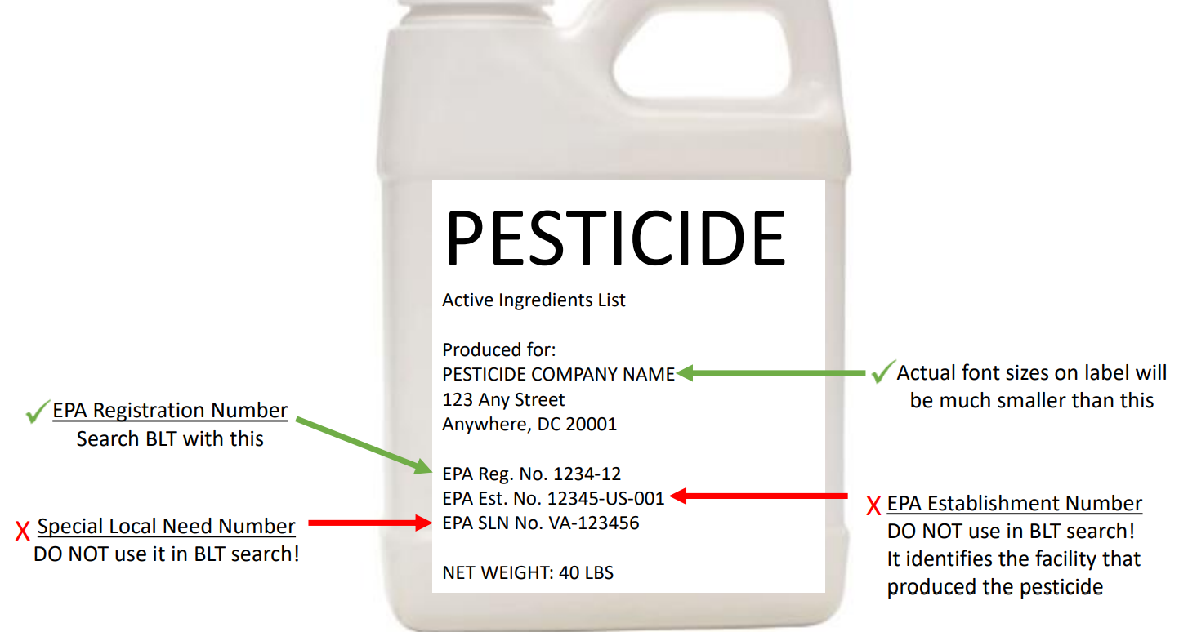
Bulletin Live! Two Website
Endangered and Threatened Species Protection Requirements
Add EPA Registration Number
MUST search by Reg Number, not name.
Found on first page of product information.
https://www.epa.gov/pesticides/bulletins

Slide 19
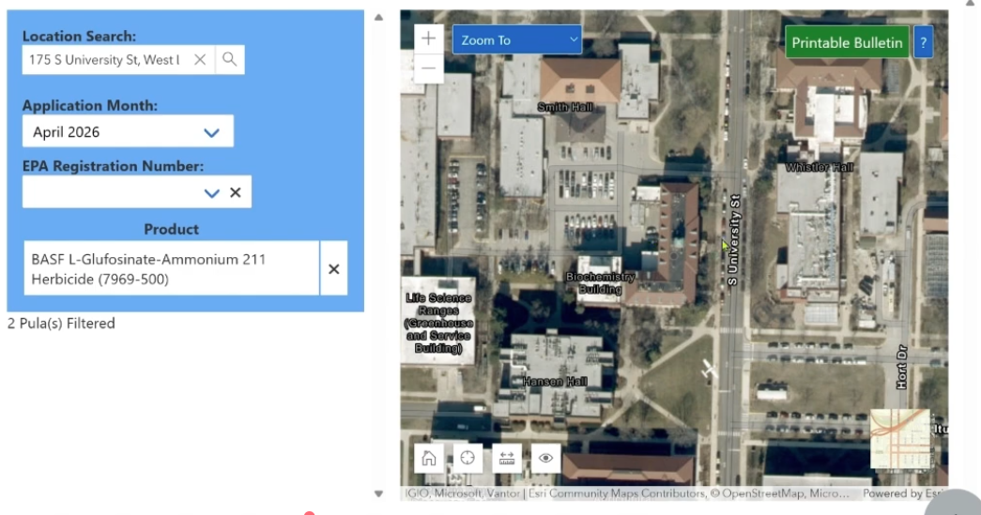
Bulletin Live! Two Website
Endangered and Threatened Species Protection Requirements
Once all information is in. You will see if there is a PULA for your selected pesticide.
For this example, there is NO PINK, so there is no PULA → NO additional restrictions on this product in this target area.
This is web based, as you move the map it will update for additional Bulletins.
If “Printable Bulletin” is green you have loaded all appropriate bulletins for this target area.
https://www.epa.gov/pesticides/bulletins

Slide 20
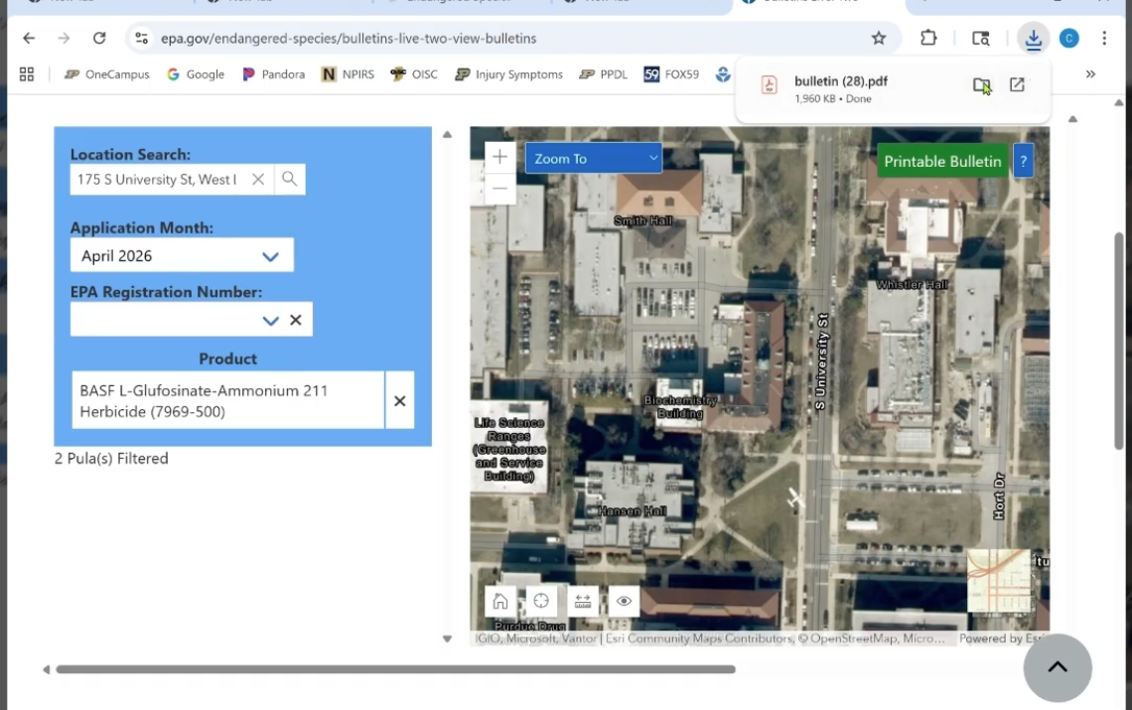
Bulletin Live! Two Website
Endangered and Threatened Species Protection Requirements
Click “Printable Bulletin” to download the Bulletin for this target area and pesticide.
STRONGLY RECOMMENDED TO SAVE THESE OR PRINT THEM FOR YOUR RECORDS AS PROOF THAT THESE WERE CHECKED.
https://www.epa.gov/pesticides/bulletins

Slide 21
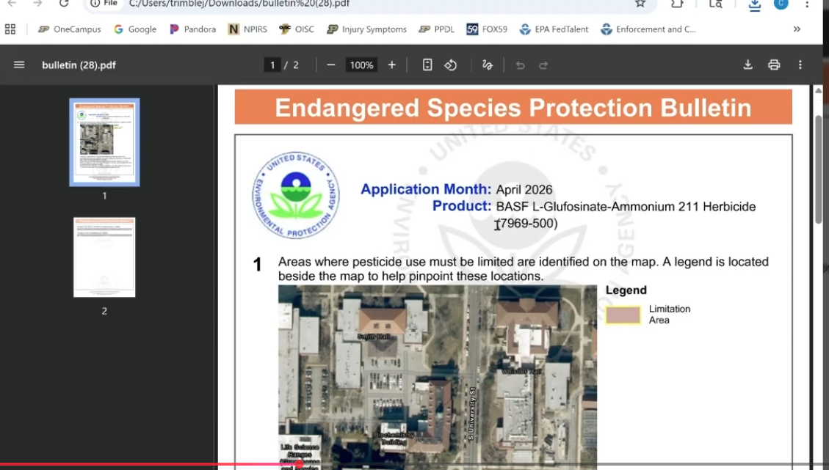
Bulletin Live! Two Website- Bulletins
Endangered and Threatened Species Protection Requirements
Example of a “Bulletin”
Shows map of target area
Shows any Limitation Areas
NO CURRENT REQUIREMENT FOR RECORD KEEPING.
Not required however, maps can change at any time! Changes are made as products are registered, reregistered, or as endangered species are updated.

Slide 22
Bulletin Live! Two Website- Tank Mixes
Endangered and Threatened Species Protection Requirements
ALSO can use multiple products under one search.
Example: a tank mix with multiple products
Will be in this example
In tank mix, you will have to follow the MOST STRICT guidelines listed on the labels.
Highest downwind buffer requirements
Highest point system
Most strict BLT
Example of a “Bulletin” WITH PULA using the same product as a tank mix.

Slide 23
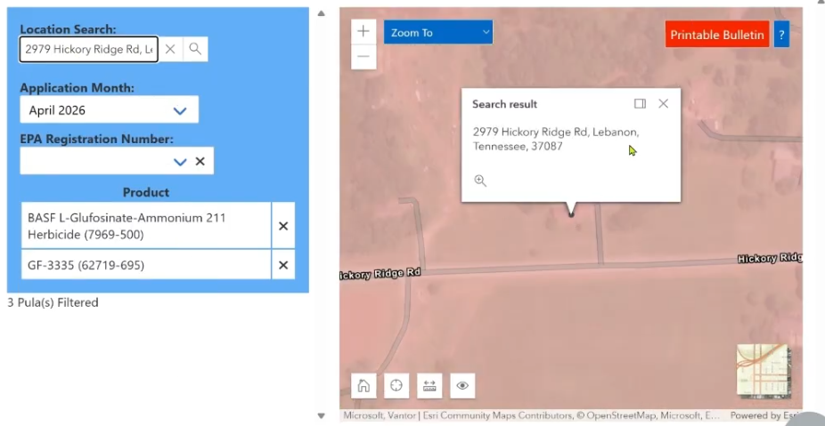

Bulletin Live! Two Website- PULA with a Bulletin as a Tank Mix
Endangered and Threatened Species Protection Requirements
Example of a “Bulletin” with a PULA
Shows map of target area that has a PULA associated with these pesticides.
This example has more than one pesticide listed under the search.

Slide 24
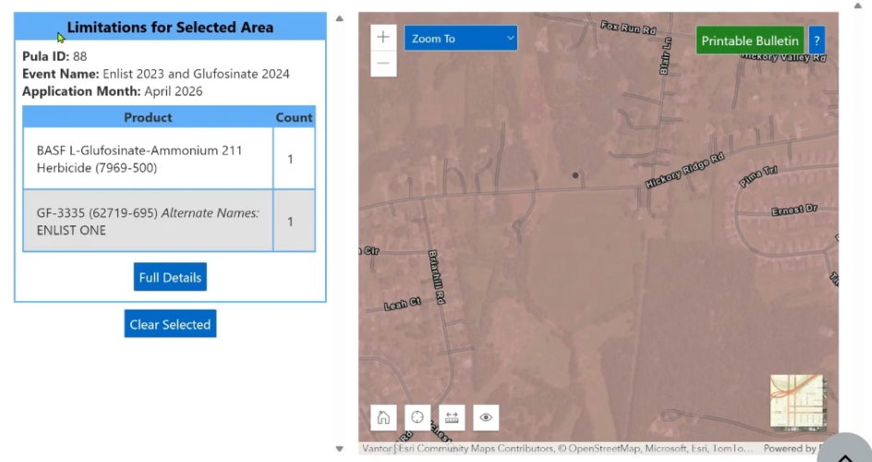
Bulletin Live! Two Website- PULA with a Bulletin as a Tank Mix
Endangered and Threatened Species Protection Requirements
Example of a “Bulletin” with a PULA
Click on target field.
Printable Bulletin should be Green.
Blue and White box on the left should change and show “Limitations for Selected Areas”
Can select “Full Details” to have a quick look at limitations.
Download the Bulletin for full details and limitations.

Slide 25
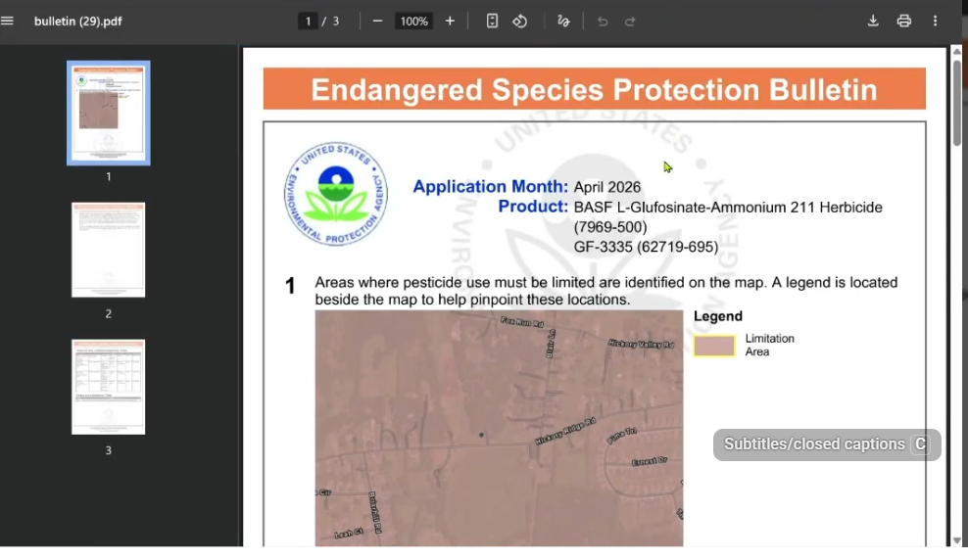
Bulletin Live! Two Website- PULA with a Bulletin as a Tank Mix

Slide 26
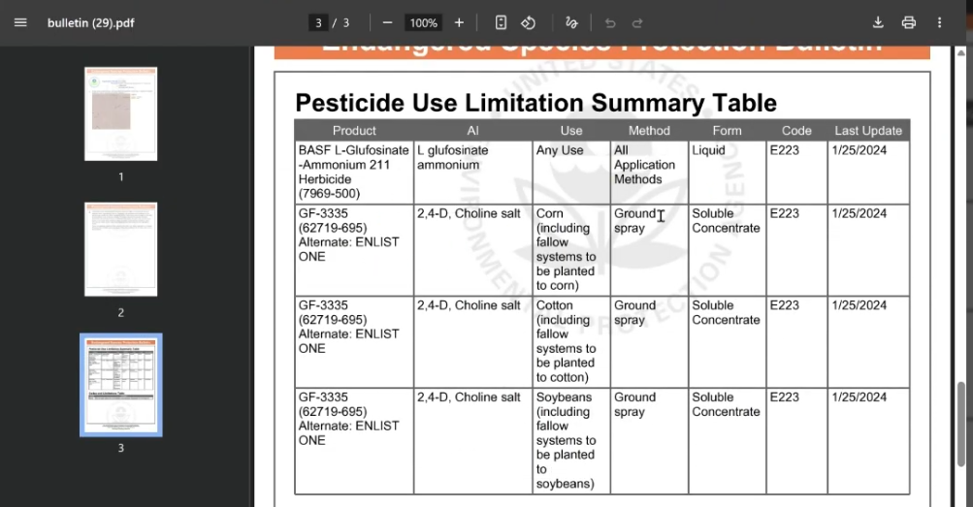

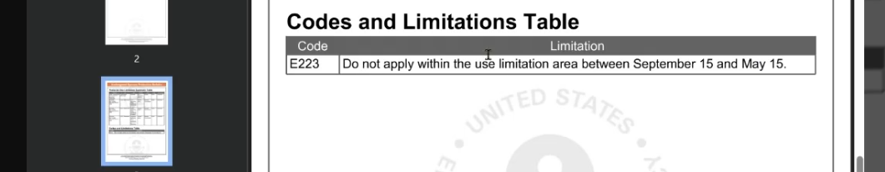
Bulletin Live! Two Website- PULA with a Bulletin as a Tank Mix
Endangered and Threatened Species Protection Requirements
Example of a “Bulletin” with a PULA
Will provide additional information for Pesticide Use Limitations.
Pesticide Use Summary Table
Codes and Limitations Table
Will show the actual limitations for using this product(s).
Not required to save this but it is strongly suggested.

Slide 27
Bulletin Live! Two Website- After checking for PULA
If your search shows no additional PULAs.
Follow application directions as the label is listed.
For THIS example (Using Liberty Ultra, in Indiana, with No PULA):
Must reach the 10ft downwind buffer.
Must obtain the 3 mitigations points required.
Next Step
Check Spray Drift Buffer Calculator to see if we can reduce downwind buffer.

Slide 28
Spray Drift Buffer Tools

Slide 29
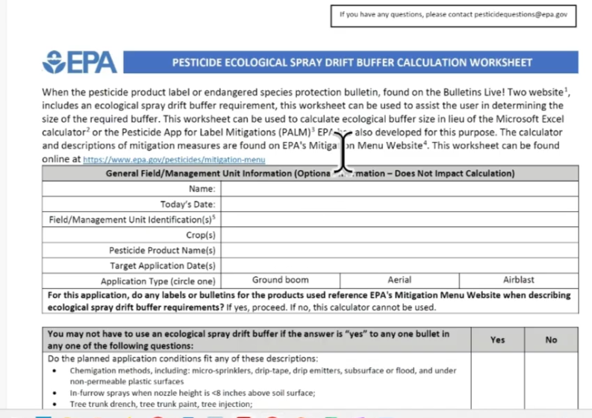
Spray Drift Buffer Calculator Tools
EPA provides THREE ways to do this calculation
Use Pesticide Ecological Spray Drift Buffer Calculation Worksheet
Paper worksheet that can be printed
Calculations are manual. Must be careful not to make any errors.

Slide 30
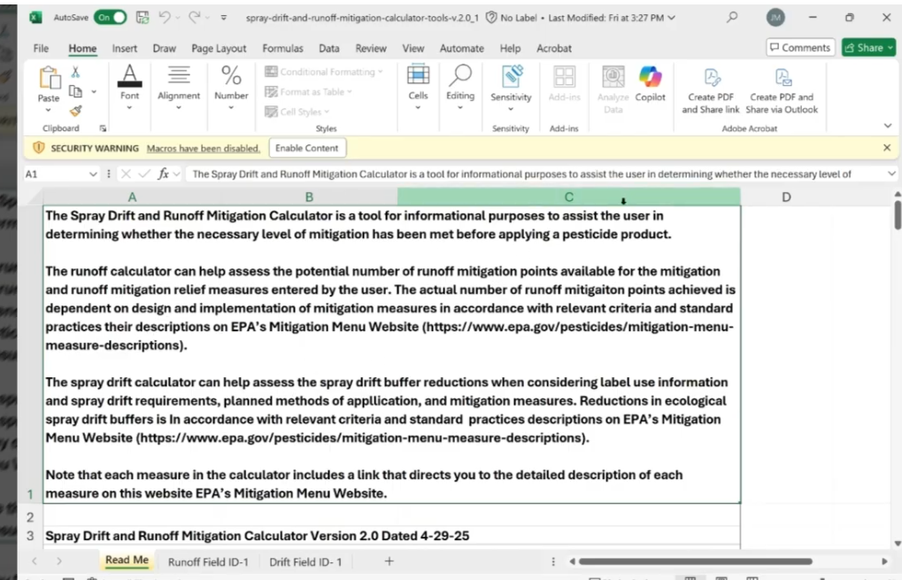

Spray Drift Buffer Calculator Tools
EPA provides THREE ways to do this calculation
Use Pesticide Ecological Spray Drift Buffer and Runoff Calculation Excel Spreadsheet
Microsoft Excel template
Calculations are completed within the template.
Best for those familiar with Excel
Can be more difficult to use.
Same spreadsheet to calculate Runoff/Erosion mitigation points (will show that later on).
Select the Drif Field tab below.

Slide 31
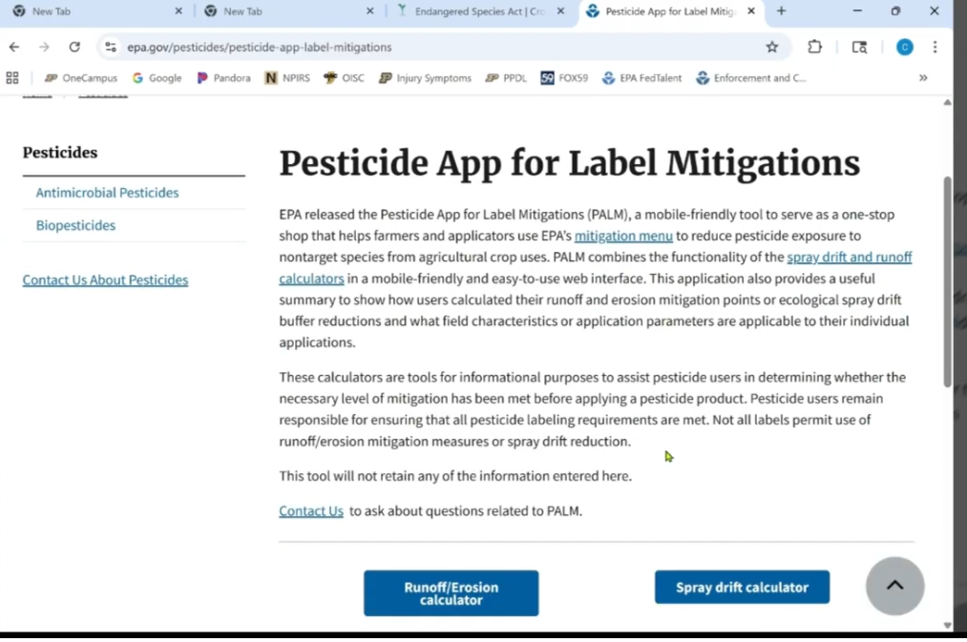

Spray Drift Buffer Calculator Tools
EPA provides THREE ways to do this calculation
Use EPA PALM
PALM- “Pesticide App for Label Mitigation”
Web based, not a phone “app” but can be used on your phone using the web browser.
Easiest to use.
www.epa.gov/pesticides/pesticide-app-label-mitigations
Will use this website for Spray Drift Calculator AND Run off Erosion Calculator.
Select “Spray Drift Calculator” to get started.

Slide 32
Using EPA PALM Website
Step by Step Guide to calculating, and reducing spray drift buffers

Slide 33
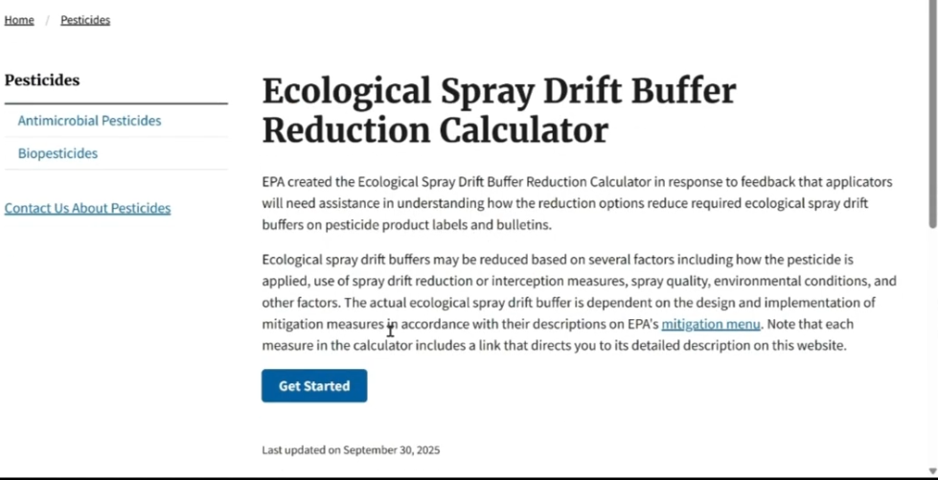
EPA PALM- Calculating “Ecological Spray Drift Buffer Reduction”
We will use the EPA PALM website to calculate the Spray Drift Buffer Reduction for our example.
Will ask questions.
Goes step by step as you answer

Slide 34
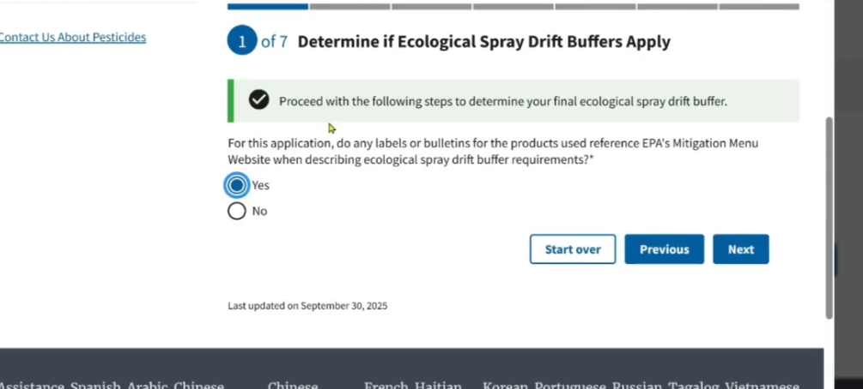
EPA PALM- Calculating “Ecological Spray Drift Buffer Reduction”
We will use the EPA PALM website to calculate the Spray Drift Buffer Reduction for our example.
Question 1:
Did the label or Bulletin you downloaded require you to have a buffer?
Y? N?

Slide 35
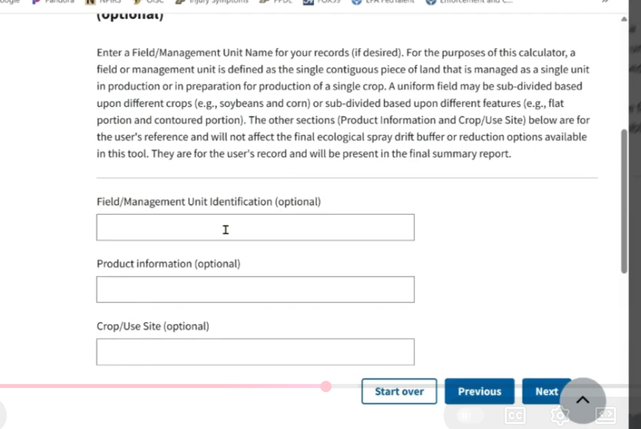
EPA PALM- Calculating “Ecological Spray Drift Buffer Reduction”
We will use the EPA PALM website to calculate the Spray Drift Buffer Reduction for our example.
Next Question
Has option fields but this information will be added to the printout at the end.
Best for record keeping.

Slide 36
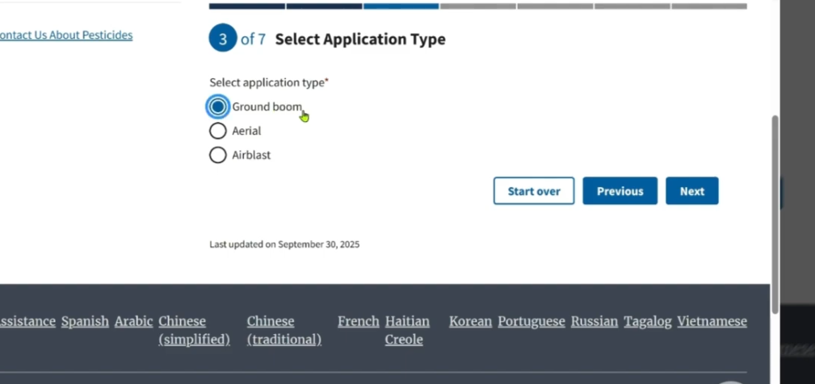
EPA PALM- Calculating “Ecological Spray Drift Buffer Reduction”
We will use the EPA PALM website to calculate the Spray Drift Buffer Reduction for our example.
Next Question
Application Type
This example will use Ground boom

Slide 37
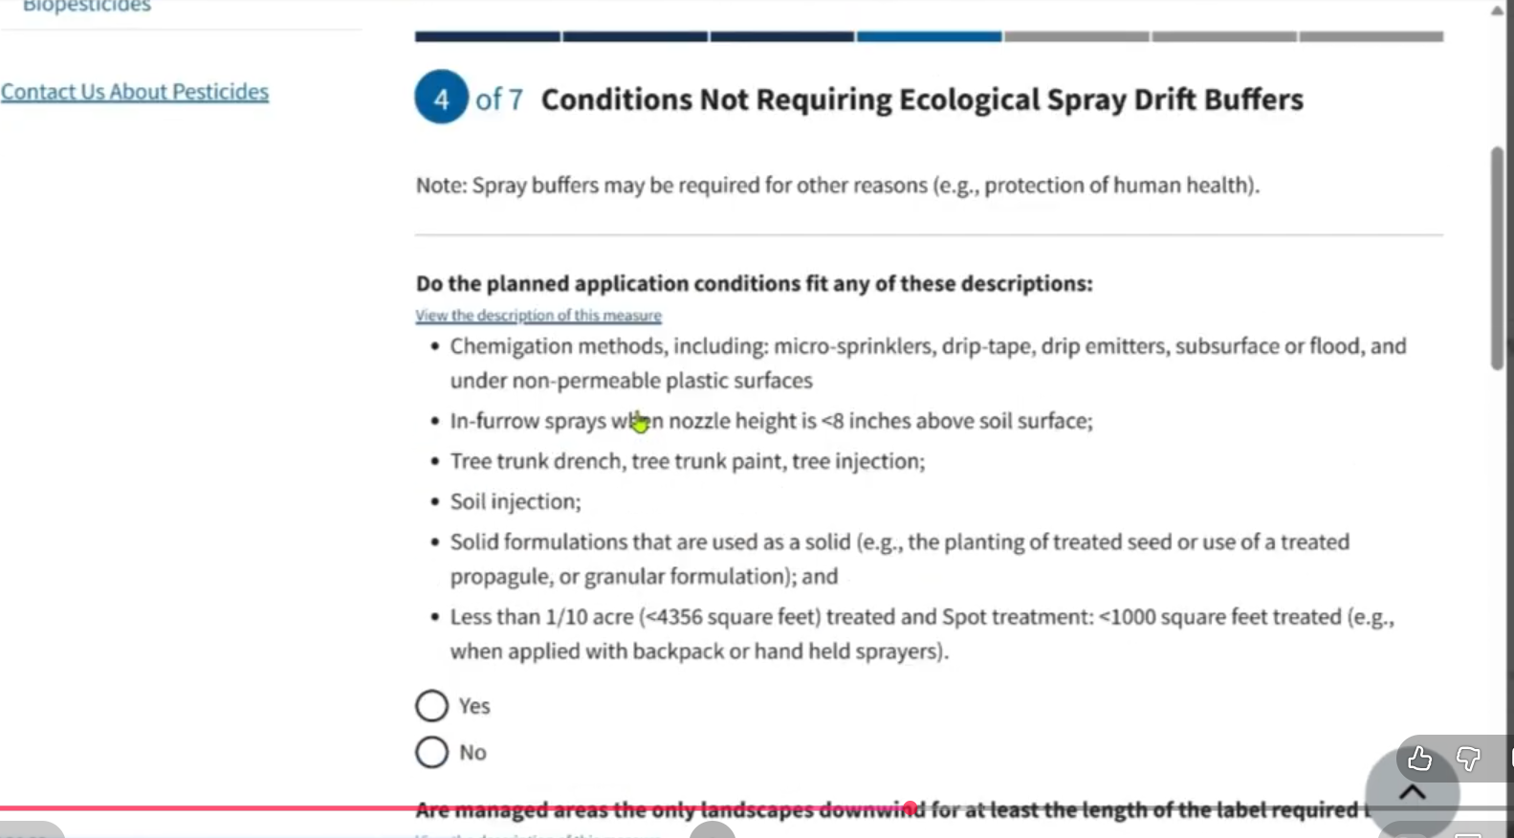
EPA PALM- Calculating “Ecological Spray Drift Buffer Reduction”
We will use the EPA PALM website to calculate the Spray Drift Buffer Reduction for our example.
Next Question
Conditions Not Requiring Ecological Spray Drift Buffers.
Several questions:
If you can answer YES to ANY of these questions, you will no longer require a spray drift buffer AT ALL.
Look for “Skip to Final Summary” if you have met these requirements.
No other questions need answered.

Slide 38
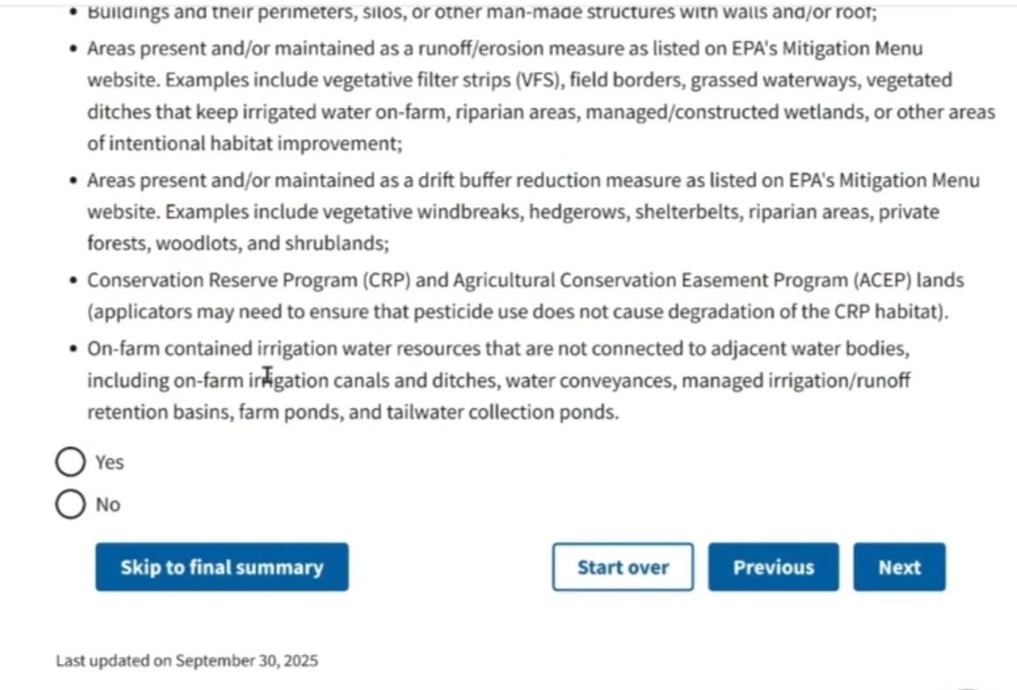
Bulletin Live! Two Website- Calculating “Ecological Spray Drift Buffer Reduction”
We will use the EPA PALM website to calculate the Spray Drift Buffer Reduction for our example.
Next Question
Conditions Not Requiring Ecological Spray Drift Buffers.
Several questions:
If you can answer YES to ANY of these questions, you will no longer require a spray drift buffer AT ALL.
Look for “Skip to Final Summary” if you have met these requirements.
No other questions need answered. You are DONE.

Slide 39
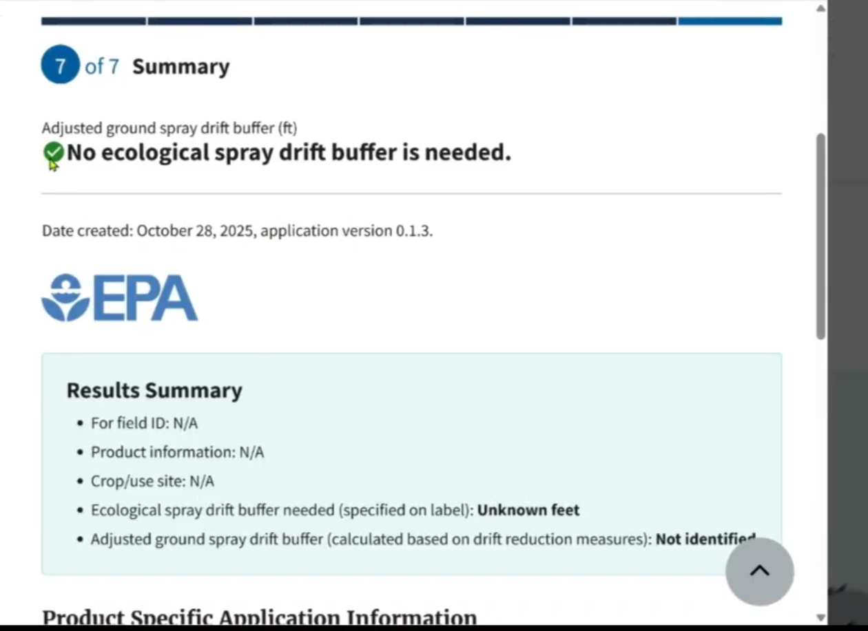
EPA PALM- Calculating “Ecological Spray Drift Buffer Reduction”
We will use the EPA PALM website to calculate the Spray Drift Buffer Reduction for our example.
Next Question
Conditions Not Requiring Ecological Spray Drift Buffers.
Several questions:
If you can answer YES to ANY of these questions, you will no longer require a spray drift buffer AT ALL.
Look for “Skip to Final Summary” if you have met these requirements.
No other questions need answered. You are DONE.

Slide 40
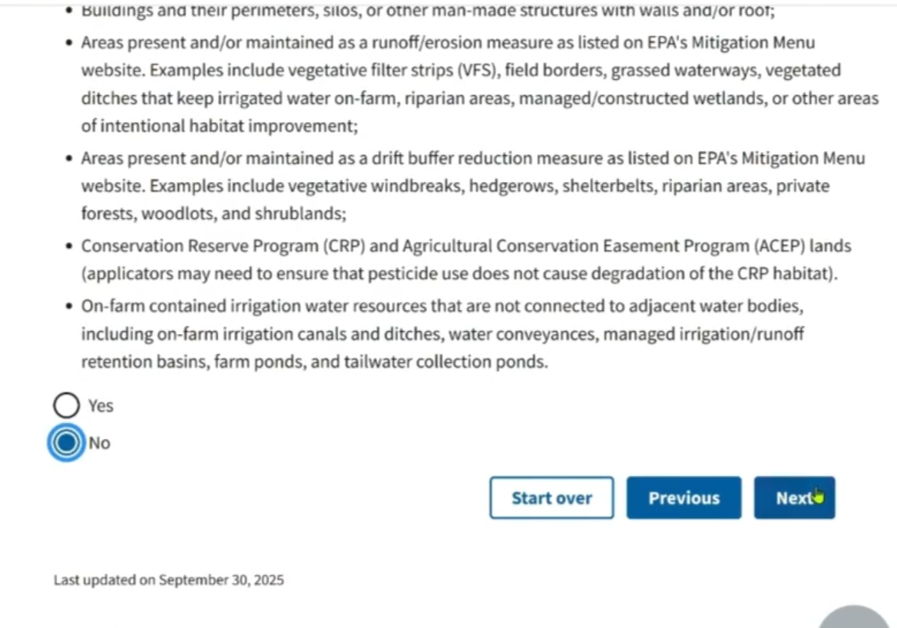
EPA PALM- Calculating “Ecological Spray Drift Buffer Reduction”
We will use the EPA PALM website to calculate the Spray Drift Buffer Reduction for our example.
Next Question
Conditions Not Requiring Ecological Spray Drift Buffers.
Several questions:
If you can answer NO to all of these questions you will need to continue to the next step.
This will be the more common situation.

Slide 41
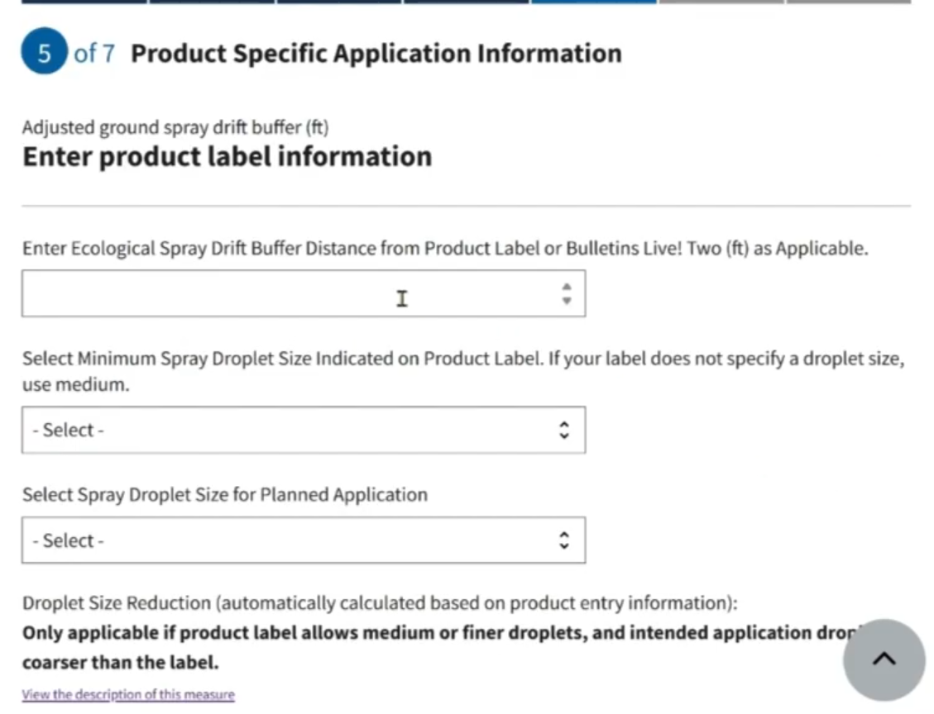
EPA PALM- Calculating “Ecological Spray Drift Buffer Reduction”
We will use the EPA PALM website to calculate the Spray Drift Buffer Reduction for our example.
Next Question
Product Specific Application Information
Several questions:
Information from the Label and Bulletin for the Product(s) you have.
Allows for some flexibility of application to mitigate the buffer size.

Slide 42
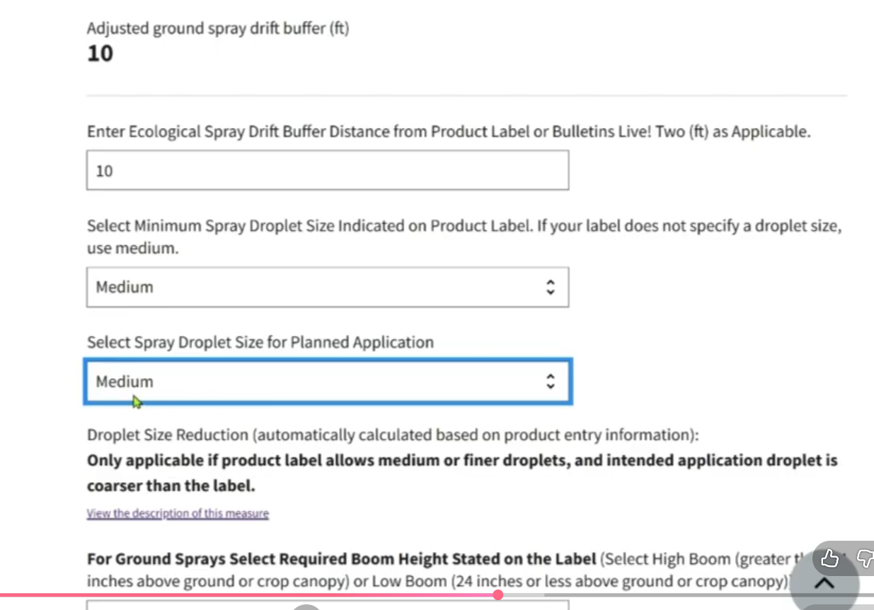
EPA PALM- Calculating “Ecological Spray Drift Buffer Reduction”
We will use the EPA PALM website to calculate the Spray Drift Buffer Reduction for our example.
Next Question
Product Specific Application Information
Several questions:
Information from the Label and Bulletin for the Product(s) you have.
Allows for some flexibility of application to mitigate the buffer size.
Liberty Ultra Example
MEDIUM Droplet size = 10 ft Buffer

Slide 43
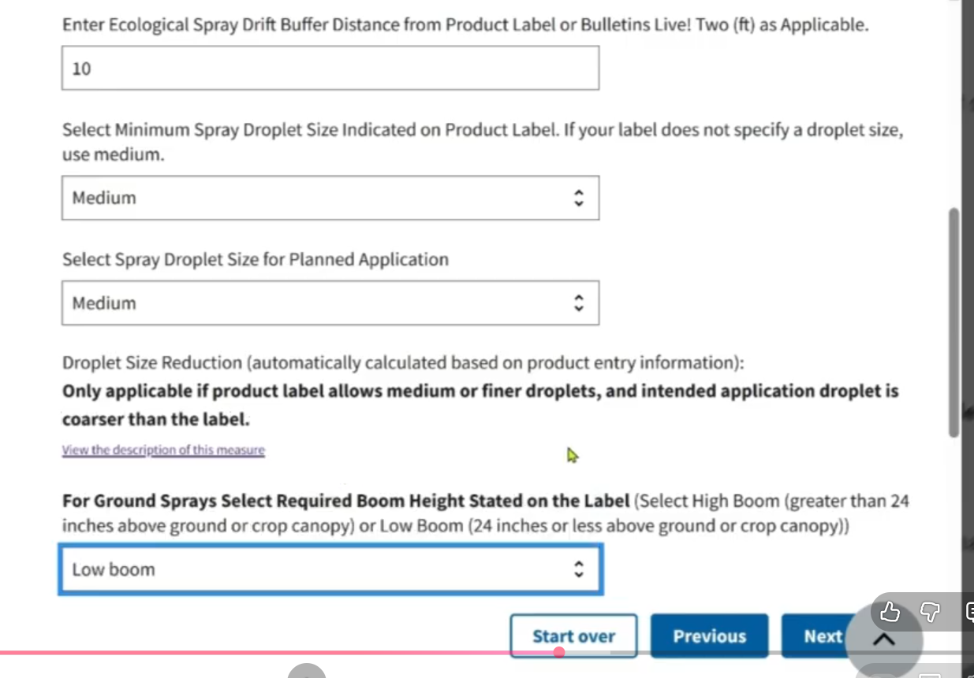
EPA PALM- Calculating “Ecological Spray Drift Buffer Reduction”
We will use the EPA PALM website to calculate the Spray Drift Buffer Reduction for our example.
Next Question
Product Specific Application Information
Several questions:
Liberty Ultra Example

Slide 44
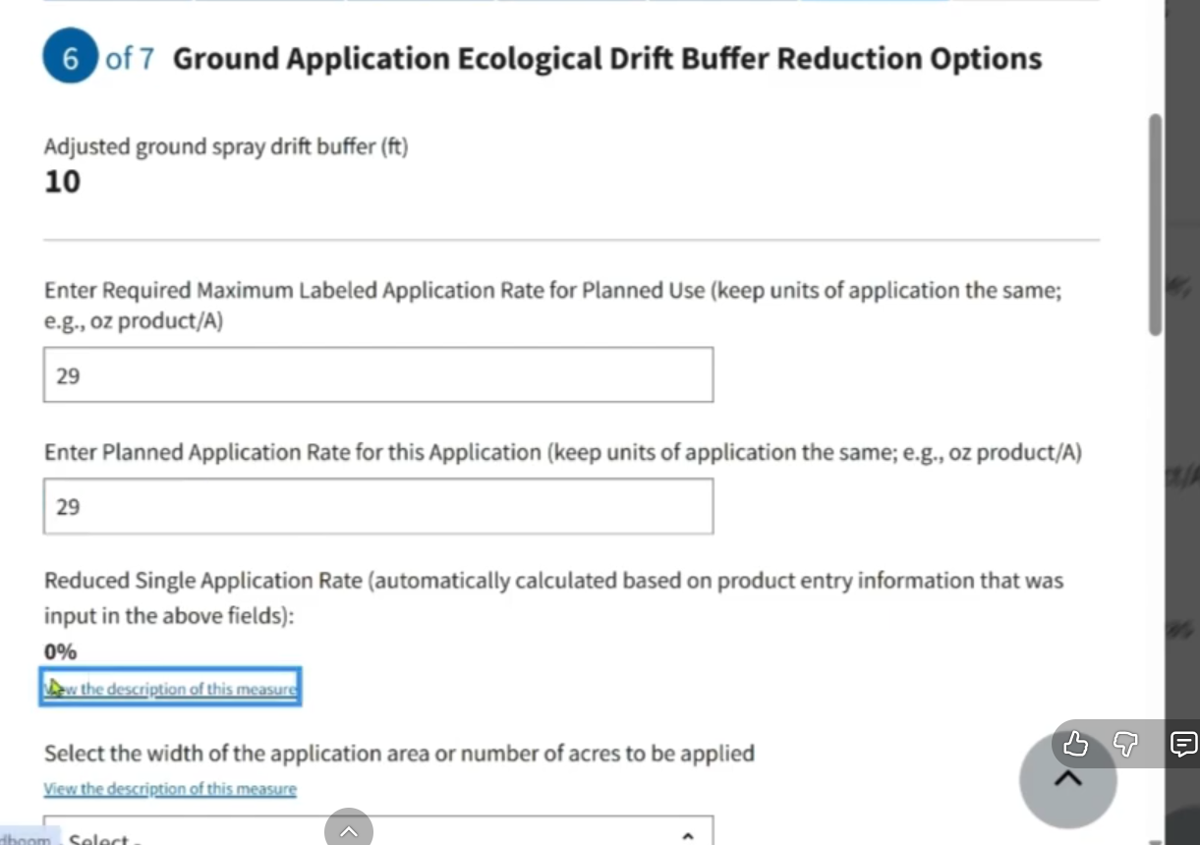
EPA PALM- Calculating “Ecological Spray Drift Buffer Reduction”
We will use the EPA PALM website to calculate the Spray Drift Buffer Reduction for our example.
Next Question
Ground Application Ecological Drift Buffer Reduction Options
Several questions:
Allows for some flexibility of application rate to mitigate the buffer sizer.
Find information from the product label for Max Labeled Application Rate (what is the max rate)
Liberty Ultra Example
What rate we will use for Planned Application Rate.
Is there a reduction in the buffer from the change of rate?
Application Rate and Max rate the Same NO Reduction

Slide 45
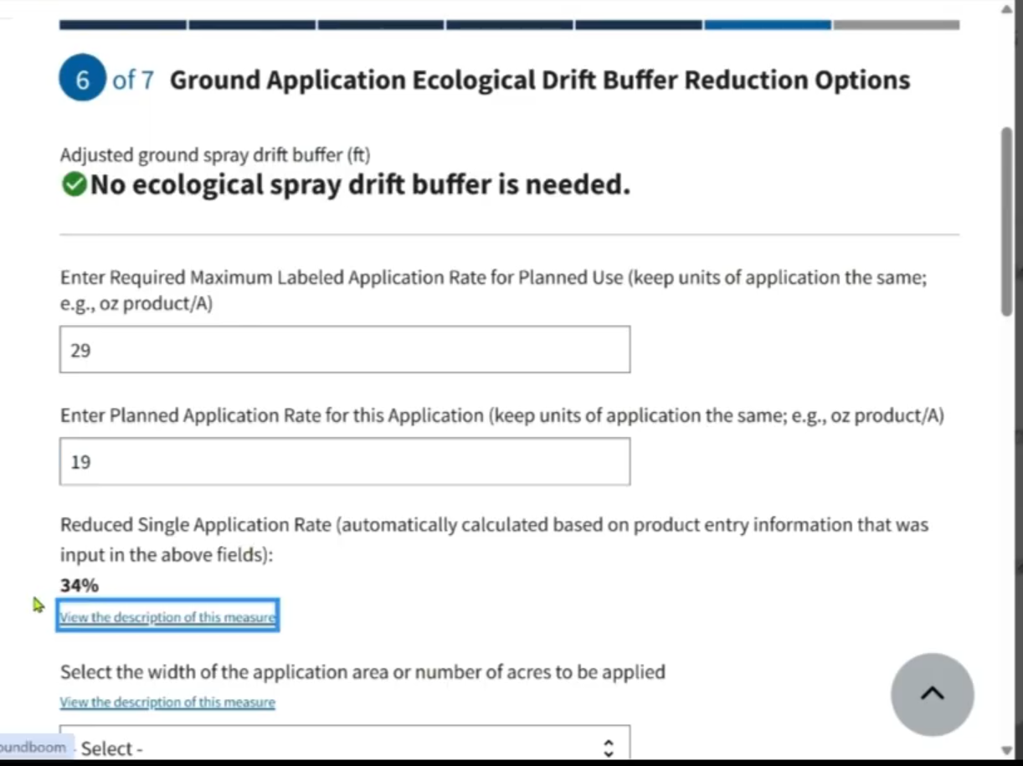

EPA PALM- Calculating “Ecological Spray Drift Buffer Reduction”
We will use the EPA PALM website to calculate the Spray Drift Buffer Reduction for our example.
Next Question
Ground Application Ecological Drift Buffer Reduction Options
Several questions:
Allows for some flexibility of application rate to mitigate the buffer sizer.
Find information from the product label for Max Labeled Application Rate (what is the max rate)
Liberty Ultra Example
What rate we will use for Planned Application Rate.
Is there a reduction in the buffer from the change of rate?
Application Rate less (CANNOT be less than the label minimum rate) than Max rate

Slide 46
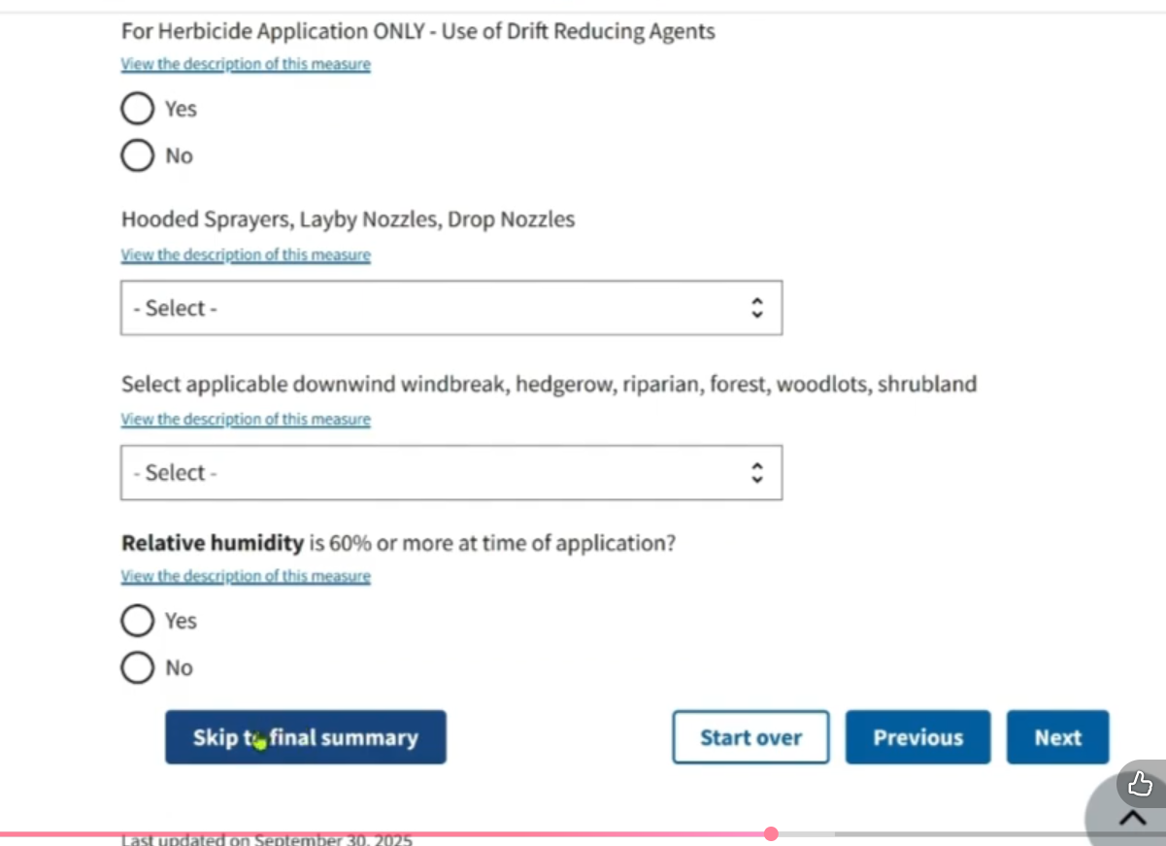
EPA PALM- Calculating “Ecological Spray Drift Buffer Reduction”
We will use the EPA PALM website to calculate the Spray Drift Buffer Reduction for our example.
Next Question
Ground Application Ecological Drift Buffer Reduction Options
Several questions:
Liberty Ultra Example
Always look for the “Skip to Final Summary” button at the bottom. If you have reduced the buffer to ‘0’, you can skip to the end.
Even if there is other unanswered questions.
Additional questions help to reduce the buffer, only if needed.
Suggested to download/print the summary for your records.

Slide 47
Runoff/ Erosion Mitigation Calculation Tools

Slide 48
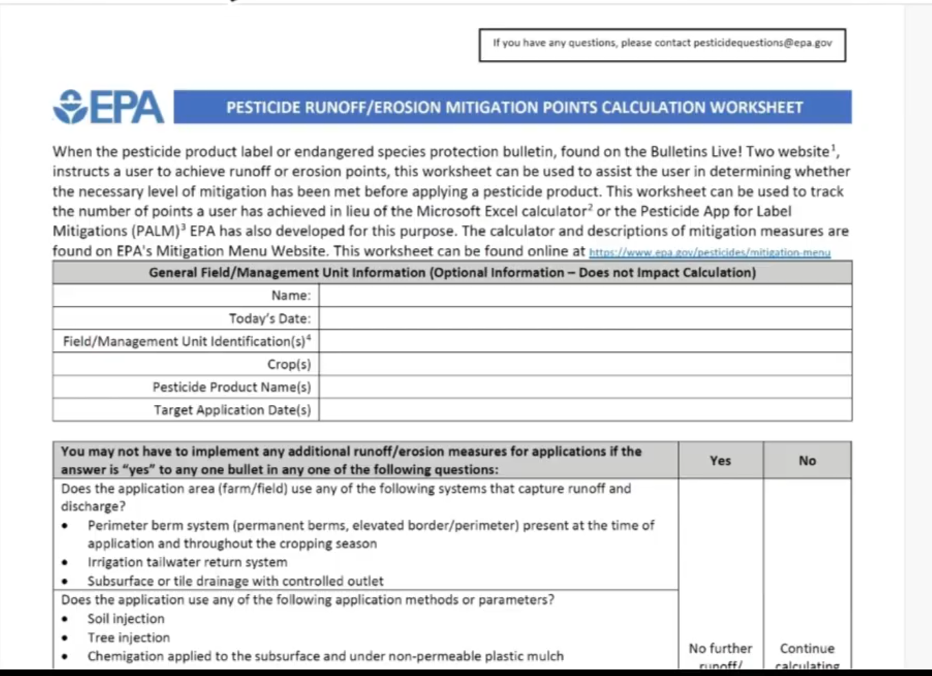
Runoff/Erosion Mitigation “Points” Calculation Tools
EPA provides THREE ways to do this calculation
Use Pesticide Runoff/Erosion Mitigation Points Calculation Worksheet
Paper worksheet that can be printed
Calculations are manual. Must be careful not to make any errors.

Slide 49

Runoff/Erosion Mitigation “Points” Calculation Tools
EPA provides THREE ways to do this calculation
Use Pesticide Ecological Spray Drift Buffer and Runoff Calculation Excel Spreadsheet
Microsoft Excel template
Calculations are completed within the template.
Best for those familiar with Excel
Can be more difficult to use.
SAME spreadsheet as the Spray Drift Buffer.
Calculations on a separate tab below.
Select Runoff Field ID below

Slide 50
Runoff/Erosion Mitigation “Points” Calculation Tools
EPA provides THREE ways to do this calculation
Use EPA PALM
PALM- “Pesticide App for Label Mitigation”
Easiest to use.
www.epa.gov/pesticides/pesticide-app-label-mitigations
Select “Runoff/Erosion Calculator” to get started.

Slide 51
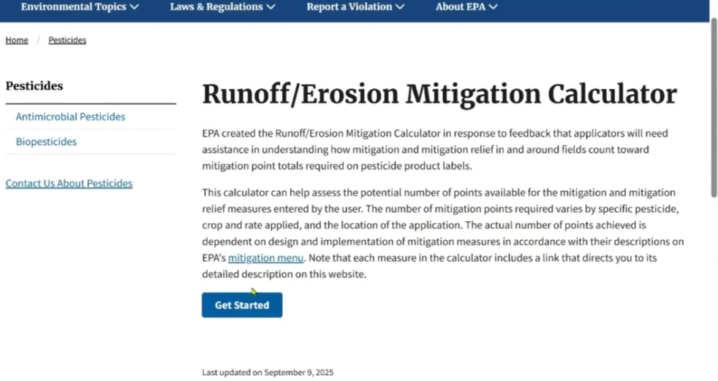
Runoff/Erosion Mitigation “Points” Calculation Tools
EPA provides THREE ways to do this calculation
Use EPA PALM
PALM- “Pesticide App for Label Mitigation”
Easiest to use.
www.epa.gov/pesticides/pesticide-app-label-mitigations
Select “Runoff/Erosion Calculator” to get started.

Slide 52
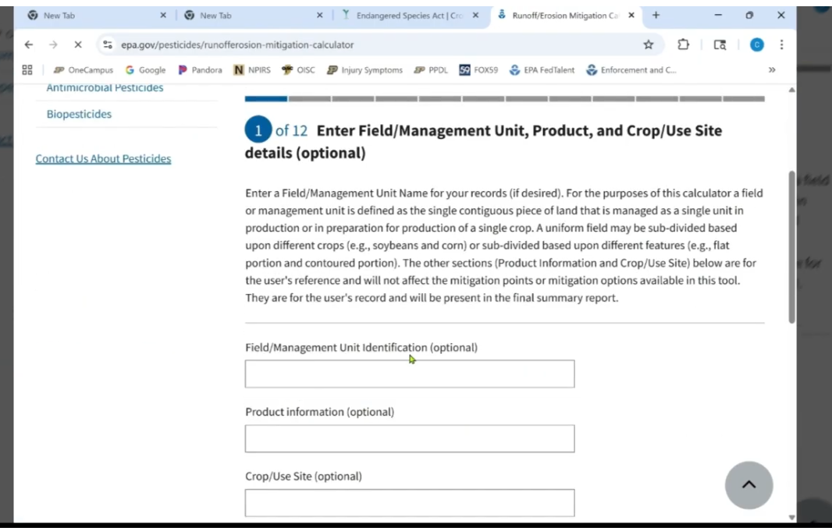
Runoff/Erosion Mitigation “Points” Calculation Tools
EPA provides THREE ways to do this calculation
Use EPA PALM
Question 1:
Enter Field, Product, Crop information

Slide 53
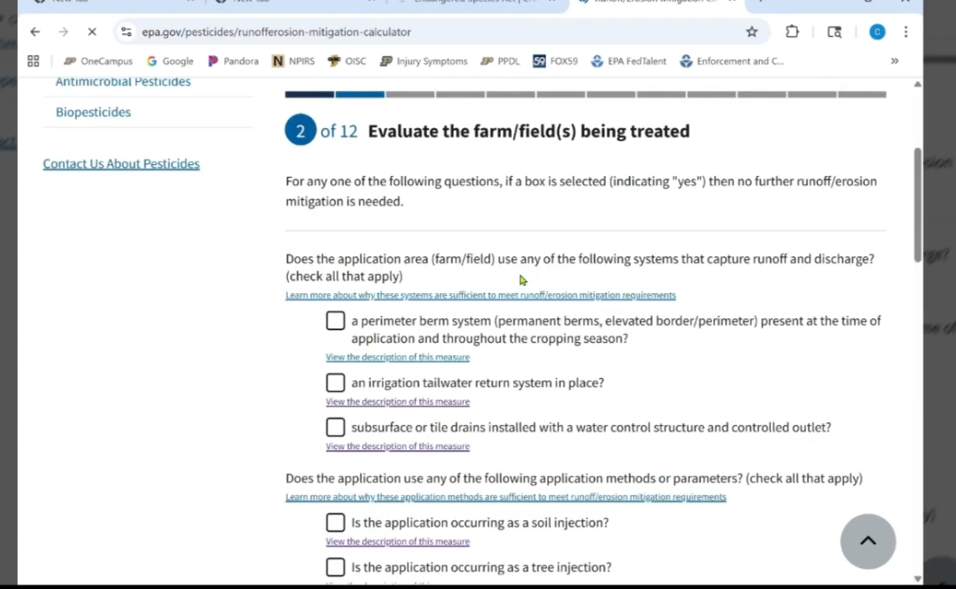
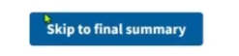
Runoff/Erosion Mitigation “Points” Calculation Tools
EPA provides THREE ways to do this calculation
Use EPA PALM
Next Question:
Evaluate the farm/field(s) being treated
Similar to the first page of the Drift Buffer page. If you can select YES by clicking ANY of these options, you will fulfill your required “Points”.
Look for “Skip to Final Summary” bottom if you have met these requirements.
No other questions need answered. You are DONE. Download/Print for records as suggested

Slide 54
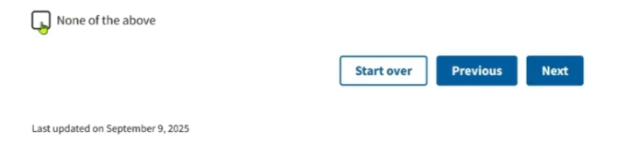
Runoff/Erosion Mitigation “Points” Calculation Tools
EPA provides THREE ways to do this calculation
Use EPA PALM
Next Question:
Evaluate the farm/field(s) being treated
Not common to select any of these options
If you are unsure on the description or if these apply click the “View the description of this measure” to get more information and the definition on the requirement.
Click “None of the Above” box at the bottom of the page

Slide 55
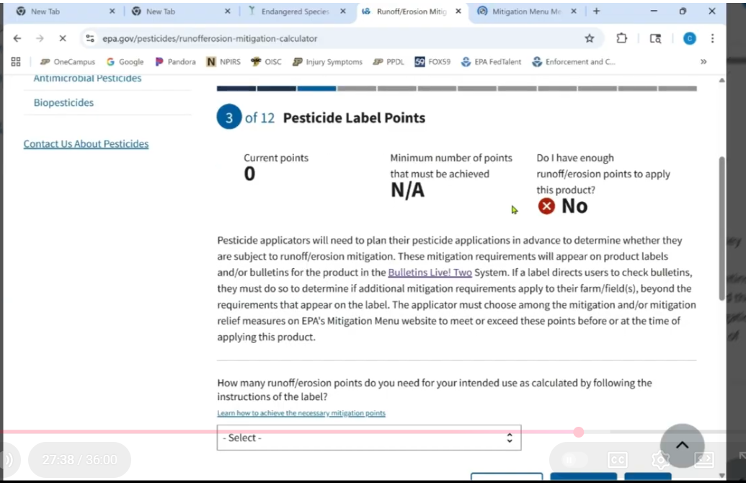
Runoff/Erosion Mitigation “Points” Calculation Tools
EPA provides THREE ways to do this calculation
Use EPA PALM
Next Question:
Pesticide Label Points
Add the required amount of points for your specific product.
Use the highest point number if there is a tank blend.
Found on the label

Slide 56
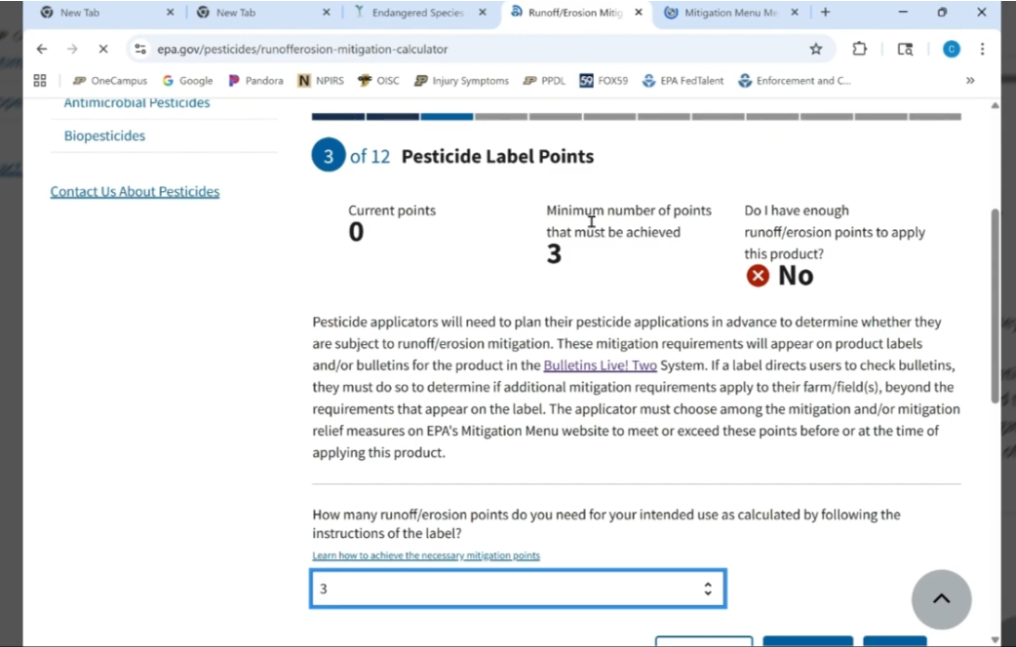
Runoff/Erosion Mitigation “Points” Calculation Tools
EPA provides THREE ways to do this calculation
Use EPA PALM
Next Question:
Pesticide Label Points
Liberty Ultra Example
Requires 3 points
The top of the page will continue to update as you go through the questions.

Slide 57
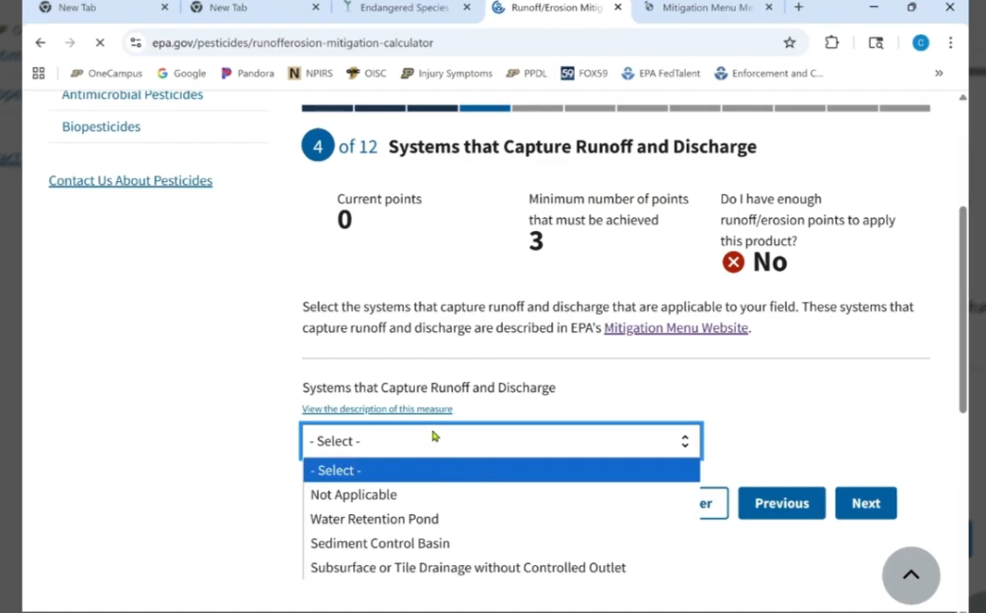
Runoff/Erosion Mitigation “Points” Calculation Tools
EPA provides THREE ways to do this calculation
Use EPA PALM
Next Question:
Systems that Capture Runoff and Discharge
If any apply, points will be added.
If not applicable, points will be 0, cont to next question.
This example, Not Applicable.

Slide 58
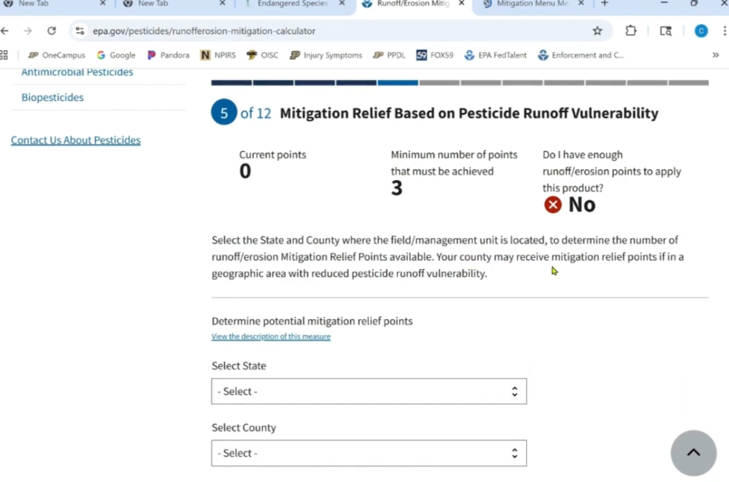
Runoff/Erosion Mitigation “Points” Calculation Tools
EPA provides THREE ways to do this calculation
Use EPA PALM
Next Question:
Mitigation Relief Based on Pesticide Runoff Vulnerability
Most important to select State and County of application.
Each county is awarded Points just by location on how likely runoff will occur in that county and how waterways are in that County.
There are some counties that have 0 points.

Slide 59
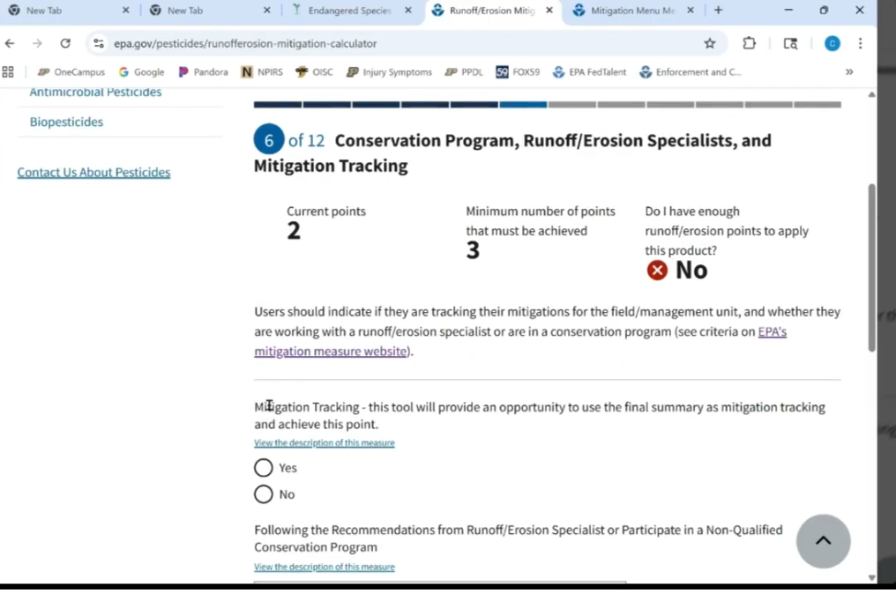
Runoff/Erosion Mitigation “Points” Calculation Tools
EPA provides THREE ways to do this calculation
Use EPA PALM
Next Question:
Conservation Program, Runoff/Erosion Specialist, and Mitigation Tracking
Select YES for Mitigation Tracking. That is what we are doing right now.
Will give points for tracking.
Would give a total of 3 points for LIBERTY ULTA example and we would be done.

Slide 60
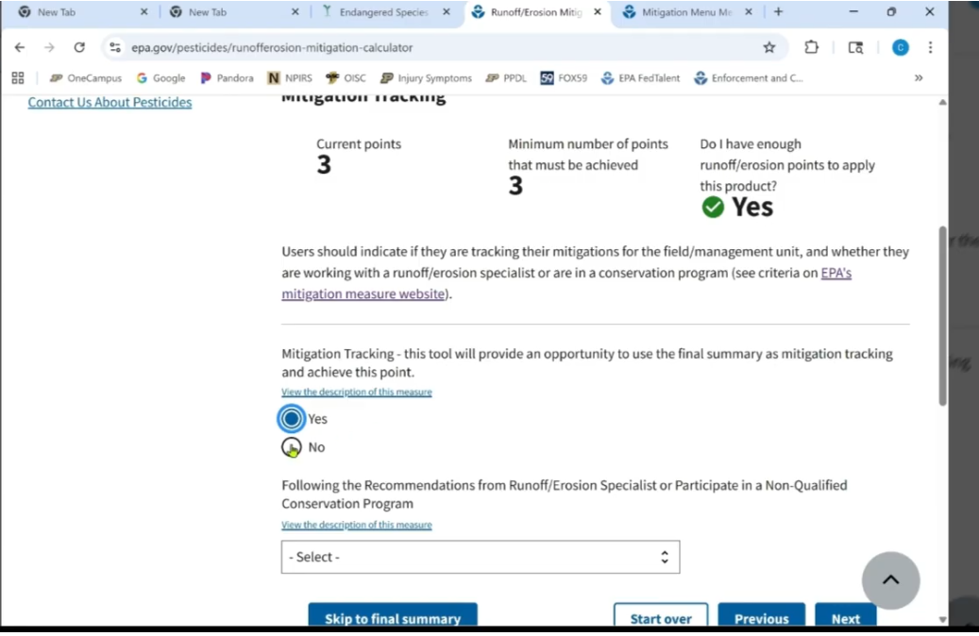
Runoff/Erosion Mitigation “Points” Calculation Tools
EPA provides THREE ways to do this calculation
Use EPA PALM
Next Question:
Conservation Program, Runoff/Erosion Specialist, and Mitigation Tracking
Select YES for Mitigation Tracking. That is what we are doing right now by filling out this calculator tool.
Will give points for tracking.
Would give a total of 3 points for LIBERTY ULTA example and we would be done.
(We will select no to continue on this Tutorial)

Slide 61

Runoff/Erosion Mitigation “Points” Calculation Tools
EPA provides THREE ways to do this calculation
Use EPA PALM
Next Question:
Field Characteristics
Add specific characteristics per field
Slope and soil types
Flatter fields get awarded more points
More sandy soils get awarded more points
Good resource for finding soil types by exact locations: Web Soil Survey https://websoilsurvey.nrcs.usda.gov/app/

Slide 62

Runoff/Erosion Mitigation “Points” Calculation Tools
EPA provides THREE ways to do this calculation
Use EPA PALM
Next Question:
In Field Mitigation Measures
Gives MANY more options to get points awarded.

Slide 63

Runoff/Erosion Mitigation “Points” Calculation Tools
EPA provides THREE ways to do this calculation
Use EPA PALM
Next Question:
Field –Adjacent Mitigation Measures
Gives MANY more options to get points awarded.

Slide 64

Runoff/Erosion Mitigation “Points” Calculation Tools
EPA provides THREE ways to do this calculation
Use EPA PALM
Next Question:
Other Mitigation Measures
Gives MANY more options to get points awarded.

Slide 65

Runoff/Erosion Mitigation “Points” Calculation Tools
EPA provides THREE ways to do this calculation
Use EPA PALM
Next Question:
Application Parameters (optional)
If you STILL needed points at the very end.
Allows you to add the Maximum Labeled Annual Application Rate found on the Label. AND The Planned Annual Application Rate
Lower rates (not lower than label minimum) will award points.

Slide 66

Runoff/Erosion Mitigation “Points” Calculation Tools
EPA provides THREE ways to do this calculation
Use EPA PALM
Next Question:
Application Parameters (optional)
If you STILL needed points at the very end.
Allows you to add the Maximum Labeled Annual Application Rate found on the Label. AND The Planned Annual Application Rate
Lower rates (not lower than label minimum) will award points
Max is 29, actual planned application is 19
This example, awarded 2 Points

Slide 67

Runoff/Erosion Mitigation “Points” Calculation Tools
EPA provides THREE ways to do this calculation
Use EPA PALM
Next Question:
Resulting Mitigation Points
Final Results

Slide 68

Runoff/Erosion Mitigation “Points” Calculation Tools
EPA provides THREE ways to do this calculation
Use EPA PALM
Next Question:
Resulting Mitigation Points
Final Results
Print/download

Slide 69
Summary of New Label Section Requirements to Look For

Slide 70
Resources

Slide 71
Resources
EPA Mitigation Menu- Has definitions and additional Information
www.epa.gov/pesicides/mitigation-menu
Also has step by step what you would need to do.
EPA Pesticide and Endangered Species Educational Resources Toolbox
www.epa.gov/endangered-species/pesticides-and-endangered-species-educational-resources-toolbox
Guidance documents, handouts, presentations, webinars, and other resources
Download the Spray Drift and Runoff Mitigation Calculator Spreadsheet here
Download the Spray Drift and Runoff Mitigation Calculator paper worksheet here
Crop Life America
www.croplifeamerica.org
www.croplifeamerica.org/esa
3rd party organizations with great information
Has YouTube videos and other helpful resources

Slide 72

Resources
YouTube Video- That follows this handout
How to Comply with the Endangered Species Act
https://www.youtube.com/watch?v=sZex6gYGhT0

Slide 73
Resources
Crop Life America- Very short YouTube Videos
Adapting to ESA: Mitigating Overview https://youtu.be/BWlgBhgephY?si=NJhyPifvpQrfOSkk
Adapting to ESA: Bulletin Live! Two
https://youtu.be/_ayFOsYQCLs?si=C7lvI59ero-l64JG
Adapting to ESA: Spray Drift
https://youtu.be/V_sM0Q9s2Ho?si=cCjkCdL4lqsA3vmm
Adapting to ESA: Runoff https://youtu.be/2CpXDR23PHw?si=T0WTmW2009BRIEyK
Find all of these on the CropLife America YouTube Channel @croplifeamerica

Slide 74
Questions? Contact the Officed of the Indiana State Chemist
Mitch Trimble
jmtrimbl@purdue.edu 765-494-1492
Nate Davis Manager of Certification and Licensing davi1280@purdue.edu
765-494-7108
Located at Purdue University
175 S University St.
W. Lafayette, IN 47907
www.oisc.purdue.edu
Notes:
https://myplate-prod.azureedge.us/sites/default/files/2024-04/MyPlatePoster-White20x16.pdf
https://extension.purdue.edu/news/county/elkhart/2023/03/how-to-build-a-balanced-breakfast.html

