Slide 1
Understanding the Revised Worker Protection Standard
What Ag employers and others need to know

Slide 2
Who is responsible for compliance?
The agricultural employer
Not the certified applicator

Slide 3
Exempt from some portions
Owners and members of immediate family
Spouse
Children
Stepchildren
Foster children
Grandparents
Grandchildren
In-laws
Notes:
If more than 50 % of an LLC or other corporation type is owned by immediate family members, they are eligible for the exemption.
The exemption allowed in the WPS applies only to the owners and their immediate family members on any agricultural establishment where a majority of the establishment is owned by one or more members of the same immediate family. A “majority of the establishment” means that more than 50% of the equity in the establishment is owned by one or more members of the same immediate family as defined above.

Slide 4
Exempt from which portions?
Pesticide safety training
Notice of applications
Posting and SDS
Emergency assistance
Minimum age* (must be 18, a Private Applicator or Fully Certified to use Restricted Use Pesticides)
Still must follow ALL label requirements

Slide 5
WPS in a nutshell
Pesticide safety training for employees
Pesticide safety, application, hazard info
Notice about applications
Respirator fit testing
Decontamination supplies
Emergency assistance
Notes:
Required to get a medical evaluation prior to use of respirator.

Slide 6
Pesticide safety training
Workers must be trained before entering treated area
Handlers must be trained before performing any handling task
Trained yearly
Employer must keep record of training
Two years

Slide 7
Who can conduct training?
Certified pesticide applicators
Commercial or private applicators
Graduates of Train the Trainer courses
Designated trainers (extension educators)

Slide 8
What does training involve?
Present with EPA approved materials
Trainer present entire time
No distractions
New content (2018)

Slide 9
Safety, application & hazard info
Must be displayed if app within 30 days and workers or handlers are present
Information about applications
Emergency information
SDS (was MSDS)
Pesticide safety poster
New content required 2018

Slide 10
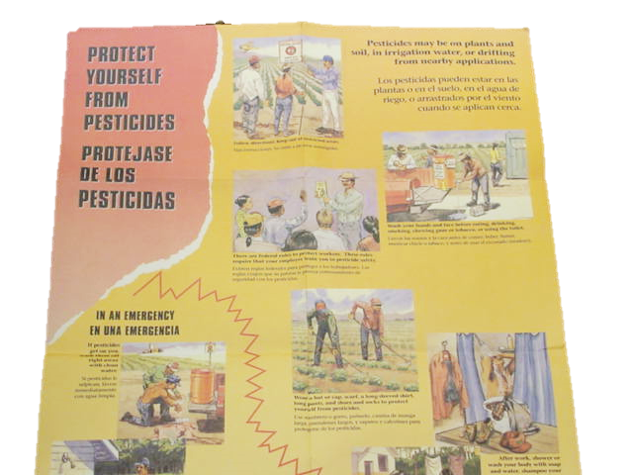

Slide 12
Application info
Location and description of treated area
Product name, EPA Reg.#, active ingredient(s)
Restricted Entry Interval (REI)
Description of treated area
Time and date of application
Start and end times
Keep records for two years

Slide 13
Notice about applications
Verbally warn workers and post warning signs if required by the label
All danger poison products
Otherwise post warning signs if the REI is >
4 hours for enclosed space (greenhouse)
48 hours for outdoor production

Slide 14
Respirator requirements
When a respirator is required by the label employers must provide prior to use
Medical evaluation
Respirator training
Fit testing
Keep records of above for two years

Slide 15
Decontamination supplies
Within ¼ mile of worksite
Water – 1 gallon per worker, 3 per handler
If protective eyewear required for handlers
1 pint immediately available
Extra 3 gallons for eye flush
Plenty of soap and single use paper towels
Change of clothes for handlers

Slide 16
Emergency assistance
Transport promptly to medical facility
Promptly provide to medical personnel
Product name, EPA Reg.#, active ingredients
How pesticide was being used
Circumstances of exposure
SDS

Slide 17
Help is available
Joe Becovitz – (765)494-1589—regulator
becovitz@purdue.edu
Fred Whitford – (765)494-1284—extension
fwhitford@purdue.edu
Resources:
https://pesticideresources.org/

