Slide 1
Overview of Today’s Discussion
2023-2024 Legislative Changes
Storage & Containment of Bulk Pesticides
Direct Supervision of Noncertified Applicators Using RUPs
Use of General Use Pesticides (GUPs) For Hire
Application Record Keeping
Restricted Use Pesticide(RUP) Dealer Record Keeping
Drones
Clean Sweep

Slide 2
2023-2024 Legislative Changes
Effective July 1, 2024
Moved most requirements from rule into law
As result some state rules were replaced with less stringent federal rules
Notes:
Requirements that were moved from rules now into law were passed by the General Assembly

Slide 3
State Requirements Replaced by Federal Rules in Law
Storage and Containment of Bulk Pesticides
Direct Supervision of Noncertified Applicators Using RUPs
Agricultural Pesticide Worker Protection Standards (WPS)
Notes:
What was affected?
RUP = Restricted Use Pesticide

Slide 4
Storage & Containment of Bulk Pesticides
Previously in Indiana Rule
Bulk was defined as greater than 55 gal. capacity container
Previously applied to all bulk pesticides
Previously both stationary bulk & portable minibulk required:
Secondary containment (dikes)
Operational pads (mix/load)
Replaced by less stringent federal rule https://www.epa.gov/sites/default/files/2015-05/documents/regulations-glance-table-7.pdf
--Most farmers are excluded--
Notes:
With some exceptions the revised Bulk Pesticide Requirements no longer apply to farmers
Changes to bulk PESTICIDES – Only. Bulk Fertilizer Containment requirements still apply

Slide 5
Storage & Containment of Bulk Pesticides
All previous requirements basically remain, EXCEPT…
New dike & mix/load pad requirements apply to only:
Tanks capable of storing 500 gal. or greater (refillable minibulks no longer included)
4,000 pounds or greater of dry storage
Agricultural pesticides (non-agricultural pesticides no longer included)
Refilling establishments (refill minibulks & portable containers)
Commercial applicator locations
Custom blender locations
Notes:
Farmers who sell pesticides and are a business must follow containment requirements.

Slide 6
Storage & Containment of Bulk Pesticides
New requirements also include:
At least monthly inspection of dikes & pads
Initiate same day repairs of cracks, leaks, etc.
Keep records of inspections & repairs for 3 years

Slide 7
Direct Supervision of Noncertified Applicators Using RUPs
Direct Supervision Applies to RUP use only, not use of GUPs
Applies to both Private Applicators & Commercial Applicators.
Applicator must be at least 18 years old.
Supervisor’s responsibility to ensure compliance by noncertified applicator.
Notes:
https://www.ecfr.gov/current/title-40/chapter-I/subchapter-E/part-171/subpart-C/section-171.201
Noncertified applicator of RUP, must be 18 years old.
GUP == General Use Pesticides

Slide 8
“Use” of RUPs includes:
Application
Mixing and/or Loading
Storage
Transportation
Disposal of pesticides and pesticide containers
Notes:
The term “use” means more than just applying pesticides.
IC 15-16-5-36"Use“ Sec. 36. As used in this chapter, “use” means an act of handling, releasing, or exposing individuals or the environment to a pesticide. The term includes the following:
(1) Application or supervision of an application of a pesticide, including mixing or loading the pesticide.
(2) Storage of pesticides and pesticide containers by the intended applicator of the pesticides.
(3) Transportation of pesticides and pesticide containers by the intended applicator of the pesticides.
(4) Disposal of pesticides and pesticide containers by the intended applicator of the pesticides.

Slide 9
Direct Supervision of Noncertified Applicators Using RUPs
Supervisor must ensure noncertified applicator:
Has been trained within last 12 months on WPS agricultural handler training
Has been trained within last 12 months on specific equipment use
Has continuous access to the label(s)
Has label required PPE & is wearing it correctly
Has product-specific & site-specific use directions for each application site*
Has equipment that has been determined to be properly operating, daily
Has means for immediate communication with supervisor
Supervisor is physically present, if label requires it
Is aware of noncertified applicator training records
Notes:
Again, applies to both Commercial and Private Applicator certified Supervisor, if the employee applying a restricted-use pesticide is not certified. Includes private applicator’s family members if apply RUP and not certified.
Recommend anyone on farm applying RUP, be a private applicator. If the farm employee is not, required WPS training must be done annually and record kept of the training.

Slide 10
Site-Specific Use Directions Could Include:
Search results for nearby sensitive fields or sites:
Field Watch
Drift Watch
Bee Check
Search results for Endangered Species Act restrictions (Bulletins Live Two)
Pesticide Use Limitation Areas (PULAs)
No spray restrictions
Mandatory buffers
Mandatory conservation practices
Waterbody or well location restrictions
Sensitive neighbor agreements
Notes:
Site Specific Direction must be done for EACH application site.
Endangered Species Live! Two site: https://www.epa.gov/endangered-species/bulletins-live-two-view-bulletins

Slide 11
Annual Training for Noncertified RUP Users
Annual noncertified applicator training:
Federal Worker Protection Standard (WPS) ag handler training
Annual training records must include:
Trainee’s printed name & signature
Date training provided
Name of the trainer (certified applicator or trained trainer)
Title or description of training (see above)
Notes:
Recap:
Employer’s responsibilities, whether commercial or farmer, is to provide annual training, labels, PPE, site-specific instructions, immediate voice contact to non-certified employee applying RUP
Use includes: mixing, loading, transporting, disposal
Recommend - Farm or commercial employees using RUPs, be certified.
https://www.pesticideresources.org/wps-resources/worker-protection-standard-wps-for-pesticide-handlers/

Slide 12
Use of General Use Pesticides (GUPs) For Hire
Must be at least 18 years of age
Must be a certified applicator or a registered technician (RT)
Certified applicator must pass core + cat. (usually 1, 4, or 11)
RT must complete at least one https://oisc.purdue.edu/pesticide/training_rt_gups.html :
Core Exam
In Person Core Exam Training (source: Purdue Pesticide Programs)
In Person Registered Technician Training (source: Purdue Pesticide Programs)
E-Learning Core Training (source: Purdue Pesticide Programs)
Worker Protection Standard (WPS) for Pesticide Handlers (English video)
Worker Protection Standard (WPS) for Pesticide Handlers (Spanish video)
Notes:
Slides 12, 13 applies to Commercial Pesticide Businesses.
Farm employees applying GUP do not need to be Registered Technician, a RT= is a For-Hire pesticide applicator
General Use pesticides applied on the farm do no require ANY certification

Slide 13
Use of General Use Pesticides (GUPs) For Hire
RT can start work immediately after training if:
Send email to OISC stating intent pestlicense@groups.purdue.edu
Submit application form & fee within 5 days
No longer any supervision requirements for GUP use by RTs
All enforcement goes to the applicator
Notes:
Slides 12, 13 to Commercial Pesticide Businesses.

Slide 14
RUP Application Record Keeping
Application record keeping required for RUP applications.
No specific form or format required, paper or electronic are OK.
Kept for 2 years from date of application
Records now require application start and stop times

Slide 15
RUP Application Record Keeping
1.Name of the customer, property owner, or custodian of the site of application.
2.Address, geographic coordinates, or general location description of site.
3.Name of the person making the application.
4.Name of the commercial applicator or private applicator responsible for the application, if different from #3.
5.License number of the commercial applicator or private applicator responsible for the application.
6.Date of application.
7.Start and stop times of the application.
8.Description of plants, crop, animals, commodities, stored products, or sites treated.
9.Principal pests to be controlled.
10.Specific acreage, area, parts of the structure, parts of the property, or number of plants or animals treated, or other appropriate description.
11.Each brand name of each pesticide product applied.
12.EPA registration number of each pesticide product applied.
13.Amount of each pesticide product used, expressed as either total quantity or volume of the:
A)packaged product; or
B)diluted mixture and active ingredient concentration (percentage).
Notes:
Complete list of RUP record items. Record keeping details available at https://www.oisc.purdue.edu/pesticide/pdf/pesticide_recordkeeping_031224.pdf or
PPP-152

Slide 16
GUP Application Record Keeping
No record keeping required for GUP applications

Slide 17
Restricted Use Pesticide(RUP) Dealer Record Keeping
Annual RUP dealer registration still required for each location
Records must still be kept for 2 years from date of sale
Record keeping elements modified to comply with federal rule
Notes:
Commercial Business NOT Private

Slide 18
Restricted Use Pesticide(RUP) Dealer Record Keeping
(1) Name of the certified applicator for whom the purchase or distribution is being made.
(2) Certification, license, or permit number of the certified applicator.
(3) Except for a certification from the state chemist, the state, tribe, or federal agency that issued the certification.
(4) Certification, license, or permit expiration date of the certified applicator.
(5) Certification, license, or permit categories of the certified applicator.
(6) Address of the certified applicator or application business that employs the certified applicator.
(7) Date of distribution.
(8) Brand name of the pesticide product.
(9) Environmental Protection Agency registration number of the pesticide product.
(10) Amount of pesticide product distributed.
(11) Any applicable emergency exemption or state special local need registration number.
(12) Signature or verifiable confirmation of the person presenting the certification credentials, ordering, or taking delivery of the product.
Notes:
This is SALES of RUPs for every sale, regardless of purchaser.

Slide 19
Summary
RUP use now allows for direct supervision of noncertified applicators.
Direct supervision for RUPs is now more detailed.
Annual WPS ag handler & direct supervision training can be the same.
Bulk containment required for > 500 gal. ag refillers/applicators only.
RT training for GUP use has multiple options, but can be WPS training.
No more required record keeping for GUP applications, RUP only.
RUP sales require a few extra record keeping elements.
Notes:
First 4 bullets for both Private Applicators and Commercial
Last 3 bullets for Commercial

Slide 20
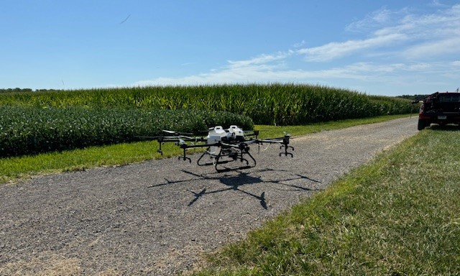
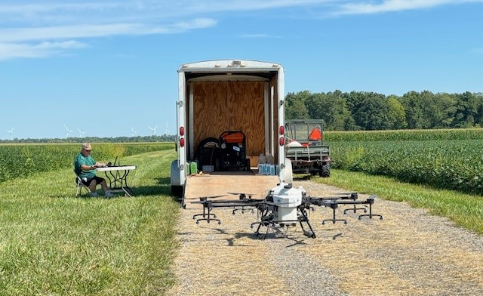
Drones/UAV
Indiana Regulatory Requirements
It’s more than buying and flying
Notes:
Category 11 Required to fly a drone when making a pesticide application

Slide 21
Drones/UAV Private Applicator
Indiana Regulatory Requirements
Exams:
Core
Category 11
FAA 107
FAA 137
Notes:
Category 11 added to private applicator permit. Recertification requirement the same = 3 PARPs/5 years
Even if a farmer is using nothing but GUP’s, if they are using a drone or traditional aerial application, a category 11 is required
Observer that Does Not Touch Pesticides = no certification required

Slide 22
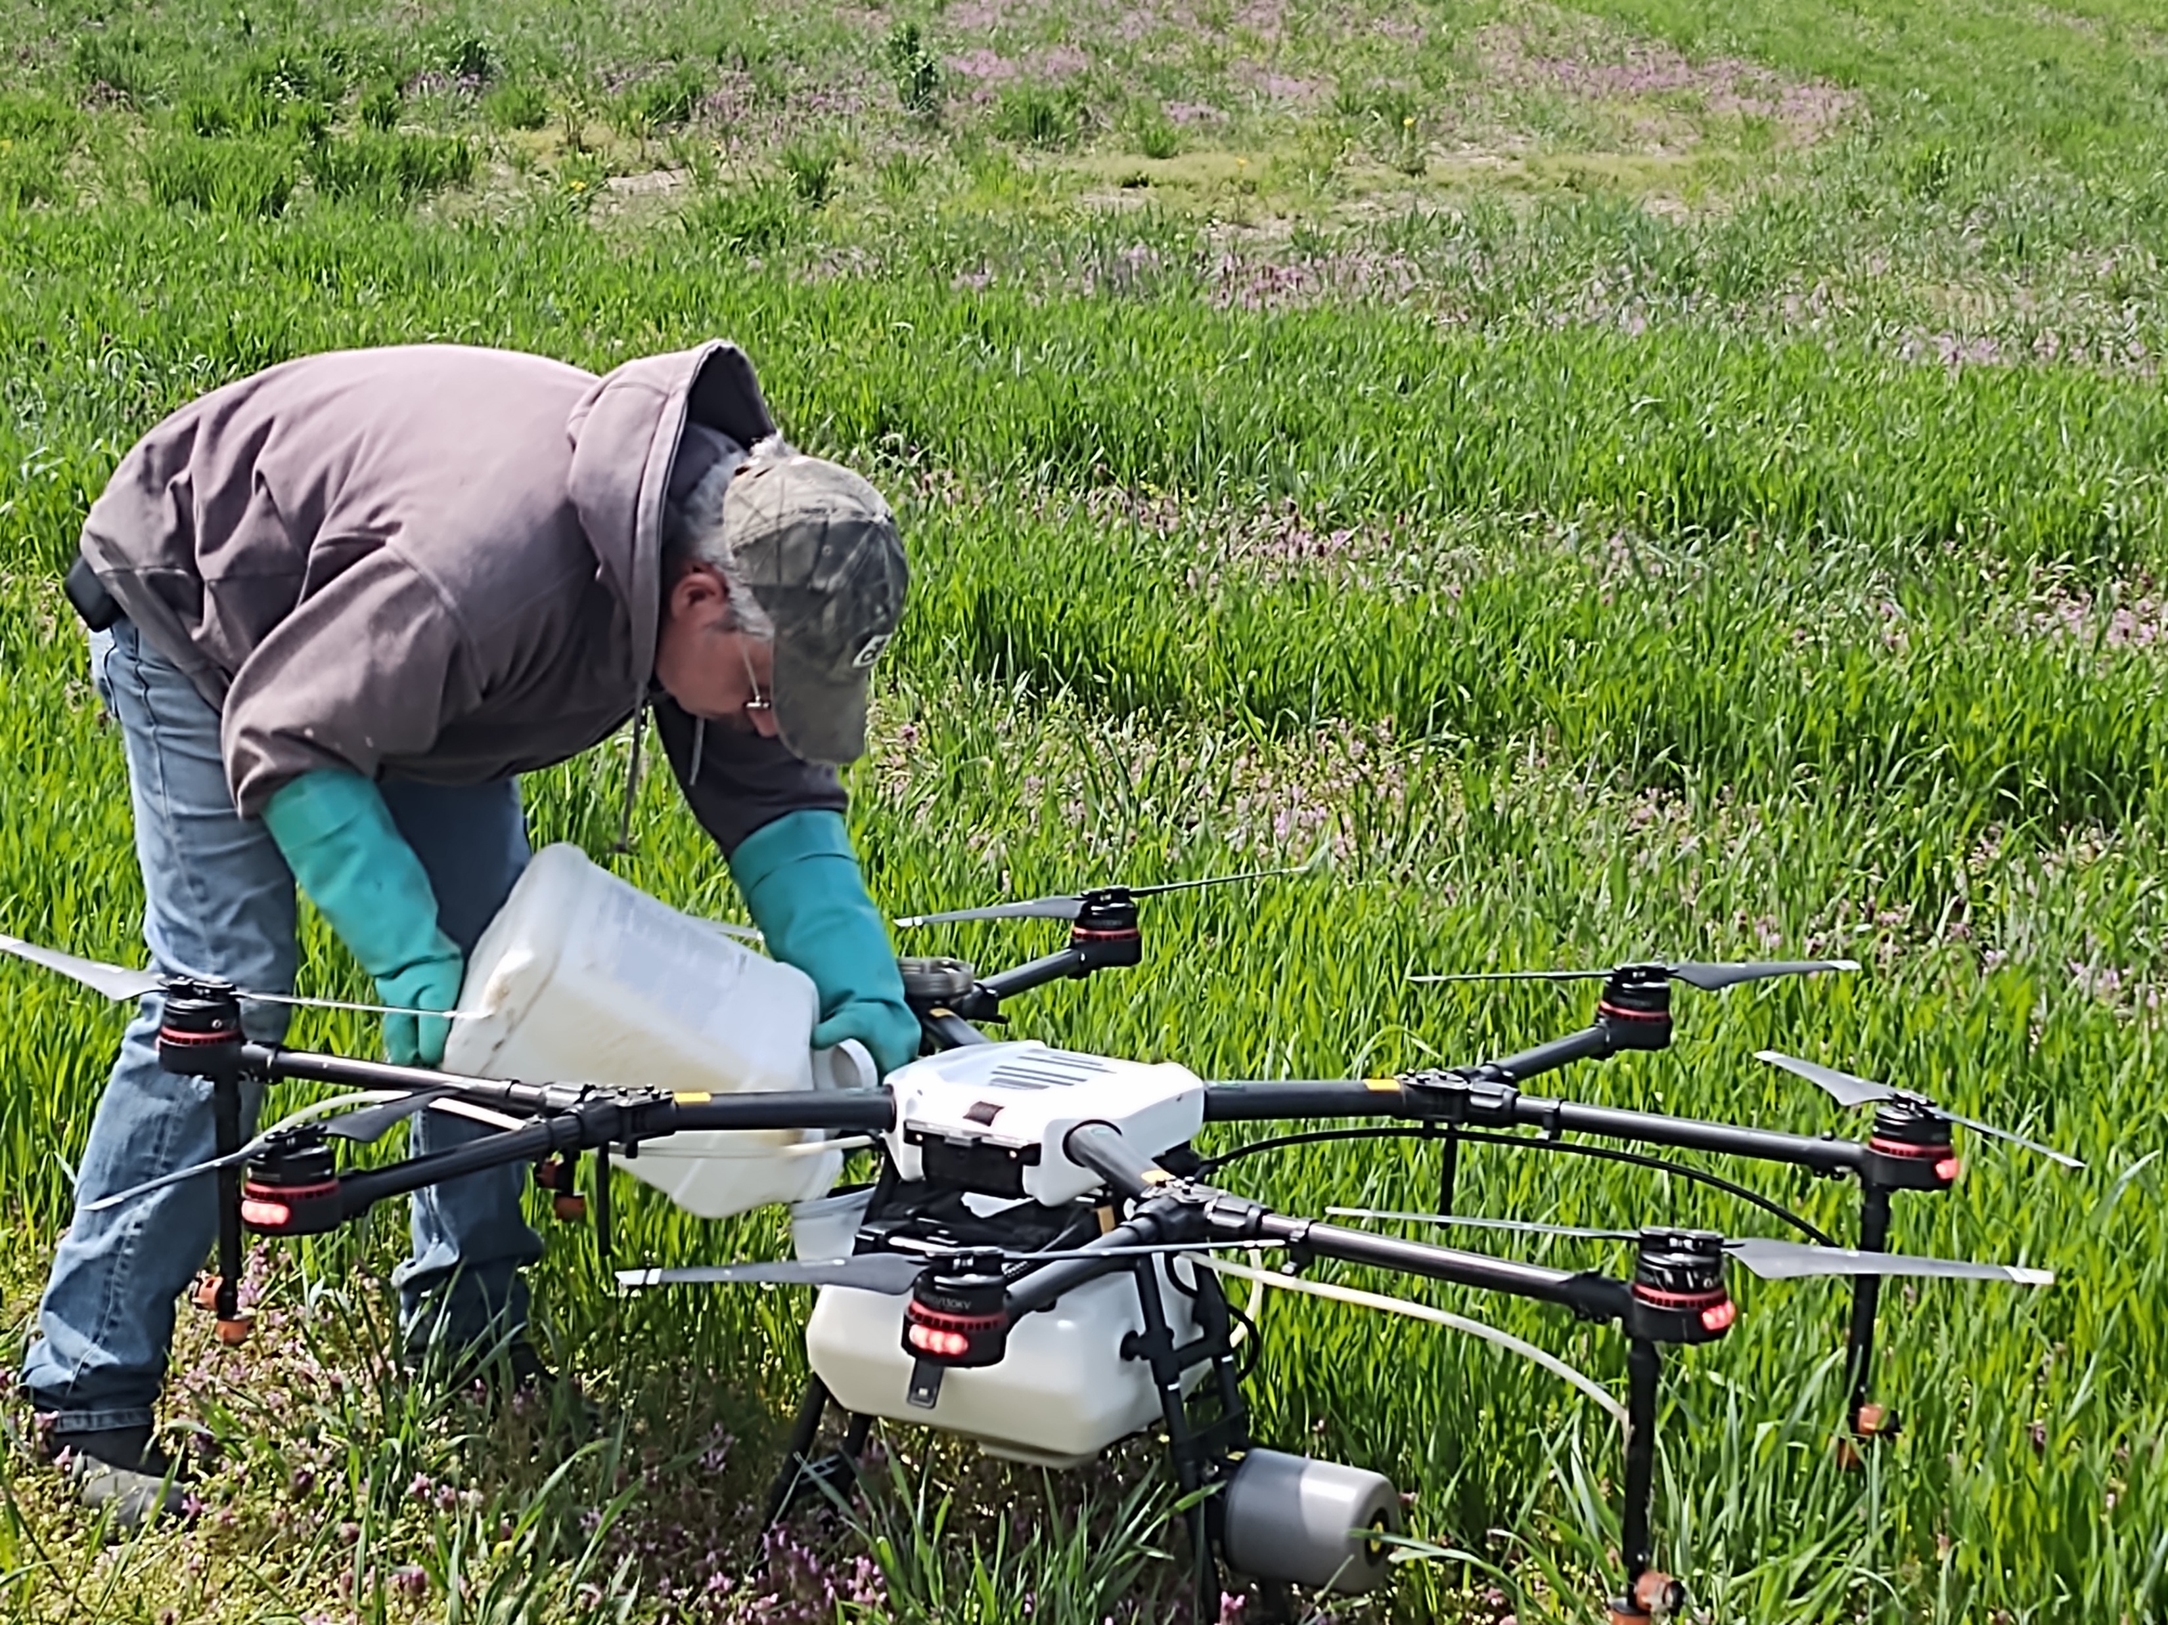
Drones/UAV Private Applicator
Restricted Use Pesticide Applications
Mixer/Loader must be Private Applicator
OR
One of the Mandatory Annual Training Options for Non-Certified Applicators has been met
Notes:
Mixer/Loader RUP applications = Must be Private Applicator OR Mandatory Annual Training ie Slides 8-11.
https://oisc.purdue.edu/pesticide/training_nca_rups.html

Slide 23
Drones/UAV Commercial Applicator
Indiana Regulatory Requirements
Exams:
Core
Category 11
FAA 107
Notes:
Commercial for-hire applications
Observer that Does Not touch pesticides = no certification required
Mixer/Loader of General Use Pesticides = Commercial Applicator OR Registered Technician
Mixer/Loader of Restricted Use Pesticides = Commercial Applicator OR Mandatory Annual Training Options for Non-Certified Applicators Applying Restricted Use Pesticides
https://oisc.purdue.edu/pesticide/training_nca_rups.html
Commercial category is not needed if ONLY making aerial/drone pesticide applications. For example, flying on a weed or algae treatment to a pond does not require Category 5. Fence rows and ditch banks, category 6 is not required.

Slide 24
Drones/UAV Business
Indiana Regulatory Requirements
$300,000 commercial liability insurance
FAA Part 137
Apply for Indiana Pesticide Business License and For Hire Applicators License
(submit Certificate of Insurance and a copy of FAA 137)
Notes:
The FAA part 137 is the document that shows that the company has FAA approval to fly under minimums and apply “economic poisons” (pesticides). There is no exam associated with the 137.
OISC does require that a licensee send a copy of their 137 with their application.

Slide 25
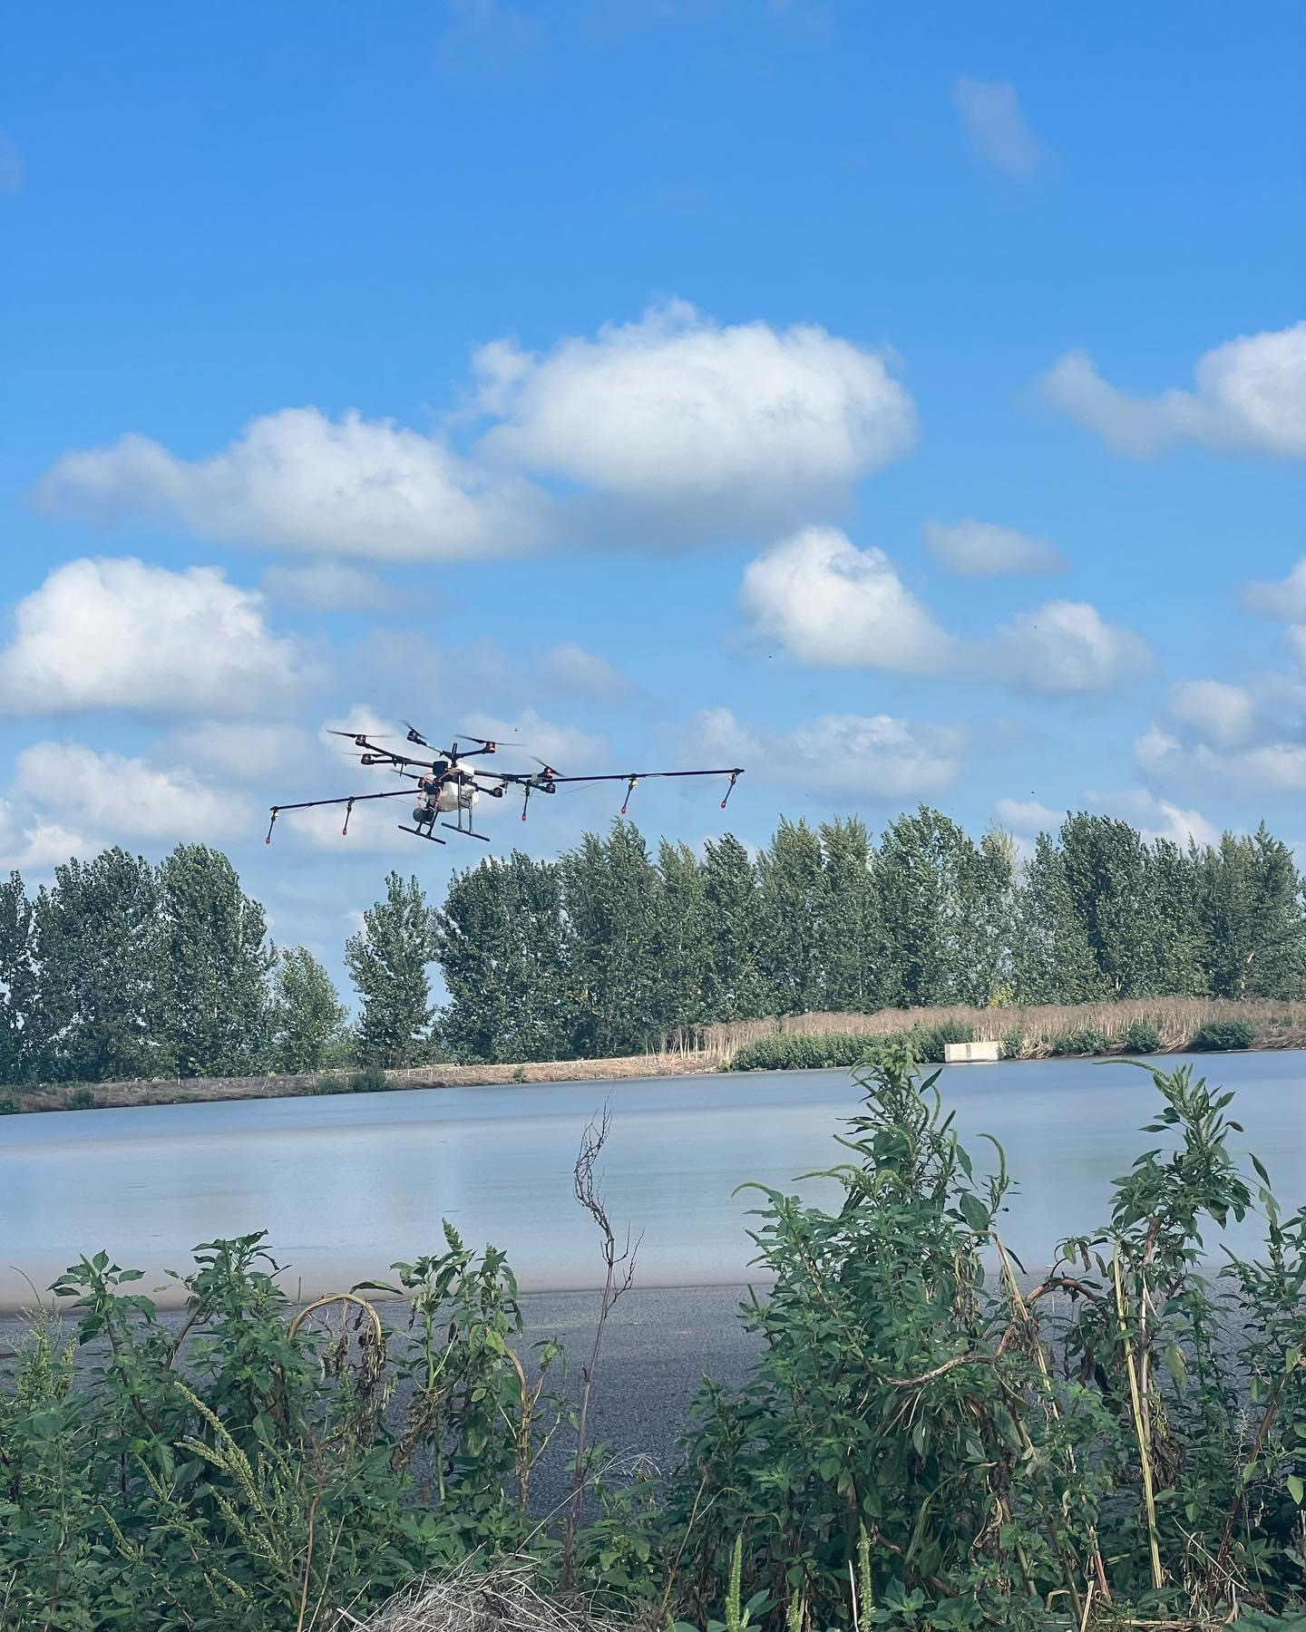
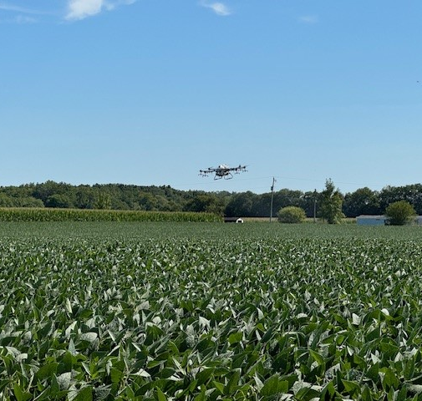
Drones/UAV
Indiana Regulatory Requirements
A category 11 applicator can apply aerially without additional categories (right of way, aquatics, ag)
Notes:
If ground equipment also used to apply pesticides -- you must be certified in the appropriate category.
For example Category 1 agriculture pest management. Category 6 Right of Way.
Can begin applications when Category 11 seen online record.
https://inplants.oisc.purdue.edu/USAPlantsIN/ApplicatorLogin.aspx

Slide 26
Clean Sweep Pesticide Disposal
Pesticide Disposal
Open to anyone
Most participants are Farmers and Pesticide Businesses
Allows for “no questions asked” disposal of suspended, canceled, banned, unusable, opened, unopened or just unwanted pesticides.
If it is a pesticide, we will accept it for disposal.
Locations change each year.
2nd and 3rd week of August
Notes:
Up to 250 pounds no charge
Anything over 250 pounds will be invoiced at $3.00 per pound. Increase from $2.50/lb
Clean Sweep is pesticide disposal --- not pesticide CONTAINER disposal

Slide 27
Can you spot it?
Located by Pest Management Professional while making an application to non-working farm.
Contacted OISC
Disposed of via Clean Sweep
If you are unsure, contact OISC.
Notes:
Red circle animated. 2,4,5-T AKA “Agent Orange”

Slide 28
2025 Clean Sweep Disposal Dates / Locations
To be added to the email list to receive information and participant form please contact:
Mitch Trimble
cleansweep@groups.purdue.edu
765-494-7142
***FORMS WILL NOT BE SENT OUT OR BE AVAILABLE VIA THE OISC WEBSITE UNTIL MAY 1, 2025***

Slide 29
Questions?
Nate Davis
Manager, Certification and Licensing
Office of Indiana State Chemist
davi1280@purdue.edu
765-494-7108

