Slide 1
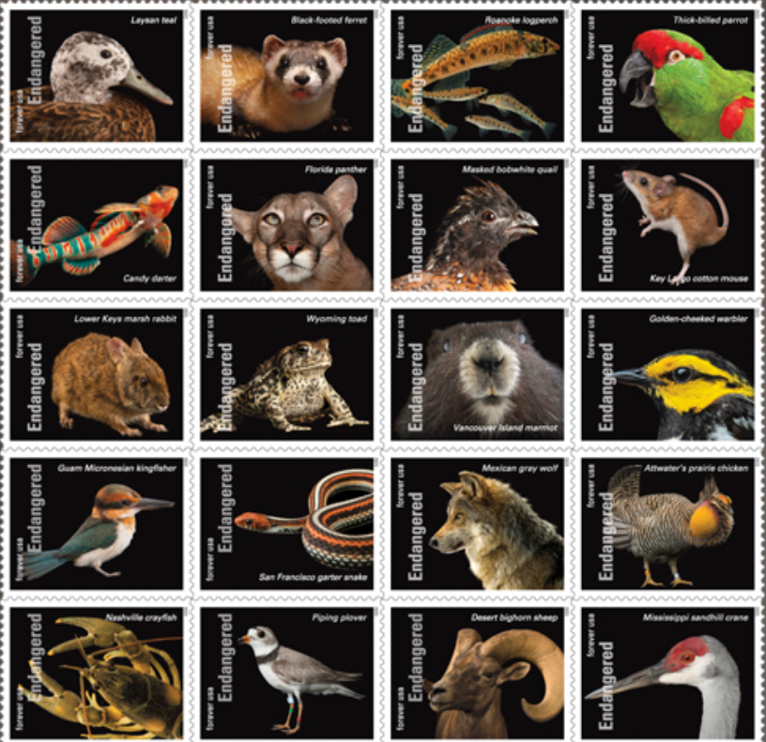
ENDANGERED SPECIES ACT: WINTER 2026 TRAINING
Bill Chism,
Kim Brown
Niranjana Krishnan
Developed December 2025
Notes:
The Endangered Species Act requires all federal agencies to consider threatened and endangered species and their critical habitat in any action. Pesticide labels are starting to be released that assess those impacts. This presentation will discuss the label changes and impact on management practices. Recent surveys suggest most farms will see little impacts.

Slide 2
OUTLINE OF SPRAY DRIFT AND RUNOFF EROSION PRESENTATIONS
Short introduction to ESA (both presentations)
This covers Fish and Wildlife Services species, the National Marine Fisheries Services only has ~ 100 species and will be in a separate presentation and may require additional mitigations
Where to find information: pesticide labels, Bulletins Live! Two (BLT), Pesticide Use Limitation Area (PULA), Mitigation Menu
Types of Mitigation Options:
Mitigations to reduce Off-Field Risks (i.e., runoff/erosion, spray drift)
Mitigations to reduce On-Field Risks (e.g.., timing restrictions, reducing % or field treated, etc.)
Where are mitigations not needed: application methods, sites, and within managed areas, example maps (both)
Example language from labels (both)
Spray Drift Presentation: mitigation options and calculations (only one presentation)
Runoff/Erosion: mitigation options and calculations (only one presentation)
Conclusion: species have recovered, working with a team of people, etc. (both)
Websites (both)

Slide 3
INSTRUCTIONS TO PRESENTERS SLIDE TO BE DELETED BY PRESENTER
This is designed so that it can be two presentations on ESA. Slides 1 to 21 (Introduction) and 56 to 59 (Conclusion) will be the same for both presentations.
If you want to create a spray drift presentation, e.e., runoff is not a problem in your state
Use slides 1 to 36 and 56 to 59
If you want to create a runoff/erosion presentation, i.e., spray drift is not a problem in your state
Use slides 1 to 24, 37 to 59
Some states are impacted by National Marine Fisheries Service mitigations. A list of pesticides, map of states, list of counties, and a short presentation will be available later at WSSA.net/endangered-species and https://pesticidestewardship.org/
There is a short presentation on ESA already at these two websites.
State level information …

Slide 4
WEBSITES FOR PRESENTER REFERENCE
SLIDE TO BE DELETED BY PRESENTER
State maps of the number of endangered and threatened species by county and ESA mitigations for 2022 to the present for pesticides can be found at https://festf.org/FESTF_Maps
A database of pesticides that have ESA language can be found at https://festf.org/Maps_and_Materials
A list of runoff/erosion mitigation relief points can be found at https://www.epa.gov/system/files/documents/2024-10/county-mitigation-relief-points-runoff-vulnerability.pdf
A list of FWS species for each state can be found at https://ecos.fws.gov/ecp/report/species-listings-by-state-totals?statusCategory=Listed
Here is the link to download any state runoff/erosion relief points under the County Maps tab. https://acreblitz.com/resources

Slide 5
What we hope the audience will learn
What can growers and applicators do to protect Endangered Species – keep pesticide on site
In addition to ESA these mitigations can help reduce risks to the environment and human health
Will all pesticide labels change immediately – could take 15 years
Where can I find Endangered Species Act Information - label, BLT, Mitigation Menu, PALM
What are examples of runoff/erosion mitigation options – conservation practices, cover crop, etc
What are examples of spray drift mitigation options – larger droplets, lower boom, etc

Slide 6
ENDANGERED SPECIES ACT (ESA)
ESA(1973) provides a program for conservation of threatened and endangered (i.e., listed) species and critical habitats.
Administered by U.S. Fish and Wildlife Service (FWS) and National Marine Fisheries Service (NMFS).
ESA states all federal agencies must ensure their actions do not harm listed species. this includes the U.S. Environmental Protection Agency (EPA’s) action of registering pesticides under Federal Insecticide, Fungicide, Rodenticide Act (FIFRA).
EPA ESA “harm" refers to the ESA prohibition on "take," which includes direct killing/harming and, significant habitat modification that injures species

Slide 7




GOVERNMENT AGENCY ROLES
EPA
Regulates pesticides and approves labels and collects data and growth perspectives to inform decision-making
FWS
Protects listed terrestrial and freshwater species
NMFS
Protects listed marine (saltwater) species
USDA
Analyzes impacts of mitigations for agriculture
The “Services”
Notes:
+Placeholder insecticide strategy.
As listed in the statute the agencies that enforce the ESA are the U.S. Fish and Wildlife Services and/or the U.S. National Marine Fisheries
EPA assesses the risk and consults with "the Services" as needed.
If there is potential harm, the agency will modify the labels as needed to mitigate risk.

Slide 8
WHY NOW? “MEGASUIT” SETTLEMENT WAS FINALIZED ON SEPT 12, 2023
"...the EPA may not avoid compliance with the ESA..."
Migrant Clinicians Network vs EPA. Dec 2023, 9th Circuit
It's déjà vu all over again. EPA comes before this court once more because of its failure to abide by the law....EPA cannot flout the will of congress-of the people-just because it thinks it is too busy or understaffed.
Center for Food Safety v. Regan, Dec. 2022, 9th circuit
"Before registering a pesticide, EPA must consult with the statutorily specified agencies that have expertise on risks to species' survival. But for decades EPA routinely skipped that step when it registered pesticides...."
Center for Biological Diversity v. EPA, Dec. 2022, DC Circuit
EPA has long had a fraught relationship with the ESA. It has made a habit of registering pesticides without making the required effects determination.
In re: Center for Biological Diversity and Center for Food Safety, Nov. 2022, DC Circuit
Notes:
Though ESA was passed in 1973, EPA undertook ESA assessments for pesticide registrations/re-registrations fewer than 5% of time. This resulted in multiple lawsuits, with a megasuit settlement in September 2023.

Slide 9


Over 1,700 Species are on the Endangered Species List
Plants
Birds
Fishes
Mammals
Snails
Amphibians
Clams
Insect
Reptiles
Crustaceans
Coral
Arachnids
U.S. Fish & Wildlife Service
NMFS
Over 900 species are potentially impacted by herbicides.
Over 900 species are potentially impacted by insecticides.
Notes:
Graphics from Ryan DeWitt, NMFS, NOAA
450 listed species are plants
580 listed species that depend on plants for food and shelter

Slide 10
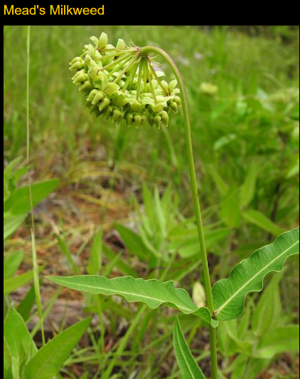
ESA: COMPLIANCE AND WILL IT GO AWAY
Compliance with label mitigations
State lead agencies will enforce labels
Each state will decide the best way to do that
Will it go away?
Any modifications would require bipartisan support (e.g., some years congress can’t even pass the budget)
The ESA has been successfully functioning for 50 years, and people want to protect Bald eagles, Florida manatees, etc.
Mead’s Milkweed

Slide 11
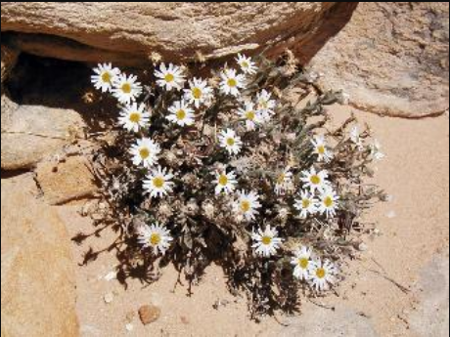
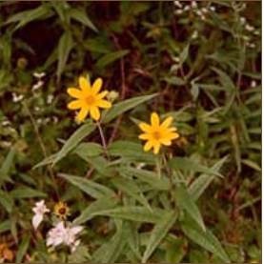
ESA IS SUCCESSFUL:
Animals | Plants
Bald eagles | Eggert’s sunflower
Peregrine falcons | Maguire daisy
Manatees | Mountain golden heather
Sea turtles | Robbins’ cinquefoil
Southern sea otter | San Clemente Island bush mallow
Maguire primrose | San Clemente Island lotus
Black-footed ferret | San Clemente Island paintbrush
Gray wolf | sandplain gerardia
 | seabeach amaranth
 | small whorled pogonia
 | Tennessee coneflower
 | Texas wild rice
 | Virginia round-leaf birch
 | Santa Cruz Island Dudleya
 | Santa Cruz Island bedstraw
Maguire Daisy, US FWS
Center for Biological Diversity (2023) said 99% of listed species are Still alive and 291 species have been saved or on the road to recovery (some examples)
Eggert’s Sunflower, CBD
Notes:
99.8% of listed species have survived

Slide 12
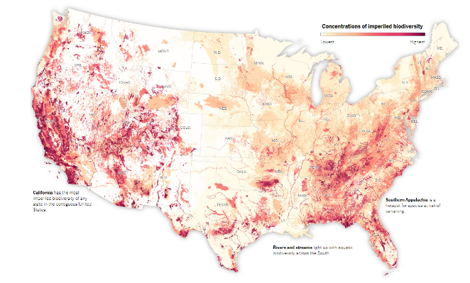
ESA PROTECTION: PEOPLE SAY THIS IS TOO COMPLICATED. BUT THE EPA OR COURTS HAD THREE MAIN REGISTRATION CHOICES
Option 1: Remove pesticide from the U.S. marketplace
Any pesticide that could impact listed species or critical habitat could have its registration removed
Option 2: Restrict its use to only crops/sites in counties or states without listed species or critical habitat
Map of listed species, more red shows larger populations (NY times 2022 map)
Option 3: Add mitigations to protect species
Minimizes the number of impacted users, allows use in many crops/sites and areas
Outlook: Would you prefer to not have access to the product or have access to it with mitigations?
Notes:
These are the options that the courts and EPA had at the beginning of the process. Now that the process has been started the options may look different.
Map is from New York Times 2022, darker colors means more species.

Slide 13
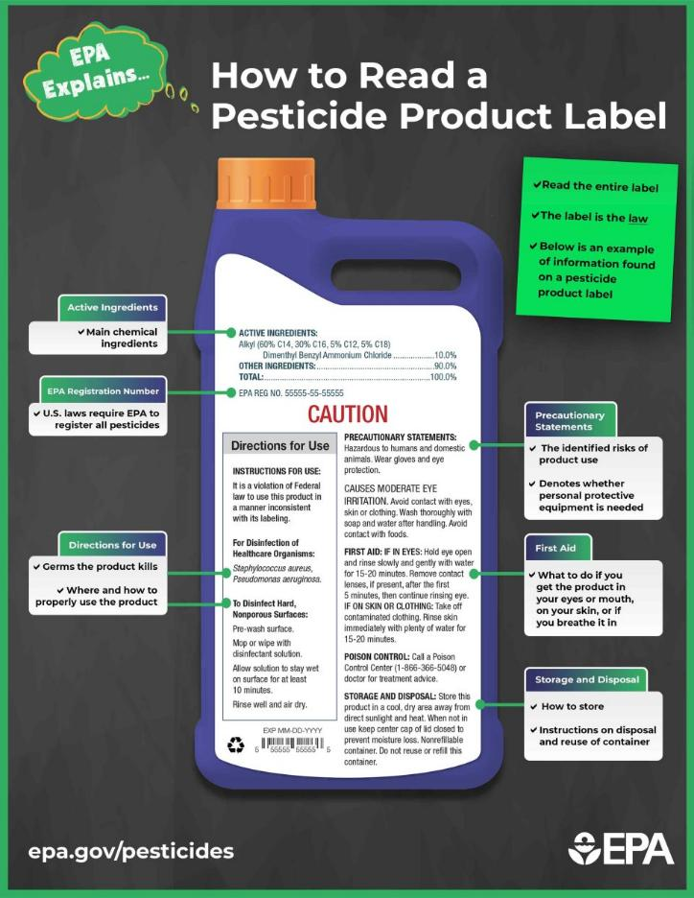
PESTICIDE LABELS WILL BE CHANGING TO PROTECT THREATENED AND ENDANGERED (LISTED) SPECIES AND THEIR HABITAT ONLY A FEW LABELS WILL BE CHANGING THIS YEAR! IT MAY TAKE SEVERAL YEARS FOR THE PROCESS TO CATCH UP FOR ALL PESTICIDES

Slide 14
FWS Listed Species Protection for Conventional Pesticides
Herbicide Strategy
For agricultural uses in the lower 48 states
Minimize spray drift and runoff/erosion exposure to reduce potential population level effects to listed plants and listed species that depend on plants
Insecticide Strategy
For agricultural uses in the lower 48 states
Minimize spray drift, runoff/erosion and on-field exposure to reduce potential population level effects to listed invertebrates and listed species that depend on invertebrates
Fungicide Strategy – Under Development
Draft April 2026
Final November 2026
Vulnerable Species Action Plan
Mitigation for listed species for which pesticides have been identified as a stressor
Includes on- and off-field exposures
Applicable to agricultural and non-agricultural uses
Rodenticide Strategy
Published Biological Evaluation with mitigation for all listed species and designated critical habitats on all 11 rodenticides as a group
Includes on- and off-field exposures
Applicable to agricultural and non-agricultural uses
Hawaii Strategy – Under Development

Slide 15
EXAMPLE LABELS WITH ESA MITIGATIONS
Isocycloseram (Insecticide) Vertento ™, Incipio ™, and Zivalgo ™ for cotton, vegetables, tree fruit. Final label 2025
Check Bulletins Live! Two
ESA Spray Drift Buffers: aerial 300 ft, ground 30 ft, airblast 85 ft, chemigation 25 ft
Buffers to bystanders and habited structures cannot be reduced
ESA Runoff/Erosion: 2 , 4, or 6 points depending on crop
Glufosinate-p (Herbicide) Liberty Ultra™ for canola, corn, cotton, soybean trait crops. Final label 2024
Check Bulletins Live! Two
ESA Spray Drift Buffer: aerial 50 ft, ground 10 ft
ESA Runoff/Erosion: 3 points
Notes:
Information from https://festf.starchapter.com/Mitigation_Tracker

Slide 16
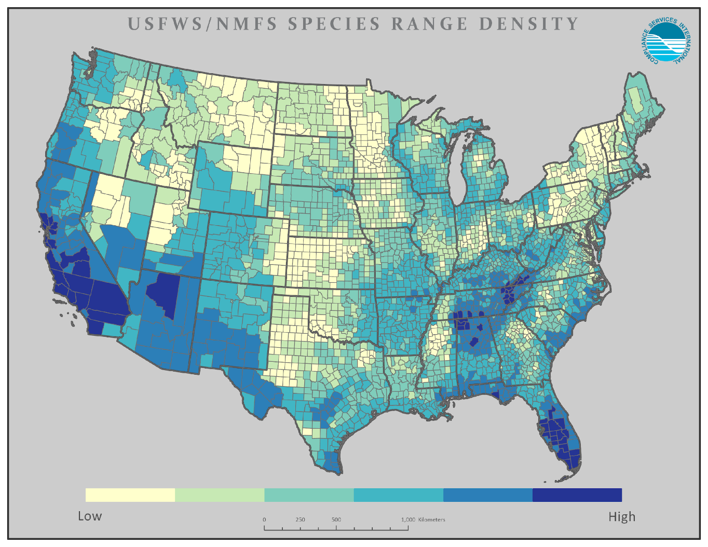


A NATIONAL SITUATION WITH LOCAL IMPLICATIONS
EVERY COUNTY IN THE US HAS AT LEAST ONE ESA-LISTED SPECIES AND IMPACTS ARE LOCAL. THESE NEED TO BE ADDRESSED LOCALLY BY THE END USER.
DARKER THE COLOR THE GREATER DENSITY OF SPECIES
Notes:
Map thanks to Compliance Services International (CSI) For individual state maps see https://festf.org/FESTF_Maps

Slide 17
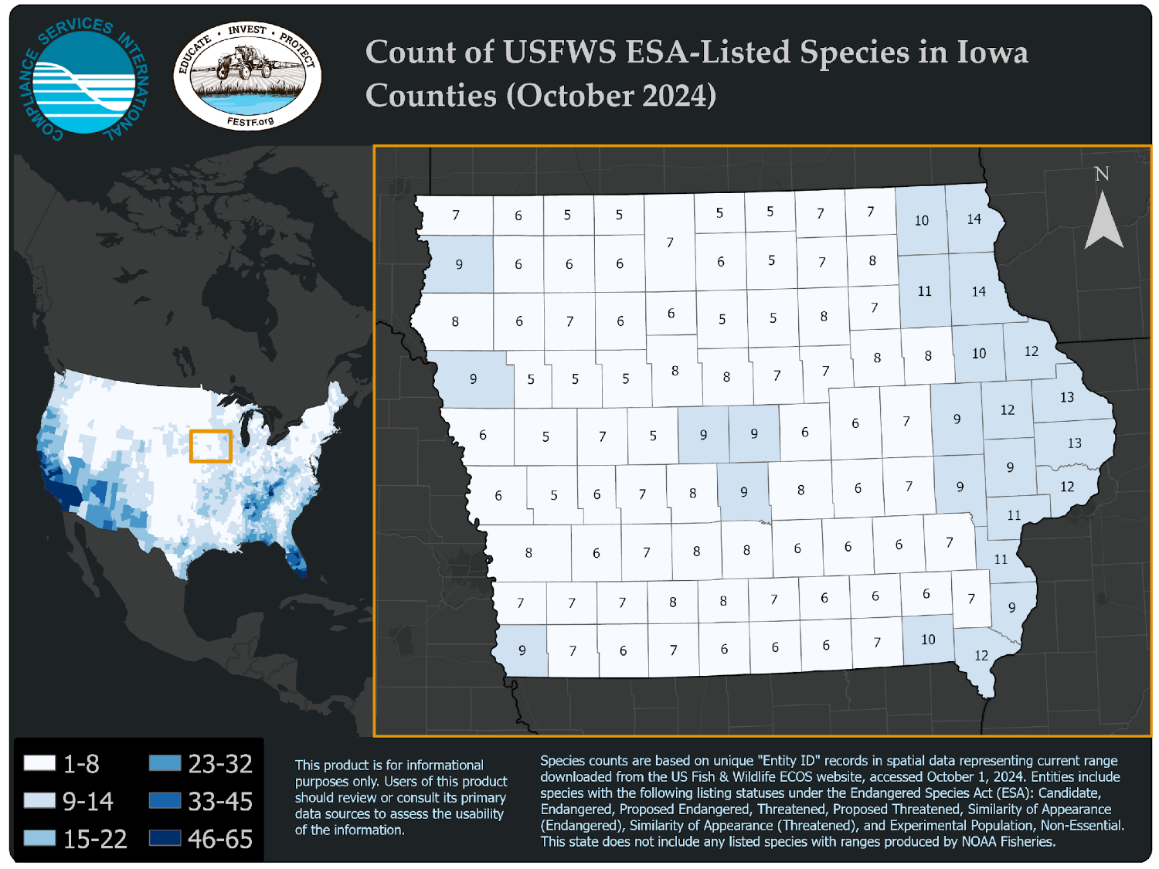
Iowa has 18 listed species
Notes:
Maps are provided courtesy of Compliance Services International (CSI) and the FIFRA Endangered Species Act Task Force (FESTF). Every state map is available under the Resources section of the FESTF website at www.festf.org/FESTF_MAPS . And the FWS list of species for each state is at Listed species with spatial current range believed to or known to occur in each State

Slide 18
LABEL CHANGES TO PROTECT LISTED SPECIES AND THEIR CRITICAL HABITAT
Mitigations may be nationwide (i.e., on the general label) or geographically specific (e.g., Bulletins Live! Two) or Pesticide Use Limitations Area
1. Mitigations to reduce Off-Field Risks
a. Spray drift
b. Runoff/Erosion
2. Mitigations to reduce On-Field Risks
a. Timing restrictions, reducing percent of field treated, etc.
Notes:
The types of mitigation include off-field (spray drift, runoff/erosion) and on-field mitigation (example: timing restriction) These types of mitigation may be nationwide (i.e., on the general label), or geographically-specific (i.e., in PULAs). ANY of the types of mitigation could be nation-wide or geographically specific, depending on the pesticide. The geographically-specific mitigation for PULAs may be located on the label or in a bulletin.

Slide 19
WHERE WE CAN FIND REQUIRED MITIGATIONS
For agricultural uses, mitigations have to be determined for each field/farm
Required spray buffer and runoff/erosion mitigation can be different for each pesticide and crop combination
Label reductions may not be possible in all cases (e.g., buffers to bystanders, habited structures, sink holes, water bodies, wells, etc. may still be needed)
Mitigations may appear on up to 3 places:
On the product label (in the future it may be on seed bag tag of treated seed)
Label may direct user to Bulletins Live! Two (BLT) webpage https://www.epa.gov/endangered-species/bulletins-live-two-view-bulletins
Label may direct user to Mitigation Menu webpage https://www.epa.gov/pesticides/mitigation-menu

Slide 20
PESTICIDE USE LIMITATION AREAS (PULAS)
EPA identifies geographic areas most critical to conserve a listed species and then adds buffers (1,000 feet or less) to account for potential offsite transport from a treated field.
If a field is in a PULA use of certain pesticides may be restricted
OR
additional mitigations may be required
If Bulletins Live! Two shows your field is outside of a PULA, it is in your best interest to document that there are no limitations within the month of your pesticide application.
You must check Bulletins Live! Two within 6 months before the application
Disclaimer: You should have a record of the date you obtained your bulletin

Slide 21
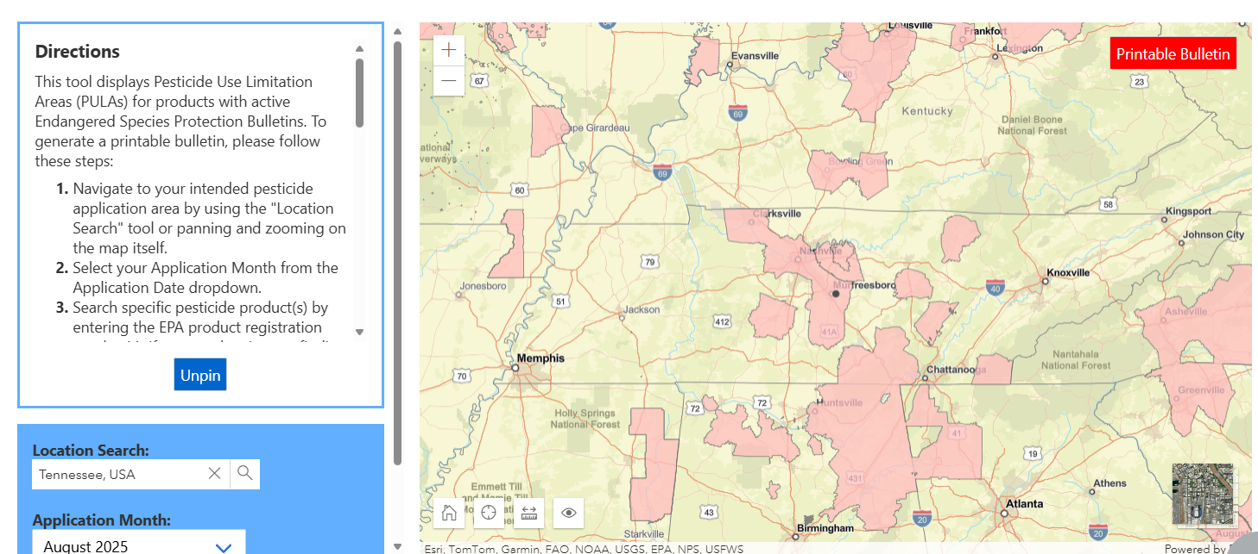
Bulletins Live! Two – Tennessee,
Shaded Areas are PULA’s for Dicamba applied to Dicamba Tolerant Crops

Slide 22
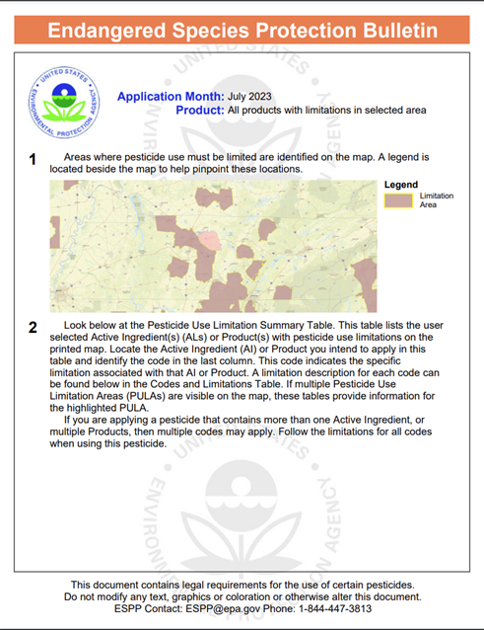
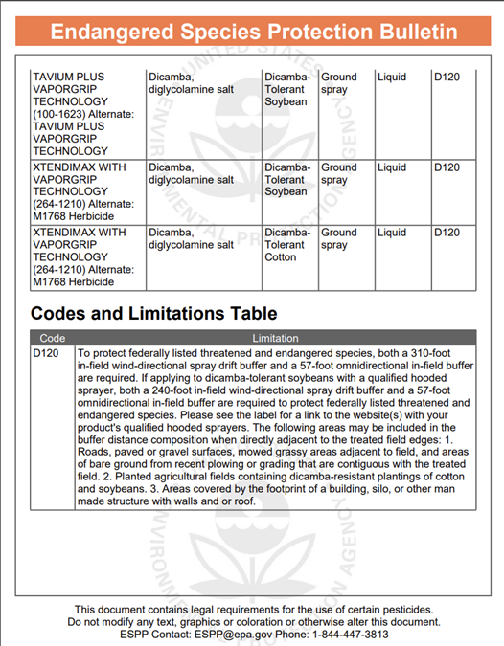
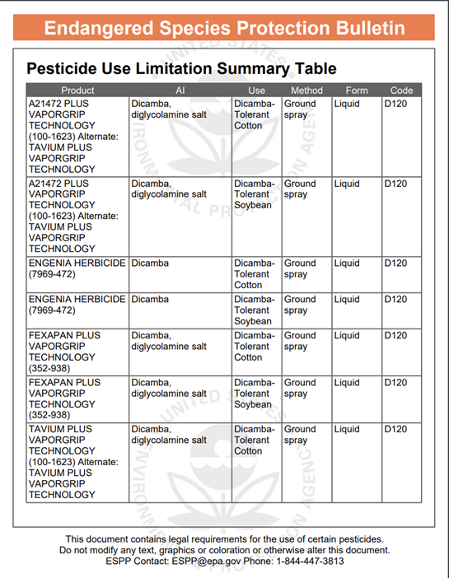
Notes:
This is all products that have restrictions in the counties selected in TN.
You can update this for your own state if you would like.

Slide 23
NO MITIGATIONS IF APPLICATION SITE IS NEXT TO A MANAGED AREAS FOR BOTH SPRAY DRIFT (DISTANCE SPECIFIED) AND RUNOFF/EROSION (1,000 feet)
Managed Area “What is not a protected area” from Insecticide Strategy page 5
Managed area needs to be a contiguous area to count for drift or runoff/erosion
Agricultural fields, pastures, forage fields, and private rangelands, including untreated portions of the treated field;
Roads, paved or gravel surfaces, mowed grassy/fallowed areas adjacent to field, and areas of bare ground from recent plowing or grading that are contiguous with the treated area;
Buildings and their perimeters, silos, or other man-made structures with walls and/or roof;
Areas present and/or maintained as a runoff/erosion measure as listed on EPA’s Mitigation Menu website. Examples include vegetative filter strips (VFS), field borders, grassed waterways, vegetated ditches, riparian areas, managed/constructed wetlands, or other areas of intentional habitat improvement;
Notes:
Insecticide Strategy Table 11. Runoff/Erosion Managed Areas
Insecticide Strategy Table 16. Spray Drift Managed Ares
Definition Slide at end

Slide 24
NO MITIGATIONS IF APPLICATION SITE IS NEXT TO A MANAGED AREAS FOR BOTH SPRAY DRIFT AND RUNOFF/EROSION
Areas present and/or maintained as a drift buffer reduction measure as listed on EPA’s Mitigation Menu website. Examples include vegetative windbreaks, hedgerows, shelterbelts, riparian areas, private forests, woodlots, and shrublands;
Conservation Reserve Program (CRP) and Agricultural Conservation Easement Program (ACEP) lands;
On-farm contained irrigation water resources that are not connected to adjacent water bodies, including on-farm irrigation canals and ditches, water conveyances, managed irrigation/runoff retention basins, farm ponds, and tailwater collection ponds.
The label will explain if a buffer cannot be reduced through mitigations (e.g., pollinator protection, protection of aquatic areas, wells, sinkholes, habited structures, hospitals, day care centers, etc.)
Notes:
Insecticide Strategy Table 11. Runoff/Erosion Managed Areas
Insecticide Strategy Table 16. Spray Drift Managed Ares

Slide 25
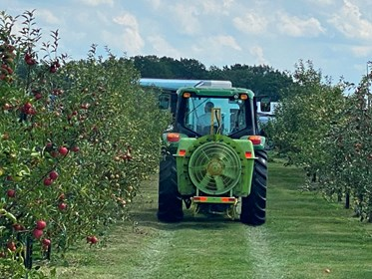
SPRAY DRIFT SECTION
REMINDER: SOME SPRAY DRIFT BUFFERS ARE NOT FOR ESA AND CANNOT BE REDUCED BY MITIGATION OPTIONS
E.G. BUFFERS TO WELLS, SINKHOLES, HOSPITALS, DAY CARE CENTERS, WATER BODIES, ETC.
Some of the examples that follow are hypothetical and just used as examples for applicators to better understand the mitigations.

Slide 26


Spray Drift buffers, for ESA, are downwind only
Glufosinate-p Herbicide
Supplemental Label Drift Reducing Adjuvant: aerial 2.5% and ground 0.3% volume of finished spray at low boom height
Mandatory aerial buffer = 50 feet, with medium droplets, maximum wind 15 mph, maximum height 10 ft. Label only allows 3 ways to reduce distance
Mandatory ground buffer 10 feet, with medium to coarser droplets with winds between 3 to 15 mph. Label only allows 4 ways to reduce distance
Isocycloseram Insecticide
Spray drift buffers aerial = 300 ft, ground = 25 ft, overhead chemigation = 25 ft, airblast = 85 ft
Buffers to areas occupied by humans for residential or commercial purposes cannot be reduced
Droplet size aerial and ground require medium or coarser droplet size
Winds speed 3 to 15 mph
Reductions in spray drift buffer, label says to use buffer reduction options listed in mitigation menu
Notes:
Include Vertento label language, page 22-23. Spray drift mgt. page 21. Includes specific mitigation options.
Add a note: some spray drift buffers cannot be mitigated.
Liberty Ultra medium or coarser droplet size, wind between 3 to 15 mph. The label only lists 4 ways to reduce drift not the total of 15 ways from mitigation list

Slide 27
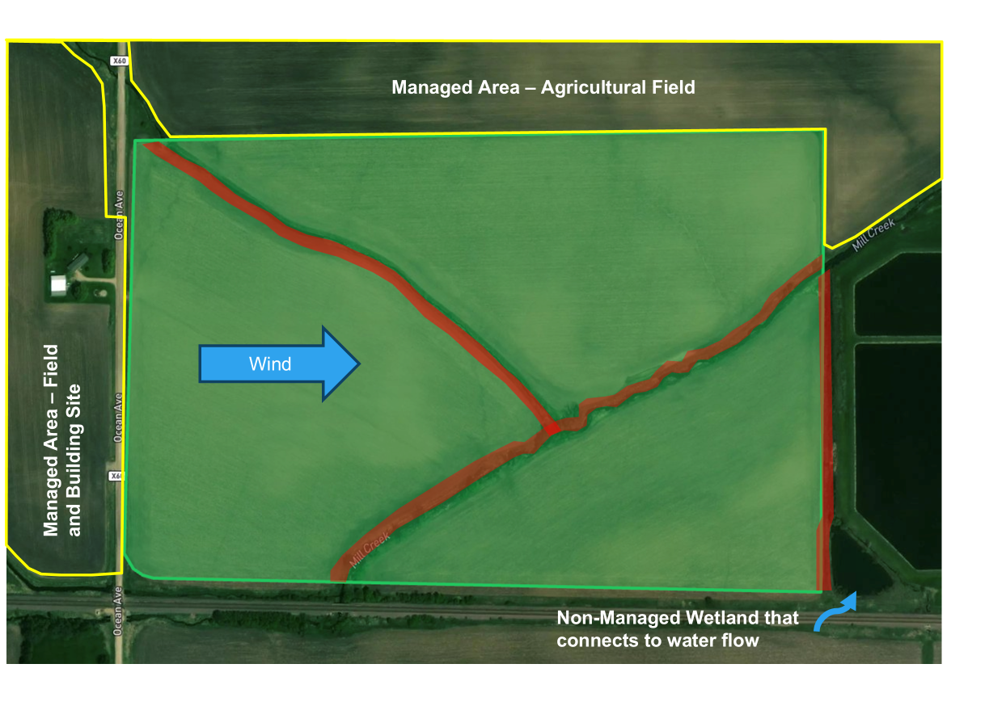
Spray Drift Scenario
Applying Liberty Ultra
Aerially Applied
Winds 8 mph W
Red = creek Label Requirements Requires 50 ft buffer Medium or coarser droplet size Max rate for planned use of 19 fl oz/A Options to Reduce Buffer DRA & coarse droplets = 35% Use rate is reduced 25% = 25% Relative humidity > 60% = 10% Total Reduction = 65%

Slide 28
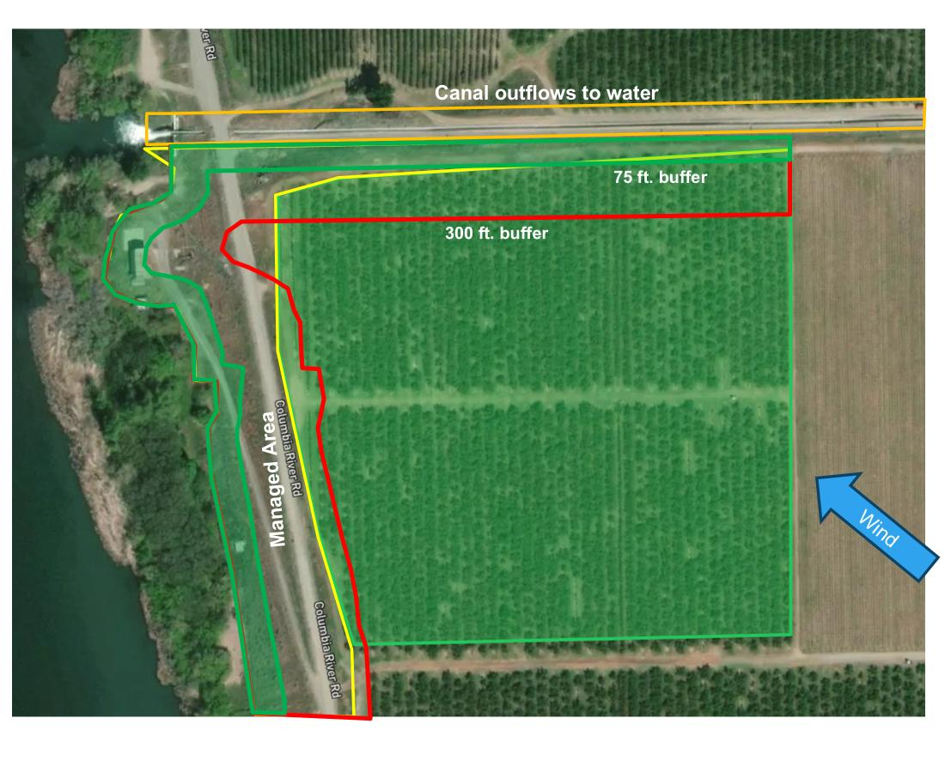
SPRAY DRIFT SCENARIO
Applying Vertento @ 1.5 fl oz/A
Aerially Applied
Winds 8 mph SE
Label Requirements
Requires 300 ft buffer
Medium droplet size
Max rate for planned use of 2 fl oz/A
Options to Reduce Buffer
Use coarse droplet size = 40%
Use rate is reduced 25% = 25%
Relative humidity > 60% = 10%
Total Reduction = 75%
New Buffer = 75 feet If using managed area to reduce buffer it must be a contiguous area to count
Notes:
This shows that you can spray almost the entire field. The green zone (new buffer) is not in your application area.

Slide 29

ESA SPRAY DRIFT BUFFERS: PERCENT SCALE
Buffers are downwind only, downwind only applies to ESA
Aerial 300 ft max
Ground 100 ft maximum
Airblast, orchard 85 ft max
Buffers are to protect “unmanaged areas”
There are over 15 ways to reduce buffer distances for ground applications
Application methods with low potential for drift do not need a buffer
Non-overhead chemigation methods
In furrow sprays with nozzle ≤ 8 inches above soil
Tree trunk drench, tree trunk paint, tree injection
Soil Injection
Solid formulations used as a solid
Less than 1/10 acre treated and spot treatment <1,000 sq ft
USDA NIFA
Notes:
Insecticide Strategy Table 7. Buffer Distances: Aerial 300 ft max, ground 100 ft max, airblast 85 ft max
Insecticide Strategy Table 9. Spray Drift Mitigations

Slide 30
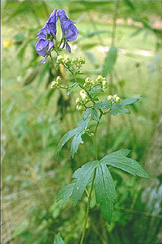
GENERAL STRATEGY FOR ACHIEVING DRIFT BUFFER REDUCTION
Check for exemptions to mitigation
Application Method
Subsurface chemigation, tree or soil injection, solid formulations, spot and small area treatments
Site Characteristics
Distance downwind to unmanaged area ≥ ESA Spray Buffers: aerial 300 ft, airblast 85 ft, ground 100 ft, chemigation 25 ft
Wind direction can change so check all sides of site
Check for downwind windbreaks, hedgerow, riparian forest, shrubland, woodland
Check for application mitigation options (ground applications)
Droplet size,
lower boom height,
drift reducing adjuvants for herbicides,
etc
Start with items 1 and 2 because they don’t change often

Slide 31
SPRAY DRIFT BUFFERS: GROUND MITIGATION OPTIONS
This and following slides do not include all examples
Mitigation Measures | % Reduction in Distance
Reduce Single Application Rate (includes banded applications) | % reduction corresponds to rate reduction from label maximum
High Boom, Droplet fine to medium-coarse DSD Droplet coarse DSD | 75% 85%
Low Boom, Droplet very fine to fine DSD Droplet fine to medium-coarse DSD Droplet coarse DSD | 50% 75% 85%
Hooded Sprayer, Over-The-Top Row Middle | 50% 75%
Sprays below top of crop using drop nozzles/layby nozzles | 50%
Spray Drift Reducing Adjuvants (Agents), Droplet Medium DSD Droplet Coarse or Very Coarse DSD | Only Herbicides (assumes starting a fine droplets) 30% 15%
DSD = Droplet Size Distribution
Notes:
Insecticide Strategy Table 7. Buffer Distances: Aerial 300 ft max, ground 100 ft max, airblast 85 ft max
Insecticide Strategy Table 9. Ground Spray Drift Mitigations
Increasing droplet size from Fine to Medium = 75% + DRA = 30% so effectively 100%
Spray Drift Adjuvant from Herbicide Strategy

Slide 32
SPRAY DRIFT BUFFERS: GROUND MITIGATION MEASURES (CONT.)
Mitigation Measures | % Reduction in Distance
Reduced Proportion of Field Treated
Field Border Application 1 Pass (field is 1/10 acre to 1 acre) 2-4 Passes (or field is > 1 acre to 4 acres) 5 – 10 Passes (or field is 4 acres to 10 acres) | 75% 35% 15%
Downwind windbreak / hedgerow / riparian / forest / shrubland / woodland | 50% for basic windbreak / hedgerows / artificial screen 75% for advanced windbreak/hedgerow/artificial screen 100% for riparian/forests/woodlots/shrubland ≥60ft width
Relative Humidity is 60% or more at time of application | 10%
Notes:
Insecticide Strategy Table 9. Ground Spray Drift Mitigations
Look at Mitigation menu for more examples
Airblast, 1 row treated = 70% reduction, 2 - 4 rows treated = 30% reduction, 5 - 10 rows treated = 15% reduction

Slide 33
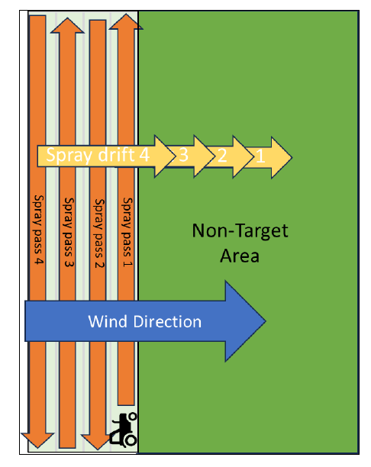
REDUCING PROPORTION OF FIELD TREATED
Field Border Application - Ground Application Example
Treat 4 to 10 A of field
or only treat
5 to 10 passes
get 15% reduction in spray drift buffer
Treat
> 1 to 4 A of field
or only treat
2 to 4 passes get 35% reduction in spray drift buffer
Treat 1/10 - 1 A of field
or 1 pass get 75% reduction
Application to field borders can reduce the spray drift buffer
Prevailing wind must be towards non-target area for buffers to be in effect
Reductions are based on size of area treated
This is in cases where only the border of the field is being treated for specific pests (insect or plant pathogen).
Notes:
Insecticide Strategy Table 8 (page 51) and Figure 5 (page 48)
The intent of this mitigation is to give growers/applicators an option to do an application along the edge of a field where a pest (typically an insect) is moving into that field.

Slide 34
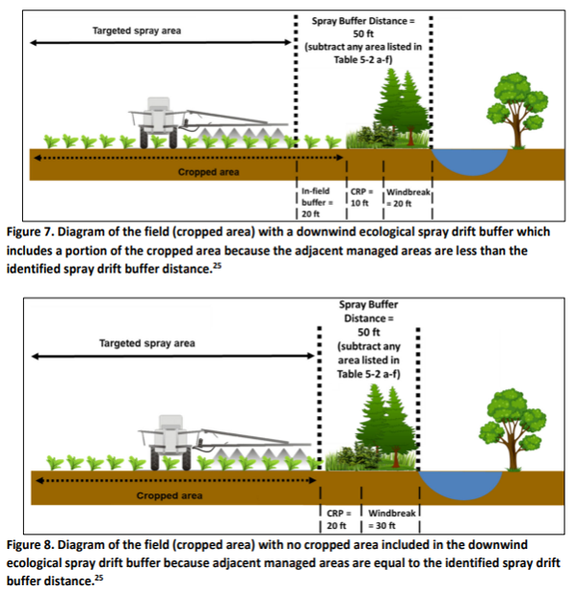
SPRAY DRIFT EXAMPLE: 50 FOOT BUFFER REQUIREMENT

Slide 35
Spray Drift Buffer Calculation - ground application
Isocycloseram Vertento ™ Insecticide (final label) –
Label requires 30 foot buffer for ground application and medium or coarser droplet
Remember continuous managed areas can be inside the spray buffer: ag fields, mowed areas, roads, etc.
20% reduction, 20% rate reduction
15% reduction reduced proportion of field treated (only 5 passes or 4 to 10 A treated)
Buffer would be 35% lower (20% + 15%) or 20ft (round to nearest 5 ft)
If buffer is <10 ft no ESA mitigation is needed
If you need a smaller buffer
Reduce the area treated (potentially treating just a strip near the road counts)
Wind breaks on downwind side of area = 50 to 100% reduction
Some buffers e.g., protecting bystanders cannot be reduced through menu options
Notes:
Round to the nearest 5 foot increment
No ecological drift buffer is required if:
• use of the buffer reduction options results in a buffer reduction ≥100%.
• use of the buffer reduction options results in a buffer <10 feet no mitigation is needed, from Mitigation Menu Step 6

Slide 36
Spray Drift Buffer Calculation: Tank Mix Example
ground application
Tank mix of three pesticides: two with ESA buffers and one without
50% reduction over-the-top hooded sprayer
10% reduction if relative humidity is ≥ 60% at time of application
15% reduction for reduced proportion of field treated (only 5 passes on 4 acre field)
Buffer would be 75% lower (50% + 10% + 15%) or 12 feet = 10 ft round to nearest 5 ft
If buffer is <10 ft no ESA mitigation is needed
Pesticide | Product A | Product B | Product C
Buffer Distances | 50 feet | 30 feet | none listed
Total Buffer | Use 50 feet (use the longest distance, do not add distances)
Notes:
Round to the nearest 5 foot increment
No ecological drift buffer is required if:
• use of the buffer reduction options results in a buffer reduction ≥100%.
• use of the buffer reduction options results in a buffer <10 feet no mitigation is needed, from Mitigation Menu Step 6

Slide 37
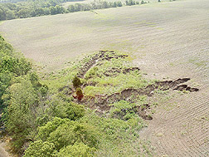
RUNOFF EROSION SECTION
REMINDERS: SOME RUNOFF/EROSION MITIGATIONS MAY NOT BE FOR ESA AND CANNOT BE REDUCED BY MITIGATION OPTIONS (CHECK THE LABEL)
Example label or bulletin language
DO NOT apply when soils are saturated or above field capacity
DO NOT apply during rain
Insecticide Strategy, unlike the Herbicide Strategy, considers insects such as adult butterflies are likely to occur on treated agriculture fields and therefore on-field mitigations may be necessary (Insecticide Strategy page 15)
To protect on-field species label may have reduced rates, changes to application timing, etc.

Slide 38
Survey Data on Runoff/Erosion Mitigation Points
2025 American Soybean Association survey:
100% of respondents would have 3 points
96% of respondents would have 6 points
71% of respondents would have 9 points
2025 Spatial Analysis of EPA’s Runoff Mitigation Point System by Hassinger, C, D. Campana, and M. Ranville: Crops surveyed were corn, cotton, and soybeans
100% of respondents would have 3 points
97 to 99% of respondents would have 6 points
69 to 72% of respondents would have 9 points
Notes:
From C. Hassinger, D. Campana, and M. Ranville 2025. ACS Presentation
This slide can help the presenter put the audience more at ease by stating that a couple of surveys have been completed and many growers can get 6 mitigation points fairly easily. Both surveys show similar/the same data.

Slide 39
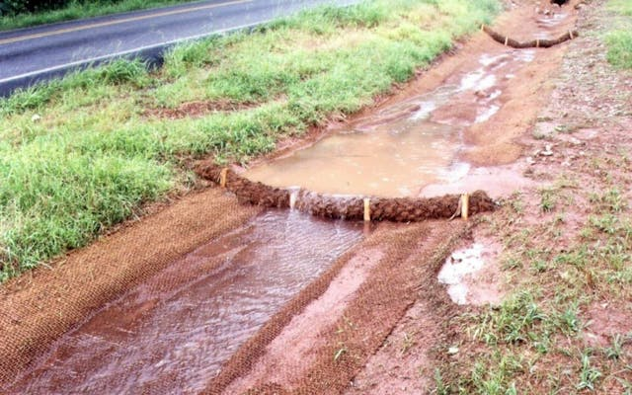
MITIGATION FOR RUNOFF/EROSION – POINT SYSTEM
Options are Designed to protect listed species and critical habitat up to 1,000 feet downslope.
Pesticides will need 0 to 9 mitigation points, which will be listed on label
There are ~40 ways to reduce runoff/erosion mitigations.
Some applications do not need additional mitigations (buffers), such as spot treatments, tree injections, chemigation, field has permanent berms, or tailwater return systems, etc.
Notes:
1,000 feet is not always specified on EPA documents

Slide 40

General Strategy for Achieving Runoff/Erosion Points
Check for exemptions from mitigation
Site characteristics,
Application methods, and
Surrounding managed areas down slope 1,000 feet of treated site
2. Check for relief points for the county (0 to 6 points)
3. Check for Field Characteristic Points
Slope <3% (2 pts)
Predominantly sandy soils (2 pts)
4. Existing cropping practices
No irrigation (3 pts)
No tillage (3 pts) or reduced tillage (2 pts)
Grassed waterways (2 pts)
5. Additional mitigation points based on EPA’s mitigation options
Start with items 1 through 4 because they don’t change very often
Notes:
From C. Hassinger, D. Campana, J. Brausch, and M. Ranville 2025. Spacial Mitigation of EPA’s Runoff Mitigation Point System ACS Presentation
*Items 1-4 do not change. This will help growers/applicators be able to potentially meet mitigation points prior to going to a website.
There are some areas with groundwater concerns where some pesticides cannot be used.

Slide 41

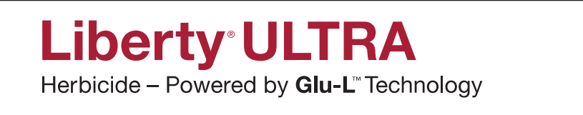
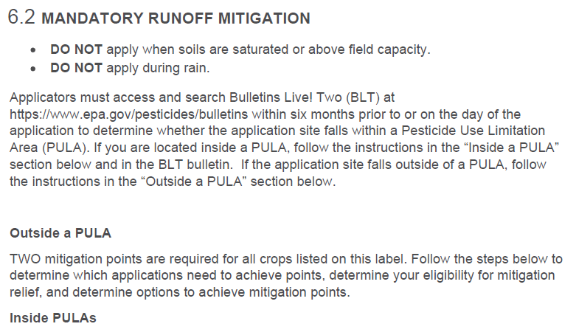
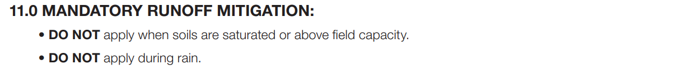
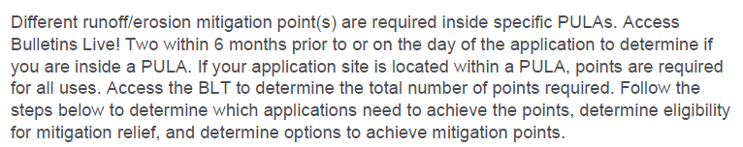
PESTICIDE USE LIMITATION AREAS (PULAs)
Both labels have different points inside vs outside PULA
Applicators must access and search Bulletins Live! Two (BLT) at https://www.epa.gov/endangered-species/bulletins-live-two-view-bulletins within six months of the application to determine whether the application site falls within a Pesticide Use Limitation Area (PULA) that has a Bulletin in BLT.
Notes:
One thing to note is that some products like Vertento have restrictions outside of the PULA for all applications. This is an example of label language outside and inside the PULA and how that changes the need for runoff mitigation points needed.

Slide 42
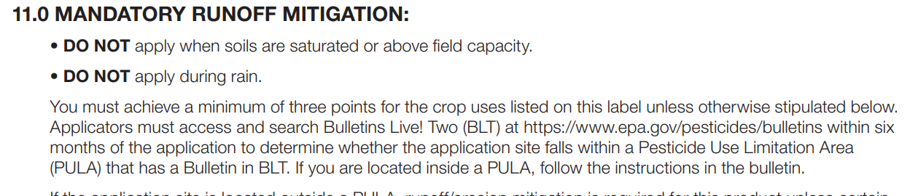
RUNOFF
Examples of runoff/erosion points
Glufosinate-P (Herbicide) 3 pts,
Isocycloseram (Insecticide) 2 pts, 4 pts, or 6 pts based on site
Simazine (Herbicide) 3 pts,
Trifludimoxazin (Herbicide) 6 pts
Notes:
Pesticide users will want to analyze the fields in advance for runoff/erosion points.
If they plan on using a pesticide during the season it would be wise to consult Bulletins Live! Two (BLT) to confirm the points needed.
Checking BLT can help determine whether they are subject to runoff/erosion mitigation.

Slide 43
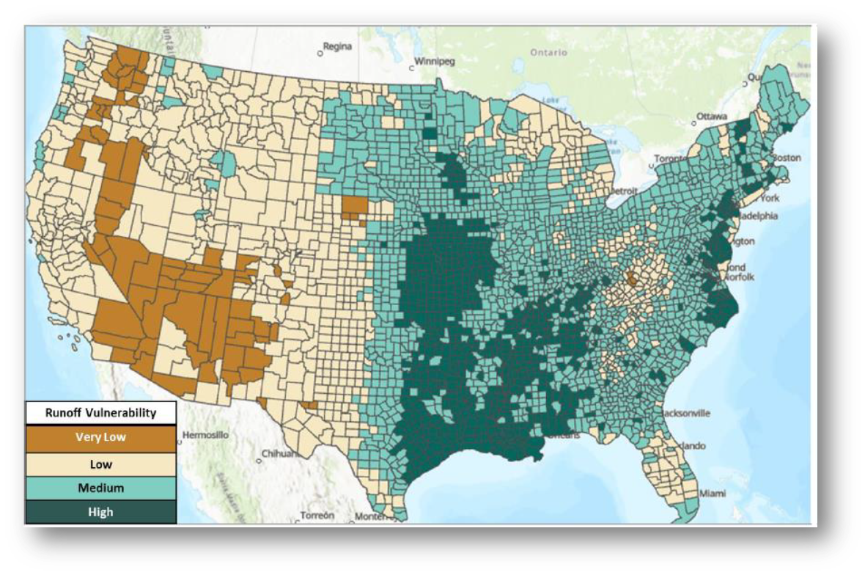
RUNOFF VULNERABILITY RELIEF POINTS
(0 TO 6 POINTS)
Relief Points
Dark Brown = 6 pts
Light Brown = 4 pts
Light Green = 2 pts
Dark Green = 0 pts

Slide 44
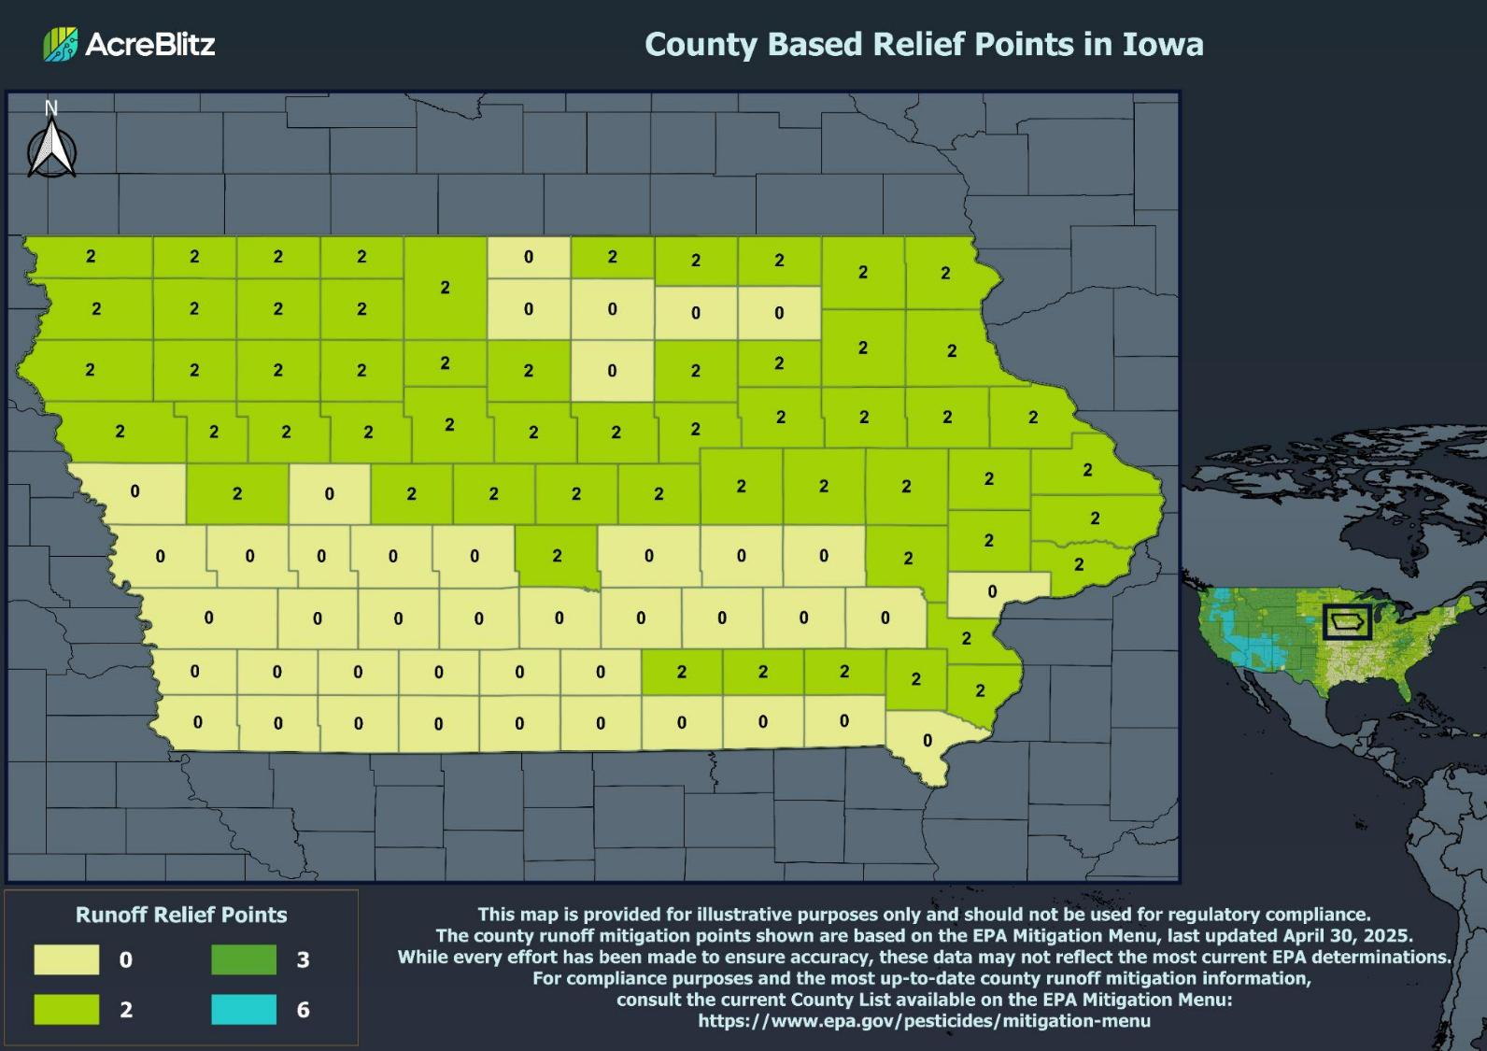
Notes:
Here is the link to download any state under the County Maps tab.
https://acreblitz.com/resources

Slide 45
RUNOFF/EROSION MITIGATION OPTIONS
This and following slides do not include all examples
Location
County-based relief
In-field Measures
Irrigation water management
Conservation tillage
Cover crops
Vegetative strips
Reservoir tillage
Field-adjacent Measures
Grass waterway
Vegetative filter
Vegetative ditch
Riparian area
Terrestrial habitat
Field Characteristics
Slope ≤3%
Coarse-textured soils
EPA Qualified Conserv. Program
Other
Mitigation tracking
Technical Specialist or Conservation program
Two from: in-field, field-adjacent, or runoff/discharge
Pesticide Specific
Annual rate reduction
Reduction % field treated
Soil incorporation
Measures must be implemented using descriptions on EPA mitigation menu.
https://www.epa.gov/pesticides/mitigation-menu-measure-descriptions
Notes:
The technical specialist must meet the following characteristics:
Have technical training, education and/or experience in an agricultural discipline, water or soil conservation, or other relevant discipline that provides training and practice in the area of runoff or erosion mitigation technologies/measures; and
Participate in continued education or training in the area of expertise which should include runoff and erosion control; and
Have experience advising on conservation measures designed to develop site specific runoff and erosion plans that include mitigation measures described in EPA’s Mitigation Website.
EPA has identified the following examples of technical experts: NRCS and similar state or regional level program staff, Certified Crop Advisor, Pesticide Control Advisor, Certified Professional Agronomist, National Alliance of Independent Crop Consultants (NAICC), EnviroCert International, Inc., Certified Professionals in Erosion and Sediment Control, Technical Service Providers, and extension agents. EPA acknowledges that this list is not exhaustive, and the inclusion of an organization should not be construed as an endorsement of any particular group by EPA.
EPA has developed the following minimum characteristics for a conservation program to receive the two points. Only programs that include all of these characteristics are eligible for the points:
The program provides advice from individuals who meet the same characteristics provided above for technical experts; and
The program provides site-specific guidance tailored to the grower/applicator’s crop and/or location; and
The program focuses on reducing or managing runoff and/or erosion (including for example, soil loss, soil conservation, water quality protection) from agricultural fields or other pesticide use sites; and
The program provides documentation of program enrollment. This documentation does not need to be provided to EPA; and
The program includes verification of implementation of the recommended measures or activities (measures were established and maintained). Verification can be done through the conservation program and provided to the program enrollee. Verification is not required to be submitted to EPA.

Slide 46
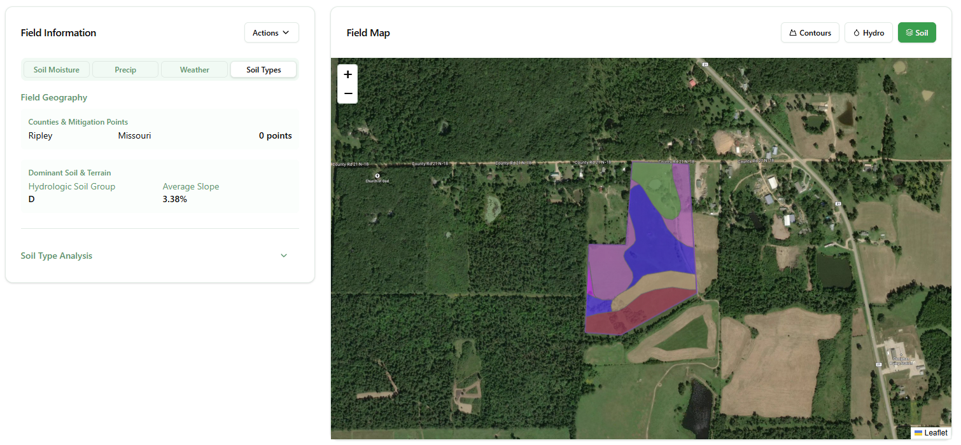
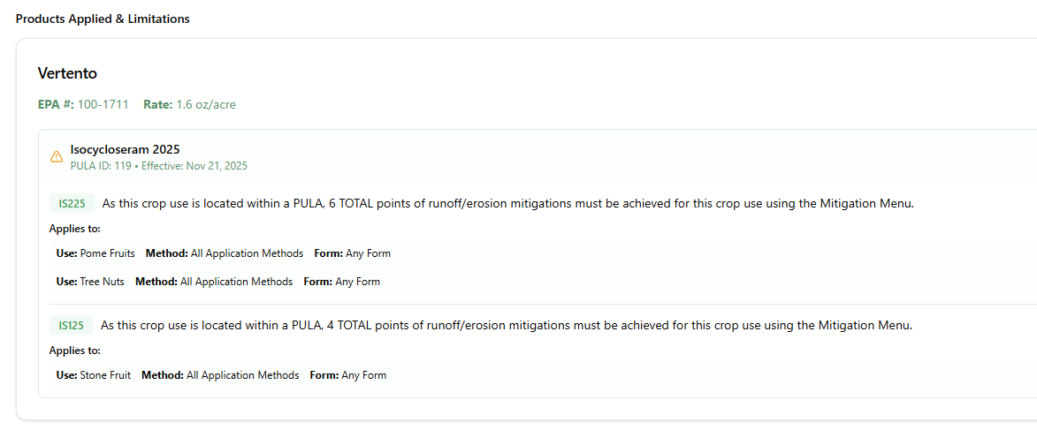
Example: Vertento Insecticide
All Crops in and out of PULA require 2 runoff mitigation points.
Number of points needed per crop inside of the PULA
Cotton, Soybeans, Corn, etc. - 2
Pome Fruits & Tree Nut - 6
Stone Fruit - 4
Other Potential Limitations on BLT
DO NOT use on cucurbits in bloom from two hours after sunrise until two hours before sunset.
Notes:
In this example this field is in a PULA requiring additional mitigation points than the minimum 2 points listed on the label. Listed are a few examples of runoff mitigation points.
This map is sourced from AcreBlitz ESA Check Tool at https://acreblitz.com/pula-check
EPA is has not verified apps or websites accessed outside the EPA.

Slide 47
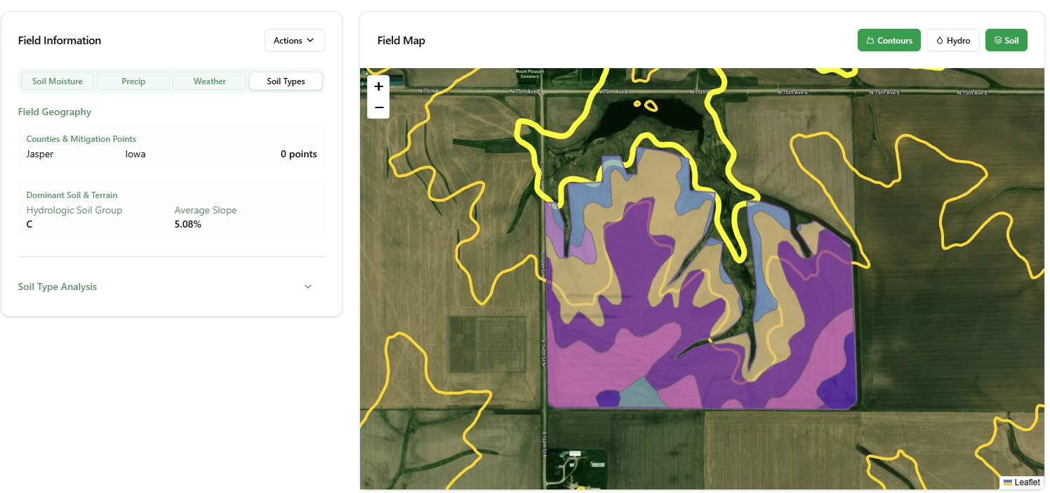
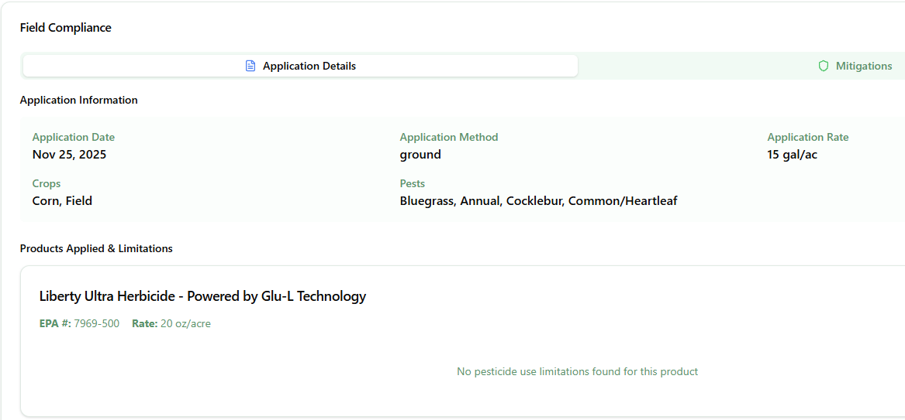
Example: Liberty Ultra Herbicide
All applications requires 3 mitigation points per label requirement
In this example, no additional limitations in this PULA
Meeting 3 points:
Mitigation tracking = 1 point
Reduced tillage = 2 points
Additional/other points can be referenced on the mitigation menu
Notes:
This is an example of field with the soil types highlighted in the selected field. The yellow lines are the contours in the field to show slope changes within the field. This county has 0 runoff mitigation relief points. One way of meeting the necessary points in mitigation tracking for 1 point and if the producer is practicing reduced tillage for 2 points. With the slope of this field there is a high likelihood that reduced tillage is taking place.
This map is sourced from AcreBlitz ESA Check Tool at https://acreblitz.com/pula-check

Slide 48
Application Parameters Options
Mitigation Relief | Qualifying Practices | Points
Annual application rate reduction | Any application 10% to ˂30% less than the maximum labeled annual application rate | 1
 | Any application 30% to ˂60% less than the maximum labeled annual application rate | 2
 | Any application ≥60% less than the maximum labeled annual application rate | 3
Reduction in proportion of the field treated (banded application, partial field treatment, ground precision sprayer, smart sprayer, or other specialized method) | Portion of field not treated: 10 to ˂30% (banded application, partial treatment, precision sprayers) | 2
 | Portion of field not treated: 30 to ˂60% | 3
 | Portion of field not treated: ≥60% | 4
Soil incorporation | Watering-in or mechanical incorporation before a runoff producing event. | 1
Notes:
We have listed the most common options and not everything.
Insecticide Strategy Table 14. Runoff/erosion mitigation measures

Slide 49
FIELD CHARACTERISTIC OPTIONS
Mitigation | Qualifying Practices | Points
Field slope | Field slope ≤3% (naturally low slope or flat fields; flat laser leveled fields) | 2
Predominantly sandy soils | >50% sand, loamy sand, or sandy loam soil without a restrictive layer that impedes the movement of water through the soil. See mitigation worksheet. | 2
EPA Qualified Conservation Program | Operation consists of farm with distinct program & program achieves 9 pts & elements are maintained once it has been “qualified” | 9
See EPA mitigation worksheet for full description https://www.epa.gov/system/files/documents/2025-09/runoff-mitigation-worksheet-september-2025_1.pdf
Notes:
Insecticide Strategy Table 14. Runoff/erosion mitigation measures

Slide 50
IN-FIELD MITIGATION MEASURES
Mitigation | Qualifying Practices | Points
Conservation tillage | No-till, including perennial crops (e.g., orchards that are not tilled) | 3
 | Reduced tillage, strip tillage, ridge tillage, mulch tillage | 2
Reservoir tillage | Reservoir tillage, furrow diking, basin tillage | 3
Contour farming | Contour farming, contour tillage, contour orchard and perennial crops | 2
Vegetative strips – In-field | Inter-row vegetated strips, strip cropping or intercropping, alley cropping, prairie strips, contour buffer strips, contour strip cropping, vegetative barrier (occurring in a contoured field) | 2
Irrigation Water Management | Dry farming, non-irrigated lands Soil moisture sensors with center pivots & sprinklers, drip tape, drip emitters Flood or furrow irrigation with computerized hole selection | 3 2 2
Anionic Polyacrylamide (PAM) | Use of water soluble PAM in irrigation water | 2
Terrace farming | Terrace farming, terracing, field terracing | 2
Cover crop or continuous ground cover | Cover crop or continuous groundcover; with tillage | 1
 | Short-term cover crop or continuous groundcover; no tillage | 2
 | Long-term cover crop or continuous groundcover; no tillage | 3
Notes:
Mulching with Natural and Artificial Materials would give 1 or 3 points
Erosion Barriers (not listed) would give 2 points

Slide 51
FIELD-ADJACENT MITIGATION OPTIONS
Mitigation | Qualifying Practices | Points
Grassed waterway | Grassed waterway | 2
Vegetative filter strips adjacent to field | 20 to 30 ft wide | 1
 | 30 to < 60 ft wide | 2
 | ≥60 ft wide | 3
Vegetative ditch | Vegetative ditch | 1
Riparian forest buffer; riparian herbaceous cover | 20 to 30 ft wide | 1
 | 30 to < 60 ft wide | 2
 | ≥60 ft wide | 3
Constructed and Natural Wetlands | Wetland and riparian landscape/habitat | 3
Landscape / Habitat Improvement | 20 to 30 ft wide = 1 pt, 30 to 60 ft = 2 pts, ≥60 ft = 3 pts | 1 - 3
Filtering Devices: filters, sleeves, socks | Using compost amendments or act. charcoal | 1 - 3
Notes:
Insecticide Strategy Table 14. Runoff/erosion mitigation measures
Filtering Devices with Activated Carbon or Compost Amendments not included = 3 or 1 pts

Slide 52
SYSTEMS THAT CAPTURE RUNOFF AND HAVE CONTROLLED DISCHARGE
Mitigation | Qualifying Practices | Points
Water retention systems | Retention pond, sediment basins, catch basins, sediment traps | 2
Subsurface Drainages and Tile Drainage Installed without Controlled Drainage Structure | Subsurface tile drains, tile drains | 1
Notes:
Insecticide Strategy Table 14. Runoff/erosion mitigation measures

Slide 53
OTHER
Mitigation | Qualifying Practices | Points
Mitigation tracking | Documented at the field or farm level, using paper or electronic format | 1
Working with or following recommendations from a technical specialist | Have technical training, education and/or experience in the area of runoff or erosion mitigation. Criteria are specified in the Insecticide Strategy | 1
 | or
Participating in a non-qualifying conservation program | The program provides advice from technical experts to reduce or manage runoff/erosion | 2
Using mitigation measures from multiple categories | Practices must be used from at least 2 of the following categories: in-field, field-adjacent, or systems that capture runoff and discharge | 1
Notes:
Insecticide Strategy Page 71 -73

Slide 54
Runoff/Erosion Mitigation Calculation
Our example requires 6 points (0 to 9 point scale)
Remember if a managed area is within 1,000 downhill, mitigation may not be needed (check your state regs): ag fields, gravel areas, mowed areas, roads, etc.
Some counties get runoff vulnerability relief points (0 to 6 points)
3 points non-irrigated
3 points for grass cover (continuous cover crop no tillage)
1 point for vegetative ditch that does not flow to ambient water body
1 point for mitigations from multiple categories
1 point for tracking mitigations
9 points
If additional points are needed
Reduce percent of field/site treated, reduce use rate
Notes:
glufosinate-P (herbicide) 3 pts,
Isocycloseram (Insecticide) 2 pts, 4 pts or 6 pts depending on site
simazine (Herbicide) 3 pts,
trifludioxazin (herbicide) 6 pts

Slide 55
Runoff/Erosion Mitigation Calculation: Tank Mix Example
Tank mix of three pesticides: two with ESA points and one without
Remember if a managed area is within 1,000 downhill mitigation may not be needed (check your state regs): ag fields, gravel areas, mowed areas, roads, etc.
2 points for runoff vulnerability relief points (counties get 0 to 6 points)
3 points for non-irrigated farmland
3 points for grass cover (continuous cover crop no tillage)
1 point for vegetative ditch that does not flow to ambient water body
1 point for mitigations from multiple categories
1 point for tracking mitigations
11 points
Pesticide | Product A | Product B | Product C
Mitigation Points | 6 | 3 | None listed
Total Points | 6 points (use the largest number, do not add the points)
Notes:
glufosinate-P (herbicide) 3 pts,
Isocycloseram (Insecticide) 2 pts, 4 pts or 6 pts depending on site
simazine (Herbicide) 3 pts
trifludioxazin (herbicide) 6 pts

Slide 56
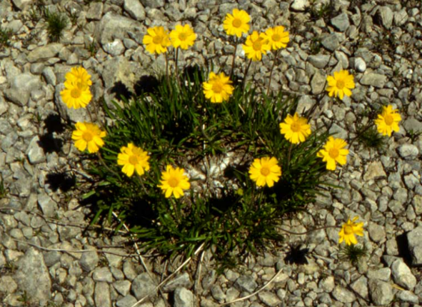
CONCLUSION
Work collaboratively with user, consultant, sales representative, and state
The ESA assessment process is very new and still evolving
Growers will generally have to look at ESA on a field-by-field basis
ESA changes will happen gradually over several years
Is there state specific information or a contact person?
Lakeside daisy
Notes:
We will have more in depth information as we move forward.

Slide 57
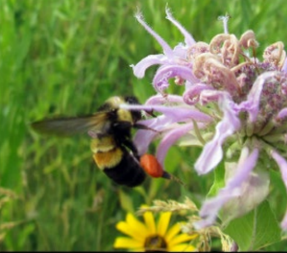
ESA RESOURCES
Rusty patch bumblebee
EPA Endangered Species Main Page
https://www.epa.gov/endangered-species
EPA Bulletin Live! Two (BLT)
https://www.epa.gov/endangered-species/bulletins-live-two-view-bulletins
Pesticides and Endangered Species Educational Resources Toolbox
https://www.epa.gov/endangered-species/pesticides-and-endangered-species-educational-resources-toolbox
EPA Mitigation Menu
https://www.epa.gov/pesticides/mitigation-menu
Weed Science Society of America webpage – definitions, handouts, and presentations
https://wssa.net/endangered-species/
Compliance Services International
– AMMPS: Avoidance, Minimization, and other Measures for Protecting Species https://ammpspecies.com/
FIFRA Endangered Species Task Force - ESA species maps, mitigation tracker
https://festf.org/
Center for Integrated Pest Management – Pesticide Environmental Stewardship Website
https://pesticidestewardship.org/
Acre Blitz - Compliance assistance and PULA Check Tool
acreblitz.com
CropLife America ESA Toolbox and ESA Technical Guide to Mitigation
https://www.croplifeamerica.org/esa
Notes:
There are also webinar recordings that could be helpful for the presenter and the applicators.
EPA does have a detailed webinar on Bulletin Live! Two (BLT) listed in the Toolbox
Located on The Pesticide and Endangered Species Educational Resources Toolbox

Slide 58
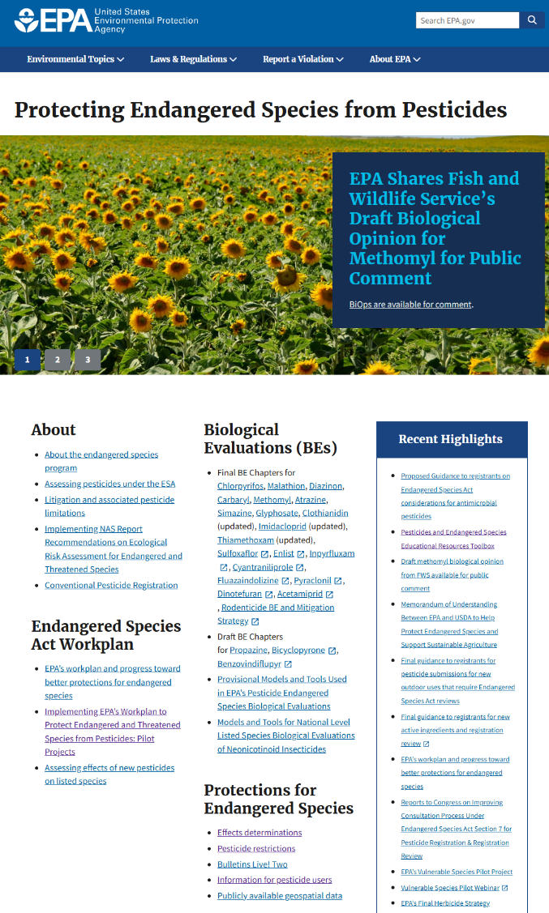

EPA ENDANGERED SPECIES MAIN PAGE
Notes:
QR code to get all EPA ESA resources

Slide 59
COLLABORATIVE EFFORT – DECEMBER 2025
WEED SCIENCE SOCIETY OF AMERICA, ENDANGERED SPECIES ACT COMMITTEE
BILL CHISM, CHAIR
AMERICAN ASSOCIATION OF PESTICIDE SAFETY EDUCATORS
NIRANJANA KRISHNAN, UNIVERSITY OF MARYLAND
KIM BROWN, KIM BROWN CONSULTING
SUPPORT FROM U.S. ENVIRONMENTAL PROTECTION AGENCY
ANY MENTION OF TRADE NAMES, MANUFACTURERS OR PRODUCTS DOES NOT IMPLY AN ENDORSEMENT BY THE US GOVERNMENT OF THE UNITED STATES ENVIRONMENTAL PROTECTION AGENCY. EPA AND ITS EMPLOYEES DO NOT ENDORSE ANY COMMERCIAL PRODUCTS, SERVICES, OR ENTERPRISES.

