Slide 1
Private Applicator Recertification Program (PARP)
2027

Slide 2
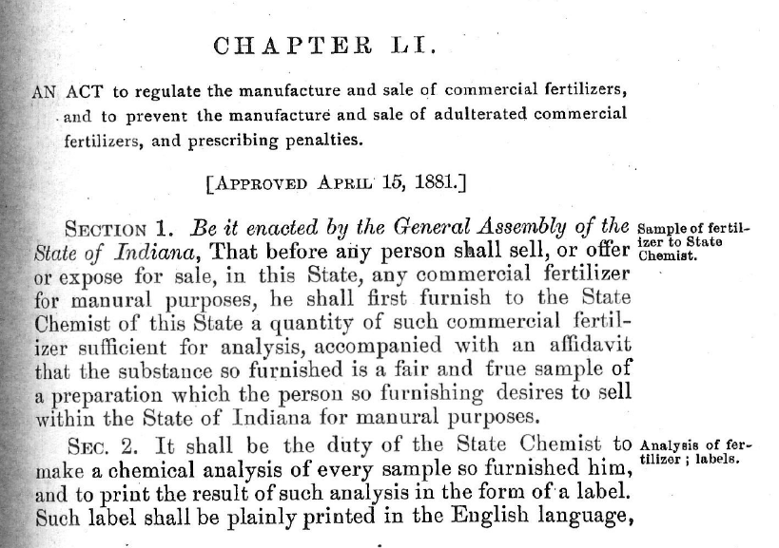
OISC - 145 Years Old

Slide 3
Private Applicator Recertification
Keeping Your Permit Current
  Private applicator permits are valid for five years.
  Attend three private applicator recertification programs (PARP) in your 5 -year certification period to recertify.
    One of the three PARP’s can be taken online through Purdue Pesticide Programs
    Only two PARP’s can be taken in a single year, one online, one in-person, or both in-person.
  Or retake the pesticide or fertilizer certification exam prior to the end of your certification period to recertify.

Slide 4
Supervision of a Non-Certified Applicator making RUP Applications
Noncertified (No certification or licensure) Individuals can apply RUP’s under the supervision of a Private Applicator.
  The certified and permitted Private Applicator shall be legally responsible for all requirements and activities by the noncertified applicator.
    The noncertified individual must complete one of the mandatory trainings
    The certified and permitted Private Applicator must keep records for two years for the training in item above, that includes the following:
      WPS Pesticide Handler Training.
      Pesticide Safety Training for Non-Certified Applicators Using RUP
  Requirement Continued on Next Slide

Slide 5
Supervision Requirements
The certified and permitted Private Applicator must ensure the following for the noncertified individual:
  Access to product labeling at all times during use.
  Personal protective equipment is available, clean, and is being worn correctly.
  Understandable site-specific instructions covering precise location, precautions, use directions, and potential adverse effects.
    Must have for each application site.
  Daily proper operation verification of all mixing, loading, transferring, and application equipment.
    Keep Record.
  Means of immediate communication between the noncertified applicator and the certified and permitted Private Applicator.
  Physical presence of certified and permitted Private Applicator at the work site, if required by label.

Slide 6
Or a simpler route
Study the Pesticide Core Manual
  Take the optional in-person or online Pesticide Core training
Pass the Pesticide Core exam.
Submit Private Applicator Permit Application.
Become a Private Applicator
  Private Applicators can be unrelated employees of the ag commodity producer.
None of the previous supervision requirements are required to apply restricted use pesticides (RUP).
Notes:
Pesticide core exam: Closed book/note, 70 multiple choice questions, 49 correct passing.
Exam vendor Metro Institute, by appointment, on computer, over 20 locations, $55/exam.

Slide 7
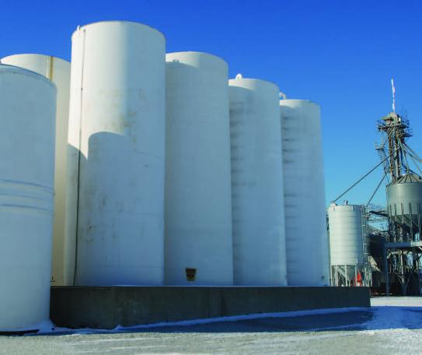
Storage and Containment, part 1
Bulk was defined as greater than 55 gal. capacity container
Previously applied to all bulk pesticides
  Both stationary bulk & portable minibulk required:
    Secondary containment (dikes)
    Operational pads (mix/load)
Rule was replaced by less stringent federal rule 40 CFR 165

Slide 8
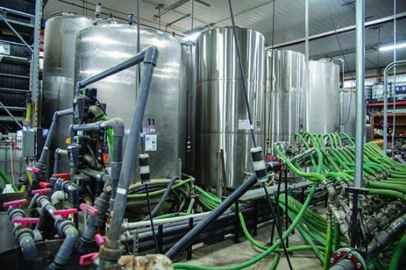
Storage and Containment, part 2
New dike & mix/load pad requirements apply to only:
  Tanks capable of storing 500 gal. or greater (refillable minibulks no longer included)
  4,000 pounds or greater of dry storage
  Agricultural pesticides (non-agricultural pesticides no longer included)
    Refilling establishments
      Refill minibulks & portable containers
    Commercial applicator locations
    Custom blender locations
New requirements also include:
  At least monthly inspection of dikes & pads
  Initiate same day repairs of cracks, leaks, etc.
  Keep records of inspections & repairs for 3 years

Slide 9
Endangered Species Act (ESA) Update
What Private Applicators Need to Know
  Federal law passed in 1973 to protect threatened and endangered species and their habitats.
  Requires federal agencies (EPA) to ensure their actions do not jeopardize protected species or destroy critical habitat.
    Federal Requirement
      States are tasked with ensuring compliance.
Why Does This Matter to Applicators?
  New ESA label requirements will include additional measures to reduce impacts to protected species.
  Additional Record Keeping

Slide 10
6 Steps for a Safe & Compliant Application
Step 1: Plant for the Growing Season/year
  Identify what crops are being grown and what pesticide products are expected to used on each of your fields.
Step 2: Read Pesticide Product Labels
  Identify the need to check Bulletins Live! Two, the number runoff/erosion points achieve, and the mandatory downwind spray buffer distance.
Step 3: Check Bulletins Live! Tow (BLT) Website
  Identify if your field is in a Pesticide Use Limitations Area (PULA) For any additional mitigation measures, then print available bulletins.
Step 4: Identify Product with Most Restrictive Mitigation Measures
  Determine which product being applied through the crop cycle/year requires the highest number of mitigation points and largest mandatory spray drift buffer.
Step 5: Use EPA Worksheets or App (PALM) to Calculate Points & Buffers
  Confirm you have enough points to apply the product and finalize the size of the downwind buffer you must leave (if any)
Step 6: Apply the Product!

Slide 11
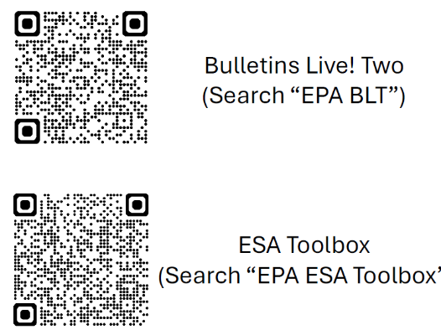
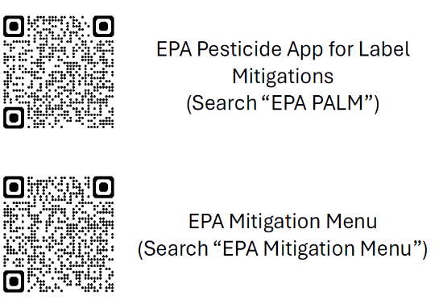
ESA Resources
EPA General & Technical Helpline: 1-844-447-3813 Email: ESPP@epa.gov
Questions? Call or Text the Office of the Indiana State Chemist: 7665-637-6678

Slide 12
Drift
A person may not apply a pesticide in a manner that allows it to drift from the target site in sufficient quantity to cause harm to a nontarget site.
“Nontarget site” means any site that is not the intended target site of the pesticide application, including, but not limited to, the following: (A) Personal property. (B) Public property. (C) A body of water. (D) A person. (E) An animal. (F) Livestock. (G) Managed bees. (H) A commodity. (I) A desirable plant

Slide 13
Drone Pesticide Application
Your Private Applicator Permit does not allow you to make aerial drone applications.
Aerial Drone Applications Require:
  FAA Part 107 Pilots License
  FAA Part 137 Exemption for Pesticide Application
  OISC Category 11 – Aerial Application Exam
Must submit Part 137 Exemption to OISC for the Category 11 – Aerial Application to be added to your Private Applicator Permit.

Slide 14
Fumigant Applications
Your Private Applicator Permit does not allow you to make fumigant applications.
Fumigant applications require category 7d–Fumigant certification
  Pass 7d-Fumigant exam
  Category 7d-Fumigant added to your Private Applicator Permit as a rider on your permit.
Only PA Permit holders with a category 7d-Fumigant rider can make fumigant applications their property.

Slide 15
Fertilizer Updates, part 1
Fertilizer rules moved to law
To increase transparency and reduce rules
  Moved from rule to law
  355 IAC 2, 7, 8, 9, & 10
    Fertilizer Containment,
    Fertilizer Certification & Use
Ag Ammonia rules
  355 IAC 3
  Kept as rule due to the technical aspects of the rule.

Slide 16
Fertilizer Updates, part 2
Change to definition of staging
“Staging” means the placement of fertilizer material:
  Gathered in a pile to be used for field application within one hundred twenty (120) days; or
  At a production area for:
    (A) livestock (as defined in IC 15-17-2-47); or
    (B) poultry (as defined in IC 15-17-2-87);
  Additional setbacks
  Production Area:
    Barn
    Feed Lot

Slide 17
OISC Agricultural Regulatory System (OARS)
This database will provide a platform to best support our regulated community, program sponsors, and the public.
Coming Spring 2027
OISC has been working to build a digital database system to manage our regulatory needs across our different programs.
Instant CCH/PARP credits awarded – once the attendance is submitted, attendees instantly receive their credits
Automated Alerts – remaining CCH/PARP credit needs, upcoming programs
Allows applicators and businesses to:
Edit account information
Submit applications online
Add/remove applicators
Pay/renew online.

Slide 18


Pesticide Disposal Options
Ag Container Recycling Council ACRC
The ACRC program accepts triple rinsed, rigid high-density polyethylene (HDPE) containers, 55 gallons and smaller,
which previously held professional use agricultural chemicals including pesticides, animal health, specialty pest control, micronutrient, biologicals, fertilizer, and/or adjuvant products.
Disposal Contractor will pickup triple rinsed empty containers.
Schedule Disposal Contractor
  G. Phillips and Sons, LLC
  248-961-3360
  pickup@gpsagrecycle.com
  www.gpsagrecycle.com

Slide 19
Pesticide Disposal Options
Clean Sweep
Open to anyone
Allows for “no questions asked” disposal of suspended, canceled, banned, unusable, opened, unopened or just unwanted pesticides.
If it is a pesticide, we will accept it for disposal.
Free Up to 250 pounds, $3.00 a pound over that.
Locations change each year.
2nd and 3rd week of August
No Empty Containers, dispose of empty containers per the label directions.
Dates and Locations available in May via the OISC website.

Slide 20

Driftwatch
Notes:
Video is 3:46 minutes

Slide 21

Questions
Pesticide Certification Manager
  Nate Davis
  765-494-7108
  davi1280@purdue.edu
Private Applicator Certification and Licensing Specialist
  Audrey Powell
  765-494-6271
  powellaw@purdue.edu
Fertilizer
  Program Administrator
  Matt Pearson
  765-494-1547
  pearsonm@purdue.edu

