Slide 1





DRIFTWATCH

Slide 2

Presentation Overview
What is DriftWatch?
What is new?
How do I register as an applicator?
How do I register my specialty crop?
How do I get signs?

Slide 3
Mission
To develop and provide easy-to-use, reliable, accurate and secure on-line mapping tools intended to enhance communications that promote awareness and stewardship activities between producers of specialty crops, beekeepers and pesticide applicators.

Slide 4
Why DriftWatch?
Drift is expensive!!
2019 EEE outbreak in northwest Indiana, Driftwatch producers were protected.
Some labels REQUIRE applicators to check DriftWatch before making pesticide applications.
Some crops cost more than $10,000 an acre to replace.
What are you neighbors growing?? (bees or organics)
Wider variety of applicators (aerial, turf, mosquito control, and right of way) use driftwatch every time they apply

Slide 5
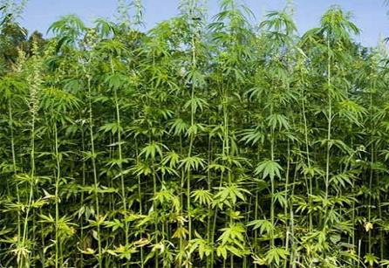
What is New in 2020
Select protected sites from DNR will be added to Map
Must be owned and/or managed by the State (DNR)
Must have a shared border with an agricultural area
Approximately 33 sites have been added
Hemp allowed on Map
Dropdown listed as
“Industrial Hemp”

Slide 6

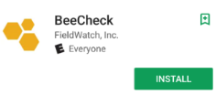
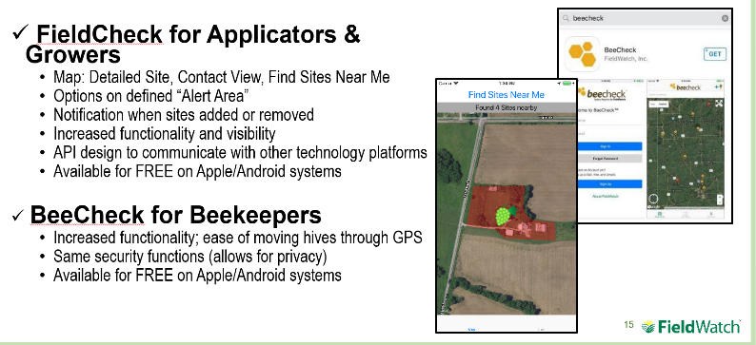
What is New
2 new apps for mobile use- FieldCheck (applicators) and BeeCheck (beekeepers)

Slide 7
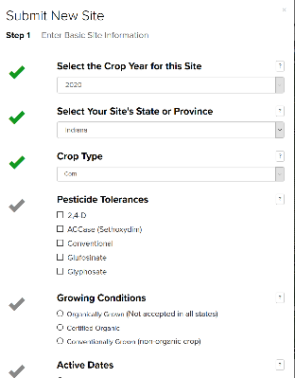
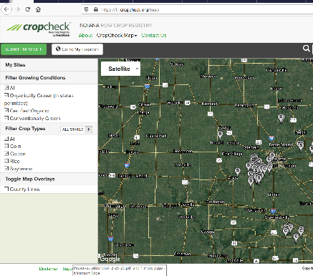
What is New
Cropcheck - New in 2019! Row crop registry program www.cropcheck.org

Slide 8

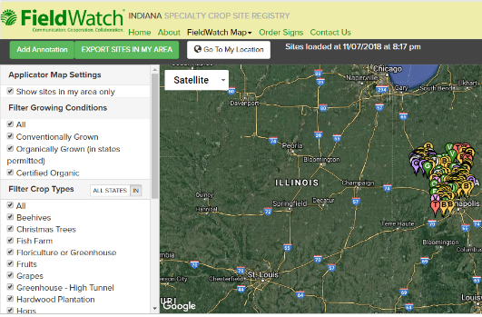
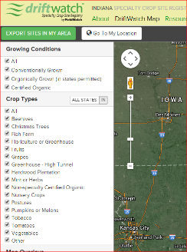
What is New
Membership with FieldWatch can allow organization to download or live stream.
Annotations for applicators

Slide 9
DriftWatch-State View

Slide 10
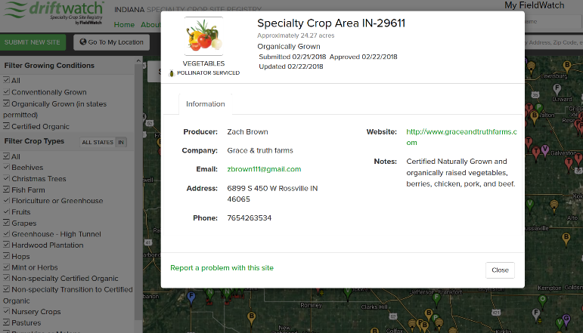
Zoomed in view

Slide 11
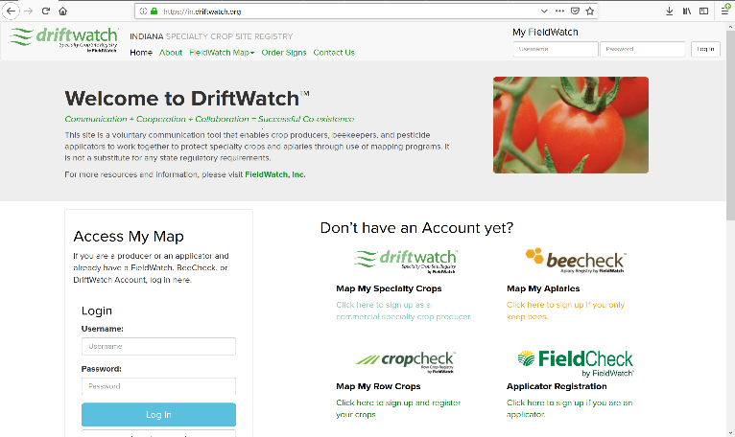
How to sign up?
It’s free!

Slide 12
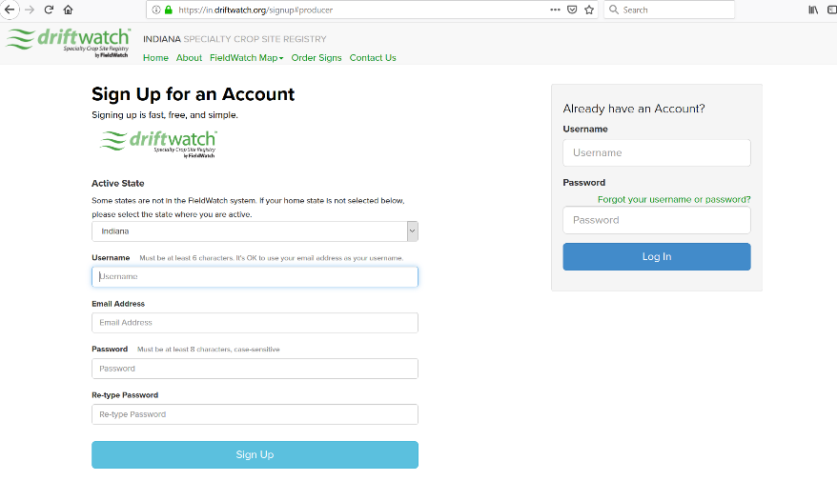
Login information
Does your producer have no email: use no.email@driftwatch.org
This really help us at renewal time!

Slide 13
User Contact Information
Same for producers & applicators

Slide 14
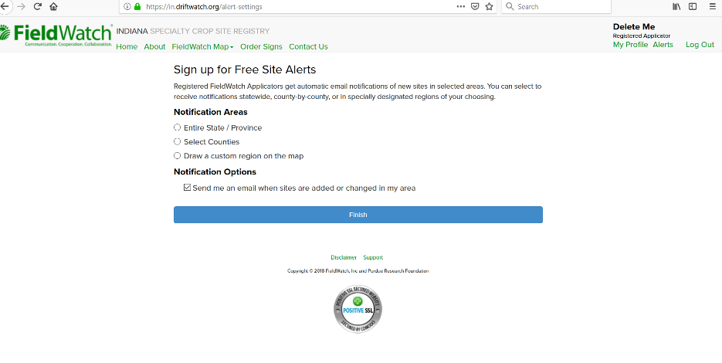
Signing up as an Applicator: Notification options

Slide 15
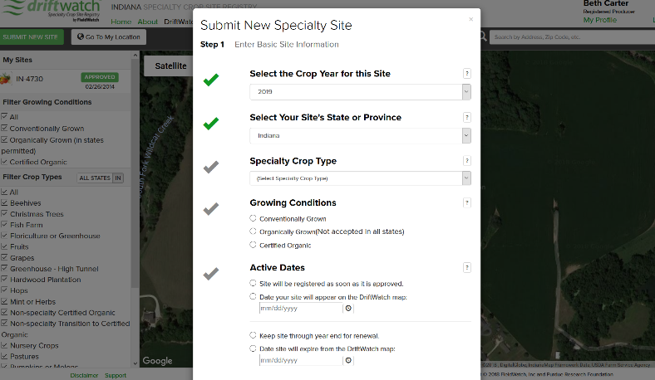
Registering Your Site as a Producer
2) Submit new site button
3) Fill out crop info
1) Login

Slide 16
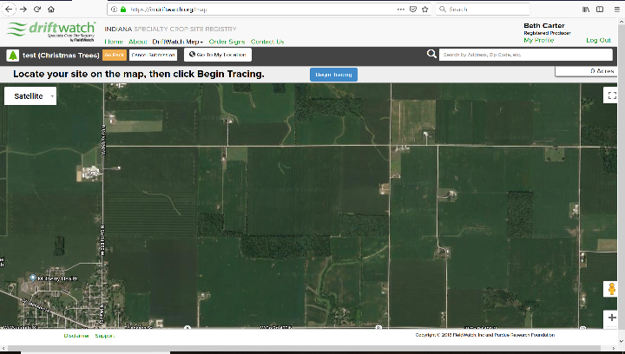
Registering your Site as a Producer- Continued
4) Begin tracing button

Slide 17
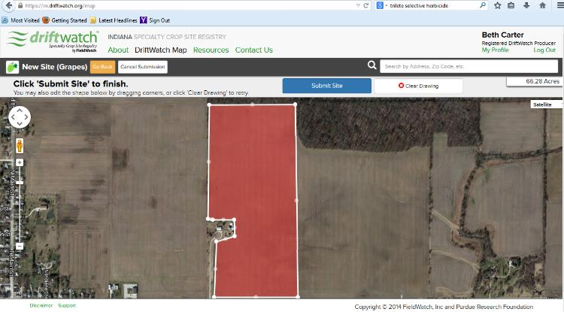
Registering your Site as a Producer- Continued
5) Draw
6) Submit

Slide 18
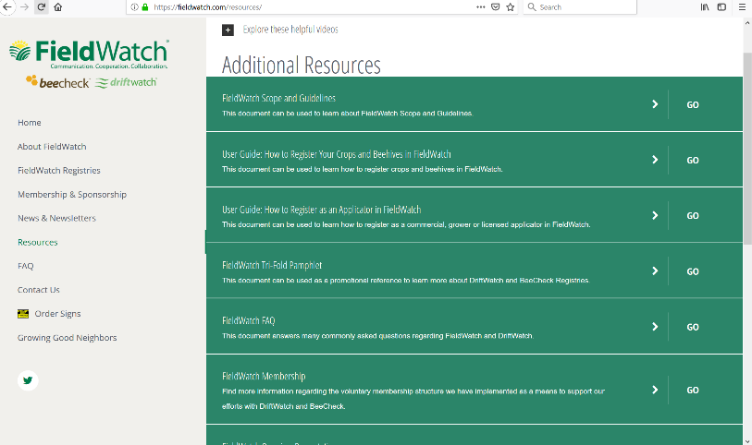
Need more help?
https://fieldwatch.com/resources/

Slide 19

Field signs

Slide 20
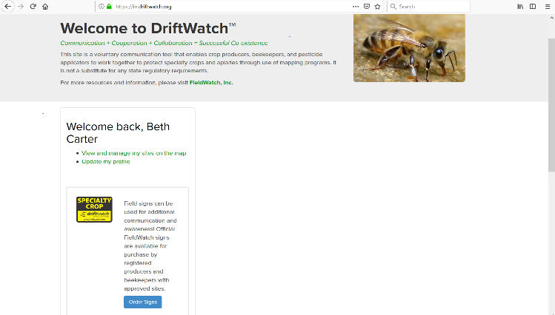
Ordering signs

Slide 21
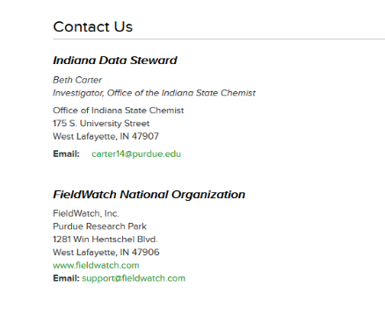
Thank You!
Mailing address:
PO Box 221610
St. Louis, MO 63122
877-443-4353

