Slide 1
From Soils to Streams
Ann Kline, ANR Educator
kline60@purdue.edu
Emily Kring, ANR Educator
ekring@purdue.edu
Amy Webster, ANR Educator
awebster@purdue.edu
Notes:
Speaker background should include conservation or soils knowledge to have a discussion (not a lecture) with farmers at a PARP, Field Day, or other event.
Presentation length: 30 minutes
Handouts (optional):
www.nrcs.usda.gov/sites/default/files/2022-12/NRCS-Checklist-for-Growers-Factsheet-2021-English.pdf

Slide 2

Where does your water end up?
River Runner
Follow along:
Notes:
Here's how you should ask this question: If a water droplet were to land right here at *your current location*, where would it end up?
*Mention to the participants that they can scan the QR code and do it themselves, too.
"River Runner" will open after you click the rain drop
WiFi Accessibility:
WiFi: Drop the rain drop closest to your location as possible. Attendees will be able to see towns they recognize "down river" and connect where their water ends up.
No WiFi: Take screenshots of your county ahead of time or "unhide" the slides.
Once you drop the raindrop or search your location, double click for the program to begin.
In the beginning, keep the slider on "more detail" to talk about major rain events and point out recognizable locations that you see along the way. Use the slider to fast forward but take the time to connect the idea that it all is heading DOWN stream in a connected manner.
Slow down when you get closer to the Gulf of Mexico.

Slide 3
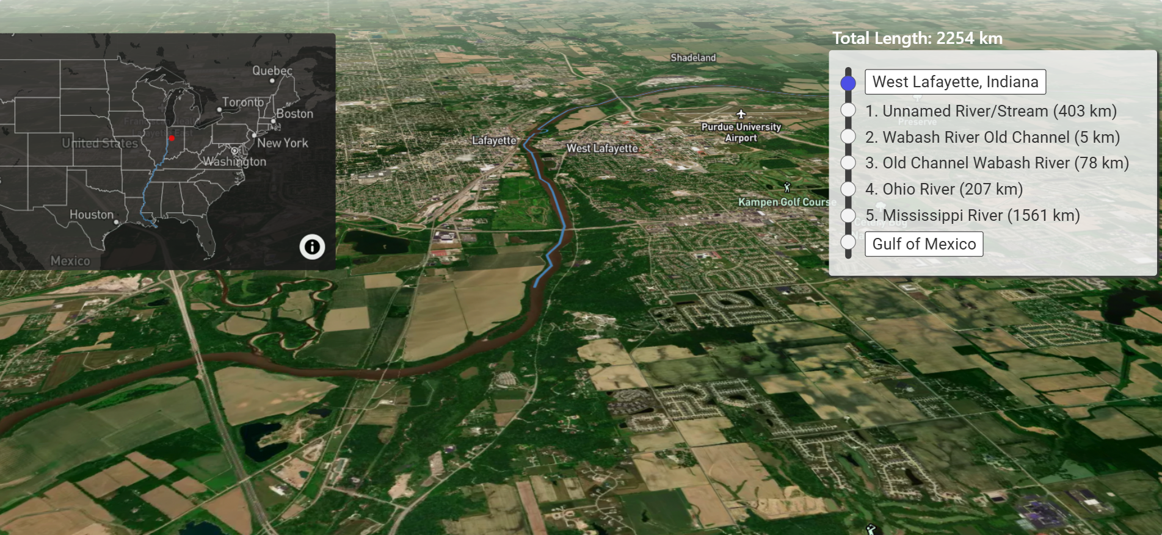
Where does your water end up?
Notes:
Hidden slide #1 if you don't have WiFi accessibility.
Discuss rivers/streams in the area you're in
Look ahead to streams further south and discuss their connection.
Make sure you drive the point home that all streams connect and your water (plus whatever it takes with it) heads south.

Slide 4
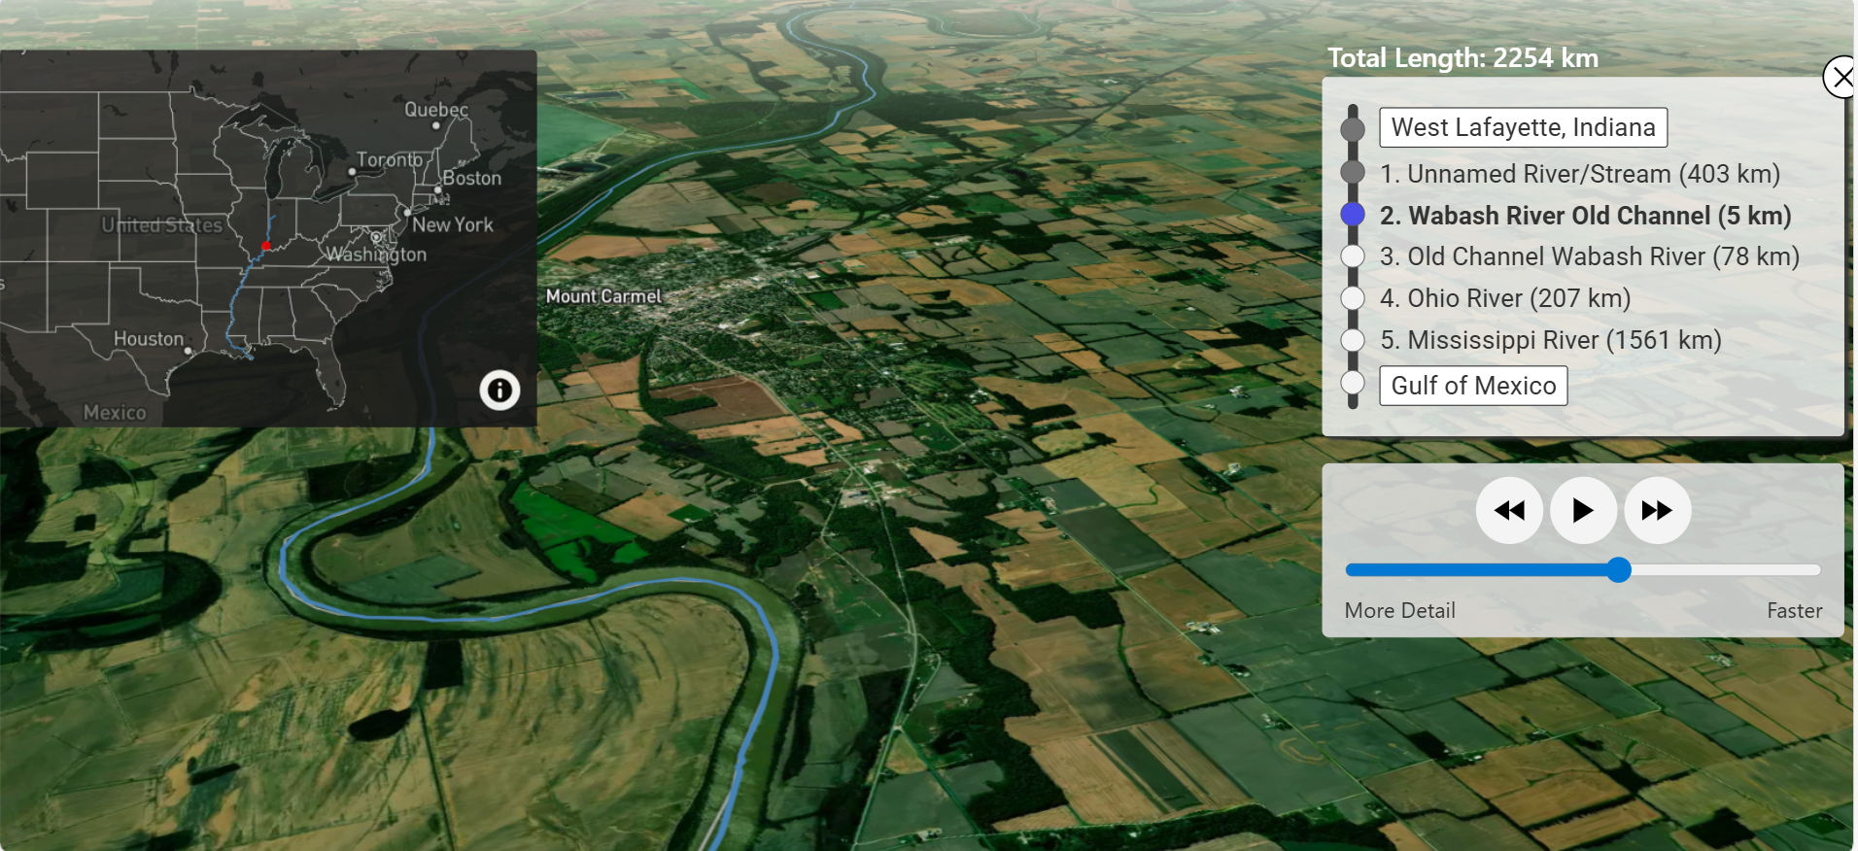
Where does your water end up?
Notes:
Hidden slide #2 if you don't have WiFi accessibility.
Discuss rivers/streams in the area you're in
Look ahead to streams further south and discuss their connection.
Make sure you drive the point home that all streams connect and your water (plus whatever it takes with it) heads south.

Slide 5
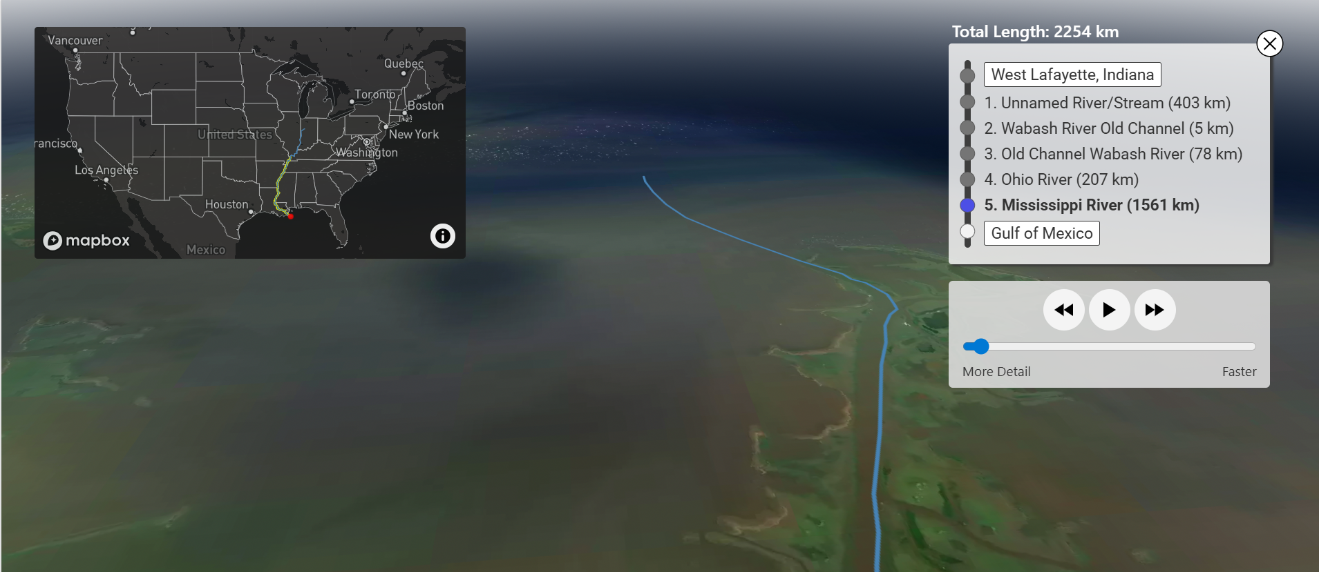
Where does your water end up?
Notes:
Hidden slide #3 if you don't have WiFi accessibility.
Discuss rivers/streams in the area you're in
Look ahead to streams further south and discuss their connection.
Make sure you drive the point home that all streams connect and your water (plus whatever it takes with it) heads south.

Slide 6
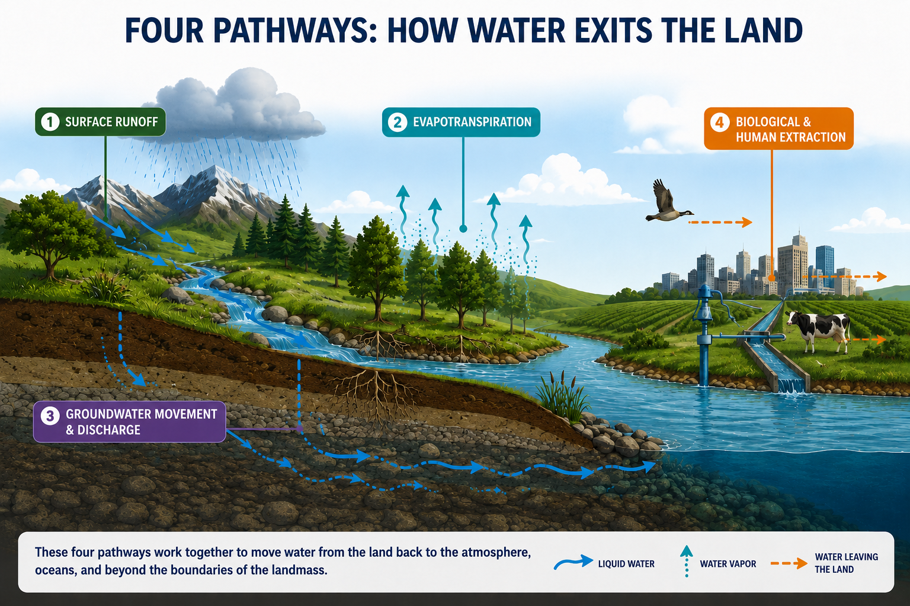
Four pathways: how water exits the land
Notes:
Water exits the land through four primary pathways: surface runoff (flowing into rivers and oceans), evapotranspiration (returning to the atmosphere), groundwater discharge (seeping into aquifers and springs), and extraction (human or biological consumption).
1. Surface Runoff - Water that cannot be absorbed by the soil moves across the earth's surface due to gravity.
Streams & Rivers: Overland flow collects into channels, creating networks that drain into larger water bodies.
Ocean Discharge: Rivers continually empty their flow directly into the sea, which is the most massive exit point for surface water.
Drainage Systems: In urbanized environments, rainwater leaves land via storm drains and wastewater systems directly into local waterways.
2. Evapotranspiration - Water transitions from liquid to vapor and returns directly to the atmosphere.
Evaporation: The sun's heat causes water from puddles, lakes, and damp soil to vaporize.
Transpiration: Plants absorb water from the soil through their roots, drawing it up to the leaves where it evaporates into the air through tiny pores called stomata.
3. Groundwater Movement & Discharge - Water seeps deep into the soil and rock layers, moving underground before re-emerging.
Percolation & Seepage: Water travels downward via gravity into aquifers, which are underground reservoirs of saturated rock and sediment.
Springs & Seeps: Groundwater eventually finds pathways back to the surface, bubbling out at the base of hills, into the beds of lakes, or into the ocean.
4. Biological & Human Extraction - Water physically leaves the landmass inside living organisms or through engineered diversion.
Flora & Fauna: Water is permanently locked into the mass of trees, plants, and animals, or transported off land via migration.
Human Pumping: Agriculture and municipalities pull vast quantities of water out of the ground (via wells) and surface supplies to be used, eventually redistributing it through consumption or evaporation.

Slide 7
What does water pick up on the way?
Sediment
Heavy Metals
Pathogens
Salts
can be carried by water
Nutrients
Plastics
Chemicals
Thermal Pollution
Which of these can you control?
Notes:
Walk through the major pollutants in our waters:
Sediment
construction sites - disturbs and exposes the soil, increasing rain-driven runoff
urban runoff - pavement and rooftops do not allow infiltration and increase water flow speed, thereby carrying more nutrients. Stormwater volume and velocity scours streambanks
deforestation causes loss of root structure holding soil in place and exposes soil surfaces to erosion. Also, without the canopy and leaf litter, more water flows over the land
ag runoff – tilled fields, bare soil, etc. Allows soil to wash off fields during rain
transportation - roads and drainage systems can channel water and carry sediment efficiently
Nutrients: N & P: ag fertilizers, manures, sewage and septics, wildlife and livestock, lawncare
Pathogens: bacteria, viruses, protozoa: human and animal waste (manure, untreated sewage, septics, wildlife)
Salts: road de-icing salts, industrial discharge, irrigation return flows, water softener discharge from homes and wastewater discharge
Heavy metals: industrial discharge, mining, urban runoff, old pipes
Chemicals: ag or home pesticides, urban runoff, industrial solvents or waste, pharmaceuticals (ag, households, stormwater, landfills)
Plastics: stormwater runoff, waste mismanagement and litter washing synthetic fibers, breakdown of larger plastics, including PFAS
Thermal pollution power plants and factories, industrial cooling, urban runoff from hot pavement and rooftops, loss of shade and streamside vegetation

Slide 8
What is in your control?
Sediment
Heavy Metals
Pathogens
Salts
Farmers can influence these most
Nutrients
Plastics
Chemicals
Thermal Pollution
Notes:
Ask audience and facilitate discussion before revealing.
Great read to help you prepare: Manure and Water Quality Concerns: https://lpelc.org/wp-content/uploads/2019/03/L01_sec4.pdf

Slide 9
Sediment
Sediment
Why do we care?
Smothers aquatic habitat, eggs
Fills downstream waterways
Harms fish (gills, feeding, spawning)
Carries nutrients (esp. P), pollutants
What can we do?
Reduce tillage
Plant cover crops
Use filter strips and buffer strips
Stabilize streambanks
Pathogens
Nutrients
Chemicals
Notes:
Sediment (construction, urban runoff/lawncare, deforestation, erosion, ag fertilizers)
Ask the questions – why we care and what we can do – and see how many of the answers the audience knows before sharing the answer.

Slide 10
Pathogens
Sediment
Why do we care?
Contaminates drinking water
Causes human/animal illness
Closes beaches
What can we do?
Manage manure timing, storage
Incorporate manure
Limit livestock access to waterways
Manage runoff and erosion
Follow setbacks
Perform routine septic maintenance
Pathogens
Nutrients
Chemicals
Notes:
Pathogens – bacteria, viruses, protozoa: (manure, untreated sewage, septics, stormwater, wildlife)
Routine septic maintenance – OR repair/replace failing septic system

Slide 11
Nutrients
Sediment
Why do we care?
Fuels algal blooms
Lowers oxygen (fish kills)
Degrades drinking water
What can we do?
Use 4Rs
Install filter / buffer strips
Grow cover crops
Incorporate nutrients
Avoid application before rain
Limit livestock access to waterways
Perform routine septic maintenance
Pathogens
Nutrients
Chemicals
Notes:
Nutrients - N & P: (ag fertilizers, manures, lawncare)
Eutrophication: over-enrichment of water bodies with nutrients (esp N & P), causing algae blooms and oxygen depletion, harmful to aquatic life.
Creates “dead zones”
Per EPA: Dead zones are areas of water bodies where aquatic life cannot survive because of low oxygen levels. Dead zones are generally caused by significant nutrient pollution, and are primarily a problem for bays, lakes and coastal waters since they receive excess nutrients from upstream sources.
Review 4Rs and discuss right source, rate, time, place – ask audience if they can remember the 4Rs before you share them
Helpful handout: https://wrl.mnpals.net/islandora/object/WRLrepository%3A102
Routine septic maintenance – OR repair/replace failing septic system

Slide 12
Chemicals
Sediment
Why do we care?
Toxic to humans and wildlife
Contaminates drinking water
Can move to groundwater
Harms ecosystems
What can we do?
Follow label: setbacks, restrictions, reporting
Prevent drift
Avoid application before rain
Keep away from wells, streams
Pathogens
Nutrients
Chemicals
Notes:
Chemicals – pesticides, industrial solvents, pharmaceuticals: (ag, households, stormwater, landfills)
Follow the label:
Setbacks
Water restrictions
Report spills to IDEM if threaten IN waters

Slide 13
If you could fix one problem spot..
Where do you notice water standing the longest after a big rain?
Which fields or areas have the least soil protection?
Where are inputs most at risk in reaching water?
If a heavy rain hit tomorrow, what areas on your farm would concern you the most?
Notes:
***Use this slide for farmers/PARP presentations
Handout ideas: space for notes and ability to circle/make a mental action plan for change.
Make this a discussion- this slide feeds right into the summary slide on what can be done. Help farmers make personal connections here.
Why is that rain staying around? What can be done to distribute the rain?
What can we do with that spot? Give some answers to what we can do in that spot specifically. Cover crops, filter strips, reduce erosion
Where do you mix? Where do you load? Is there a pathway to water there because we need to think about that more.
Talk through livestock access, bank stabilization, manure management importance when rain hits.
When was the last time you pumped your septic tank?
Test your soil – to understand nutrients as well as soil types, which lead to discussion on erodibility, leaching tendencies
Don't overapply fertilizer/manure

Slide 14
If you could fix one spot in your garden
Where do you notice water standing the longest after a big rain?
Could this area be turned into a rain garden?
What part of your yard dries out the fastest?
Maybe it's time to consider plants with deeper root systems?
What's one area of your yard that's hard to maintain?
Is it time to switch to low-maintenance landscaping with native plants?
Where could you "slow water down" on your property?
Have you considered installing a rain barrel?
Notes:
***Use this slide for gardeners/conservationists
Handout ideas: space for notes and ability to circle/make a mental action plan for change.

Slide 15
Summary: What can we do?
Sediment
Manage runoff and erosion
    Reduce tillage
    Plant cover crops
    Use filter & buffer strips
    Stabilize banks
Use 4Rs for nutrients
Contain manure in storage
Limit livestock access to waterways
Follow pesticide labels and prevent drift
Manage septic
Pathogens
Nutrients
Chemicals
Notes:
Review 4Rs and discuss right source, rate, time, place

Slide 16
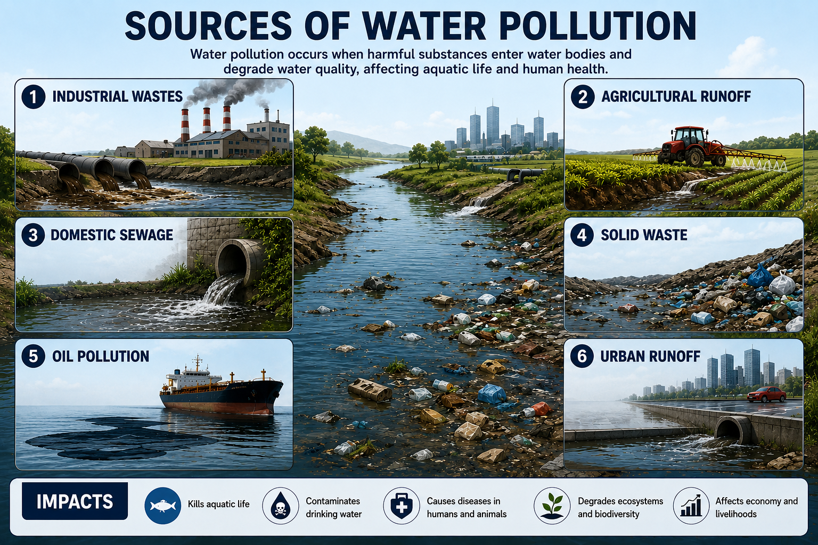
Sources of Water pollution
Notes:
Industrial Waste: Chemicals and toxic waste from factories are discharged into bodies of water.
Agricultural Runoff: Fertilizers, pesticides and manure wash off from fields into rivers and lakes.
Domestic Sewage: Untreated sewage and wastewater from homes and communities contaminate water bodies.
Solid Waste: Dumping of plastic, garbage and other solid waste into water leads to contamination.
Oil Pollution: Oil spills and leaks from ships, tankers and offshore drilling contaminate large areas of water.
Urban Runoff: Rainwater runoff from roads, parking lots and construction sites carries pollutants lie oil, heavy metals and dirt into water bodies.

Slide 17


Thank You
This program was developed by Purdue Extension Agriculture and Natural Resources Educators Ann Kline, Emily Kring, and Amy Webster through their participation in the Indiana Watershed Leadership Academy (IWLA). Their involvement in the IWLA was supported through a grant from the Sustainable Agriculture Research and Education (SARE) program.

Slide 18
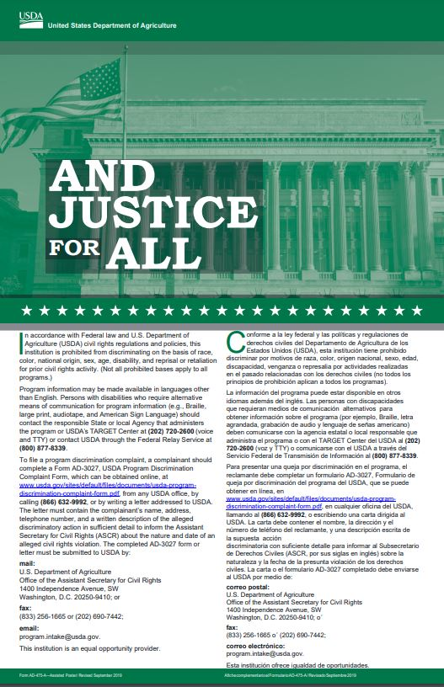
AND JUSTICE FOR ALL
In accordance with Federal law and U.S. Department of Agriculture (USDA) civil rights regulations and policies, this institution is prohibited from discriminating on the basis of race, color, national origin, sex, religious creed, disability, age, political beliefs, or reprisal or retaliation for prior civil rights activity.
To file a program discrimination complaint, a complainant should complete a Form AD-3027, USDA Program Discrimination Complaint Form, which can be obtained online at www.usda.gov/sites/default/files/documents/usda-programdiscrimination-complaint-form.pdf, from any USDA office, by calling (866) 632-9992, or by writing a letter addressed to USDA.
The letter must contain the complainant’s name, address, telephone number and a written description of the alleged discriminatory action in sufficient detail to inform the Assistant Secretary for Civil Rights (ASCR) about the nature and date of an alleged civil rights violation. The completed AD-3027 form or letter must be submitted to USDA by:
mail:
U.S. Department of Agriculture
Office of the Assistant Secretary for Civil Rights
1400 Independence Avenue, SW
Washington, D.C. 20250-9410; or
fax:
(833) 256-1665 or (202) 690-7442;
email:
program.intake@usda.gov.
This institution is an equal opportunity provider.

Slide 19
And justice for all - Español
Conforme a la ley federal y las políticas y regulaciones de derechos civiles del Departamento de Agricultura de los Estados Unidos (USDA), esta institución tiene prohibido discriminar por motivos de raza, color, origen nacional, sexo, credo religioso, discapacidad, edad, creencias políticas, venganza o represalia por actividades realizadas en el pasado relacionadas con los derechos civiles.
Para presentar una queja por discriminación en el programa, el reclamante debe completar un formulario AD 3027, Formulario de queja por discriminación del programa del USDA (PDF, 462 KB), que se puede obtener en línea, en cualquier oficina del USDA, llamando al (866) 632-9992, o escribiendo una carta dirigida al USDA. La carta debe contener el nombre, la dirección y el número de teléfono del reclamante, y una descripción escrita de la supuesta acción discriminatoria con suficiente detalle para informar al Subsecretario de Derechos Civiles (ASCR, por sus siglas en inglés) sobre la naturaleza y la fecha de la presunta violación de los derechos civiles. La carta o el formulario AD-3027 (PDF, 462 KB) completado debe enviarse al USDA por medio de:
correo postal:
U.S. Department of Agriculture
Office of the Assistant Secretary for Civil Rights
1400 Independence Avenue, SW
Washington, D.C. 20250-9410; o´
fax: (833) 256-1665 o´ (202) 690-7442;
correo electrónico: program.intake@usda.gov para consultas relacionadas con cumplidores discriminatorios sobre interacciones con el USDA
askusda@usda.gov para cualquier otra consulta
Tenga en cuenta todas las preguntas / formularios de elegibilidad relacionados con SNAP, diríjase a https://www.fns.usda.gov/snap/recipient/eligibility
o la oficina local de SNAP: https://www.fns.usda.gov/snap/state-directory
Esta institución ofrece igualdad de oportunidades.

