Slide 1
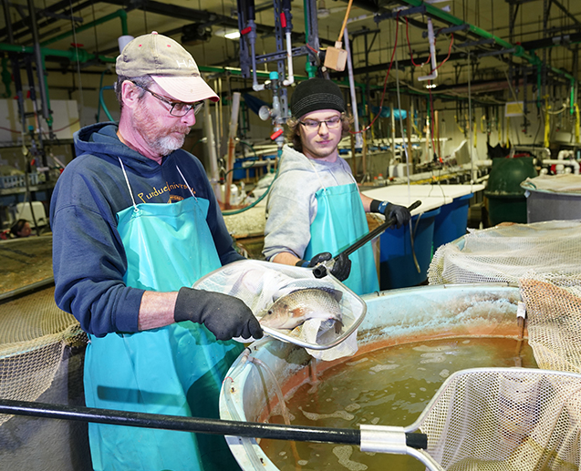
Water Quality and Aquaponics

Slide 2
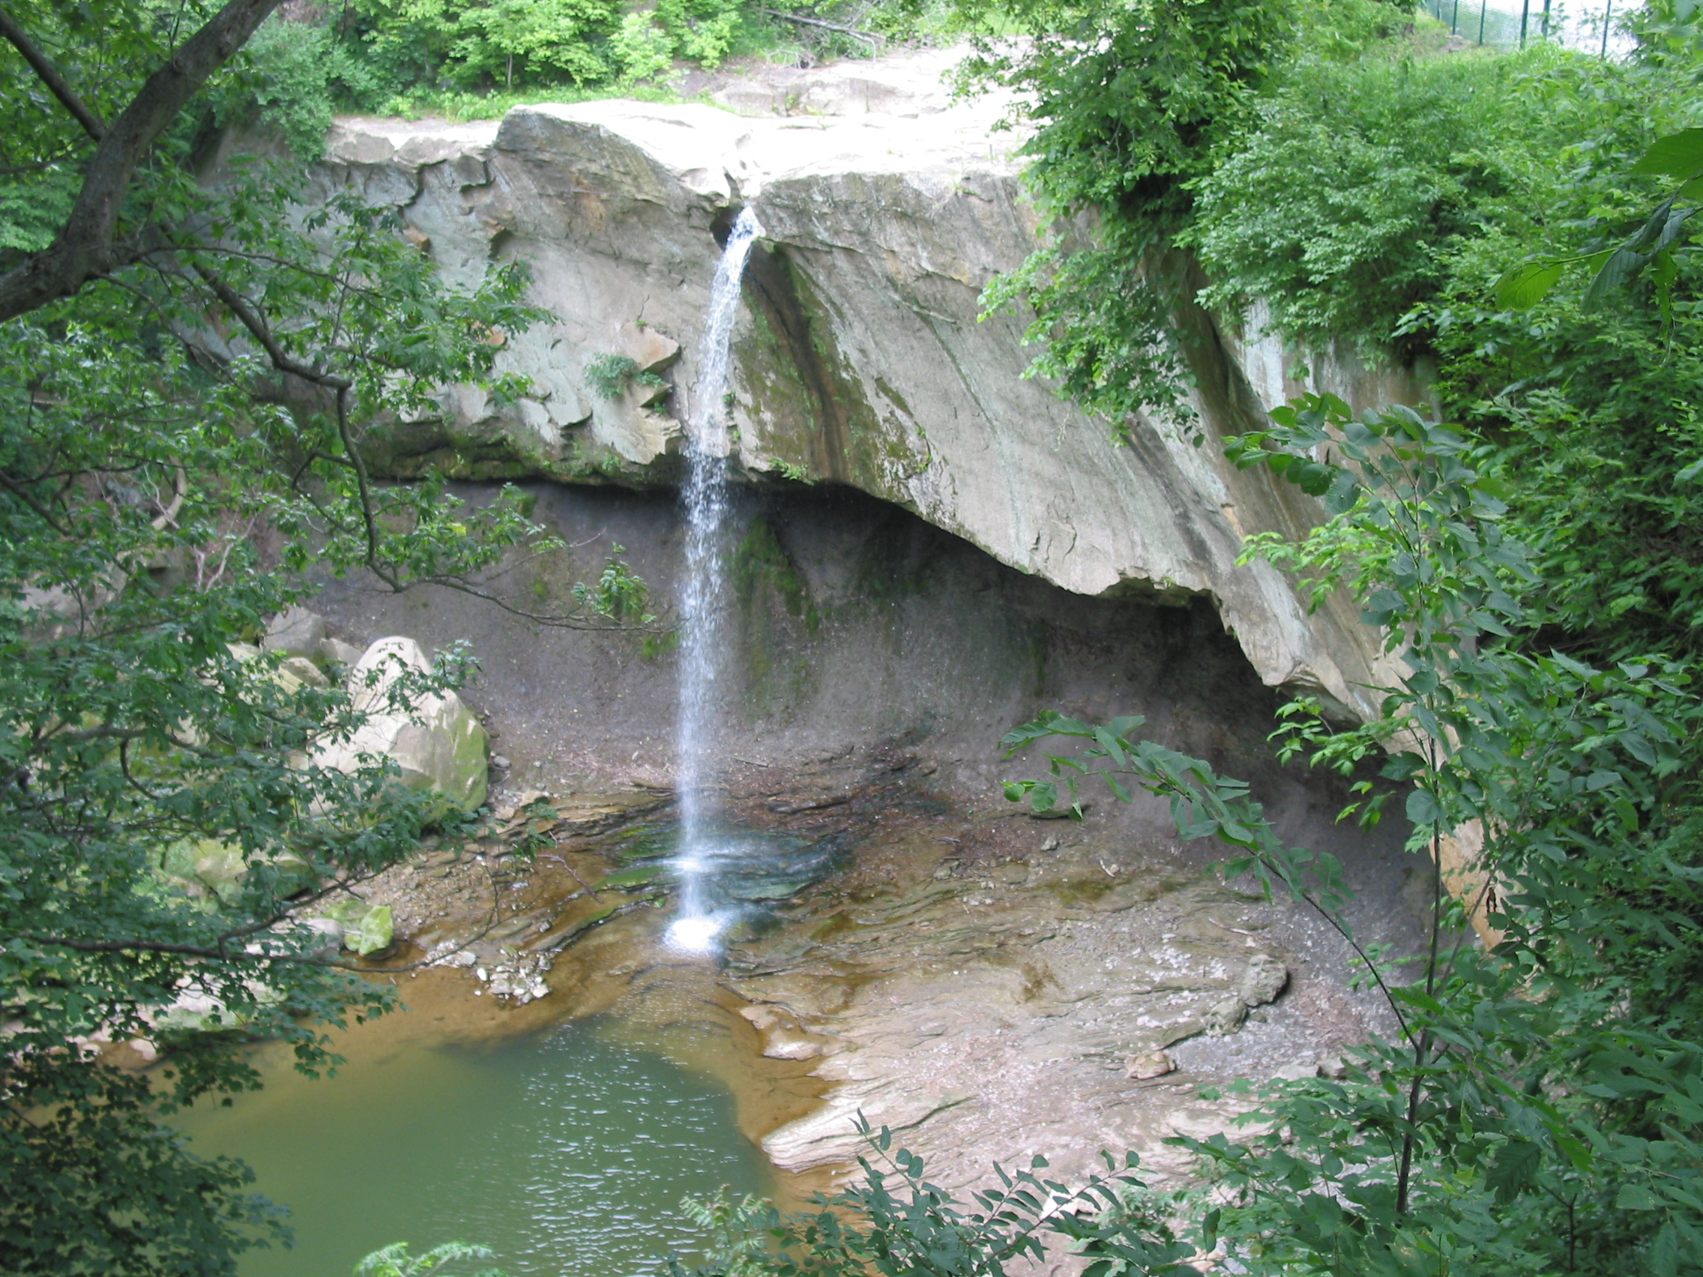
Water quality and aquaponics
Learn to take and interpret water quality measurements.
Notes:
Photo by the author.

Slide 3
Aquaponics water quality
Having good water quality is important in an aquaponics system both for the health of the fish and the plants.
Currently, most aquaponic systems use a lot of fresh water – replacing up to 20% of the water in their tanks each day to maintain water quality.
BiG researchers are exploring ways to use less water while still maintaining the health of plants and animals in the system.

Slide 4
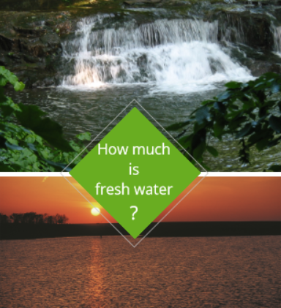
Salt water and fresh water
Fresh water is one of the basic needs for plants, people, and all other animals
What % of the world’s water is fresh water?
?
Notes:
Photo credits:
Waterfall – NC?
Sunset over wate: NRCS.gov

Slide 5
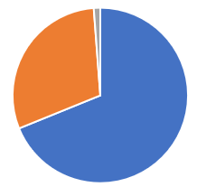
Salt water and fresh water
Fresh water accounts for about 3% of the Earth’s total water.
The rest, 97%, is salt water!
Fresh water is found in surface water, ground water, and ice & snow.
  Ice, snow, glaciers – about 69% of all fresh water (blue)
  Groundwater – 30% of all fresh water (orange)
  Fresh surface water – 1.2% of all fresh water (gray)
ICE, SNOW, GLACIERS
GROUNDWATER
FRESH SURFACE WATER
69%
30%
1.2%

Slide 6
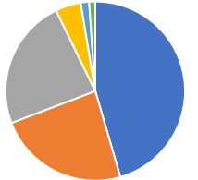
Where is fresh surface water found?
Lakes and reservoirs – 45.5%
Groundwater – 23.7%
Plants and animals – 23.6%
The atmosphere – 4.6%
Rivers and streams – 1.5%
Wetlands – 1.1% (green)

Slide 7
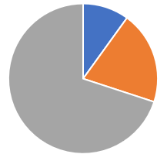
Water consumers
There are three main categories of freshwater users: domestic, industrial
and agricultural.
Domestic usage of the world’s water accounts for about 10% of the world’s water.
Industry uses about 20% of the water withdrawn worldwide.
Agriculture uses about 70% of the water withdrawn worldwide.
Domestic
Industry
Agricultural

Slide 8
Aquaponics water
Water temperature and water quality (WQ) must be carefully maintained in an aquaponics system to assure the health of the plants and animals as well as to safeguard surface and groundwater from contaminated wastewater.
  This is particularly true for tilapia, a commonly grown aquaponics species.
Goldfish are the recommended species for the classroom because they are more tolerant of lower water quality and can survive in a larger temperature range than most species of fish.

Slide 9
Preferred water temps
Fish do best at preferred water temps
Production aquaponic systems generally raise fish that can be sold to local restaurants or grocery stores.
  Common species: catfish, shrimp (or prawns), trout, tilapia and hybrid striped bass
  For example: tilapia prefer water that is 79-90 F; catfish do best in water that is 75-86 F; and goldfish can prefer 68-74 F.
The preferred water temperature for fish is often
different than the preferred temperature for plants.
  For example, water for hydroponic plants is generally 65-80 F
Energy use can be very high to heat and cool water flowing between the fish and the plants.
Notes:
Although not, strictly, a water quality issue, water temperatures affect fish health.

Slide 10
Activity 1: Water quality test
You are probably already monitoring water quality if your classroom has an aquaponics system or aquarium.
If you do not have an aquaponics system or aquarium,
you can test water collected from a river, lake or stream.
Test the water daily (M-F) and record the values.
Keep records of the day and time you test and any changes
to your system.
Review any changes or trends in the water quality at the end
of each week and note any problems or correlations you see.

Slide 11
BiG water quality monitoring
Many physical and chemical levels must be regularly monitored and carefully controlled in an aquaponics system.
BiG researchers are monitoring water quality and pathogens in the wastewater to assure the safety of the food produced and balance:
  Maximum growth of the plants and fish
  Nutrient efficiency
  System sustainability

Slide 12
BiG water quality monitoring
Aquaponics water quality analysis is important to keep plants and fish healthy. BiG researchers monitor:
Question: How many of these acronyms do you already know?
Alkalinity
BOD
COD
Dissolved oxygen
Hardness
NH3-N
NO2-N
NO3-N
pH
P
Temperature
Total dissolved solids
Total suspended solids
?

Slide 13
Activity 2: Learn water quality terms
Work with a partner to test yourself using the water quality flashcards.
Student A shows student B a flashcard and counts (silently) for 3 seconds.
  Put flashcards aside when student B correctly fills in the blank or identifies the water quality acronym within 3 seconds.
  Stack the flashcards that are not correctly answered.
  Continue for all 13 cards
Student A shows student B the flashcards again, setting aside those that are correctly answered within 3 seconds.
Repeat until all terms are correctly identified or your teacher tells you to stop.
Repeat this process with student B showing student A the cards.

Slide 14
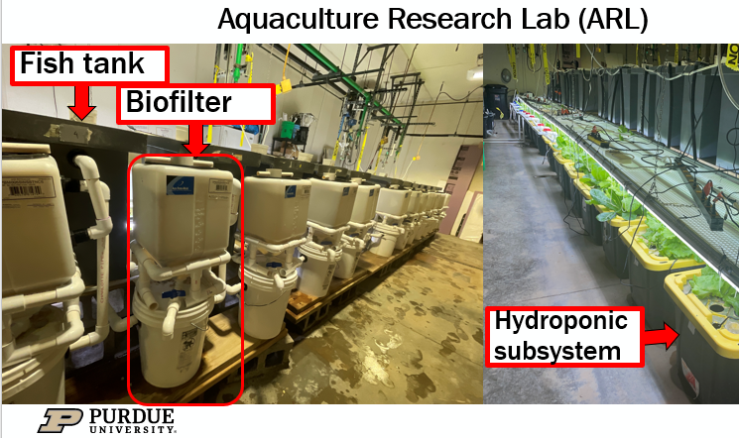
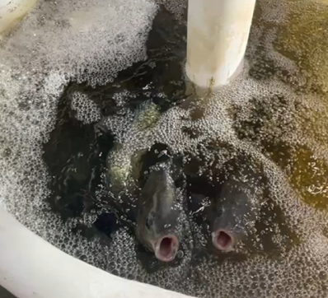

BiG Research: Water quality
A major objective of our research is to
reduce the amount of nutrient wastes
from aquaponic production.
Leftover feed and fish feces results in
toxic nitrogen product accumulation.
We hypothesize that the integration of
microalgae cultivation, anaerobic digestion,
and biorefining processes in the aquaponics
system will significantly reduce nutrient wastes.
  Bacteria in the biofilter breaks nitrogen products
  into ammonia, nitrite, and nitrate (the least toxic).

Slide 15

https://purdue.ag/big-project
This work is supported by the Sustainable Agricultural Systems program, project award no. 17001002, from the U.S. Department of Agriculture’s National Institute of Food and Agriculture. Any opinions, findings, conclusions, or recommendations expressed in this publication are those of the author(s) and should not be construed to represent any official USDA or U.S. Government determination or policy.

