Slide 1
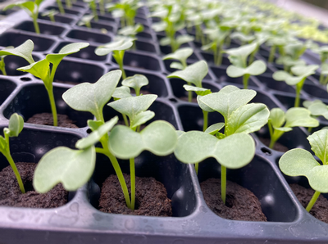
Comparing the Nutritional Value of Different Foods

Slide 2
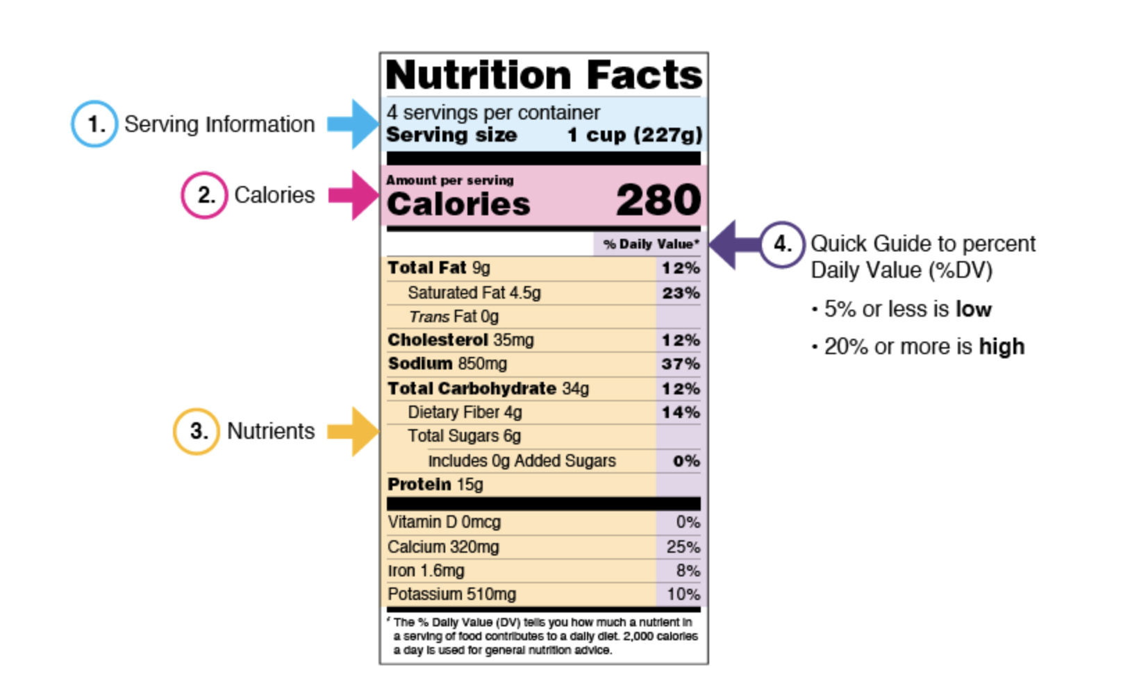
Nutritional value of foods
Comparing the nutritional value of different foods:
Learn what you can find out by reading food labels.
Notes:
Source: FDA nutrition facts. www.fda.gov/nutritioneducation

Slide 3
Nutritional value of foods
Comparing the nutritional value of different foods, continued:
Food production, processing and distribution is one of the United States’ greatest achievements.
But, while current global food systems produce sufficient calories to keep pace with U.S. population growth, many Americans consume nutrient-poor diets that contribute to increased incidence of diet-related obesity and chronic diseases.
  Poor nutrition and physical inactivity increase the risk of chronic conditions like obesity, depression, type 2 diabetes, heart disease, and some cancers — which can lead to disability and premature death.
  Fewer than 1 in 10 children and adults consume their recommended amount of vegetables.
Notes:
Source of bullet #3: https://www.cdc.gov/cdi/indicator-definitions/npao.html

Slide 4
Our food system
Concerns about the American food system
  Population growth requires increased amounts of food.
  Some farming practices cause environmental degradation.
  Many people still struggle with malnutrition.
Lack of access — fresh, nutritious food is not always
easily available due to:
    Food desert – an area with limited access to affordable, nutritious food.
    Food swamp – an area with an overabundance of unhealthy food options.
    Food mirage – a geographic area where there are many places to buy food,
    but the food is too expensive for the community.
The BiG researchers hope that aquaponics will make blue foods more readily available and more affordable.

Slide 5
Nutrition deficiencies
Proper nutrition is important to human health.
Cardiovascular diseases, the largest contributor to
global mortality, are largely driven by diet-related factors.
  Cardiovascular disease (CVD) includes heart and blood
  vessel diseases
  Cardiovascular diseases caused 20.5 million deaths in 2021 (National Institutes of Health, NIH.gov)
  Most (80%) CVD-related deaths occurred in low- and
  middle-income countries (NIH.gov)
Eating well has long-term benefits to your heart and blood vessels.
Notes:
Most (80%) CVD-related deaths occurred in low- and middle-income countries (NIH.gov, https://www.ncbi.nlm.nih.gov/pmc/articles/PMC10809869/#:~:text=Cardiovascular%20diseases%20(CVDs)%20are%20the,%2D%20and%20middle%2Dincome%20countries )
COVID-19 caused approximately 14.9 million deaths in 2020 and 2021 (World Health Organization, WHO, https://www.who.int/data/stories/global-excess-deaths-associated-with-covid-19-january-2020-december-2021)

Slide 6
Benefits of healthy eating
Keeps skin, teeth and eyes healthy
Supports muscles
Helps achieve and maintain a healthy weight
Strengthens bones
Supports brain development
Supports healthy growth
Boosts immunity
Helps the digestive system function
Notes:
Benefits of Healthy Eating, PDF or https://www.cdc.gov/nutrition/resources-publications/benefits-of-healthy-eating.html, Benefits of Healthy Eating for Children and Adults

Slide 7
Vitamins and minerals
Vitamins and minerals, also called micronutrients, are the building blocks for good health.
People who do not have enough of these essential nutrients develop micronutrient malnutrition, which can be devastating.
Consequences include serious birth defects, undeveloped cognitive ability, and reduced productivity.
Severe micronutrient malnutrition contributes to maternal and infant deaths and childhood blindness.
Notes:
Source: www.cdc.gov/nutrition/micronutrient-malnutrition/
BE sure to include some examples with images of deficiencies. (Reviewer: These are really impactful when I use them in my classes.)

Slide 8
Assignment
Complete the Comparing Food Nutritional Values table to compare the nutritional values of five (5) foods.
Highlight the highest and lowest values for each nutrient in your table.
  Highlight High Value and Low Value below your table.
  There should be one of each of the highlighter color in each row.
Notes:
Nutrition Facts label: The label lists the quantity of calories, carbohydrates, fat, fiber, protein and vitamins per serving of the food, making it easier to compare the nutrition of similar products.

Slide 9
Discussion
What food had the most sodium?
How does reading a food label help you make better food choices?
How does your label choices affect your results?
How could you make this activity more useful to your health?
How does what we eat can affect our health?

Slide 10

Value of blue foods
Blue foods are a critical source of nutrition and help improve human health by:
  Reducing micronutrient deficiencies (examples: vitamin A, calcium, iron).
  Providing a critical source of protein and omega-3 fatty acids that help reduce the risk of diet-related noncommunicable diseases.
  Providing a healthy alternative to red and processed meat consumption, which have been related to several health risks.
Notes:
Omega-3 fatty acids:
Essential fatty acids play important roles in your body and may provide several health benefits. EPA and DHA are the primary ones (found in certain fish). ALA (alpha-linolenic acid) is another omega-3 fatty acid (found in plant sources such as nuts and seeds).
Eicosapentaenoic acid (EPA) is one of several omega-3 fatty acids. It is found in cold-water fatty fish, such as salmon. It is also found in fish oil supplements, along with docosahexaenoic acid (DHA). Omega-3 fatty acids are part of a healthy diet that helps lower risk of heart disease.

Slide 11
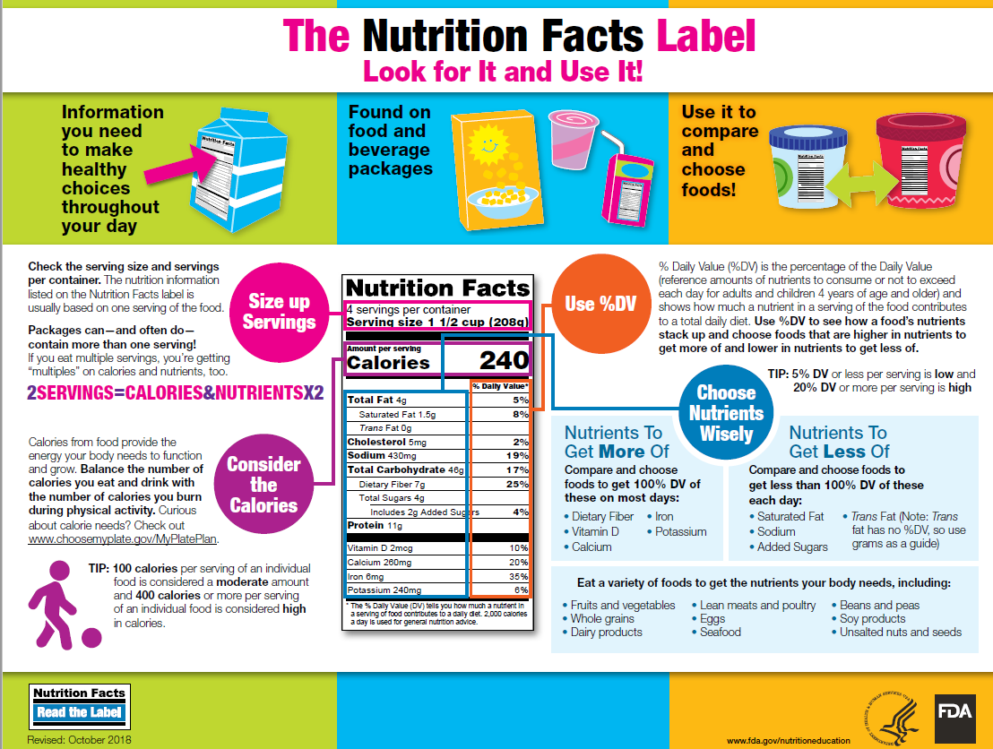
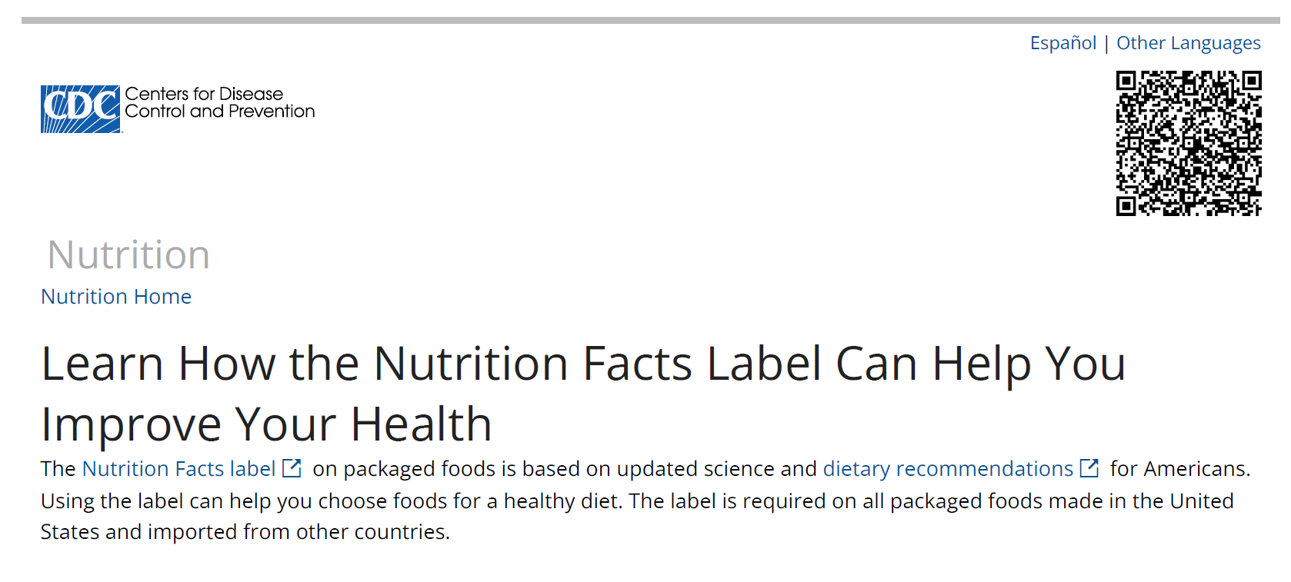
Assignment
Read The Nutrition Facts Label, Look for It and Use It!
  Source: the FDA (Food and Drug Administration)
Read Learn How the Nutrition Facts Label
Can Help You Improve Your Health
  Source: the CDC (Center for Disease Control)
Notes:
Sources:
The Nutrition Facts Label Look for It and Use It! https://www.fda.gov/media/89314/download
Read the CDC (Center for Disease Control) Nutrition Facts label http://www.cdc.gov/nutrition/strategies-guidelines/nutrition-facts-label.html

Slide 12
Challenge
Compare the food labels of chicken, beef, sausage, bacon, two types of seafood.
Compare the food labels of beans (canned and dried), vegetables (canned and fresh), and fruits (canned and fresh).
Compare the food labels of milk (whole and 1%), cheese, yogurt and ice cream.
Notes:
Source: FDA nutrition facts. www.fda.gov/nutritioneducation

Slide 13

https://purdue.ag/big-project
This work is supported by the Sustainable Agricultural Systems program, project award no. 17001002, from the U.S. Department of Agriculture’s National Institute of Food and Agriculture. Any opinions, findings, conclusions, or recommendations expressed in this publication are those of the author(s) and should not be construed to represent any official USDA or U.S. Government determination or policy.

