Slide 1
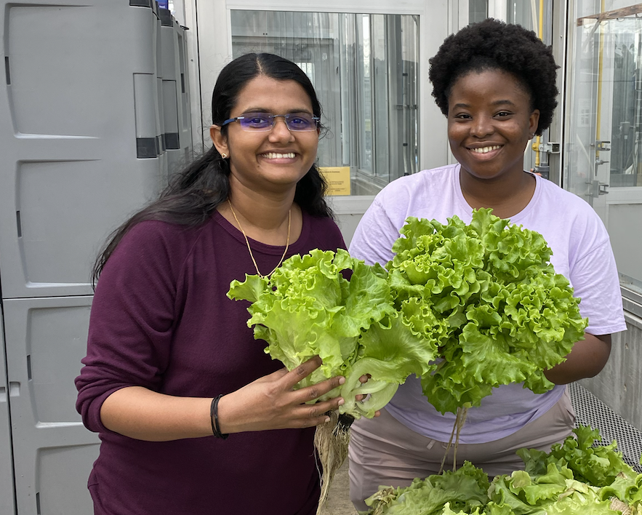
Comparing the Financial and Environmental Costs of Food Production

Slide 2
Comparing costs
Comparing the financial and environmental costs of food production
Learn what is involved in the food production supply chain.

Slide 3
Comparing costs
Comparing the financial and environmental costs of food production:
Financial and environmental costs must be carefully considered and monitored in any sustainable food production system.
Both aquaponics and conventional food production use land and water resources, and both produce waste products.
Understanding and assessing the costs of agricultural production requires understanding the food supply chain.

Slide 4
Food supply chain components
Production:
  Planting
  Fertilizing
  Watering
  Harvesting
  Cooling
Storage
Transportation
Processing
  Including value-adding
Packaging
Distribution
Marketing
Retailing
Consumption
Each of the food supply chain components have inputs and outputs that entail costs.

Slide 5
Food supply chain components
Each component of the food supply chain has inputs and outputs.
Inputs and outputs entail costs.

Slide 6
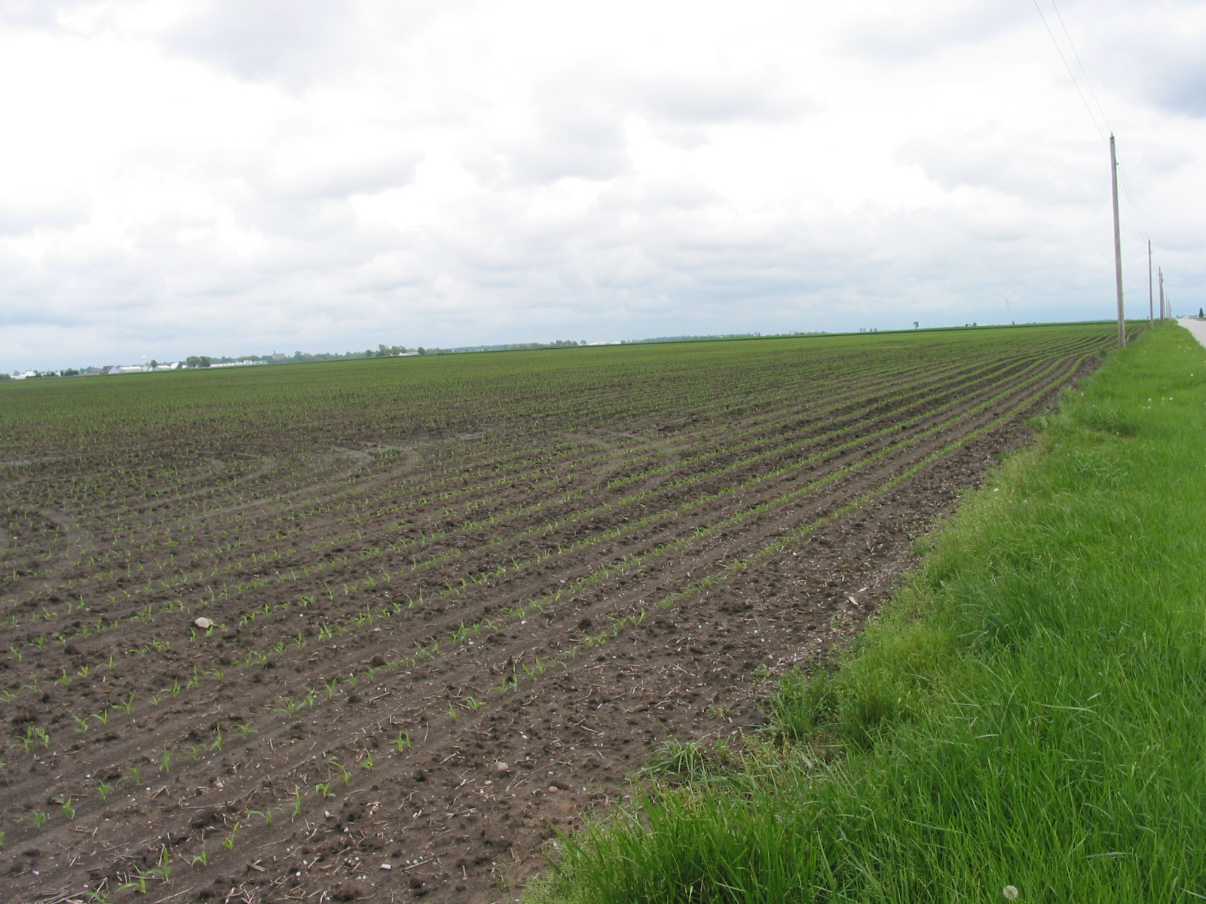
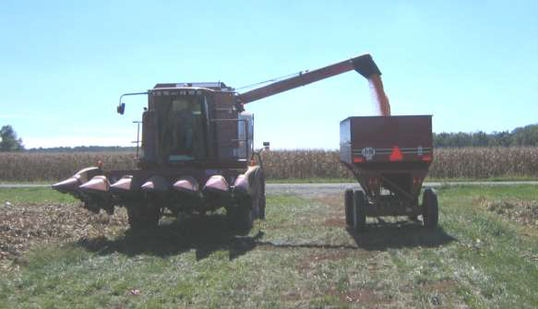
Inputs
Inputs include everything that goes into making food.
Input costs include all costs incurred by the producer/farmer.

Slide 7
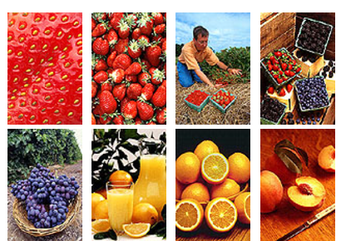
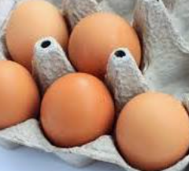
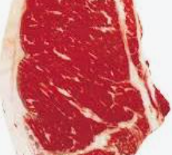
Outputs
The output is the food that has been produced.
Output costs include the costs incurred in the supply chain after the food leaves the farm.
Photos from USDA
Notes:
Photos from USDA.gov

Slide 8
Externalities
Food production costs incurred by people who are not benefiting financially from the sale of a product are called externalities.
Examples of externalities include: water (ground and surface), chemical runoff, odors and production wastes. They also include less tangible things, such as aesthetic costs.
  Example 1: Trash that litters the roadsides, such as fast-food wrappers, bottles and cans.
  Example 2: People living near a confined animal feeding operation (CAFO) sometimes complain of the animal smells that they must live with, although they do not benefit financially from the CAFO.

Slide 9
Input costs
Producer costs:
From farm to table
Land
Labor
Management
Waste disposal
Producer costs dependent on product:
  Animal ag: Antibiotics, equipment
  and feed and supplements
  Plants – fertilizer and seed
Branding
Cleaning
Labeling
Labor
Packaging
Processing
Storage
Transportation (truck, fuel, insurance)
Value-adding
Waste disposal

Slide 10
Assignment: Plant sale
You will be individually brainstorming to start with, and then we’ll move to small group discussions to discuss costs.
List everything that you can you think of that would incur a cost if your class decided to raise flower and herb plants to sell locally for Mother’s Day.
List at least one item for each of the following:
  Financial costs:
  Environmental costs:
  Personal costs:
Estimate how many plants your class will sell and the total financial costs incurred. You may use the internet to check local store prices.

Slide 11
Assignment, continued: Group work
Work in small groups to combine your lists.
Estimate the total input costs for your group’s list.
Total costs ($) = the sum of all items that must be purchased.
Estimate the price your groups plans to charge for each plant and
how many plants would be sold.
  Be sure you have enough pots in your inputs for the number you plan to sell.
  Calculate the total income your group believes you could make. Income ($) = number of plants sold x cost/plant.
Estimate how much money your group thinks you could make with
this project = Total intake ($) – Total costs ($)

Slide 12
Class discussion
Which group estimated the highest input costs?
Which group estimated the highest income?
Which group estimated the highest profit (income – input costs)?
Who do you think was the most accurate?
What are the externality costs of holding a fundraising plant sale?
  Environmental
  Personal

Slide 13
Activity reflection
What were the major costs of holding a plant sale?
What price must the plants be sold for to make a profit?
What externalities were you able to think of?
How do cost considerations for a school-supported venture differ from that of a farmer/producer?

Slide 14
Aquaculture costs
The two major costs of raising fish and plants in the Midwest are power costs and water usage.
  Power costs – High energy inputs required
  Water costs
    Usage – currently a large amount of water is withdrawn from surface and/or groundwater to maintain water quality.
    Returned with contaminants – high level of nutrient wastes created

Slide 15
BiG Project research
We are trying to reduce power and water usage on aquaponic farms by studying:
A food production system that integrates aquaponics with microalgae cultivation, anaerobic digestion, and biorefining processes.
Assessing the economic and environmental performance of our integrated aquaponics food production system to develop evidence-based management practices and business models.

Slide 16
Additional challenges
Gaps exist in research on animal-plant-microbe co-management, benefit-risk assessment, and financing of aquaponics systems. Examples include:
Learn how to reduce the high startup costs of an
aquaponics system.
Explore ways for producers to find financing.
  While there are financial supports for producers of major crops, these are not yet available for aquaponic operations.
Learn how to maintain high water quality for both plants and fish.

Slide 17

Our challenge:
A major objective of the BiG research is to:
Assess economic and environmental performance of Integrated Aquaponics Food Production System (IAFPS) and develop evidence-based management practices and business models.
What would you do?

Slide 18

https://purdue.ag/big-project
This work is supported by the Sustainable Agricultural Systems program, project award no. 17001002, from the U.S. Department of Agriculture’s National Institute of Food and Agriculture. Any opinions, findings, conclusions, or recommendations expressed in this publication are those of the author(s) and should not be construed to represent any official USDA or U.S. Government determination or policy.

