Slide 1
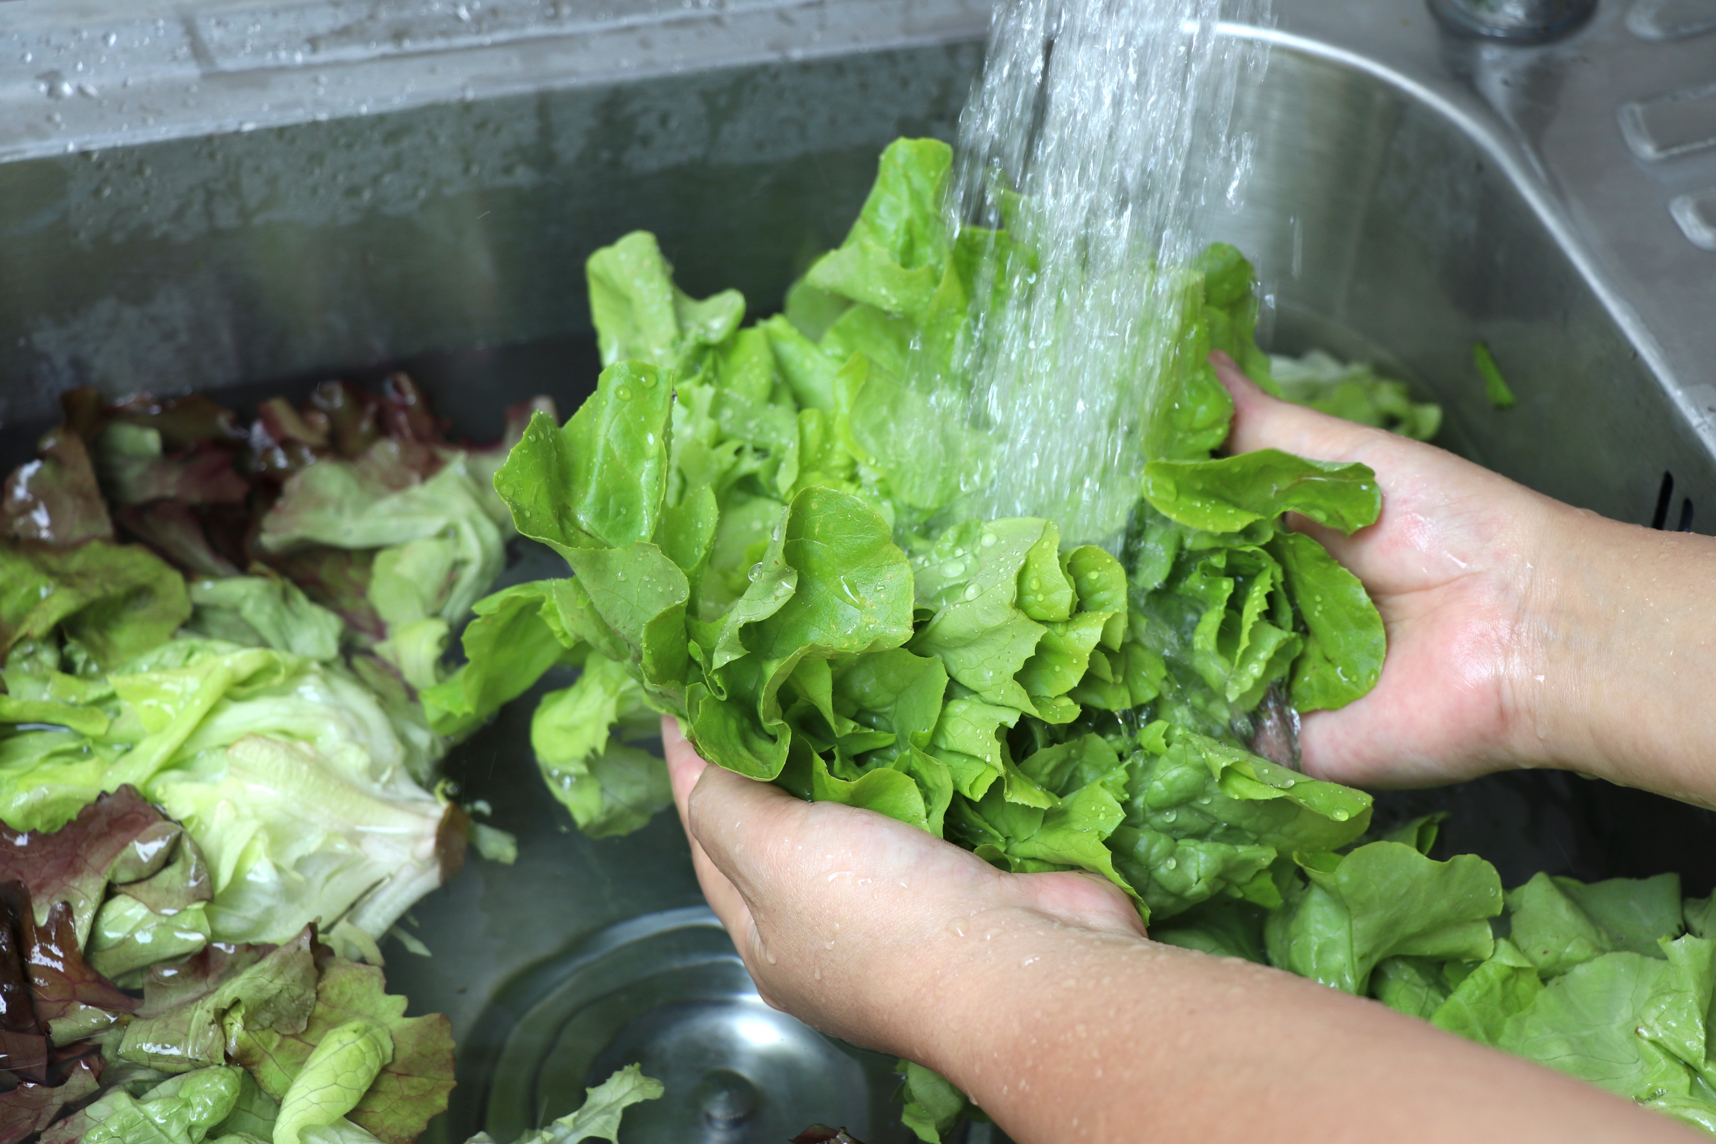
Food Safety
in the Kitchen

Slide 2

Food safety in the kitchen
Learn / review important safe food handling practices

Slide 3
Food safety in the kitchen
Fish and plants from an aquaponic system must be processed (washed and usually cooked) before being served.
Food safety is critical at home, while harvesting,
and in a processing plant.
Because:
  Foodborne illnesses are caused by eating or drinking food or beverages that are contaminated with microbes or pathogens.
  Foodborne contaminants can make people sick and even cause death.
  Foodborne illness is responsible for approximately 48 million illnesses, 128,000 hospitalizations, and 3,000 deaths each year in America.

Slide 4
Safe food preparation
How much do you already know about safe food preparation?
The next slide will list five (5) important food preparation concepts and a description of each. Each box can be printed as a card.
See if you can match the words with the best description.
Then, work with a partner to compare your answers.
Share your answers.

Slide 5
Food preparation
Bacteria
Use a disposal paper towel to remove water.
Wash under cold running water to remove dirt and reduce bacterial contamination. Commercial, homegrown and organic produce
can all be sources of harmful bacteria.
Dry hands
Do this with soap under warm running water for 20 seconds to remove bacteria.
Gloves
Very small creatures (can be seen only under the microscope) that cannot be washed off hands without soap. Your hands may carry many varieties,
and some harmful varieties, like Salmonella and E. coli, can attach and
survive on surfaces for a long time without water or nutrients.
Wash hands
Wash produce
These may reduce bacterial transfer from food to hands and hands back to food. However, handwashing is still necessary before and after removal.
Notes:
The cards can be printed to be physically manipulated.

Slide 6
Food preparation (answers)
Very small creatures (can be seen only under the microscope) that cannot be washed off hands without soap. Your hands may carry many varieties,
and some harmful varieties, like Salmonella and E. coli, can attach and
survive on surfaces for a long time without water or nutrients.
Bacteria
Dry hands
Use a disposal paper towel to remove water.
Gloves
These may reduce bacterial transfer from food to hands and hands back to food. However, handwashing is still necessary before and after removal.
Wash hands
Do this with soap under warm running water for 20 seconds to remove bacteria.
Wash produce
Wash under cold running water to remove dirt and reduce bacterial contamination. Commercial, homegrown and organic produce can all be sources of harmful bacteria.

Slide 7

What is cross-contamination?
Cross-contamination is the transfer of harmful bacteria to food from other foods, cutting boards and utensils if they are not handled properly (USDA).

Slide 8
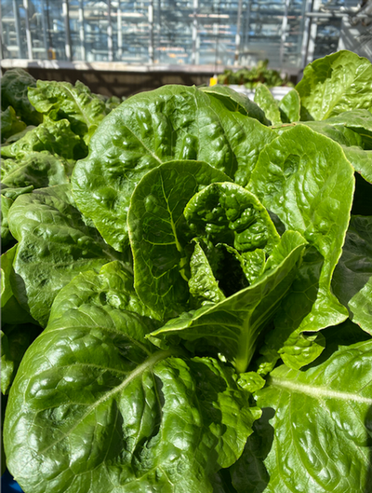
Foodborne outbreak prevalence
Produce is the food category that accounts for the highest number of foodborne illness outbreaks (CDC).
In 2021, an outbreak was reported on packaged leafy greens contaminated by Salmonella Typhimurium. Leafy greens contaminated in this multi-state outbreak were grown in indoor hydroponic operation.
Food safety practices must be followed to ensure the safety of the food grown in the Aquaponic system.

Slide 9
Aquaponic cross-contamination sources
Bacteria and other pathogens can be introduced from:
Fish feed: Improper feed storage and handling can be a potential source of contamination in the system.
  Best Practice: Use high quality feed; Store in a clean and dry environment; Washing your hands and using gloves can prevent contamination.
Inadequate hygiene by systems handlers and visitors can lead to pathogens introduction at various produce stages, from initial planting to crop contamination during harvesting.
  Best Practice: Wear proper protective clothes, wash hands before and after interacting with each part of the aquaponic system, and wear gloves.

Slide 10
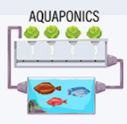
Aquaponic cross-contamination sources
Some water sources can introduce harmful bacteria and chemicals to the system.
  Best Practice: Regular water testing is essential to monitor water quality and mitigate these risks.
Organic waste accumulation (fish wastes and uneaten food) can introduce pathogens and/or lead to the growth of harmful bacteria into the system.
  Best Practice: Water filtration, proper system cleaning, and maintenance minimize these risks.

Slide 11
How to limit cross-contamination?
The USDA recommends using one cutting board for fresh produce and bread and a separate one for raw meat, poultry, and seafood. This prevents bacteria from the seafood but also poultry or meat from contaminating a food that requires no further cooking referred as ready to eat.
fresh produce and bread
raw meat, poultry and seafood
Using color-codded cutting board can also be a good idea.

Slide 12
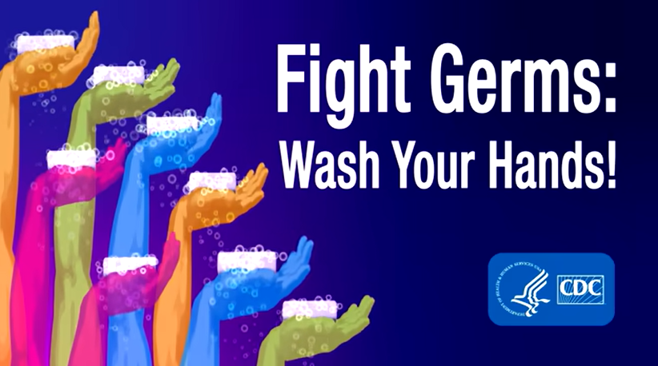
Wash hands
It is recommended that we wash our hands with soap under running warm water for 20 seconds to remove bacteria.
  More than 98% of surveyed consumers knew they should wash their hands with soap and water.
  Many people over-estimate how long they wash their hands. So, time yourself by singing “Happy Birthday” song twice when washing your hands.
Research shows that many people do not follow this recommendation.
  Study 1:
    64% of meal preparers did not wash their hands before starting meal preparation
    Only 10% washed hands for 20 seconds or longer
    36% washed hands for 5 seconds or less
  Study 2:
    Nearly 40% of meal preparers did not wash their hands after touching raw chicken
    About 30% did not use soap.
  Study 3:
    Over half (68%) of food workers either did not wash their hands or did not wash appropriately.
Notes:
Graphic from: CDC video, Fight Germs. Wash Your Hands! https://www.youtube.com/watch?v=eZw4Ga3jg3E

Slide 13
Dry your hands
It is important to dry your hands because wet hands pick up more germs than dry hands.
Drying your hands – with paper towels or a hand dryer – are both effective.
The most important thing is to dry your hands completely.
The National Institute of Health (NIH) recommends that health care workers paper towels dry their hands thoroughly with single-use, disposable paper towels.
Wearing gloves can help keep food safe, but gloves cannot replace clean hands.
  Always wash your hands before putting on gloves and after taking them off.
  Be sure to change gloves if they get dirty or if you switch tasks to prevent spreading germs.

Slide 14
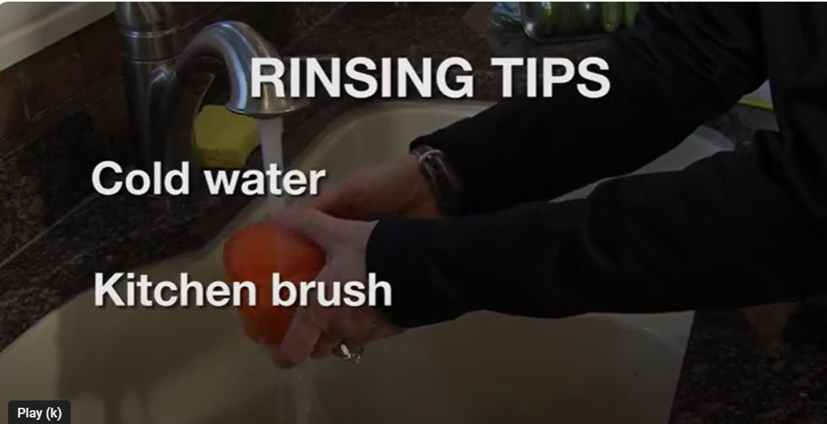
Wash produce
Fruits and vegetables should be washed under
running cold water to remove dirt and reduce
bacterial contamination.
Do not wash fruits and vegetables with:
  Soap or bleach solutions, many fresh produce are porous and could absorb these chemicals, changing their safety and taste.
  “Fruit and vegetable washes” are not recommended by FDA because the safety of their residues has not been evaluated, and their effectiveness has not been tested or standardized.
Commercial, homegrown, aquaponic, and organic produce can all be sources of harmful bacteria.
Notes:
Graphic: Mayo Clinic Minute: Quick Tips for Washing Fruits and Vegetables: https://www.youtube.com/watch?v=d41O6StbMTU

Slide 15

Observing others
Watch the Gordon Ramsay Cooks Mediterranean Sea Bass video
  Video: https://www.youtube.com/
  watch?v=FaIynhb0twk
Take notes of the safe food preparation errors that you see.
Notes:
Video: https://youtu.be/FaIynhb0twk?si=aBHdhpAYMnA7Kg7m
or Google “Gordon Ramsay Cooks Mediterranean Sea Bass in Under 10 Minutes | Ramsay in 10”
Length: 10 minutes, 12 seconds

Slide 16
Class review
Each student should share one preparation error they saw in the video.
How many of you saw this error?
After everyone has had a chance to report:
What other errors, that have not yet been mentioned, did anyone see?
Can anyone think of anything else?
Notes:
Video: https://youtu.be/FaIynhb0twk?si=aBHdhpAYMnA7Kg7m
or Google “Gordon Ramsay Cooks Mediterranean Sea Bass in Under 10 Minutes | Ramsay in 10”
Length: 10 minutes, 12 seconds

Slide 17

Food safety errors
Error | Time
None of the vegetables were washed on camera | na
Touched fish with unwashed hands | 0:45
Touched chili with unwashed hands | 0:59
Touched eggplant with unwashed hands | 1:03
Touched his watch and moved to cutting vegetables | 1:07
Used a cloth towel to wipe his hand | 2:42
Used the same cutting board for the fish and vegetables | 3:24
Used the same knife for fish and vegetables | 3:25
Did not wash hands after handling fish | 3:40
Cut tomatoes on the same cutting board used for fish and vegetables | 3:40
Lemon was not washed before zest was used | 4:12
Did not was the pan (wiped it with a cloth towel) | 4:29

Slide 18
Food safety errors
Error | Time
Placed the towel in his pocket | 4:34
Wiped the cutting board with the towel that was in his pocket | 5:00
Still used chili piece that fell on uncleaned countertop | 5:15
Cut chili using a dirty knife and the same cutting board | 5:16
Used a cloth towel to wipe his hand | 5:26
Touched the fridge door and didn’t clean his hands after | 5:48
Blew on the sauce | 5:58
Used the same spoon for broth and chopped tomatoes | 6:16
Tapped the tasting spoon to the pan | 6:36
Used a cloth towel to wipe his hand | 6:46
Used fresh oregano without washing it | 6:52
Lemon was not washed before being used | 7:21

Slide 19
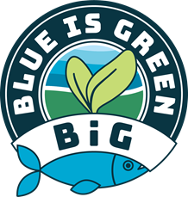
Food safety errors
Error | Time
Did not wash hands after handling fish | 7:34
Used a cloth towel to wipe his hand | 7:49
Used a spoon for couscous that he tasted the sauce with | 7:57
Wiped the cutting board with the same cloth towel | 8:15
Touched the fish without washing hands | 8:19
Touched fish with hands during cooking | 8:20
Turn fish filet over with hands | 8:31
Used a fish knife to cut lemon | 8:39
Used the same spoon and hands to serve the fish | 9:32
Used dirty hands to serve eggplant | 9:41
Used a cloth towel to wipe his hand | 9:49
Oil faces a contact with hands before poured on food | 9:51

Slide 20

https://purdue.ag/big-project
This work is supported by the Sustainable Agricultural Systems program, project award no. 17001002, from the U.S. Department of Agriculture’s National Institute of Food and Agriculture. Any opinions, findings, conclusions, or recommendations expressed in this publication are those of the author(s) and should not be construed to represent any official USDA or U.S. Government determination or policy.

