Slide 1
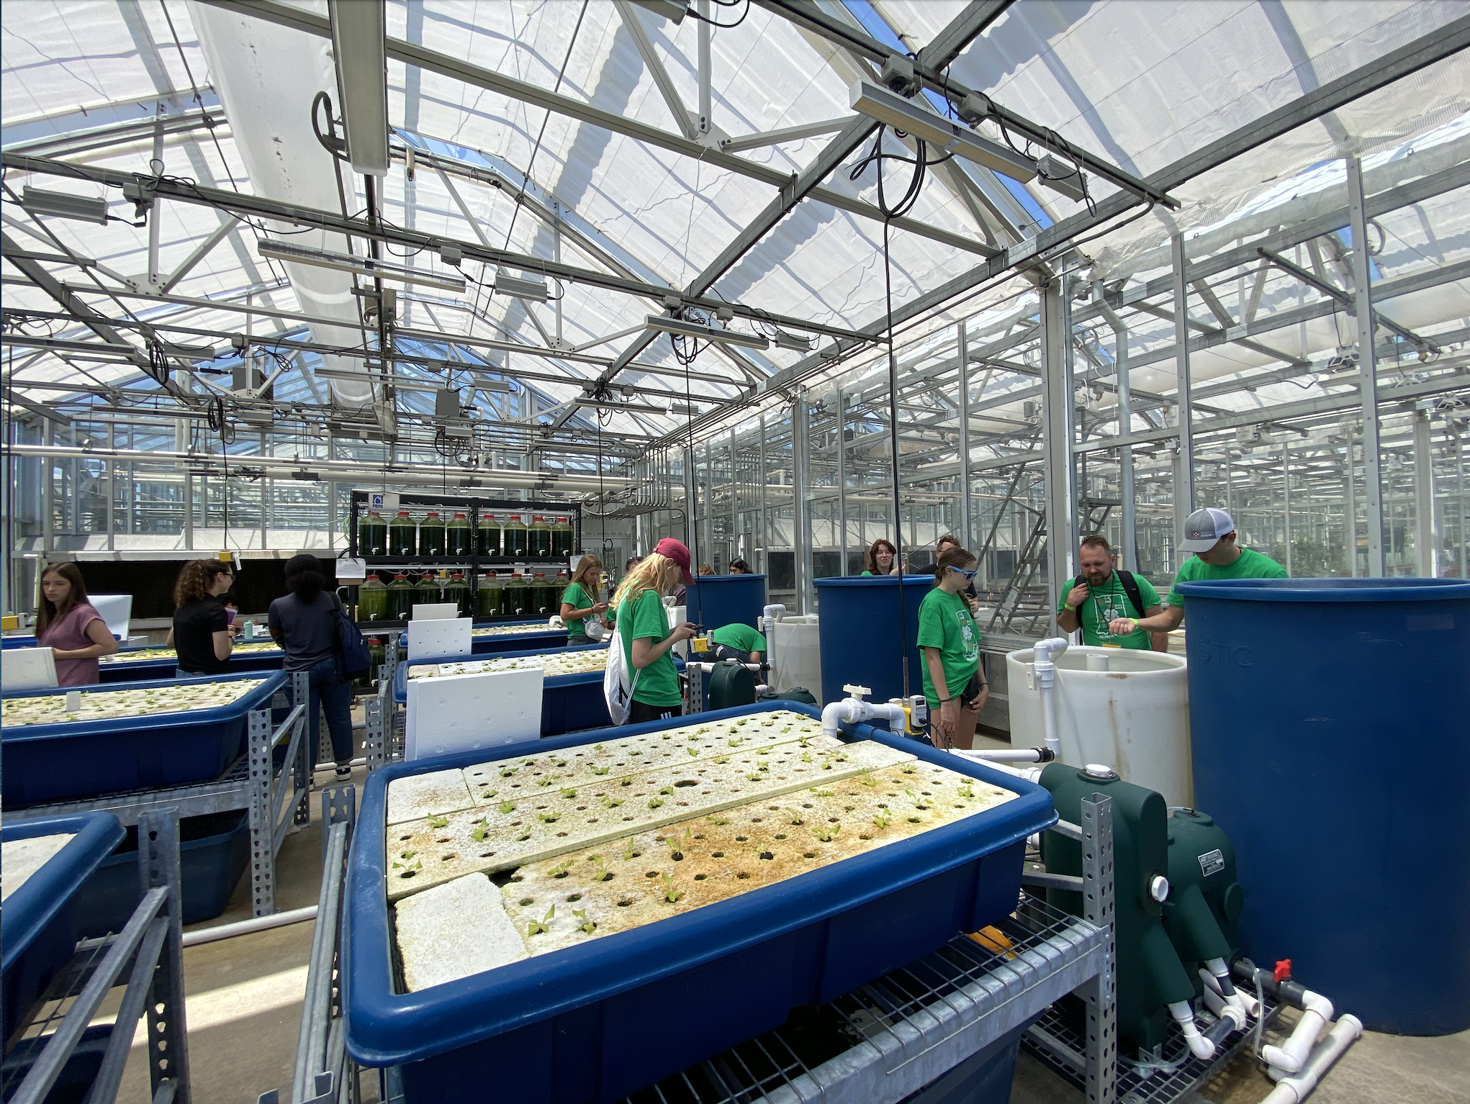
Let’s get started!
Let’s Get Started!
Notes:
Glossary:
Aquaculture. Cultivation of aquatic animals or plants for food.
Aquaponics: The combination of recirculating aquaculture and hydroponics.

Slide 2
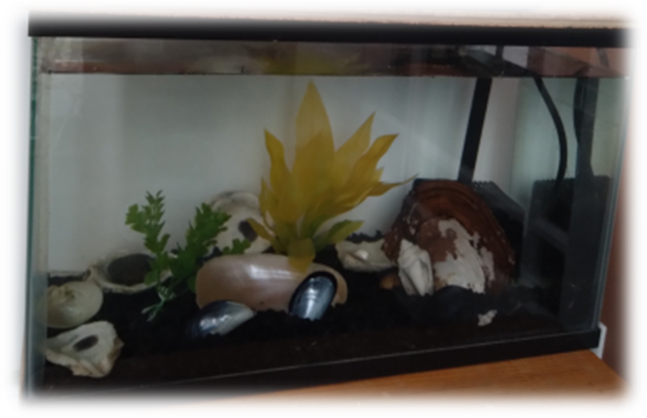
Let’s get started!
You will set up your own aquaponics system with goldfish and an herb of your choice.

Slide 3

Aquaponics
Aquaponics is a system of raising plants and aquatic animals together.
Animal wastes serve as a nutrient source for the plants.
These systems can be any size. Functioning systems range from simple
10-gallon tank to those holding thousands of gallons of water.
Aquaponics systems have the same basic system components:
  Fish or shrimp
  Plants
  The tank, hoses, filter and a pump
Notes:
Authors: Natalie Carroll, Paul Brown, Tim Rice
Glossary:
Aquaculture. Cultivation of aquatic animals or plants for food.
Aquaponics: The combination of recirculating aquaculture and hydroponics.

Slide 4
Materials needed
Aquarium with:
  Artificial light if you do not have a bright spot to place the tank (but not in direct sunlight)
  Filter and pump
    A sponge filter can be used instead of a carbon filter. They are simple to use as long as you have a small air pump for tank aeration.
    Larger filters can hold more good bacteria that break down harmful chemicals in the water.
  Grow bed options: stones; clean pea gravel; styrofoam
  Optional tank accessories: plants, marbles, figures, buildings. (Note: Accessories must be colorfast and insoluble.)
Bacteria starter (nitrifying bacteria)
Fish net
Goldfish food
Water testing kit to check water parameters: pH, ammonia, nitrite
Cleaning materials:
  Salt, non-iodized
  Gravel vac or tube to clean debris from the stones at the bottom of the aquarium.
Air stone or dichlorination chemical if using chlorinated water.
Do not purchase your goldfish until the tank is cleaned, seasoned and set up.
Do not purchase plants
until your fish have
acclimated to your tank.

Slide 5

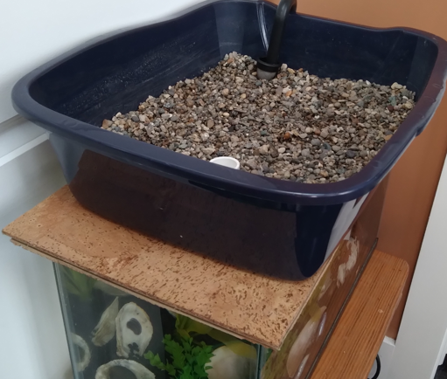
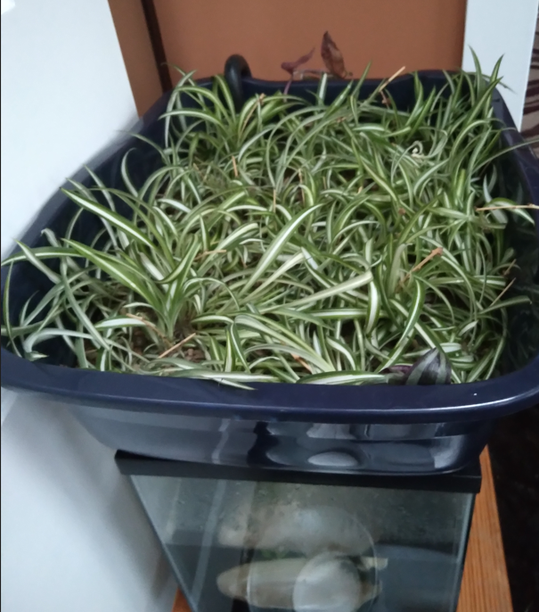
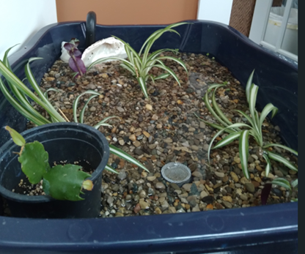
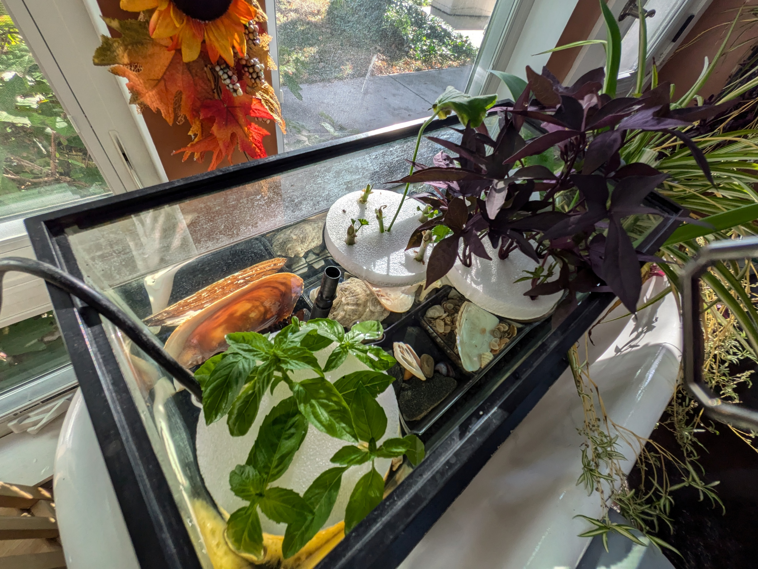
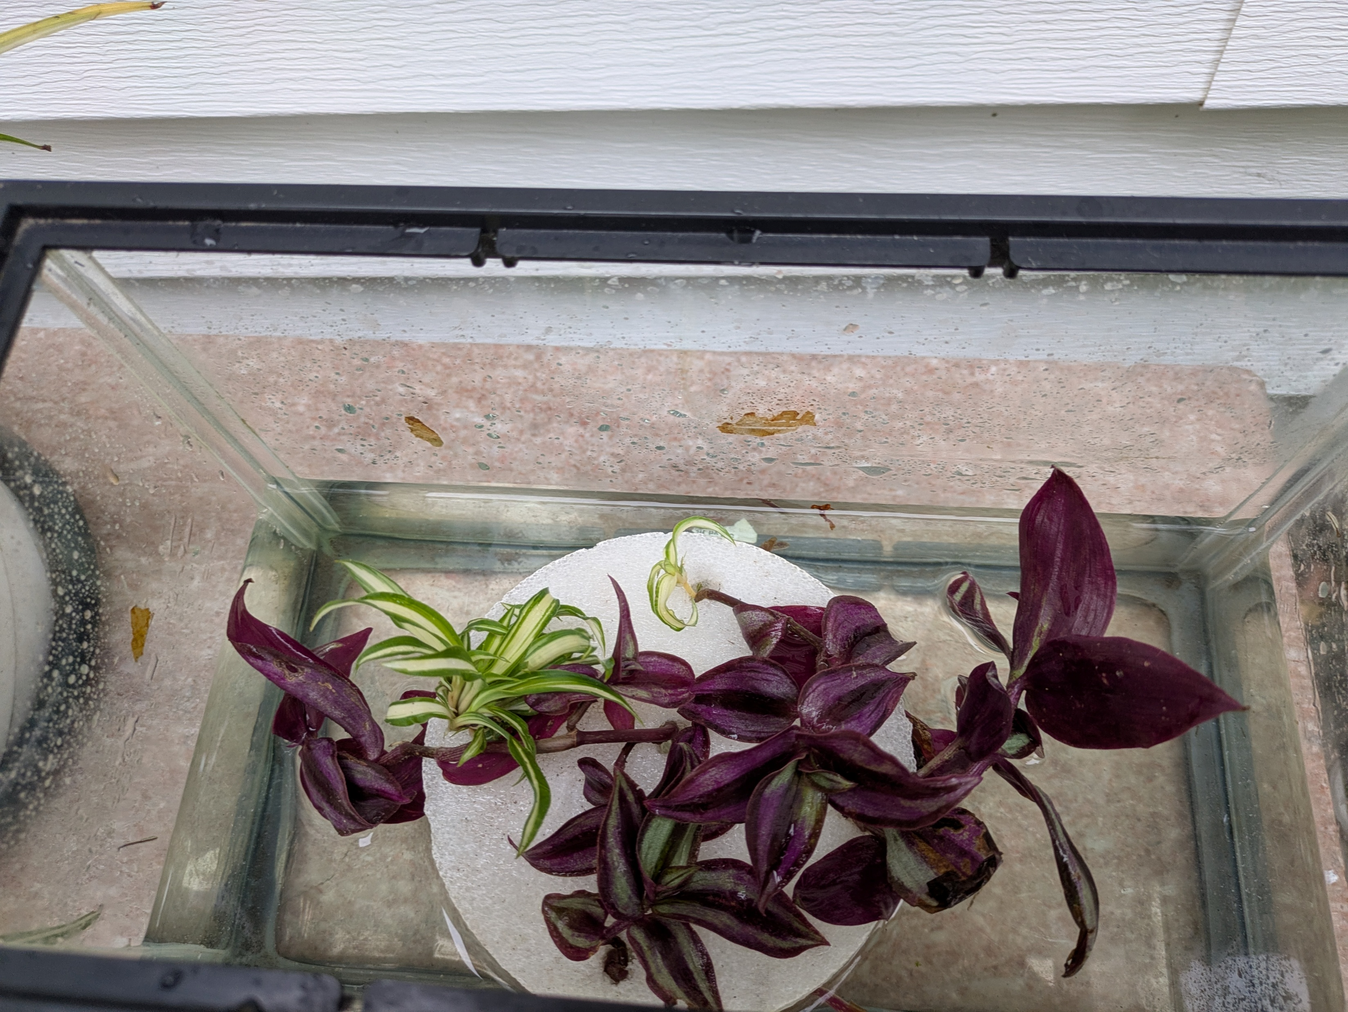
Grow bed
A bed of clean pea gravel in a container above the tank can also hold plants.
Place a grow bed on top of tank with water flowing into the bed and draining at the other end.
Use a timer to cycle the water for 30 minutes
5-8 times/day.
Record what happens.
Photos show both a gravel grow bed and Styrofoam plant holders.
Seeds do not do well in these systems as roots are needed to hold the plants upright.

Slide 6
Clean your tank
Wash the tank and any accessories in tap water.
  Do not use soap or detergent because they can leave residues that can harm your fish.
Place the accessories in the tank and fill to the top with hot water.
Add as much non-iodized salt as will dissolve when you stir it into the hot water.
Leave the salt water in the tank for one hour.
Remove the salt water by dipping or siphoning. Never tip a full tank (the water is too heavy).
Rinse the tank and accessories with water.

Slide 7
Setting up your system
Tank placement:
  Place near a window for natural light but out of direct sunlight and drafts.
  Use artificial light (grow lights) if needed. The fish (and plants) will need
  8-10 hours of light each day.
  Temperatures between 65 degrees and 70 degrees Fahrenheit are best for goldfish.
Fill your tank with 8-9 gallons of tap water.
  Chlorinated water must de-gassed by aerating it with an air stone or dichlorination chemical.
Add nitrifying bacteria to regulate the nitrogen cycle.
  The bacteria convert ammonia (produced by fish waste) into nitrite.
  Add additional bacteria whenever you change the water.
Place clean gravel and any accessories in the bottom of your tank.
Place the pump and filter in the tank.

Slide 8
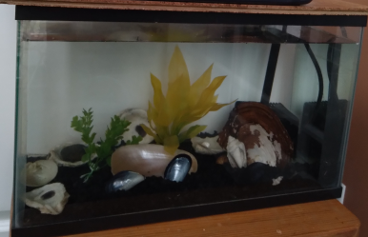
Setting up your system
Start the pump to assure water is flowing properly.
Allow the water to “cycle” before adding your fish.
  Aquarium cycling is the process of creating
  a biologically safe environment for the fish.
  Cycling the tank makes the water healthier
  for your fish and plants.
  It is best to wait until ammonia readings
  are zero. Cycling can take 2-6 weeks.

Slide 9
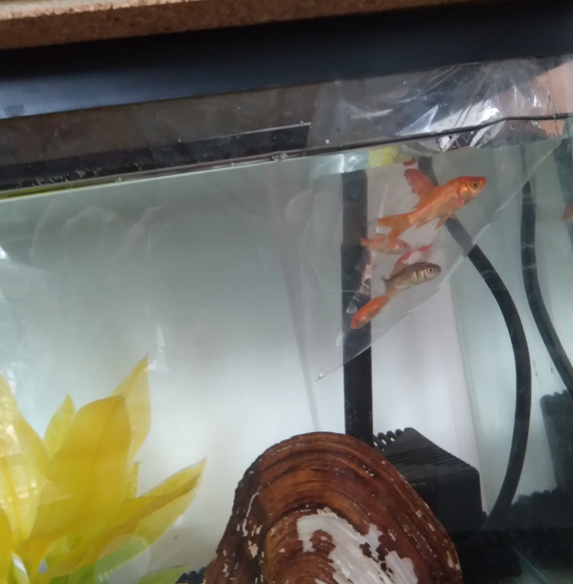
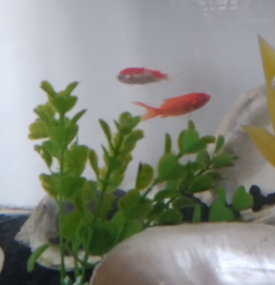
Adding the goldfish
Purchase 6-8 goldfish for a 10-gallon tank
  Stock 1 inch of fish per gallon of water
Place the plastic bag containing your fish in the tank as soon as possible.
Leave the fish in the bag for one hour so you don’t shock your fish.
  The water temperature in the bag will equilibrate with the tank water temperature.
  Adding a little aquarium water to the bag every 10-15 minutes can help the goldfish acclimate to the new water. This is not as important for goldfish as it is for less hardy fish.
Release your fish from the plastic bag after an hour.
Note that fish do not like being touched, bright lights or loud noises.
Notes:
Purchase and add your goldfish.
If you need to find a location to purchase, search for “feeder fish.” A search for “goldfish” will result in locations of goldfish crackers.

Slide 10
Feeding your fish
Feed your fish once a day.
Offer small amounts of food for no longer than 5 minutes.
  Sometimes they may want more food than normal and sometimes less than normal.
  Avoid overfeeding. Uneaten food will degrade your water quality.
Initial feeding behavior may be aggressive — they are hungry. But it will slow within a few minutes as they consume the amount of food they want.

Slide 11
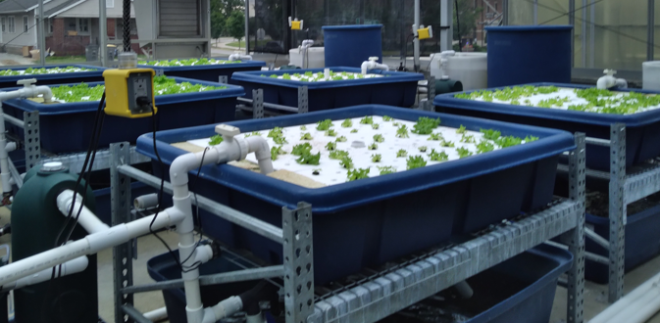
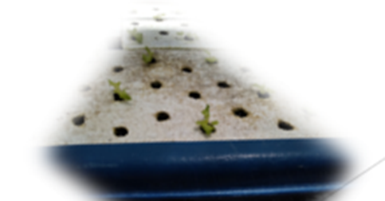
Adding plants
Purchase and add plants when fish are established (a week or two).
  Small herb plants may be available in the produce section of grocery stores.
  Cuttings from herbs, house plants or flowers may be used.
Polystyrene foam board
  Cut about 15” x 8” for a 10-gallon tank.
  Cut small openings in the polystyrene for your herbs.
Place the plants
  Potted herbs: remove from pots and gently rinse soil off the roots.
  Place the herbs or cuttings in the holes in the polystyrene foam board.
Providing extra aeration may be needed if the fish have limited access to the surface water due to the polystyrene board.

Slide 12
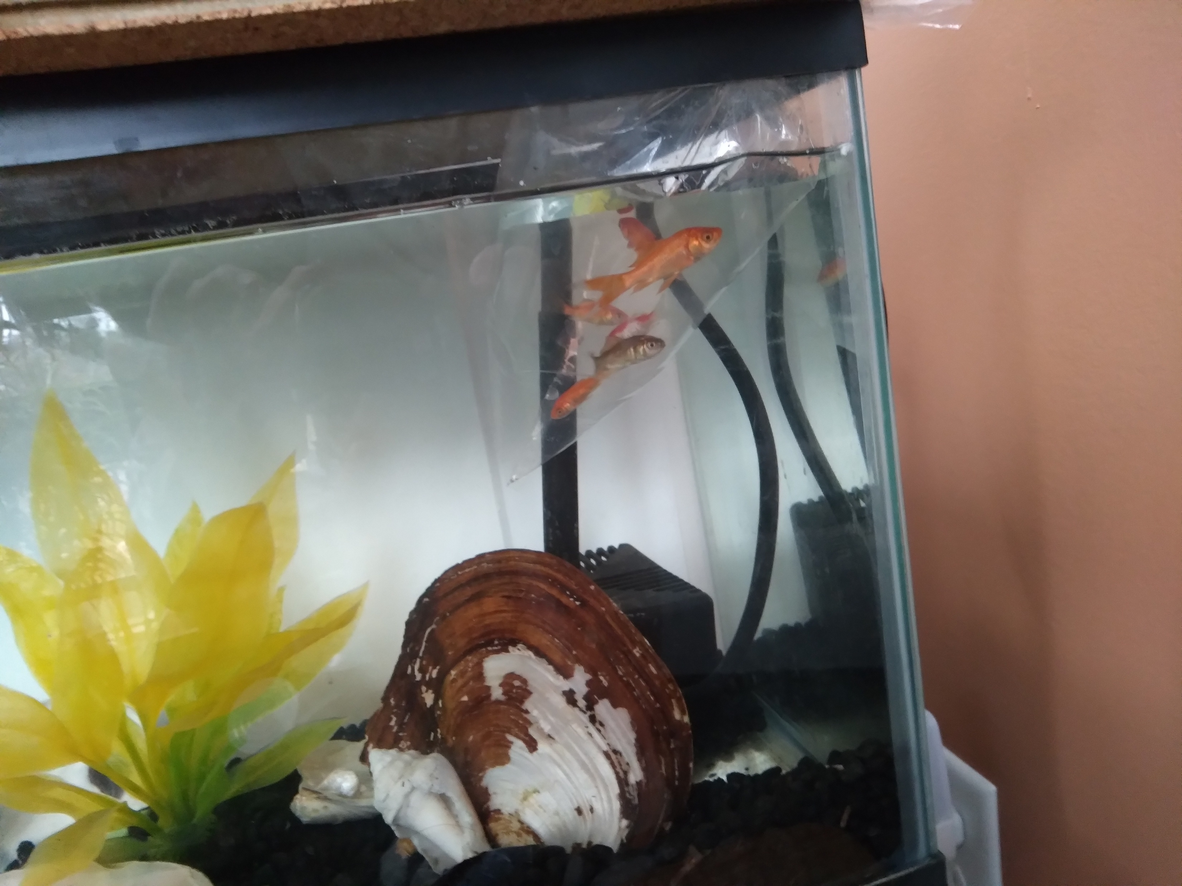
Maintaining your system
Weekly:
Test your water pH, ammonia and nitrite levels.
  Clean more often if contaminate levels are high.
  Record your data.
Keep track of fish and plant growth.
Clean your tank.
  Remove leftover food and fish waste with a tube, gravel vac, or tool.
  Watch for algae growth.
    Clean algae off the glass with an aquarium algae scraper.
    Reduce lighting (bulbs or sunlight) if algae growth is excessive.
Remove 25-30% of the water and replace with cycled water.

Slide 13
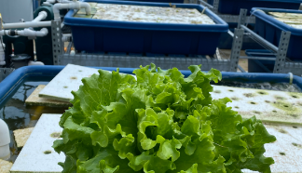
Watch them grow!
Monitor and record your fish and plant growth.
Harvest the plants or selected leaves from your herbs as desired.
Harvest herbs when they get too large for your tank.

Slide 14
Disposal of goldfish
Goldfish are an invasive species – never release them into the wild.
When they are released into the wild, goldfish can grow to the size of football and weigh up to 4 pounds! These voracious eaters carry parasites, foul the water, and uproot native plants and animals.
See the U.S. Fish & Wildlife Service article, How to Break Up with Your Goldfish (https://www.fws.gov/story/how-break-your-goldfish), for more information.
Alternatives for disposal:
  Gift to a friend or family member.
  Donate to a pet store or aquarium.
  Euthanize.
Notes:
How to Break Up with your Goldfish, U.S. Fish & Wildlife Service, https://www.fws.gov/story/how-break-your-goldfish

Slide 15
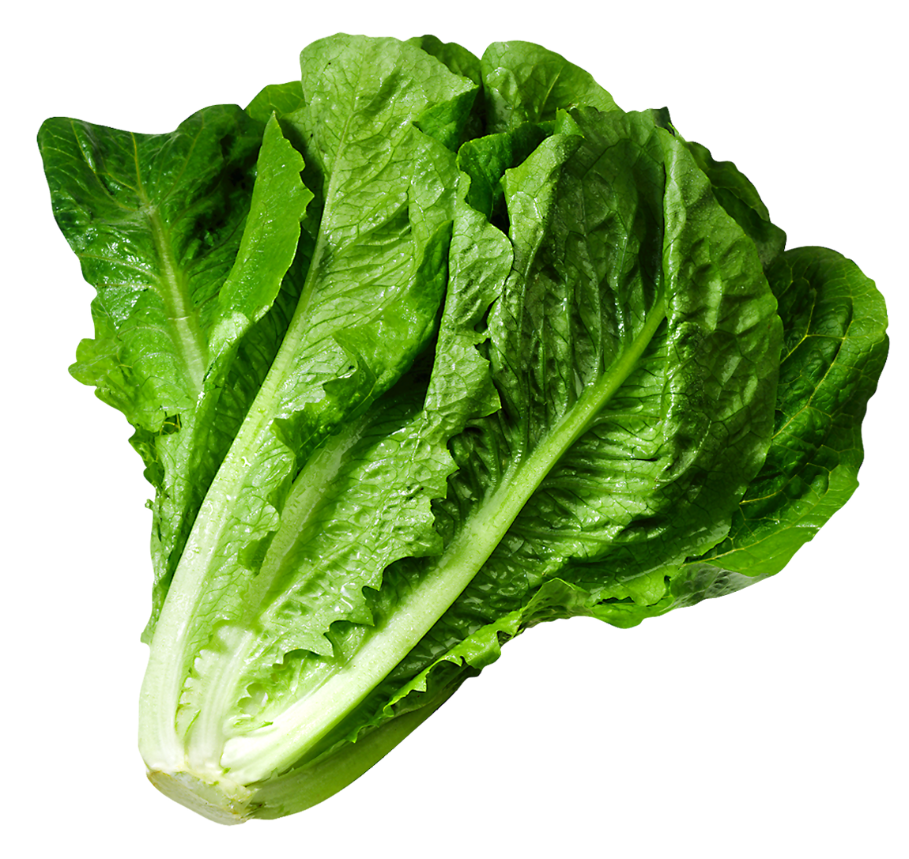
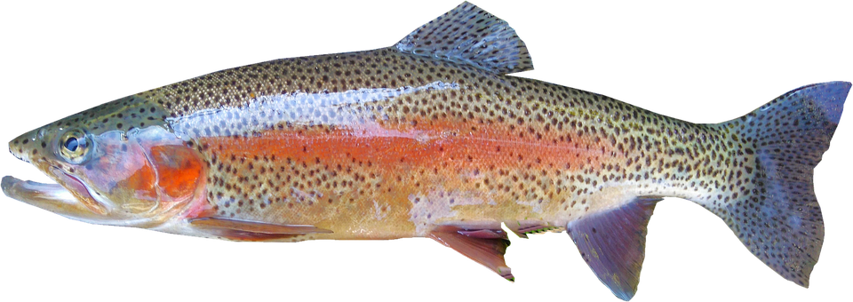
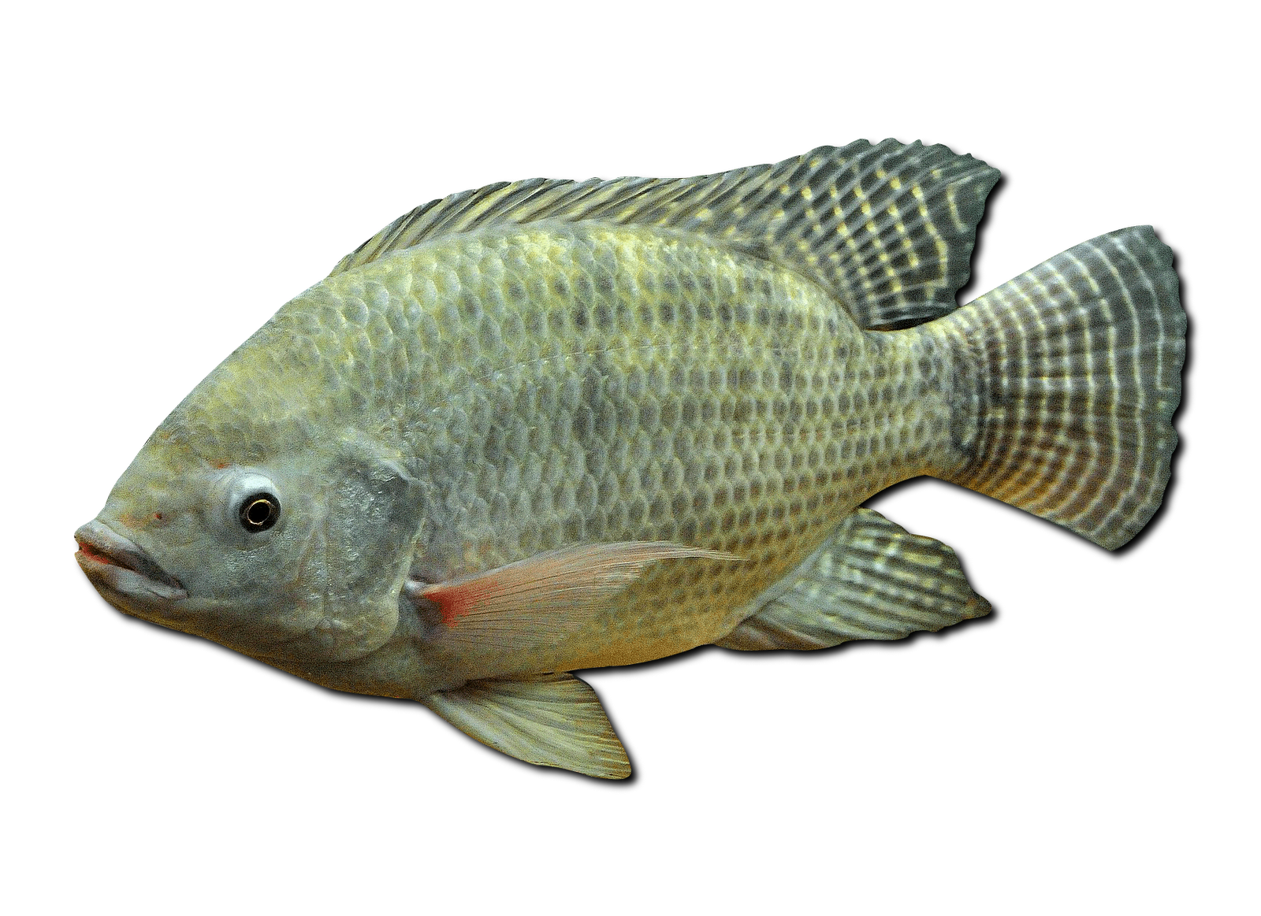
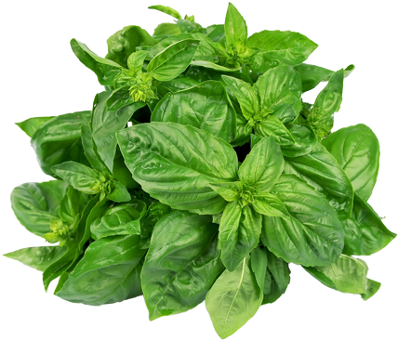
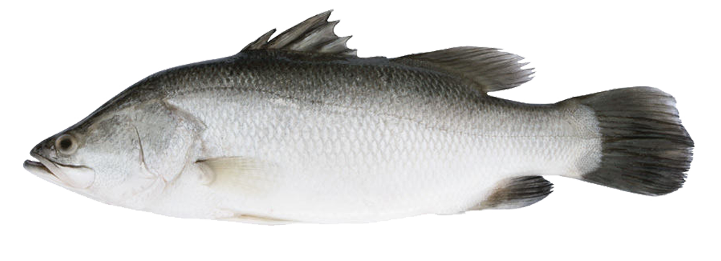
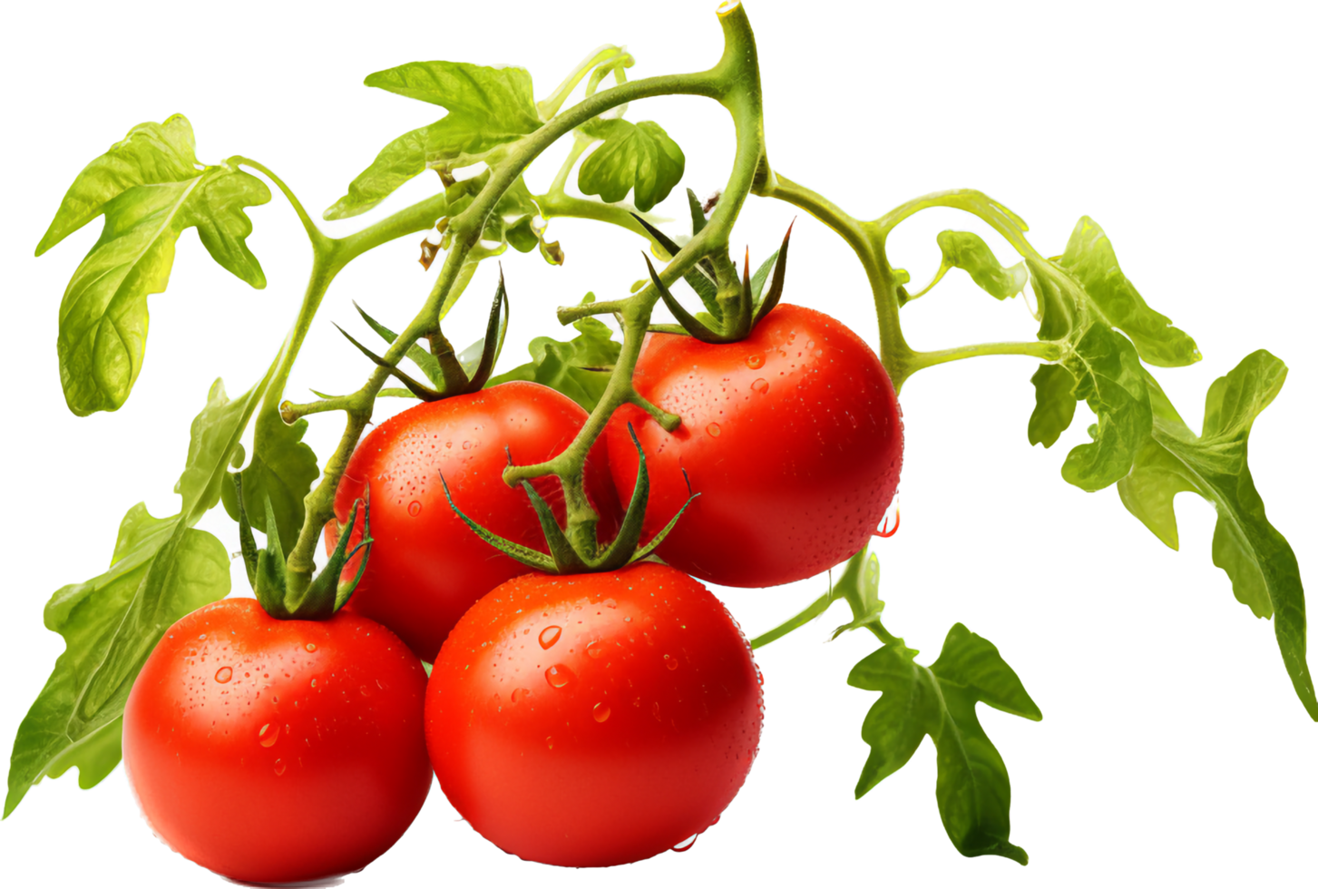
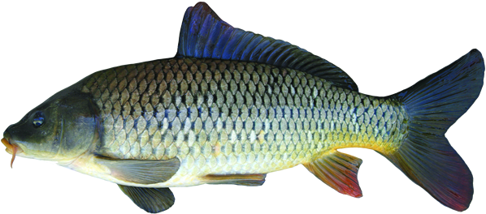
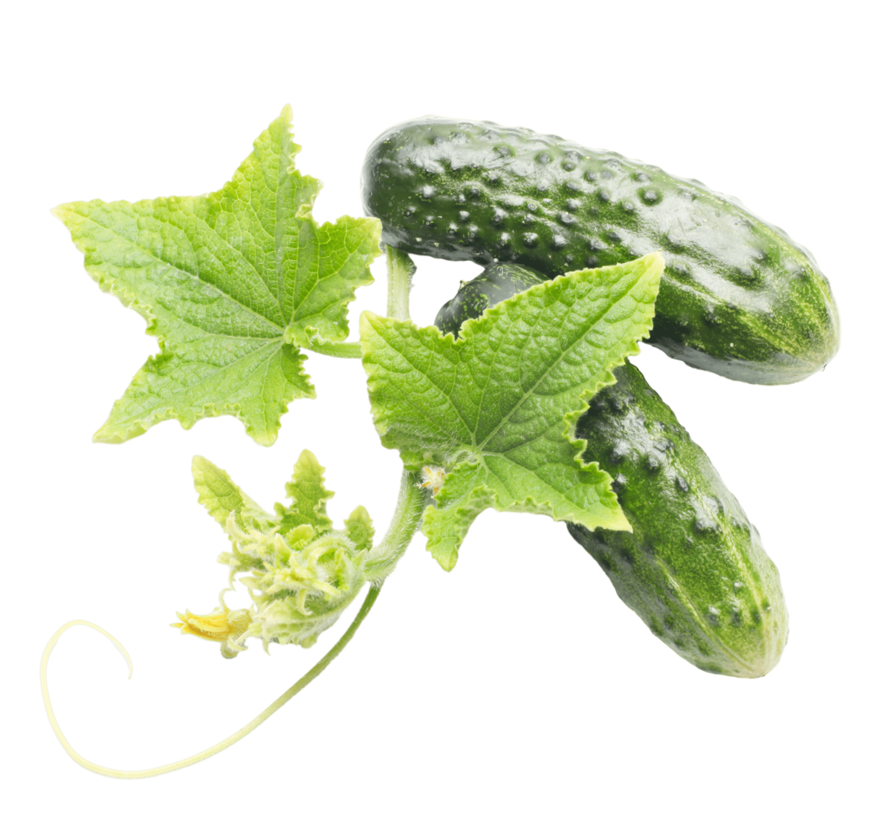
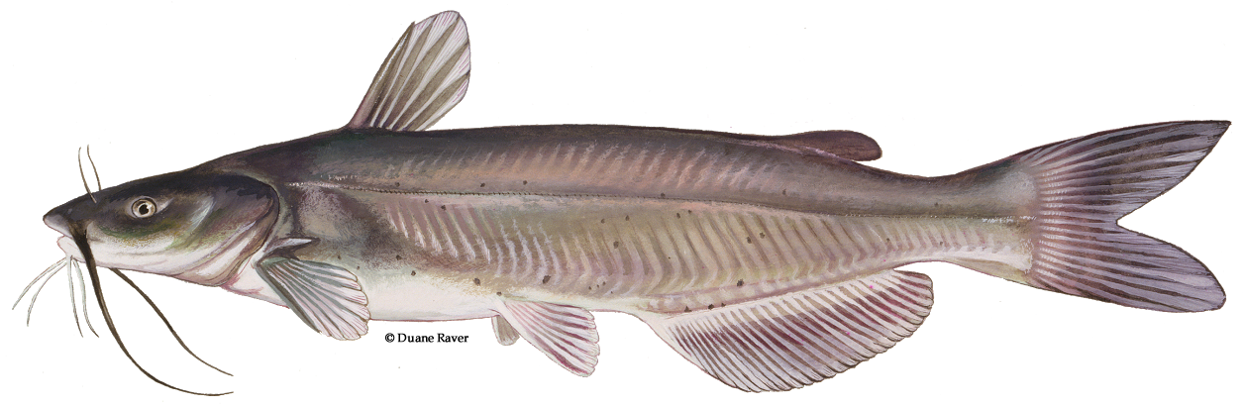
Common aquaponics species
Aquatic organisms
Rainbow trout
Nile tilapia
Barramundi
Carp
African catfish
Crops
Lettuce
Basil
Tomatoes
Cucumber

Slide 16
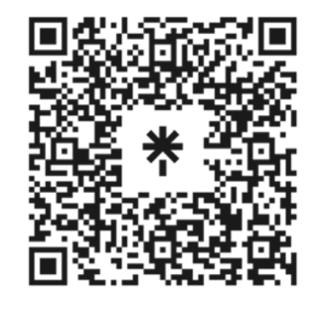
https://purdue.ag/big-project
This work is supported by the Sustainable Agricultural Systems program, project award no. 17001002, from the U.S. Department of Agriculture’s National Institute of Food and Agriculture. Any opinions, findings, conclusions, or recommendations expressed in this publication are those of the author(s) and should not be construed to represent any official USDA or U.S. Government determination or policy.

