Slide 1
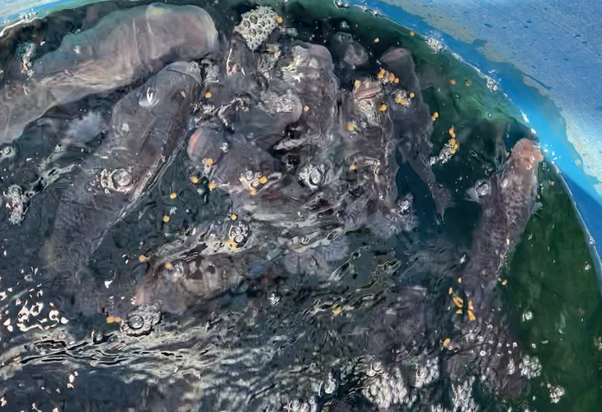
Plant
and Fish Nutrition

Slide 2
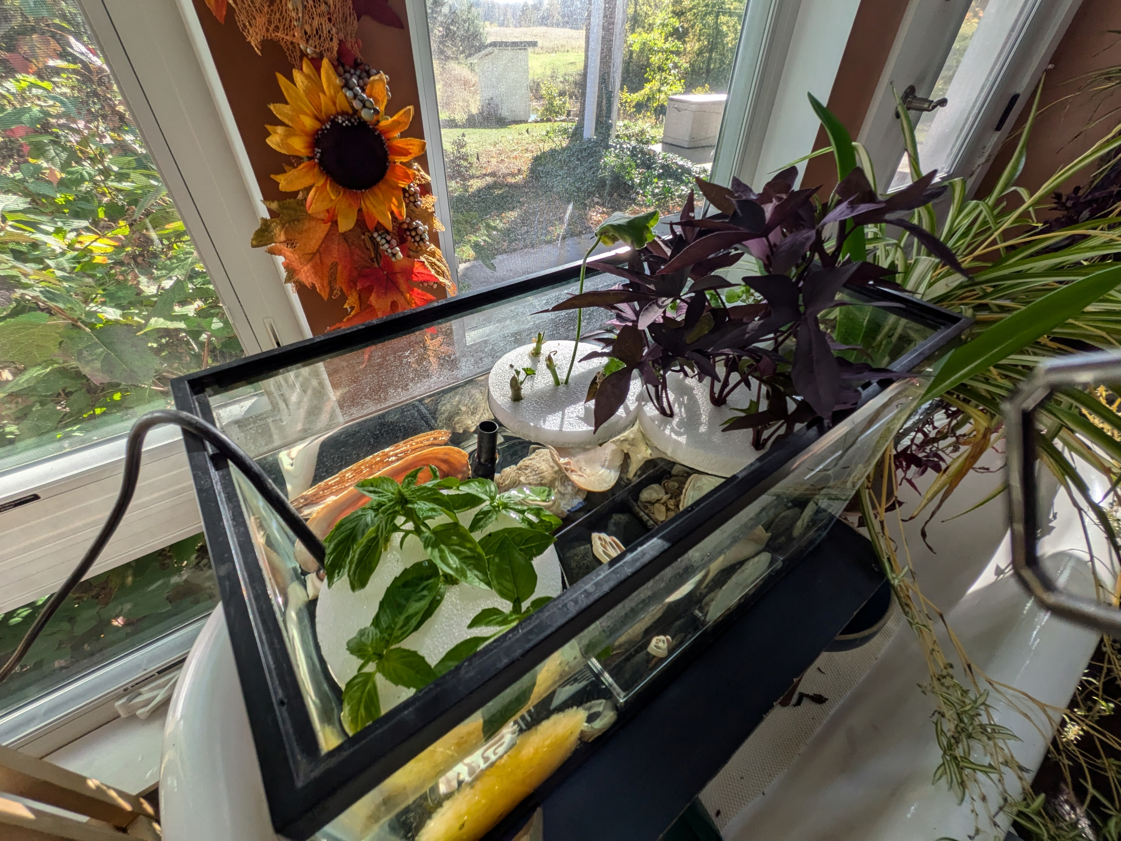
Plant and fish nutrition
Learn about important plant and animal nutrients.

Slide 3
Plant and fish nutrition
Aquaponics is the combination of aquaculture and hydroponics (growing plants in water).
Aquaponics systems rely on the interaction and synergy between plants and animals.
The primary nutritional input in an aquaponic systems is the fish food.
So, the flow of nutrients in an aquaponics system starts with, and is maintained by, regular feeding of the fish.
Fish produce waste, which provides nutrition for the plants.
Notes:
Authors: Paul Brown, Timothy Rice, Natalie Carroll

Slide 4
Animal nutrition
Animals (humans included) obtain vitamins from their diet and require more than 40 nutrients, including:
Carbohydrates
Fats
Fiber
Minerals
Proteins
Vitamin A
Vitamin B-12
Vitamin: calcium
Vitamin: iron
Vitamin: riboflavin
Vitamin: zinc
Water

Slide 5
Nutrition deficiencies
Common goldfish nutrition deficiencies:
Deficiency | Can Cause
Vitamin A | Skeletal deformities
Vitamin C | Can cause broken back disease, where the fish's backbone becomes deformed
Vitamin B-complex | Can cause brain, spinal cord and nerve disorders
Iodine | Can cause thyroid hyperplasia
Note that vitamins C & E are important for immune function.

Slide 6
Goldfish nutrition
Goldfish food requirements:
  A protein level of 30% (older fish) to 35% (younger fish).
  One of the first three ingredients listed should be fishmeal, shrimp or krill.
Recommendations:
  Goldfish should eat a mix of flakes, pellets, frozen, and freeze-dried food.
  Adult goldfish should eat 3% of their body weight daily; fry and fingerlings can eat up to 5%.
  Goldfish don't have a true stomach, so it's best to feed them multiple smaller meals per day.
  Goldfish are cold-blooded, so their metabolism slows down when the water temperature drops.
You can also look for foods that are specifically formulated for goldfish; they need more carbohydrates than other types of fish.

Slide 7
Plant nutrition
Plants require at least 14 nutrients, and production can be limited by a lack of adequate minerals.
Macronutrients
Nitrogen (N)
Phosphorus (P)
Potassium (K)
Calcium (Ca)
Magnesium (Mg)
Sulfur (S)
Micronutrients
Chlorine (Cl)
Boron (B)
Iron (Fe)
Manganese (Mn)
Copper (Cu)
Zinc (Zn)
Nickel (Ni)
Molybdenum (Mo)
Note that some minerals can be toxic to plants, including:
Aluminum (Al)
Boron (B)
Chlorine (Cl)
Iron (Fe)
Manganese (Mn)
Sodium (Na)
Notes:
Glossary:
Macronutrients – essential in relatively large amounts to the growth and health of a living organism.
Micronutrients – essential in very small amounts to the growth and health of a living organism.

Slide 8
Common aquaponic plant deficiencies
Deficiency | ID | Remedy
Calcium | Leaves exhibit necrosis, which usually appears in newer leaves first. The edges of the leaves turn black and begin to curl. | Supplement with calcium carbonate*
Iron | Observe yellowing of the newer leaves. The new leaves may even turn white while older leaves stay green. | Supplement with chelated iron. This can be added to the water in the system. If the iron deficiency is severe, it can be applied as a spray directly on the plant leaves.
Potassium | Observe yellowing of older leaves, starting from the edge and moving toward the center, leaving the veins of the leaf green the longest. The plant will be stunted in growth, and new leaves may look deformed. | Supplement with potassium carbonate*
*Allow three days between adding both calcium and potassium carbonates because an interaction can occur between calcium and potassium in high concentrations.
Notes:
Necrosis – localized death of living tissue.

Slide 9
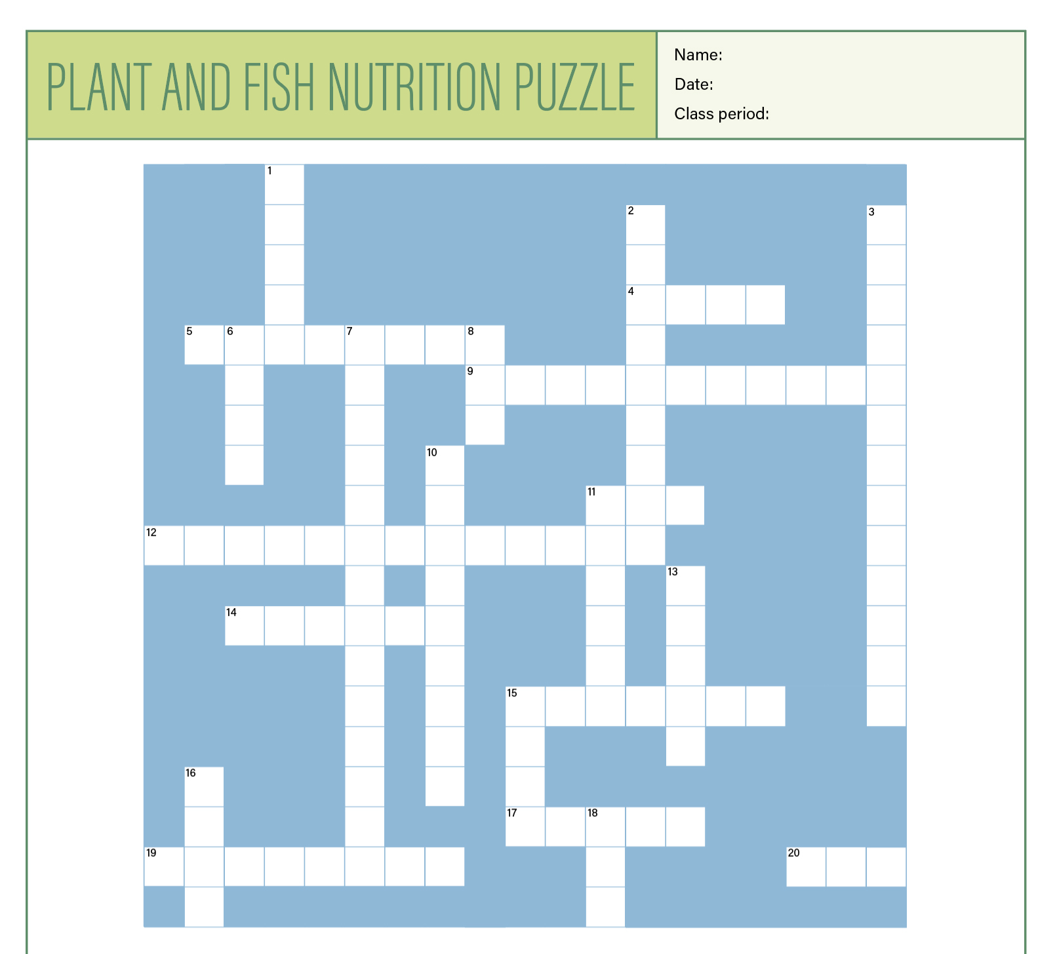
Assignment: Crossword puzzle
Complete the aquaponics nutrition crossword puzzle

Slide 10
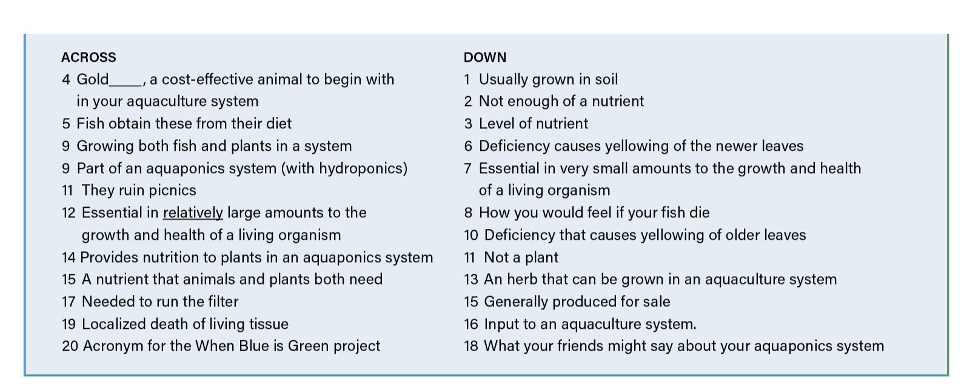
Puzzle clues

Slide 11
Answers

Slide 12
Discussion
Why is nutrition important for all living things?
How does an aquaponics system reflect our global food system?

Slide 13
Discussion answers
Nutritional deficiencies can cause a failure
to thrive and even illness.
Earth is a closed system, so merely throwing something away does not get rid of it — rather, it is moved to another location. Reusing nutrients by composting is a
great way to recycle plants and dead fish.

Slide 14

https://purdue.ag/big-project
This work is supported by the Sustainable Agricultural Systems program, project award no. 17001002, from the U.S. Department of Agriculture’s National Institute of Food and Agriculture. Any opinions, findings, conclusions, or recommendations expressed in this publication are those of the author(s) and should not be construed to represent any official USDA or U.S. Government determination or policy.

