Slide 1
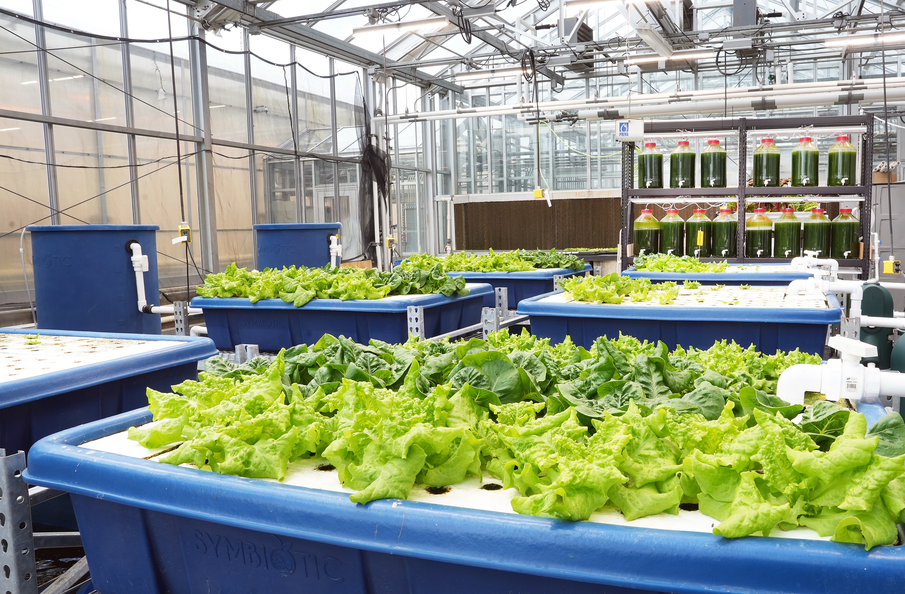
BiG Aquaculture System

Slide 2
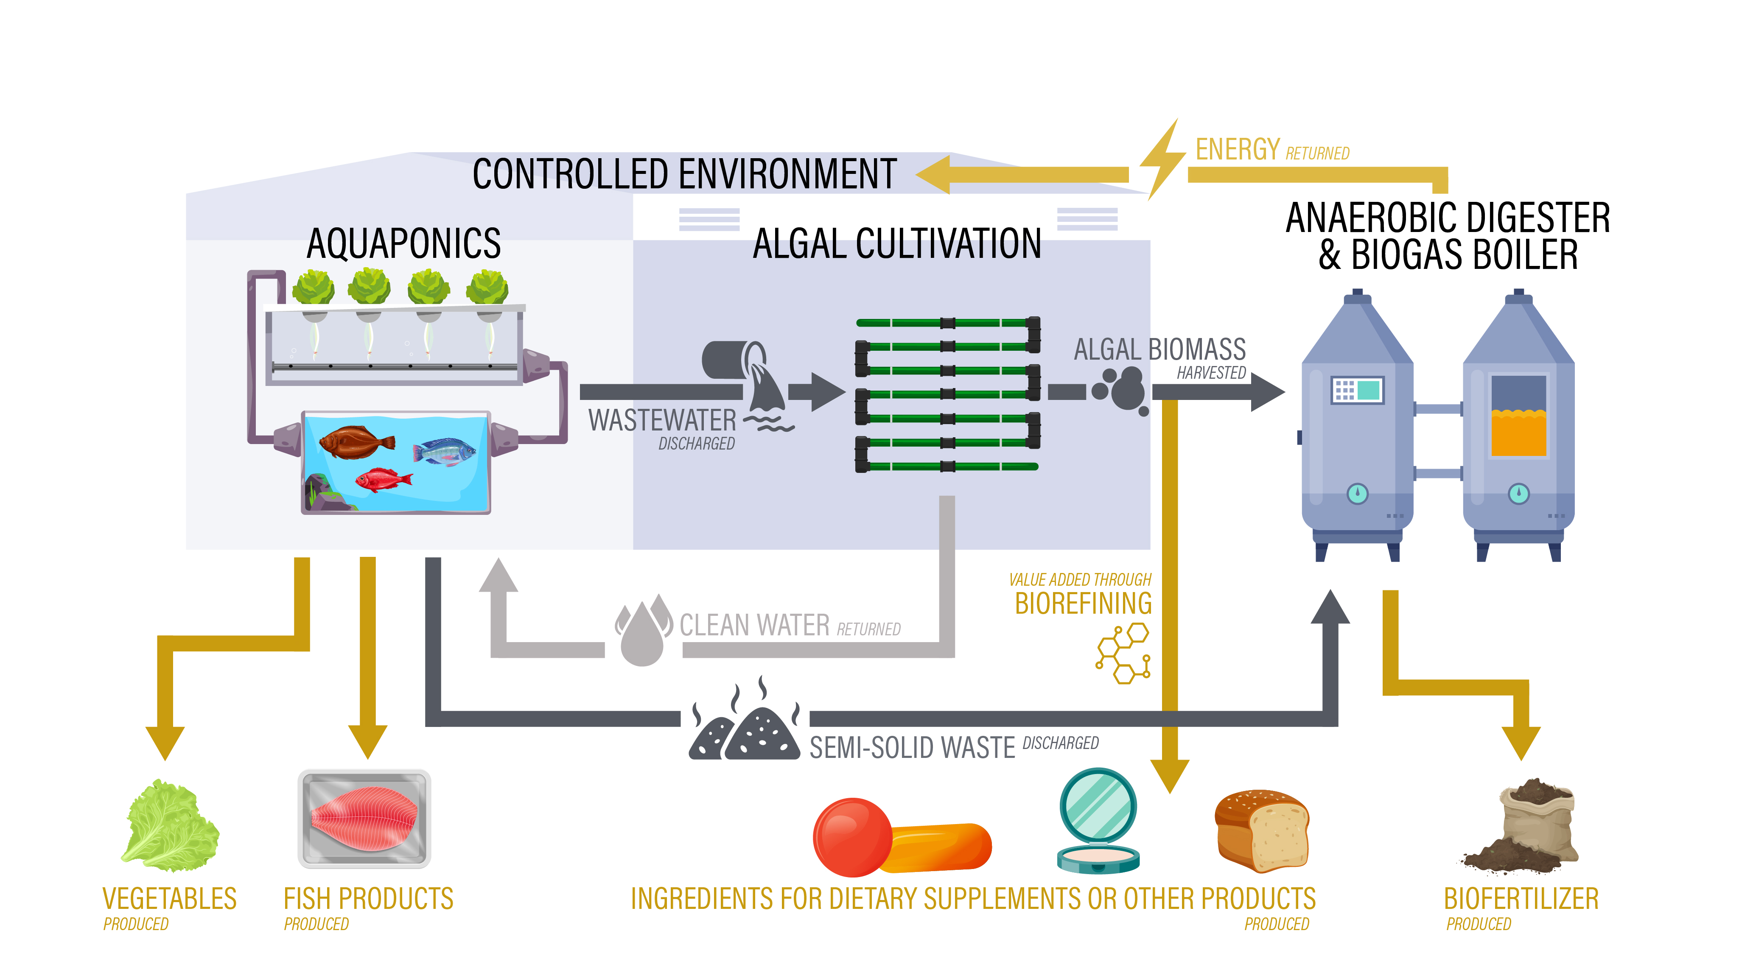
BiG Aquaculture System
Learn the importance of a systems approach
and how it applies to aquaponics.

Slide 3
Systems
The systems approach is used in many disciplines
to assure that inputs, outputs and impacts are considered during product development.
Inputs and outputs both entail costs.
The product, the fish and plants, will, hopefully, yield a profit for the producer.

Slide 4
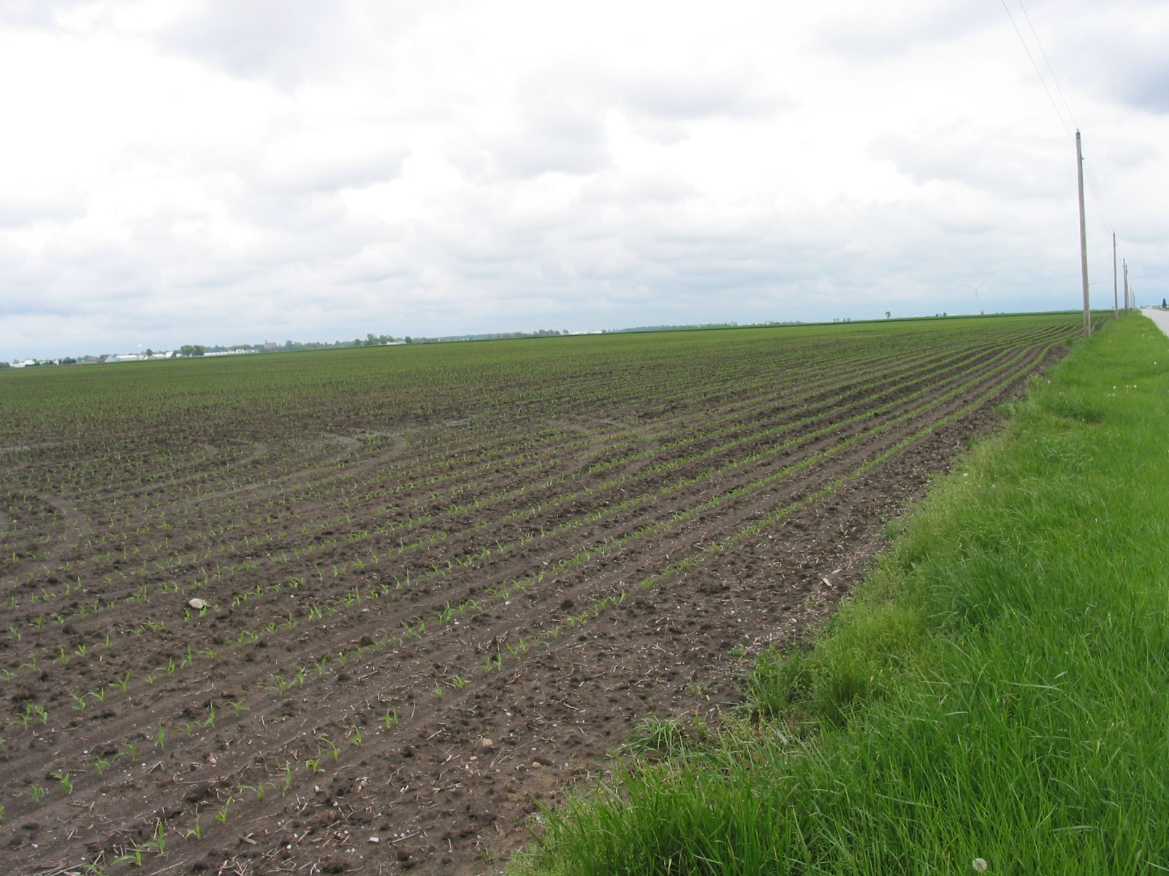
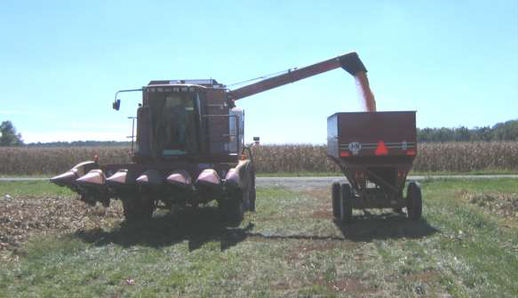
Inputs
Inputs include everything that goes into making food.
Input costs include all costs incurred by the producer/farmer.
Notes:
Graphics: Natalie Carroll

Slide 5
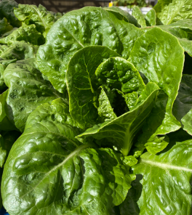
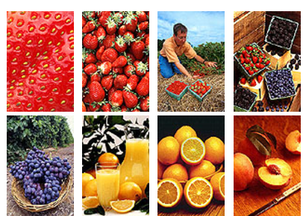
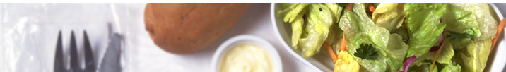
Outputs
The output is the food that has been produced.
Output costs include the costs incurred in the supply chain after the food leaves the farm.
Notes:
Graphics: USDA

Slide 6
Consider your school as a system
Consider your entire school system. What are the
  Inputs?
  Outputs?

Slide 7
Inputs
Art teachers
Assistant principals
Board of Education
Buildings – building and maintenance
Buses and bus drivers
Coaches
Drama teachers
Financial support from state and national governments (taxes)
Food
Food waste composting or disposal
Government support
Groundskeepers
Janitors
Lunch
Lunch providers/staff
Nurse
Parents
Pencils, pens & paper
Principal
Sewage disposal or onsite system
Sports fields – creation and maintenance
Students
Teachers
Textbooks and other educational resources
Transportation – gasoline for buses, teachers, staff and parents
Trash management (recycling and disposal)

Slide 8
Outputs
Community entertainment – drama, music, sports
Students – educated and insightful

Slide 9
The system approach
A food system includes everything from production to consumption and disposal of wastes.
  This is often called “farm to table.”
Food system sustainability requires a systems approach that considers all inputs, outputs and relevant supply chain interactions associated with the food.
The aquaponics system combines recirculating aquaculture and hydroponics and has many inputs and outputs.

Slide 10
When Blue is Green (BiG) Project
BiG researchers are testing new components in their aquaponics system in order to reduce waste and assure an economically viable system.
The major components of the BiG aquaponics system are:
  Fish, plants and tanks
  Algal processing (bioreactor + anerobic digester + biogas boiler)
  Anerobic digester and biogas boiler
  Processing (fish and plants)
Each component has specific inputs and outputs that must be carefully monitored for costs and environmental impact.

Slide 11
The BiG aquaponics system
Aquaponics combines recirculating aquaculture and hydroponics, which allows the nutrients produced by waste from animal rearing to be used by the plants as a natural fertilizer.
Water quality maintenance is very important with aquaponics to reduce the generation of waste (sludge and wastewater).
Sludge contains considerable amounts of nitrite, nitrate,
ammonia and phosphate.
  Wastes are fermented to produce biogas through anaerobic digestion and are used for soil enrichment or fertilizer for agricultural purposes.
Microalgae is being studied as a way to treat aquaponic waste.
  Microalgae can assimilate nutrients to produce biomass that can be converted into biofuels.

Slide 12
Assignment
The goal of the BiG aquaponics project is to create a zero-waste,
grid-independent and economically viable aquaponics system.
BiG researchers are using a systems approach to improve current aquaponics systems, as described in the handout (BiG System Components).
Read the system components information and work in teams to draw
a schematic that shows how the system components work together.
The components are: 1) algae bioreactor; 2) algal processing;
3) anerobic digester and biogas boiler; 4) the aquaponics tanks,
fish, and plants; 5) biorefining; and 6) fish & plant processing.

Slide 13
Assignment
Sketch a schematic of the BiG system
  Think about what you think this system might look like.
  Include all inputs and outputs.
Read the information in the BiG system components handout to learn more about the system.
See if you can complete the boxes in our system schematic (next slide).

Slide 14
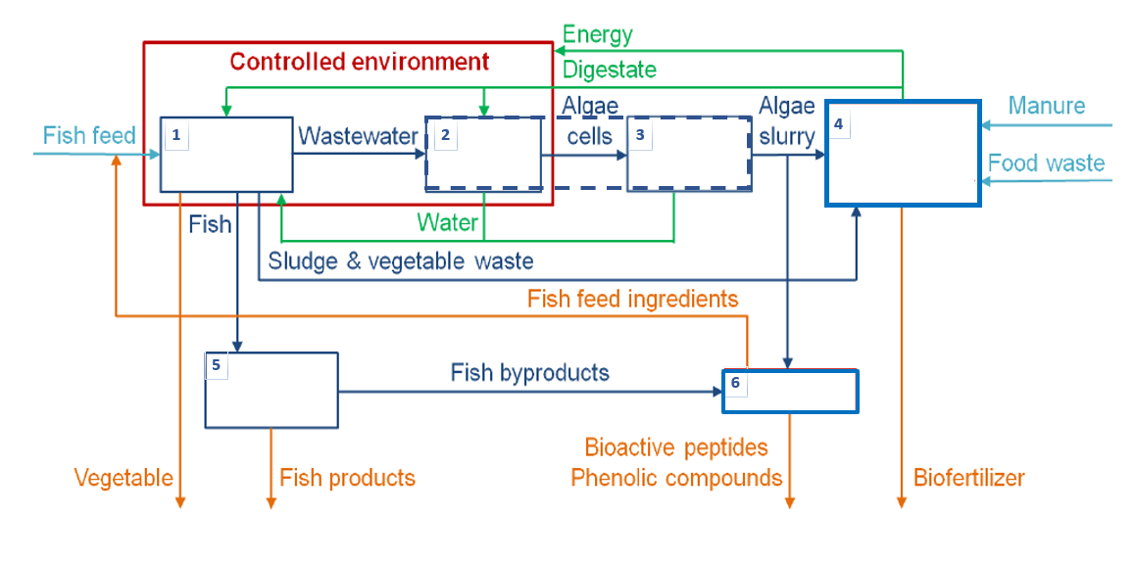
BiG system schematic

Slide 15
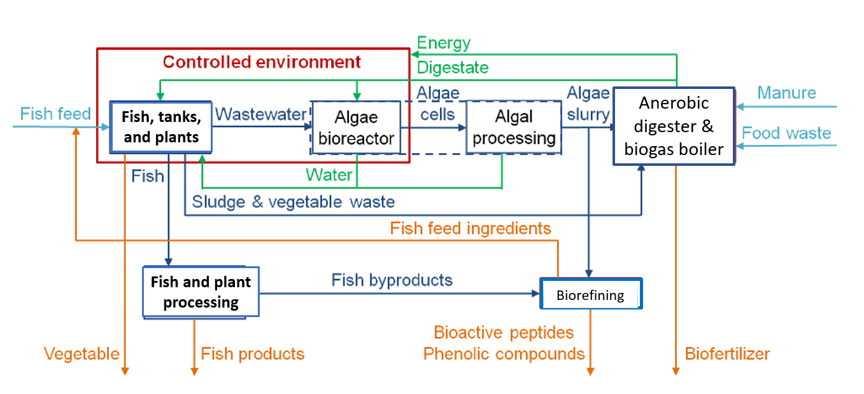

BiG system schematic

Slide 16
This graphic may be easier to understand.
(The one you just worked on is the scientist’s graphic).
Our integrated aquaponics system will include the traditional components of an aquaponics system along with the additional algal cultivation unit, biogas boiler and anaerobic digester.

Slide 17
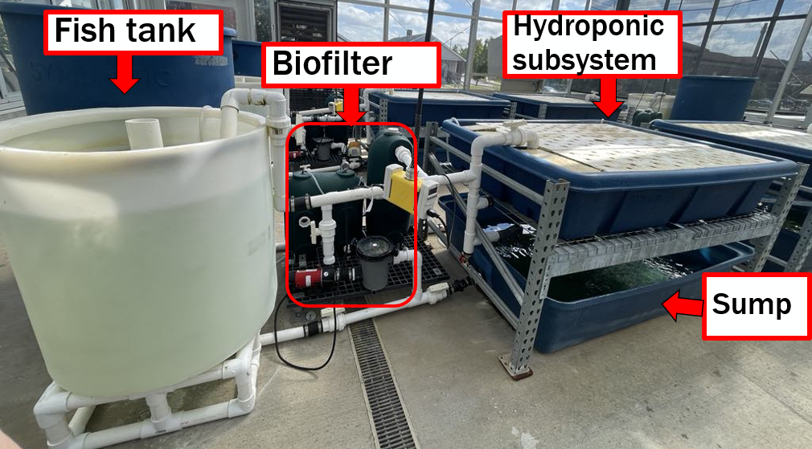
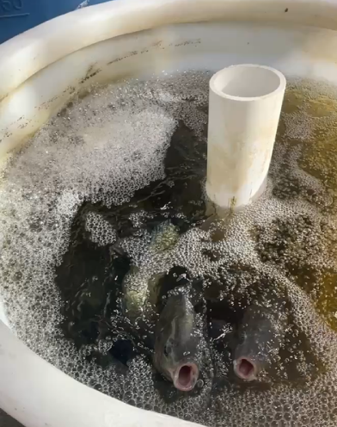
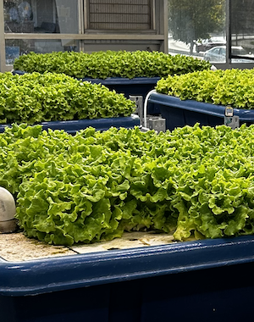
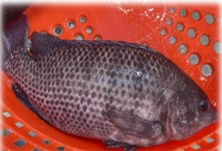
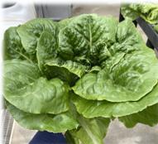
BiG pilot test lab
Ongoing Research
Different fish densities
Different lettuce densities

Slide 18
Q&A
What components does a basic aquaponics system include?
What additional components have the BiG added to try and create a zero-waste, grid-independent, economically viable system?
What is a systems approach?
Why is a systems approach to food production important?
What should be included in your systems approach
to planning for life after high school?

Slide 19

https://purdue.ag/big-project
This work is supported by the Sustainable Agricultural Systems program, project award no. 17001002, from the U.S. Department of Agriculture’s National Institute of Food and Agriculture. Any opinions, findings, conclusions, or recommendations expressed in this publication are those of the author(s) and should not be construed to represent any official USDA or U.S. Government determination or policy.

