Slide 1
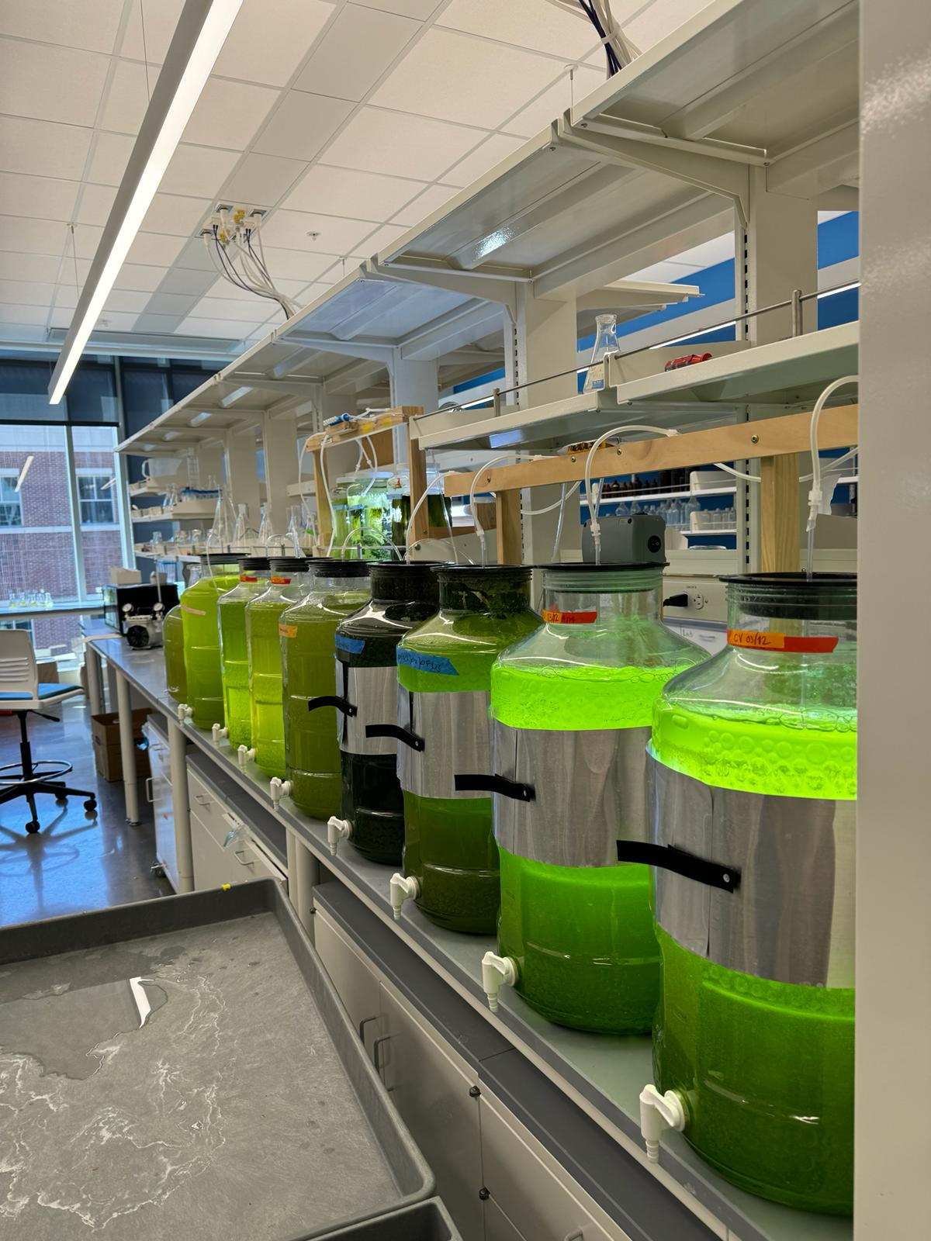
Wastewater Recycling

Slide 2
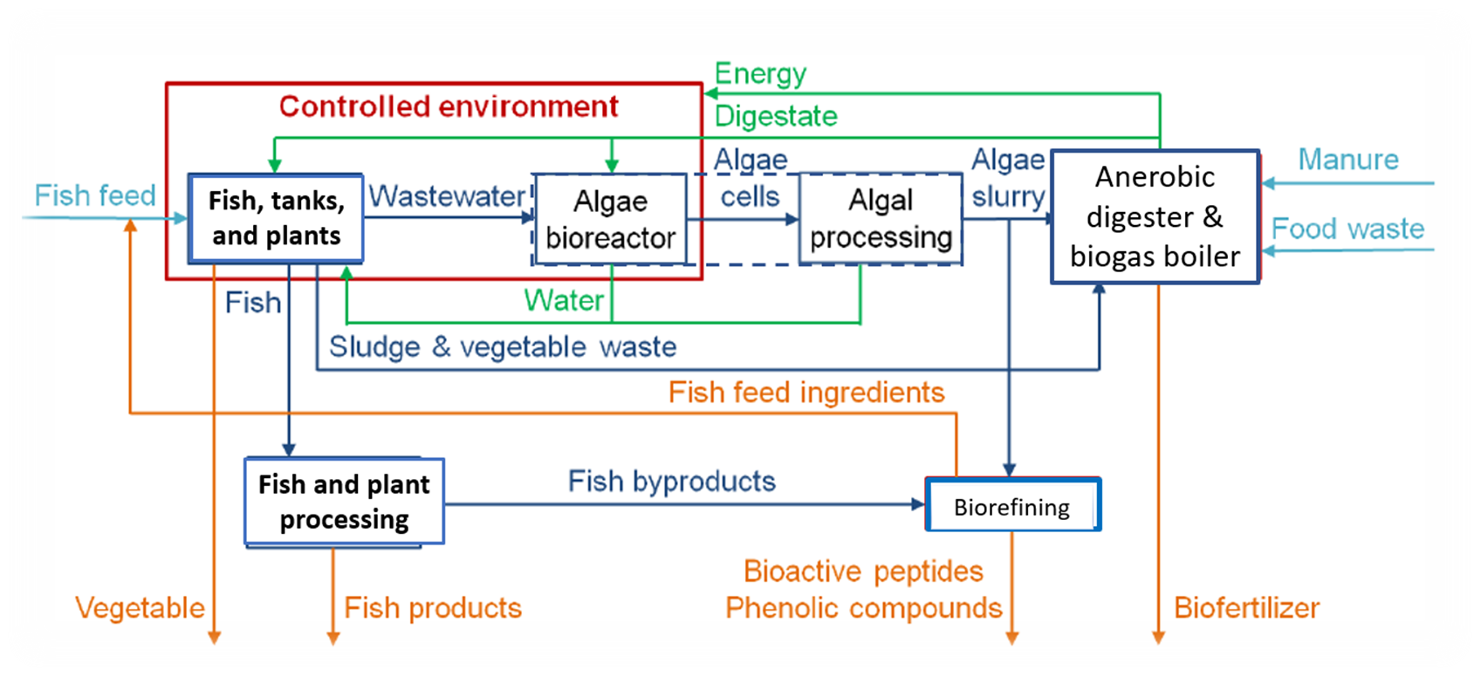
Wastewater recycling
Learn about efforts being made by BiG researchers to reduce nutrients and contaminants from aquaponics wastewater.

Slide 3
Environmental concerns
Water pollution can harm plants and animals, including humans.
Contaminated wastewater must be properly treated to avoid water pollution.
Municipal or onsite systems treat human wastewater.
  Municipal systems serve communities and are financed by taxes.
  Onsite systems (sometimes called septic systems) serve individual homes in rural areas. Rural homeowners are responsible for maintaining their onsite system.

Slide 4
PPCPs
PPCPs are pharmaceuticals and personal care products.
Large quantities of PPCPs enter our environment each day.
Neither municipal sewage treatment plants nor septic systems are equipped for PPCP removal.
PPCPs are present in our nation’s water bodies and have been found in most places sampled.
Over 100 individual contaminants have been identified in environmental samples and drinking water.
Steroids were the most frequently found PPCP in water samples and are believed to cause ecological harm.

Slide 5
PPCP risks
The actual risks posed by PPCPs to humans are unknown. It is suspected that they may increase resistance to antibiotics.
Environmental steroids & estrogens may be the cause of:
  Earlier puberty in girls.
  Delayed puberty in boys.
  Decreased sperm counts in boys.
Aquatic exposure risks are higher than human risks because aquatic organisms have continual exposures, multigenerational exposures, exposure to higher concentrations, possible low-dose effects.
Both natural and synthetic sex steroids may cause low dose effects
and a disruption of aquatic endocrine systems.

Slide 6
Unused medicines
Proper disposal of unused medicines is important to protect our water.
Follow specific disposal instructions on the drug label or patient information.
Do not flush prescription drugs down the toilet unless written information specifically instructs you to do so.
Take advantage of community drug take-back programs.
If no take-back program is available, remove medicines from their original containers and mix them with used coffee grounds or kitty litter and place them in the trash in a sealable bag, empty can, or other container to prevent the medication from leaking.

Slide 7
Aquaponics wastewater
Despite using less land and water than conventional food production, aquaponics creates considerable nutrient wastes.
Nutrients and organic matter released from aquaculture farm effluents affect the water ecosystem by creating oxygen depletion through overgrowth of cyanobacteria and microalgae.
The primary waste products of aquaponics are the fish waste solids (manure) and uneaten food.
Fish solids must be removed to maintain a healthy water quality.
Notes:
Effluents - liquid waste or sewage discharged into a river, lake or stream.

Slide 8
Aquaponics waste
Plant roots and other inedible plant parts culled during harvest are also waste products generated by aquaponics systems.
Wastewater from an aquaponics system is rich in nutrients.
The wastewater from aquaponics system can contain pollution sources:
  Biological, chemical and physical contaminants.
  Organic matter and dissolved nutrients.
If not handled properly these pollutants can cause
eutrophication, oxygen depletion and degradation
of benthic communities.
Notes:
Eutrophication – the process by which nutrient-rich water, often from agricultural runoff, causes excessive algae growth and may cause the death of aquatic animals due to a lack of oxygen in the water.
Benthic communities - groups of organisms that live in or near the bottom of lakes, rivers and oceans.

Slide 9
Reducing aquaponics waste
The When Blue is Green (BiG) project collaborators are working to recycle waste generated by aquaponics systems rather than disposing of it.
Researchers are studying algae and anaerobic
digestion to reduce wastes.
Two treatment systems are being studied:
  Anaerobic digestion of algae, aquaponics byproducts and fish manure.
  Algal bioreactor that uses carbon dioxide, wastewater and algae to produce biomass and oxygen.

Slide 10
Anaerobic digestion
Anaerobic digestion of algae, aquaponics byproducts, and manure is being studied.
Research to date has shown different results with anaerobic digestion:
  Some research found significant sludge reduction and improved nutrient recovery but not enough to use as a source for plant nutrients.
  Some research found increased concentrations of N, P, K, Ca, and Fe in the anerobic digestion effluent.
So, further research is needed!
BiG researchers hypothesize that adding an algae bioreactor and algal processing before the anaerobic digester will remove significant amounts of nitrogen (as ammonia) and organic carbon from the wastewater, thereby reducing the amount discharged.
Notes:
Reminder:
N – nitrogen
P – phosphorous
K – potassium
Ca – calcium
Fe – iron
https://pubchem.ncbi.nlm.nih.gov/periodic-table/

Slide 11
Assignment
Complete the Waste Disposal worksheet.
Both human and aquaponic wastewater problems were introduced and discussed in the worksheet.
Question 1: How are human wastewater problems like those encountered with an aquaponics system?
Question 2: How are human wastewater problems different from those encountered with an aquaponics system?

Slide 12
Aquaponics challenges
Aquaponics uses less land and water than conventional food production.
But aquaponics still requires high energy inputs and creates considerable nutrient wastes.

Slide 13

Challenge: How would you solve?
A major objective of the BiG research is to:
Design, construct and evaluate a resilient and sustainable food production system (FPS) that integrates aquaponics with microalgae cultivation, anaerobic digestion and biorefining processes
How would you solve this challenge?

Slide 14

https://purdue.ag/big-project
This work is supported by the Sustainable Agricultural Systems program, project award no. 17001002, from the U.S. Department of Agriculture’s National Institute of Food and Agriculture. Any opinions, findings, conclusions, or recommendations expressed in this publication are those of the author(s) and should not be construed to represent any official USDA or U.S. Government determination or policy.

