Slide 1
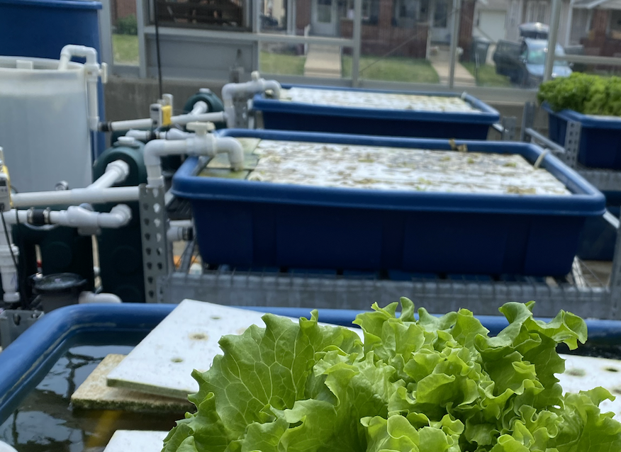
Why Flow Rates Matter

Slide 2
Why flow rates matter
Learn how flow rate may affect concentrations of various chemicals in a hydroponic system.

Slide 3
Why flow rates matter
Water is essential for agriculture, including fish production and crop cultivation in blue foods systems.
Water quality and water quantity are two characteristics of water.
Water quality is directly related to the health and productivity of fish and crops.
Water quantity contributes to plant growth and transpiration.

Slide 4
Measuring water quantity
Water quantity is measured by flow rate multiplied by time.
Flow rate describes how much water passes per unit of time, such as gallon per hour.
Flow rate is important. It describes how quickly water is cycled between the fish tank and plant tank so that the right amount of oxygen and nutrients can be supplied, and waste can be removed in time.

Slide 5
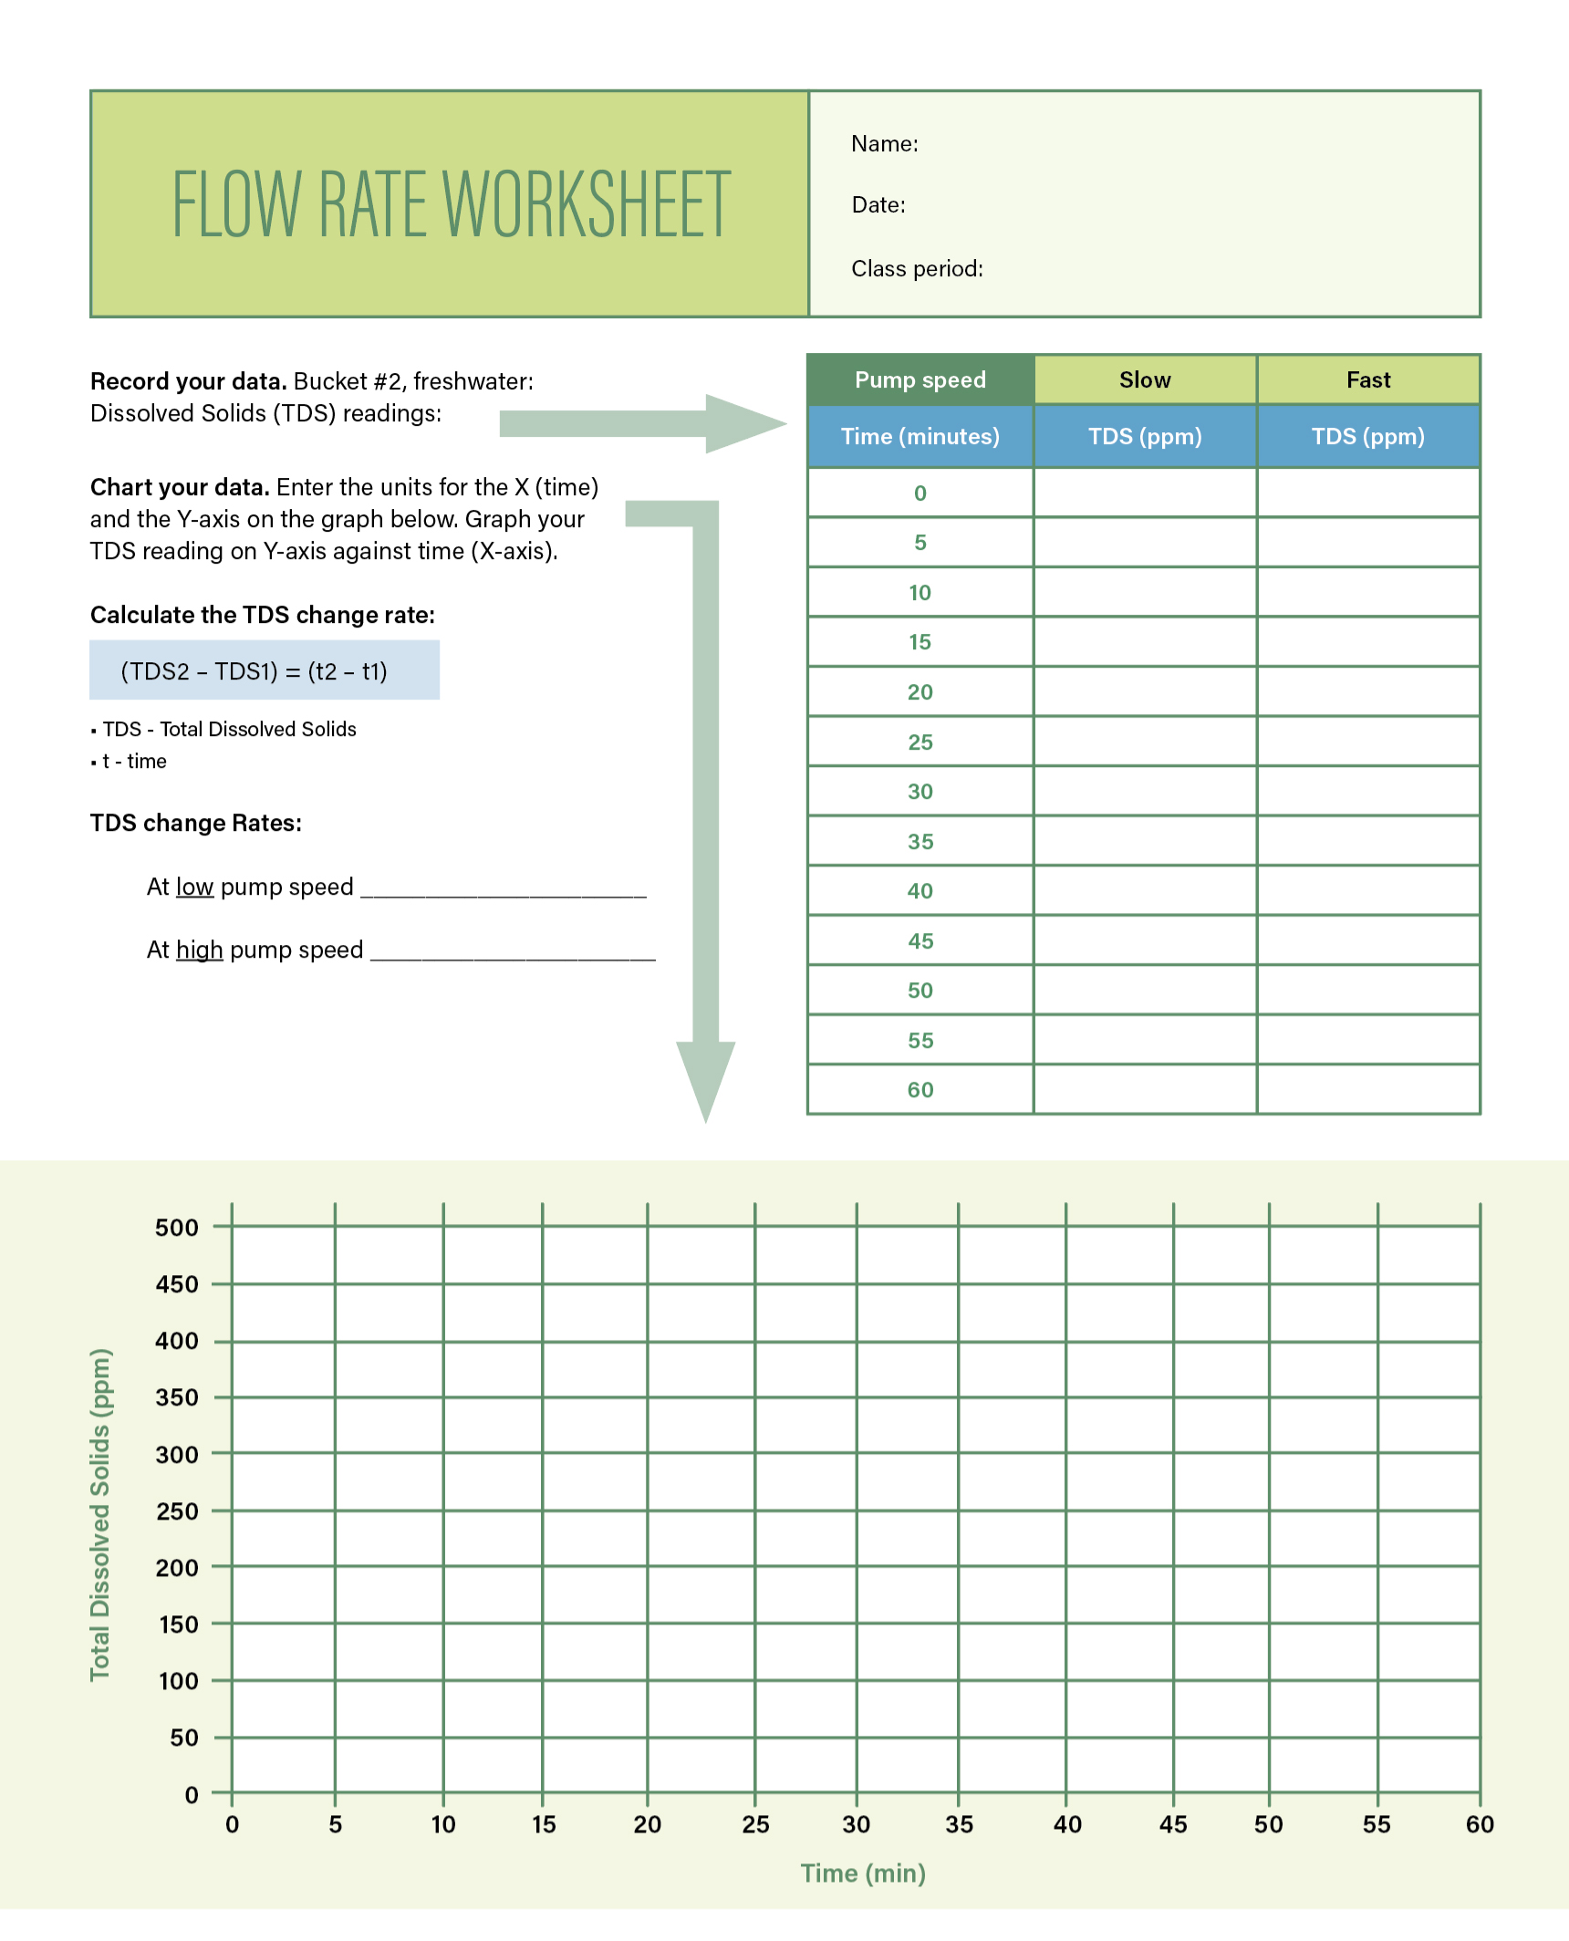
What you’ll need
Student worksheets:
Flow rate lab instructions
  The supplies you’ll need are listed
Flow rate worksheet
    Completed by teams or the entire class

Slide 6
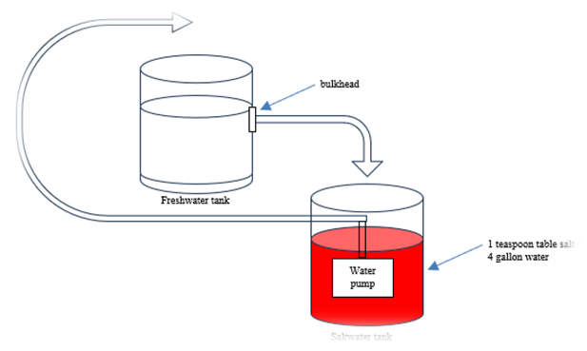
Assignment
Measure the effect of flow rate on total dissolved solids (TDS) concentrations.
For safety and visibility,
salt and food coloring
dye are used instead
of chemicals in the tank.

Slide 7
Instructions: Setup
Follow the instructions in the flow rate lab sheet to set up your experiment.
Take an initial total dissolved solids (TDS) reading once you have set up your equipment and before starting the pump.
You will run two trials: One with the slowest pump speed and one with the fastest pump speed.

Slide 8
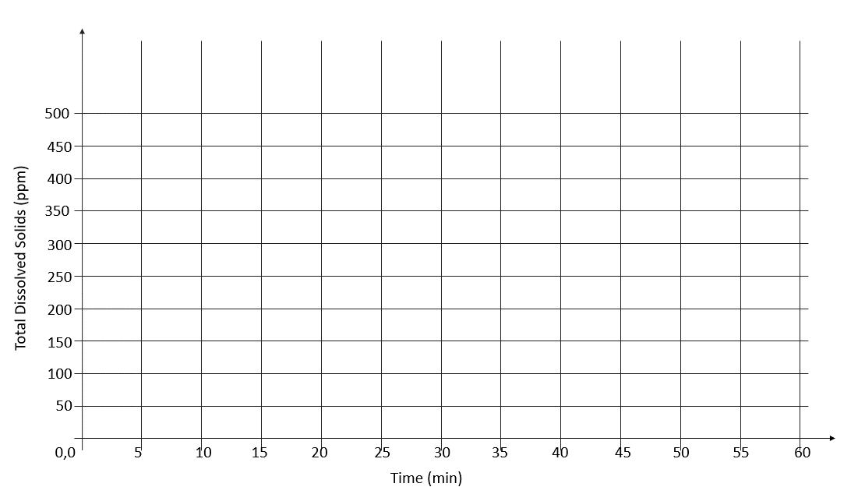
Results
Graph your TDS readings for both trials.
Calculate the TDS changing rate: (TDS2 – TDS1)/(t2 – t1)
  TDS – Total Dissolved Solids
  t – time
Answer the four questions
about this experiment.

Slide 9
Discussion
How was the TDS impacted by flow rate?
Based on your understanding of how flow rates impacted TDS (salt), how do you think flow rates impact nutrient and oxygen supplies in an aquaponics system? How do flow rates impact water quality?
How do flow rates impact point-source pollution in rivers?
How does flow rate or mixing affect water quality in rivers and lakes?

Slide 10
Answers
How was the TDS (salt) impacted by flow rate?
  The TDS rate of change was higher, with higher flow rates showing how
  flow rate affects how quickly nutrients and/or contaminants mixed with the fresh water.
Based on your understanding of how flow rates impacted TDS (salt), how do you think flow rates impact nutrient and oxygen supplies in an aquaponics system?
  Higher flow rates speed up nutrient and oxygen supplies in an aquaponics system.
How do flow rates impact point-source pollution in rivers?
  Flow rates and mixing is responsible for both the extent and the location that point-source pollution moves in streams and rivers.
How does flow rate or mixing affect water quality in rivers and lakes?
  Flow rates affect the volume of water entering a river or lake in a given time. Flow rates contribute to mass transfer efficiency of substance in the water. In other words – higher flows cause quicker mixing of contaminants.

Slide 11

https://purdue.ag/big-project
This work is supported by the Sustainable Agricultural Systems program, project award no. 17001002, from the U.S. Department of Agriculture’s National Institute of Food and Agriculture. Any opinions, findings, conclusions, or recommendations expressed in this publication are those of the author(s) and should not be construed to represent any official USDA or U.S. Government determination or policy.

