Slide 1
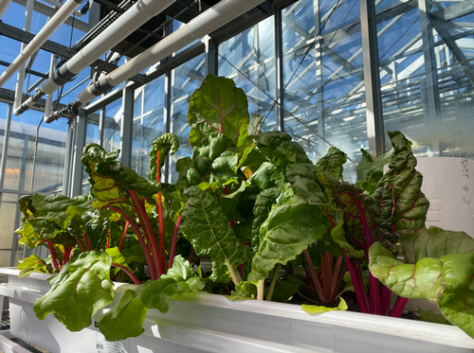
A zero-waste,
grid-independent, economically viable aquaponics system:
Is it possible?

Slide 2
Research question
A zero-waste, grid-independent, economically viable aquaponics system: Is it possible?
Learn what a zero-waste, energy-independent, economically viable system entails.

Slide 3

BiG research goal
An aquaponics system = aquaculture + hydroponics. The system uses nutrients from animal wastes as a natural fertilizer for plants.
Researchers working on the When Blue is Green project are trying to develop a system that
  Creates zero waste
  Is energy independent
  Is economically viable

Slide 4
Definitions
Energy independence: Eliminating reliance on energy supplied by a power company.
Economic viability: A product or project is economically viable if its economic benefits exceed its economic costs, when analyzed for society as a whole.
  The economic costs of the project are not the same as its financial costs. Economic costs include externalities and environmental impacts.
  Externalities are economic impacts that affect persons who may not benefit from the product or project.
Zero waste: Maximize recycling, minimize waste, reduce consumption and ensure that products are designed to be reused, repaired or recycled back into the environment or marketplace.

Slide 5
Challenges
A major environmental problem with an aquaponics system is the large amount of water — up to 20% of the total — discharged every day to maintain water quality.
  Note: The Natural Resources Conservation Service (NRCS), part of the U.S. Department of Agriculture) is working to reduce water use by farmers and gardeners. (Drought is a growing concern. The western United States experienced severe drought in 2021 and 2022.)
Discharged water contains water contaminants — ammonia, nitrites, nitrates, phosphates and organic carbon — leading to potential environmental impacts.
Reducing the amount of waste generated will decrease negative environmental impacts.

Slide 6
BiG Project efforts
Microalgae culture is being studied as a way to treat animal waste to reduce these contaminants and to produce biomass that can be converted into biofuel to help power the system.
It is hoped that converting aquaponic wastes to energy will generate the power needed to run the system and fully recycle animal and plant wastes.
  Large energy usage is another challenge for aquaponics systems.
Using system wastes to create energy will increase economic viability

Slide 7
Assignment
Complete the Defining a zero-waste, power independent and economically viable system table.
  Use these definitions to indicate which goal each
  consideration most closely matches.
    EI for energy independence
    EV for economic viability
    ZW for zero waste
Then see if you can complete the statements about EI, EV and ZW without referring to the definitions.

Slide 8
Q&A: Economic viability
Definition: A product or project is economically _________ if its economic benefits exceed its economic __________, when analyzed for society as a whole.
The economic costs of the project are not the same as its ____________ costs.
Externalities and environmental _________ must be considered.
The economic impacts on people who may not __________ from the product must also be considered.

Slide 9
Q&A: Energy independence
Definition: Eliminating reliance on __________ supplied by a power company.
Reducing fossil _____ use (source of 60% of U.S. electricity power)
Autonomy from the national ___________ energy grid.
Produce _____ energy than you consume.
Goal: Reduced energy ________.

Slide 10
Q&A: Zero waste
Definition: ____________ recycling, ___________ waste, reduce consumption and ensure that products are designed to be reused, repaired or recycled back into the environment or marketplace.
Who is responsible? Both ________ and industry.

Slide 11
To summarize:
A zero-waste, grid-independent and economically viable
aquaponics system would be possible when:
  All waste is used within the system or by complimentary systems.
  All power requirements are generated by wastes from the system.
  The costs of production, including all inputs and outputs, are less than the income generated by the system.

Slide 12
BiG project efforts
BiG researchers’ objectives to achieve a zero-waste,
grid-independent and economically viable aquaponics system:
Objective 1:
Partner
with diverse stakeholders to identify barriers and opportunities for blue foods and aquaponics.
Objective 2:
Design, construct and evaluate a resilient
and sustainable food production system that integrates aquaponics with microalgae cultivation, anaerobic digestion and
biorefining processes.
Objective 3:
Assess economic
and environmental performance of
an integrated aquaponics food production system
and develop evidence-based management practices and business models
Objective 4: Engage with stakeholders
to support aquaponics
and blue
food market development.
Objective 5:
Create, pilot and publish education materials to foster a workforce prepared to support the blue food supply chain.

Slide 13

https://purdue.ag/big-project
This work is supported by the Sustainable Agricultural Systems program, project award no. 17001002, from the U.S. Department of Agriculture’s National Institute of Food and Agriculture. Any opinions, findings, conclusions, or recommendations expressed in this publication are those of the author(s) and should not be construed to represent any official USDA or U.S. Government determination or policy.

