Slide 1
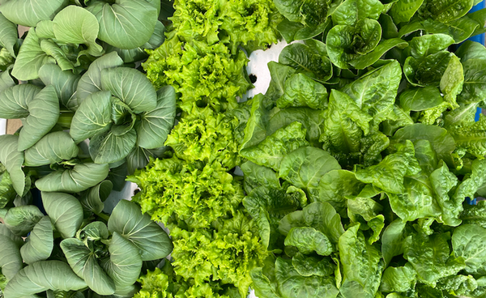
What are
Blue Foods &
Why Should I Care?
You will learn what blue foods are and why they are important.

Slide 2
Why study blue foods?
What are blue foods?
Blue foods are food derived from aquatic animals, plants, or algae.
They are often called seafood.
Why should I care?
Blue foods have the potential to address malnutrition, lower environmental impacts of food systems, and generate employment.
Blue foods provide excellent nutritional benefits and can be produced more sustainably than land-based foods.
Approximately 90% of global wild fish stocks are overfished or fished at capacity, so additional seafood production must come from aquaculture.
Aquaculture (fish farming) is one of the fastest-growing sectors that supply seafood products worldwide.

Slide 3

Purdue University research
Purdue University researchers, with funding from the U.S. Department of Agriculture (USDA), are studying ways to sustainably increase blue food production in the Midwest.
Creating environmentally friendly aquaponic farms to produce blue foods locally will help people eat better, reduce environmental costs and provide jobs.
Aquaponics is the combination of recirculating aquaculture and hydroponics.

Slide 4
Assignment
This activity will guide you to start keeping track of how much blue food you consume and how to calculate the environmental footprint.
List the food you, or a study subject, remember eating over the last week on the Food Inventory worksheet.
  Tally the types of foods you ate over the week.
By using your best guess, estimate the foods you eat less often than once a week.
Estimate your environmental foodprint by visiting the Harvard foodprint calculator website:
https://harvard-foodprint-calculator.github.io/
Notes:
Foodprint:

Slide 5
Take-home assignment
Keep track of the food you/your study subject eat for a week.
By using your best guess, estimate the foods you/your study subject eat less often than once a week.
  Tally the types of foods you ate over the week.
Calculate your actual environmental foodprint using the Harvard foodprint calculator website:
https://harvard-foodprint-calculator.github.io/
Record your Diet’s Annual Environmental Impact: carbon (kg), nitrogen (g), and water (L).

Slide 6
Class averages
Calculate your class averages by adding all values for each category:
  Carbon total =
  Nitrogen total =
  Water total =
Divide each total by the number of students

Slide 7
Discussion
Compare your first Food Inventories and Food Footprints.
Did you have a lower food environmental footprint in week 2?
  Why or why not?
How accurate do you think your first food inventory was?
What are the major contributors to your food footprint?
How do your personal choices for food and other products affect the environment?
?

Slide 8

https://purdue.ag/big-project
This work is supported by the Sustainable Agricultural Systems program, project award no. 17001002, from the U.S. Department of Agriculture’s National Institute of Food and Agriculture. Any opinions, findings, conclusions, or recommendations expressed in this publication are those of the author(s) and should not be construed to represent any official USDA or U.S. Government determination or policy.

