Slide 1
Module 1
Introductory Concepts in Nutrition
Topic 3 Nutrition through the life cycle: Children, adults and elderly
Susmita Ghosh, MS
Dr. Ratthiphone Oula, MD, MCN
Dr. Nilupa S. Gunaratna, MS, PhD
Training by Applied Nutrition Research Capacity Building (ANRCB), a project of the Lao American Nutrition Initiative (LANI)
This work is made possible through support from USAID as a supplement to a USAID Cooperative Agreement #7200AA18CA00009 (LASER-PULSE) to Purdue University. Contents reflect the views of the author(s) and do not necessarily reflect those of USAID.
For more information, please contact Catholic Relief Services Laos.
Notes:
Goal: 40 minutes
Welcome to the ANRCB Project’s Module on Introductory Concepts in Nutrition. In this video, we will discuss nutrition through the life cycle, with a focus on children.

Slide 2
Learning Objectives
By the end of topic 3, participants will able to:
Understand the importance of nutrition from a life cycle perspective.
Recognize the nutrition indicators related to child growth and development.
Identify the key proximal determinants of nutrition for children.

Slide 3
Nutrition through the life cycle
Life stages
Infant
Child
Adolescent
Pregnant & lactating mother
Adult
Elderly
Outcomes
Low birth weight, prematurity, IUGR
Inadequate growth
Impaired mental development
Higher mortality
Imapired cognitive development and school performance
Anemia
Impaired cognitive development and school performance
Anemia
Low weight gain in pregnancy
Higher maternal mortality
Anemia
Adult malnutrition
Elderly malnutrition
Determinants
Inappropriate infant and young child feeding (IYCF) practices
Frequent infection due to poor water, sanitation, and hygiene (WASH)
Inappropriate food, care, and health-seeking practices
Inappropriate food, care, and health-seeking practices
Inappropriate food, care, and health-seeking practices
Inappropriate food, care, and health-seeking practices
Reduced care capacity

Slide 4
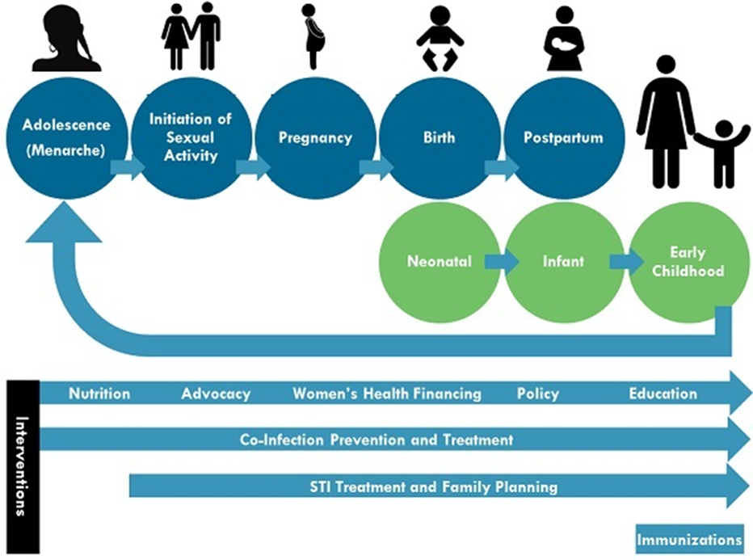
ANRCB | ‹#›

Slide 5
Nutritional Status of Children in Lao PDR
About 17% of infants have low weight at birth
Among children under 5 years of age:
33% are short for their age or stunted, indicating chronic undernutrition
9% have low weight for their height or wasting, indicating acute undernutrition
4% are overweight
Source: Global Nutrition Report, 2020

Slide 6
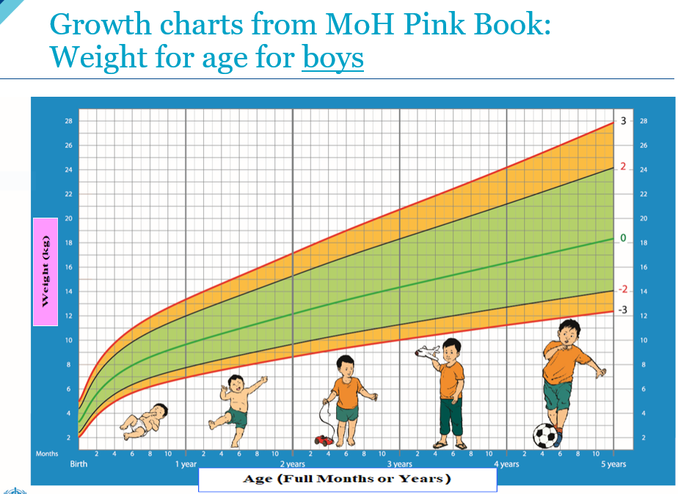
Healthy growth of children
A healthy weight or height for a child depends on sex and age
For a given sex and age, there is a natural range for weight or height
Children whose measurements are more than two standard deviations below average are considered undernourished
Z-score: the number of standard deviations above or below a mean
For example, weight-for-age Z-score (WAZ): the number of standard deviations above or below the mean weight of healthy children of a specified sex and age
If a child has WAZ less then -2, they are considered underweight
Notes:
Can we get a picture for weight?

Slide 7
Z-scores
Height-for-age (HAZ)
Indicates chronic malnutrition
HAZ < -2: stunting
HAZ < -3: severe stunting
Weight-for-height (WHZ)
Indicates acute malnutrition
WHZ < -2: wasting (moderate acute malnutrition, MAM)
WHZ < -3: severe wasting (severe acute malnutrition, SAM)
Weight-for-age (WAZ)
Combines both weight and height

Slide 8
Growth Faltering in Young Children
Mean height-for-age z-scores for children 1–59 months relative to the WHO growth standards.
Faltering already detected at birth, suggesting impaired fetal growth
Progressive faltering in first 2 years of life
Little or no catch-up growth after 2 years of age
Figure: Victora et al. 2010
Notes:
Figure from Victora, C. G., de Onis, M., Hallal, P. C., Blossner, M., & Shrimpton, R. (2010). Worldwide timing of growth faltering: Revisiting implications for interventions. Pediatrics, 125(3), e473–480.

Slide 9
The first 1000 days
The period from conception to 24 months
A key period for growth and development
A “window of opportunity”
to positively impact child nutrition
to reduce morbidity and mortality
to improve development, with the potential for lifetime benefits

Slide 10
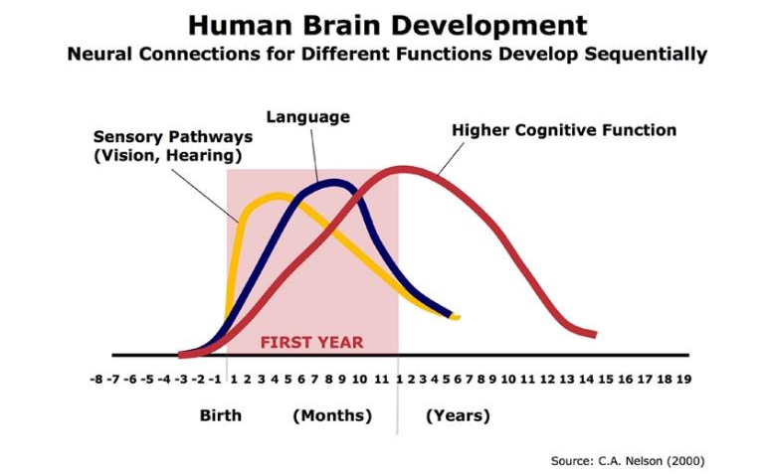
Brain development in first 1000 days
The first 1000 days are critical for brain development, including development of sensory pathways, language, and cognitive function
Development begins in utero
During this period, good nutrition and health are key for growth and development
Source: InBrief: The Science of Early Childhood Development (harvard.edu)

Slide 11
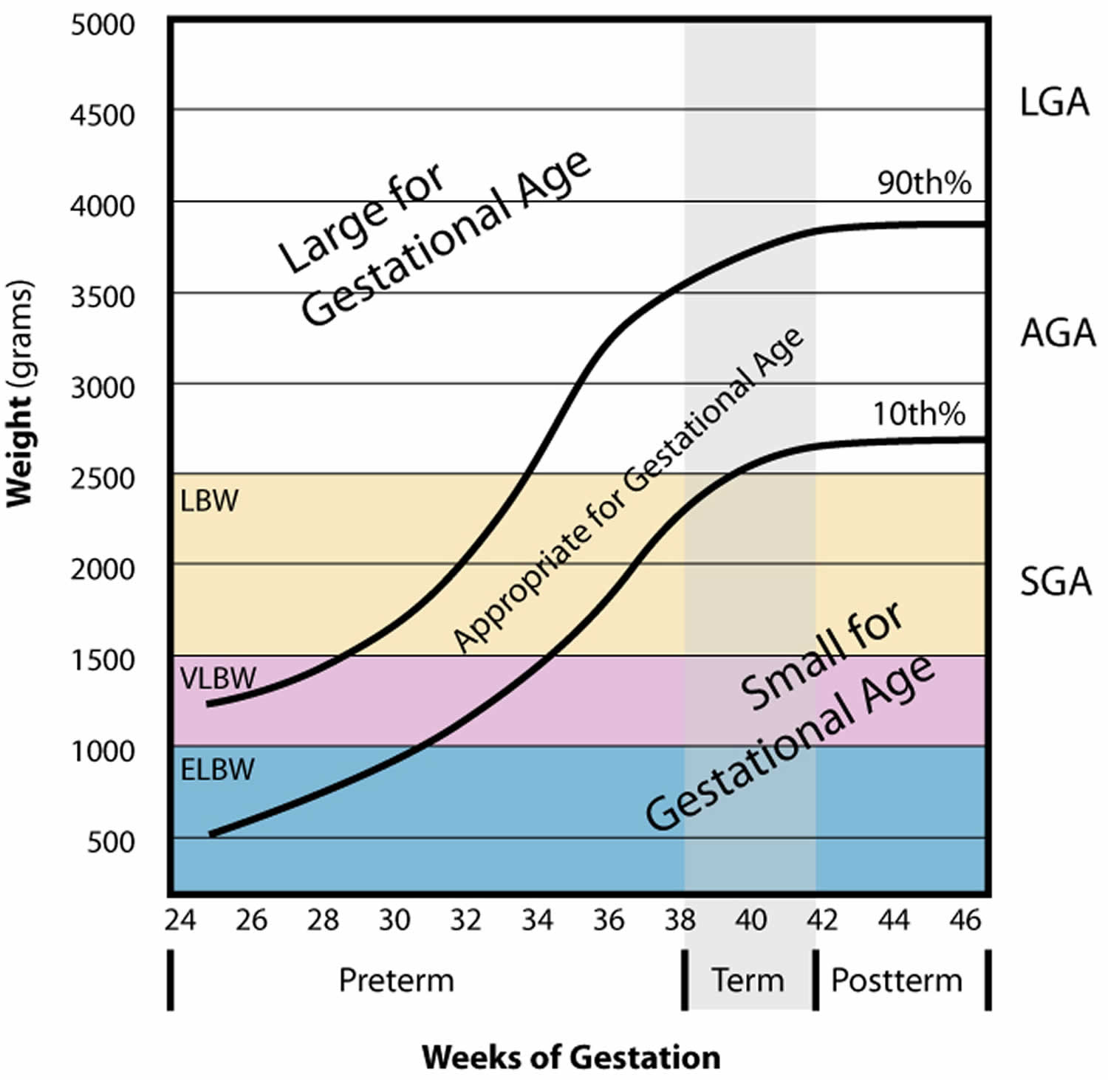
Perinatal Period
Low birthweight (LBW): birth weight < 2500 g (5.5 lbs)
LBW may be due to one or both of the following:
Preterm birth: live birth at <37 weeks of gestation
Intrauterine growth restriction (IUGR): inadequate growth in utero, resulting in a child that is small for gestational age (SGA)
Source: De Pee, S., Taren, D. and Bloem, M.W. eds., 2017. Nutrition and health in a developing world (p. 827). Humana Press.

Slide 12
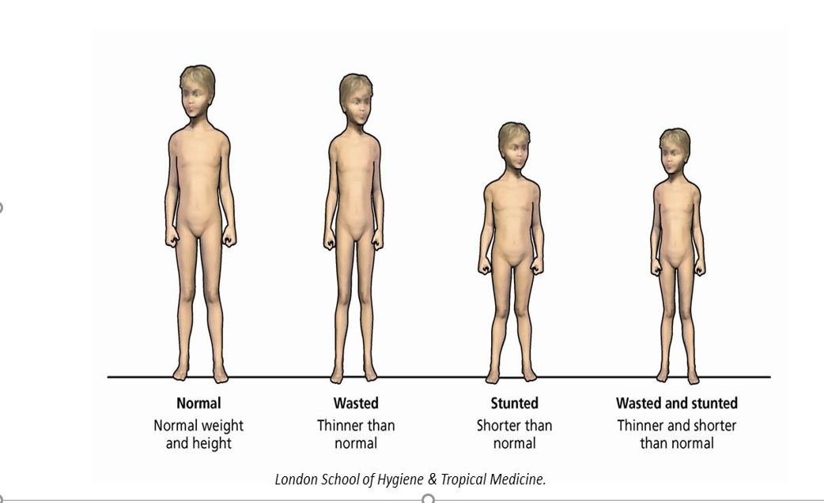
Child growth: Stunting and wasting
Source: Malnutrition Definition | Valid Nutrition

Slide 13
Forms of wasting (acute malnutrition)
Severe acute malnutrition (SAM)
Extreme form of undernutrition
Weight-for-height z-score (WHZ) < -3 SD
Mid-upper arm circumference (MUAC) <115 mm
Bilateral edema: condition where ankles and/or feet are swollen due to accumulation of interstitial fluid (fluid that fills the spaces between cells)
Moderate acute malnutrition (MAM)
Less severe but leads to SAM if it goes untreated
WHZ < -2 SD
MUAC 115 - 125 mm

Slide 14
Child wasting
Source: Health-related SDGs | IHME Viz Hub (healthdata.org)

Slide 15
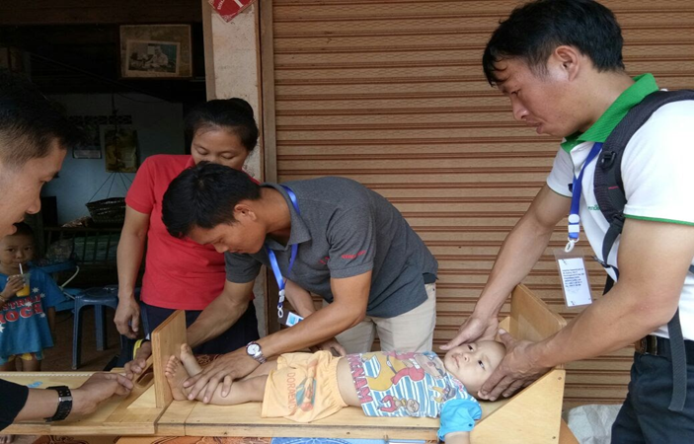
Child stunting
HAZ < -2 SD
Indicates chronic malnutrition: prolonged inadequate nutrition
Deprivation does not immediately result in stunting
Similarly, intervention will not immediately result in improved growth – measurable change may take months or longer
Catch-up growth, in which a stunted child’s HAZ increases, can be difficult to achieve

Slide 16
Child stunting
A child is most susceptible to stunting in the first 1000 days of life, and adequate nutrition and control of infection within this critical period is crucial
Factors contributing to stunting:
Inadequate nutrition, including lack of dietary diversity
Inadequate breastfeeding practices
Frequent infections
Poor maternal health and nutrition
Source: Health-related SDGs | IHME Viz Hub (healthdata.org)
ANRCB | ‹#›

Slide 17
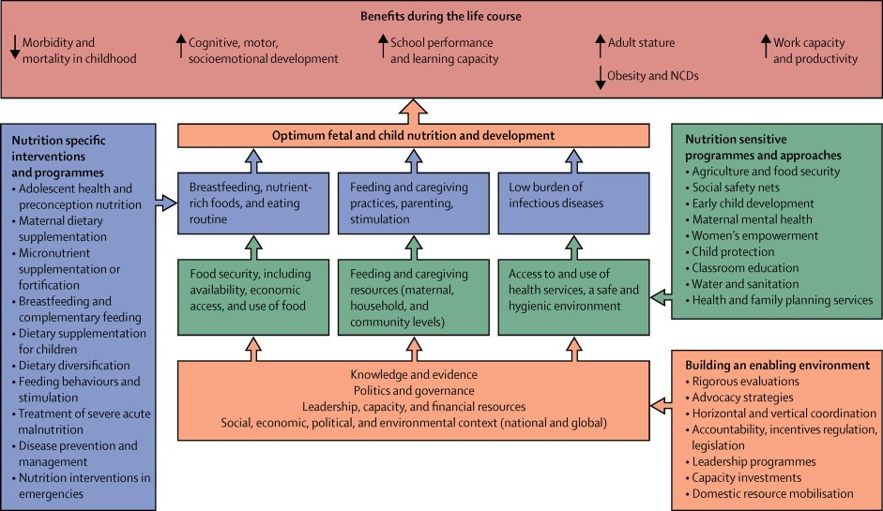
Recall: Determinants of Nutrition
Source: Black et al. 2013 – Lancet Series on Maternal and Child Nutrition
ANRCB | ‹#›
Notes:
http://www.thelancet.com/series/maternal-and-child-nutrition
Black R., Victora C.G., Walker S.P., Bhutta Z.A., Christian P., de Onis M., Ezzati M., Grantham-McGregor S., Katz J., Martorell R., Uauy R., Maternal and Child Nutrition Study Group. (2013) Maternal and child undernutrition and overweight in low-income and middle-income countries. The Lancet 382:427-451.

Slide 18
Infant and young child feeding
Infant and young child feeding (IYCF) is central to early child nutrition and development
Globally, about 30% of children under five years are stunted as a consequence of poor feeding and repeated infections
Improved feeding practices can lead to improved intakes of energy and nutrients, leading to better nutritional status
Source: WHO | Global Strategy for Infant and Young Child Feeding

Slide 19
IYCF Recommendations
WHO and UNICEF recommend:
Early initiation of breastfeeding within 1 hour of birth
Exclusive breastfeeding for the first 6 months of life.
Exclusive breastfeeding involves provision of breastmilk only – excluding food, water, or other beverages
Figure: Exclusive breastfeeding
Source: IYCF Image Bank (advancingnutrition.org)
Notes:
Is the source for images correct, or it needs updating?

Slide 20
Prelacteal Feeding
Prelacteal feeding involves giving foods or liquids to newborns (except recommended medications) before breastfeeding is established
This deprives newborns of colostrum (mother’s first milk), which is rich in nutrients and immunoglobulins
Offering prelacteal foods delays initiation of breastfeeding and interferes with exclusive breastfeeding
Prelacteal feeding can increase the risk of infection and malnutrition for the infant and is not recommended

Slide 21
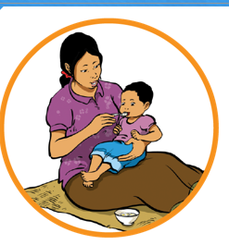
IYCF Recommendations
3. Introduction of nutritionally-adequate and safe complementary foods (solid and semi-solid foods) at 6 months, together with continued breastfeeding up to 2 years of age or beyond
Figure: Complementary feeding
Figure: Continuation of breastfeeding for 2 years of age
Source: IYCF Image Bank (advancingnutrition.org)
Notes:
Small update here

Slide 22
IYCF Indicators
An indicator is a number that measures one aspect of health in a specified population
An indicator is a tool that can be used:
To assess the specific aspect of health in a population
To monitor changes over time in this aspect of health
To set goals to improve this specific aspect of health in the population of interest

Slide 23
IYCF Indicators
1. Minimum dietary diversity: Percentage of children 6–23 months of age who consumed foods and beverages from at least five out of eight defined food groups during the previous day:
1. breast milk
2. grains, roots, tubers, and plantains
3. pulses (beans, peas, lentils), nuts, seeds
4. dairy products (milk, infant formula, yogurt, cheese)
5. flesh foods (meat, fish, poultry, organ meats)
6. eggs
7. vitamin A-rich fruits and vegetables
8. other fruits and vegetables.
Indicates increased likelihood of adequate intake of micronutrients
Source: Indicators for assessing infant and young child feeding practices: definitions and measurement methods ﻿ (who.int)

Slide 24
IYCF Indicators
2. Minimum meal frequency: Percentage of children 6–23 months of age who consumed solid, semi-solid, or soft foods (but also including milk feeds for non-breastfed children) the minimum number of times or more during the previous day:
2 times/day for breastfed infants 6-8 months
3 times/day for breastfed children 9-23 months
4 times/day for non-breastfed children 6-23 months
Source: Indicators for assessing infant and young child feeding practices: definitions and measurement methods ﻿ (who.int)

Slide 25
IYCF Indicators
3. Minimum acceptable diet: Percentage of children 6–23 months of age who consumed a minimum acceptable diet (achieving minimum dietary diversity and minimum meal frequency) during the previous day
4. Consumption of iron-rich or iron-fortified foods: Proportion of children 6-23 months of age who receive an iron-rich food or iron-fortified food that is specially designed for infants and young children or that is fortified in the home
Source: Indicators for assessing infant and young child feeding practices: definitions and measurement methods ﻿ (who.int)

Slide 26
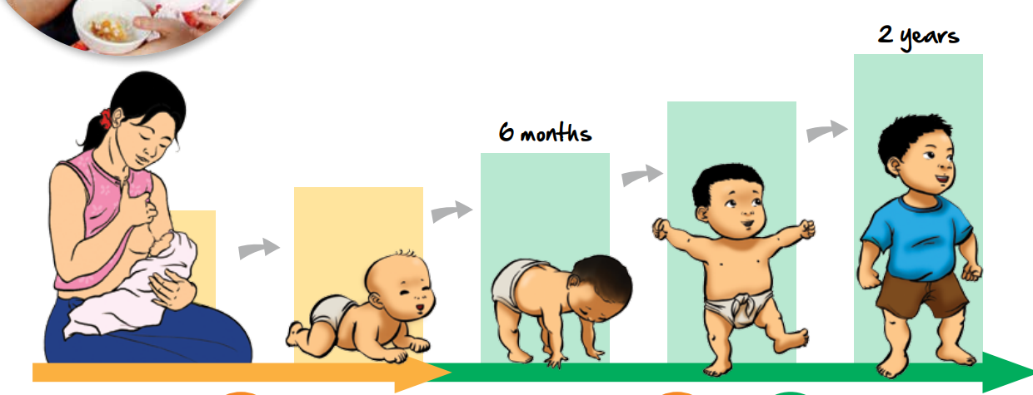
Infant and young child feeding in Lao PDR
About 44% of children below 6 months are exclusively breastfed
50% initiated breastfeeding within an hour of birth
36% of children aged 6–23 months achieve the minimum diet diversity
26% of children aged 6-23 months receive a minimum acceptable diet
Source: https://scalingupnutrition.org/wp-content/uploads/2020/07/Lao-PDR-subnational-MEAL-dashboard.pdf
Notes:
Small update: changed order of bullets

Slide 27
Nutrition and infection
There is a strong, bi-directional relationship between nutrition and infection
Healthy children will have better nutritional status
Infections can reduce appetite, reducing food and nutrient intake
Infections can increase the body’s daily requirement for nutrients
Infections of the gastrointestinal (GI) tract can reduce absorption of nutrients in food
Malnourished children are at greater risk of infection, infections of longer duration or greater severity, and mortality
Malnourished children have different bacteria in their GI tract (i.e., there are differences in their gut microbiome)

Slide 28
Recall: Determinants of Nutrition
Source: Black et al. 2013 – Lancet Series on Maternal and Child Nutrition
Notes:
http://www.thelancet.com/series/maternal-and-child-nutrition
Black R., Victora C.G., Walker S.P., Bhutta Z.A., Christian P., de Onis M., Ezzati M., Grantham-McGregor S., Katz J., Martorell R., Uauy R., Maternal and Child Nutrition Study Group. (2013) Maternal and child undernutrition and overweight in low-income and middle-income countries. The Lancet 382:427-451.

Slide 29
Strategies to reduce infection in children
Essential newborn and postnatal care for child and mother
Vaccination against childhood diseases
Timely management of childhood illness
Water, sanitation, and hygiene (WASH): access to clean water, adequate sanitation, and good hygiene practices
Reduces risk, particularly of diarrheal and respiratory illnesses
Leading causes of morbidity and mortality in young children
Source: Water, sanitation and hygiene (WASH) (who.int); Water, Sanitation and Hygiene (WASH) | UNICEF
Notes:
Over 700 children under age 5 die every day of diarrheal diseases due to lack of appropriate WASH services.
Source: Water, sanitation and hygiene (WASH) (who.int); Water, Sanitation and Hygiene (WASH) | UNICEF

Slide 30
Water, Sanitation, and Hygiene (WASH) and Nutrition
Water source far from home
High price of water
Inadequate storage
Expensive water
Low water quality
Unimproved sanitation
Poor hand-washing
Less money for food
Fecal contamination of home
Infection
Environmental enteropathy
Diarrhea
Poor water quality
Less time for food preparation
Poor nutrition status
Unprotected water source, contamination during handling
Source: WASH & Nutrition, Implementation Brief - January, 2015 (usaid.gov) (Cumming 2013)
Notes:
Source: WASH & Nutrition, Implementation Brief - January, 2015 (usaid.gov) (Cumming 2013)
Susmita, let’s add ref to the slide itself

Slide 31
Child morbidity in Lao PDR
Among children under 5 years in 2019:
Lower respiratory infections accounted for over 20% of deaths
Diarrheal diseases accounted for over 5% of deaths
Photo: https://www.path.org/articles/hope-for-a-village-a-familys-love-to-protect-their-children/
Source: GBD Compare | IHME Viz Hub (healthdata.org)
Notes:
Please insert a nice picture of a child or family?

Slide 32
Nutritional status of school-aged children
Maintaining a balanced diet and regular exercise is important for all individuals, especially school-aged children (6-12 years)
Children in this age group are required to eat a variety of foods to ensure optimal intake of all vitamins and minerals
At the same time, they may face new challenges regarding food choices and habits
Decisions about what to eat are partly determined by what is provided at home and in school and the influences from friends and the media, especially television
Source: WHO, 1995; WHO, UNICEF, United Nations University, 2001; Brown KH et al., 2004; Allen L et al., 2006
Notes:
Ref:
World Health Organization. Physical status: the use and interpretation of anthropometry. Report of a WHO 412 C. Best et al. Expert Committee. World Health Organ Tech Rep Ser 1995;854:1–452.
Allen L, de Benoist B, Dary O, Hurrell R. Guidelines on food fortification with micronutrients. Geneva: World Health Organization/Food and Agriculture Organization, 2006.
22. Kuczmarski RJ, Ogden CL, Guo SS, Grummer-Strawn LM, Flegal KM, Mei Z, Wei R, Curtin LR, Roche AF, Johnson CL. 2000 CDC Growth Charts for the United States: methods and development. Vital Health Stat 2002;11:1–190.
23. Cole TJ, Bellizzi MC, Flegal KM, Dietz WH. Establishing a standard definition for child overweight and obesity worldwide: international survey. BMJ 2000;320:1240–3.
24. Iron deficiency anaemia: assessment, prevention, and control. A guide for programme managers. Geneva: World Health Organization/UNICEF/United Nations University, 2001.
25. Brown KH, Rivera JA, Bhutta Z, Gibson RS, King JC, Lönnerdal B, Ruel MT, Sandtröm B, Wasantwisut E, Hotz C, Lopez de Romaña D, Peerson JM. International Zinc Nutrition Consultative Group (IZiNCG) Technical Document #1. Assessment of the risk of zinc deficiency in populations and options for its control. Food Nutr Bull 2004;25:S99–203.

Slide 33
School feeding programs
School feeding programs are intended to alleviate short-term hunger, improve nutrition and cognition of children, and transfer income to families.
Children receive a significant portion of their energy, protein, and micronutrient needs
Reduced short-term hunger
Children provided with balanced meal on school days
Improved health and nutritional status
Increased demand for locally produced foods
Increased school enrollment
Improved school performance
Increased local food production
Adapted from: conceptual framework of the possible of the impacts of locally sourced school feeding interventions(NEPAD, 2005a;2005b)

Slide 34
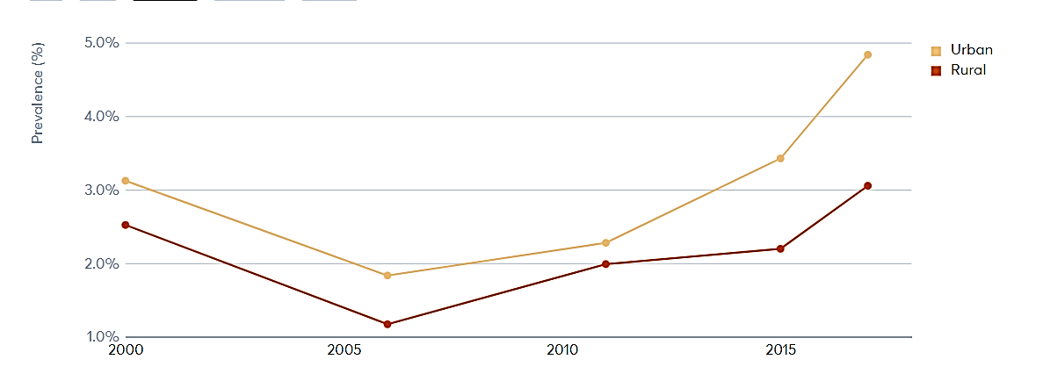
Overweight among under-five children in Lao PDR
Overweight/obesity in childhood can have metabolic and health consequences throughout life
Children who have obesity are more likely to become adults with obesity
Adult obesity is associated with increased risk of several serious health conditions including heart disease, type 2 diabetes, and cancer
Source: Global Nutrition Report | Country Nutrition Profiles - Global Nutrition Report
Notes:
Source: Childhood Obesity Causes & Consequences | Overweight & Obesity | CDC
**Risk of overweight is defined as above one standard deviation (>+1 SD) from the median weight-for-height of the WHO growth reference.

Slide 35
Takeaway messages
Optimum nutrition is important throughout the life cycle and especially in the first 1000 days of life.
IYCF and WASH address proximal causes of malnutrition.
Integrated approaches like improving IYCF practices, WASH, and school feeding programs can improve child nutrition.

Slide 36
Thank You!
ANRCB | ‹#›
Notes:
This concludes topic 3 of module one. Thank you for your attention.

