Slide 1
Introductory Concepts in Nutrition
Topic 5 Food security and food systems
Susmita Ghosh, MS
Dr. Ratthiphone Oula, MD, MCN
Dr. Nilupa S. Gunaratna, MS, PhD
Training by Applied Nutrition Research Capacity Building (ANRCB), a project of the Lao American Nutrition Initiative (LANI)
This work is made possible through support from USAID as a supplement to a USAID Cooperative Agreement #7200AA18CA00009 (LASER-PULSE) to Purdue University. Contents reflect the views of the author(s) and do not necessarily reflect those of USAID.
For more information, please contact Catholic Relief Services Laos.
Notes:
Goal: 40 minutes
Welcome to the ANRCB Project’s Module on Introductory Concepts in Nutrition. In this video, we will discuss food security and food systems.

Slide 2
Learning objectives
By the end of topic 5, participants will able to:
Explain the relationship between food security and nutrition
Have a conceptual understanding of food systems
Outline the key components of food systems such as food supply chains, food environments, and consumer behaviors
Identify linkages between food safety and nutrition

Slide 3
Food: A fundamental human right
Source: Food security and nutrition: building a global narrative towards 2030 (fao.org)

Slide 4
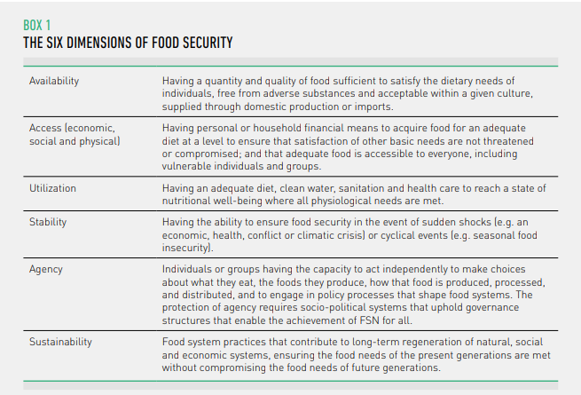
Dimensions of food security
Source: Food security and nutrition: building a global narrative towards 2030 (fao.org)

Slide 5
Food system
A food system gather all the elements (environment, people, inputs, processes, infrastructures, institutions, etc.) and activities that relate to the production, processing, distribution, preparation and consumption of food, and the outputs of these activities, including socio-economic and environmental outcomes.
Three constituent elements: food supply chains, food environments, consumer behavior
Idea: entry and exit points for nutrition
Source: HLPE Report # 12 - Nutrition and food systems (fao.org)

Slide 6
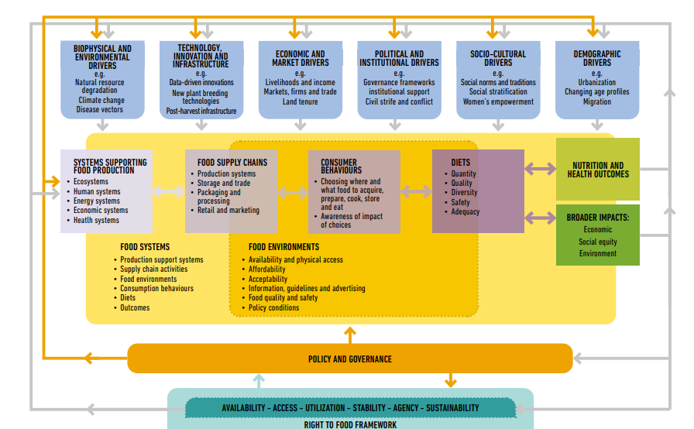
Sustainable food system framework
To support the six dimensions of food security, sustainable food systems must be:
productive and prosperous (to ensure the availability of sufficient food)
equitable and inclusive (to ensure access for all people to food and to livelihoods within that system)
respectful and empowering (to ensure agency for all people and groups to make choices and exercise voice in shaping that system)
resilient (to ensure stability in the face of shocks and crises)
regenerative (to ensure sustainability in all its dimensions)
healthy and nutritious (to ensure nutrient uptake and utilization)
Source: Food security and nutrition: building a global narrative towards 2030 (fao.org)

Slide 7
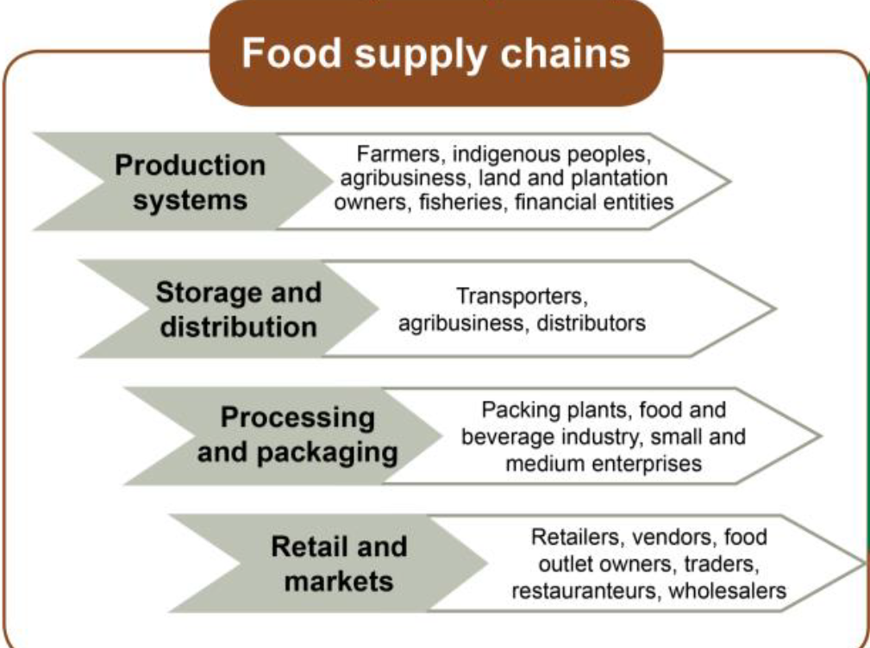
Food Supply Chains
All activities and actors that move food from production to consumption, including production, storage, distribution, processing, packaging, retailing and marketing
Crops, livestock, trees, fisheries
Inputs (agrochemicals, labor, etc.)
Source: Food security and nutrition: building a global narrative towards 2030 (fao.org)

Slide 8
Food Environment
The physical, economic, political, and socio-cultural context in which consumers engage with the food system to acquire, prepare, and consume food
The food environment includes:
Food entry points: the physical spaces where food is obtained/purchased
The built environment that allows consumers to access these spaces
Personal determinants of food choices (income, preferences, values, skills, etc.)
Political, social, and cultural norms that underlie these interactions
Source: Swinburn et al., 2014; GloPan, 2017; HLPE Report # 12 - Nutrition and food systems (fao.org)

Slide 9
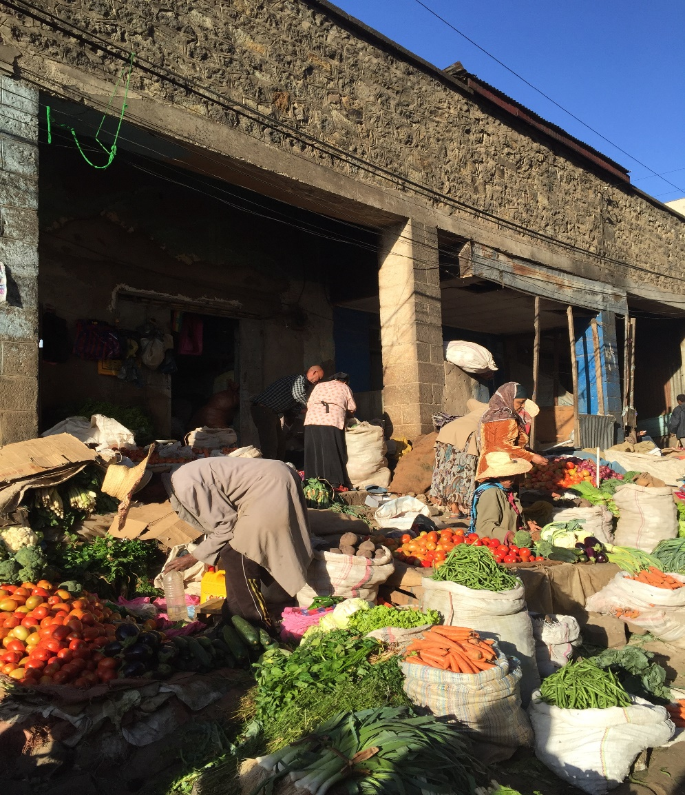
Food Environment
Key elements:
Food availability and physical access (proximity)
Economic access (affordability)
Acceptability
Promotion, advertising, information, guidelines
Food quality and safety
Policy conditions

Slide 10
Components of Access
Mobility - distance to food entry points and means of transportation
Health and disability conditions
Purchasing power to buy nutritious foods
Time, kitchen facilities, and equipment to cook
Knowledge and skills to prepare and use food
Source: HLPE Report # 12 - Nutrition and food systems (fao.org)

Slide 11
Consumer behavior
Choices and decisions made by consumers, at household or individual levels
Which foods to acquire, store, prepare, eat, and allocate within households?
Influenced by personal preferences determined by taste, convenience, culture, prices, beliefs, values, religion
Shaped by the food environment
Coping mechanisms during food insecurity

Slide 12
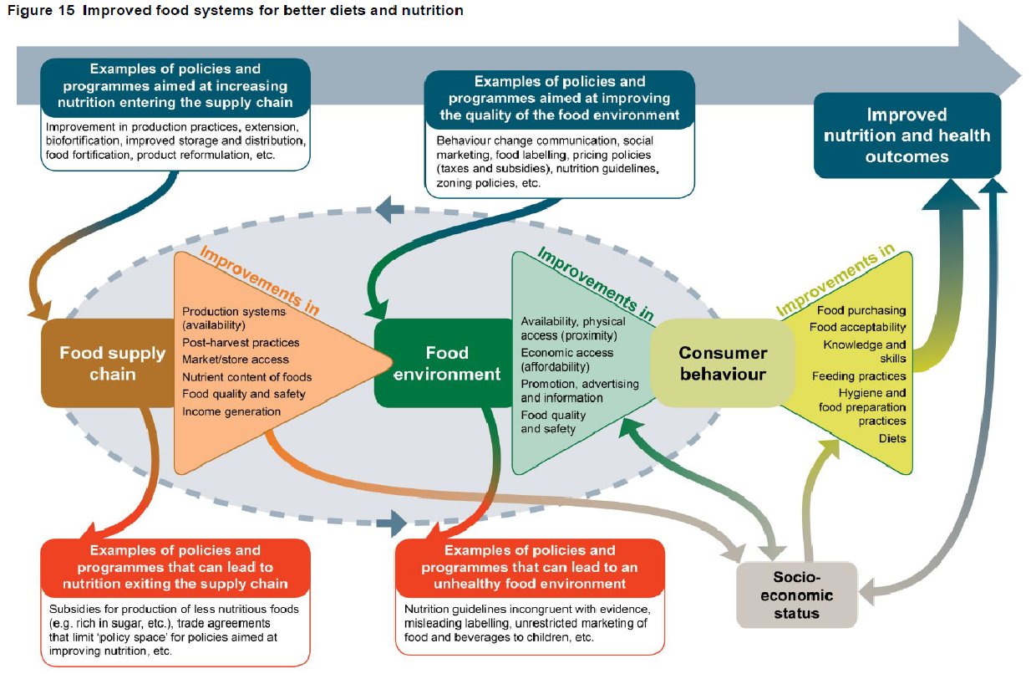
Improved food systems for better diets and nutrition
Source: HLPE, 2017

Slide 13
Drivers of food system
Biophysical and environmental drivers
Natural resources (land, water, biodiversity, etc.)
Ecosystem services (nutrient cycling, pollination, water purification, etc.)
Climate change
Innovation and technology
Agriculture (mechanization, new plant and animal breeding methods)
Food science (technologies used in food processing and preservation)
Infrastructure (roads, cold chains, etc.)
Source: HLPE Report # 12 - Nutrition and food systems (fao.org)

Slide 14
Drivers of food systems
Political and economic drivers
Leadership and governance
Food policies, regulations, programs
Taxes and subsidies
Private sector
Globalization and trade
Food prices and volatility
Land tenure
Conflicts and humanitarian crises
Socio-cultural drivers
Culture
Religions and rituals
Social traditions
Women’s empowerment
Demography
Population growth
Changing age distribution
Urbanization
Migration and forced displacement
Source: HLPE Report # 12 - Nutrition and food systems (fao.org)

Slide 15
Nutrition transition
Urbanization; economic growth; technological changes for work, leisure, and food processing; mass media growth
Transition stages
Stage 1
Hunter/ gathering
Stage 2
Famine
Stage 3
Receding famine
Stage 4
Degenerative disease
Stage 5
Desired behavioral change
Diet based on wild plants and animals
More cereal-based diet (domestication of plants and animals)
More starchy food, low fat, high fiber
Increased fat, sugar, processed foods
Increased high-calorie beverages
Decreased fat, sugar, processed foods, high-calorie beverages
Increased fruits and vegetables
Changes in eating patterns/behavior
Changes in physical activity levels
Labor intensive
Labor intensive
Labor intensive
Shift in technology for work and leisure
Sedentarism replaced with purposeful activity
Changes in morbidity patterns
Infectious and non-communicable diseases (NCDs)
NCDs predominant
Reduced NCDs
Source: Adapted from Raj S. (2020)
Notes:
Edit: see stage 5

Slide 16
Food fortification
Food fortification is a strategy to decrease micronutrient deficiencies
One or more micronutrients are added to specific, widely-consumed foods to improve the nutritional content of the food supply
The aim is to provide a public health benefit with minimal risk to health
Fortification can be voluntary or mandatory (required by law)
Examples:
Iodization of salt
Iron and folic acid fortification of wheat and other flours
Vitamin D fortification of milk
Multiple micronutrients in infant cereals

Slide 17
Food safety, sanitation, and hygiene
Food safety refers to “all those hazards, whether chronic or acute, that may make food injurious to the health of the consumer”
It refers to ways to prevent food-borne diseases arising from food contamination
Contamination can occur during food production, processing, storage, transport, distribution, or sale, as well as within the household
Safe food is food that is free of contaminants and will not cause illness or harm
There are three sources of contamination:
Biological: bacteria, viruses, fungi, rodents, insects, and their products
Physical: foreign substances, garbage, plastic, dust, soil, stone, metal
Chemical: detergents, agrochemicals, substances added during manufacturing
Sanitary conditions and hygienic practices are key to food safety within the home
Source: WHO. 2015a. Food safety. Fact Sheet No. 399. WHO Media Centre. Geneva, Switzerland. http://www.who.int/mediacentre/factsheets/fs399/en/

Slide 18
Food safety and nutrition
Recall: the bidirectional linkages between nutrition and infection
Perishable foods (vegetables, fruits, animal foods) tend to be more nutritious but also more susceptible to contamination
Food safety concerns may discourage people from eating these foods, and people who are the most nutritionally vulnerable (e.g., pregnant women, children, the poor) may be the most affected
Processing can increase food safety, shelf stability, and availability of nutrients, but it can also add unhealthy ingredients such as salt, sugar, and fat
Improving or ensuring food safety may lead to higher prices, which can decrease the poor’s access to safe foods
Source: Nordhagen et al. 2021

Slide 19
Takeaway messages
Food security and nutrition are key to realizing the right to food and to achieving SDG 2: Zero Hunger.
Sustainable food systems are key to support the six dimensions of food security.
Food systems include food supply chains and food environments, which determine consumer behavior, diets, and ultimately nutrition and health.
Food systems are rapidly changing, driven by globalization, urbanization, changes in livelihoods, climate, and many other factors.
Beyond increasing quantity of food, strategies to improve diets must also consider nutritional quality and food safety.
Food safety is important to ensure good nutrition and health.
As societies develop, a nutrition transition occurs, in which people increasingly consume unhealthy foods, physical activity decreases, and non-communicable diseases become more prevalent.

Slide 20
Thank you!
Notes:
This concludes topic 5 of module one. Thank you for your attention.

