Slide 1
Module 2
Anthropometric Measurements: Children Under 5
Developed by Dr. Michele R. Forman, Dr. Ratthiphone Oula, and Dr. Rana Chehab
In collaboration with the Center of Nutrition, Ministry of Health Lao PDR
Training by Applied Nutrition Research Capacity Building (ANRCB), a project of the Lao American Nutrition Initiative (LANI)
This work is made possible through support from USAID as a supplement to a USAID Cooperative Agreement #7200AA18CA00009 (LASER-PULSE) to Purdue University. Contents reflect the views of the author(s) and do not necessarily reflect those of USAID.
For more information, please contact Catholic Relief Services Laos.

Slide 2
Outline
Section 1: Introduction
Section 2: Weight
Section 3: Length and Height
Section 4: Mid-Upper Arm Circumference
Section 5: Head Circumference
Section 6: Anthropometric Measurement Records
Section 7: Equipment Maintenance
Section 8: Tips and practice your skills
Section 9: Applying this Training to your Work
Notes:
For community

Slide 3
Section 1: Introduction

Slide 4
Target audience for this training
This module is used for training individuals conducting routine service at health facilities and in the field

Slide 5
Training Objectives
To understand the importance of standardized anthropometric measurements;
To practice performing anthropometric measurements according to standard procedures;
To learn to interpret anthropometric measurements using growth charts;
To practice recording the results of anthropometric measurements;
To learn how to maintain the equipment used for anthropometric measurements.

Slide 6
The meaning of the word ‘anthropometry’
The word anthropometry is derived from Greek:
anthropo means human
metry means measurement
Hence, ‘anthropometry’ is the measurement of the human body and its parts.

Slide 7
Anthropometry-related forms of malnutrition
Malnutrition
Undernutrition
Overnutrition
Stunting/ Chronic Malnutrition
Overweight
Wasting/ Acute malnutrition
Obesity
Undernutrition/ Chronic and acute malnutrition

Slide 8
Why is it important to focus on children under 5 years?
Good nutrition is essential for children’s growth and development and for reducing the risk of death.
Around 45% of deaths among children under 5 are linked to undernutrition.
Children under the age of 5 are at higher risk of undernutrition.
Undernutrition in children can leave a devastating and permanent impact on a child’s physical and cognitive capabilities.

Slide 9
Why are anthropometric measurements important?
To monitor the physical growth at critical times of childhood.
To assess the nutritional status of children to guide:
nutrition policy and strategy
community screening in emergency/urgent assessment

Slide 10
Why is training on anthropometry important?
To increase the accuracy and reliability of the measurements
Accuracy: measure the correct value
Accurate: A child weighs 10kg and the scale reads 10kg.
Inaccurate: A child weighs 10kg but the scale reads 18kg.
Reliability: measure the same value every time
Reliable: The scale reads 15 kg every time.
Not reliable: The scale reads 15kg in the first measurement and 18kg in the second measurement.
Accurate and reliable: A child weighs 10kg and the scale reads 10kg every time.
Inaccurate but reliable: A child weighs 10kg but the scale reads 18 kg every time.

Slide 11
Anthropometric Measurements
Usually dependent on sex and age
A combination of different measurements:
Height/
Length
Mid-upper
Arm
Circumference
Weight
Head
Circumference

Slide 12
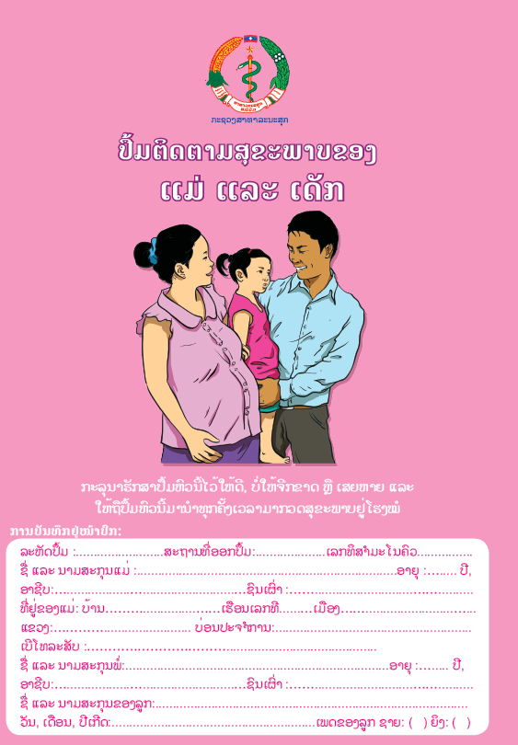
Age
Sources of child age:
Birth certificate;
Maternal and Child Health (MCH) follow up book (pink book);
Family book;
Parent’s memory.

Slide 13
Anthropometric measurements by age
 | Children 2 years or younger | Children 2-5 years
Weight | ✓ | ✓
Length | ✓
Height |  | ✓
Mid-upper arm circumference (MUAC) | ✓ | ✓
Head circumference | ✓

Slide 14
Section 2: Weight Measurements

Slide 15
Importance of weight measurements
Provides a measure of total body size;
Helps to monitor the nutritional status over time;
Allows detection of changes in weight:
- Normal weight increases with age in childhood
- Unexpected gains or losses in weight determined by comparing with distribution in each age group

Slide 16
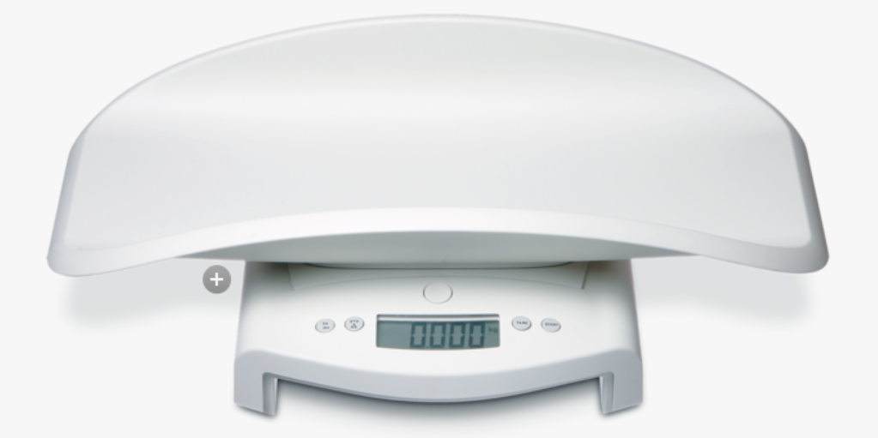
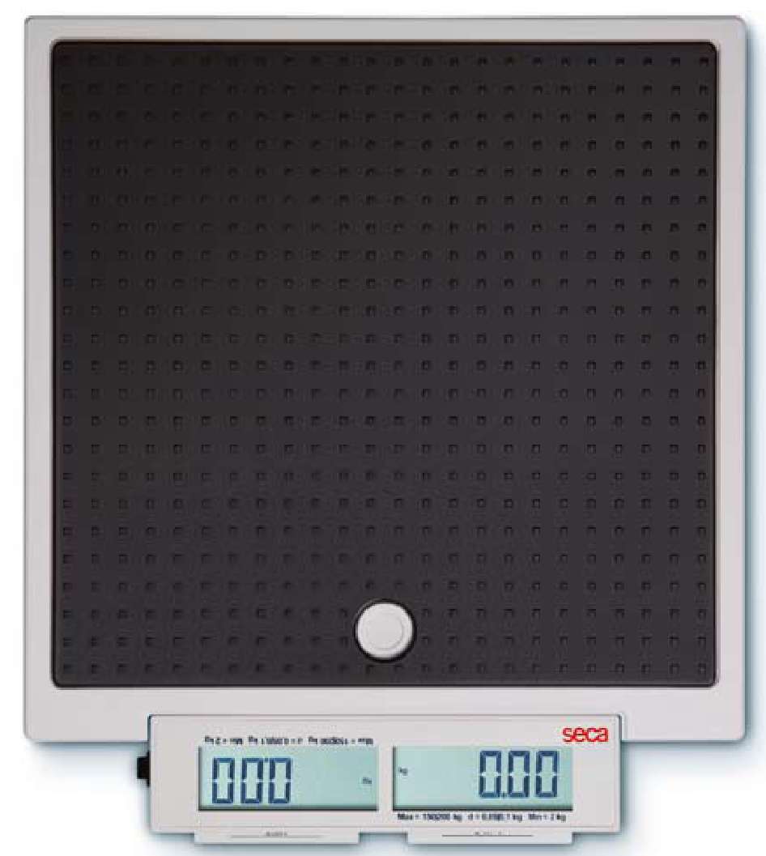
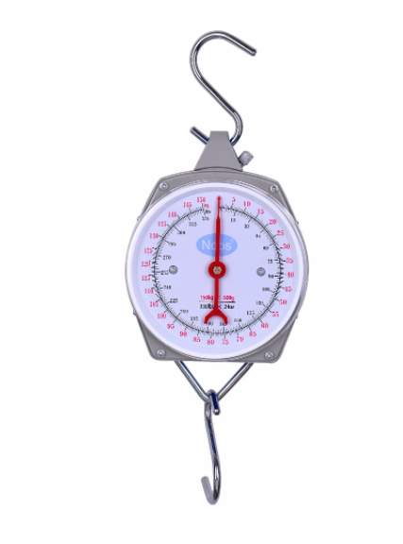
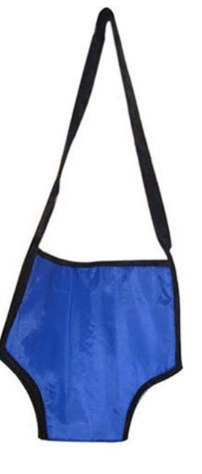
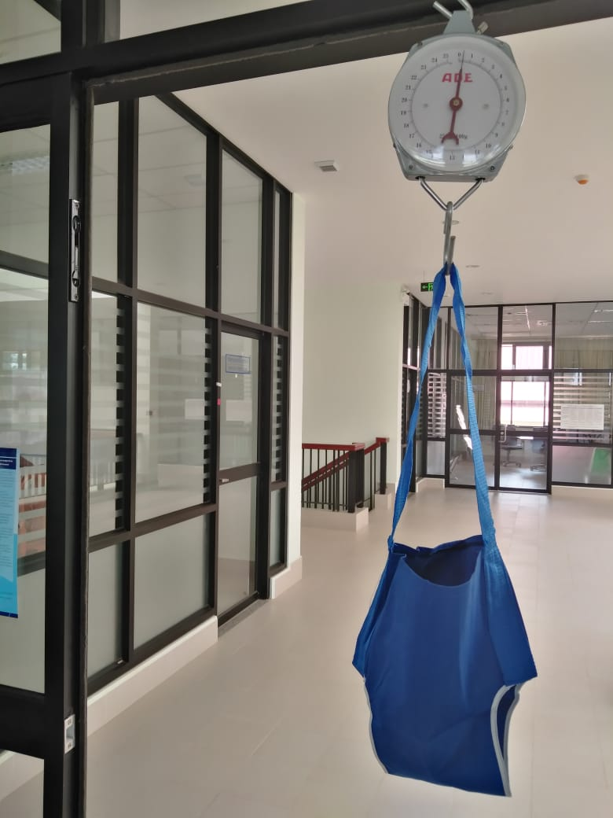
Equipment to measure weight: scales
Infant Scale
Salter scale
SECA 2-in-1 Scale (874)

Slide 17
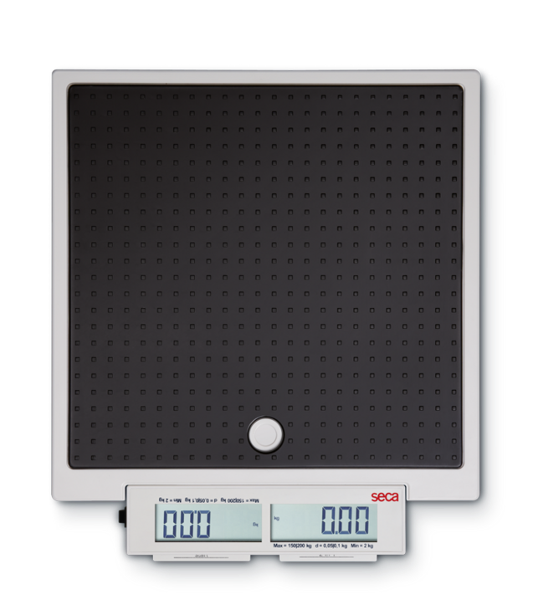
2-in-1 SECA Scale (874)
On
On and Off
2 in1

Slide 18
Prepare the scale
Take the scale out of the bag.
Put the scale on the floor.
Ensure that the unit of measurement is in kg (kilograms).
The scale must be always stored in a bag!

Slide 19
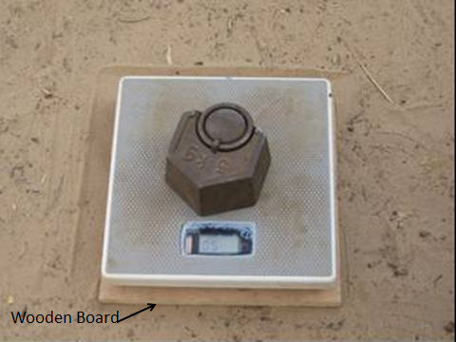
Calibrate the scale
Use a known weight.
Test to see if the scale shows the same value as the known weight.
Calibrate the scale each time it is moved to a new location.
This helps ensure accuracy and reliability of the measurements.
Weight
5 kg

Slide 20
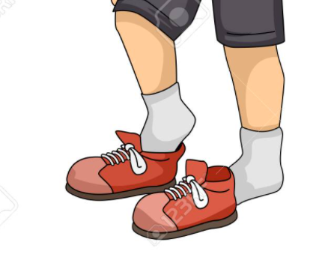
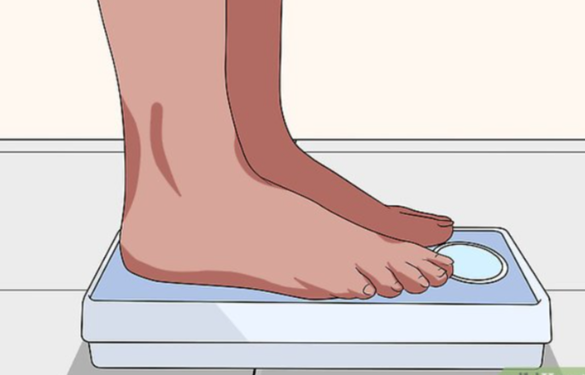
Before weighing
Baby nappy or diaper must be dry.
Heavy clothing and shoes must be removed.
Pockets must be empty.

Slide 21
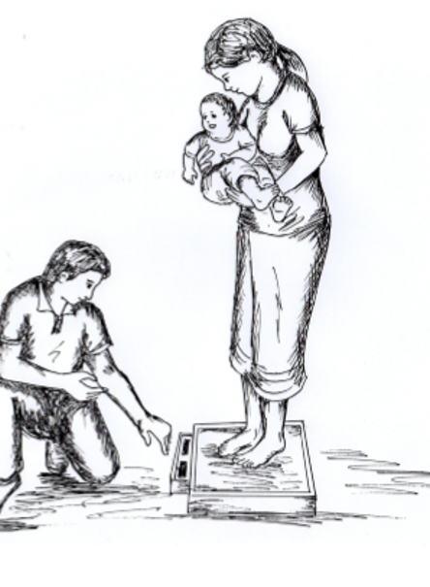
Weight of children under 2 years using 2-in-1 SECA Scale (874)
Turn the scale ON and wait until the screen reads 0.00 kg.
Mother or adult takes off shoes then gets on the scale.
Press 2 in 1 button on the scale, and wait until the number reads 0.00 kg again.
Ask the mother or adult to hold the child.
Record the weight of the child that appears on the screen.

Slide 22
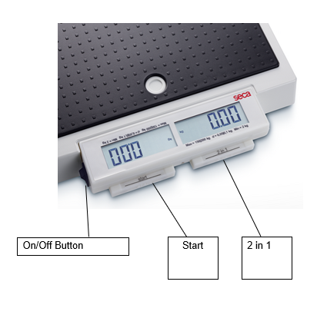
Weight of children 2-5 years old using 2-in-1 SECA Scale (874)
Check that scale reads 0.00 kg.
Child being measured stands in the center of the scale.
Arms are straight to the side, not touching anything.
When the numbers stop blinking, record the weight.
Child gets off scale.
2-in-1 SECA Scale (874)

Slide 23
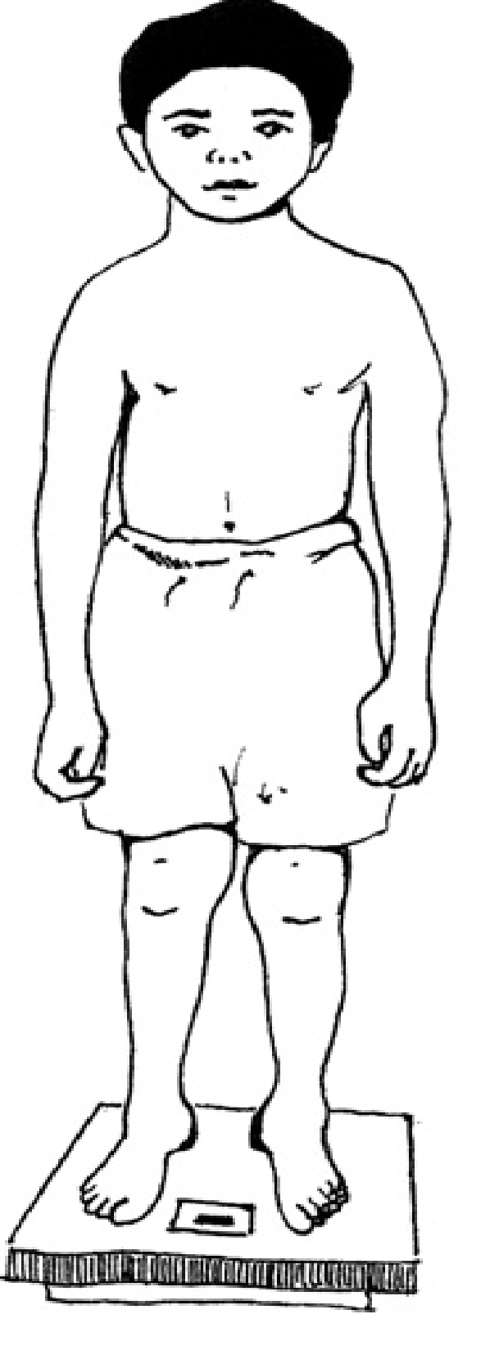
Position on scale
Take off clothes & shoes
Stand straight

Slide 24
Repeat the weight measurement
Repeat previous steps (1-5) for a 2nd measurement.
This helps ensure the reliability of the measurements.
If the two weight measurements differ by 0.5 kg or more, a 3rd measurement is required.

Slide 25
Weighing infants using Salter scale
Important: 2 people are needed for the measurement.
Ensure the scale reads 0.00 kg.
Remove all heavy clothes.
Put infant’s legs in the bag holes and make sure they are not touching anything.
Read the number on the scale to assistant to the nearest 0.1 kg.
Assistant repeats and checks the measurement is correct.
Remove infant from the bag safely.

Slide 26
Interpreting anthropometric measurements
Using Growth Charts
- For children under 5 years of age
- Different charts for boys and girls
Helps assess nutritional status and determine forms of malnutrition (if any)

Slide 27
Interpreting weight for age
Low weight for age: Underweight
- Z score between -2 and -3: moderate underweight
- Z score less than -3: severe underweight
High weight for age: Overweight & Obesity
- Z score between +2 and +3: overweight
- Z score greater than +3: obese

Slide 28
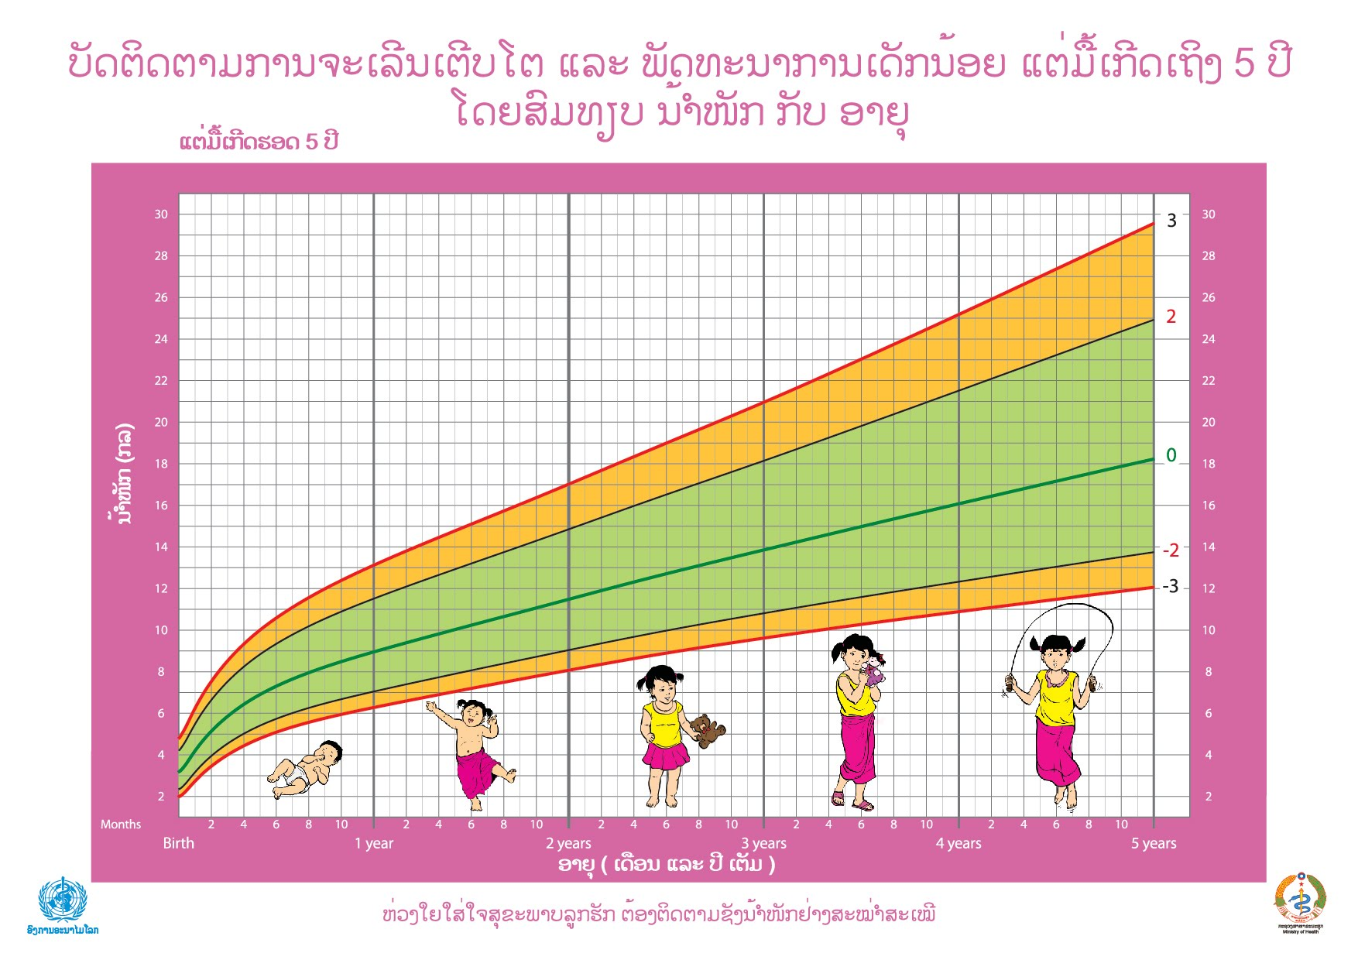
Growth charts from MoH Pink Book: Weight for age for girls
Above red line: Obesity
Well-Nourished
Overweight
Below red line: Severe undernutrition
Moderate undernutrition

Slide 29
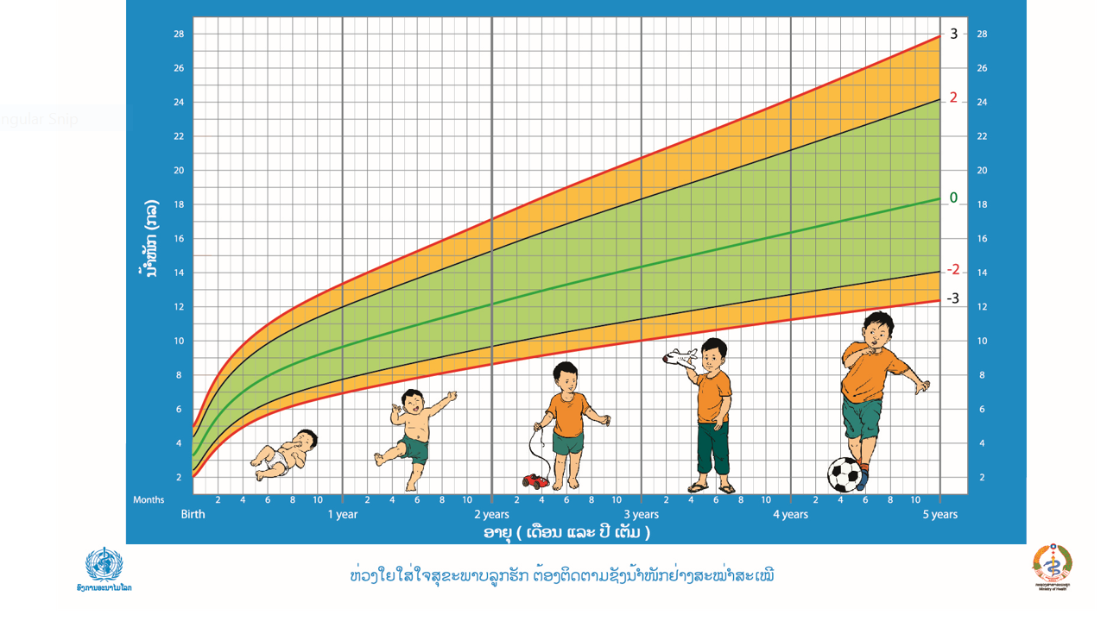
Growth charts from MoH Pink Book:
Weight for age for boys
Boy – 1 year / 9 kg
Normal Growth

Slide 30
Section 3: Length & Height Measurements

Slide 31
Importance of length & height measurements
Helps monitor child growth
Monitoring the increase in height:
Height increases with age in childhood.
Comparison with distribution of height in each age group.

Slide 32
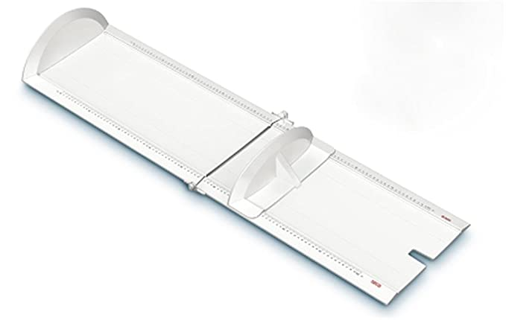
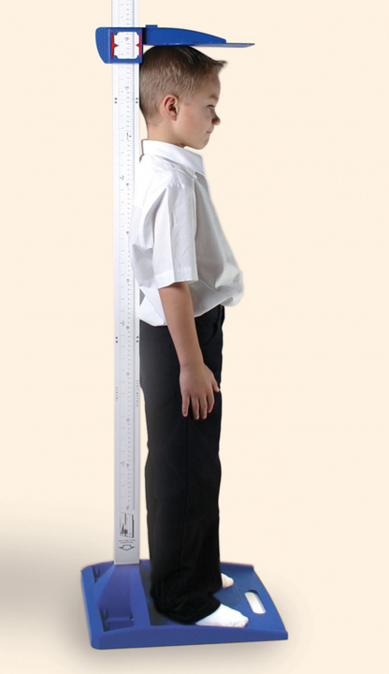
Equipment to measure length or height
Infantometer:
for recumbent length (laying on back) for children younger than 2 years.
Stadiometer:
for standing height for children 2-5 years

Slide 33
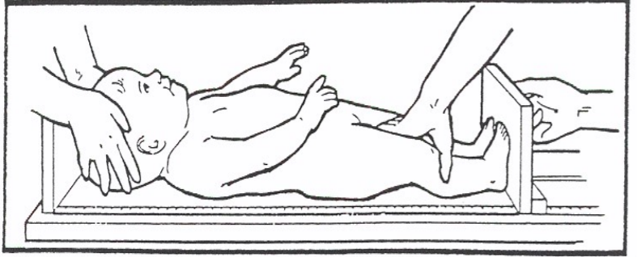
Before measuring length of children under 2 years
Unpack and assemble the infantometer
Remove heavy outer clothing
Remove shoes/socks of a baby

Slide 34
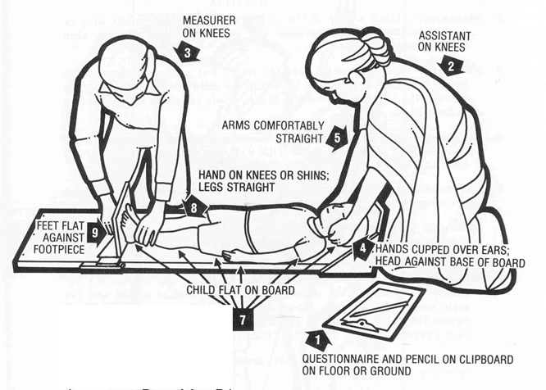
Recumbent length for children under 2 years
Two people are needed to accurately
measure recumbent length

Slide 35
Recumbent length measurement
The measurer places the baby flat on his back with the head at the front of the headboard.
The assistant holds the infant’s head so it is facing upwards.
The measurer holds down the knees as firmly as possible to flatten the legs.
The measurer tickles the base of the feet and pulls the footboard to the base of the feet.
The measurer reads and records the measurement.
Repeat steps 1-5 for a second measurement.

Slide 36
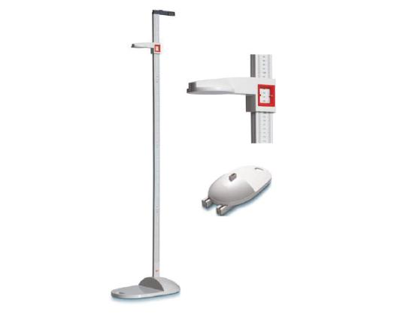
Before measuring height of children 2-5 years old
Ask child to remove heavy outer clothing, shoes & hair accessories before getting on the stadiometer.

Slide 37
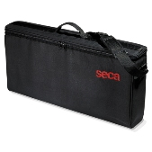
Prepare the stadiometer to measure height of children 2-5 years old
Unpack stadiometer:
Base
Numbered measuring sticks
Headboard
This bag must be carried not dragged!

Slide 38
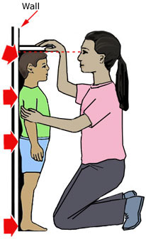
Prepare the Stadiometer to measure height
Set the base of the stadiometer on level ground (use carpet if needed).
Assemble the numbered pieces in the correct order.

Slide 39
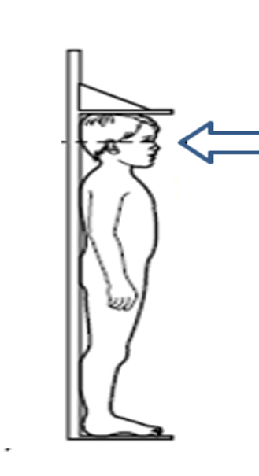
Height measurement
Feet flat, heels together.
Stand in center of base, on the footprints.
Shoulders level.
Buttocks, shoulders, head touching vertical bar.
Hands at side, not touching or holding anything.
Attach the back of the head to the stadiometer.

Slide 40
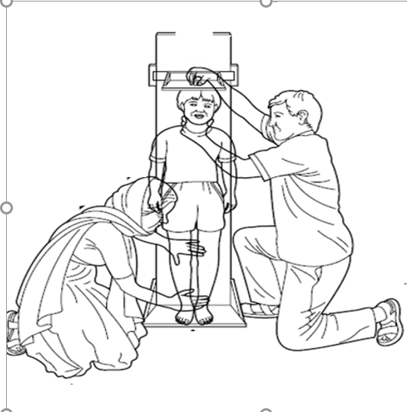
Height measurement, continued
7. The eyes looking straight ahead.
8. Do not raise or lower the jaw.
9. Child takes a deep breath and holds it
10. Lower headboard until it touches the hair (if hair is tied up, remove tie to make it smooth).
11. Child steps away & breathes.
12. The measurer can use a chair if necessary to read the numbers.
13. Record height in cm on form.

Slide 41
Repeat the height measurement
Repeat all steps (1-13) to obtain a second height measurement.
This helps ensure reliability of the measurements.
If the two height measurements differ by 0.5 cm or more, repeat the steps for a 3rd measurement.

Slide 42
Interpreting length or height for age
Reflects long-term (chronic) nutritional status
‘Low’ height or length for age: Stunting
Z score between -2 and -3: moderate stunting
Z score less than -3: severe stunting
‘High’ height or length for age: Tall
Is rarely a problem
Might require further medical investigation

Slide 43
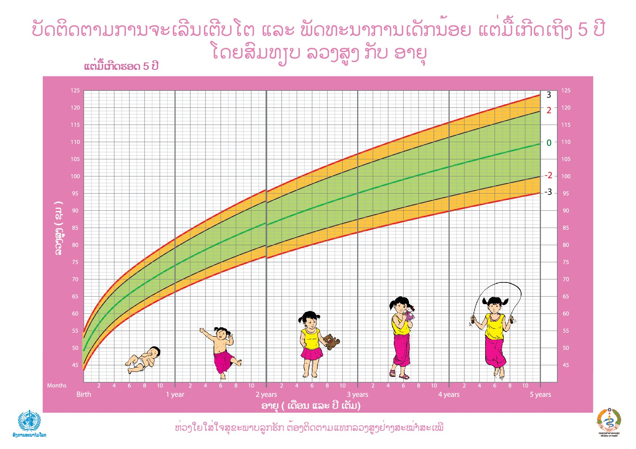
Growth charts from MoH Pink Book: Height for age for girls
Girl - 1.5 years
80cm
Normal Growth
Moderate stunting
Severe stunting
Height (cm)

Slide 44
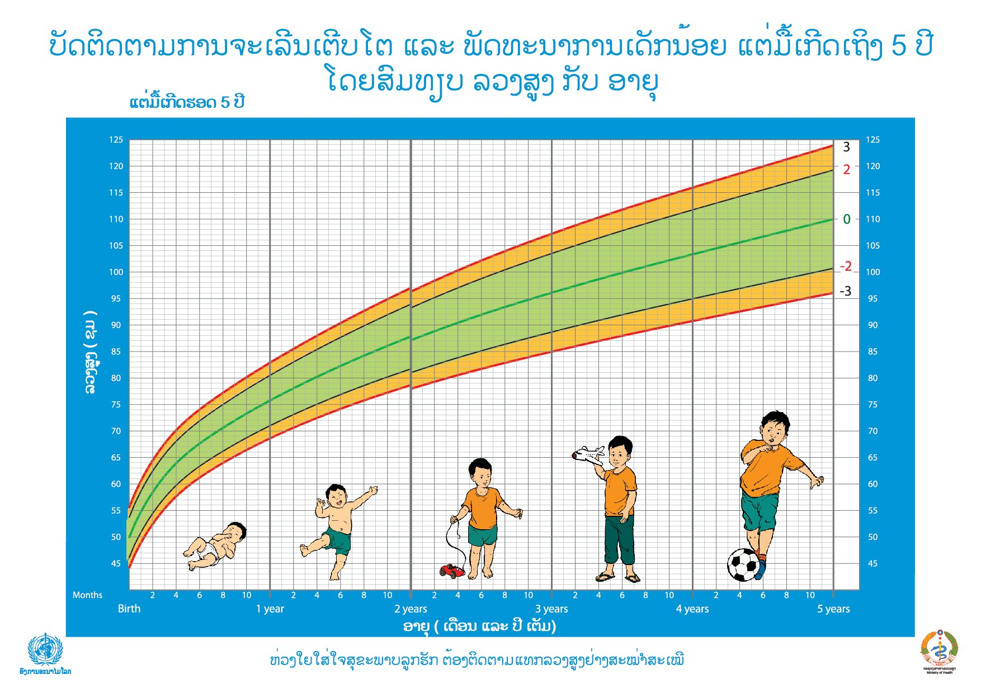
Growth charts from MoH Pink Book: Height for age for boys
Boy - 2 Years
74 cm
Moderate Stunting
Height (cm)

Slide 45
Interpreting weight for length or height
Reflects short-term/’acute’ nutritional status
Low weight for length or height: Wasting
Thin
Can be a form of severe acute malnutrition (SAM)
Z score between -2 and -3: moderate wasting
Z score less than -3: severe wasting
High weight for length or height: Overweight or obese

Slide 46
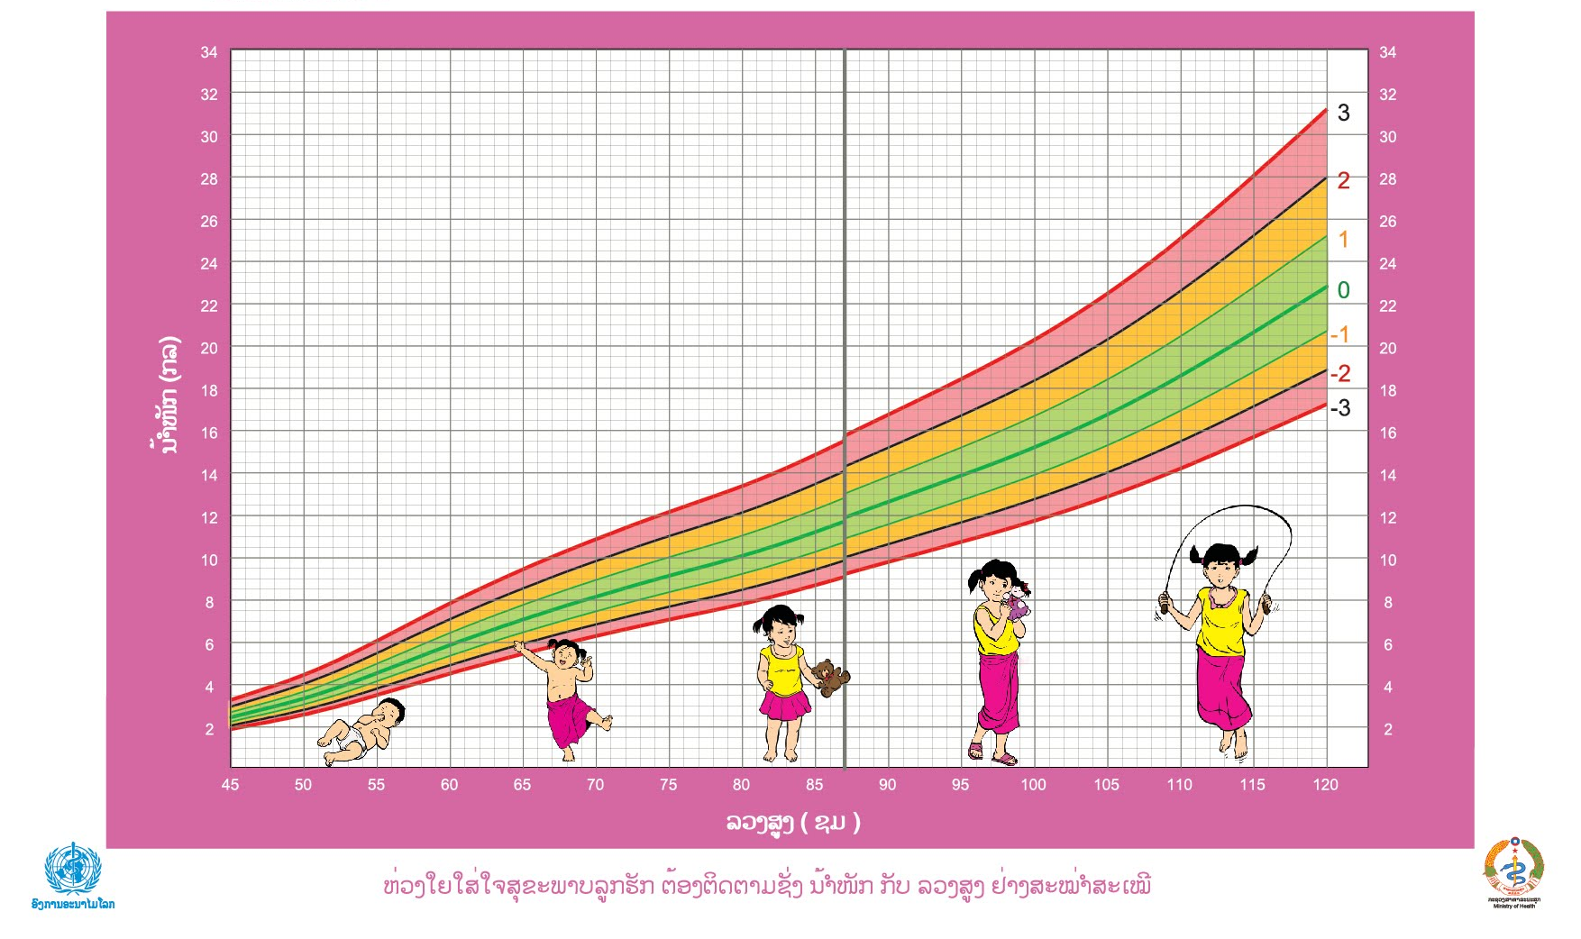
Growth charts from MoH Pink Book: Weight for height for girls
Girl - 70cm
Weight 10kg
Child has overweight
Height (cm)

Slide 47
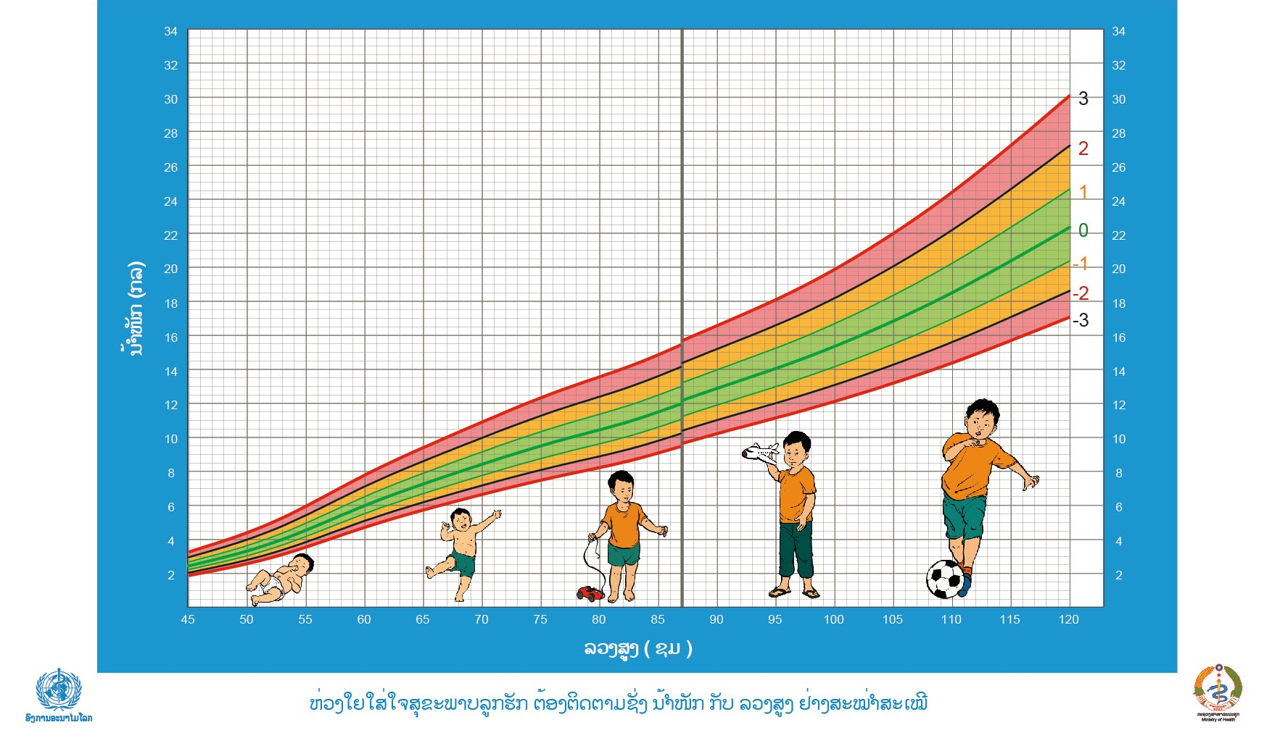
Growth charts from MoH Pink Book: Weight for height for boys
Boy - 80cm
Weight 9 kg
Normal Growth
Height (cm)

Slide 48
Forms of Undernutrition
Indicator | Z score cut offs | Nutritional Status
Weight for Age | Between -2 and -3 | Moderate underweight
 | Less than -3 | Severe underweight
Height for Age | Between -2 and -3 | Moderate stunting
 | Less than -3 | Severe stunting
Weight for Height | Between -2 and -3 | Moderate wasting
 | Less than -3 | Severe wasting

Slide 49
Section 4: Mid-Upper Arm Circumference (MUAC)

Slide 50
Importance of MUAC Measurement
Assesses arm muscle and subcutaneous fat.
Good predictor of child mortality risk.
Assesses nutritional status of pregnant women.
Easy screening tool for short-term/ acute malnutrition among children and pregnant women.

Slide 51
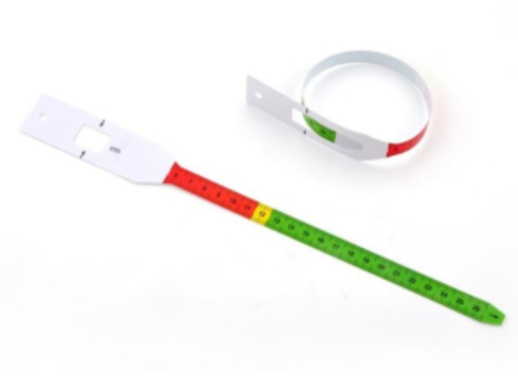
Mid-Upper Arm Circumference (MUAC) - colored tape
MUAC is measured using a colored tape that helps in assessing degrees of undernutrition.

Slide 52
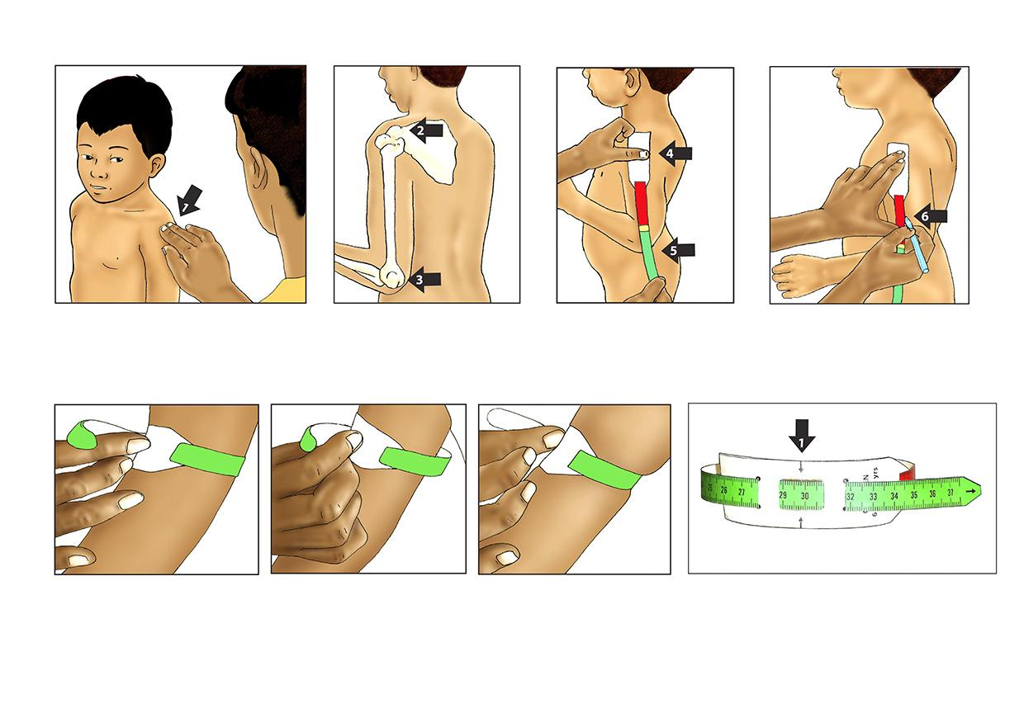
Steps for measuring MUAC
1st: Remove any clothing or cover on the child’s left arm. Then, follow these steps:

Slide 53
Measuring MUAC
Two people are needed to complete the MUAC measurement.
The measurer locates the tip of the child’s left shoulder with his/her fingertip.
The measurer bends the child’s left arm at the elbow to make a right angle.
The measurer places the beginning of the tape (marked by zero) on the tip of the shoulder and holds the tape in place with his/her thumb.

Slide 54
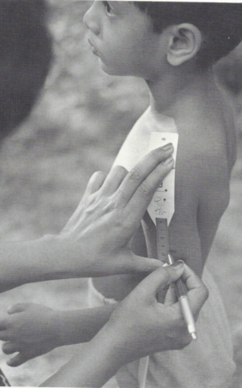
Measuring MUAC
4. The assistant pulls the tape straight down past the tip of the elbow.
5. The assistant reads the number at the tip of the elbow to the nearest cm.
6. The assistant divides the number by two. The result is the midpoint of the upper arm.
7. The assistant marks the midpoint with a pen on the arm.

Slide 55
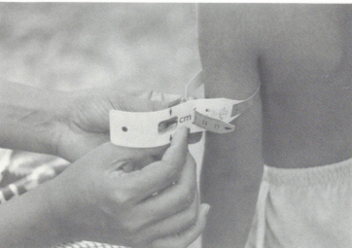
Measuring MUAC
8. The measurer pulls the tape around arm gently at the
marked point (representing the midpoint of the upper arm).
9. The measurer inserts the end of the tape through the opening hole and pulls the tape at both ends to get a feel of the arm. Do not pull too tightly and do not have the tape too loose.
10. The assistant makes sure the tape is flat on the skin and parallel to the floor.
11. The assistant records the MUAC measurement to the nearest cm.
12. Repeat steps 1-11 for a
second measurement.

Slide 56
Interpretation of the colors on MUAC tape for children under 5 years
Categorization | Color on measuring tape | MUAC measurement
Normal | Green | Greater than 12.5 cm
Moderate undernutrition | Yellow | 11.5-12.5cm
Severe undernutrition | Red | Less than 11.5cm
Source: WHO/UNICEF/WFP 2014; WHO 2013.

Slide 57
Section 5: Head Circumference

Slide 58
Head Circumference
Head circumference is the measurement of a child's head around its largest area.
It is important for all children under 2 years as it reflects head growth:
A head that is larger than normal or increasing in size faster than normal may be a sign of several problems, including water on the brain: hydrocephalus.
A small head size or slow growth rate may be a sign that the brain is not developing properly: microcephaly.

Slide 59
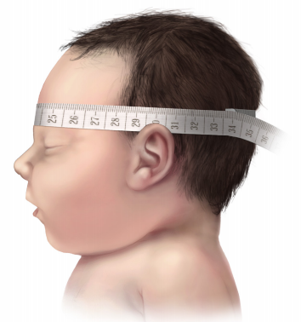
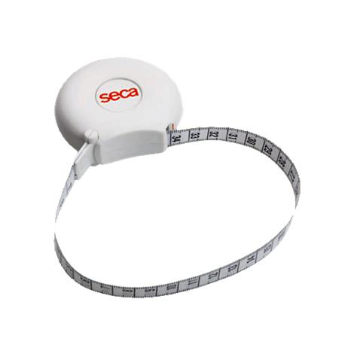
Measure head circumference
Use a flexible, non-stretchable tape.
Position the tape around the largest area of the head, just above the eyebrows and above the ear. Record the measurement.
Repeat for a second measurement to increase reliability.
For infants who cannot hold up their heads, have the mother hold the baby in her lap and gently put her hand around the back of the neck to hold up the head.

Slide 60
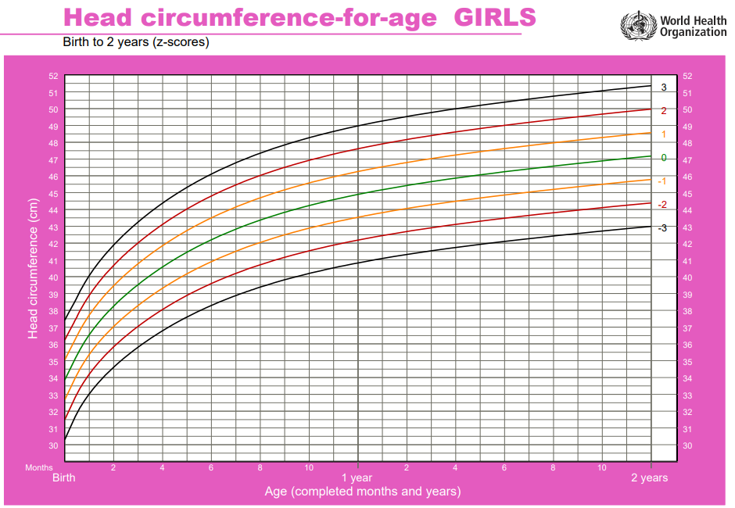
Head Circumference for
Girl 10 Months 44cm
Normal

Slide 61
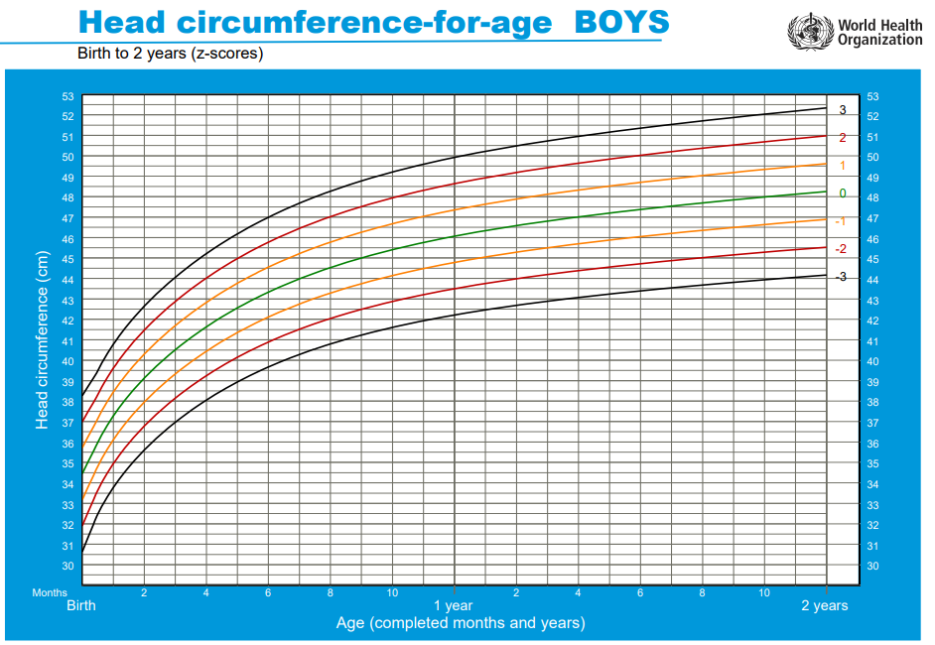
Head Circumference for Age
Boy 8 Months
43 cm
Small Head for Age

Slide 62
Section 6:
Recording Anthropometric Measurements

Slide 63
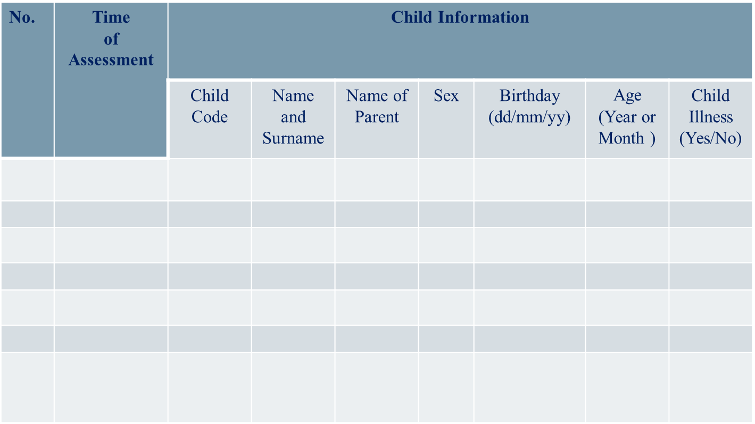
Measurement form: page 1

Slide 64
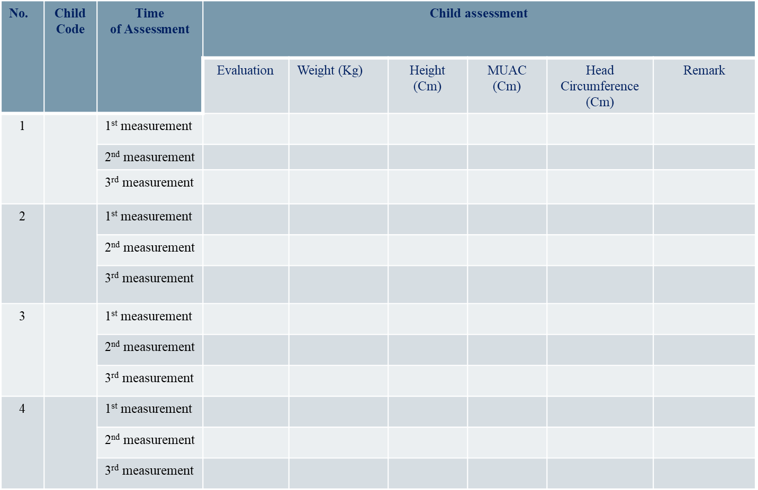
Measurement form: page 2

Slide 65
Section 7: Equipment Maintenance

Slide 66
Scale calibration
When in use, calibrate the scales every morning and evening.
In the morning, choose 2 scales at random to be calibrated.
In the evening:
Calibrate all the scales before storing them.
Wipe down the scales and return to shelf
Use Scale Calibration Log

Slide 67
Scale calibration steps
Set scale on ground and turn it on.
Check that the scale reads 0.0 kg.
Put 10kg standardized weight on the scale.
Record 1st measurement in log.
Repeat for 2nd calibration measurement.
The 1st and 2nd measurement should be 10kg. If not, weigh the standardized weight a 3rd time.
Record the results.
Inform your supervisor if the measurements are more than 0.5kg different.

Slide 68
Infantometer/Stadiometer maintenance
In the morning, check 2 infantometers/ stadiometers at random.
In the evening, check all infantometers/ stadiometers before storing them.
Steps:
Inspect the infantometers/ stadiometers for damage and missing pieces.
If in good condition, check the box.
If a problem, write it on log.
Record the results on Infantometer/ Stadiometer Log.

Slide 69
General Equipment Rules
Clean the equipment before and after use
Ensure nothing is on the scale or stadiometer when storing or moving them
Always ensure equipment is securely on the on table or floor. If floor is uneven, a carpet square can be used to help level.

Slide 70
Section 8: Tips and Practice

Slide 71
Growth Counseling - An Important Opportunity
Regular assessment of growth in children under two years old helps detect deviation from normal growth and the application of appropriate interventions.
This anthropometric training is a start to identifying children at risk of malnutrition or who are malnourished. Further training and nutrition assessment are needed to be able to complete a counseling on child growth.

Slide 72
Section 9: Applying this Training to your Work!
Notes:
https://scienceforwork.com/blog/apply-training-learning-transfer/

Slide 73
Reflection
Research shows training is only 10% of your actual learning, the most important part comes in your job.

Slide 74
References
1.Kristen Cashin and Lesley Oot. (2018). Guide to Anthropometry, A practical Tool for Program Planners, Mangers, and Implementers, Module 1: Anthropometry Basic, May 2018.
2.Measuring Child Growth for Surveys, (2011). Part I: Training for Measuring Weight, Height and Mid-Upper Circumference, Facilitator Manual, Version I, December 2011.
3. National Health and Nutrition Examination Survey (NHANES), (2017). Anthropometry Procedure Manual, January 2017.
4.Training Course on Child Growth Assessment, (Undated). WHO Child Growth Standards, H Course Direction Guide.
5.Training Course on Child Growth Assessment, (Undated). WHO Child Growth Standard, C Interpreting Growth Indicators.
6. WHO Child Growth Standards, (Undated). Length/height-for-age, weight-for-age, weight-for-length, weight-for-height and body mass index-for-age, Methods, and development.

Slide 75
Thank you!

