Slide 1
Module 3
Anthropometric Measurements: Adults and Children Above 5
Training developed by Dr. Michele R. Forman,
Dr. Ratthiphone Oula, Dr. Rana Chehab
Training by Applied Nutrition Research Capacity Building (ANRCB), a project of the Lao American Nutrition Initiative (LANI)
This work is made possible through support from USAID as a supplement to a USAID Cooperative Agreement #7200AA18CA00009 (LASER-PULSE) to Purdue University. Contents reflect the views of the author(s) and do not necessarily reflect those of USAID.
For more information, please contact Catholic Relief Services Laos.
Notes:
Audience: University students, Central hospital (doctors, nurses…), TOT
Will complete the basic training first

Slide 2
Outline
Section 1: Introduction
Section 2: Anthropometric measurement and Equipment
Section 3: Equipment Maintenance
Section 4: Interpretation of anthropometric
measurements
Section 5: Importance of anthropometric measurements in research context
Section 6: Practice your skills
Notes:
For community

Slide 3
Section 1: Introduction
ANRCB 3

Slide 4
Target audience for this training
This module is used for training individuals conducting routine service at health facilities and in the field

Slide 5
Common Anthropometric Measurements among adults
Weight
Height
Waist circumference
Hip circumference
Mid-upper arm circumference (MUAC)

Slide 6
Importance of anthropometric measurements among adults and children above 5
Commonly used indicators of nutritional status because they are non-invasive and inexpensive
Can be used among critical stages: pregnancy, childhood and adolescence
Serve as a proxy for body composition assessment: muscle, bone, and adipose tissue
Can serve as diagnostic criteria for obesity, which is associated with cardiovascular disease, hypertension, & diabetes...

Slide 7
Section 2: Anthropometric Measurements and Equipment

Slide 8
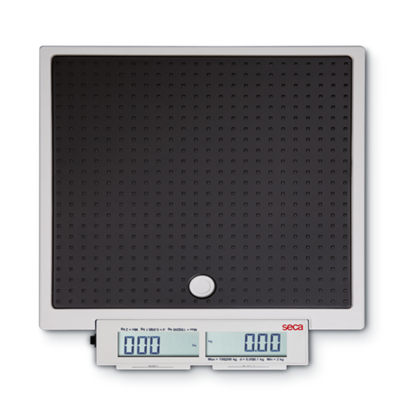
2-in-1 SECA Scale (874) for Measuring Weight

Slide 9
Before measuring weight
Prepare the scale:
Take the scale out of the bag and put it on the floor.
Calibrate the scale:
Test to see if the scale shows the same value as the known weight.
Calibrate the scale every time it is moved to a new location.
To ensure accuracy and reliability of the measurements.

Slide 10
Weight Measurement Technique
Check the scale is at 0.00 kg.
Person being measured must be barefoot, wear as little clothing as possible, and has empty pockets.
Person stands in the center of the scale, arms are straight to the side and not touching anything.
When the numbers stop blinking, record the weight.
Person being measured gets off scale.

Slide 11
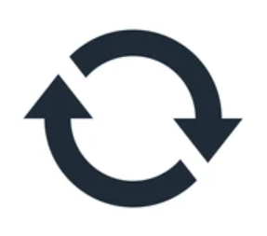
Repeat the Weight Measurement
Repeat previous steps (1-5) for a second measurement.
This helps ensure the reliability of the measurements.
If the two weight measurements differ by 0.5 kg or more, a 3rd measurement is required.

Slide 12
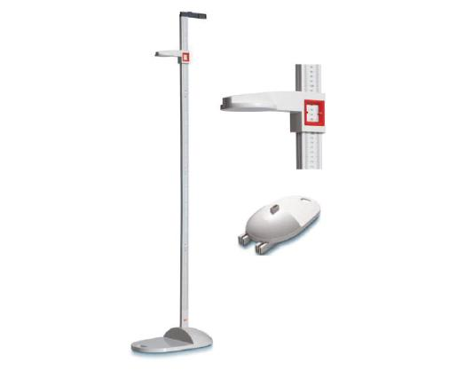
Stadiometer for Measuring Height

Slide 13
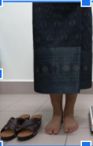
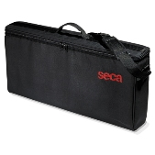
Before measuring height
Remove shoes, hats, and other headwear.
Unpack the stadiometer
Assemble the parts on level ground.
Notes:
It is important to stand with feet flat and the back straight, as slouching or raising up at all on the ball of the foot can also create an inaccurate measurement

Slide 14
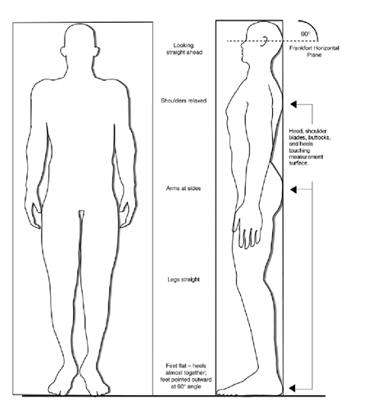
Height Measurement
Subject must stand on stadiometer barefoot.
Stand in center of base, feet flat, heels together.
Shoulders level
Buttocks, shoulders, head touching vertical bar
Hands at side, not touching or holding anything

Slide 15
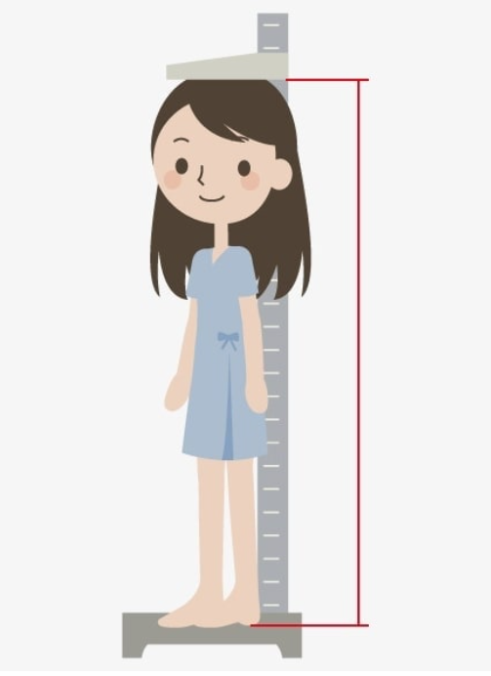
Height Measurement
6. The eyes looking straight ahead.
7. Do not raise or lower the jaw.
8. Measurer lowers headboard until it touches the hair (if hair is tied up, remove tie to make it smooth).
9. Measurer can use a chair if necessary to read the numbers.
10. Record height in cm on form.

Slide 16
Repeat the height measurement
Repeat all steps to obtain a second height measurement.
This helps ensure reliability of the measurements.
If the two height measurements differ by 0.5 cm or more, repeat the steps for a third measurement.

Slide 17
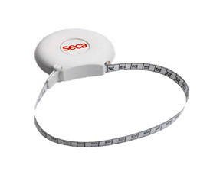
Waist Circumference
Equipment:
Measuring tape
Materials:
Anthropometry Form
Pen
Notes:
Show Stadiometer and related forms

Slide 18
Before measuring waist circumference
Find a private area
Measurement should be taken directly over the skin (not over clothing)
Participant removes shoes
Participant stands with feet touching and arms at sides

Slide 19
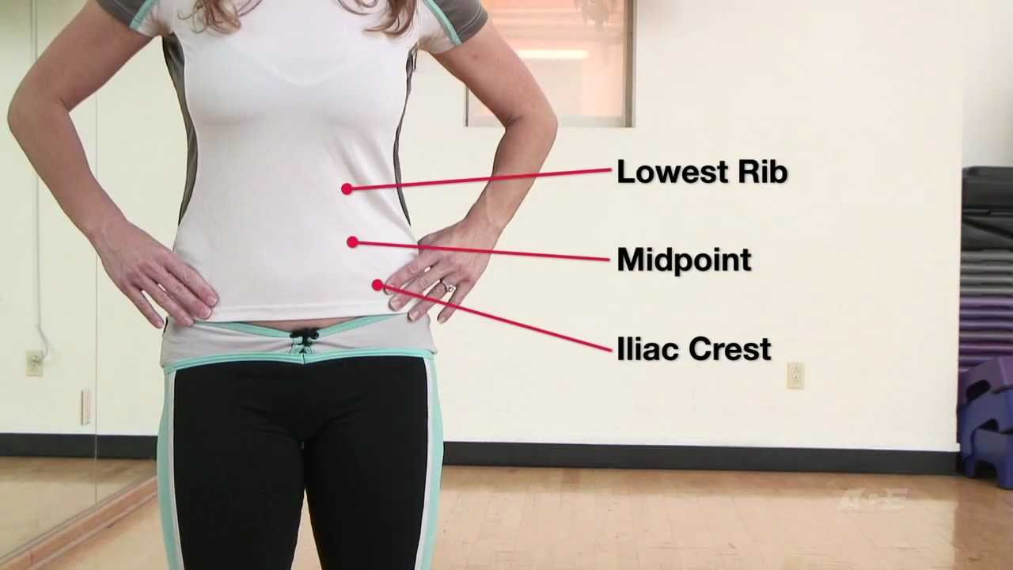
Waist Circumference Technique
Participant locates his/her lowest point of the last rib and top of hip on his/her right side.
Measurer verifies the location of the two bones.
Measurers marks the midpoint with a pen.
Repeat the same steps on the left side.

Slide 20
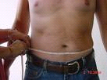
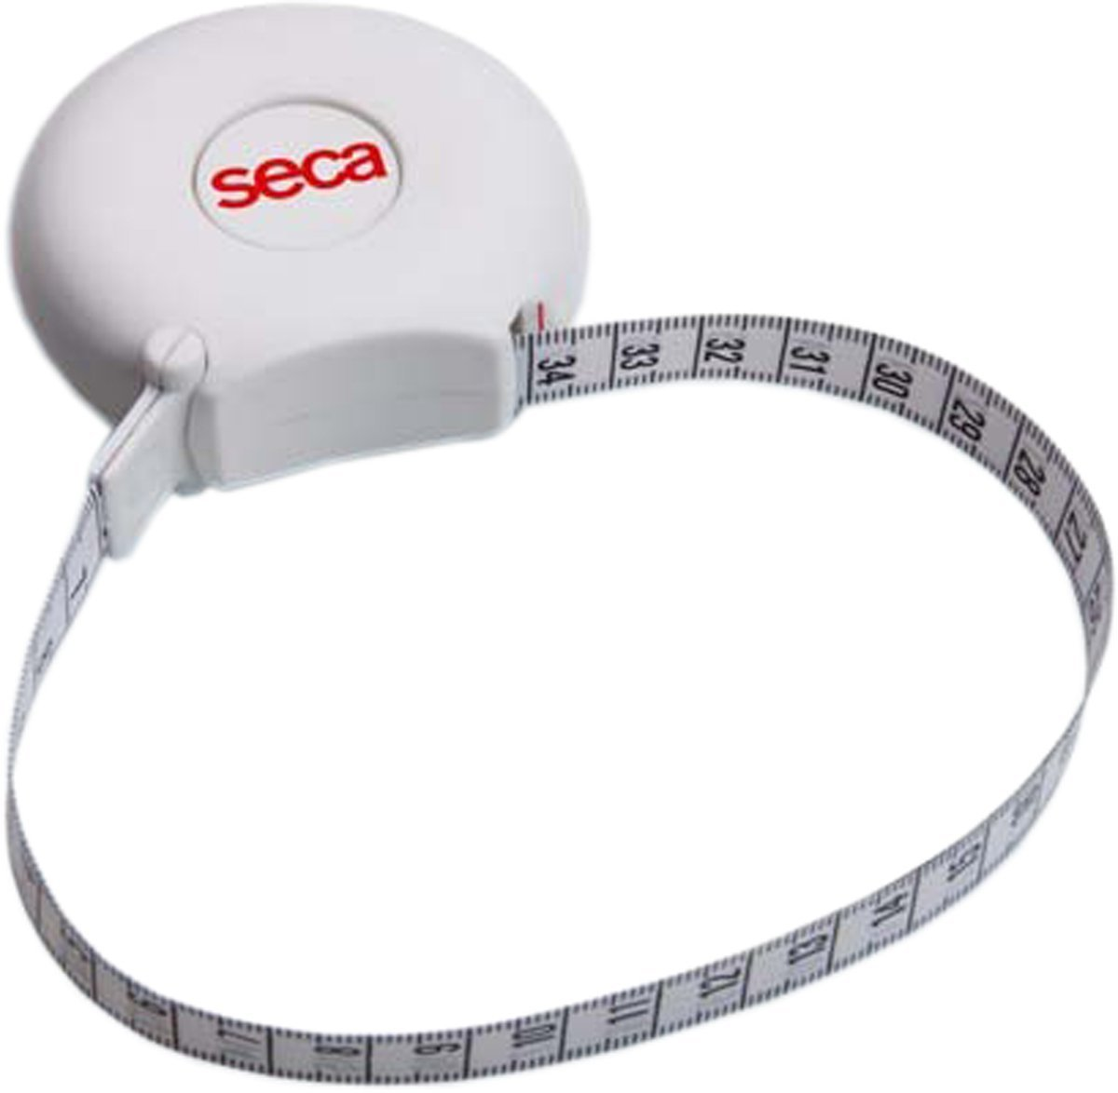
Waist Circumference Technique
5. Measurer passes tape around the
participant’s waist and clips ends
together.
6. Measurer centers tape over midpoint
marks on both sides of the participant’s body and makes sure it is not twisted.
7. Measurer pushes button on tape to tighten it and records the measurement.

Slide 21
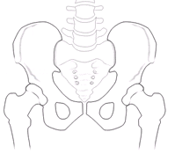
Hip Circumference
•Equipment:
– Measuring tape
•Materials:
–Anthropometry
Form
–Pen
Notes:
Show Stadiometer and related forms

Slide 22
Before measuring hip circumference
Find a private area
Participant removes shoes
Participant stands with feet touching and arms at sides
Measurement should be taken:
on top of light clothing (remove jackets or heavy outerwear)
on the widest point of buttocks

Slide 23
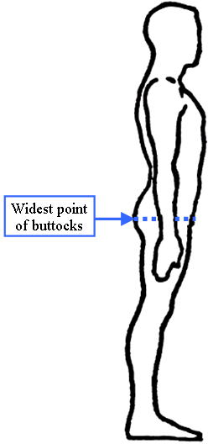
Hip Circumference Technique
Measurer passes tape around buttocks and clips ends together.
Measurer adjusts tape to sit at widest point of buttocks.
Measurer pushes button on tape to tighten it and records the measurement.

Slide 24
Notes for Hip & Waist Circumference Measurement
Tape should be snug & not twisted.
Read the tape on the number side.
Record measurement to the nearest mm on the anthropometry form.
Release tape and repeat the measure a second time to ensure accuracy and reliability of the measurement.

Slide 25
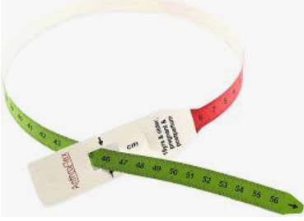
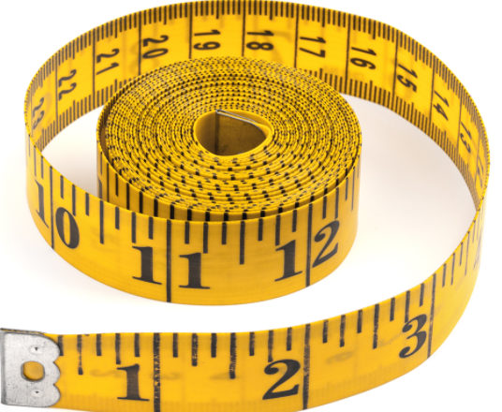
Mid-upper arm circumference
Equipment:
Colored measuring tape or SECA
tape or general measuring tape
Materials:
Anthropometry Form
Pen
Two people are needed to complete
the MUAC measurement.
Notes:
Show Stadiometer and related forms

Slide 26
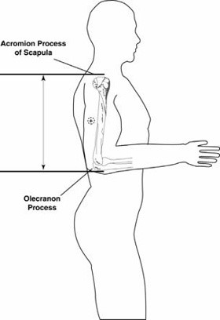
MUAC measurement
Locating the midpoint of upper arm:
The measurer locates the tip of the left shoulder with his/her finger tip.
The measurer bends the left arm at the elbow to make a right angle.
The measurer places the beginning of the tape (marked by zero) on the tip of the shoulder and holds the tape in place with his/her thumb.

Slide 27
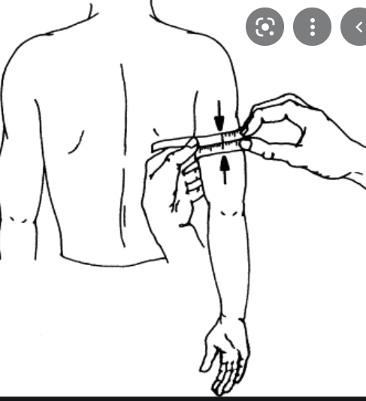
MUAC measurement
Locating the midpoint (continued):
4. The assistant pulls the tape straight down past the tip of the elbow.
5. The assistant reads the number at the tip of the elbow to the nearest cm.
6. The assistant divides the number by two, the result is the midpoint of the upper arm.
7. The assistant marks the midpoint with a pen on the arm.

Slide 28
MUAC measurement
8. The measurer pulls the tape around arm gently at the marked midpoint of the upper arm.
9. The measurer inserts the end of the tape through the opening hole (color tap with hole) for SECA or general tape just take it around of arm then pulls the tape at both ends to get a feel of the arm. Do not pull too tightly and do not have the tape too loose.
10. The assistant makes sure the tape is flat on the skin and parallel to the floor.
11.The assistant records the MUAC measurement to the nearest cm.
12. Repeat steps 1-11 for a second measurement.

Slide 29
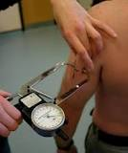
Triceps Skinfold Thickness
The triceps skinfold is necessary for calculating the upper arm muscle circumference.
- Its thickness gives information about the fat reserves of the body, whereas the calculated muscle mass gives information about the protein reserves.
-Skinfold measurement is a technique to estimate how much fat is on the body. It involves using a device called a caliper to lightly pinch the skin and underlying fat in several places. This quick and simple method of estimating body
fat requires a high level of skill to get
accurate results.
ANRCB | 29

Slide 30
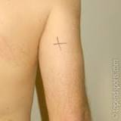
Triceps Skinfold Thickness
-At the level of the mid-point between the acromiale (lateral edge of the acromion process, e.g. bony tip of shoulder) and the radiale (proximal and lateral border of the radius bone, approximately the elbow joint), on the mid-line of the posterior (back) surface of the arm (over the triceps muscle).
ANRCB | 30

Slide 31
Section 3: Equipment Maintenance

Slide 32
Equipment Maintenance
Clean the equipment before and after use.
Ensure nothing is on the scale or stadiometer when storing or moving them.
In the field, put equipment on table or floor or carpet on floor.

Slide 33
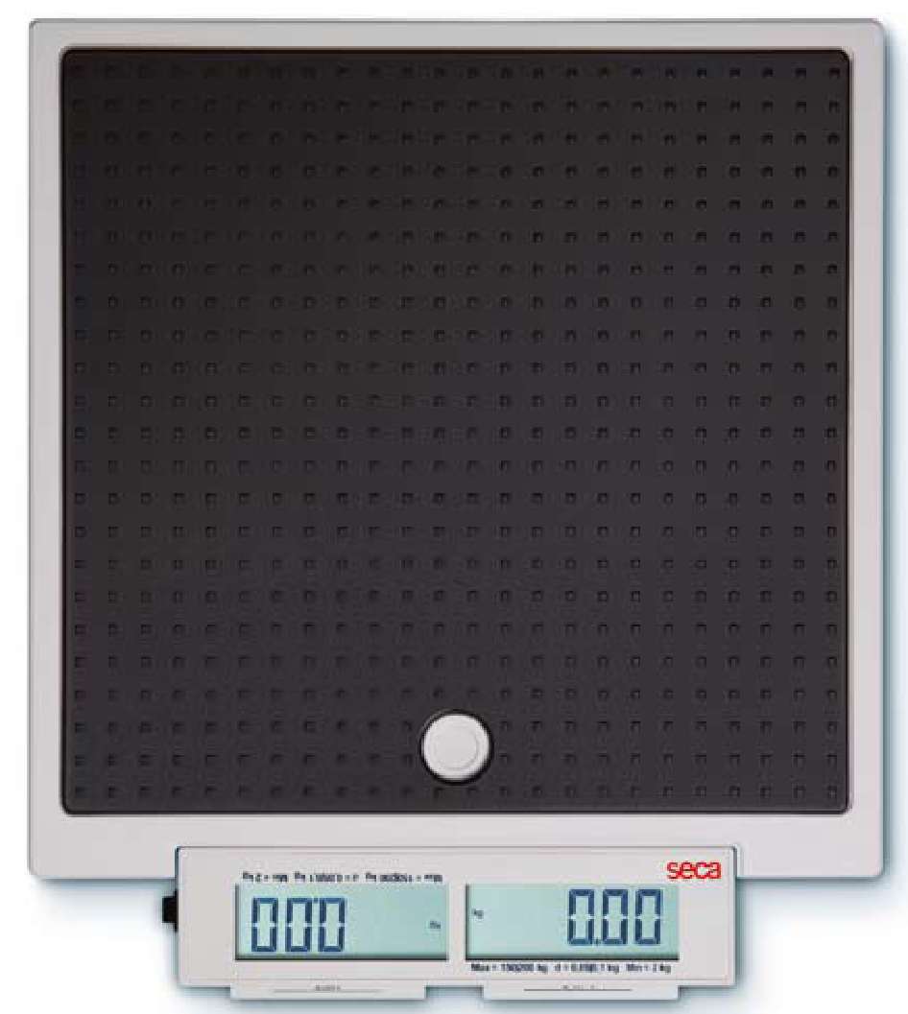
Scale calibration
When in use, calibrate the scales every morning and evening.
In the morning, choose 2 scales at random to be calibrated.
In the evening:
Calibrate all the scales before storing them.
Wipe down the scales and return to shelf.
Use Scale Calibration Log to note any errors/ breaks in the scales.

Slide 34
Scale calibration steps
Set scale on ground and turn it on.
Check that the scale reads 0.0 kg.
Put 10kg standardized weight on the scale.
Record 1st measurement in log.
Repeat for 2nd calibration measurement.
The 1st and 2nd measurement should be 10kg. If not, weigh the standardized weight a 3rd time.
Record the results.
Inform your supervisor if the measurements are more than 0.5kg different.

Slide 35
Measuring Tape Maintenance
Coil the tape carefully before storage or transport.
Report problems with tape to supervisor.

Slide 36
Section 4: Interpretation of anthropometric measurements

Slide 37
Common anthropometric indicators used in research setting
Body Mass Index (BMI)
Waist circumference
Waist to Hip Ratio (WHR)
MUAC

Slide 38
BMI & categories

Slide 39
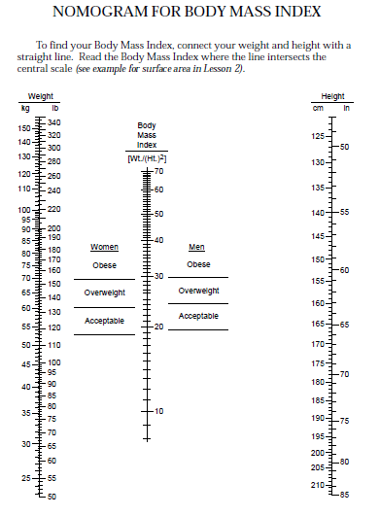
Example
Weight = 45 kg
Height = 125 cm
Result = Obese

Slide 40
Practice: BMI calculations
1. Calculate your BMI using the formula:
2. Estimate your BMI using the nomogram form.
3. Compare the two BMI values.

Slide 41
Weight gain during pregnancy by BMI categories
Before pregnancy |  | Total first trimester weight gain | 2nd and 3rd trimester weight gain per week | Total pregnancy weight gain
BMI | Weight status
<18.5 | Underweight | 1-3 kg | 0.44-0.58 kg | 12.5-18 kg
18.5-24.9 | Normal weight | 1-3 kg | 0.35-0.5 kg | 11.5-16 kg
25-29.9 | Overweight | 1-3 kg | 0.23-0.33 kg | 7-11.5 kg
>30 | Obese | 0.2-2 kg | 0.17-0.27 kg | 5-9 kg

Slide 42
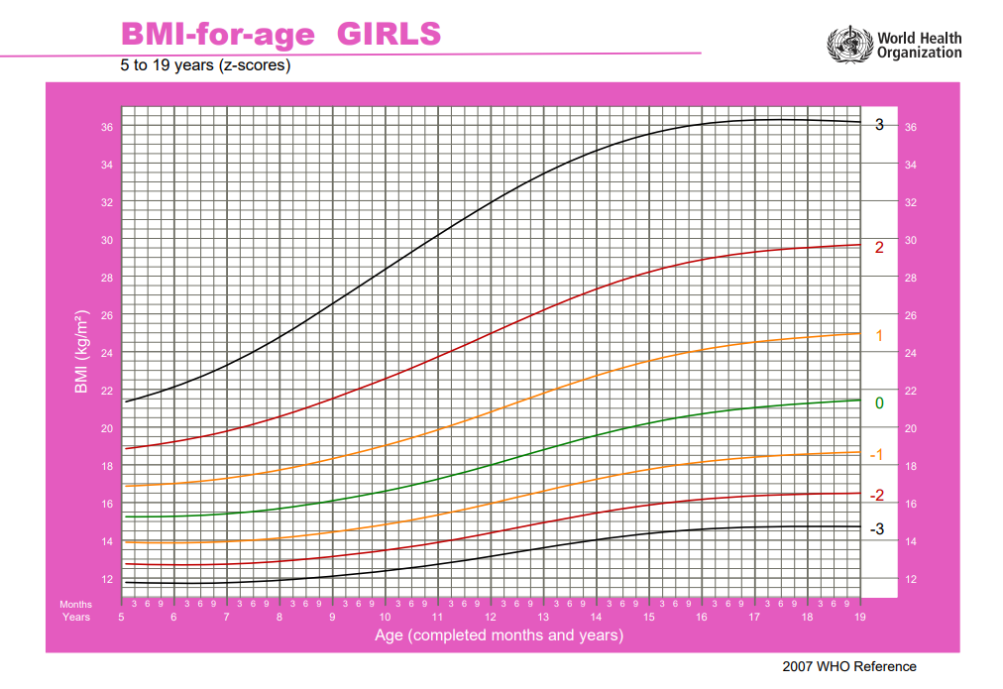
Girl 8 Years BMI 21 Overweight

Slide 43
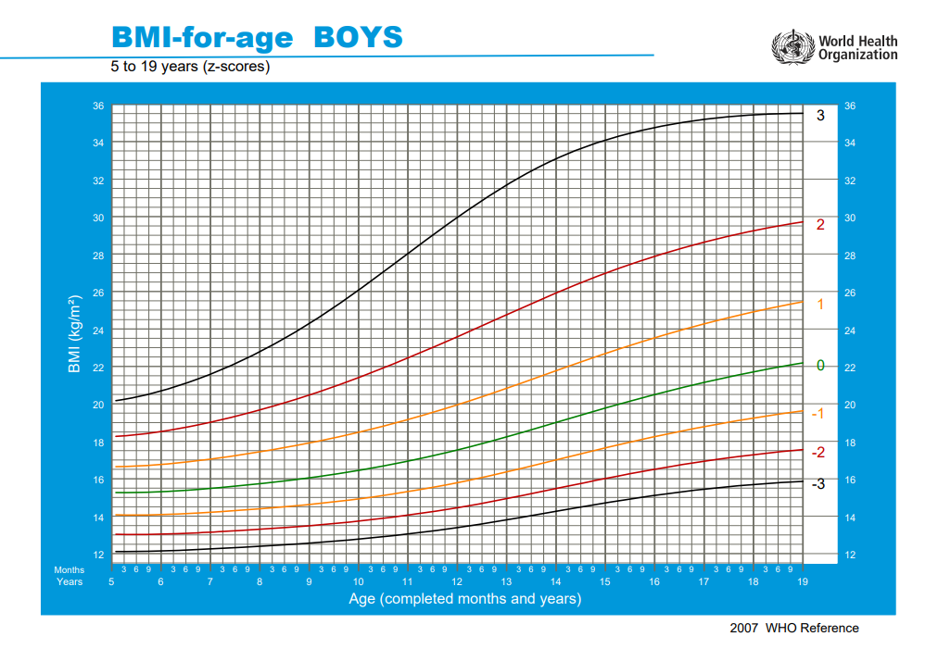
Boy 7 Years
BMI 22
Obese

Slide 44
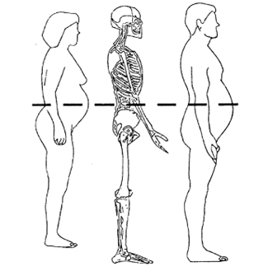
Waist circumference
Substitute technique for more sophisticated assessment of % of body fat.
Waist circumference above a given level indicates greater risk of cardiovascular disease:
>88 cm in women
>102 cm in men

Slide 45
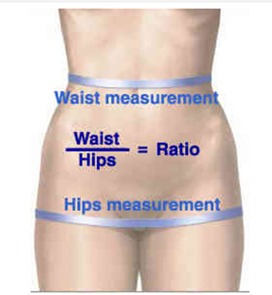
Waist-to-Hip Ratio (WHR)
Waist circumference: narrowest part of waist
Hip circumference: widest area of hips
WHR: Divide waist measurement by hip measurement

Slide 46
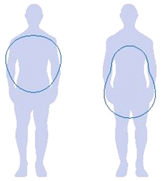
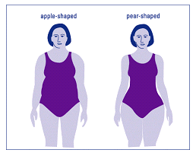
Waist-to-Hip Ratio (WHR)
Reflects fat distribution in body:
Apple shape or Pear shape
Useful to determine where fats is distributed
Fat distribution is associated with disease risk (cardiovascular disease, hypertension, diabetes…)

Slide 47
Association of WHR with Non-communicable disease (NCD)
WHR >0.90 in men and >0.85 in women are associated with higher likelihood of all-cause and cardiovascular disease mortality
Apple-shape (waist circumference> hip circumference) is associated with higher risk of NCDs since the fat is distributed around the vital organs like the liver.

Slide 48
MUAC classification for adults
MUAC (cm) | Nutritional status
>23 | Normal
21-23 | Minor undernutrition
17-21 18-21 (with recent weight loss) | Moderate undernutrition
<17 <18 (with recent weight loss) | Severe undernutrition
These MUAC cutoffs are applicable for adults including pregnant women.

Slide 49
MUAC classifications for children
 | Nutritional status
Targets | SAM | MAM | Normal
5-9 years | <135mm | ≥135-145mm | ≥145mm
10-14 years | <160mm | ≥160-185 mm | ≥185

Slide 50
Triceps skinfold thickness
Ability | Gender | Good
Normal | Male | 81-90 mm
Normal | Female | 91-100 mm
Athletic | Male | 61-80 mm
Athletic | Female | 71-85 mm
https://www.ptdirect.com/training-delivery/client-assessment/taking-skin-fold-body-fat-measurements
ANRCB | 50

Slide 51
Section 5: Importance of anthropometric measurements in research context

Slide 52
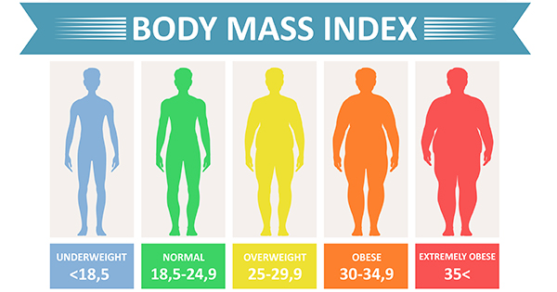
Anthropometric indicators and obesity
Indicators such as BMI, waist circumference, and waist-to-hip ratio, help assess risk of obesity and related complications including NCDs.
BMI can be used to define obesity categories
Reference: Waist Circumference and Waist–Hip Ratio: Report of a WHO Expert Consultation Geneva, 8–11 December 2008

Slide 53
Anthropometric indicators and obesity
2. Waist circumference and BMI together can help determine the risk of NCDs:
Reference: Waist Circumference and Waist–Hip Ratio: Report of a WHO Expert Consultation Geneva, 8–11 December 2008

Slide 54
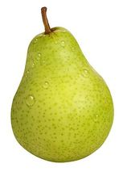
Anthropometric indicators and obesity
3. Waist to hip ratio can also help assess the risk of NCDs:
A high number indicates increased risk of ill-health from diabetes and cardiovascular disease.
WHR | Shape | Risk level
Females: <0.85 Males: <0.90 | Pear | Low risk
Females: >0.85 Males: >0.90 | Apple | High risk

Slide 55
CVD associated with Obesity
Obesity is associated with increased risk of morbidity and mortality.
The main cause of obesity‐related deaths is CVD.
Abdominal obesity or apple shape is associated with a range of metabolic abnormalities: decreased glucose tolerance, reduced insulin sensitivity and adverse lipid profiles, which are risk factors for type 2 diabetes and CVD.
Reference: Waist Circumference and Waist–Hip Ratio: Report of a WHO Expert Consultation Geneva, 8–11 December 2008
Notes:
BMI has been the chosen indicator to measure body size and composition, and to diagnose underweight and overweight.
Waist circumference, waist–hip ratio and waist– height ratio as being superior to BMI in predicting CVD risk.

Slide 56
Cancers Associated with Obesity
In female
In male
Breast (menopause)
Endometrium
Cervical
Ovarian
Colorectal and anus
Kidney
Liver/ Gallbladder
Pancreatic
Esophageal
Hematopoietic
Prostate
Colorectal and anus
Kidney
Liver/Gallbladder
Pancreatic
Esophageal
Hematopoietic

Slide 57
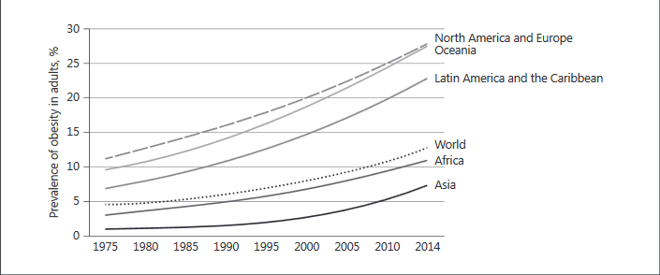
Increasing rates of obesity worldwide
Prentice AM Annal Nutr Metab 2018

Slide 58
Obesity prevalence among adults in Lao PDR
Obesity is a public health problem in Lao PDR:
High prevalence rates of obesity
Females: 6.7% between 1997 and 2016
Males: 3.7% between 1997 and 2016
Increasing prevalence of obesity
Females: from 2% to 6.7% rising at an annual rate that reached a maximum of 9.52% in 1999
Males: from 0.7% to 3.7% rising at an annual rate that reached a maximum of 20.0% in 2003
Pengpid, S., Vonglokham, M., Kounnavong, S. et al. The prevalence of underweight and overweight/obesity and its correlates among adults in Laos: a cross-sectional national population-based survey, 2013. Eat Weight Disord 25, 265–273 (2020). https://doi.org/10.1007/s40519-018-0571-5

Slide 59
Section 6: Practice your skills

Slide 60
Practice
Do the following measurements twice in each person:
weight and height
waist and hip circumference
MUAC
Complete the Anthropometry form for each person
Calculate BMI and WHR

Slide 61
Thank You

