Slide 1
Module 4
Surrogate Anthropometric Measurements for Clinical Use
Training developed by Dr. Michele R. Forman, Dr. Ratthiphone Oula, Dr. Rana Chehab
Training by Applied Nutrition Research Capacity Building (ANRCB), a project of the Lao American Nutrition Initiative (LANI)
This work is made possible through support from USAID as a supplement to a USAID Cooperative Agreement #7200AA18CA00009 (LASER-PULSE) to Purdue University. Contents reflect the views of the author(s) and do not necessarily reflect those of USAID.
For more information, please contact Catholic Relief Services Laos.

Slide 2
Outline
Section 1: Introduction
Section 2: Surrogate Measures of Body Size
Section 3: Interpretation of measurements
Section 4: Equipment Maintenance
Section 5: Practice your skills
ANRCB | 2

Slide 3
Section 1: Introduction
ANRCB | 3

Slide 4
Target audience for this training
This module is used for training individuals who:
have already completed Modules 2 and 3 for children and adults.
want to understand anthropometric measures used in special circumstances such as clinical settings when standard measures are not available.

Slide 5
NOTE
Surrogate anthropometric measurements should not be used in place of standard measures when standard measures are feasible. Surrogate measures are less accurate than standard measures.
ANRCB | 5

Slide 6
Examples of surrogate anthropometric measurements
Arm span
Ulnar length and width
Lower leg length
ANRCB | 6
Notes:
Necessary equipment/ tools for measuring ulnar length and width: Ulnar length and width
Calipers
Graph/grid
Ruler
Lower leg

Slide 7
Surrogate anthropometric measures to be used in special circumstances
When it is difficult or expensive to measure the primary outcome.
Among specific populations such as elderly, individuals with physical disability
In clinical studies among patients for nutrition assessment and improvement.
ANRCB | 7

Slide 8
Why use surrogate anthropometric measures?
Serve as proxy to measure body size among specific populations (ex: elderly, individuals with physical disability, in hospital patients)
Allows for nutrition assessment among these populations who otherwise cannot be assessed
Accurate serial anthropometric measurements can help identify underlying nutritional problems in children.
ANRCB | 8

Slide 9
Section 2:
Surrogate Anthropometric Measurements
ANRCB | 9

Slide 10
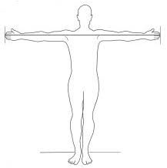
Arm Span
Measures distance between the middle fingertips on each hand when arms are stretched out.
Simple, low cost, quick
Important measure for the assessment of growth and hormone deficiency diseases.
Arm span is on average equal to an individual’s height.
ANRCB | 10
Notes:
If the arm span is less than height then a chondrodystrophy may be limiting bone growth. If the arms plan is longer than height then abnormalities of spinal growth may be a possibility.
In an epidemiological survey, with a large number of subjects, especially valuable to establish methods which can measure both quickly and accurately.

Slide 11
Arm Span for children
Equipment:
Tape measure
Sheet to put on the floor
ANRCB | 11

Slide 12
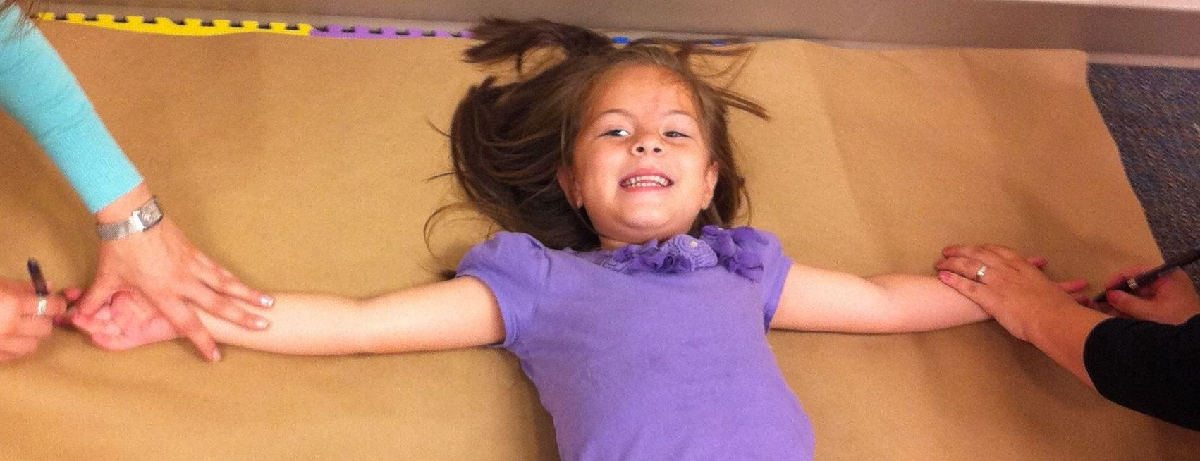
Arm span-Procedure
Measurer places his/her hand on the back of the child and gently helps the child to lay down.
The recorder centers the child in the middle of the sheet for the measurement.
Child does ‘wings’ out.
Measurer and recorder stand on opposite sides of the child (left and right) and extend the child’s elbows.
ANRCB | 12

Slide 13
Arm span- procedure
5. Make sure the palms of hands are up, and middle finger of hand is extended to the maximum.
6. Measurer and recorder mark sheet at the end of the middle finger of each hand on the opposite sides.
7. Child stands up.
8. Measurer measures the distance between the two points marked on the sheet with the tape.
9. Repeat the steps for a second measurement.
ANRCB | 13

Slide 14
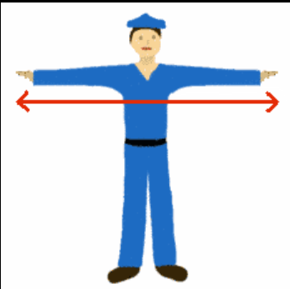
Arm span for adults-Procedure
Adult stands with his/her back and buttocks touching the wall and the arms stretched out horizontally.
Recorder holds the tape at the first furthermost finger tip.
Measurer stretches the tape and holds it at the furthermost finger tip of the second hand.
Note the measurement between the two furthermost finger tips.
ANRCB | 14

Slide 15
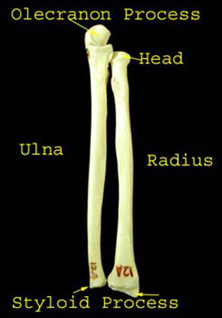
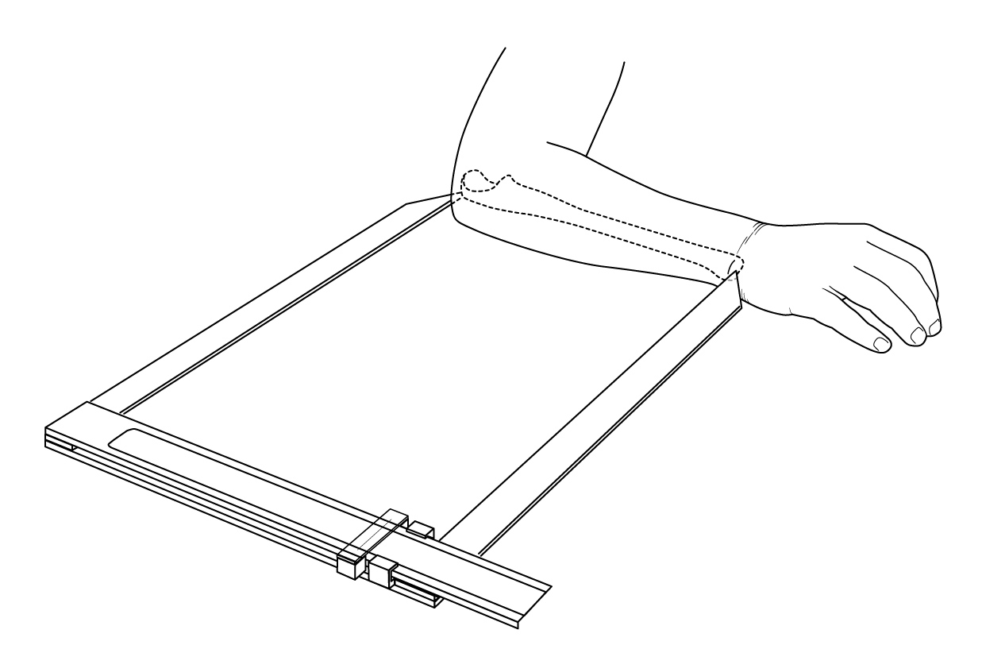
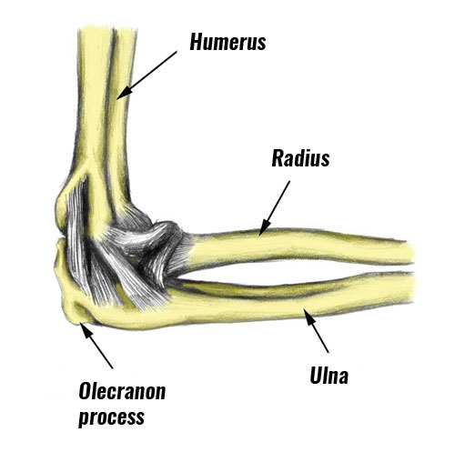
Ulnar length
The measure of the ulna between the olecranon and styloid processes
Measure between the point of the elbow and the midpoint of the prominent bone of the wrist (left side if possible)
Can be used to estimate length/ height of children
ANRCB | 15

Slide 16
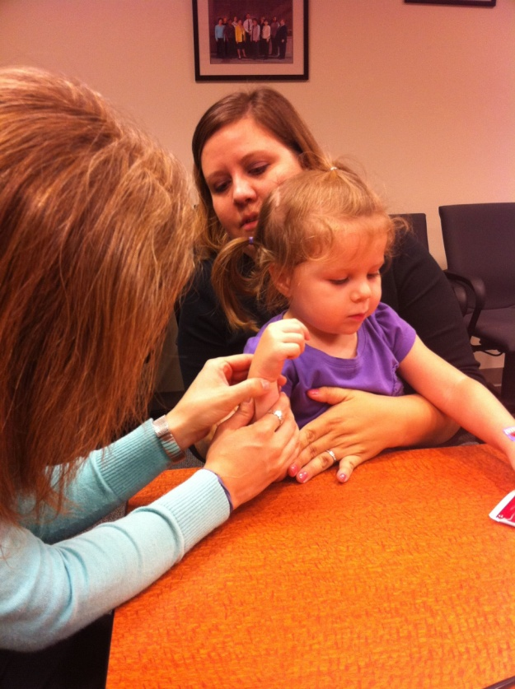
Ulnar length- Procedure
If measuring ulnar length among children, the child must sit in the mother’s lap or lie down.
If measuring the ulnar length of adults, the adult should be sitting down on a chair.
ANRCB | 16

Slide 17
Ulnar length- Procedure
The measurer locates the Styloid process:
Flex right elbow approximately 90◦ and position comfortably alongside the body, pointing upwards in the vertical direction. (Ex: If the elbow is touching the table, the arm points upward).
Wrist should be straight (unbent) and the hand should be in the same axis as the forearm. Fingers should be slightly bent with the extended thumb pointing to the right shoulder (hitch-hiker position).
ANRCB | 17

Slide 18
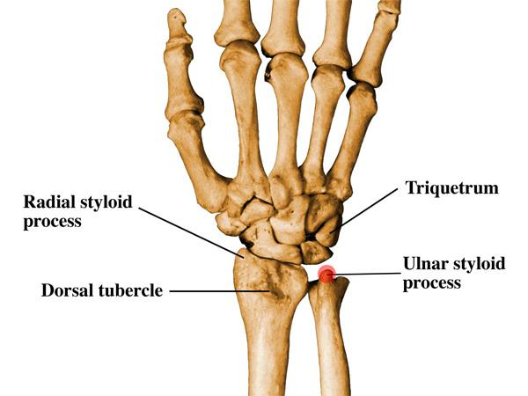
Ulnar length- Procedure
The measurer locates the Styloid process (continued):
Palpate and locate the distal end of the ulna (a.k.a. Styloid process).
Ask the individual to bend and straighten his/her wrist to help confirm the location of the Styloid process.
The measurer marks a line of
about 1 cm at the Styloid process.
ANRCB | 18

Slide 19
Ulnar length- Procedure
2. Locate the Olecranon process.
Flex right elbow approximately 90◦ and position comfortably alongside the body, in the horizontal direction.
Palpate and locate where the tissue meets the bone above the elbow. There should be a slight indentation in the center, with two prominent points on either side.
The measurer marks a line at the Olecranon process.
ANRCB | 19

Slide 20
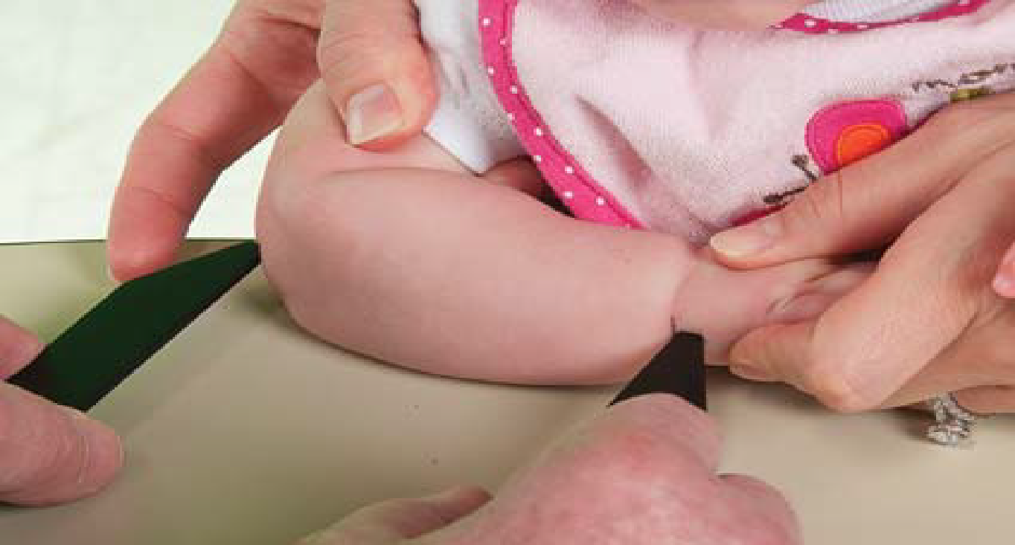
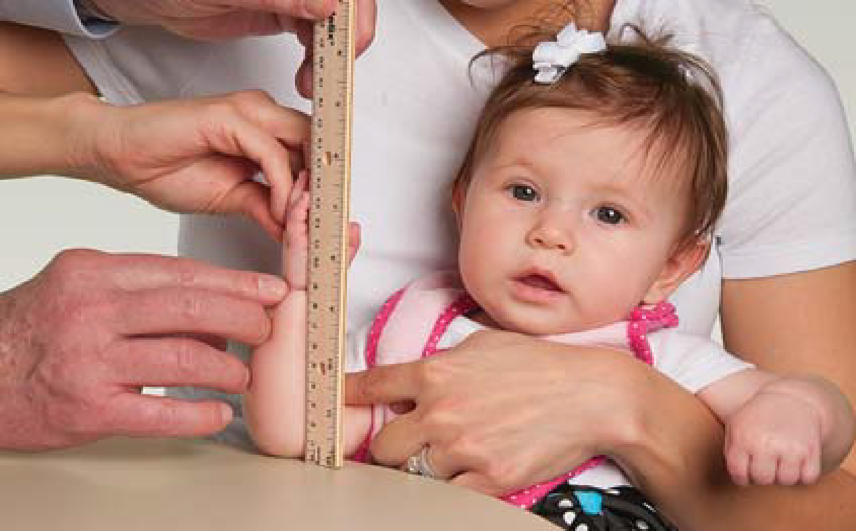
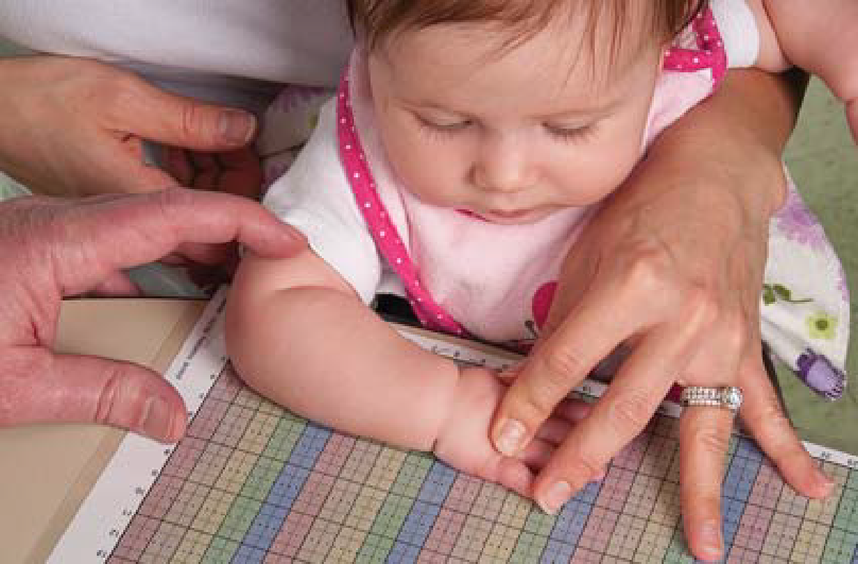
Ulnar length- Procedure
3. After locating the Styloid and Olecranon processes, the distance between them can be measured (reflecting the ulnar length) using:
Caliper
Ruler
Grid
ANRCB | 20

Slide 21
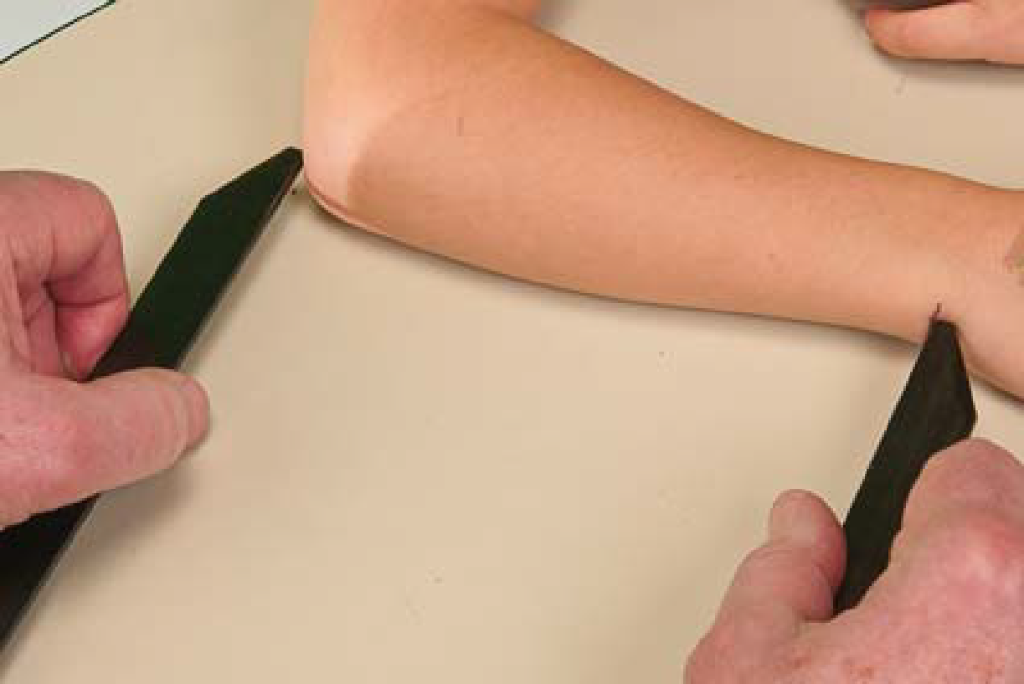
Ulnar Length using Caliper
Flex the individuals’s elbow at 90 degrees
Position calipers carefully at the 2 marked points of the Styloid and Olecranon processes.
Make sure calipers are parallel with arm.
Have recorder check that the caliper is parallel.
Measure the distance using the caliper between the 2 marked points.
ANRCB | 21

Slide 22
Ulnar Length using Ruler
Hold the individual’s forearm in a perfectly vertical position perpendicular to the ground.
Thumb points at right shoulder
Hold the ruler parallel to the individual’s arm
Measure the distance using the ruler between the 2 marked points of the Styloid and Olecranon processes.
ANRCB | 22

Slide 23
Ulnar Length using Grid/ Paper
Forearm across body, axis parallel with grid
Palm down
Set the point of the olecranon process at zero on the grid
Mark the point of the Styloid process on the grid
Measure the distance between the 2 points of the Styloid and Olecranon processes marked on the grid.
ANRCB | 23
Notes:
On paper, mark 4x - Both ends of ulna and both edges of forearm at maximal width Label the set of markings 1 thru 4 Compute the calculations before child leaves just in case you might need to repeat measurement.

Slide 24
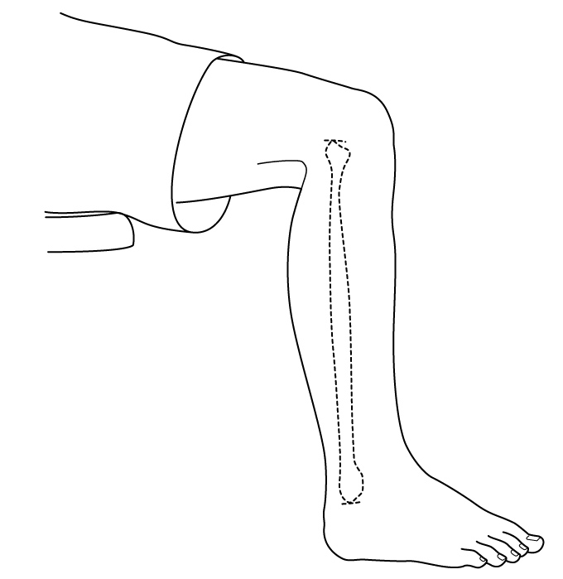
Measurements Lower Leg Length
Measure from base of heel to top of knee
Knee & ankle bent 90 degrees, heel on floor, or suspended for calipers
Flex hip to allow knee to bend when heel is suspended)
ANRCB | 24

Slide 25
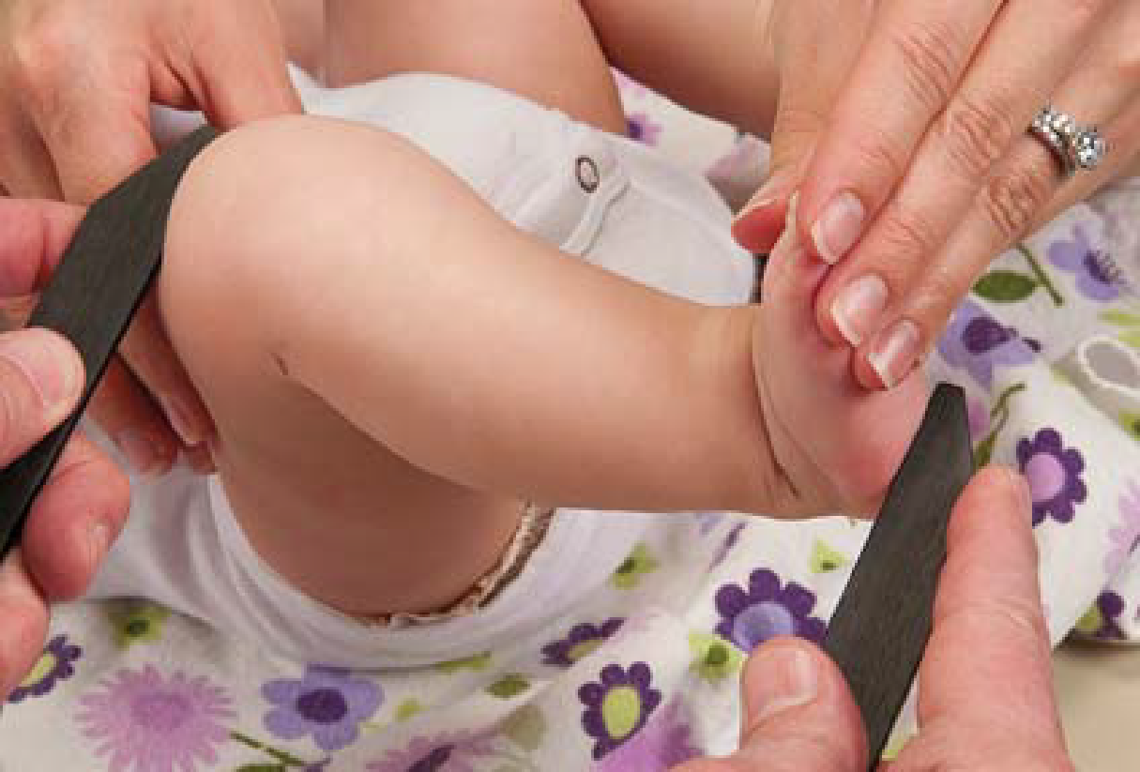
Lower leg length using Caliper
Bend the knee and ankle 90 degrees
Bend the foot at 90 degrees
The two sides of the caliper should be on the knee and the foot.
Make sure calipers are parallel with foot. Have recorder check that they are parallel.
Record measurement on the caliper.
ANRCB | 25

Slide 26
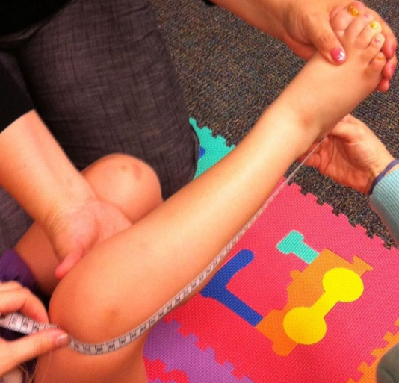
Lower leg length using Tape
Place the “zero” end of tape at middle/ base of the heel
Estimate the top of the bent knee visually
Place the other end of the tape of the top of the knee
Record measurement using the tape.
Note that calf causes tape bowing
ANRCB | 26

Slide 27
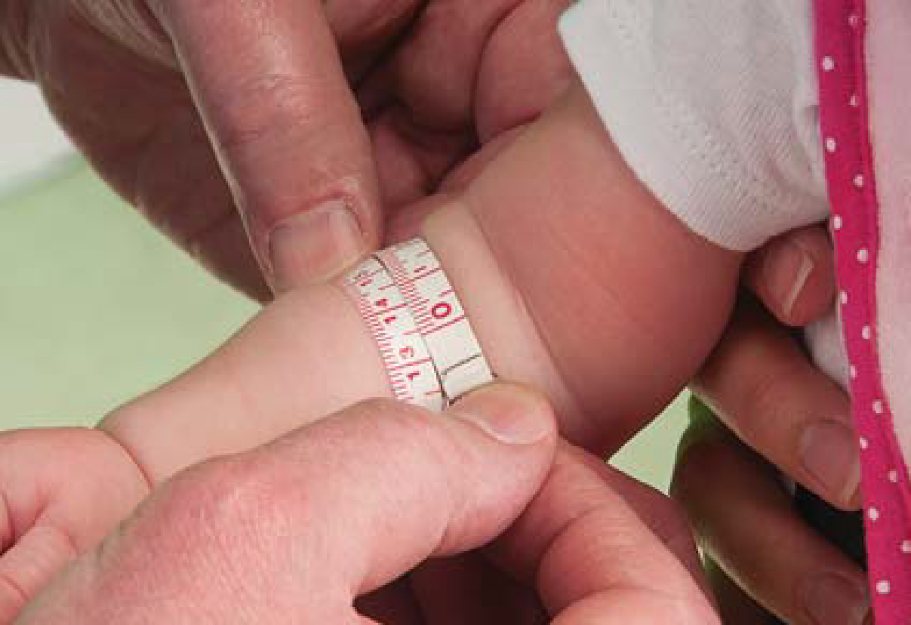
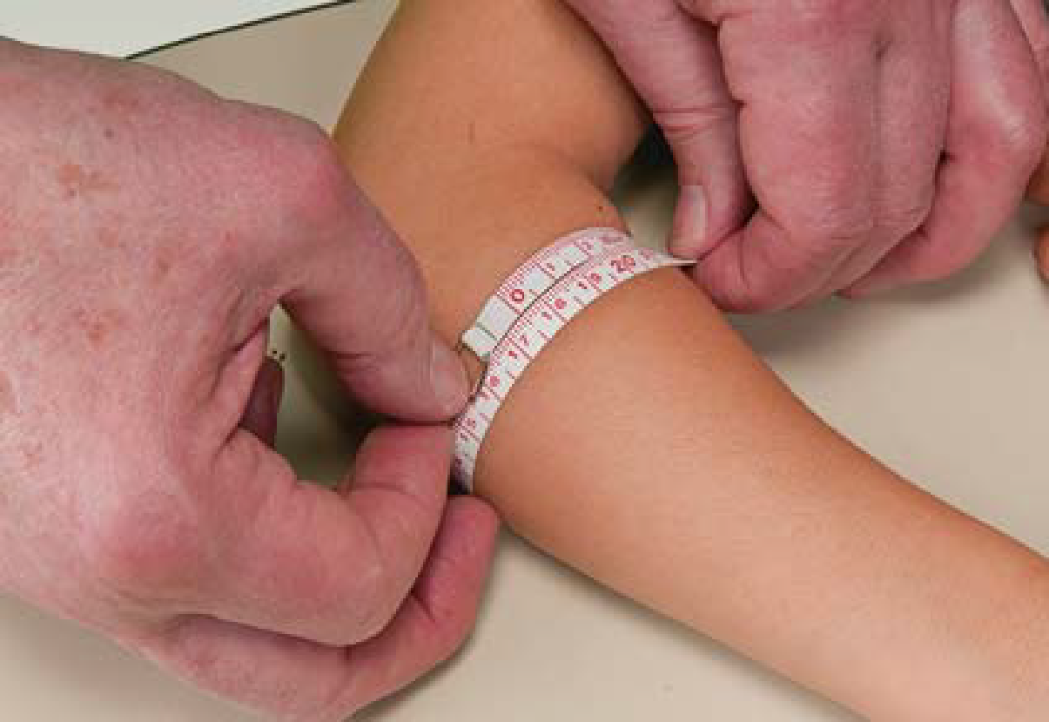
Forearm Circumference using tape
Forearm Circumference: Tape Measurement Upper Figure
Forearm Outward- Elbow Open and Arm Suspended
Good Method
Forearm Circumference: Tape Measurement Lower Figure
Forearm Across Body- Elbow Bent 90 degrees and arm resting on table
ANRCB | 27

Slide 28
Forearm Width using Grid
Other Surrogate Total Body Weight
Forearm Outward
Arm straightened and pointing outward from body
Palm down
Angle across grid
Mark the maximal width of the forearm on grid
Label the points
ANRCB | 28

Slide 29
Tips
Repeat each measurement twice to ensure accuracy and reliability of the measurements

Slide 30
Section 3:
Interpretation of measurements
ANRCB | 30

Slide 31
Arm span vs height
The arm span measurement can be compared to the person's height. On average, arm span is approximately equal to height.
ANRCB | 31

Slide 32
Ulnar length vs height
Variables | Males(n=50) | Females(n=50)
Mean height,cm | 171 ± 8.05 | 157 ± 8.22
Height range,cm | 159-187 | 145-169
Mean ulnar length, cm | 27.40 ± 2.13 | 24.70 ±1.43
Ulnar length range ,cm | 24-31 | 23-27
Reference: Estimation of Body Stature Using the Percutaneous Length of Ulna of an Individual
ANRCB | 32
Notes:
Height can then be used to assess nutritional status as discussed in Module 2.

Slide 33
Lower Leg Length for adults
Sienkiewicz-Sizer (1997) has developed special formulas for the elderly:
Men: length = (2.02 x LLL) – (0.04 x age) + 64.19.
Woman: length = (1.83 x LLL) – (0.24 x age) + 84.88.
https://nutritionalassessment.mumc.nl/en/lower-leg-length-measurement
ANRCB | 33

Slide 34
Average of low length
 | MINUS (short) | STANDARD (normal)
Inside leg length | 75 cm | 81 cm
Length with large hem | 80 cm | 86 cm
https://www.dassy.eu/pt/About_us/News/the-right-inside-leg-length/

Slide 35
Interpretation of height measurements
After height is estimated using the surrogate measurements, height can then be used to assess nutritional status as discussed previously in Module 2:
growth charts for children
calculating BMI for adults

Slide 36
Section 4:
Equipment Maintenance
ANRCB | 36

Slide 37
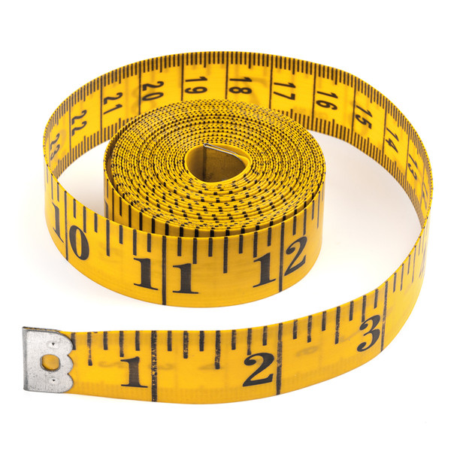
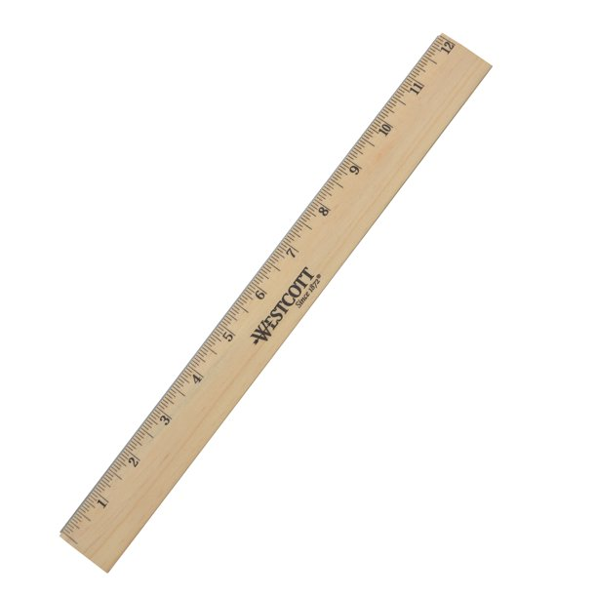
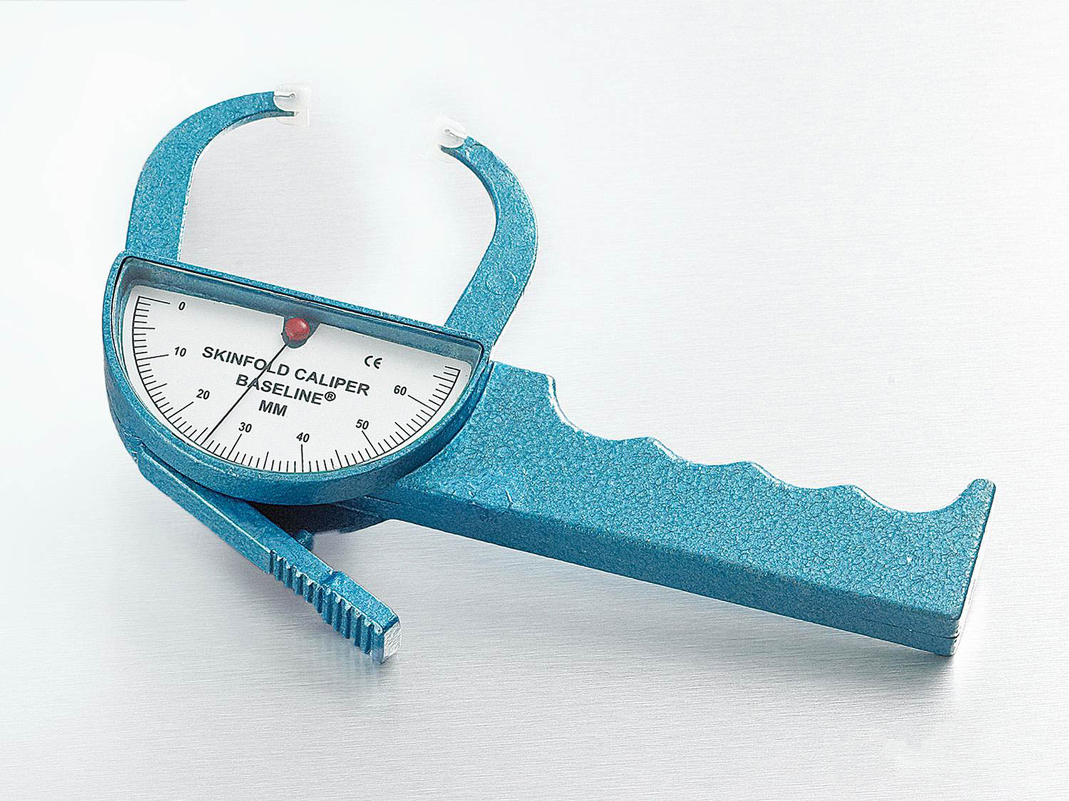
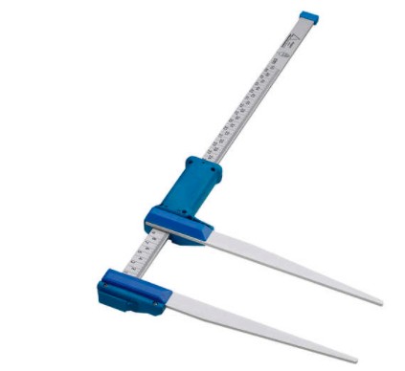
List of Equipment
Tape
Ruler
Grid
Caliper
Skinfold thickness caliper

Slide 38
Equipment Maintenance
Check that the equipment is ready to use before measurement.
Clean the equipment before and after use.
Ensure nothing is on the equipment when storing or moving them.
In the field, put equipment on table or floor or carpet on floor avoid from water and tear.

Slide 39
Section 5:
Practice your skills by working in pairs for measurement, record on form and interpret results.
ANRCB | 39

Slide 40
Summary slide
Surrogate measures are less accurate and should NOT be used in place of standard measures when standard measures are feasible.
Surrogate measures should be only used in special populations like elderly, individuals with disabilities, and in hospital patients.
Examples of surrogate measures include: arm span, ulnar length, and lower leg length.
These measures can be used to estimate height which in turn is used to assess nutritional status of individuals.

Slide 41
Note
This is an introductory training to surrogate measurements. Individuals who will be working with special populations requiring use of surrogate anthropometric measurements should seek further information and training.

Slide 42
Thank You

