Slide 1
Advanced Anthropometry_ENGLISH Master VERSION HISTORY
DATE | AUTHOR | DESCRIPTION OF CHANGES
April 4, 2021 | Team | Michele shared slides

Slide 2
Advanced Training Michele R. Forman 05/12/2021

Slide 3
Overview
Arm span
Surrogate measures of body size:
Ulnar length and width
Calipers
Graph/grid
Ruler
Lower leg
Triceps skinfolds

Slide 4
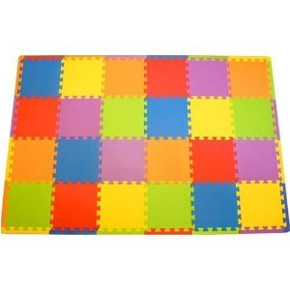
Arm Span
Tape measure, ‘how you grow’ flexible plastic sheet, or floor mat to place on floor or bed
Measurer & recorder

Slide 5
Procedure
Gently have child lay down with hand of recorder behind the back to center the child for measurement
Child does ‘wings’ out
Recorder and measurer extend the elbows, the palms of hands are up, and middle digit of hand to the maximum
Say elbows, palms, middle digit together to help synchronize

Slide 6
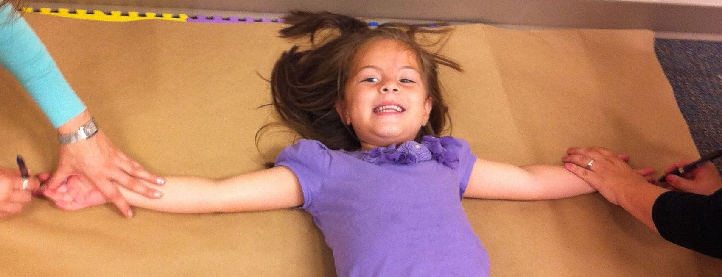
Procedure
Mark paper at the end of the middle finger of each hand
Measure the distance between the two points with the tape measure
Child does not have to retain position now.
Repeat measurement.

Slide 7
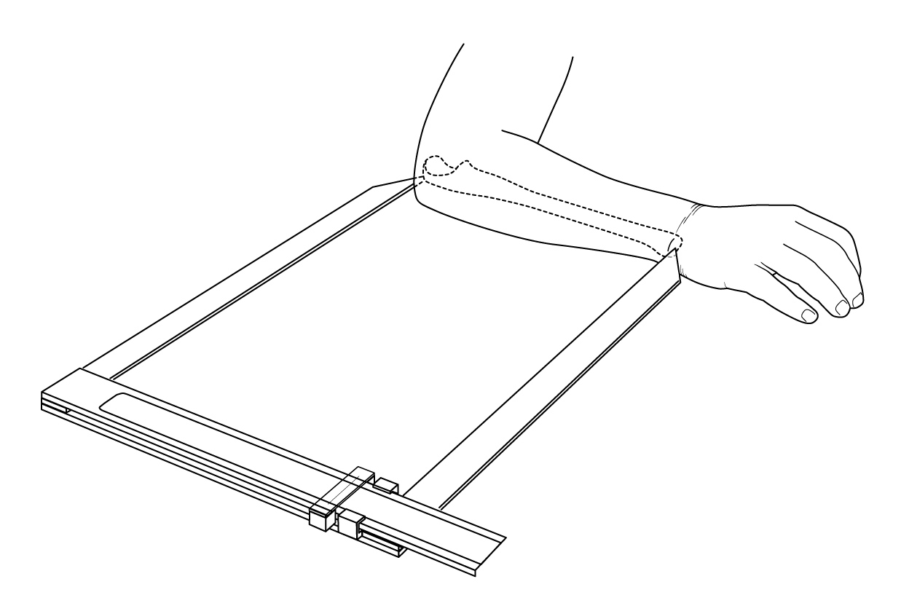
Surrogate Measures of Body Size
“Gold Standard” Method
Caliper Length Measurement
Ulna

Slide 8
Ulnar Length: Palpation and Marking
Ask the participant to sit in the mother’s lap or to lie down.
Styloid Process: Flex right elbow approximately 90◦ and position comfortably alongside the body, pointing upwards in the vertical direction. (Ex: If the elbow is touching the table, the arm points upward).
Wrist should be straight (unbent) and the hand should be in the same axis as the forearm. Fingers should be slightly bent with the extended thumb pointing to the right shoulder (hitch-hiker position).
Palpate and mark a line of about 1cm at the distal end of the ulna (a.k.a. Styloid process).

Slide 9
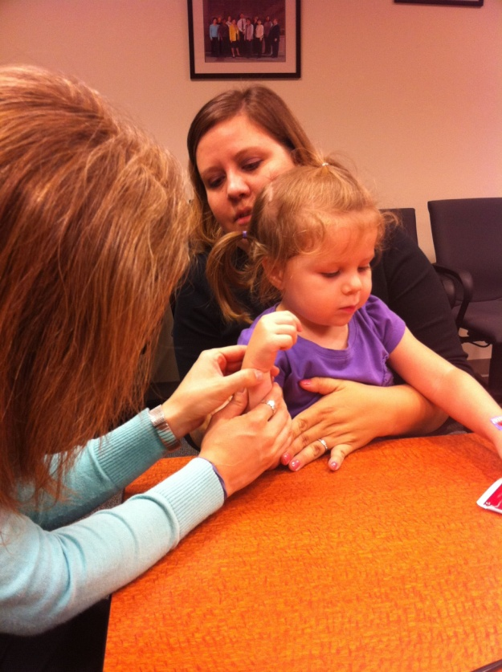
Ulnar Length: Palpation and Marking
Note: You can ask the child to bend and straighten his/her wrist to help locate the Styloid process, however it should be straightened when marking.
Olecranon: Flex right elbow approximately 90◦ and position comfortably alongside the body, in the horizontal direction.
Palpate and locate where the tissue meets the bone above the elbow. There should be a slight indentation in the center, with two prominent points on either side.

Slide 10
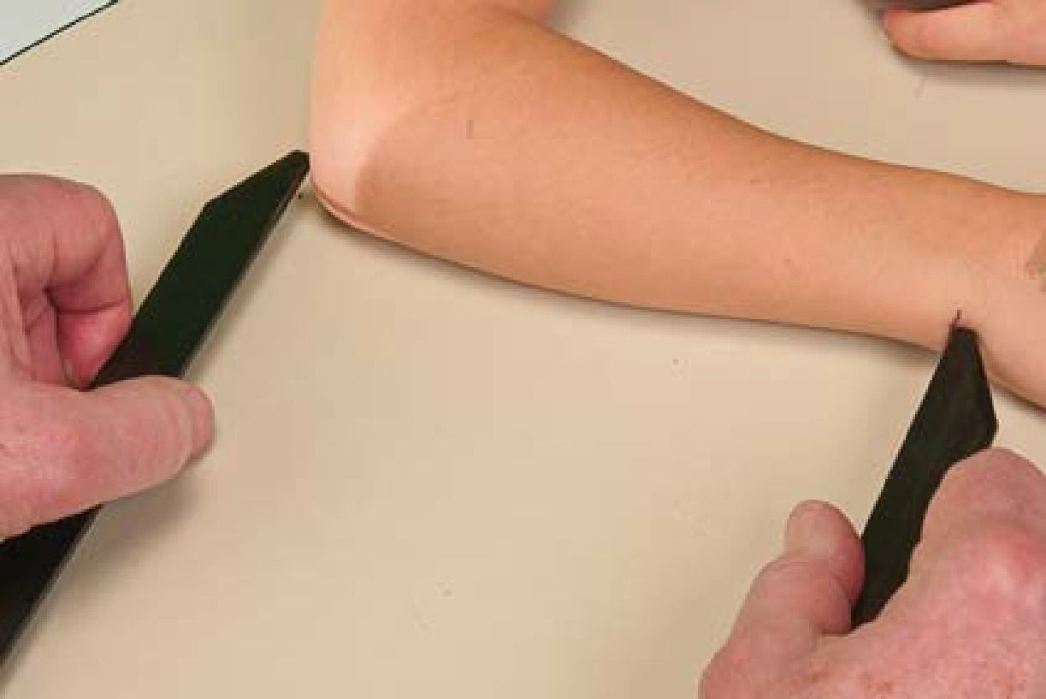
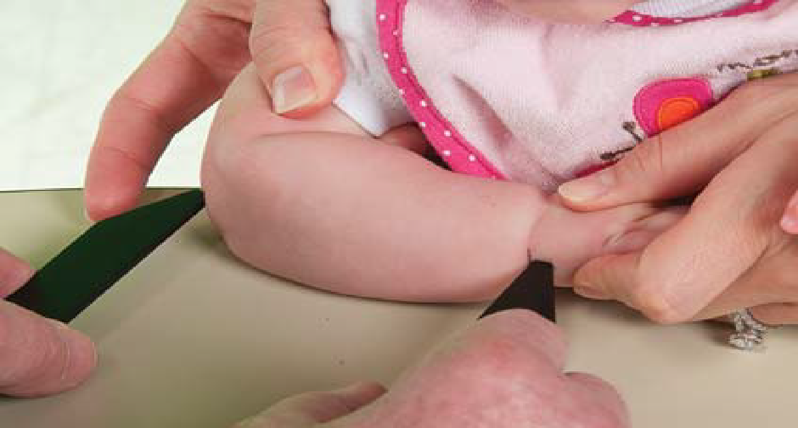
Surrogate Measures of Body Size
“Gold Standard” Length Measurement
Ulna length: Caliper
Flex elbow 90 degrees
Place left caliper arm at left-most END of olecranon (NOT AT ELBOW TIP)
Keep left hand touching caliper arm to end of olecranon
Touch right caliper arm to ink mark at distal ulna and read measurement
Make sure calipers are parallel with arm. Have recorder check that they are parallel.

Slide 11
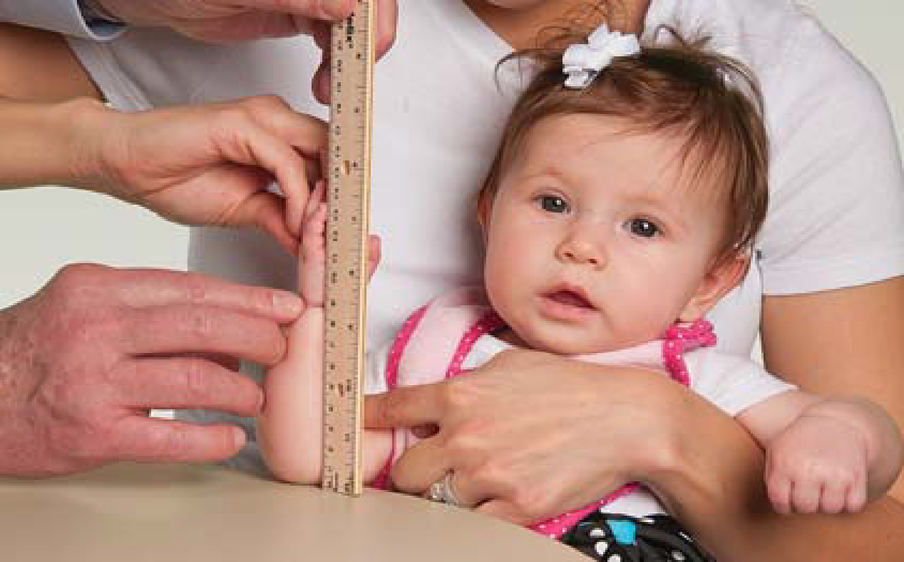
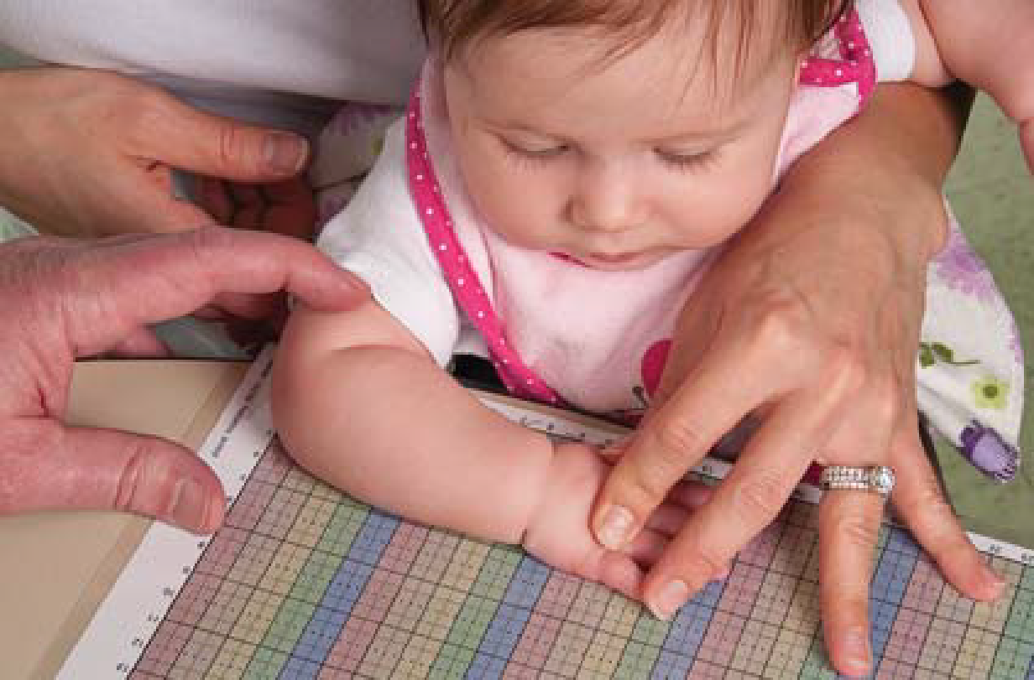
Surrogate Measures of Body Size
Ulna length: Ruler Measurement
Ulna /Forearm is perfectly vertical
Thumb points at right shoulder
Ulna length: Grid /Paper Measurement
Forearm across body, axis parallel w grid
Palm down
(Careful in setting olecranon at zero)
On paper, mark 4x - Both ends of ulna and
both edges of forearm at maximal width
Label the set of markings 1 thru 4
Compute the calculations before child leaves just in case you might need to repeat measurement

Slide 12
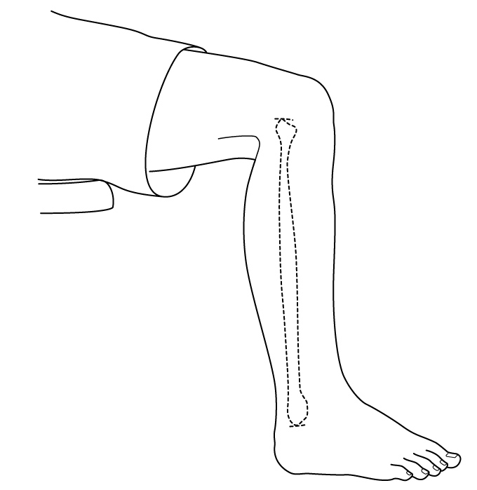
Surrogate Measures of Body Size
Lower Leg Length Measurements
Lower Leg Length
Measure from base of heel to top of knee
Knee & ankle bent 90 degrees, heel on floor, or suspended for calipers
Flex hip to allow knee to bend when heel is suspended)

Slide 13
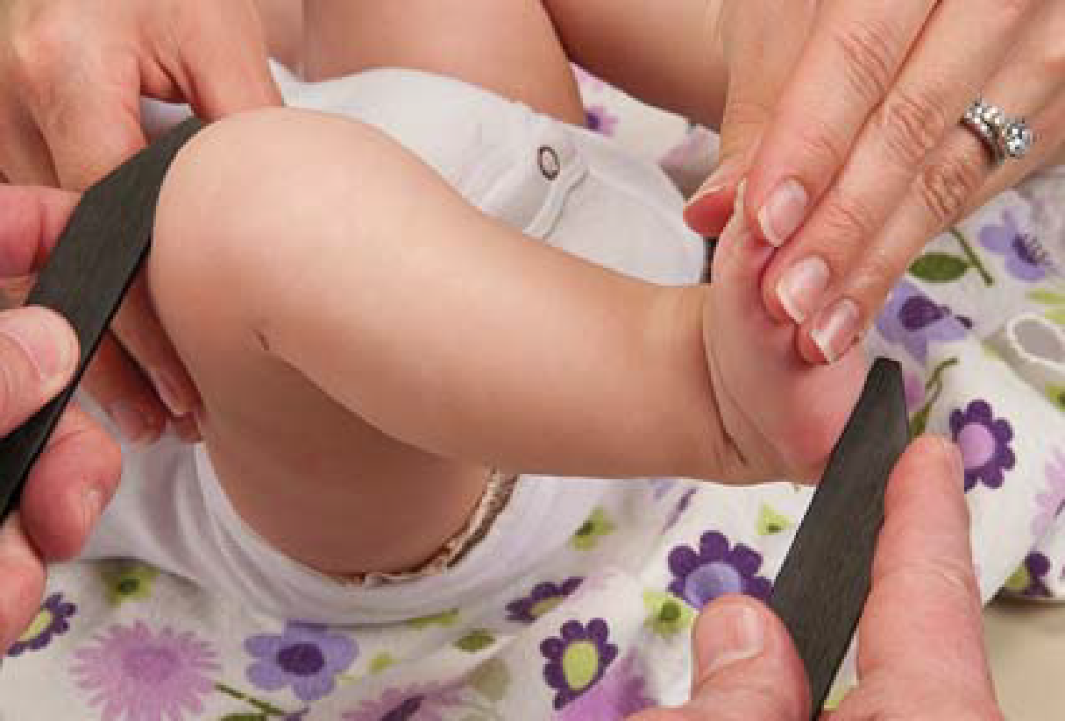
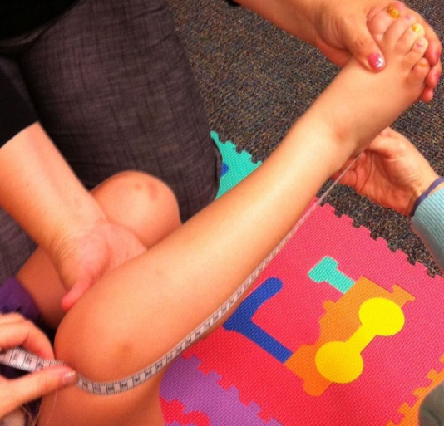
Surrogate Measures of Body Size
Lower Leg Length
Measurement Methods:
Caliper Measurement
Upper Photo
Knee and ankle bent 90 degrees
Hip is flexed to allow knee to bend when heel is suspended
Foot at 90 degrees
Make sure calipers are parallel with arm. Have recorder check that they are parallel.
Tape Measurement
Lower Photo
Zero end of tape at heel
Top of bent knee is visually estimated for reading of tape
Note that calf causes tape bowing

Slide 14
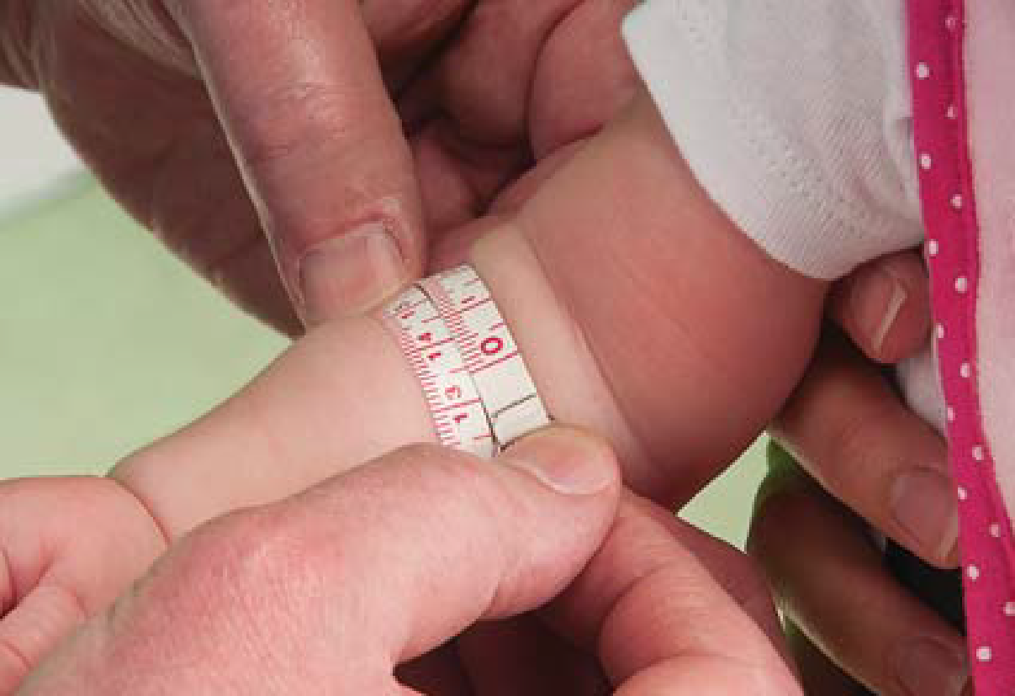
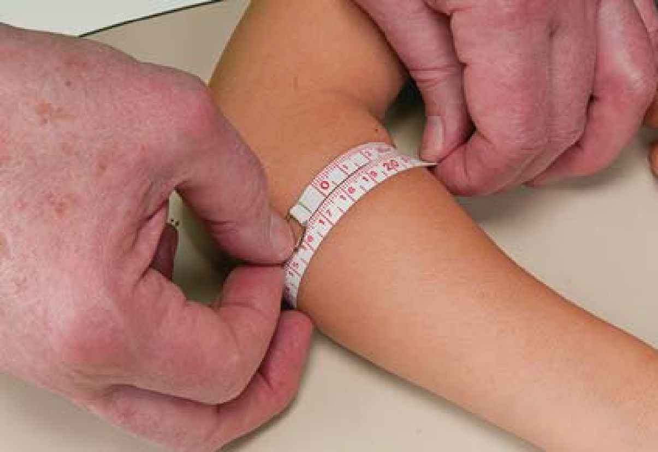
Surrogate Measures of Body Size
“Gold Standard” Measurement
Insertion Tape Measurements
[Not Shown]
Other Surrogate Weight Measurement
Forearm Circumference: Tape Measurement Upper Figure
Forearm Outward- Elbow Open and Arm Suspended
Good Method
Forearm Circumference: Tape Measurement Lower Figure
Forearm Across Body- Elbow Bent 90 degrees and arm resting on table
[Wrong Method]

Slide 15
Surrogate Measures of Body Size
Other Surrogate Total Body Weight
Forearm Width: Grid
Forearm Outward
Arm straightened and pointing outward from body
Palm down
Angle across grid
Mark the maximal width of the forearm on grid
Label the points

Slide 16
Replicate measures
In 10% of all mother-child dyads – so one in nine of nine sub-groups
Perform replicates by other staff measurer
Replicates should be completed as if this was the first set of measurements for the child
Make sure new data form (different color) is used with second staff member indicated as measurer
Notes:
Stats: measures of central tendency—mean, median, SD, by age, gender, and ethnicity
Biases: by scale, by anthropometrist, by stadiometer and anthropometrist, by season of the year for problems in stadiometer,

Slide 17
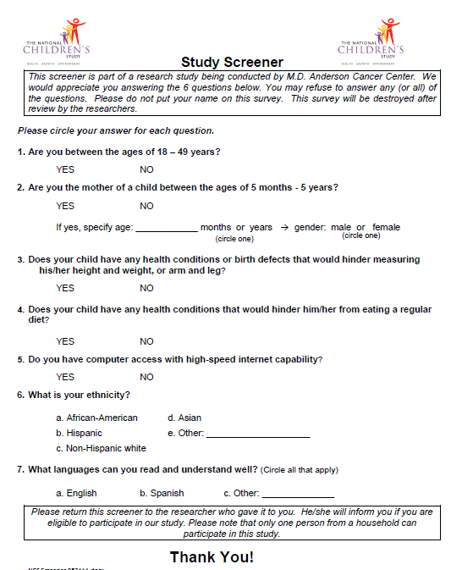
Screener:

Slide 18
Questionnaire: Introduction to Participant
3 Main Sections:
Socio-demographics
Child’s history
Mother’s history
To be completed by the mother of the child
Suggested Interviewer script:
Let’s get started. The purpose of this questionnaire is to learn more about the food your child eats and how they grow. It takes about 15-30 minutes to complete.
We will first start with a few background questions…

Slide 19
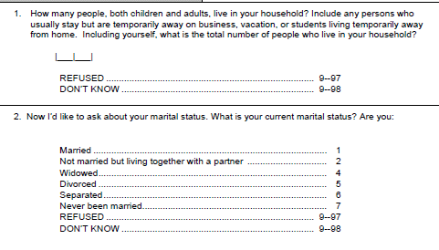
Marking Instructions
8
Notes:
NOTES:
Note the correct way to:
Write in numbers clearly
Circle response code.

Slide 20
Skip Patterns
Notes:
Be aware of skip patterns that direct you to the question.
Follow the wording, do not improvise

Slide 21
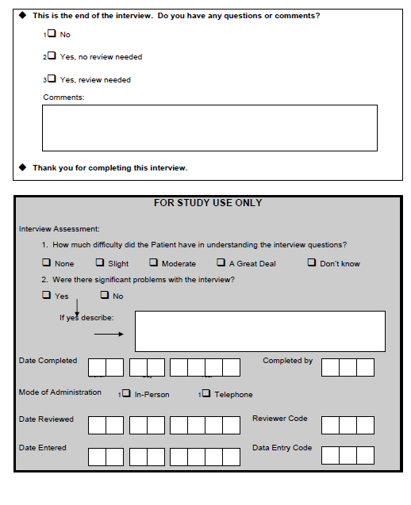
Questionnaire: Interviewer Assessment

Slide 22
If child uncooperative, obtain priority measurements
No personal identifiers on form
Notes:
If child uncooperative, please obtain the priority measurements as indicated by an asterisk

Slide 24
Setting the Stage
Stick labels with ID, DOB, gender, & Study center
Collating the forms/packets
Sufficient number of consent forms (our copy & mothers)
Environment
Nursery school vs. clinic
Other day care setting
Family home
Notes:
Okay for participant to answer Refused or accept Do not know.
Qx can be done with the child being measured by the other 2 team members if the child is comfortable.
We practiced in Chinese-Americans. Engage with coloring book before starting measurements.
If you go to nursery where child is familiar with surroundings, helpful. Child associates clinic with shots.
Discuss mats and gizmos. Stickies on wall, squishy balls.

Slide 25
Setting the Stage
Setting up equipment
1 room per team
Infantometer
Chair for mother
Child size table & chair for child (grid, ruler)
Getting the mother & father involved
Newborns & infants
Showing pictures and assisting
Toddlers & young children
May be able to go on their own

Slide 26
Setting the Stage
Engaging the child
Introductions to the mother & child
Floor mats
Toys
Wall stickers
Coloring books/crayons & mini story books
Squishy balls that light up
Making it a game
Reward stickers
Snacks/drinks for hungry child

Slide 27
Setting the Stage
Length of questionnaire will vary by
Age of child
Maternal recall
Do not let her obsess – okay to use “Don’t Know” response
Form
Contact information for appointment scheduling or to send incentives

Slide 28
What did we learn
Group sessions after anthropometrics
Compile vignettes and share with other study centers on phone calls

Slide 29
Overview
Review of anthropometric measurements
Replicate Measurements
Equipment Maintenance
MOP
Study Flow
Questionnaire
Setting the Stage

Slide 30
Review of Measurements
6 measurements
11 different methods
2-3 person team
Measurer
Observer/recorder
3rd – screen, consent, & interview
Pocket guide
Steps for measurer
Photos to show participants
Notes:
Discuss 3rd person to screen and consent

Slide 31
Height: Helpful Hints
Have a mobile or other object on the wall facing the stadiometer to help focus to retain the frankfurt plane of the child and keep the head still
Check the chin does not drop down – the most common problem in retaining frankfurt plane
Check the heels, buttocks, shoulders and head are against the vertical piece.
Check heels are together at the base
Michele R. Forman

Slide 32
Recumbent Length
Place crown of head with steady pressure against the head board
Position the head looking up---mom’s job to hold the sides of the child’s head and reassures the infant
A mobile or colorful object with noise helps to distract the baby

Slide 33
Recumbent Length
Knees: Gently press the knees down to assure that full length of legs is measured
Tickle feet to flex 90° so feet are flexed up
Quickly bring the foot board up to the heel & call out measurement to the nearest 0.1 cm or mm
Say knees/ tickle/move board/ read
Repeat procedure

Slide 34
Recumbent Length: Helpful Hints
Measurer must be on side of infantometer with metrics to read the length
Get mom involved
Dangle mobile to distract baby
Leave this procedure for last as it can be the most disturbing to the baby and therefore the mother
If foot board gets disengaged, then move it up to the rounded top to re-engage. Do not push pegs back in.

Slide 35
If child uncooperative, obtain priority measurements
No personal identifiers on form
Notes:
If child uncooperative, please obtain the priority measurements as indicated by an asterisk

Slide 37
Basic Principles and Statistical Techniques of Anthropometric Assessment
Choosing a reference vs a standard
Cut-offs
Expression of cut-offs

Slide 38
Reference Data for Growth
Reference data come from:
Data collection of children based on age, sex and other variables
Use equipment for anthropometry measurement by testing of true value before use regularly
Measurer get training
Remeasurement in each time

Slide 39
What is data growth for WHO: standard?
Data collected among 3000+ children of different ages from many countries.
800 out of 3000 children remeasured all of the time.
Using easy program for data collection.
(All children in a study were exclusively breastfed during measurement)

Slide 40
Cut-offs
WHO’s defines cut-off as: “the value which marks the boundary of acceptability”
Helps estimate the prevalence of children above or below a given level of undernutrition or overnutrition.
Therefore, cut-offs determine how serious undernutrition or overnutrition is and the priority of management assigned to it.

Slide 41
Equipment Maintenance
Quality control (morning)
Chose 2 stadiometers at random
Calibrate stadiometer with a measuring yard stick or rod for comparison
Inspect stadiometers for broken or missing pieces
If in good condition, check the box
If a problem, write the problem in the box

Slide 42
Equipment Maintenance
Both measurements should be 44.0 lbs
If both measures are NOT 44.0 lbs:
Weigh the standardized weight a 3rd time
Record the results
Inform your supervisor if measure is more than ½ lb different

Slide 43
Equipment Maintenance
Calibrate scales…continued
Remove weight & turn scale off
Turn scale on and check that it reads 0.0 lbs
Put 44.0 lbs standardized weight on scale 2nd time
Record 2nd measurement in log
Wipe down the scale and return to shelf

Slide 44
Equipment Maintenance
Quality control (morning)
Chose 2 scales at random
Calibrate scales
Put 44.0 lbs standardized weight on scale
Record 1st and 2nd measurement in log
If measurements are more than ½ lb off, inform supervisor

