Slide 1

Topic 6.7
Statistical Design and Planning: Data Collection and Management
Training developed by Kate Eddens, PhD, MPH
Indiana University School of Public Health
Department of Epidemiology and Biostatistics
In collaboration with the Ministry of Health Lao PDR
Training by Applied Nutrition Research Capacity Building (ANRCB), a project of the Lao American Nutrition Initiative (LANI)
This work is made possible through support from USAID/Laos as a supplement to a USAID Cooperative Agreement #7200AA18CA00009
(LASER-PULSE) to Purdue University. Contents reflect the views of the author(s) and do not necessarily reflect those of USAID.
For more information, please contact Catholic Relief Services Laos.
Notes:
Welcome to Topic 6.7 Statistical Design and Planning: Data Collection and Management.

Slide 2
Learning Objectives
Upon completion of Topic 6.7, you will be able to:
Describe the role of data collection in data management and planning a study
Identify modes of data collection and their pros and cons
Construct a data collection instrument
Understand the purpose of a codebook and create a codebook to document data collected
Understand the purpose of study protocols including data collection protocols and how to create protocols
Notes:
Upon completion of Topic 6.7, you will be able to: Describe the role of data collection in data management and planning a study, identify modes of data collection and their pros and cons, construct a data collection instrument, understand the purpose of a codebook and create a codebook to document data collected, and understand the purpose of study protocols including data collection protocols and how to create protocols.

Slide 3
Data, Information & Knowledge
Data
Raw, unsummarized, and unanalyzed facts
Information
Data processed into a meaningful form
One person’s information can be another’s data
Knowledge
Knowing what information is required
Knowing what the information means
Notes:
Data are raw unanalysed facts. Information is data processed into a meaningful form, but one person’s information can be another person’s data. Knowledge is knowing what information is required, and what the information means. How are these represented in research? Datasets, Results, and Literature

Slide 4
Data, Information, & Knowledge
Knowledge
Data
1. Request
3. Interpretation
Decision
2. Conversion
Information
Notes:
What role does data management play? First, knowledge is needed to determine what data to collect and how to collect them, then providing data to be converted to information, and making sure that data are appropriately represented, as information is turned into knowledge, and into decisions.

Slide 5
Data Collection
Data collection is the process of recording observations about your study sample, that we then use to make inferences about a population
In this topic, we’ll primarily cover data collection via survey or interview
The components to this include measures of:
  Exposures and outcomes
  Sociodemographics and modifiers
  Potential confounders
Notes:
Data collection is the process of recording observations about your study sample, that we then use to make inferences about a population. In this topic, we’ll primarily cover data collection via survey or interview. The components to data collection include, at the very minimum, measures of Exposures and outcomes, sociodemographics and modifiers, and any potential confounders.

Slide 6
Data Collection in Data Management
Plan the data needs of your study
Data collection (primary or secondary)
Data entry
Data validation and checking (“cleaning”)
Aggregate, select, sort, and weight cases
Transform data
Export data for analysis
Data manipulation (analysis) and results
Raynald Levesque, “SPSS Programming and Data Management, 2nd edition”
Notes:
Data collection is one of the first components of data management, but first, you must plan for the data needs of your study.

Slide 7
Study Planning and Set-up
The most important step!
Minutes spent here will save you hours or days later
Data collection planning:
  Variables and measures
    What data will you collect?
  Mode of administration, data collection tools, hiring and training and planning
    How will you collect it?
    Who will collect it?
    Where will it be collected?
    When will it be collected?
  Why are you collecting these data?
Notes:
The set-up stage of the study is the most important step from a data collection and management perspective. Spending time here will save you so much time later. This seems counter-intuitive because, after all, there is no data yet to be managed, but this is where you decide what data you are going to collect, how you are going to collect it, who is going to collect it, when it is going to be collected, where it is going to be collected and, most importantly, why it is going to be collected.

Slide 8
Study Planning and Set-up
Keep it simple!
Research questions and associated hypotheses inform data collection and analysis
Does each question further your goal?
Data security
Data entry planning
Data transfer planning
Data storage planning
Notes:
“Why are data collected” seems to be a rather odd question, but you need to determine what uses the data will be put to before you collect. Keep it simple! Does each question further the assessment of your research goals and hypotheses? Don’t include variables because they might be significant unless you feel strongly enough about them to have included them in a hypothesis. Otherwise, you will end up with an unwieldy survey and a fishing expedition for your analysis. You should also start thinking about data security at this stage, including how will your data be securely entered, securely transferred to you, and how will it be securely stored once you get it.

Slide 9
Common Data Collection Instruments
Interviews
Telephone surveys
Internet surveys
Medical bus
Health apps
Other methods?
Notes:
Common data collection instruments or modes of administration include interviews, whether in person or over the phone, telephone surveys, internet surveys, a medical bus or vehicle health applications on smartphones and other methods. What are some other methods that you may use for your study.

Slide 10
Interviews
Often used for a small group of subjects for a broad range of topics
  Structured – essentially a survey but administered by a person; fixed responses (multiple choice)
  Unstructured – questions differ for each subject and can be conditional upon responses to previous questions; open responses
Pros
  You have control of the environment
  Can probe for more information where necessary
  Establish trust and rapport more easily in person; interviewer from community
  Qualitative data
Cons
  Expensive, infrastructure, burdensome, limits sample size
Notes:
Interviews are often used for a smaller group of subjects for a broad range of topics, but they can also be used for mid sized studies. Structured interviews are essentially a survey, but administered by a person. There are typically fixed responses or multiple choice. Unstructured interviews include questions that differ for each subject and can be conditional upon responses to previous questions. They may have open responses. The pros of doing interviews are that you have control of the environment, and you can probe for more information where necessary. You can also establish trust and rapport more easily in person, particularly when you have an interviewer who's from the community that you're studying. You can also use interviews to collect qualitative data. Cons are that it can be expensive to do and you have to hire and train individuals to conduct the interviews. You need the infrastructure setup to do them, that is a device or electronic survey for data collection that the interviewer takes with them, or paper structured interview that they take with the, and potentially recording devices. It can be burdensome, because of the intensive human resources needed to conduct interviews. And it may limit your say sample size. However, I would argue that the quality of data that you can get from an interview or interview assisted survey is worth the reduction in sample size. And you can easily conduct interviews, in, say, a sample of 500 people.

Slide 11
Telephone Surveys
Trained interviewers contact and gather information from respondents
Random Digit Dialing (RDD) might be possible with list
Pros
  May be easier to access people, although not all have a phone or answer
  Good quality control: trained interviewer, recordings
  Anonymity may lead to more accurate responses
  Quick data processing: computer assisted telephone interviewing (CATI)
Cons
  Time consuming
  Hard to reach people
  May be excluding populations who don’t have telephone
Notes:
In telephone surveys, trained interviewers contact and gather information from respondents. Random digit dialing might be possible if you have a list of phone numbers, although this has become much harder in the era of cell phones and smartphones and really may not be applicable. Pros are that it may be easier to access people than trying to interview in person, although not all people have a phone. Or in the case of the of some countries, people don't answer the phone. You have good quality control if you train the interviewer and you have recordings of the surveys. And the anonymity may lead to more accurate responses. You can do quick data processing, particularly if you're using a computer assisted telephone interviewing system, which is a specific system that collects and processes data as you are collecting them. cons are that it is time consuming. And it can be hard to reach people. You might also be excluding populations who don't have a telephone.

Slide 12
Internet Surveys
Pros
  Quick and easy to implement: can use free online platforms
  Anonymous responses
  No interviewer burden, which may lead to better responses for sensitive topics, but you can do this in other modes as well.
Cons
  Who are your respondents? (selection bias!)
  How do you know who they are?
  People tend to “satisfice” on internet surveys, which means they select the easiest answer to skip quickly to the end.
  Lower completion rate
  Data may not be as valid
  Excluding those who do not have access to the internet can bias your study.
Notes:
Internet surveys are surveys that are administered over a website. The pros are that they are quick and easy to implement, and you can use all kinds of free online platforms for data collection. You are also able to get anonymous responses. There's no interviewer burden, which may lead to better responses for sensitive topics. But you can do this in other modes as well, you just have to be creative. The cons are: who are your respondents? Will they have access to the internet? Will this lead to selection bias? How do you know who they are? When people are responding to a survey over the internet, you may not have a good way of confirming their identity, or unless you use specific email addresses or other personal information that only the person responding to the survey could provide. People tend to satisfice on internet surveys, which is a term that means they select the easiest answer so that they can skip quickly to the end. You have lower completion rates in internet surveys, and your data may not be as valid because you're unsure whether the person completing it is a real person who is interested in your study and is responding truthfully. It also excludes those who don't have access to the internet and that can bias your study.

Slide 13
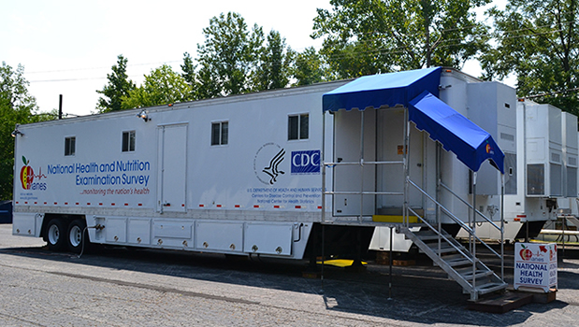
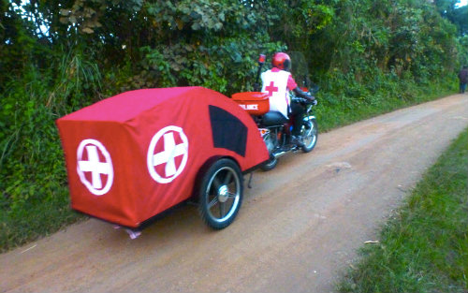
Medical vehicle or trailer
Take everything to the people in one vehicle for data collection
Pros
  Can conduct a survey or interview and
  collect medical specimens and anthropometrics
Cons
  Expensive!!!
  Takes a great deal of time
Notes:
You may also use a medical vehicle or trailer that takes everything that you need to conduct your data collection and sample collection to the community. The pros are that you can conduct surveys and interviews and collect medical specimens and anthropometrics, but the cons are that it can be very expensive to establish a medical vehicle and can also take a great deal of time to go into communities.

Slide 14
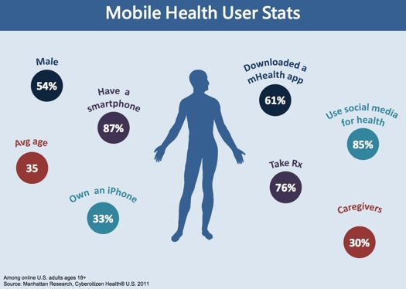
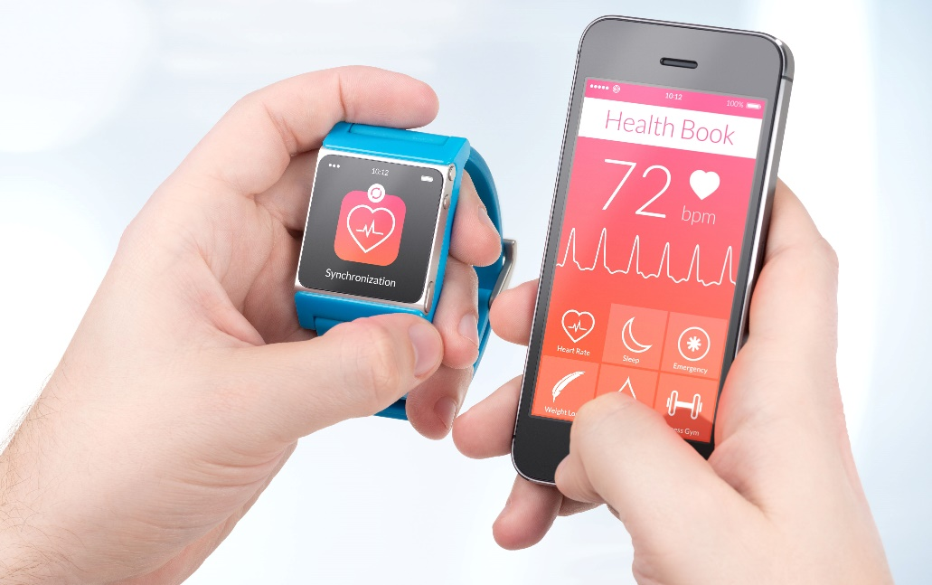
Health Apps
Pros
  Instant data and communication
  Can customize to meet your study needs
Cons
  Limiting your participants to those who have smartphones can bias your data
  Reach is suspect unless you are specifically creating it for your study participants
Notes:
Health apps are another option for data collection. The pros are that it's instant data and communication and you can customize them to meet your study needs, if you are able to have an app developer on your team. Cons are that it limits your participants to those who have smartphones, and that can bias your data. And the reach is suspect unless you are specifically creating it for your study participants.

Slide 15
How to choose?
Consider when you might prefer to use an unstructured interview or survey over structured
  Exploration versus confirmation, understanding patterns
Consider bias associated with each data collection format, and weigh trade-offs
Consider your resources and what you CAN do
Consider your population and how you might best reach them
Notes:
So how do you choose? Consider when you might prefer to use an unstructured interview or survey over structured. Typically, that is when you're doing exploratory studies or qualitative studies versus confirmatory, or quantitative studies. And when you're trying to understand patterns, consider the bias associated with each data collection format and weigh your trade offs. Consider your resources and what you can do and consider your population and how you might best reach them.

Slide 16
How to choose?
Self-administered versus interviewer-assisted interviews and surveys
  Always better in person, unless questions are deeply sensitive, but even then, you can allow the respondent to interact with data collection tool
  Interviewers can help prompt respondents, and establish rapport
  Hiring interviewers from your target population improves participation
  BUT interviewer bias is very real: you cannot pay an interviewer by the interview, for example!!
  TRAINING IS ESSENTIAL!!!
Online versus in-person or over the phone
  Online leads to satisficing and lower response rates; hard to trust data
  Telephone may improve your reach, but requires more resources
  Paper is great for a record, no matter the mode or method!
  Back up databases!!!!
Notes:
Self-administered versus interviewer-assisted interviews and surveys. Typically, it's always better to be able to collect data from a person in person unless the questions are deeply sensitive. But even then, you can allow the respondent to interact directly with a data collection tool for those sensitive questions. Interviewers can help prompt respondents, establish rapport, and explain instructions. Hiring interviewers from your target population improves participation by creating better trust and reliability. But interviewer bias is also very real. You have to train, train, train, train your interviewers, and you cannot do things like paying interviewers by the interview. For example, I am aware of a study that was done in that way. And it just creates an opportunity for fake data collection for incentivizing. Approaching people who don't actually meet the study requirements, and for entering data quickly to skip on to the next person in online versus in person or over the phone. Online leads to satisfying satisficing and lower response rates and it is hard to trust the data. Telephone might improve your reach but requires more resources. And in any case, paper is great for a record no matter the mode or the method. That way you can check back and reference the paper records during data entry, or when you're trying to understand discrepancies no matter what you need to back up your databases.

Slide 17
Creating a Data Collection Instrument
Data collection instrument includes all of your survey questions and any instructions or scripts needed for the interviewer or respondent.
It should include the source of all of your items and any psychometrics for those sources: measures of reliability and validity
Notes:
Data collection instrument includes all of your survey questions and any instructions or scripts needed for the interviewer or respondent. It should include the source of all of your items and any psychometrics for those sources, or measures of reliability and validity.

Slide 18
Creating a Data Collection Instrument
How do you select and create measures for your data collection instrument?
In general, you should choose, in this order:
  Existing, validated measures from well-established instruments
  Existing, validated measures from well-established instruments that are slightly adapted to your population
  Measures from instruments that have been previously used in your population but may not yet have validation
  Measures that you or your study team create yourself.
Notes:
So how do you select and create measures for your data collection instrument? In general, you should choose, in this order, existing validated measures from well established instruments. If you cannot find those, existing validated measures from well established instruments that are slightly adapted to your population. Third, measures from instruments that have been previously used in your population but may not yet have validation. And finally, a last resort is measures that you or your study team create yourself.

Slide 19
Creating a Data Collection Instrument
Creating as much of your survey instrument from validated and reliable measures helps to:
Create consistency in data collected across studies in the field
Ensure that your measures are measuring what they are supposed to measure (validity), every time (reliability)
Make it easier to reproduce the study in different populations
An exception is when the items do not fit your population’s culture or beliefs
  Adapt measures to fit your culture (e.g., foods, behaviors, beliefs)
  Create new measures to fit your population, and TEST these before administering them in a survey, if possible (could be just on face validity)
Notes:
When you create as much of your survey instrument from validated and reliable measures as you can, this helps to create consistency in data collected across studies in the field. Ensure that your measures are measuring what they're supposed to measure (the validity) every time, (which is the reliability) and make it easier to reproduce the study in different populations. An exception to this is when the items don't fit your population’s culture or beliefs. And when that happens, you can adapt measures to fit your culture. For example, types of foods, eating behaviors, or certain beliefs. Or, create new measures to fit your population and test these before administering them in a survey, if possible. And that could even be just on face validity that you test with a handful of members of the population to see if they make sense.

Slide 20
Example of survey measures: psychometrics
Notes:
An example of survey measures that have been tested and used in well established studies and have the psychometrics reported for them are these measures. This is a scale of beliefs about lung cancer screening, created by Lisa Carter Harris. I have the publications that are the sources of the psychometrics, and also what the psychometrics are, such as a Cronbach’s alpha of .89, and that there were found to be significantly lower perceived barriers for people who had been screened versus those who had not. But this item contains all of the information I need to know about how much I can trust these survey measures to measure what I'm interested in understanding about my population.

Slide 21
Examples of survey measures: adapted
Items measuring health service seeking behavior and knowledge: Use of health care services
Item | Response options | Source & Psychometrics
Today, what kind of place, if any, do you usually go when you are sick or when you need advice about your health? Is it a hospital emergency room, a clinic at a hospital, a neighborhood clinic or health center, a private doctor's office, an urgent care clinic, the VA, or somewhere else? | 0 = No usual place of care 1 = Hospital emergency room 2 = Clinic at a hospital 3 = Health department 4 = Neighborhood clinic/health center 5 = Remote Area Medical 6 = Private doctor's office 7 = Urgent care clinic 8 = VA (Veterans Administration) 9 = University/Student health center 888 = Don’t know 999 = No opinion/Refused | Adapted from Kaiser New Orleans Five Years After the Storm Survey, May 2010¹⁸⁰
In your opinion, what is the quality of the care or advice you receive there? Is it excellent, good, fair, or poor? | 1 = Poor 2 = Fair 3 = Good 4 = Excellent 888 = Don’t know 999 = No opinion/Refused | Kaiser New Orleans Five Years After the Storm Survey, May 2010¹⁸⁰
In general, is there a particular doctor or nurse you see at the place you usually go for health care or advice, or not? | 0 = No 1 = Yes 888 = Don’t know 999 = Refused | Kaiser New Orleans Five Years After the Storm Survey, May 2010¹⁸⁰
Notes:
An example of an adaptive measure is this first question about what kind of place do you usually go when you're sick or need advice about your health? The question stem was kept about the same, but this question was being asked in a rural population that had different options for receiving medical care, such as a place called Remote Area Medical. And so, we wanted to make sure that we included that in the response options, so we adapted it for our population’s culture and behaviors.

Slide 22
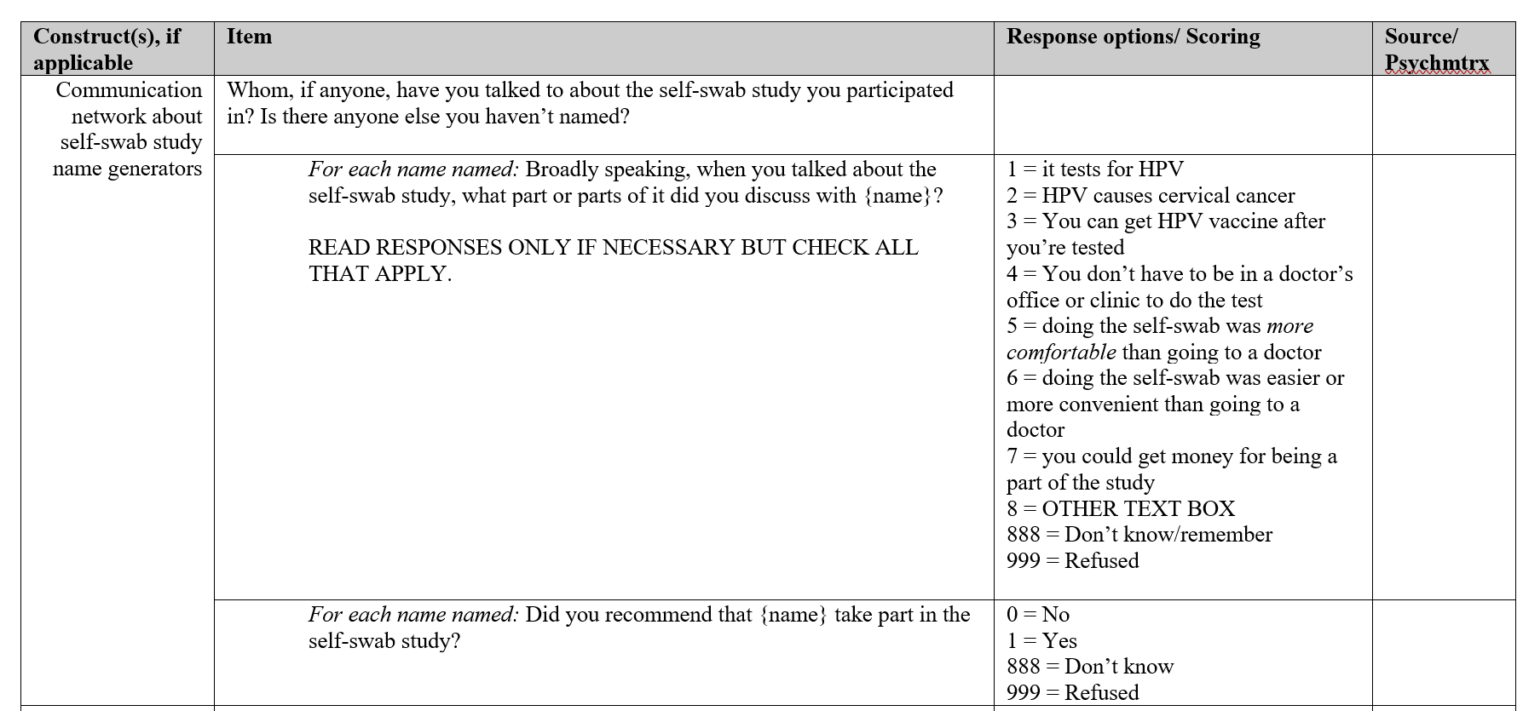
Examples of survey measures: created
Notes:
Creating your own survey measures should only be done when there is no previous evidence of measures that fit your need, or that can be adapted to fit your need, or for items that are specifically about the very study you are conducting In this example, participants were from a parent study about using a self-administered vaginal swab to test for the Human Papillomavirus or HPV. We wanted to know who participants spoke to about being in that study and had to create a question and responses for topics they may or may not have discussed with anyone about the study. These items were so unique and specific to the study, they had to be created. But 97% of measures in this survey were from previously validated studies.

Slide 23
Designing survey questions
Remember your survey's purpose
All other rules and guidelines are based on this one. Every questions should support your reason for conducting the study.
2. If in doubt, throw it out
If you cannot think of a concrete research benefit that will result from the question, don't use it.
Notes:
I will very briefly cover designing your own survey questions, but you can go back and look at this at your own pace. First, remember your survey’s purpose; every question you have should support your reason for conducting the study. And if you're in doubt, throw it out.

Slide 24
Designing survey questions
3. Keep your questions simple
Compound sentences force respondents to keep a lot of information in their heads and are likely to produce unpredictable results. Break questions down into component parts.
4. Stay focused - avoid vague issues
Be specific about what information you want from the participant. Don’t ask “When was the last time you ate rice?” instead ask “On how many days of the past 7 days did you eat rice?”
Notes:
Keep your questions simple. Break them down into component parts and stay focused avoid vague issues like when was the last time you ate rice instead of specific questions on how many days of the past seven days did you eat rice?

Slide 25
Designing survey questions
5. If a question can be misinterpreted, it will be
Be clear and concise. Always beware of imprecise language and avoid double negatives.
6. Make sure the respondent has enough information
It can be beneficial to break down questions that require background information into two parts: a screening item describing the situation which asks if the respondent knows about it, and a follow-up question addressing attitudes the respondent has about the topic.
7. Include only one topic per question (avoid "double-barreled" questions)
How would you interpret the responses to "Please rate your satisfaction with the amount and kind of care you received while in the hospital." The “amount” and “kind” are two different questions. If you want to be able to come up with specific recommended actions, you need specific responses.
Notes:
If a question can be misinterpreted, it will be. Be clear and concise. Beware of imprecise language and avoid double negatives and make sure the respondent has enough information to respond. Sometimes you it may be beneficial to break down questions that require background information into two parts. Include only one topic per question, meaning avoid double barreled questions. You can't ask someone to rate their satisfaction with the amount and kind of care you need to ask amount and kind into different questions.

Slide 26
Designing survey questions
8. Avoid leading questions
It is easy, and incorrect, to write a question that the respondent believes has a "right" answer. "Most doctors believe that eating vegetables is good for you. Do you agree?" is an example of a leading question. Even the most well-meaning researcher can slant results by including extraneous information in a question. Leading questions can bias results.
9. Consider alternate ways to ask questions that might get biased responses
Some questions are obviously sensitive, but there are questions about beliefs and behaviors that you may not realize could bias the person’s response. For example, the question: "Did you vote in the last election?" has an element of sensitivity. Respondents might be unwilling to admit that they did not vote, because of civic pride or embarrassment. To avoid respondent alienation, it can be useful to mitigate the cost of answering "No" by including a way out. For example: "There are many reasons why people don't get a chance to vote. Sometimes they have an emergency, or are ill, or simply can't get to the polls. Thinking about the last election, do you happen to remember if you voted?"
Also, people are less likely to lie about their age in face-to-face interviews if they are asked what year they were born, rather than how old they are.
Notes:
Avoid leading questions. You don't want someone to hear “most doctors believe that eating vegetables is good for you. Do you agree?” Even the most well-intentioned person can slant results by including too much information in a question. And consider alternate ways to ask questions that might get biased responses. There's some questions that are obviously sensitive. But some questions are just about beliefs or behaviors you may not realize could bias the person's response. Instead of asking, “Did you vote in the last election?” You may say “There are many reasons why people don't get a chance to vote. Sometimes they have an emergency or are ill or simply can't get to the polls, thinking about the last election. Do you happen to remember if you voted?” Also, people are less likely to lie about their age in face to face interviews if they're asked what year they were born rather than how old they are.

Slide 27
Designing survey responses
Response options need to be mutually exclusive and exhaustive
This is the most important rule to follow when providing response options. If response options are not mutually exclusive, the respondent will have more than one legitimate place for their answer.
You must also ensure that the response options you provide cover every possibility. Asking "Which of the following beverages did you drink at least once during the past seven days?" and providing a list of coffee, soda and tea might be sufficient if you were doing a study on the consumption of caffeinated drinks, but they would not work if you wanted to know about broader consumption habits.
If you are unable to provide a complete list of options, at least provide an "Other" choice. If the list of choices is too long, an open ended-question might be a better option.
Notes:
Make sure your response out options are mutually exclusive and exhaustive.

Slide 28
Designing survey responses
Keep open-ended questions to a minimum
While open-ended (or verbatim) questions are a valuable tool, they should not be over-used. Not only can they result in respondent fatigue, but they pose problems in terms of coding and analysis.
People interpret things differently, particularly when it comes to time
Trouble-spots include responses such as "Always," "Sometimes" and "Never." You must build in a temporal frame of reference to ensure that all respondents are answering in the same way. As in this example from an interviewer-administered questionnaire, "I am going to read a list of foods. For each one, please tell me whether you eat it regularly. By regularly I mean, at least three out of every seven days."
Notes:
Keep open ended questions to a minimum. And remember that people interpret things differently, particularly when it comes to time. You can get a lot of trouble with responses like always, sometimes and never. And you may want to provide context for those.

Slide 29
Designing survey responses
If possible, always use a "Don't Know" response
It is useful to allow people to say they simply do not have an opinion about a topic. However, some investigators worry that people will opt for that choice, reducing the ability to analyze responses. Evidence shows that this fear is largely unfounded. The goal of your research should help you decide if a "Don't Know" option would be wise. For example, if you only want information from those with an informed opinion or higher interest, offer a "Don't Know" choice.
Notes:
If possible, always use a don't know response for people and allow them to refuse a question, although don't offer a refusal.

Slide 30
Designing survey responses
Provide a meaningful scale
The end points of response scales must be anchored with meaningful labels. For example, "Please rate your satisfaction with the care provided to you today. Let’s use a scale where 1 means 'Very Satisfied' and 5 means 'Very Dissatisfied.'" You could also give each point on the scale a label.
The number of scale points (3, 5 or 7) can have little effect on the conclusions you draw later. Choosing how many points, then, is often a matter of taste.
There are three things to remember when constructing a response scale.
  First, an odd number of points provides a middle alternative. This is a good way to provide respondents with moderate opinions a way out (similar to the "Don’t Know," choice above).
  Secondly, if measuring extreme opinions is critical, use a scale with a greater number of points.
  Finally, you generally gain nothing by having a scale with more than 7 points and will probably find that you will collapse larger scales when it comes time to analyze the data.
Notes:
Provide a meaningful scale. The endpoints of response scales must be anchored with meaningful labels. So, if you say rate on a scale of one to five, you need to let them know what one means and what five means. It doesn't really matter how many scale points there are, that's just a matter of taste. And here are some things to remember when constructing a response scale.

Slide 31
Creating Codebooks
Notes:
Going to talk for a moment about creating code books.

Slide 32
Creating a Data Collection Instrument
Compile these measures in a word processing document and then begin to label them for a data collection instrument
If electronic, construct the measures and create a codebook with variable information, then enter the data into the survey creation interface, and finally print a paper version that can be used as a backup
If paper instrument, do the same steps: construct the measures and create a codebook with variable information, enter the data into a data entry interface which might be in the style of a survey, and either print a paper version that can be used as your paper data collection instrument, or construct the measures into a paper instrument separately, with variable IDs or information with each question for ease of later data entry.
Notes:
First, compile these measures in a word processing document and then begin to label them for a data collection instrument. If it's electronic, construct the measures, create a codebook with variable information, and then enter the data into a survey creation interface. And you can finally print a paper version that can be used as a backup. If you're using a paper instrument, you could do the same steps so that you have the data collection database ready, and then create the paper instrument separately or use the printed version.

Slide 33
Survey instruments / data entry forms
Data collection tools are relatively common and accessible.
What do you have access to? What tools do you prefer?
Are you collecting data in the field? Do you need internet access? Do you need the ability to record images or audio?
Here are some standard data entry or collection forms you could use:
Google Forms
Survey Monkey
Qualtrics
RedCap
Microsoft Access Database
Customized programs or apps
Notes:
Data collection tools that are electronic are relatively common and accessible. What do you have access to? And what tools do you prefer? Are you collecting data in the field? Do you need Internet access or the ability to record images or audio, you can use some standard data into your collection forms like Google Forms, Qualtrics, REDCap, Microsoft Access, survey monkey, or customized programs and apps.

Slide 34
Creating a Codebook from your Data Collection Instrument
Variable name* - the name you give a variable for use in the dataset (usually less than 8 characters)
Variable label* - description of variable content
Variable description (question)* - question text
Variable type* - text or numeric
Code values* - values assigned to the response options
Value labels* - the actual text of the response option
Missing value codes* - how you code missing data
Notes:
The most fundamental components of a codebook are the variable name, label, and description (which is typically the question), as well as the type of variable, the code values and value labels for every response option, as well as missing value codes. You may also include the variable length or column location.

Slide 35
Creating a Codebook
A codebook describes the contents, structure, and layout of a data collection.
A well-documented codebook contains all of the information needed to understand each variable in a file
Codebooks are important for consistency and transparency in research
Usually begin with basic front matter
  study title,
  name of the principal investigator(s),
  table of contents, and an
  introduction describing the purpose and format of the codebook.
Might include methodological details (e.g., sampling scheme, how weights were computed) and data collection instruments
  May instead have a separate user guide and/or data collection instrument.
Notes:
A codebook is a document that describes the contents, structure, and layout of a data collection. It should contain all of the information you need to understand each variable in a file. They are very important for consistency and transparency in research, allowing for data reproduction. It usually begins with some front matter that includes the study information such as title, rincipal investigator, table of contents, and format. The front matter might include additional methodological details like sampling scheme and how weights are computed.

Slide 36
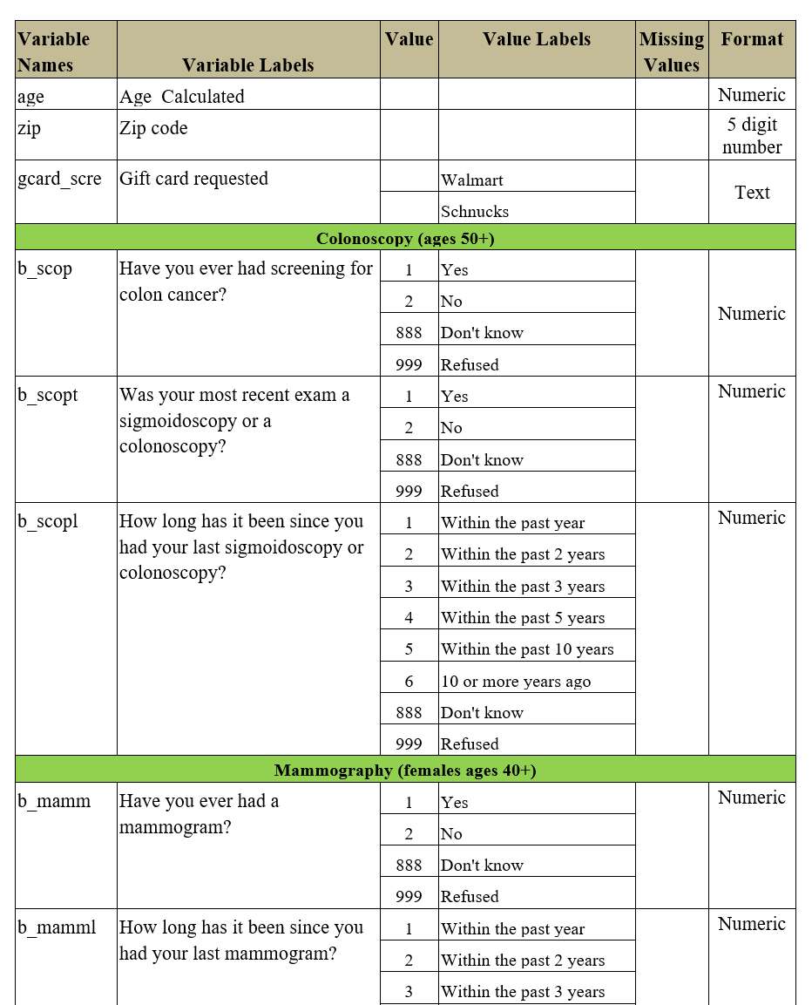
Sample Codebook 1
By column:
Variable name*
Variable label* (Variable description /question)
Code values*
Value labels* and Missing value codes*
Variable type/format*
Notes:
Here’s an example of a page of a codebook. You’ll see in the first column is the variable name, the second column has the variable label, such as age or postal code, or the variable description, which is the question stem. Value codes for categorical variables are in the next column, and the value labels for each response option are next, including missing value codes and labels. The final column contains the format or type of variable, for example, numeric or text.

Slide 37
Sample Codebook 2
Variable label / Variable description (question text)
Code values +
Value labels +
Missing value codes
Variable name
Source of each variable
Notes:
This is a basic codebook created before data collection from a study that I conducted, and it contains the variable description or label (the question), the response options and value codes for each as well as for missing values, the variable name, and the source of each item that was used in the study.

Slide 38
Creating a Codebook – Useful Extras
Transformations and re-coding of basic variables
Frequencies
Source of each variable
Sampling scheme
Data collection instrument(s)
Data collection training and procedures
Data entry training and procedures
Reports
Notes:
A more detailed codebook might contain transformations and recoding of basic variables, descriptive characteristics, and as mentioned previously, source of variables and potentially sampling scheme and data collection instruments themselves. You may include procedures for data collection and data entry, however I tend to create separate protocols for those procedures.

Slide 39
Codebook with Data Transformations
Construct | Item | Response option/ scoring | variable | Source/ Psychometrics
Strength of ties | How likely would you be to discuss personal issues with {name}? | (1=not at all likely, 7=very much likely) 888 = Don’t know 999 = Refused | SOT_1x | Cronbach’s alpha = .93; 5-item scale answered on a 7-point scale. Responses summed to give a composite score of tie strength.
 | How likely would you be to spend some free time socializing with {name}? | (1=not at all likely, 7=very much likely) 888 = Don’t know 999 = Refused | SOT_2x
 | How likely would you be to perform a LARGE favor for {name}? | (1=not at all likely, 7=very much likely) 888 = Don’t know 999 = Refused | SOT_3x
 | In your opinion, how likely would {name} be to perform a LARGE favor for you? | (1=not at all likely, 7=very much likely) 888 = Don’t know 999 = Refused | SOT_4x
 | On a scale of 1 to 7 with 1 being not at all close, and 7 being extremely close, please rate your closeness to {name}. | (1=not at all close, 7=extraordinary close) 888 = Don’t know 999 = Refused | SOT_5x
Strength of ties composite and derivatives | TOTAL Strength of Ties Score (SUM) for Alter X [SOT_Scor = SOT_1x + SOT_2x + SOT_3x + SOT_4x + SOT_5x] | Computed | SOT_ScrX
 | Strength of Ties Score RATIO for Alter X [SOT_Rto = SOT_Scor / 35] | Computed | SOT_Rto
Notes:
This is an example of a set of individual variables or questions that make up a score, and then the data transformations that were used to create the composite score and a mean score.

Slide 40
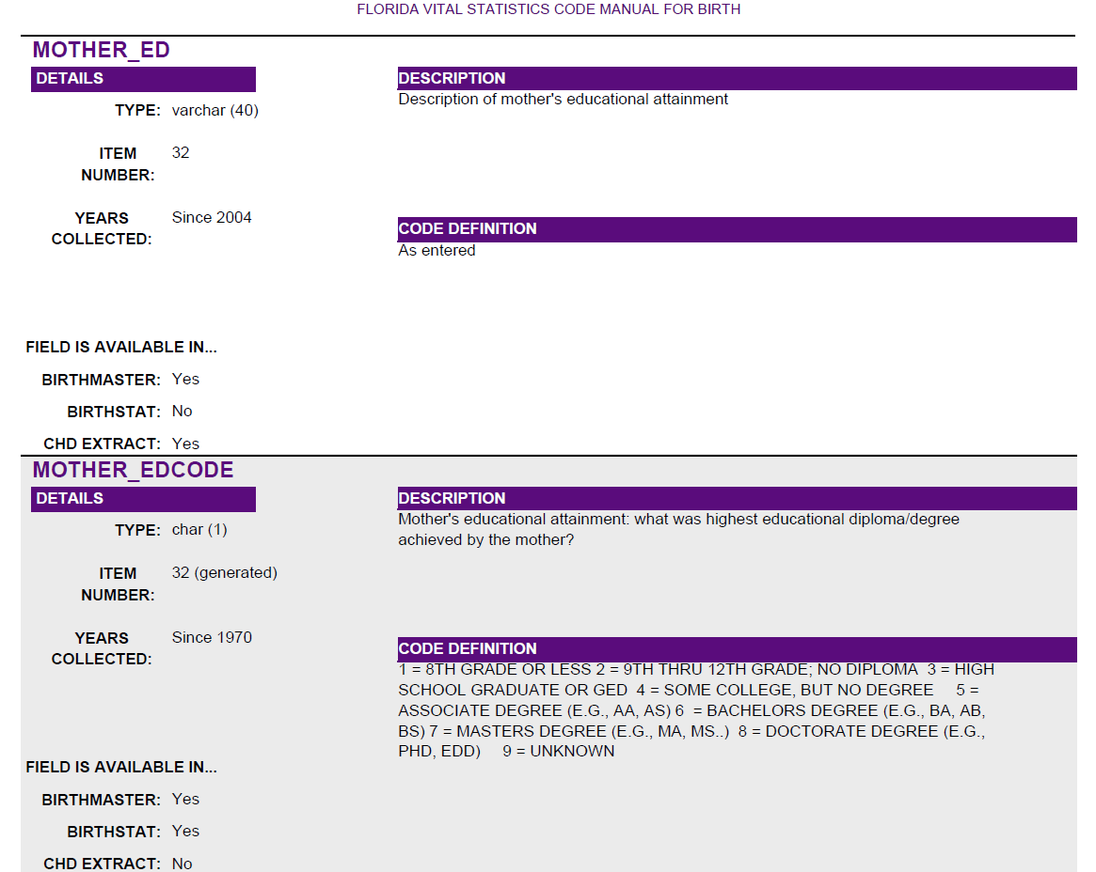
Highly Detailed Codebook: Vital Statistics
Notes:
This is just another example of a more detailed codebook of a state vital statistics code manual for births in the state of Florida. It includes the same basic components, plus the item number, the years the variable has been collected, and other datasets that contain this variable.

Slide 41
Creating a Codebook
May have a pre-collection and post-collection codebook:
Pre-data collection, your codebook would have the basic information needed to create your data collection instrument, as in previous examples.
Post-data collection, your codebook would contain all of the pre-data collection information and add information such as:
  Variable position in the dataset, Type and Format, Variable Measurement
  Code Values and Labels + Missing Value Codes for both user-missing and system-missing if not included previously
The main addition is having basic descriptives of each variable:
  Count and percent for each value of categorical data
  Measures of central tendency and dispersion for continuous data (e.g., mean, sd, quartiles)
  System missing values and valid n
Notes:
You might create a codebook for use before data collection, that contains all of the basic information you need for each variable in order to create the data collection instrument. After data collection occurs, you can add information to the codebook, including information on variable position and format in the dataset, and basic descriptives of each variable, such as count and percent for categorical variables, and measures of central tendency and dispersion, such as mean and standard deviation, for continuous variables, and the system missing values and valid count for each variable.

Slide 42
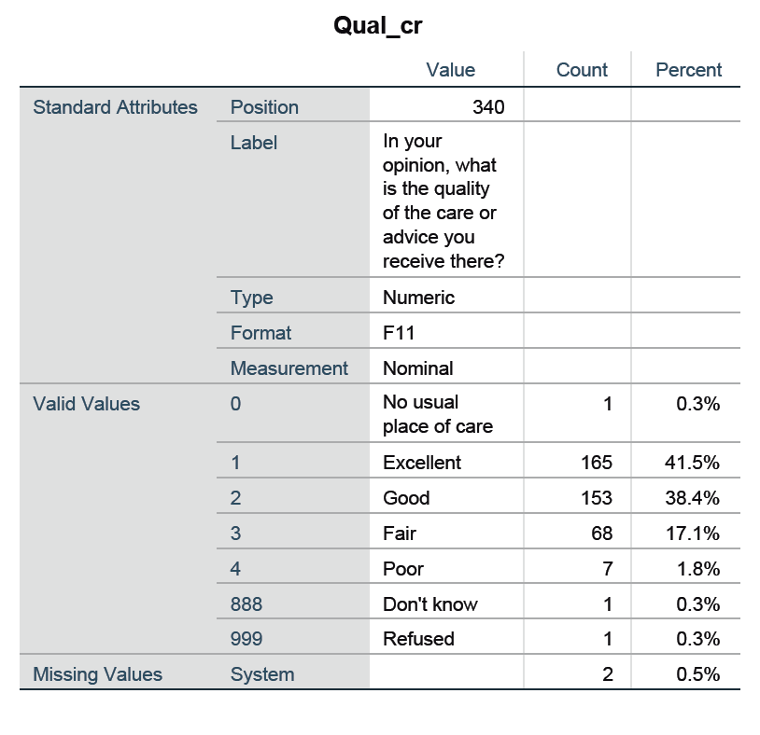
Sample HCC Codebook: Post-collection
Variable Name
Position in the dataset
Variable Label
Variable Type
Variable Format
Variable Measurement
Code Values + Missing Value Codes
Value Labels
Basic descriptives:
Count for each value
Percent for each value
System missing values
Notes:
In this example, you can see a question from the pre-data collection codebook and the information added for this variable into the codebook once data collection has concluded. The additional information includes more descriptives of the variable itself and the counts and percents for each value of response. It also includes system missing data, which means that for some reason, there is missing data on that variable that was not indicated as missing by the person collecting data. This may also appear when some questions are the result of display logic, and may not be asked of all participants.

Slide 43
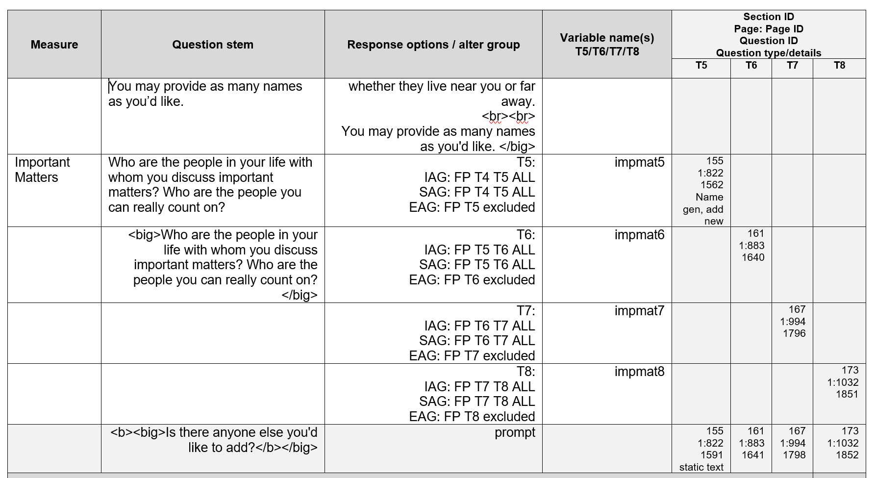
Codebooks for Longitudinal Studies
Notes:
If you are conducting a longitudinal study, you will typically be asking a set of questions at baseline, and then a set of questions that are asked at each follow-up, some of which will be the same as baseline and some that are not, but typically the follow-up questions will be the same at each follow-up wave. In this example, this codebook shows questions for follow-ups at time 5, time 6, time 7, and time 8. The variables are appended with the number of the wave at the end, and there is slightly different information about the location of the variable in the data collection instrument for each wave.

Slide 44
Creating a Codebook: Post-collection
Variable sources (validated questionnaires)
Marginals (frequencies)
Transformations and recodings
Data Location
Data Structure (file linkages)
Unique Identifiers
Weights
Notes:
In summary, you may include this additional information for each variable and the dataset, and any other information that might be useful to you.

Slide 45
Problems to Avoid in Coding Data
How many children under the age of 18 years live in your household?
___
Don’t know/Not sure
Refused
And what are their ages?
__ years __ months
__ years __ months
…
Don’t know/Not sure
Refused
Notes:
There are some problems in coding data. For instance, you want to make sure that if you are including code values for missing data, those values are not equivalent to a valid value in the data. In this example, don’t know or not sure is missing data coded with the value 8, and refused is missing data coded as 9. However…

Slide 46
Problems to Avoid in Coding Data
Notes:
As you can see in running frequencies of the variable, all of the values for ages 8 years old and 9 years old are not present, and there are many respondents coded as don’t know or refused. What has happened is that all children who are 8 or 9 years old are accidentally put into the missing data categories.

Slide 47
Creating Protocols
Notes:
I’m going to talk next about the importance of creating protocols for your study

Slide 48
Protocols
Written protocols should be created for EVERY task that occurs in your study, particularly in data collection, or in an experiment/ intervention study. You can and should create protocols for:
Recruitment
Consent and participation
Randomization
Training of study staff
Data collection / interview
Incentive distribution
Administration of intervention
Follow-up and contact
Data management and export
Data analysis
Train study staff on your protocols!
Notes:
Written protocols are essential not only to data management, but to every process of your study. Written protocols should be created for every task in your study, from recruitment through data collection, participant management, and data management and analysis. You should then train your study staff using these protocols!

Slide 49
Protocols
Written protocols should consist of step-by-step instructions for how to carry out all aspects of the study.
Decision trees or decision logic can be created for complex processes that may have several courses of action.
There should be very little left up to the study staff to decide. This creates an environment in which fidelity to the study plan can be the default.
Protocols can be updated as needed, and staff retrained.
Notes:
Protocols include step-by-step instructions for how to carry out all aspects od the study. You can include decision trees or decision logic for complex processes that may have several courses of action. The goal is to leave very little up to the study staff to decide, so that you are creating an environment in which fidelity to the study plan can be the default course of action. Protocols can be updated as needed, and when they are, staff should be retrained on that protocol.

Slide 50
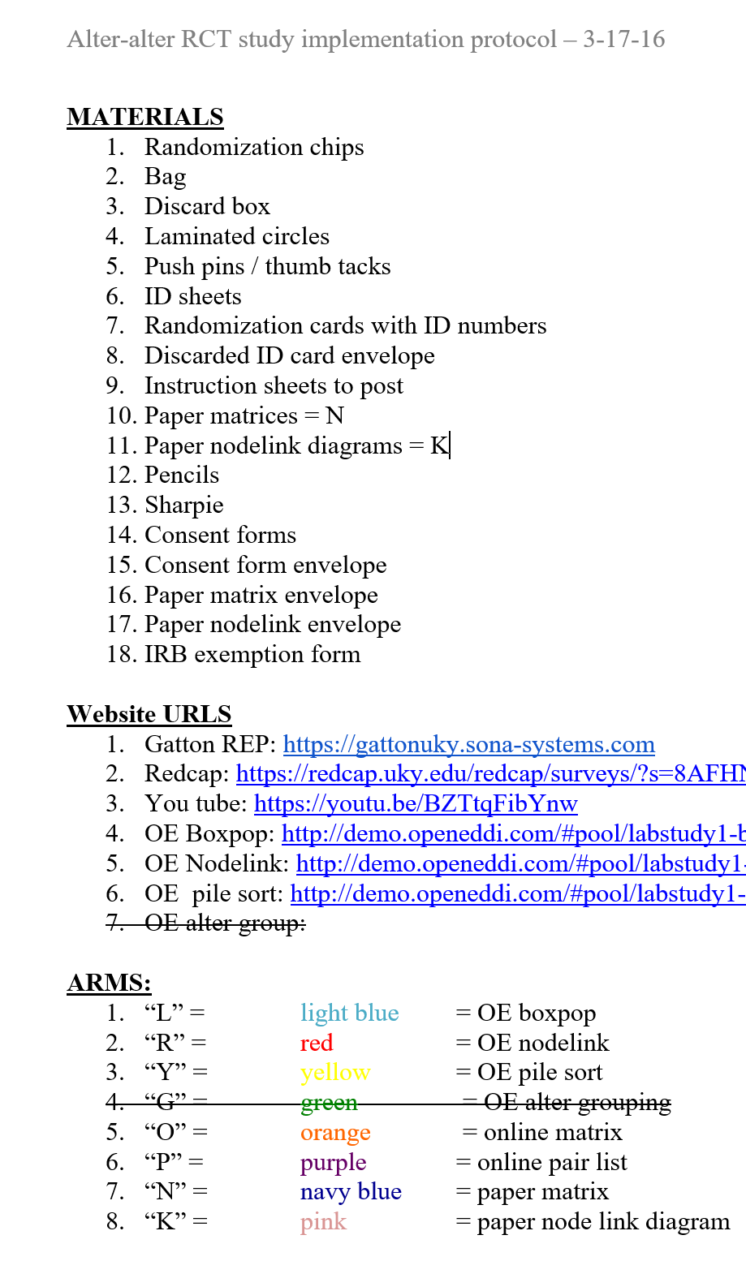
Protocol example:
RCT Process
A checklist of materials needed before conducting the experiment
Website links to software
List of labeled, colored chips for randomization to study arms
Notes:
Here’s an example of a protocol for how to carry out a randomized, controlled trial. The protocol first consists of a list of all materials needed to conduct the experiment, URLs or website links to all software or information needed to conduct the study, and in this case, a list of the study arms and the color and code on the chips that are assigned to those study arms, for non-replacement randomization to study groups.

Slide 51
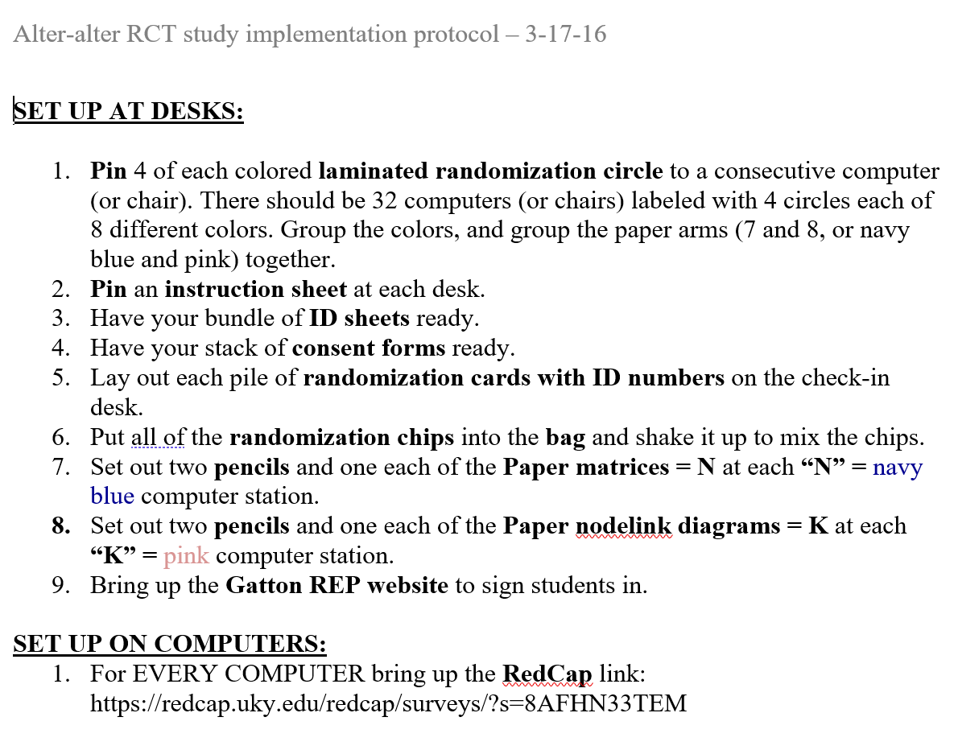
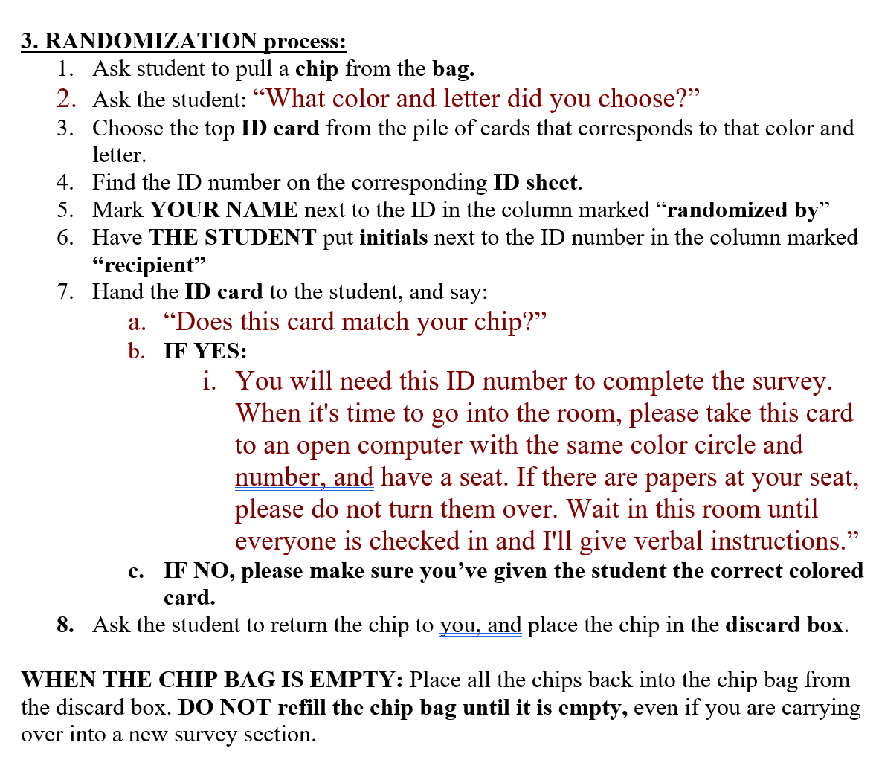
Protocol example: RCT Process
Here: Computer setup and randomization to study arms
Also: Consent process, how to run experiment, incentive distribution, breakdown of study site
Notes:
Two more examples from this protocol are the instructions to set up the study at each desk in the laboratory, and how to conduct the randomization process, which consisted of participants blindly pulling a colored chip from a bag that indicated their study group. Other parts of this protocol that are not shown are the consent process, how to run the experiment, how to distribute incentives, and breakdown of the study site at the end of each day.

Slide 52
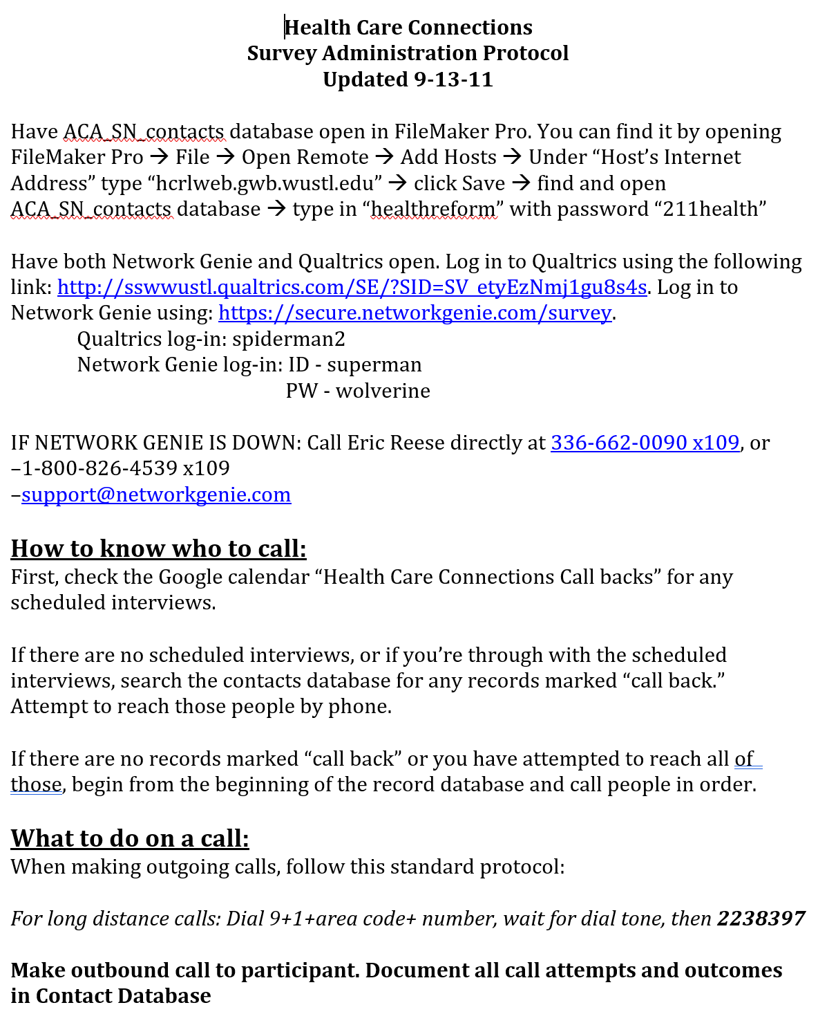
Protocol example:
Data collection 1
Where to find participant contact information
URLs for data collection software and login information
XXXXXXX
XXXXXXX
XXXXXXX
XXXXXXX
XXXXXXX
Who to call for software help, if needed
XXXXXXX
XXXXXXX
How to know which participant to call
How to begin a call and document call attempts and outcomes
Notes:
This is an example of a protocol used to begin the process of calling participants for survey data collection. You’ll see that it begins with where to find contact information for each study participant, the internet addresses for the data collection software programs needed for data entry, login information, and who to contact in case the software programs don’t work properly. Next, how to find the calendar that lists which participant is meant to be contacted that day, and how to begin a call and thoroughly document any call attempts and the oucomes of each.

Slide 53
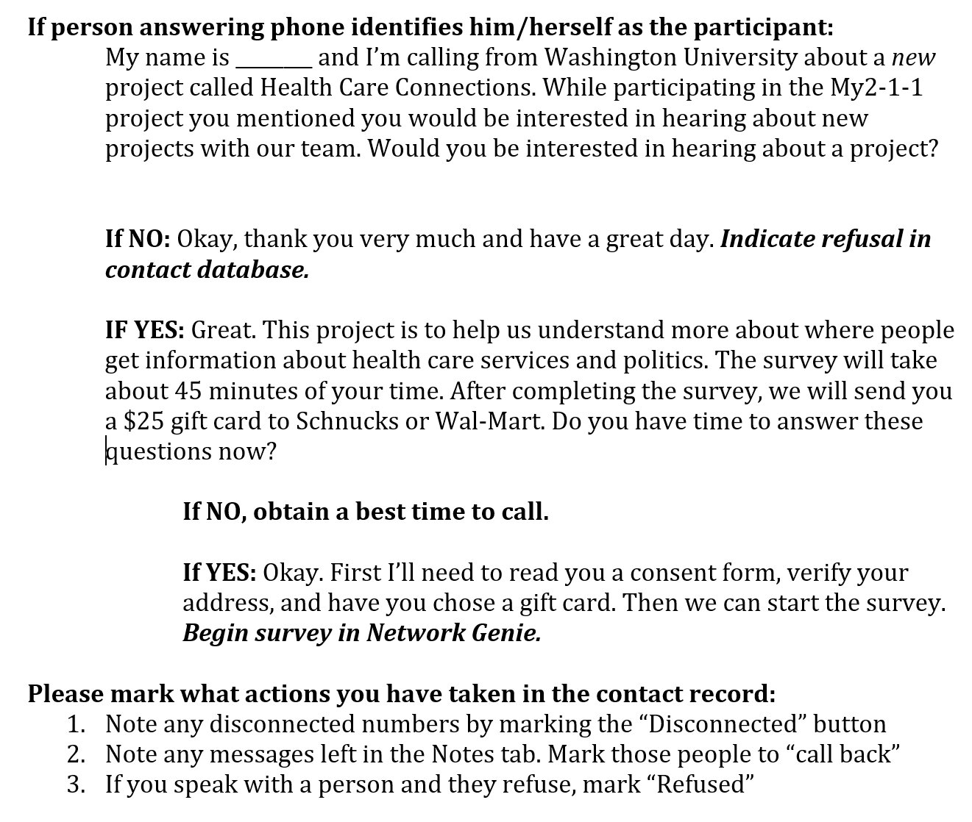
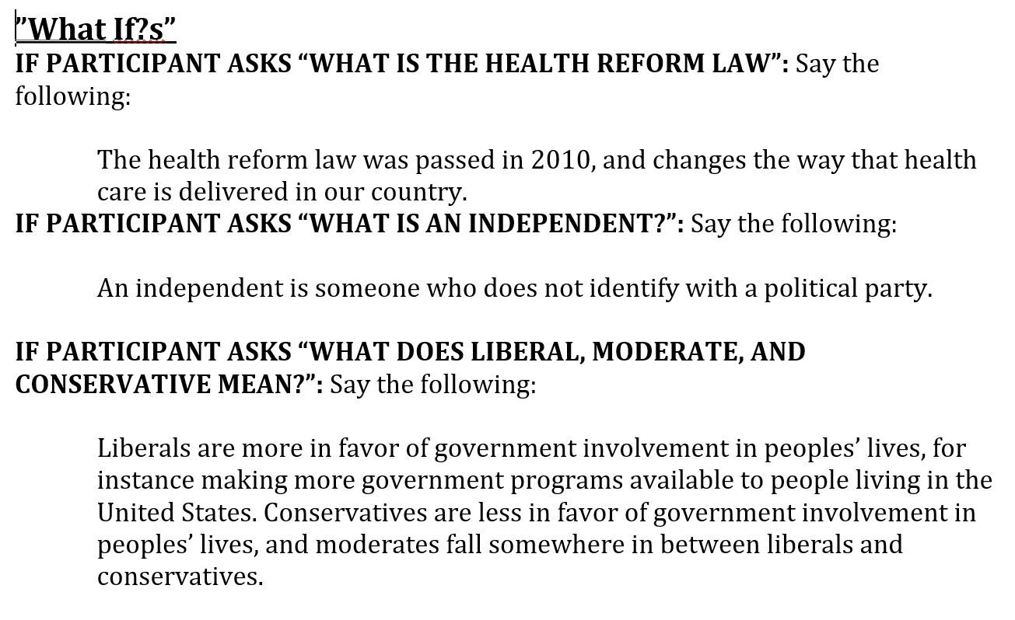
Protocol example:
Data collection 1
Decision tree for recruitment of participants and survey planning
  Scripts for use on the call
How to indicate in the contact record what action occurred as a result of the call
A list of “What Ifs” in the event of participant questions
Notes:
There are exact scripts for talking with participants, and decision trees for what to do in case of every possible response. Again, documenting the action that occurred on the call, and a list of “What If?”s in case participants ask specific questions in the process of the interview.

Slide 54
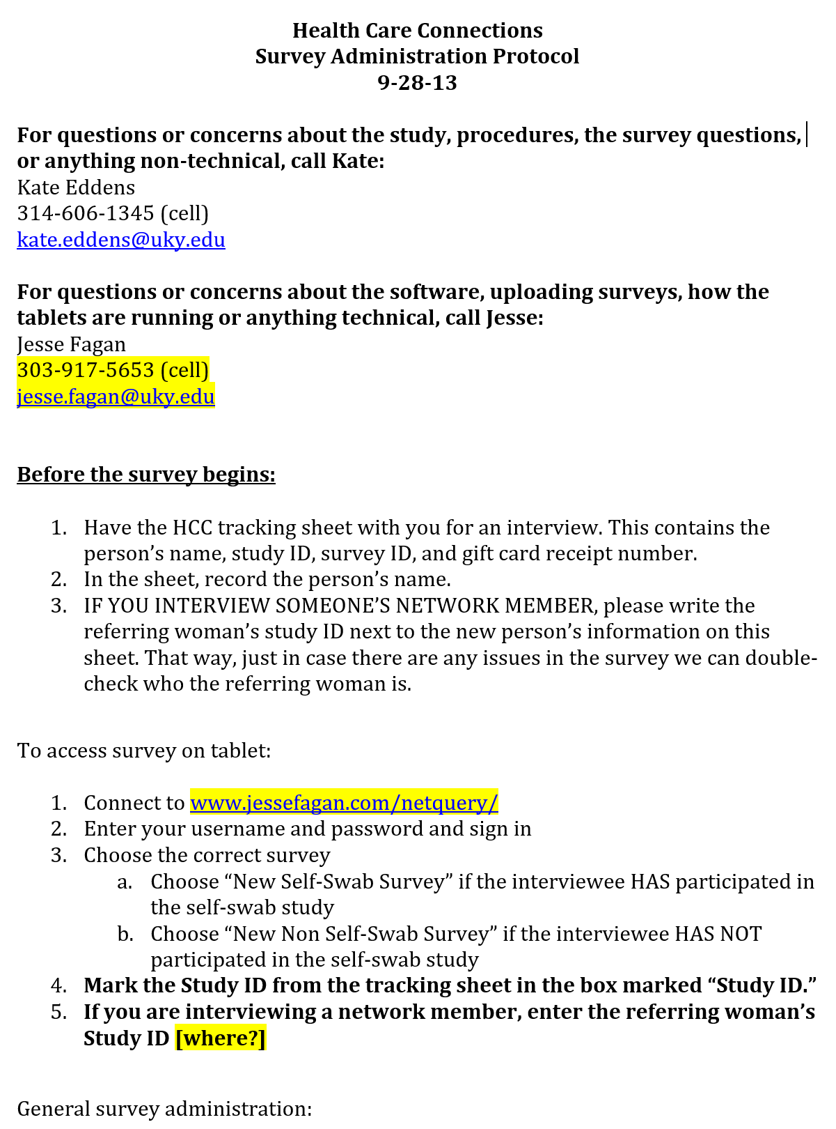
Protocol example:
Field data collection
XXXXXXX
Who to contact for study related assistance
Who to contact for technical assistance
What to have with you and actions to take before the survey begins
How to access software on device
How to document who you are interviewing
Continues to describe step-by-step survey administration, what to do when the survey is complete, and how to return to an incomplete interview if interrupted
XXXXXXX
XXXXXXX
XXXXXXX
XXXXXXX
XXXXXXX
XXXXXXX
XXXXXXX
Notes:
Field data collection can be particularly tricky, and you need to make sure your study staff has everything they need to complete data collection. This includes anyone they should call for questions, and their contact information, what they need to have with them and what actions to complete before leaving for the field, how to access software, and document participants, and it continues on to describe step-by-step survey administration, what to do when the survey is complete, and – importantly – how to return to an incomplete interview if their data collection process is interrupted. This will happen, so it’s very important to have a plan in place!

Slide 55
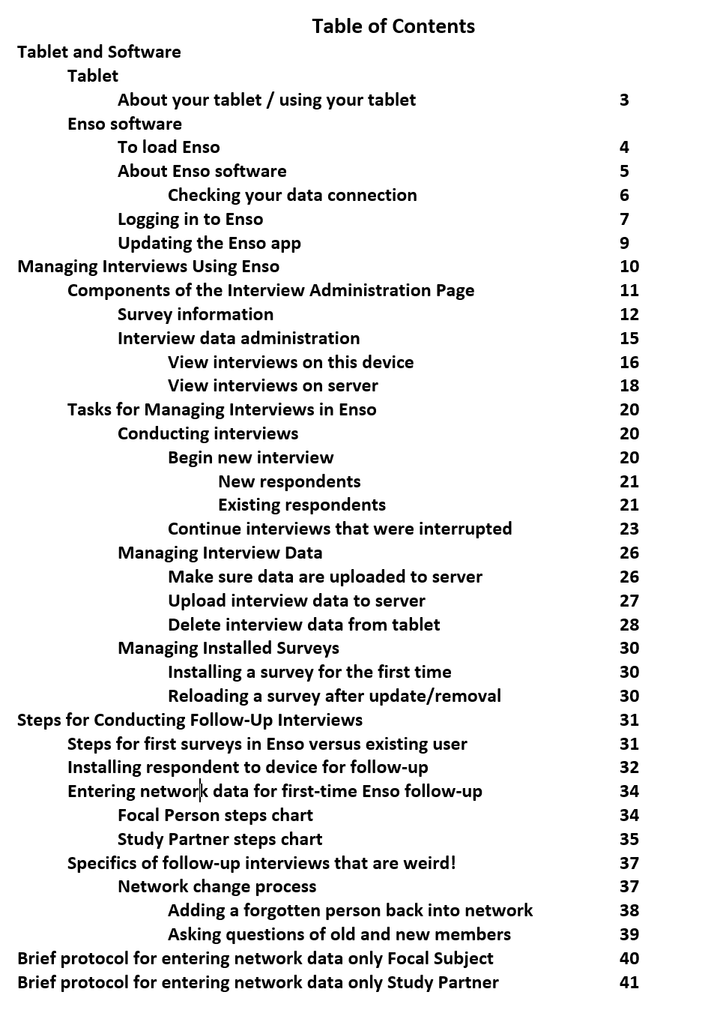
Protocol example:
Field data collection
Create a detailed protocol with a Table of Contents and screenshots of steps with software programs for training, and create “quick reference” or “cheat sheets” for brief reference when study staff are more accustomed to data collection
Notes:
. For complex studies, I highly recommend creating a detailed protocol with a table of contents and screenshots of steps with software programs for training, and then creating quick reference or cheat sheets for brief reference when study staff are more accustomed to data collection.

Slide 56
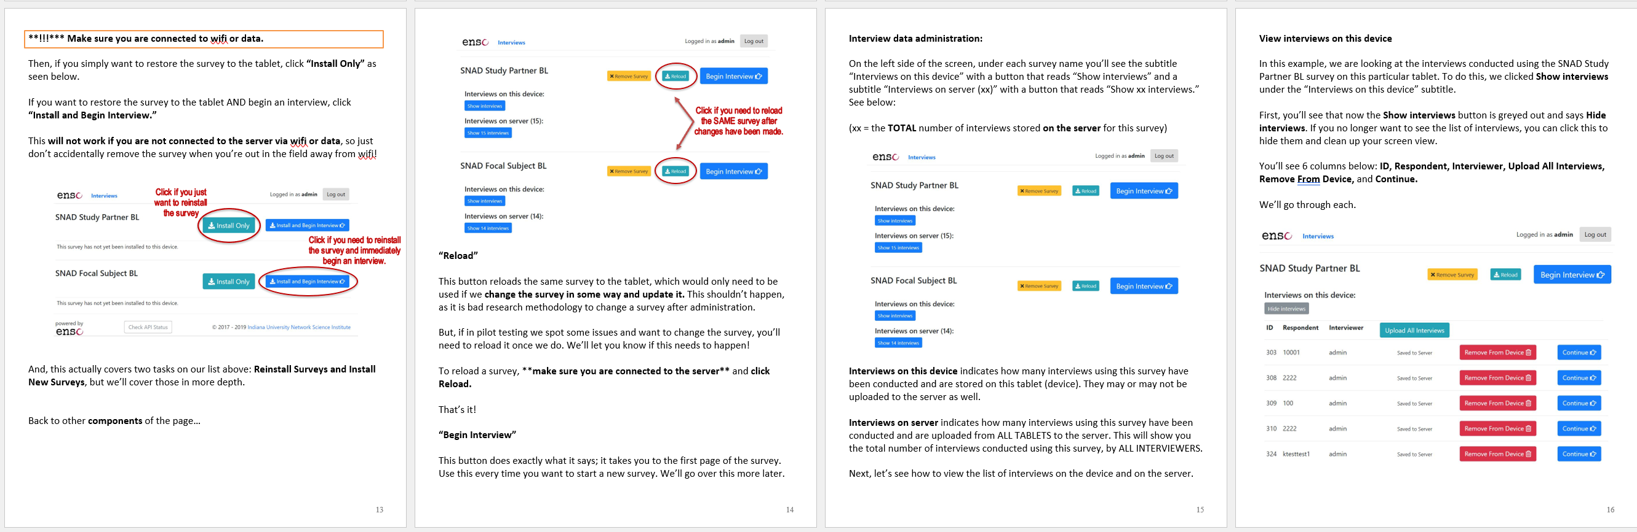
Protocol example:
Field data collection
Step-by-step means every single step!
Including screenshots helps reduce ambiguity
Helps for people who are visual learners
Can reference screenshots when reporting issues
Notes:
I know that you can’t read this, but these are four pages of the protocol from the previous slide. I want to demonstrate that there are detailed instructions including screenshots for each step of data collection. Documenting every step of the process with screenshots of the processes helps to reduce ambiguity, helps for people who are visual learners, and allows the study staff to reference specific pages or screens when reporting issues or asking questions.

Slide 57
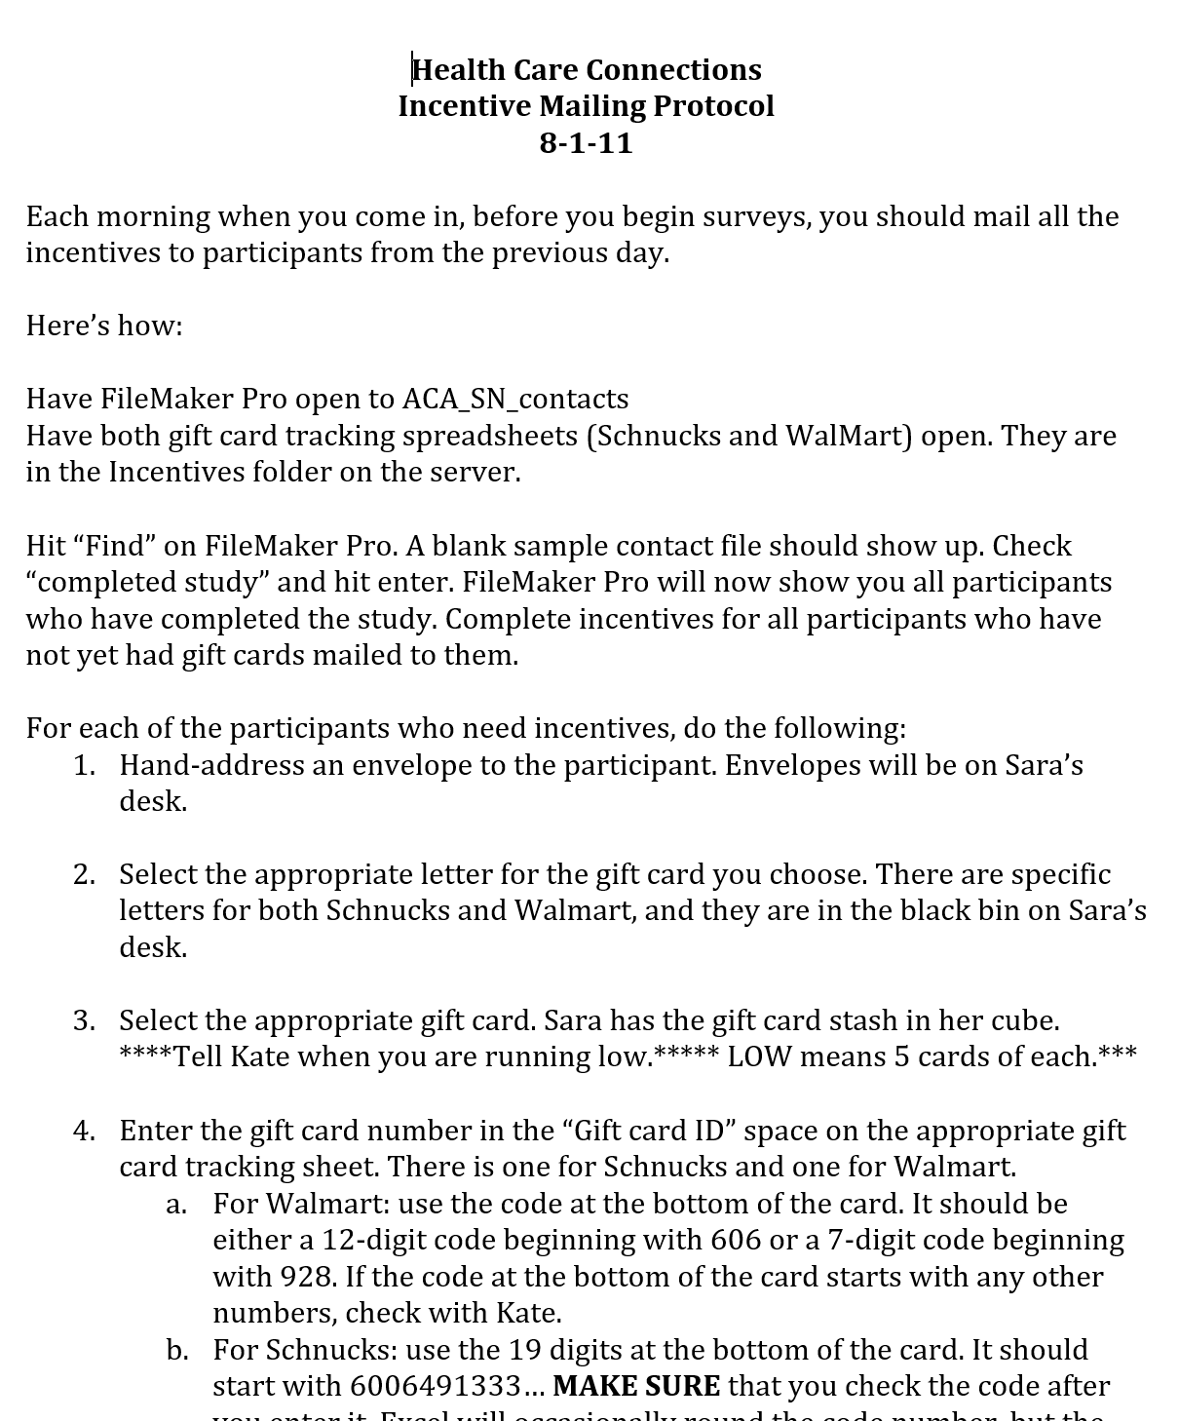
Protocol examples: “Cheat sheet” and Incentive Mailing
Notes:
You can give interviewers a quick start list that they can take with them to perform data collection in the field. In the second example, there is a list of steps required to track and mail incentives to participants in a study. There are simply so many small steps needed in these processes, that you don’t want to leave a study staff person trying to figure out what they’re supposed to do.

Slide 58
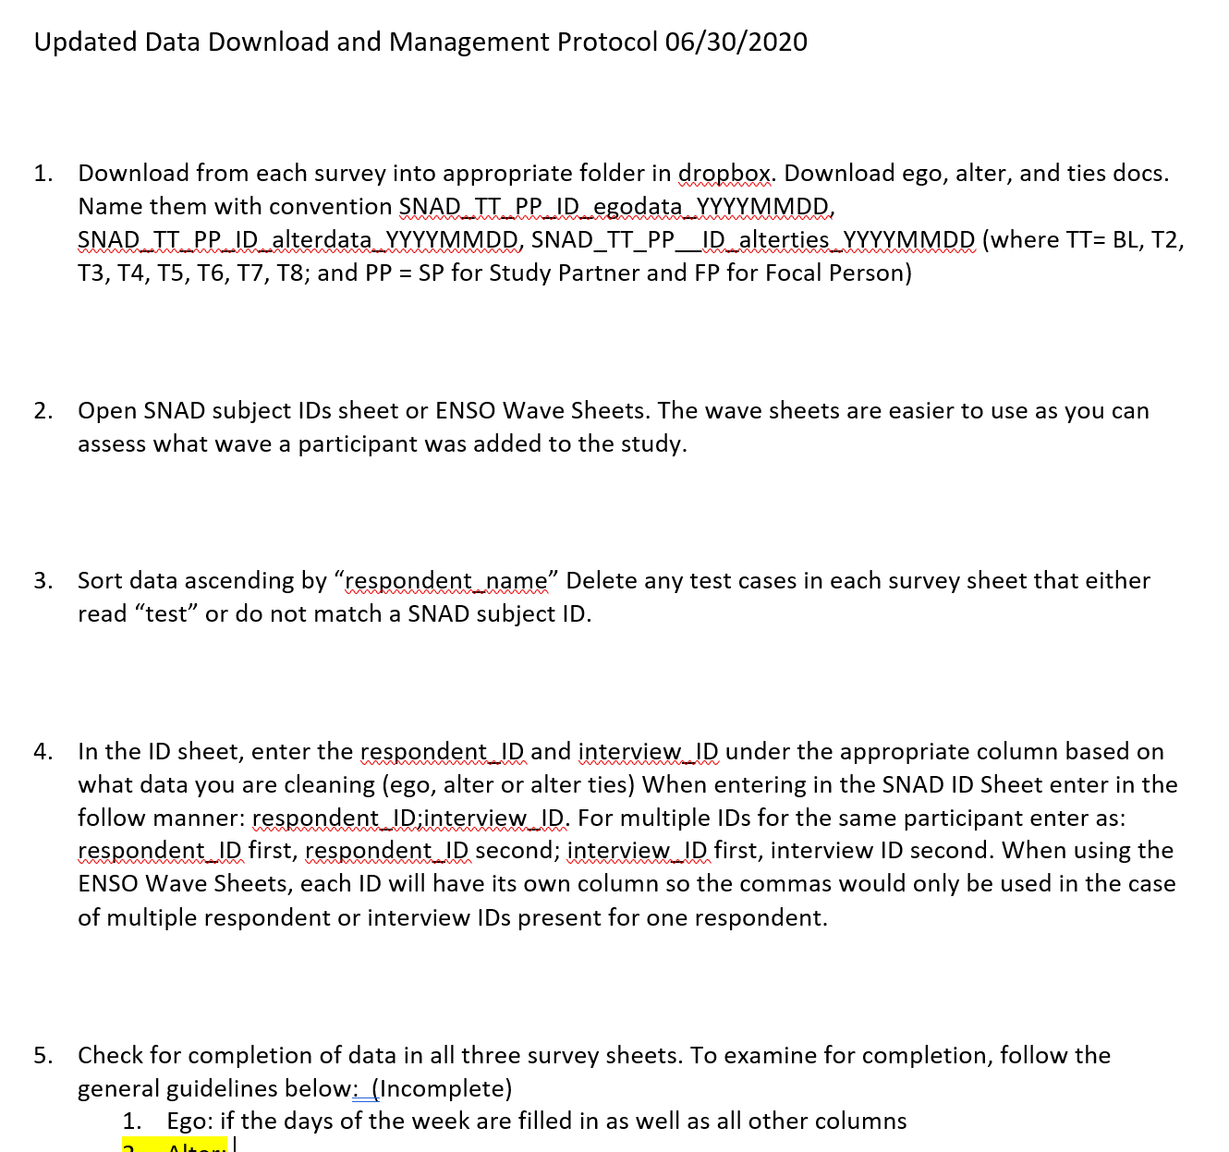
Protocol example: Data Export/ Validation/ Management
Where to export data
Naming conventions
How to check for complete data
Flagging respondents with incomplete data
Flagging redundant IDs
Flagging anything “weird”
Instructions for what to do with flagged information
Notes:
Protocols for downloading, exporting, cleaning, and valdating data are essential. For studies with multiple waves of data, checking for complete data across all waves for every participant is important, and data may need to be merged into a single dataset. You should have instructions for flagging any discrepancies and how to resolve them.

Slide 59
Creating Study Protocols
Creating protocols takes time in the planning of your study
Investing in training with protocols saves time and resources being spent on correcting errors later
Greatly increases the internal validity and rigor of your study
Contributes to transparency and reproducibility
Notes:
While creating protocols takes time in the planning of your study, investing the time in creating protocols and training study staff on these protocols saves a tremendous amount of time and resources spent on correcting errors and reducing ambiguity later. It also greatly increases the rigor and internal validity of your study, and allows for transparency so others can see exactly how your study was run, which is important for reproducibility as well as for demonstrating that all procedures were done ethically.

Slide 60
Data Collection & Management Summary
Data collection is how we make observations of our sample and translate them into inferences about our population
The mode and method of data collection will depend on your specific research question and population
Use existing, validated measures whenever possible
Create codebooks to organize and summarize data
Create protocols for every part of study implementation to reduce ambiguity and increase fidelity and rigor
Notes:
In summary, data collection is how we make observations of our sample and translate them into inferences about our population. The mode and method of data collection will depend on your specific research question and population. Use existing, validated measures whenever possible, create codebooks to organize and summarize data, and create protocols for every part of study implementation to reduce ambiguity and increase fidelity and rigor.

Slide 61
Final Thoughts:
Taking time to carefully plan all aspects of data collection and study implementation and thoroughly training study staff before you ever begin collecting data will save time and resources spent on correcting errors later.
Thank you!
Notes:
Final Thoughts:
Taking time to carefully plan all aspects of data collection and study implementation and thoroughly training study staff before you ever begin collecting data will save time and resources spent on correcting errors later.
Thank you!

Slide 62
Data Collection
Baseline Interview
Types of interviews
Types of questions
Brevity is the soul of wit!
Survey walk through
Notes:
-PHONE is quickest because there is no mailing time wait although it may take several weeks to actually reach a respondent.
-PHONE historically has the highest response rates although these are faltering with caller id and privacy manager systems.
-PHONE data are entered into the computer as they are collected so downstream data entry is eliminated
-PHONE data collection is usually the most expensive method
-MAILED surveys are less expensive
-MAILED surveys historically had lower response rates than phone
-MAILED surveys have slower response time
-MAILED surveys require some form of downstream data entry although certain types (OPSCAN or SCANTRON, or OCR scan) can be read by computers (these still require extensive editing)
-NEWER methods such as data entry kiosks and traditional methods such as face to face interviewing also work but might not be able to obtain a representative sample
-INTERNET data collection shows great promise but is crippled by difficulties in identifying respondents
-LIKERT and TRUE FALSE are appropriate if you know the entire realm of possible answers and facilitate data analysis
-OPEN-ENDED questions are appropriate if you feel that you do not have enough information to provide response options. However they require considerable work before they are ready for data analysis
-Also, consider that forcing a respondent into a given response category by designing a close-ended question is the same as coding them into a pre-conceived qualitative data category. Unless you are willing to let the respondent set the categories through a technique like concept mapping, perhaps you are better served by creating close-ended questions.

