Slide 1

Topic 7.4
Data Cleaning
Training developed by Roger Zoh, PhD
and Kate Eddens, PhD, MPH
Indiana University School of Public Health
Department of Epidemiology and Biostatistics
In collaboration with the Ministry of Health Lao PDR
Training by Applied Nutrition Research Capacity Building (ANRCB), a project of the Lao American Nutrition Initiative (LANI)
This work is made possible through support from USAID/Laos as a supplement to a USAID Cooperative Agreement #7200AA18CA00009
(LASER-PULSE) to Purdue University. Contents reflect the views of the author(s) and do not necessarily reflect those of USAID.
For more information, please contact Catholic Relief Services Laos.
Notes:
Welcome to Module 7 Statistical Analysis Topic 7.4, Data Cleaning.

Slide 2
Learning Objectives
By the end of Topic 4, participants will be able to:
Dichotomize variables
Create and use dummy variables
Address missing data and understand imputation
Conduct basic data wrangling steps such as merging and joining data
Perform these data cleaning steps in Stata
You can follow along with all commands in Stata using the DO file: “Module_7_Topic_7_4_Example_Syntax.do” and the 2017 MICS 10% random sample data file.
Notes:
By the end of Topic 4, participants will be able to: Dichotomize variables, Create and use dummy variables, Address missing data and understand imputation, Conduct basic data wrangling steps such as merging and joining data, and Perform these data cleaning steps in Stata. Please note that you can follow along with all commands in Stata syntax with the DO file “Module 7 Topic 7_4 Example Syntax” and the 2017 MICS 10% random sample data file.

Slide 3
Dichotomize variables
Dichotomizing a variable means to create a binary variable from a variable that has more than two categories or more than two numeric values
Create a new variable using conditional statements
  Generate new variable command is “gen”
  variable will be the name of the new variable we would like to create
  We then set it equal to something which will be the equation or value we use to create the new variable
  “replace” is used to assign additional values or categories to the variable
Example: From the MICS data, create a new variable that takes the value 1 when an infant is less than one year of age and 0 otherwise.
gen variable=something
replace variable=something
Notes:
We’ll begin with dichotomizing variables. Dichotomizing a variable means to create a binary variable from a variable that has more than two categories or more than two numeric values. We discussed why we might want to create a version of a variable with less detail in Topic 7.3, and here we’ll walk through how to do this in Stata. We will create a new variable using conditional statements. Here we have a statement that tells Stata to generate a new variable, or “gen.” We tell Stata to generate a variable, and we give variable a name, and then we tell Stata what that variable will be, meaning the equation or value of an existing variable that we want to use to create the new one. We use “replace” in order to assign additional values to our new variable. Let’s look at an example from the MICS data in which we create a new variable that takes the value 1 when an infant is less than one year of age, and 0 otherwise.

Slide 4
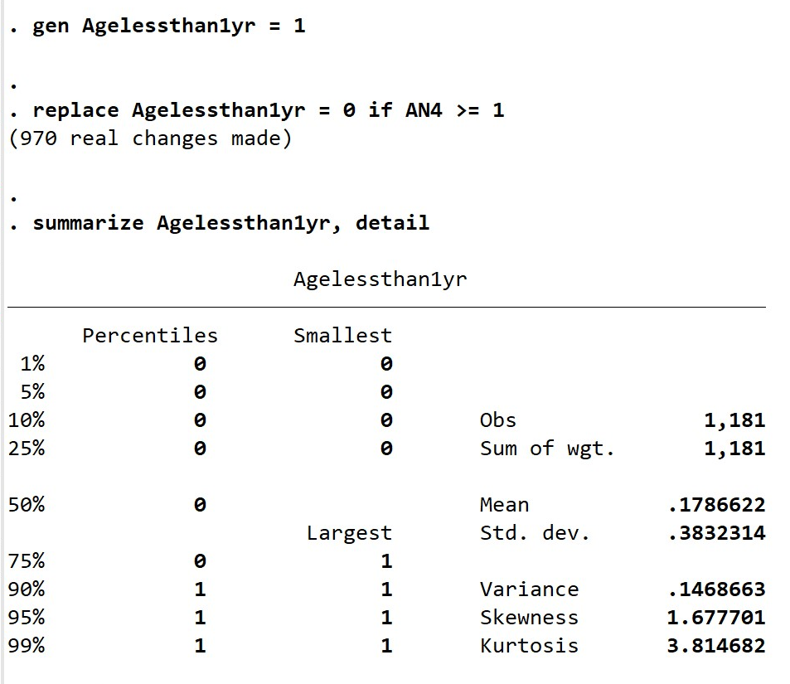
Dichotomize variable
summarize AN4, detail
to see central tendency and dispersion of values for age of child in years
gen Agelessthan1yr = 1
replace Agelessthan1yr = 0 if AN4 >= 1
summarize Agelessthan1yr, detail
Creates a new variable for age less than 1 year =1. Replace 1 with 0 if age is 1 year old or older
Notes:
First, we summarize the variable AN4 which is age of child in years with detail to observe the central tendency and spread, as we covered in Topic 7.3. We’ve already decided we want the split to be between 0 years of age and 1 or more years of age, so we don’t have to make decisions based on the spread, but this helps us to check our work and see how the new variable will be distributed. We then use the command “gen” and our new variable name, “Agelessthan1yr” which we set equal to 1. We then ask Stata to replace Agelessthan1yr with zero if the value of AN4 is greater than or equal to 1, which means 1 year of age. Then, we summarize our new variable with detail to assess the results.

Slide 5
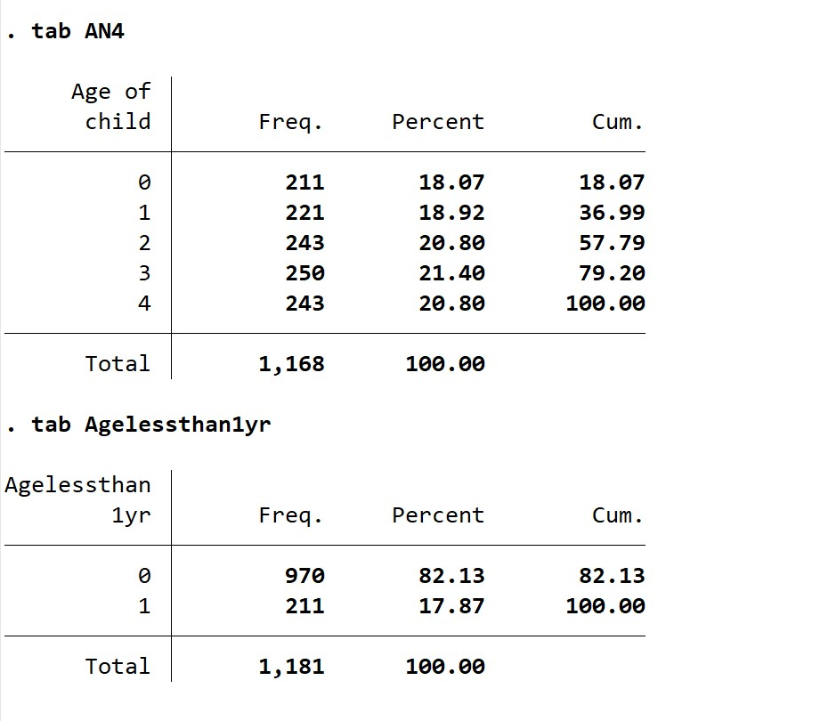
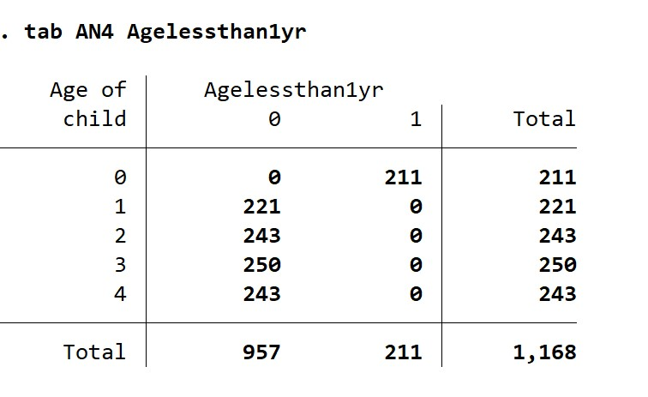
Dichotomize variable
Check recoding or variable creation by comparing frequency tables of each and making sure the new variable has the expected frequencies or creating crosstabs to make sure the old values were coded correctly into new values.
tab AN4
tab Agelessthan1yr
tab AN4 Agelessthan1yr
Notes:
I always recommend checking any variable recoding or new variable creation by comparing frequency tables of the old and new variables, or by running a crosstabulation of the two variables. This helps us see if the old values were correctly coded into the new values. We have frequency tables for AN4 and our new Agelessthan1yr variable on the left, and a crosstabs on the right, and we can see that the values seem to be recoded properly.

Slide 6
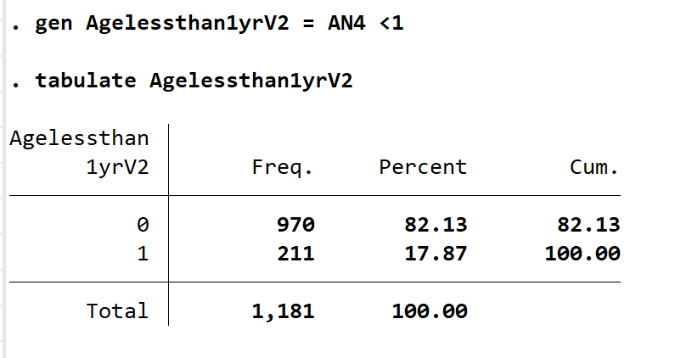
Another simple way to dichotomize
Add output to equal desired numeric value
gen Agelessthan1yrV2 = AN4 <1
tabulate Agelessthan1yrV2
gen new variable = (condition) if another condition
Notes:
You can also dichotomize by simply creating a new variable that you set equal to some condition of another variable. In this example, we generate a new variable with the “gen” command and call it age less than one year version 2 (Agelessthan1yrV2) and set it equal to AN4 < 1 year of age. Then Stata creates this new variable with all observations of children less than 1 yer of age with a value of 1 and then it defaults to assigning a value of zero to the remaining observations.

Slide 7
Be careful with missing data
Notes:
Be sure to be aware of missing data that might be transformed into your new value. We see that there are only 1,168 observations of AN4, but we are getting 1,181 observations of our new variable, so it is likely coding some children who do not have a value for age as a zero for our new variables. We’ll look at how to approach missing data later in this topic.

Slide 8
Dichotomize/Dummy Variables from Continuous Data
The “cut” command is your friend for creating dummy variables from continuous data variables
Cut points are from smallest to largest values
Example: Create 4 categories for BMI for all children with BMI less than 30
egen new variable = cut(variable), at(cut points) icodes
Notes:
When you want to create categories of a new variable from a continuous variable, the command cut is your friend! You can create cut points from the distribution of the variable from smallest to largest values. For example, we’ll use the cut function to look at creating 4 categories of BMI for all children in the sample who have a BMI less than 30

Slide 9
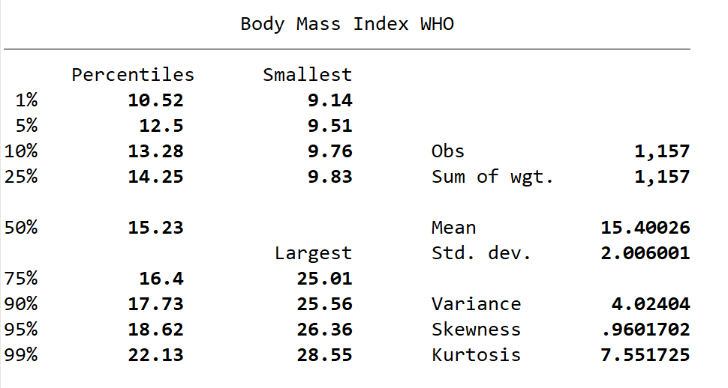
Dichotomize/Dummy Variables from Continuous Data: Find cutpoints
First, we’ll summarize BMI less than 30 to find the quartiles in the distribution
summarize BMI if BMI <30, detail
Q1: 9.14 to 14.25
Q2: 14.26 to 15.23
Q3: 15.24 to 16.40
Q4: 16.41 to 28.55
Notes:
First, we’ll summarize BMI for those with BMI less than 30 so that we can see where the quartiles are in the distribution. We see that there are 1,157 observations of BMI less than 30. If you recall from 7.3, this summary detail gives us the smallest four values and the largest 4 values, and the values for each listed percentile. Here we see that our smallest value is 9.14, so our first quartile contains BMI from the smallest value of 9.14 to 14.25, which is the 25th percentile value. The next quartile is from 14.26 to 15.23, our 50th percentile value, the third percentile is from 15.24 to our 75th percentile value of 16.40, and 16.41 to our largest value 28.55 is our highest quartile. Now we can use these values to create cut points.

Slide 10
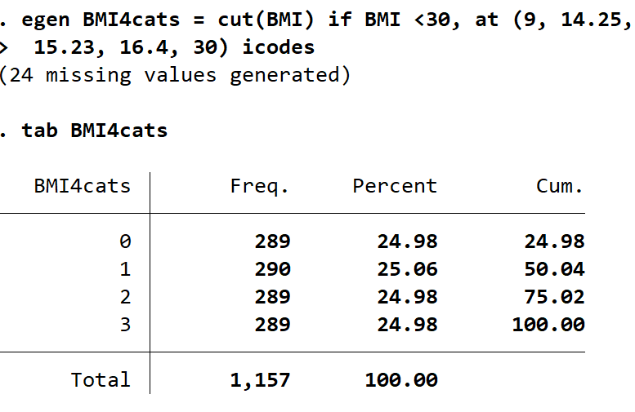
Dichotomize/Dummy Variables from Continuous Data: Create groups
Example: Create 4 categories for BMI for BMI that is less than 30
egen BMI4cats = cut(BMI) if BMI <30, at (9, 14.25, 15.23, 16.4, 30) icodes
tab BMI4cats
Q1: 9.14 to 14.25
Q2: 14.26 to 15.23
Q3: 15.24 to 16.40
Q4: 16.41 to 28.55
Notes:
We use the values we found for the quartile ranges to create the cutpoints at 9 for the lowest, then the upper limit of the first quartile, 14.25, then the upper limit for the second quartile, 15.23, and so on. When we run our command and then look at the table of our new variable, we can see that we did an excellent job of making roughly equivalent quartile categories for BMI.

Slide 11
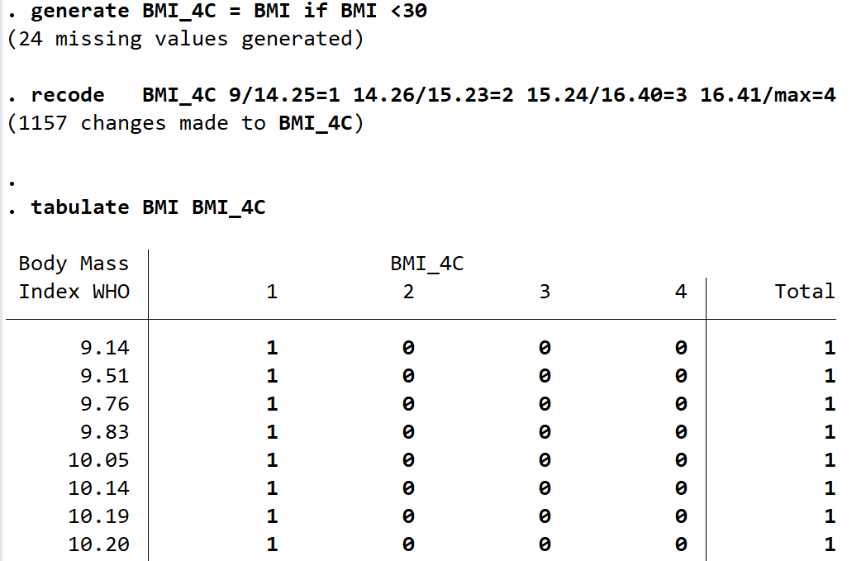
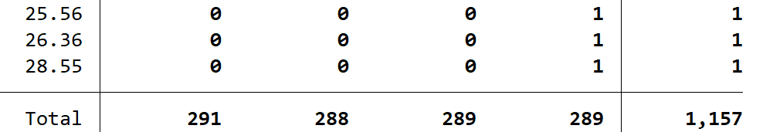
Recoding Variables
Example: Create 4 categories for BMI for BMI that is less than 30
generate BMI_4C = BMI if BMI <30
recode BMI_4C 9/14.25=1 14.26/15.23=2 15.24/16.40=3 16.41/max=4
(“/” indicates the range of values between both numbers)
Q1: 9.14 to 14.25
Q2: 14.26 to 15.23
Q3: 15.24 to 16.40
Q4: 16.41 to 28.55
Note: You can recode BMI directly into these categories, but you will LOSE your original BMI values if you don’t create a new variable.
Notes:
Similarly, we can use the “recode” function and command to recode BMI into categories. First, create a new variable so that you do not recode into the SAME variable and replace your original values. If you want to replace your original values, you don’t need the new variable, but I would strongly suggest that you never recode into the same variable. Here, our new variable is called BMI_4C, for BMI 4 categories. Then, you type the command “recode” and here you can list the values that you want to go into the new categories. In this example, a forward slash indicates a range of values. We’re using the same range of values here as in the previous example. You can see in the output that when we crosstab BMI and BMI_4C, we get the 4 categories of BMI as columns, and while I couldn’t put the entire output here, the beginning and end show the values for BMI are properly coded.

Slide 12
Recoding Variables
You can find additional syntax for recoding variables by searching “recode” through the Help Menu in Stata, but here is the basic syntax:
recode varlist (rule) [(rule) ...] [, generate(newvar)]
where varlist is any variable or list of variables you want to recode,
“rule” is any of the rules below that you’d like to apply to recode (see table),
nonmissing all nonmissing values not changed by the rules
missing all missing values (., .a, .b,..., .z) not changed by the rules
else all nonmissing and missing values not changed by the rules
* synonym for else
+--------------------------------------------------------------------------------------------+
| rule | Example | Meaning |
|------------------------------+---------------------+------------------------------------- |
| # = # | 3 = 1 | 3 recoded to 1 |
| # # = # | 2 . = 9 | 2 and . recoded to 9 |
| #/# = # | 1/5 = 4 | 1 through 5 recoded to 4 |
| nonmissing = # | nonmiss = 8 | all other nonmissing to 8 |
| missing = # | miss = 9 | all other missings to 9 |
+--------------------------------------------------------------------------------------------+
Notes:
You can find additional syntax for recoding variables by searching “recode” through the Help Menu in Stata, but here the basic syntax consists of recode, and then the variable or list of variables to recode, and then a set of rules for recoding, examples of which are shown in the table. You can add “generate newvariable” to the end to tell Stata to recode your variable into a new variable rather than creating the new variable first, as we did in the previous slide.

Slide 13
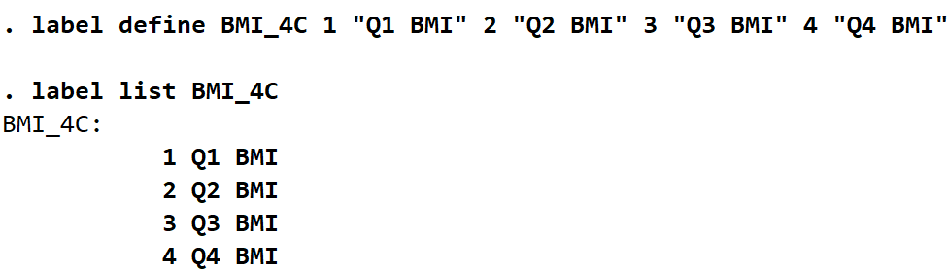
Label Variables
We can add labels for our variables and variable values with the “label” function.
To see a list of all our variable value labels, type label list
  Try this on the MICS random sample to see all value labels
To define a value label for a variable named “mylabel1”, we type:
label define mylabel1 1 "Value 1" 2 "Value 2"
  to add additional labels for values, we can use the term “add” at the end: label define mylabel1 0 "Value 0" 3 "Value 3", add
Example: label our BMI categories as Q1, Q2, Q3, Q4
label define BMI_4C 1 "Q1 BMI" 2 "Q2 BMI" 3 "Q3 BMI" 4 "Q4 BMI"
label list BMI_4C
Notes:
We can add labels for our variables and values with the “label” function. To see a list of value labels for all of the variables in your dataset, type label list. You should try this with the MICS sample and see how values are labeled. You can also type label list for one variable, or a few. To define labels for a variable, for example, one named “mylabel1”, we can type the command “label define” and then the variable name, and then each value of that variable and the label you would like to attach to it, in quotation marks. You can repeat this for all values you want to label. If you want to add additional labels later, you can simply do the same command with the word “add” at the end. Say we’d like to label our BMI categories as quartile 1, quartile 2, and so on. We can type label define, then our variable BMI_4C, then the values and the labels. We can then type label list BMI_4C to view our value labels.

Slide 14
Label Variables
Label the dataset “My data”
label data "My data"
Label v1 “First variable”
label variable v1 "First variable"
Define value label named mylabel1
label define mylabel1 1 "Value 1" 2 "Value 2"
Add labels for values 0 and 3 to mylabel1
label define mylabel1 0 "Value 0" 3 "Value 3", add
Copy mylabel1 to mylabel2
label copy mylabel1 mylabel2
Redefine value 0 in mylabel2 to mean “Null”
label define mylabel2 0 "Null", modify
Apply value label mylabel1 to v1
label values v1 mylabel1
Save all currently defined value labels to mylabels.do for use with other datasets
label save using mylabels.do
List names and contents of all value labels
label list
Drop all value labels
label drop _all
Notes:
You can also search the “label” function in the Help Menu to find commands for labeling your new variables or recodes. Here is a list of commands you may find useful, but you can find more in Stata Help.

Slide 15
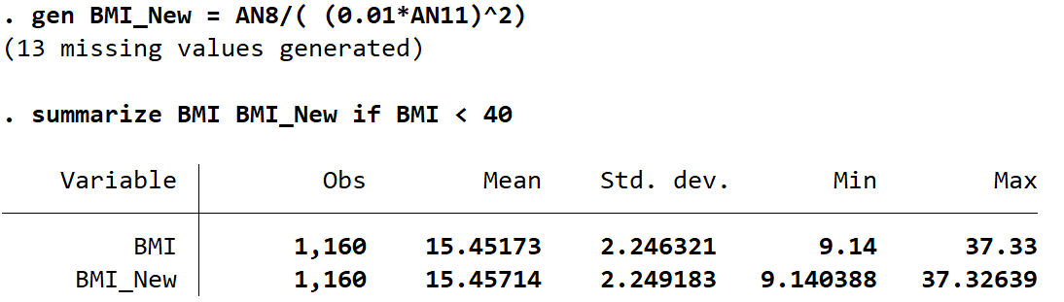
Creating New Variables
Create a new variable using a formula, for example calculating BMI from weight and height:
AN8 = weight in kilograms
AN11 = height or length in centimeters
BMI = weight in kg / (height in m)^2
gen BMI_New = AN8/( (0.01*AN11)^2)
summarize BMI BMI_New if BMI < 40
Notes:
You’ve seen how we create new variables with the gen, generate, and egen commands throughout this topic. This is just one example of how you can also create a variable by inputting a formula that transforms or uses other variables. In this example, we can use the actual formula for BMI of weight in kilograms divided by height in meters squared because we have weight in kilograms in the MICS data, variable AN8, and length or height in centimeters, variable AN11, which we can convert to meters squared. We simply type the gen command with the name of our new variable, “BMI_New” and then set it equal to the formula for BMI with our variables in place. Then, we can summarize the data alongside the BMI variable in the MICS data to make sure that our formula was correct. We see from summary measures that it is the same.

Slide 16
Missing data
Sometimes in our datasets we have values that we couldn’t observe
These may be represented as empty cells, a period (.), or with unusually high values like 99.99 or 99999.99, etc.
Use describe to see if you have missing data
Please use the function mdesc in Stata to find information about missing data (if missing data is coded as .)
  You may need to install mdesc in your version of Stata, which you can do by searching for it in the “Help” menu, and clicking “install”
Notes:
Sometimes in our datasets we have values that we couldn’t observe. These may be represented as empty cells, a period, or with unusually high values like 99.99 or 99999. You can use the describe function to see if you have missing data. Please use the mdesc function in Stata to find information about missing data, if missing data is coded as a period. You may need to install the mdesc package in your version of Stata, which you can do by searching for it in the “Help” menu, and clicking “install”.

Slide 17
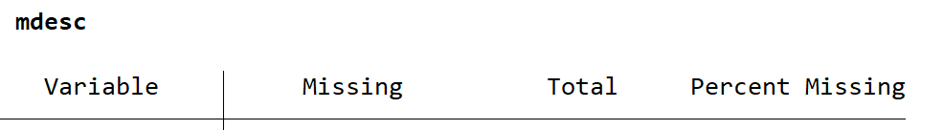
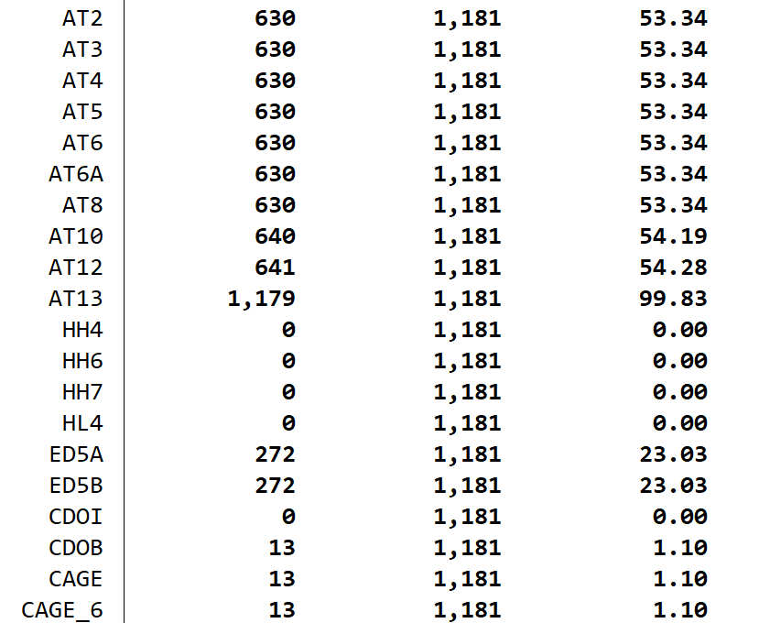
Missing data
When we perform mdesc on the MICS data sample, we see that it will give us information on the number and proportion missing for each variable, given that those missing values were indicated by a period “.”
Notes:
When we perform mdesc on the MICS data sample, we see that it will give us information on the number and proportion missing for each variable, given that those missing values were indicated by a period.

Slide 18
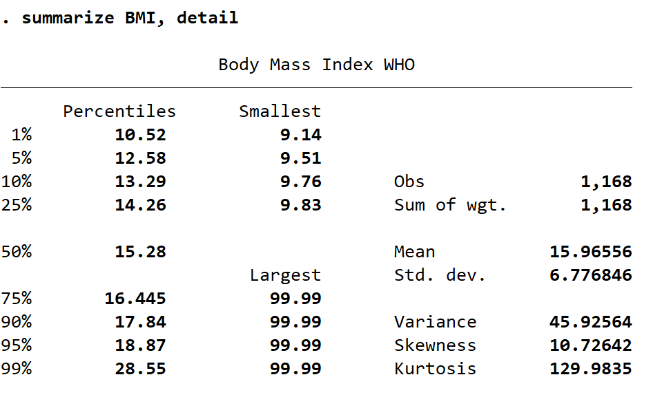
Missing Data
summarize BMI, detail
Notes:
When we summarize BMI with detail, we see that the largest percentiles contain values of 99.99, which is odd, because I doubt that there are actual children in this sample who have a BMI of 99.99! Sometimes you have to go back to documentation of the survey or data collection process and see what other potential entries for missing values may be for each variable or dataset.

Slide 19
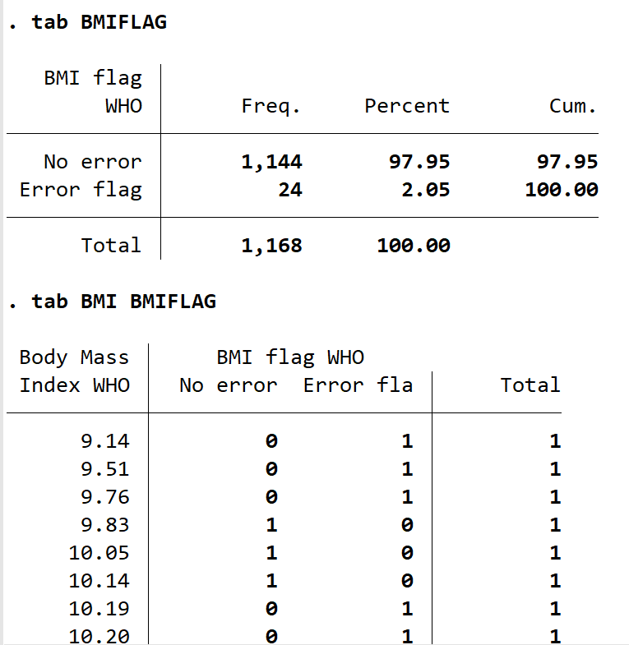
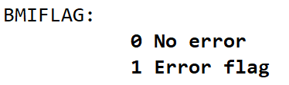
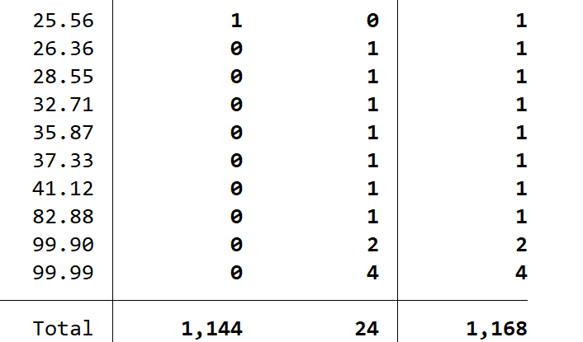
Missing data
MICS has a “BMIFLAG” variable that tells us when a reported BMI is likely an error.
Typing the command label list gives us a list of the value labels for variables, where we find:
Notes:
If we visit the documentation for the MICS data, or even just by looking at all of the variables, we see that there’s a flag for errors in BMI reporting, called “BMIFLAG.” If we type the command “label list” we’ll find a list of all labels for categorical variables in the dataset, and we see that BMIFLAG value of 1 means that there’s an error with that BMI. If we look at the table of BMIFLAG, we see there are 24 errors, and by creating a crosstab of BMI and BMIFLAG, we see that all of the BMI values of 99 and greater are errors, and, in fact, all of the values of BMI greater than 25.56 are flagged as errors.

Slide 20
Missing Data: How to uncover?
search mdesc and install
mdesc variable1 variable 2 …
search mvpatterns and install
mvpatterns
or
mvpatterns variable1 variables 2 ….
Notes:
You can search for and install packages for the commands “mdesc” and “mvpatterns” in the Stata help menu. You can run either command for the entire dataset, or for a list of variables. Mdesc will tell you the number and percent of observations coded as missing with periods, as mentioned before.

Slide 21
Missingness pattern
You may want to investigate missingness pattern
Pattern shows “+” for valid value and “.” for missing value
Example: mvpatterns BMI CAGE UB9 AN13D IM2
mvpatterns
or
mvpatterns variable1 variable2 ….
Notes:
The command mvpatterns will give you a list of each variable, variable type, number of observations, number of missing values or “mv”, and the variable label for a list of variables that you provide or on the entire dataset. It will show you patterns of missing values, as well, with a plus sign indicating that the value is valid, and a period indicating that it is missing. We see in this output that several variables had observations missing for 13 participants or rows, and when we look at the patterns, it appears that for 13 rows, data were completely missing, indicated by five periods.

Slide 22
Imputation
Sometimes it is ok to remove all the rows with missing data from our data set.
Other times, it is not! When we cannot remove all the rows with missing data, we can use multiple imputation approach.
While multiple imputation may be beyond the scope of this training, you can find information:
  Search for “multiple imputation” in the Help Menu in Stata and find the mi suite of commands with instruction
  Useful link on Multiple imputation: https://stats.oarc.ucla.edu/stata/seminars/mi_in_stata_pt1_new/
Notes:
Sometimes it is okay to remove all the rows with missing data from our data set, and other times, it is not! When we cannot remove all of the rows with missing data, we can use a multiple imputation approach to predict and impute values for our missing observations using what we know about the other variables and observations. In short, it uses modeling to predict what the value of the missing data would be given all of the other data we have for that participant. This is beyond the scope of this specific training, but can be done in collaboration with a statistician, or by searching the Help Menu for “multiple imputation” and following the instruction there. This takes time and thoughtfulness to complete. There is also a link to a useful document on multiple imputation in this slide.

Slide 23
Concatenate two datasets, by row
We may collect data at different time periods, by different people, or have it stored in different places, and need to merge our data matrices
Assuming two datasets or data matrices have:
  observations/participants in rows and variables in columns, and;
  the same number of variables, then…
We can concatenate (append, or join) the two datasets by row, using:
append using filename (or path to file)
Notes:
Sometimes we might need to join data sets or data matrices together, for instance if we have collected data at different time periods, or from different populations, or have it stored in separate places. Assuming two datasets or data matrices have observations or participants in the rows and variables in the columns, and that they have the same number of variables, we can concatenate – meaning to join, or append – the two datasets by row, using the command “append using” and the filenames or file paths to the two datasets.

Slide 24
Example concatenate two data sets, by row
Combine samples from two data sets identified by the variable svar
clear
append using "J:\FromBox\LAOS_STATA\Week7_4\LaosPDRGroup1.dta" "J:\FromBox\LAOS_STATA\Week7_4\LaosPDRGroup2.dta"
tab svar
Notes:
In this example, imagine we’ve created two different Stata datasets called LaosPDRGRoup1 with 394 rows of observation and LaosPDRGroup2 with 393 rows of observation, and he created a variable called “svar” or “shared variable” which had a value of 1 for Group 1 and a value of 2 for Group 2. Running the “append using” command with the filepath to each dataset, and then running a table for the variable svar tells us that the datasets were joined properly, as we can see the frequency of svar 1 is 394, and svar 2 is 393, which are each the “N”s for each data group.

Slide 25
Concatenate two data sets, by variables
Sometimes we want to connect two datasets with the same sample (participants or observations) but with different variables
Sometimes both datasets might have similar variables
Both datasets need to have at least one common variable with which the merge will be done
We can use the merge function in Stata
merge 1:1 variable using dataset
Notes:
In other cases, we may want to connect two datasets with the same sample or participants, but with different variables. Sometimes both datasets might have similar variables but both must have at least one common variable with which the merge can be performed. We can do this with the merge function in Stata, by typing the command merge 1:1, then the variable that the datasets share, and then using and the name of the dataset that we will merge with the current dataset we have open.

Slide 26
Concatenate two data sets by variables,
Example: Describe datasets
Notes:
In these example datasets, one is called “Subset 1” and contains the four variables UB9, CAGE, BMI, and SampleID. In “Subset 2” we have variables IM2, AN13D, BMI, and SampleID again. While they share BMI in common, we can’t merge with BMI because values for BMI are not unique to each participant. SampleID is a unique value for each participant or observation.

Slide 27
Concatenate two data sets by variables,
Example: Merge
Merge 1:1 SampleID using “J:\FromBox\LAOS_STATA\Week7_4\Subset2.dta”
Notes:
With Subset 1 open, we use the merge 1:1 command with SampleID using the filepath to the Subset 2 dataset. You can see that it gives us a result in which all of the 1,181 observations were successfully matched, and zero were not matched. We can use “Describe” to see that all of our variables are in the new dataset, with no duplicates.

Slide 28
Practice
Choose few variables of interest from the LAOPDR_MICS2017_random10.dta data set
Select at least 10 variables of interest not all categorical (include weight and BMI for example)
Create a dummy variable for the continuous variable of your choice
Check if the variables you selected have missing or unusual (too small/too large) values
Split the data set with equal number of samples and then recombine them
Split the variables in two sets (5 variables in 1 and 5 in another) then merge the data using the sample IDs.
Notes:
You may choose to practice these data management skills by repeating some of the commands we’ve introduced today on variables of interest in the Lao PDR MICS 2017 random 10% sample data. You can select at least 10 variables of interest including both categorical and continuous data types, create dummy variables, examine missing data, split your dataset and merge by row and by variables.

Slide 29
In summary, you should now be able to…
Use Stata commands “gen”, “generate”, “replace”, “egen”, “cut”, “recode”, and “label” to create, label, recode, and dichotomize variables
Identify missing values using the “mdesc” and “mvpatterns” commands, and by using “summarize” and “describe” to examine data values that may seem out of the ordinary
Understand the basics of imputing missing values and know where to find more information
Install packages or functions in Stata
Combine datasets by row using “append” and by variable using “merge 1:1” commands
**All syntax is in the DO file “Module_7_Topic_7_4_Example_Syntax.do”

Slide 30
Final Thoughts:
Data management is essential to conducting rigorous data analysis and having accurate results. It can be very easy to make and report incorrect conclusions because of small errors such as missing data or improper recodes. Invest the time in cleaning your dataset well and recording all the steps you’ve taken, and you’ll save future time, resources, and energy!
Notes:
Final Thoughts: Data management is essential to conducting rigorous data analysis and having accurate results. It can be very easy to make and report incorrect conclusions because of small errors such as missing data or improper recodes. Invest the time in cleaning your dataset well and recording all the steps you’ve taken, and you’ll save future time, resources, and energy!

