Slide 1

Topic 7.5:
Data Visualization
Training developed by Roger Zoh, PhD and Kate Eddens, PhD, MPH
Indiana University School of Public Health
Department of Epidemiology and Biostatistics
In collaboration with the Ministry of Health Lao PDR
Training by Applied Nutrition Research Capacity Building (ANRCB), a project of the Lao American Nutrition Initiative (LANI)
This work is made possible through support from USAID/Laos as a supplement to a USAID Cooperative Agreement #7200AA18CA00009
(LASER-PULSE) to Purdue University. Contents reflect the views of the author(s) and do not necessarily reflect those of USAID.
For more information, please contact Catholic Relief Services Laos.
Notes:
Welcome to Module 7 Statistical Analysis, Topic 7.5: Data Visualization.

Slide 2

Learning Objectives
By the end of Topic 7.5, you should be able to:
Choose the appropriate graphical display for each type of data
Perform basic data display commands in STATA including graphical summaries of variables and graphical comparisons
Be aware of other options for creating visualizations of data
Data Visualization
You can create the graphs in this topic using the Stata DO file “Module 7 Topic 7.5 Stata Example Syntax” and the MICS 2017 10% random sample data.
Notes:
By the end of Topic 7.5, you should be able to: Choose the appropriate graphical display for each type of data, Perform basic data display commands in STATA including graphical summaries of variables and graphical comparisons, and be aware of other options for creating visualizations of data. You can create the graphs in this topic using the Stata DO file Module 7 Topic 7.5 Stata Example Syntax and the MICS 2017 10% random sample data.

Slide 3
Data Presentation
There’s a story behind every data set. Your job is to tell the story as accurately as possible
Some data sets are simple: Weight and height study
Some data sets are complex: Network or relational datasets
Data presentation is one of the most important tools you will learn and improve upon.
It is the first step in any data analysis
Carefully executed, it can change a plain presentation or report into stellar work
LOOK AT THE DATA
Graphs and Summary Measures: Summarize study data in a concise and meaningful way
Notes:
Why is data presentation and visualization important? There’s a story behind every dataset and your job is to tell the story as accurately as possible. Some data sets are simple, such as one that might only have weight and height, which are two measures that are universally understood. Some data sets are very complex, like relational or network data. The concepts can be challenging to communicate. One of the best ways we can communicate our story and make data accessible is through data presentation. The essential function of data presentation is to look at your data. It’s the first step in any data analysis. When we really understand our data and learn to communicate it, this can become a very powerful tool. We can use graphs and/or summary measures to look at our data. Both may summarize study data in a concise and meaningful way if you pick the appropriate data presentation tool.

Slide 4
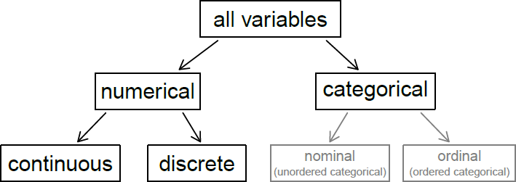
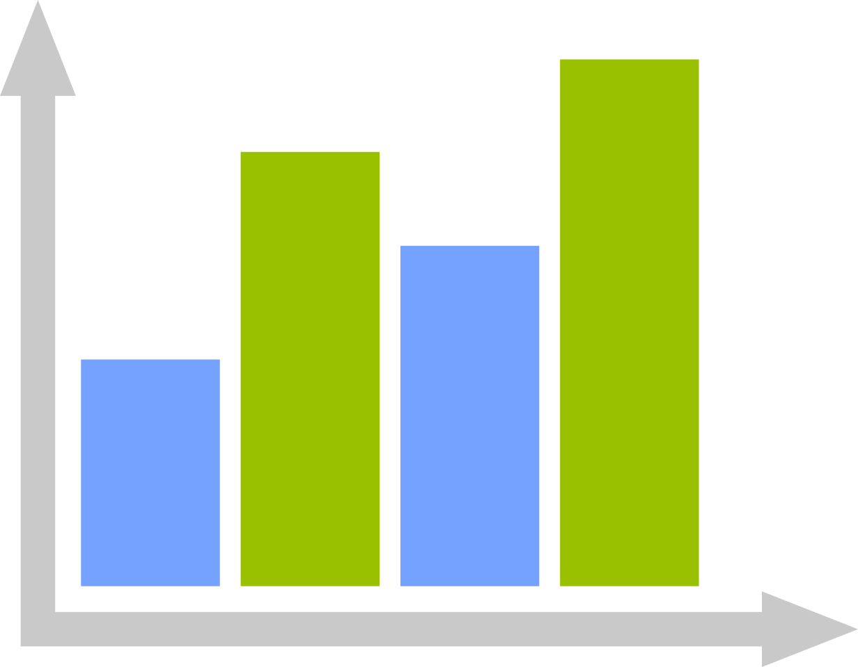
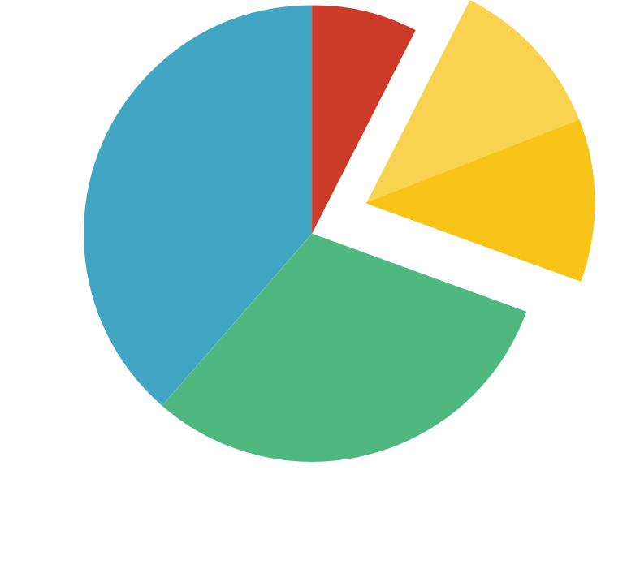

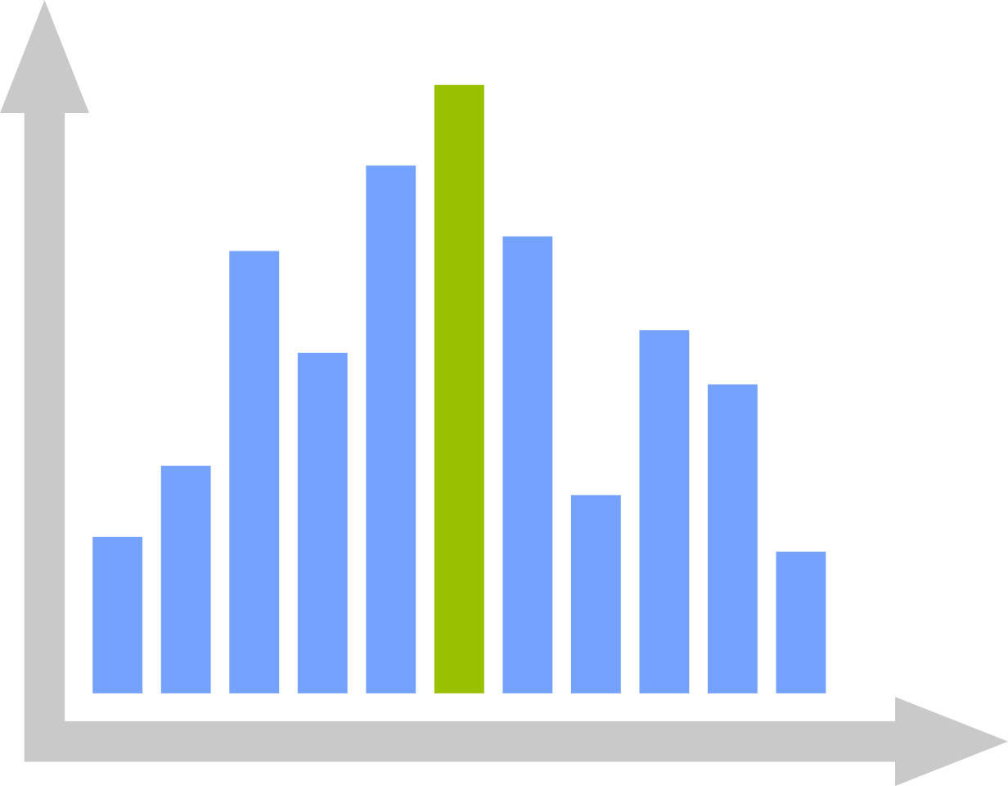
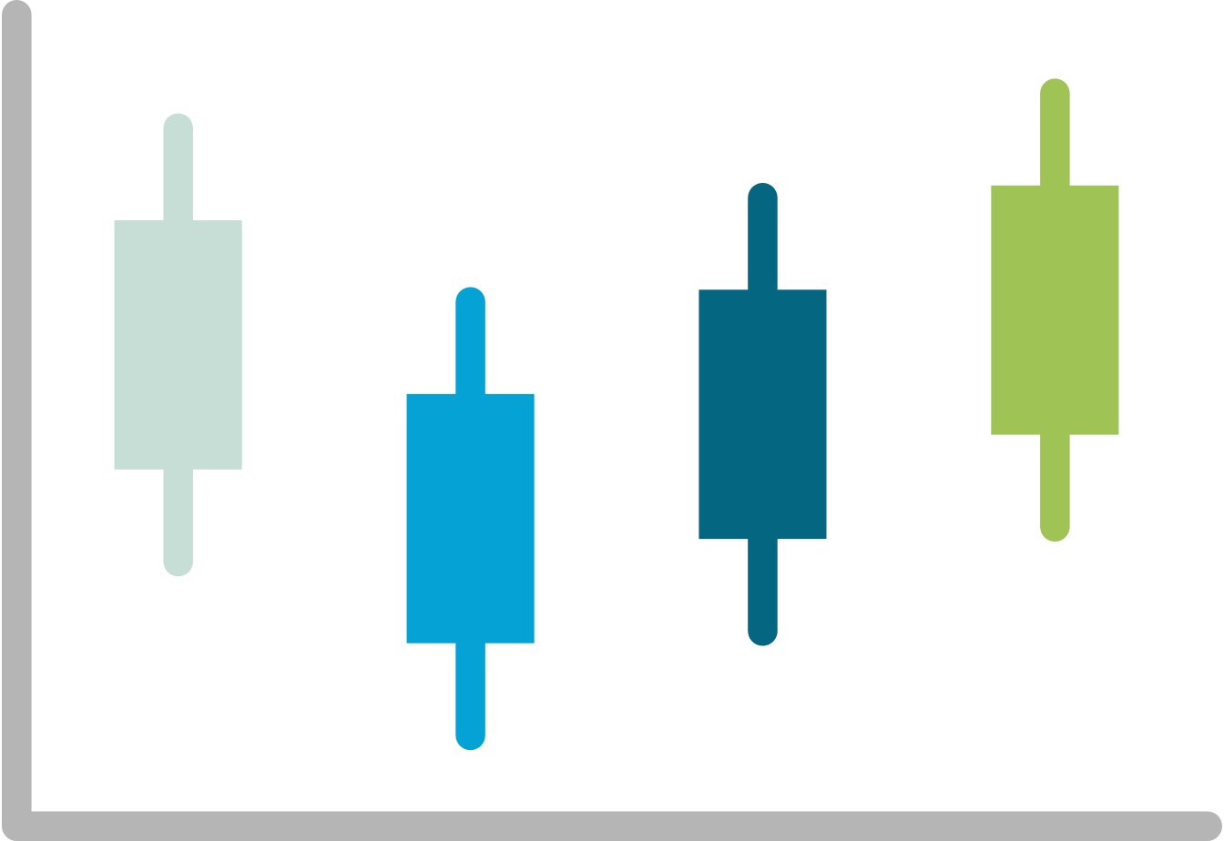
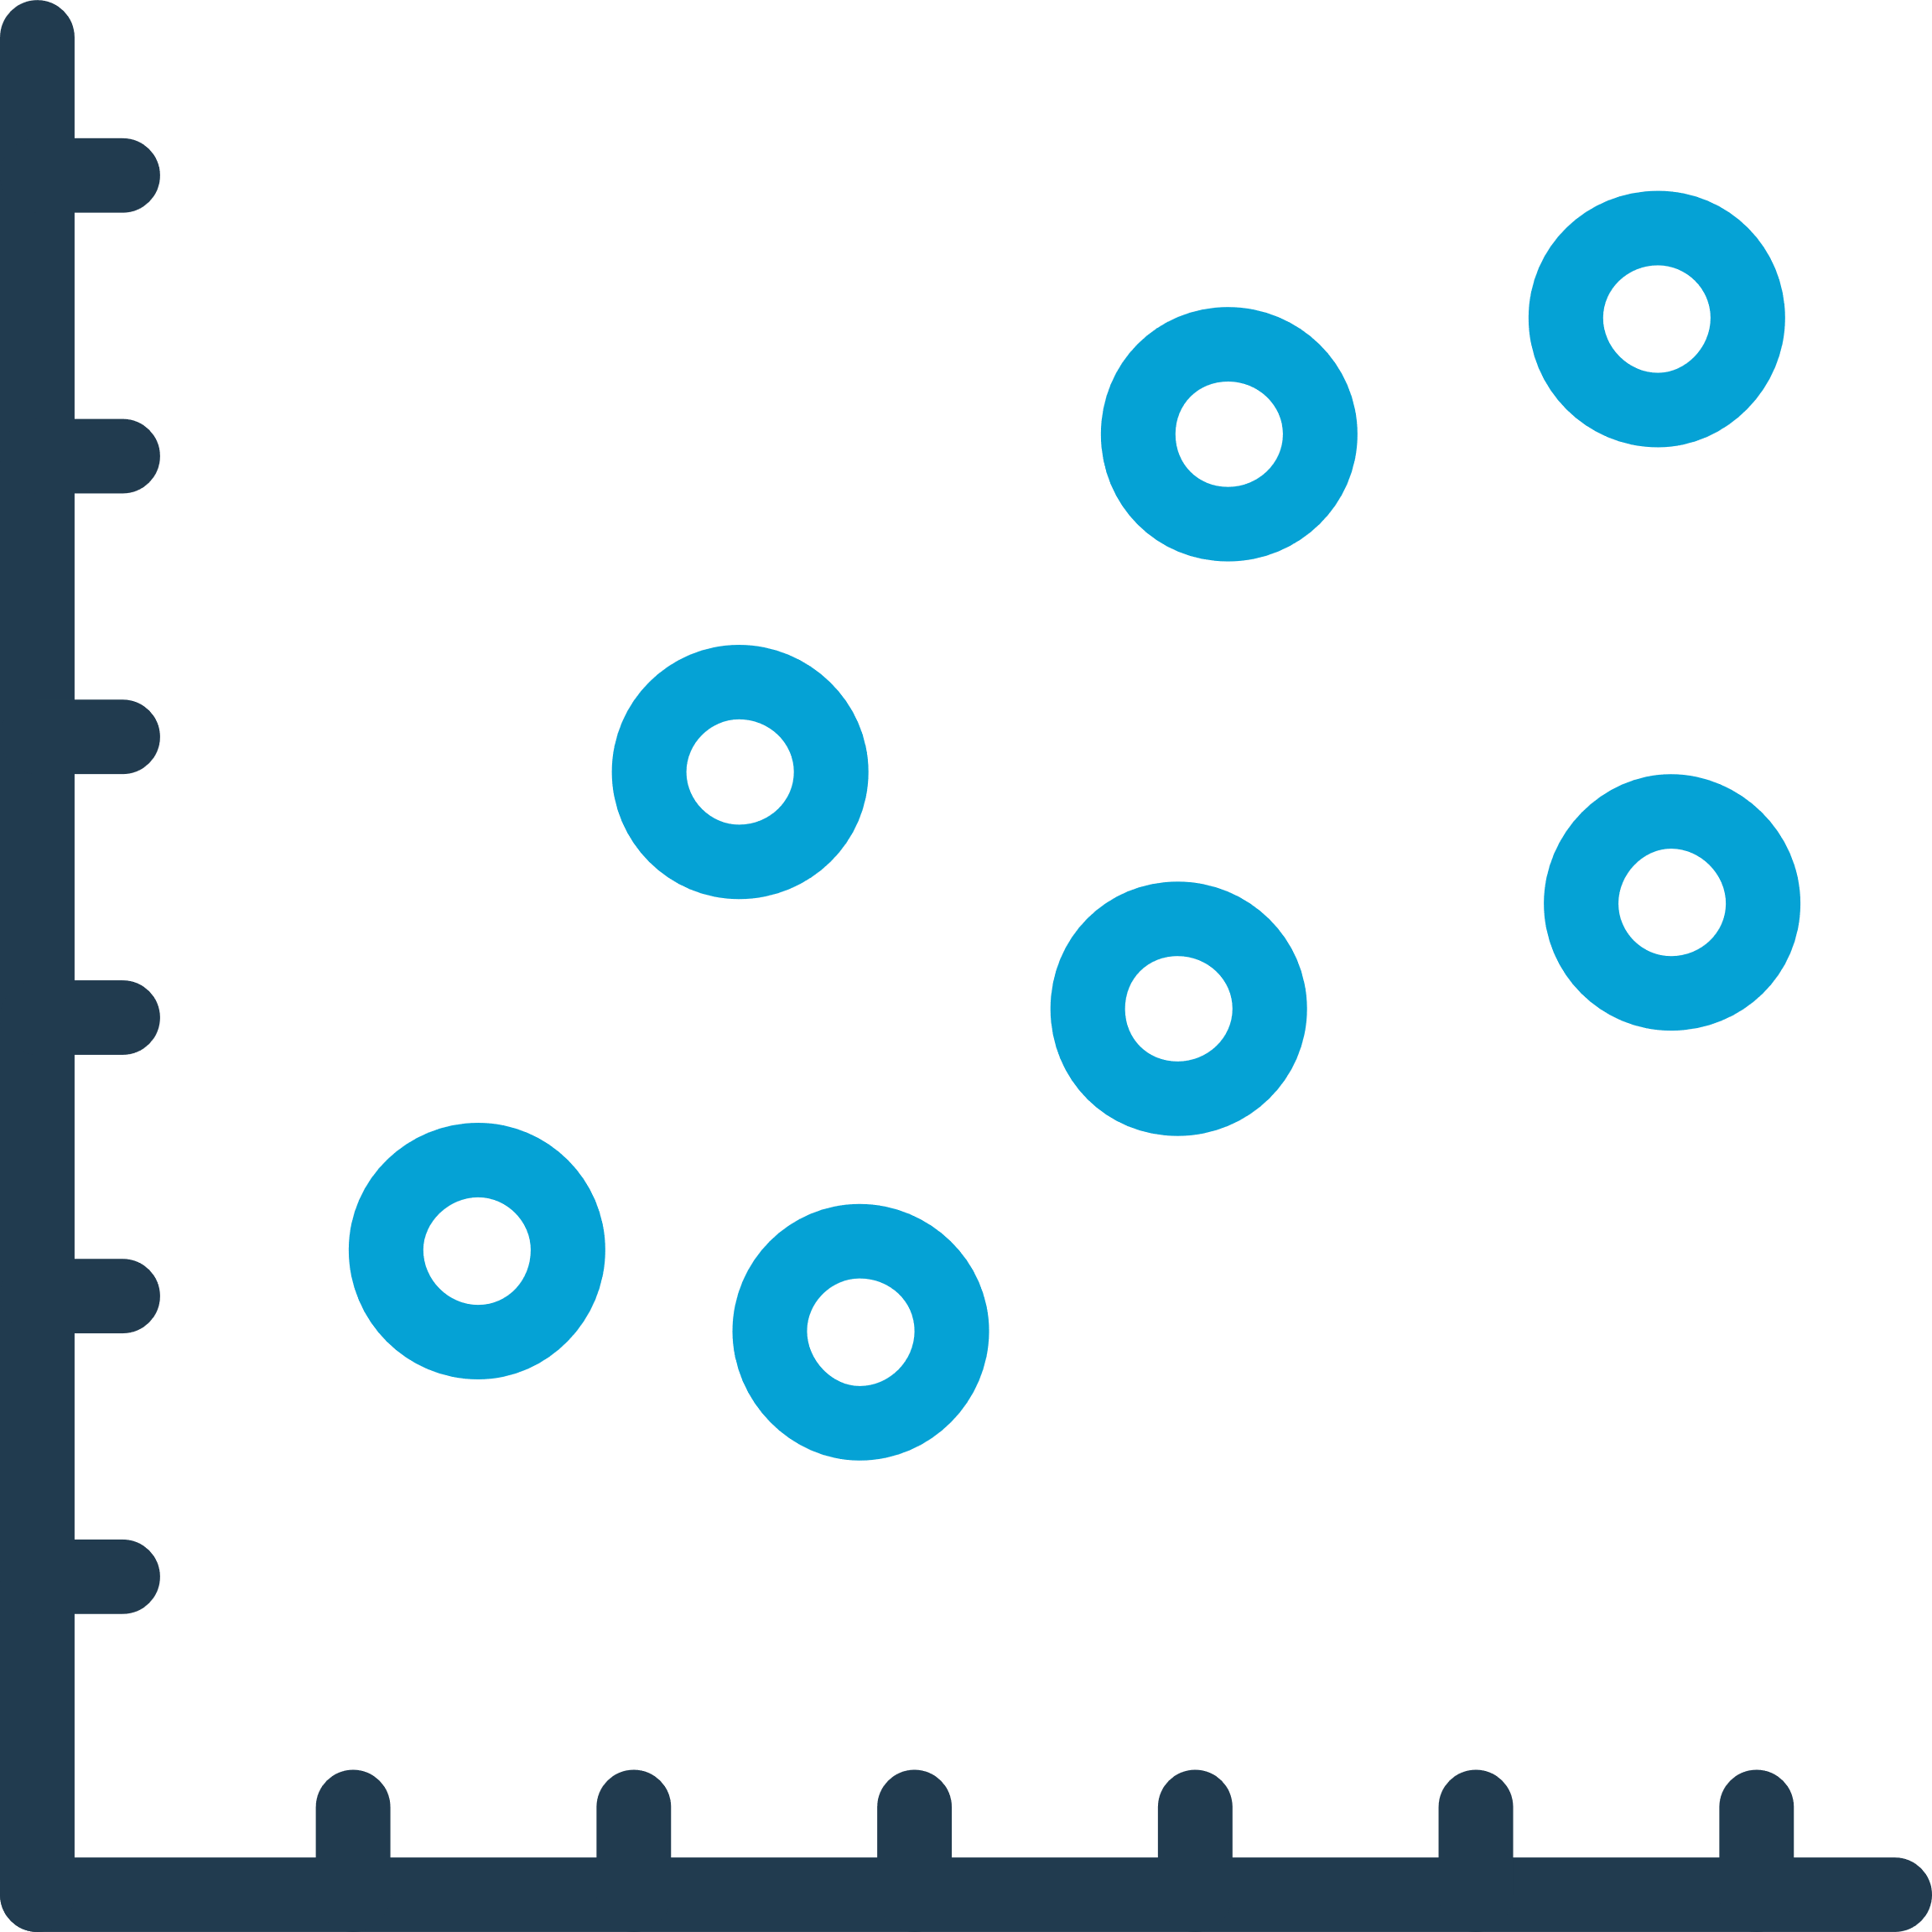
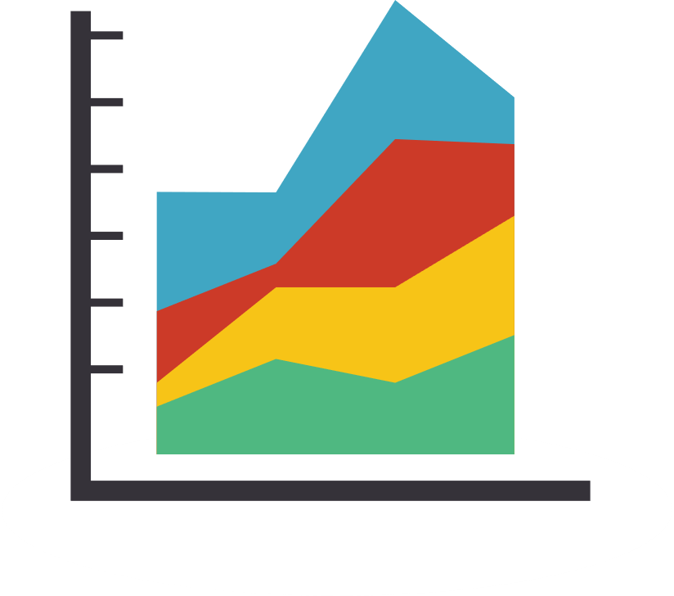
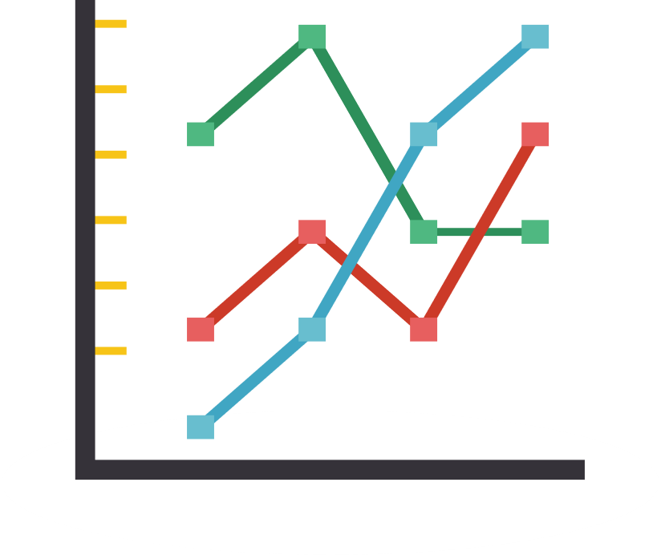
Graphical Summaries by Data Type
Bar Charts
Pie Charts
Mosaic Plots
Histograms
Box plots
Scatter plots
Useful for nominal data
No order to horizontal axis
Similar to the histogram
Pie chart
No order necessary
Useful for proportions
Categorical variable by categorical variable
Continuous or ordinal data on horizontal axis
Continuous
Show dispersion
Continuous by continuous or other
Other plots
Line graphs
Frequency polygons
Mosaic plots
Notes:
Different types of data require different tools and types of graphical summaries. Here, we have the types of data – categorical and interval, and their subtypes, and a loose arrangement of data visualization tools by which type of data they best represent. This is not an exact grouping! We can often use tools across data types when we’re comparing different types of data, or when we want to look at how data are distributed across multuple variables. These plots and graphs are the ones that we’ll talk about today.

Slide 5
Graphical Summaries: Categorical Data
Frequency Tables: (covered in 7.3)
  Frequency (n) and relative frequency (%) of observations in each category
Bar Charts
  A graphical way to display the frequency distribution for nominal or ordinal data
  Horizontal axis: Categories
  Vertical axis: Frequency or relative frequency of observations in each category
Pie Charts
  Slices are proportions of a whole
Mosaic Plots
  Contingency table/Crosstabs for more than one variable
Notes:
Now I’m going to introduce the tools that we often use to present categorical data. The most frequently used data presentation tools for categorical data are frequency tables, bar charts, pie charts, and mosaic plots. I’ll cover each of these in more detail over the first part of this topic.

Slide 6
Frequency Table
  Table 1. Tabulate the variable EC13 Dataset
Notes:
As a review, here is an example of a frequency table of reported Ethno-linguistic group of household head. It shows the categories of the categorical variable in the first column, the frequency of each category in the 2nd column with the pink circle, the relative frequency (percent) in the 3rd column with the green circle, and the cumulative relative frequency in the last column. The cumulative relative frequency is the sum of proportions of the current and previous categories in the table, and hence always equals to 100% for the last category. By now, you should know that to create this table you can simply type the command “tabulate” and the variable of interest, here, “ethnicity.”

Slide 7
Frequency Distribution: Bar Chart
Notes:
Here is an example of bar chart. It graphically presents the data from the table on the previous slide on relative frequency of ethno-linguistic group of household head. The categories of the data are presented on the horizontal x axis, while the relative frequencies are displayed on the vertical y axis. The height of each bar is proportional to the relative frequency of each category, therefore, the category with the largest number of observations is the tallest bar on this graph. We may also label each bar by the percent of each category, as shown here.

Slide 8
Bar Chart in Stata
To create a bar chart with relative frequencies of categorical variables:
histogram ethnicity, discrete percent addlabels ylabel(,grid)
// "discrete” for categorical or non-continuous variable
// “percent" or “frequency” for relative frequencies or frequencies on the y axis
// "addlabels" puts labels on the bars
// "ylabel(,grid)" tells it to add grid lines and labels on the y axis
Notes:
To create a bar chart in Stata with relative frequencies of categorical variables, the easiest way is to use the histogram command. Type histogram and the variable you’d like to chart. “Discrete" tells Stata it's categorical, or not a continuous variable. "Percent" tells Stata you want the relative frequencies or percentages on the y axis, and you can type “frequencies” for the counts. "addlabels" puts labels on the bars, and "ylabel(,grid?)" adds grid lines and labels on the y axis. There are other ways to manipulate the colors, width of the bars, and more, which can be found in the help menu.

Slide 9
Bar Chart in Stata: Use Graph Editor
graph bar, over(ethnicity)
Can also apply schemes:
graph bar, over(ethnicity) scheme(economist)
Right-click on the chart in Stata to open
Graph Editor tool, and then right-click on bars to change the object color, size, etc.
Notes:
You can also use the command “graph bar” to create a bar graph. Use the option “over” and the variable of interest to get bars of each level of that variable. As mentioned, you can change the properties of the graph by using the Graph Editor tool. Any time you create a graph in Stata, you can right-click on the graph to get a menu from which you can select “Start graph editor.” This will open Graph Editor, where you can right-click on any component of the graph to open the menu of options for that specific component, or you’ll find a menu of graph components to the right of the graph that you can choose from. There are also visual schemes or themes you can apply. Try typing the option “scheme(economist)” with your graph bar command and see what your graph looks like.

Slide 10
Frequency Distribution: Pie Chart
Notes:
Here is an example of a pie chart, graphically presenting the data from the table on the previous slide on relative frequency of ethno-linguistic group of household head. Pie charts can be good when you are trying to understand the distribution of components of a whole The categories of the observations are displayed as slices of the pie, with the size of the slice corresponding to the proportion of the whole that category contributes. You can see in the legend how each color represents one of the five categories of ethno-linguistic group. You can change the settings for a pie chart in Stata as well, by using the Graph Editor, or syntax found in the “graph pie” help file. Sometimes it helps a reader, visually, to see how levels of a variable are part of a whole, as in a pie chart, and sometimes it helps a reader to see a bar chart, which, when reporting relative frequencies, is still parts of a whole, it can appear to be comparing the categories moreso than representing them. How do you prefer to see nominal data presented? Can you think of variables in your data that would be better represented by a pie chart or a bar chart?

Slide 11
Bar Chart in Stata
To create the default pie chart on the previous slide:
graph pie, over(ethnicity)
To create the pie chart at right, find the following syntax in the Stata DO File for Topic 7.5:
graph pie, over(ethnicity) plabel(_all percent, size(medium) format(%3.1g)) line(lalign(outside)) title(Ethno-linguistic group of household head, size(medlarge)) legend(size(small)) scheme(economist)
Notes:
The Stata syntax to create a pie chart is simply graph pie, and the option “over” with the variable in parentheses, just like the graph bar command. To create this pie chart, you can go to the DO file for Topic 7.5 and run the syntax for this which is in a theme or scheme that The Economist magazine created. You can use the Graph Editor to move labels and change characteristics of the chart.

Slide 12
Case of two categorical variables
We may be interested in two categorical variables at the same time
We may be interested in the ethno-linguistic group distribution by region of Lao PDR
Notes:
What if we want to look observations by levels of two categorical variables at the same time? Let’s say we want to look at ethno-linguistic group by region of Lao PDR. You should recall from 7.3 that we can create a contingency table to look at variables by levels of another variable. We do this in Stata with the tab or tabulate command, and the variables we want to include in the table, with our row variable first.

Slide 13
Can get more info from Tabulate
Notes:
And, if you recall from Topic 7.3, we can add row, column, and cell percentages using the tabulate command. This gives us the relative frequencies of ethnicity by region.

Slide 14
Mosaic Plots: 2 categorical variables
Note: Also called spineplots,
Marimekko charts, or Mekko charts
Notes:
This is a mosaic plot of Ethno-linguistic group of head of household by Region of Lao PDR. In the past few years, mosaic plots, also called spineplots, Marimekko charts, or Mekko charts have become more common as a way to display categorical data. These can be a little confusing at first, even though they’re quite pretty! If you look at the legend to the right of the plot (click), you can see that each color represents one of the 5 categories of the categorical variable ethnicity. If you look at the x axis along the bottom of the chart (click), you see that there are essentially three columns (click), each corresponding to a region of Lao PDR. The width of the columns (click) is the proportion of the total sample that each region contributes. Along the y axis, the height of each colored shape (click) corresponds to the proportion of each region (click) that a specific Ethno-linguistic group contributes. I’ll compare this chart to the frequency table on the next slide to help you see which proportions contribute to which cells.

Slide 15
Mosaic Plots: 2 categorical variables
Notes:
Here, I’ve put the table and the plot side-by-side to make it easy to show which parts of the plot represent which proportions in the table. I’ve taken the legend and put it next to the rows of the table to easily see which ethno-linguistic group matches which color, and the row of the table they represent. First, let’s look at how the proportions of the region columns correspond to the plot columns. You can see that this total proportion of the sample that resides in the North region is about 38%, (click) and this corresponds to the proportion of the x axis that the North region column occupies on the plot. Central (click) is about 39%, and the South region (click) is a little more than 22%. (click) Looking now just at the first column for North (click), and at the table column for North Region, we can see that of the total sample that resides in the North (click), 28% is Lao-Tai, represented by the blue-grey color block. About 33% (click) is Mon-Khmer, represented by this orange box, about 26% (click) Hmong-Mien in the green box, and about 13% (click) Chinese-Tibetan, as you can see with the red box. There is no one in the sample that identified as another ethnicity (click) or for whom we have missing data, so there is no blue box in the column for North Region. Similarly, you can read the Central Region column in the table and see how these relative frequencies for ethnicity correspond with the colored boxes in the plot. There is only one red box in the plot, in the North Region. Chinese-Tibetan participants who were in the MICS data all lived in the North. Hmong-Mien participants only live in the North and Central regions, but not the South. So, not only can we look at this plot and quickly see what the dominant ethno-linguistic groups are in Lao PDR -- Lao-Tai and Mon-Khmer based on this sample – we can also quickly see that there are three regions of Lao PDR and what the ethnic group composition is of each. It may take a moment to get used to reading mosaic plots, but there is quite a bit of information you can convey when you use them to summarize data.

Slide 16
Creating Mosaic Plots in Stata
Install the spineplot function by typing: ssc install spineplot
To get the spineplot below, type: spineplot ethnicity hh7
You can customize your plot using the Graph Editor function (right-click on the plot in Stata and choose “Start Graph Editor”)
Notes:
To create a mosaic plot in Stata, you may first need to install the spineplot function by typing ssc install spineplot. Then, you type the command spineplot and the variables you’d like to include in the plot. This is the default format for a mosaic plot, but you can further customize your plot with color, font, title, placement of the legend, and you can even change the axis labels if you wanted it to read “proportion” by region or something else. To do so, right-click on the plot in Stata and a menu will appear, where you can select “Start graph editor.” Then, you can right-click on any part of the chart to open a menu to change options.

Slide 17
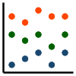


Graphical Summaries for Interval Data
Frequency Tables: if we divide the values of observations into intervals of nearly equal length
Histograms
  A graphical way to display the frequency distribution for continuous or discrete data by dividing the values of observations into intervals of nearly equal length
  Horizontal axis: Range of the variable
  Vertical axis: Frequency or relative frequency of observations in each interval
Box plots
Stem-and-leaf plots
Scatter plots, two-way scatter plots
Other: Freqency polygons, Line graphs
Notes:
To present interval type of data, we can also use frequency tables. However, we will need to divide the values of the observations into intervals of nearly equal length, given that with continuous data and some discrete data, the table would be too extensive to be useful if reporting the raw numbers. This same approach is used when creating histograms, which are similar to bar charts, but can show frequency distributions for continuous and discrete. You create intervals for observations and plot the intervals along the x axis. Box plots are very useful for showing the central tendency and dispersion of variables, as are stem-and-leaf plots. Scatter plots, line graphs, and frequency polygons show the distribution of observations for continuous variables. Many of these can also be used to show the relationships between multiple variables.

Slide 18
Frequency Tables for Interval Data
Not recommended due to long list of values unless you create intervals
Divide the values of observations into intervals of nearly equal length
Should show the original measurement scale and the frequencies associated with each category
Ways to create intervals for a continuous variable:
    Same width: e.g., 5-year age intervals, 20-24, 25-29, 30-34…
    Natural breaks in the data such as percentiles
    Meaningful cutoffs: this is the preferred way if you have clinically or practically meaningful intervals for your variable. Examples:
      age categories of clinical recommendations
      Clinically important intervals of a medical measurement
      Standard deviations/z scores for standardized/centered variables
Recommended: use a graphic format to check the distribution for and display continuous variables
Notes:
Datasets with very large sample sizes can potentially have a long list of different values for continuous variables; therefore, it is recommended that you use a graphic format to check the distribution for and visualize continuous variables. If you want to create frequency tables you will need to divide the observations into intervals of nearly equal length. Ways you can do this include intervals of the same width, like 5-year categories of age, natural breaks in the data such as percentiles, or clinically meaningful cutoffs. This is the preferred way, and any way that you decide to categorize your data must have some meaning. You may divide into different age categories based on clinical recommendations for different age groups, or meaningful groups of a medical measurement, like ranges of blood pressure from dangerously low through normal ranges and up through dangerously high. You might also report on standard deviations from a meaningful mean, like a centralized or standardized score. However, the recommendation is that you use a graphic format for continuous variables.

Slide 19
Frequency Distribution: Histogram
Histograms are a graphical way to display the frequency distribution for continuous or discrete data, by dividing the values of observations into intervals of nearly equal length
Horizontal/x axis: Range of the variable
Vertical/y axis: Frequency or relative frequency of observations in each interval
Notes:
Histograms are a graphical way to display the frequency distribution for continuous or discrete data that has been divided into intervals. In this case, your software can create default intervals based on your data, unless you have specific intervals that you plan to use instead. In histograms, you plot observations along an x axis that contains the range of the variable in intervals, and a y axis that is the frequency or relative frequency of observations in each interval. Here is an example of a histogram using the BMI data from the MICS sample. The range on the x axis is from 9 to 30, and the y axis here is the percent of the total observations of BMI that each interval represents.

Slide 20
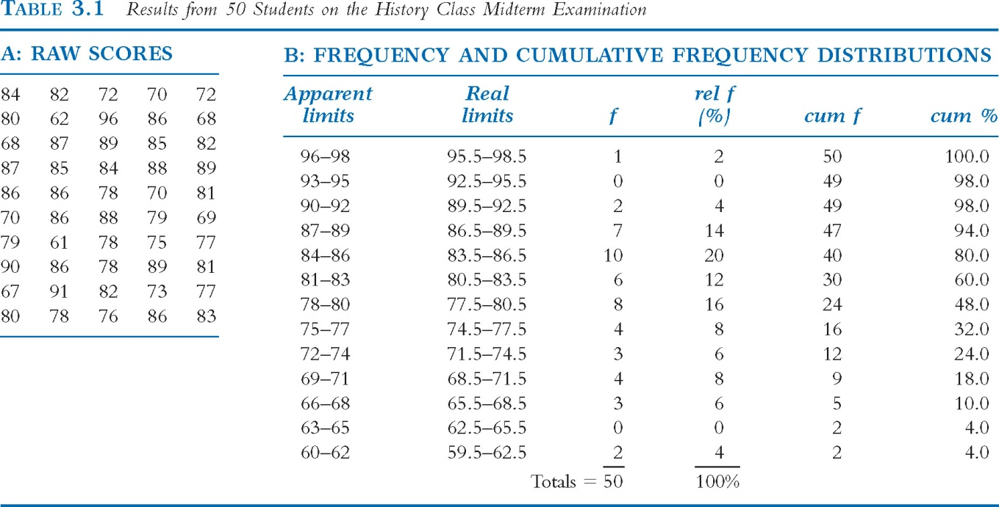
Histogram example: Exam score data
Notes:
Here is an example of data we might plot on a histogram. Imagine we have 50 students who take an exam, and they each have a score on the exam. (click) Each of these scores is in box A, ranging from 61 to 98. To naturally divide the grades into a plus – minus letter scale, where you can have an A+, an A, or an A-, for example – the professor created intervals of range 3, (click) so from 96 to 98, which would be an A+, 93-95, which is an A, and so on. You probably recognize this as a frequency distribution table, so we have our intervals listed, and then columns with the frequency (click), relative frequency (click), and cumulative frequency and percent (click) in order from lowest score to highest for each score interval.

Slide 21
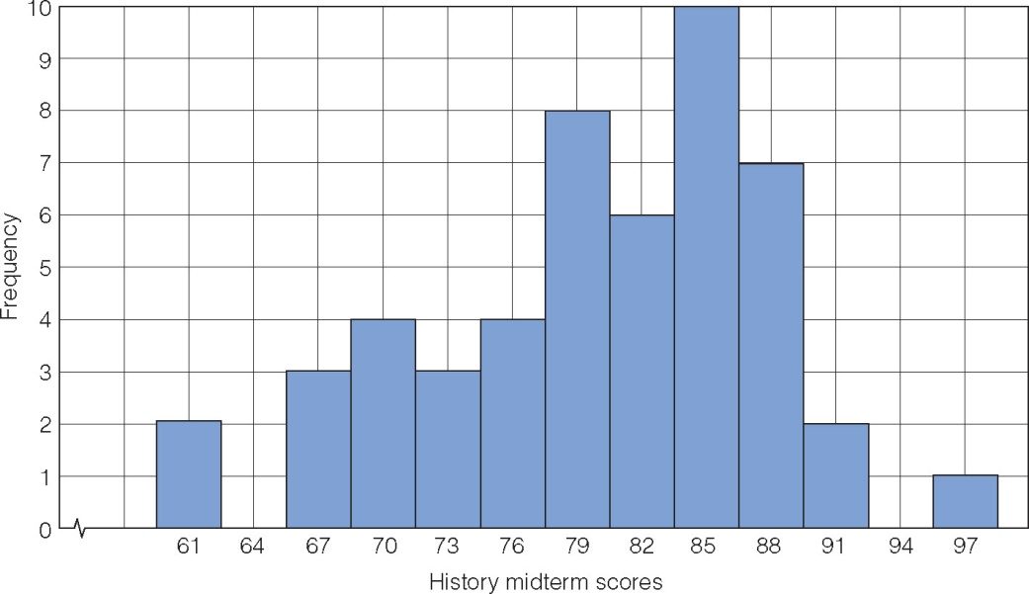
Histogram example: Histogram for scores
Height (along y-axis) is the frequency of a score
Score values change continuously along the x-axis
Each bar has a range for interval. (value represents mid-point)
Notes:
We then plot these scores using a histogram where the score values are on the x axis, and each bar has an interval range of 3, with the plotted value representing the midpoint of the interval. The height of the bar along the y axis is the frequency of a score interval. What can you see, quickly, from this histogram? What scores are most common? What scores are infrequent? Can you estimate a central value for these scores?

Slide 22
Histogram example: Exam score data
Histogram gives us the same information as that from the frequency distribution table.
x-axis: actual scores
Interval class
3 scores per interval
Labeled for interval midpoint
y-axis: frequency (height)
Number of times that score appears in data
Notes:
When we look back at the frequency distribution table, we can see that the histogram gives us the same information as the table. The x axis contains the actual scores, shown in interval bars, with 3 scores per interval. The midpoint of the bar (click) is labeled for the midpoint of the interval (click). The height of the bar shows the number of times that score appears in the data. The interval with the most observations of scores (click) is the 84-86 interval, which you can see is the highest bar.

Slide 23
Example of histogram in Stata (BMI<30)
ANRCB | 23
Notes:
Now, you could make your own histogram by hand, if you wanted to, but no need! I’ll show you how to do it in Stata. Here is an example of a histogram made in Stata. This is the distribution of valid values of BMI in the MICS sample. Looking at the x axis, what is the range of BMI in this sample, approximately? What is the width of the intervals? What does the y axis represent in this graph? How would you describe this distribution? Does it seem normally distributed? What would you estimate are some of the measures of central tendency, based on this histogram? We can answer most of these questions about BMI in our sample, or make well-informed guesses, just by looking at this graph.

Slide 24
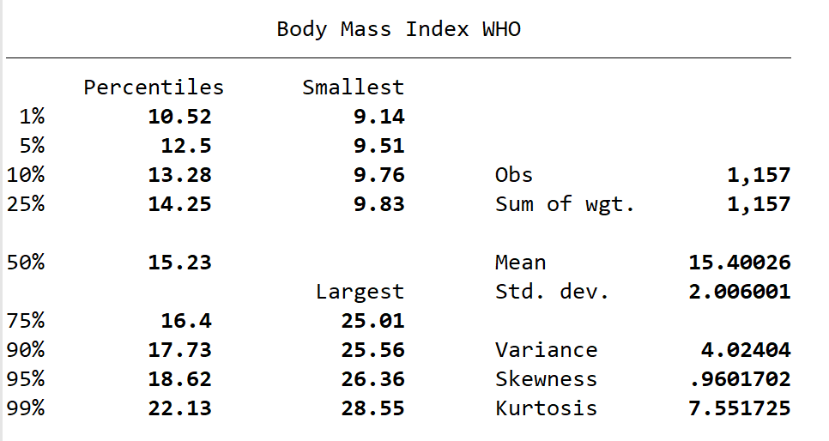
Example of histogram in Stata (BMI<30)
Range: 9.14 - 28.55
Mean: 15.40
Median: 15.23
Mode: between 14-15
ANRCB | 24
Notes:
If we run a summary of BMI in Stata, we can get the values for some of these answers and compare them to the graph. If we look at the graph, we could see even without the normal curve that the mode, with the most observations, was this interval (click) between about 14 and 15. Did you think the mean was a little more than 15? We can see the mean here (click) at the peak of the normal curve, and when we check the summary table, we see it is 15.4. The median is the value right in the middle and it can be a little harder to determine but with the shape of this curve, we can expect the median to be pretty close to the mean, and maybe a little less, because it looks like there are more observations to the left of the mean than to the right of the mean. In the table we can find the median at the 50th percentile, and it’s 15.23. The curve has a good normal shape, but like we said, it looks like there are more observations stretching out to the right of the distribution, so it is positively skewed, and our skewness statistic confirms this. In summary, we can get a lot of information from a histogram!

Slide 25
Example of histogram in Stata (BMI<30)
histogram BMI if BMI < 30, width(1) percent
histogram BMI if BMI<30, width(1) percent addlabel normal xlabel(9(3)30) (bin=20, start=9.14, width=1)
You can create histograms in Stata using the histogram command: histogram variable
This will create a default histogram, but it can be customized in menus or with syntax. Reference the DO file for Topic 7.5 for example syntax.
ANRCB | 25
Notes:
You can create histograms in Stata using the histogram command histogram and the variable of interest. This will create a default histogram, but it can be customized in menus or with syntax. Reference the DO file for Topic 7.5 for example syntax.

Slide 26
Histogram commands (Hgb in g/dl)
a)
histogram AT10 if AT10 < 17
b)
histogram AT10 if AT10 < 17, fraction
c)
d)
histogram AT10 if AT10 < 17, percent normal
histogram AT10 if AT10 < 17, frequency normal
ANRCB | 26
Notes:
These are histograms of the variable AT10 in the MICS sample, which is haemoglobin in grams per deciliter. Your default histogram will produce a plot with density as the y axis, as in figure a. You can add the option “fraction” to the end to get your fraction that each bar contributes to the whole, as in figure b. Figure c is exactly the same as b, but we’re labeling the y axis with percent, and we’ve added a normal curve with the option “normal”. Finally, figure d shows the graph with frequency as the y axis and a normal curve.

Slide 27
Example of histogram in Stata (Hgb)
histogram AT10 if AT10 < 17, kdensity
histogram AT10 if AT10 < 17, normal kdensity
ANRCB | 27
Notes:
If you want to add kernel density estimation to your plot, you can do so by adding the option “kdensity”. Kernal density is essentially a continuous and smoothed version of the histogram. You can see this well on the plot on the left. The default for Stata is to use Epanechnikov kernal density, but you can change this using syntax or the menu. You can also plot BOTH the normal density and kernel density on your graph by adding both options of “normal” and “kdensity” as in the plot on the right.

Slide 28
What else can we learn from histograms?
  Characteristics of a single population
  Compare more than one population
  Shifts in the averages of data
  Changes in variability
ANRCB | 28
Notes:
What else can we learn from histograms? We can look at the characteristics of a single population or variable, as we just did with BMI or haemoglobin in the MICS sample, but we can also compare more than one population, look at how the averages or central tendencies shift in data, and look at changes in variability as well.

Slide 29
Histograms and Shifts in Data
Dataset A
(e.g., Population A, Time A)
Dataset B
(e.g., Population B, Time B)
Notes:
Here are plots that illustrate a shift in data. These could be the same variable plotted for two different populations, for example, BMI for men and for women, or they could be the same variable among the same people at different time points, for example, haemoglobin measures in one population at Time 1 and at a second time point after an intervention. Notice how the shape of the plots are similar, but the bottom plot of Dataset B has higher values than the upper plot of Dataset A

Slide 30
Histograms and Variability in Data
Dataset A
Dataset B
Notes:
We can also see differences in the variability of data. The data or variable in Dataset A has more concentrated values, while Dataset B is more spread out, and has observations of many different values.

Slide 31
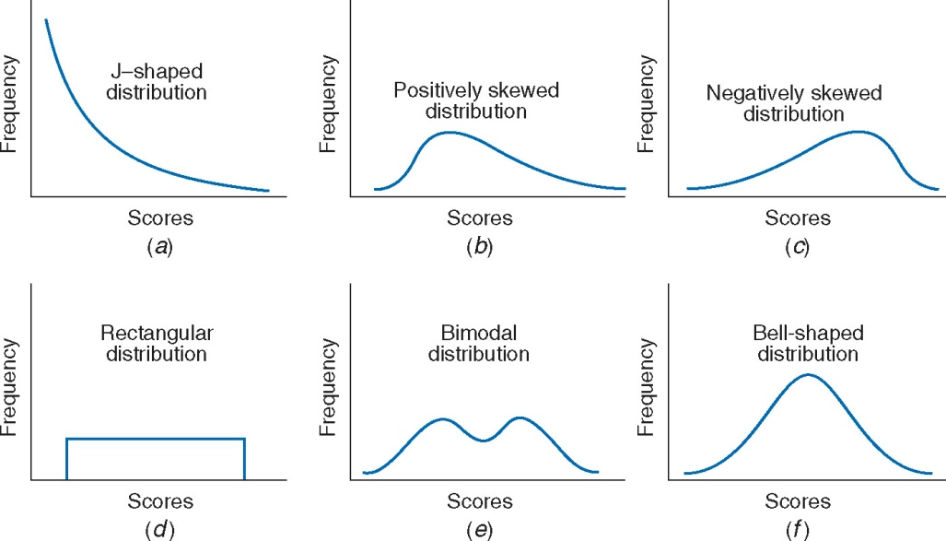
Shape of distributions
Descriptive pattern of the data
Notes:
We can understand a lot about the distribution of data when we plot it graphically using histograms.

Slide 32
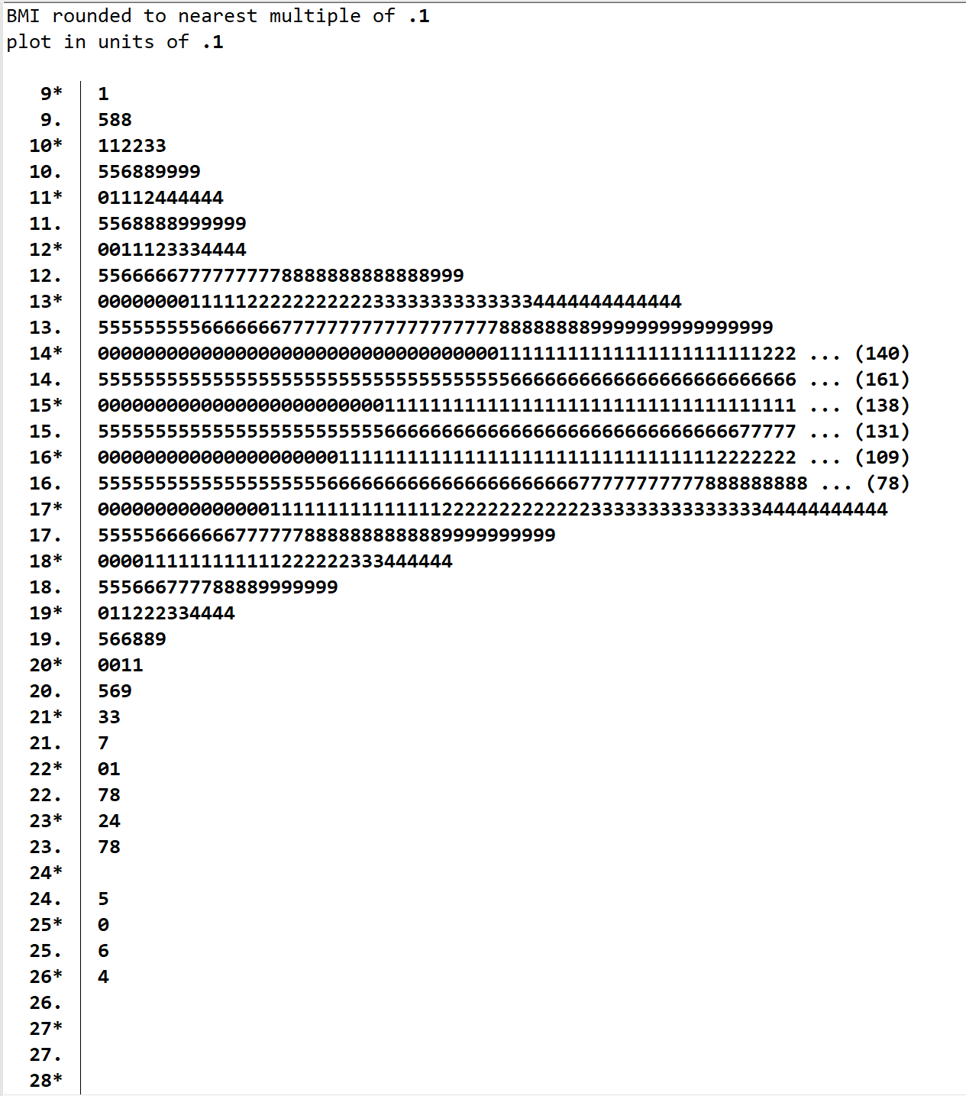
Stem-and-leaf plot (BMI)
LEAF
STEM
Frequency of each value of BMI
Value of BMI
stem BMI if BMI <30
Notes:
Stem and leaf plots are a neat way to see the frequencies of each value of observations of a variable. This is the default setting for a stem and leaf plot if you use the command “stem” and then your variable of interest. The “stem” is made up of each value of BMI except for the last digit of the value, and the leaf contains the final digit of EACH value of BMI observed in the sample. The shape helps us understand the distribution of the values. So, if we look at a BMI of 13 (click) we see the integer of BMI in the stem, and then 5 repeated 9 or 10 times, then 6 repeated 7 times, and so on. That means there are 7 observations or participants with BMI of 13.6. These can be useful for finding measures of central tendency and getting more detail than in a histogram.

Slide 33
Frequency Polygon
A dot is placed for each interval at midpoint, to represent the frequency
Connect each pair of adjacent dots with straight line
Notes:
A frequency polygon is similar to a line graph of a histogram. This is the frequency polygon for histogram of our exam scores. A dot is placed at each interval midpoint and then each pair of adjacent dots are connected with a straight line.

Slide 34
Histogram
Often used for ungrouped distributions
Useful when displaying relative frequency (proportions)
Frequency Polygon
Preferred for grouped distribution
Helpful in comparing distributions
Notes:
Here you can see the histogram and frequency polygon for exam scores on one slide. Histograms and frequency polygons provide us with the same information about the data, but the histogram is better for proportions, and ungrouped distributions. Frequency polygons are better for grouped distributions, and for comparing distributions.

Slide 35
Frequency Polygon: Comparisons
What can you observe from the graph?
Notes:
Here, we can overlay the distribution of exam scores from two groups onto the same plot for comparison. What can you tell about Group A and Group B from this graph?

Slide 36
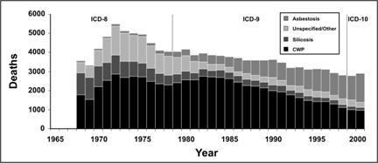
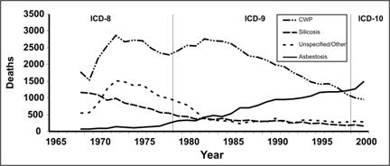
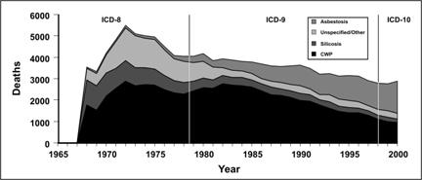
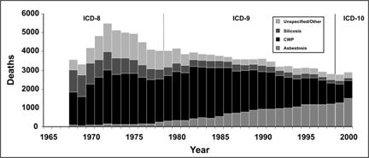
Frequency Polygons: Comparisons
Number of Deaths with Any Death Certificate Mention of Asbestosis, Coal Worker’s Pneumoconiosis (CWP), Silicosis, and Unspecified/Other Pneumoconiosis Among Persons Aged ≥ 15 Years, by Year — United States, 1968–2000
Notes:
These four plots are all showing the same information on the number of deaths from several lung diseases, but in just slightly different ways. Which of these frequency polygons do you prefer?

Slide 37
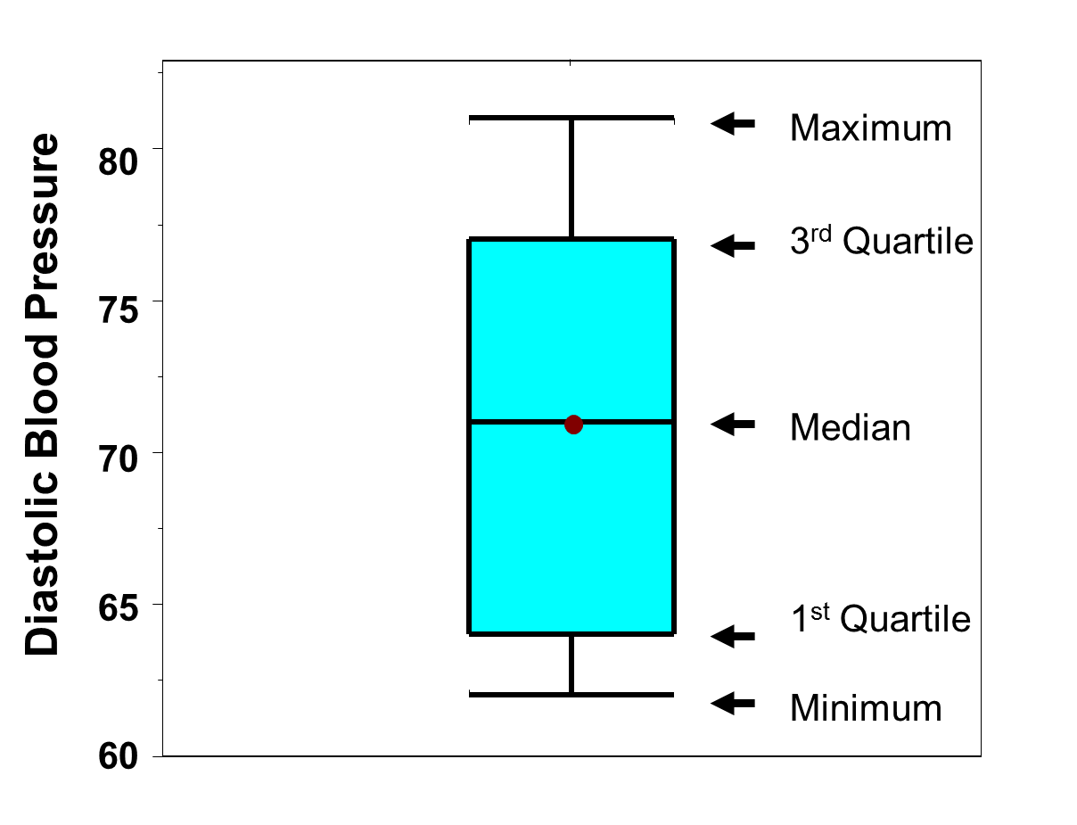
Graphical Summaries: Box Plots
  Box Plots are a graphical display of five numeric summary measures: minimum, lower quartile, median, upper quartile, maximum.
They’re a good way of visualizing data from different populations, especially comparing them
Clear definitions; don’t have to worry about # of bars, class intervals, etc.
Easily available
Modified to indicate outliers (extreme values).
Notes:
Box Plots are a graphical display of five numeric summary measures: the minimum, lower quartile, median, upper quartile, maximum. They’re a good way of visualizing data from different populations, especially when comparing them. It has clear definitions, so you don’t have to worry about the number of bars, or the class intervals or anything. They’re comprised of easily available information, and they can be modified to indicate outliers in your data, or extreme values.

Slide 38
Box Plots
The box is from 25th to 75th percentile (1st quartile to 3rd quartile)
75th percentile
This means 50% of the data are in the box
IQR can
be read off the plot
Hence, IQR = range needed to cover 50% of the data
25th percentile
IQR is a very robust measure of variability that can be judged graphically.
Notes:
The basic box plot has the box defined by the lower boundary of the lower quartile or 25th percentile, the upper boundary of the upper quartile or 75th percentile, and the median, or 50th percentile, in the middle. This means that the box represents the interquartile range or IQR, and that 50% of the data are in the box. IQR is a very robust measure of variability that can be judged graphically.

Slide 39
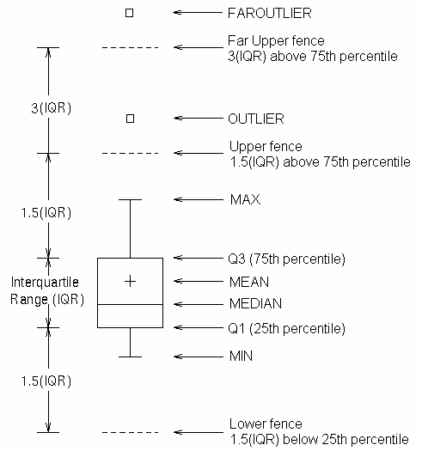
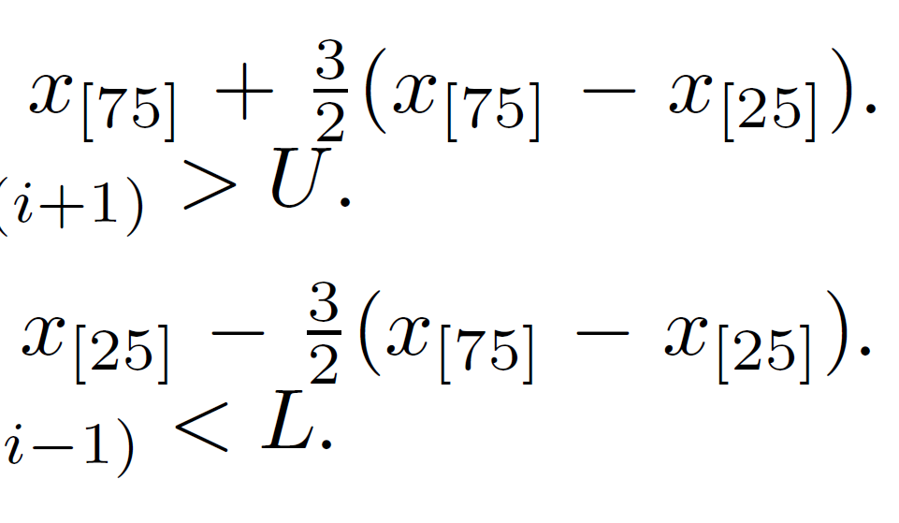
Box Plots
To the basic box, whiskers are added (highlighted in red):
Extend to adjacent values, labeled here as MAX and MIN, which are the most extreme observations in the data set that are not more than 1.5 times the height of the box beyond either quartile:
Upper:
Lower:
In fairly symmetric datasets, the adjacent values should cover approximately 99% of the measurements.
+
Any other points are called “outliers”, or data points that are not typical of the rest of the values.
Notes:
To the basic box, we add the whiskers, seen here in red, which extend to the adjacent values, labeled here as MAX and MIN, which are the most extreme observations in the data set that are not more than 1.5 times the height of the box – or the interquartile range -- beyond either quartile. When data are fairly symmetric, the adjacent values should cover about 99% of the measurements. Any other points beyond these are called outliers, or data points that are not typical of the rest of the values.

Slide 40
Box Plot Example in Stata: BMI in MICS
Outliers
= 19.625 = 16.40 + (3/2 (16.40 – 14.25))
Quartile 3 - 75th percentile
= 16.40
IQR
Median
= 15.23
(16.40 – 14.25)
Quartile 1 - 25th percentile
= 14.25
= 11.025 = 14.25 - (3/2 (16.40 – 14.25))
Outliers
ANRCB | 40
Notes:
Here, we have a box plot of the observations collected for BMI in the MICS 2017 10% random sample data. From first look, you can see that the values are fairly concentrated around 15, which we already know is near the median, mean, and mode of the variable. The box representing our interquartile range or middle 50% of data is not very tall, meaning that it doesn’t contain a wide range of values for BMI. We have quite a few outliers beyond the maximum and minimum adjacent values, or the whiskers of the plot. Let’s look at our values for these centrality measures. (Click) First, while we can read our summary values along the y axis, as we did in our histograms, I am bringing back our summary table just so you know exactly where these values are coming from. We have our median at the 50th percentile line, (click) which is 15.23. Our lower quartile, or first quartile, or 25th percentile – it has many names – is here at the bottom of the box (click), and the value is 14.25. Then we have (click) our upper quartile, or quartile 3, or 75th percentile, which is at the value of 16.40. We can then know our IQR or interquartile range. We can also calculate our upper (click) and lower (click) adjacent values or the whiskers of our box-and-whisker plot, using the formulas from the previous page, or essentially taking 1.5 times our IQR and adding it to our 75th percentile for the upper adjacent value, and subtracting it from our 25th percentile to get the lower adjacent value. Finally, (click) we have our outliers or values outside of this range. We know from our summary table what the highest and lowest values are in this variable, and we can easily see where the upper outlying values are at 28.55, 26.36, and so on, and the same for the lower values.

Slide 41
Box Plot Example in Stata: BMI outliers
Stata command for box plots is graph box variable
graph box BMI if BMI < 30
graph box BMI
Box and whisker plots are excellent for identifying outliers!!!
Plot your continuous variables when you first begin cleaning your data, and you will very easily be able to identify outliers and potential errors!
ANRCB | 41
Notes:
The Stata command for box plots is “graph box” and then the variable you want to plot. The graph on the left, which we viewed in the previous slide, was created using graph box BMI if BMI < 30. With your MICS sample, run the command “graph box” on BMI without specifying the values, which gives you box plot on the right. What do you notice? How is it different? The values are much more compressed in the IQR because we see the y axis ranges all the way to 100 to accommodate our extreme outliers! If you plot your continuous variables when you are first looking at your data, you will very easily be able to identify outlying values that might indicate errors in your data. Box plots are EXCELLENT for identifying outliers and I highly recommend using them early and often!

Slide 42
Box Plot Example: Haemoglobin in g/dL
Very extreme outlier!!
Here, we’ve plotted the values of blood haemoglobin, variable AT10.
graph box AT10
graph box AT10 if AT10 < 17
In the plot with valid values on the right, we see a fairly symmetrical plot with only a few outliers. Compare this to the summary statistics for AT10 and to the histogram for the same variable.
ANRCB | 42
Notes:
Here, we’ve plotted the values of blood haemoglobin, variable AT10. On the left plot, we have: graph box AT10. On the bottom right plot, we’ve used graph box AT10 if AT10 < 17. Again, we can see there are extreme values of 100 that don’t make sense for the measurement in our plot of the raw data, so we may want to look at those and recode this variable to not include the extreme values. Or, we can do what we did for the plot on the right, which is to plot values only under the most reasonable value for haemoglobin in the sample. In this plot with valid values, we see that it is fairly symmetrical, with only a few outliers. Compare this to the summary statistics for AT10, and to the histogram for the same variable.

Slide 43
Box Plot Example: Comparing groups
Box plots are also excellent for comparing distributions of observations.
Quickly look at how the central measures differ
Compare outliers
See whether the distributions have different shapes or placement – taller or wider boxes? Longer or shorter whiskers?
For box plots by levels of a categorical variable, we can use option “over”:
graph box variable1, over(variable2)
graph box AT10 if AT10 < 17, over(HL4)
Notes:
Box plots are also excellent for comparing distributions of observations across groups or categories. When we plot a continuous variable by a categorical variable, we can easily see how the distribution of the continuous measure differs across levels of the categorical variable. Here, we’ve plotted haemoglobin by males and females in the MICS data. What do these box plots tell you about haemoglobin in men and women in this sample? You can quickly look at how the central measures differ, and see whether the distributions have different shapes or placement: does one group have taller or wider boxes? Longer or shorter whiskers? Look at the outliers. Are there more in one group than in another? Could outliers in one group be affecting the distribution? Could it be that the range of valid values should differ by groups? There is a great deal of information available in box plot comparisons. To create box plots by levels of a categorical variable, we can use the option over, and the categorical variable in parentheses. Here, is the syntax for plotting haemoglobin levels by sex, which is HL4.

Slide 44
Graphing Multiple Variables
Graphing the relation between two variables can be helpful for a deeper understanding of both variables
One interval variable and one categorical variable:
  Box Plot of continuous variable at each level of categorical variable
  Scatter Plot with interval data grouped at each level of categorical
  Frequency polygons or grouped histograms
Both variables are interval type data:
  Scatter Plot is appropriate
Both variables are categorical type data:
  Mosaic plots already covered
  Grouped bar graphs could be used
  Frequency polygons might be appropriate
May be used in multiple combinations of data types:
  Frequency polygons or grouped histograms
  Line graphs
  Stacked bar graphs/histograms
ANRCB | 44
Notes:
We’ve touched on this a bit already in this presentation but graphing the relationship between two or more variables is very helpful for gaining a deeper understanding of each variable. There are many ways to manipulate graphs and there are many additional graphs that we can use, but this will give you a place to begin. When one variable is interval and one is categorical, box plots and scatter plots can be used, as well as frequency polygons or grouped histograms. When both variables are interval data, a scatter plot is most appropriate. We’ll cover scatter plots in a moment. When both variables are categorical, you may use grouped bar graphs or frequency polygons, and there are additional options for multiple data combinations. Stacked bar graphs, for example, can show multiple continuous variables by categorical variables.

Slide 45
Scatter Plots
Scatter Plots (or scatterplots) display the relationship between two interval variables
(a) Positive linear relationship
(b) Negative linear relationship
(c) Nonlinear relationship
(d) No relationship
Notes:
A scatterplot shows a relationship between two quantitative or interval variables. In Box A you can see a positive linear relationship where the values of y increase as values of x increase. In Box B, a negative linear relationship, the values of y decrease as the values of x increase. In both A and B, you can see that there is essentially a straight line that connects most of the dots together. We can fit a line to these values to determine whether the relationship is indeed linear. In Box C, we see a non-linear relationship where values of y decreases as x increases, until it hits a certain point at which the values of y begin to increase as values of X increase. And finally, in Box D the points seem to be randomly plotted on the graph, and we see there is no distinguishable relationship between any of the values.

Slide 46
Scatterplot in Stata: Weight by Age
ANRCB | 46
Notes:
Here's an example of a scatterplot from the MICS data of child’s weight in kilograms by age in months. This is a great example of a scatter plot, because we know, biologically, that there should be a positive linear relationship between weight and age in children, in that as age increases, weight increases. We see from this plot as well that there is a positive linear relationship between child's weight in kilograms and age in months in the MICS sample.

Slide 47
Scatterplot in Stata: Weight by Age, fit line
Scatterplots in Stata can be drawn in many ways:
scatter yvar xvar
twoway (scatter yvar xvar)
twoway (scatter yvar xvar) if statement
For weight by age, if all values are valid:
scatter AN8 CAGE
For weight by age, if you need to if/then:
twoway (scatter AN8 CAGE if AN8 <80)
twoway (scatter AN8 CAGE) if AN8 <80
For two variables and fitting a linear line. “If” only needed if you require an if/then statement:
graph twoway (scatter AN8 CAGE) (lfit AN8 CAGE) if AN8 <80
ANRCB | 47
Notes:
We can also add a linear fit line to the plot. We’ll talk more about creating regression lines and smoothing lines in Topic 7.8 but for now, we’ve used the “graph twoway” function with a command for a scatter plot and then on top of it, a command for a linear fitted line. When you combine them, you get a scatterplot with a fitted line. For regular variables with valid values, you can just use the command “scatter” and then the two variables you’d like to plot, with the y axis variable first, and the x axis variable last, no matter how many y variables you have. If you need to restrict values using an if statement, that needs to be done in a twoway scatter command, as seen in this slide.

Slide 48
Box Plots for Continuous and Categorical
graph box variable1CON, over(variable2CAT)
graph box BMI if BMI < 30,over(IM8A)
Notes:
You can use box plots to visualize a continuous variable’s distribution across levels of a categorical variable, as we have in this box plot of BMI by region of Lao PDR. The basic syntax for a box plot across a categorical variable is graph box variable1 which is your continuous variable, over variable2 which is your categorical variable.

Slide 49
Grouped Bar Chart: 2 Categorical Variables
Notes:
You can create bar charts for nominal and ordinal variables that present the relative frequencies of some variable, here the level of educational attainment of adults, both by gender and over categories of time. With this, we can compare the levels of educational attainment of men and women in 1968 and in 2000.

Slide 50
Grouped Bar Graph -- Horizontal:
2 Continuous, 2 Categorical Variables
graph hbar WAP WHP, over(hh7) over(HL4)
Notes:
This is a different kind of grouped bar graph you can create in Stata. The bars represent the means of 2 continuous variables: weight for age percentile in blue, and weight for height percentile in red. These means are then grouped by region of Lao PDR, and further split into gender. You can create this with the “graph bar” command, and here the “hbar” simply tells it to orient horizontally.

Slide 51
Stacked Bar Graph – Vertical:
2 Continuous, 2 Categorical Variables
graph bar WAP WHP, over(hh7) over(HL4) stack
Notes:
Similar to the grouped bar graph in the previous slide, this is a stacked bar graph where the means of the two continuous variables are stacked in each bar rather than in separate bars next to one another. In this graph, we’ve also labeled the means so that you can see the value of both the weight for age percentile means in blue and the weight for height percentile means in red. This is created using the graph bar command as well, with stack to indicate stacked bars.

Slide 52
Stacked Bar Graph – Horizontal:
2 Continuous, 2 Categorical Variables
graph hbar WAP WHP, over(hh7) over(HL4) stack
Notes:
This is the same graph, but on a horizontal scale.

Slide 53
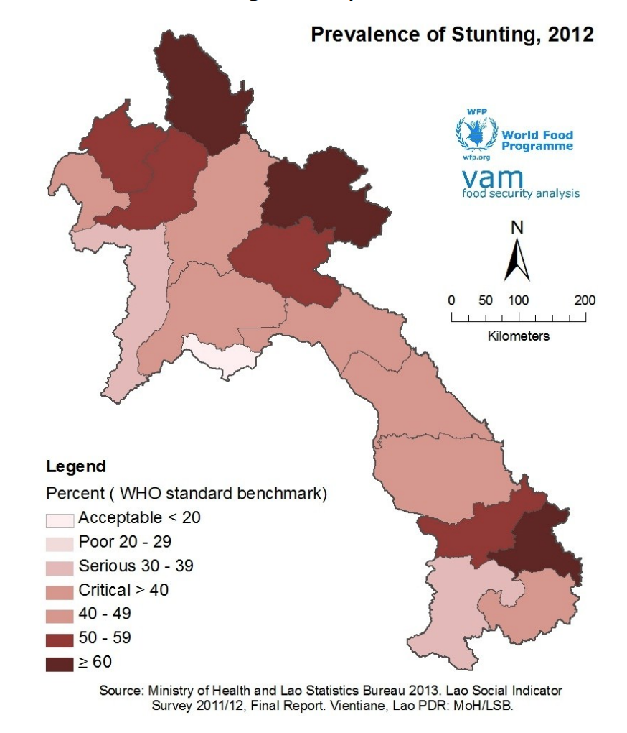
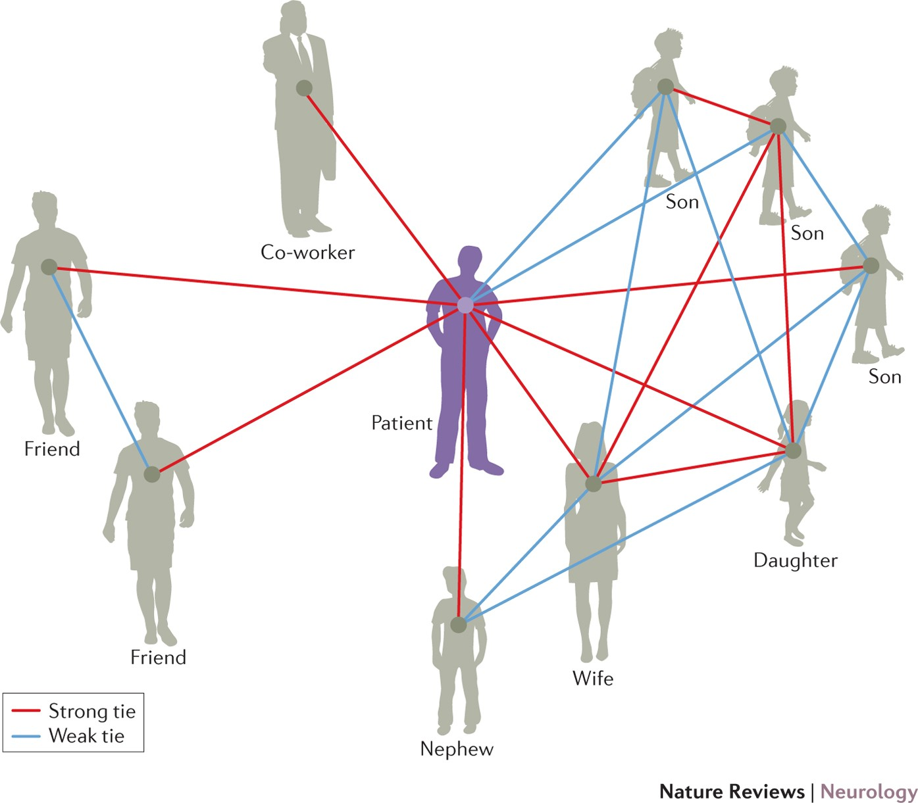
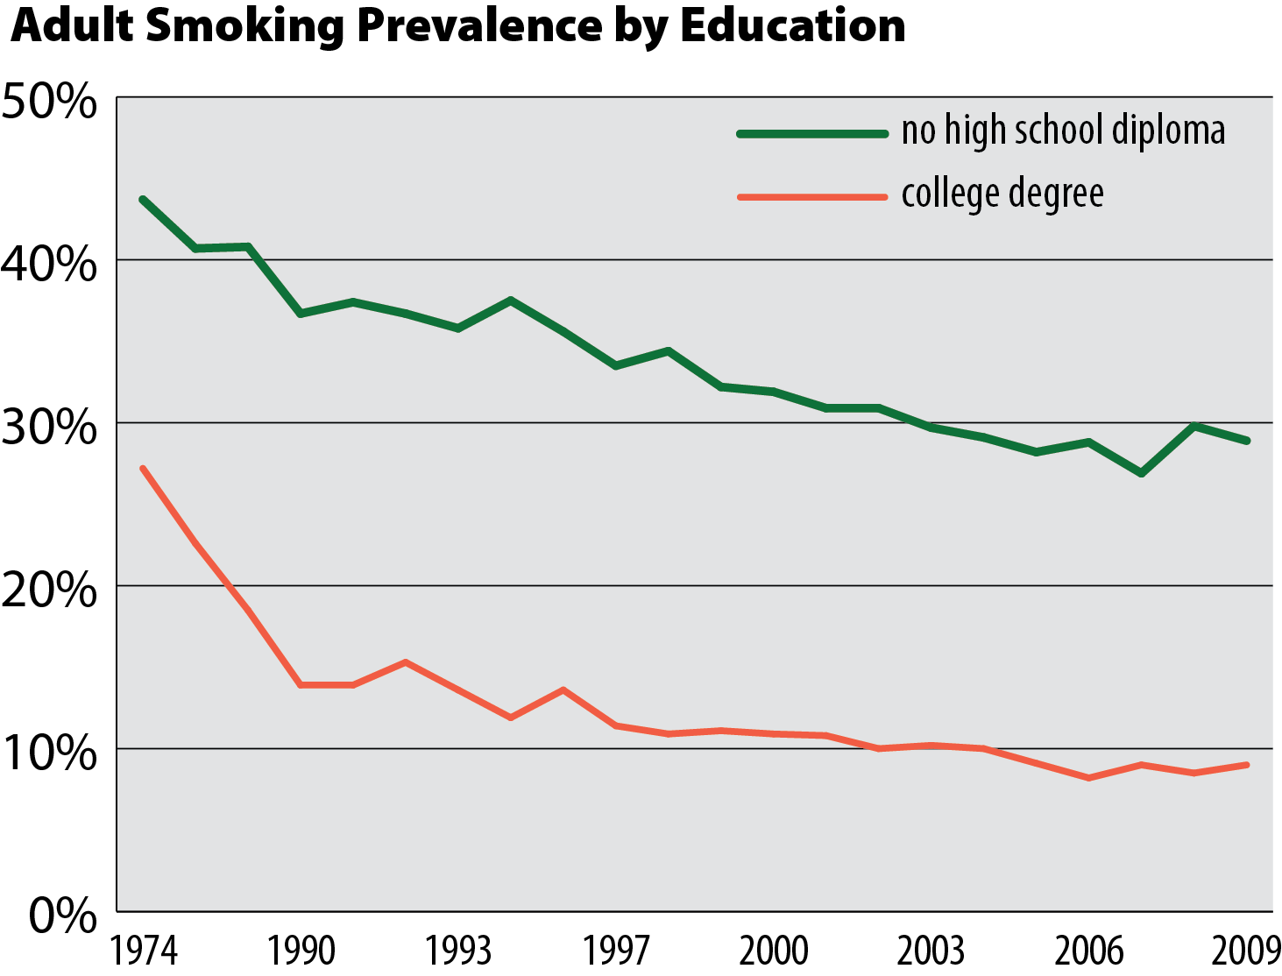
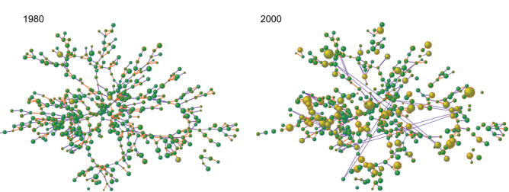
Other visualizations
Notes:
There are many more ways of visualizing data, from as simple as line graphs to mapping geographic data and personal and social network data. We can’t possibly cover them all in one module, but I encourage you to reach out and investigate interesting and compelling ways to display your data that make sense for your and your audience.

Slide 54
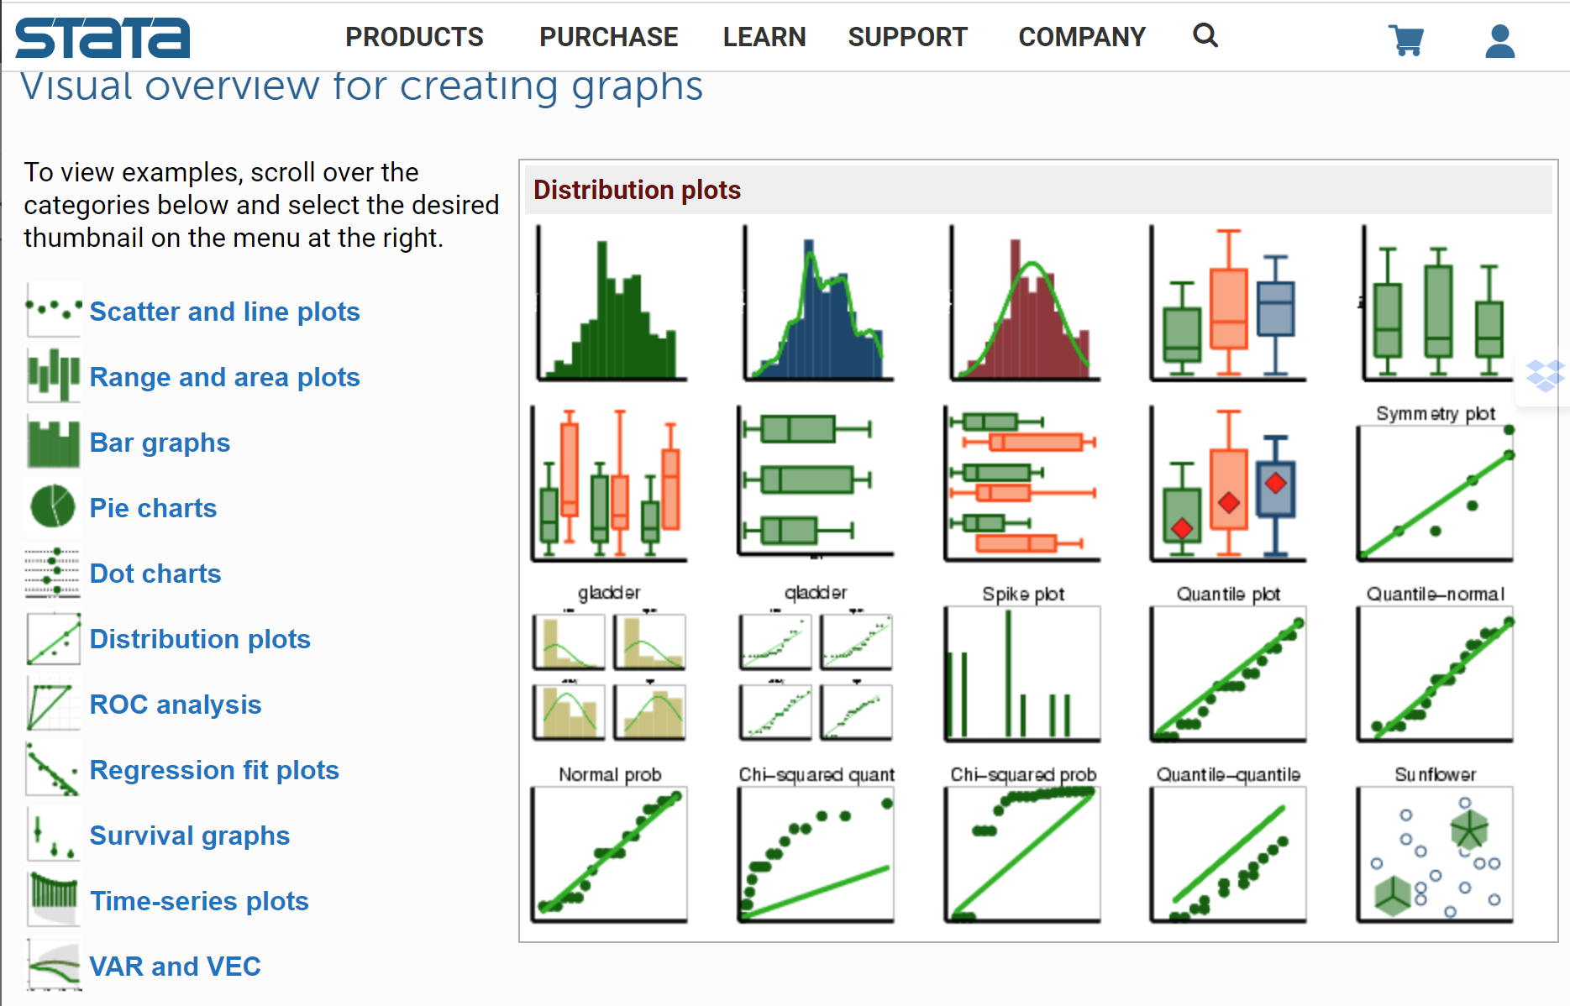
Every graph you can think of in Stata!
https://www.stata.com/support/faqs/graphics/gph/stata-graphs/
Notes:
If you need additional Stata syntax for creating graphs and charts, you can follow the link on this slide to a resource with Stata code for many visualizations.

Slide 55
In summary
Choosing the best graphical summary for your data depends on the data type
Frequency tables, bar charts, pie charts, mosaic plots are best for categorical data
Frequency tables, histograms, box plots, stem-and-leaf plots, and scatter plots are best for interval data
Histograms, bar charts, box plots, scatter plots, frequency polygons and line graphs can be used to show relationships between combinations of continuous and categorical data
Visualizing data in Stata can be completed using syntax in the related DO file or through the menu
Notes:
In summary, choosing the best graphical summary for your data depends on the data type. Frequency tables, bar charts, pie charts, mosaic plots are best for categorical data, and frequency tables, histograms, box plots, stem-and-leaf plots, and scatter plots are best for interval data. There are many charts that can be used to show relationships between combinations of continuous and categorical data, and visualizing data in Stata can be completed using syntax in the related DO file or through the menu.

Slide 56
Final Thoughts:
You are telling a story through your data, and data visualizations are the images that accompany your story. Whether the audience is only you as you manage your data, or is other scientists, or the greater population, use great graphs to make your story compelling.
Notes:
Final Thoughts: You are telling a story through your data, and data visualizations are the images that accompany your story. Whether the audience is only you as you manage your data, or is other scientists, or the greater population, use great graphs to make your story compelling

