Slide 1
Module 7 Statistical Analysis
Training developed by Roger Zoh, PhD and Kate Eddens, PhD, MPH
Indiana University School of Public Health
Department of Epidemiology and Biostatistics
In collaboration with the Ministry of Health Lao PDR
Training by Applied Nutrition Research Capacity Building (ANRCB), a project of the Lao American Nutrition Initiative (LANI)
This work is made possible through support from USAID/Laos as a supplement to a USAID Cooperative Agreement #7200AA18CA00009 (LASER-PULSE) to Purdue University. Contents reflect the views of the author(s) and do not necessarily reflect those of USAID.
For more information, please contact Catholic Relief Services Laos.
Notes:
Welcome to Module 7: Statistical Analysis

Slide 2
Module 7 Overview
This module should enhance your ability to:
Understand and use fundamental statistical approaches and analytic programs for research
Use Stata statistical software to manipulate data and perform descriptive and comparative analyses
Identify types of quantitative data and the most appropriate methods for summarizing and visualizing each
Conduct basic data cleaning and manipulation such as calculating new variables and creating dummy variables
Analyze data by comparing groups and conducting simple and multiple regression
Notes:
The goal of this module is to enhance your ability to do the following: understand and use fundamental statistical approaches and analytic programs for research, specifically using Stata statistical software to manipulate data and perform descriptive statistics and comparative analyses; identify types of quantitative data and the most appropriate methods for summarizing and visualizing each, conduct basic data cleaning and manipulation such as creating new variables and dummy variables; and analyze data by comparing groups and conducting simple and multiple regression.

Slide 3
Module 7 Overview
Statistical Analysis
7.1 – Getting Started with Stata
7.2 – Sources of Data: Experimental Studies or Observational Studies
7.3 – Descriptive Statistics and Tables
7.4 – Data Cleaning
7.5 – Data Visualization
7.6 – Comparing Groups
7.7 – Linear Regression
7.8 – Data Analysis Session and Revision – in person
Notes:
This is the structure of Module 7: we’ll begin with how to get started with basic function in Stata such as opening and describing data, then we’ll address different sources of data. We’ll move into more detailed descriptive statistics in Topic 7.3 and move through data cleaning and data visualization. Finally, we’ll walk through how to conduct comparative analyses and regression analyses in Stata, and your final data analysis session will be in person.

Slide 4
Topic 7.1: Getting Started with Stata
Training developed by Roger Zoh, PhD
with Kate Eddens, PhD, MPH
Indiana University School of Public Health
Department of Epidemiology and Biostatistics
In collaboration with the Ministry of Health Lao PDR
Training by Applied Nutrition Research Capacity Building (ANRCB), a project of the Lao American Nutrition Initiative (LANI)
This work is made possible through support from USAID/Laos as a supplement to a USAID Cooperative Agreement #7200AA18CA00009 (LASER-PULSE) to Purdue University. Contents reflect the views of the author(s) and do not necessarily reflect those of USAID.
For more information, please contact Catholic Relief Services Laos.
Notes:
Let’s begin with Topic 7.1: Getting started with Stata.

Slide 5
Session Objectives
After this session, you will have a basic understanding of Stata statistical analysis software, and will be able to:
Recognize the parts of a Stata screen
See and set a working directory for data
Create and save a log file and a do file (syntax)
Open a data file, save a data file, and import a dataset
Explore variables and data
Notes:
The objective of this section is for you to gain a basic understanding of Stata statistical analysis software. You will be able to recognize the parts of a Stata screen, see and set a working directory for your data so that it is easy to access, create and save a log file of commands performed and a do file, which is your syntax, open and save data files as well as import a dataset, and explore variables and data using Stata.

Slide 6
What is STATA?
It is a multi-purpose statistical package to help you explore, summarize, and analyze datasets.
A dataset is a collection of measures of information called variables (usually arranged by columns). A variable can have one or several values, or observations, for one or several cases.
Other statistical packages are R, SAS and SPSS.
Stata is widely used in social science research
Features | Stata | SPSS | SAS | R
Learning curve | Steep/gradual | Gradual/flat | Pretty steep | Pretty steep
User interface | Programming/point-and-click | Mostly point-and-click | Programming | Programming
Data manipulation | Very strong | Moderate | Very strong | Very strong
Data analysis | Powerful | Powerful | Powerful/versatile | Powerful/versatile
Graphics | Very good | Very good | Good | Excellent
Cost | Affordable (perpetual licenses, renew only when upgrade) | Expensive (but not need to renew until upgrade, long term licenses) | Expensive (yearly renewal) | Open source (free)
Notes:
Stata is a multi-purpose statistical package with which you can explore, summarize, and analyze datasets. We consider a dataset to be a collection of several measures of information called variables, which are typically arranged in columns. And each of these variables can have one or several values, or observations for one or several cases. You may be familiar with other statistical packages such as R, SAS, and SPSS. Stata is widely used in social science research, and is a powerful and useful tool for manipulating, analyzing and visualizing data. Other packages such as R are free to access but much more difficult to learn than Stata or SPSS. Stata takes a little time to learn, but it is also affordable in that a license is perpetual, and you only need to renew when you upgrade your package.

Slide 7
STATA 17 Screen
Notes:
This is the home screen for Stata version 17. If you are able to follow along with a version of Stata, that would be helpful, but you can always refer back to these slides for practice when you have access to Stata.

Slide 8
STATA 17 Screen (Parts)
Variable Window: Displays variables in your data set
Results Window:
Shows the results of your commands
History Window: Displays recent
commands for quick access
Properties Window: Displays characteristics of variables in your dataset
Command Window: Type STATA commands here
Notes:
The central window here is the results window. This window will display the results of any commands that you run. This is the command window, where you can type the commands that you want Stata to run on your data. To the left of the screen is the history window that displays the recent commands you’ve run, and any errors that occurred while running them. On the upper right side of your screen is the variable window, where you can find a list of the variables in your dataset. Below this, on the bottom right, is the Properties Window, which displays characteristics of the variables in your data.

Slide 9
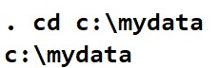
First Steps: Working Directory
To see your working directory, type (in the command window) : pwd
To change the working directory to avoid typing the whole path when calling or saving files, type: cd c:\mydata
Use quotes if the new directory has blank spaces; for example: cd “h:\stata and data”
pwd
h : \ s t a t a d a t a
Notes:
The first step to take in Stata is to set your working directory. This is the path to whatever folder you would like to store your data in as you work in Stata. In these slides, the text in red is the actual text of the command that you type into your command line, and the text in blue is the text that you type into the command line that is unique to your data. The bold black text is what Stata returns in the results window when you execute the command. To see where your working directory is, you can type pwd, and Stata will return the directory in which your data will be stored. In this example, we have a directory in the H drive called “statadata.” If you want to change this directory, you type the letters “cd” for “change directory” and then the file path to whatever directory you want to use for your Stata project. In this example, we’re changing the directory to the c drive, in a folder called my data. If your directory name has any spaces in it, for example, “stata and data”, then you want to put quotes around the entire directory path.

Slide 10
First Steps: log file (optional)
Create a log file, sort of Stata’s built-in tape recorder and where you can
1) retrieve the output of your work, and 2) keep a record of your work.
In the command line type:
log using mylog.log
This will create the file ‘mylog.log’ in your working directory. You can read it using any word processor (notepad, word, etc.).
To close a log file type:
log close
To add more output to an existing log file add the option append, type:
log using mylog.log, append
To replace a log file add the option replace, type:
log using mylog.log, replace
*Note that the option replace will delete the contents of the previous version of the log.
Notes:
The next step is optional, but recommended, and that is to create a log file. This is essentially Stata’s built-in tape recorder, where you can retrieve your work and keep a record of your work. To do this, type into the command line the text “log using” and then the name you would like to give to your log file. This will create the file “mylog.log” or whatever you choose to call it, with the .log extension, in your working directory. You and anyone else you share it with can read it using any word processor such as notepad, word, and such. But you must save it as .log to keep it in a universal format. If you use the point and click window to start and save the log file, the default is to save as an .smcl file, which requires a special program to open. To close a log file you can simply type “log close” and to add more output to your log file, you can type “log using (your log file name), append”. And if you want to replace a log file, you can use the above command with replace, but note that this WILL DELETE the contents of your previous version of the log.

Slide 11
First Steps: DO file (please do the DO!)
Do-files are ASCII files that contain of Stata commands to run specific procedures. Note that they end with “.do”
It is highly recommended to use do-files to store your commands so do you not have to type them again should you need to re-do your work.
Always use comments * comments go here *
For comments on multiple lines use /* comments go here */
Do file
Click here to open a new do file
Or type doedit
In the command window
Notes:
The next important step in setting yourself up to work in Stata is to create a “DO” file. This is essentially your syntax file, where you’ll keep all of the commands that you write and run. Do files end with the file extension d.o., or do. It is strongly recommended to use do files to store your commands as you work!! This way you do not need to type them and create them again when you need to re-do your analyses or run data cleaning on an updated dataset. It also helps you to know HOW you created variables or ran certain analyses. As I put in the title, please do the do!!! You can start a new do file by either using the point and click menu, or by typing “doedit” into the command line. You can save your comments in a do file by putting asterisks around any comments and use forward slashes to separate lines. I’ll show you an example on the next slide.

Slide 12
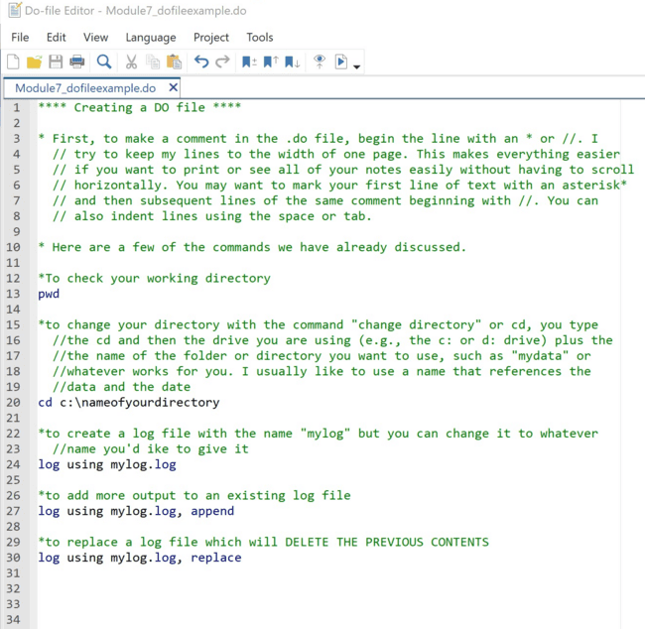
First Steps: DO file
Always use comments, with asterisks **
* comments go here *
For comments on multiple lines use //
/* comments go here */
Or
*comments start here and
//then continue here
Notes:
You can see in this example that I’ve created a do file and began the comments in it with asterisks, then continued each line of comments with two forward slashes. You can do it several ways, but this is how I like to create comments. You can find this do file in the same folder with your presentation, or perhaps the team has provided you with a copy of the do file.

Slide 13
First steps: Opening/saving Stata files (*.dta)
To open files already in Stata with extension *.dta, run Stata and you can either:
1) Go to file -> open in the menu, or
2) Type use “c:\mydata\mydatafile.dta”
If your working directory is already set to c:\mydata, just type:
use mydatafile
To save a data file from Stata go to file –> save as or just type: save, replace
If the dataset is new or just imported from other format go to file –> save as or just type:
save mydatafile /*Pick a name for your file*/
Notes:
To open files that are already in the .dta format and file extension, you can either use the point and click menu by going to “file” and then “open” and then navigating to your data, or type the command “use” and then the file path to your data file. If the file is already in your working directory, you can type the command “use” and then the name of your data file. To save your data from Stata, you can use the menu by going to “file” and then “save as” or simply type the commands “save, replace”

Slide 14
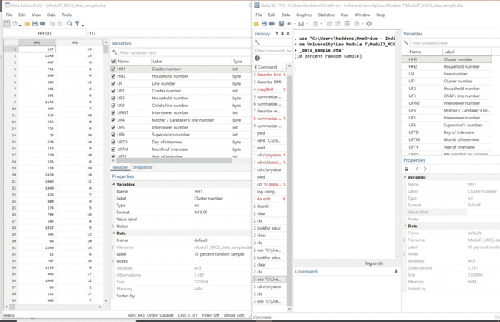
First steps: Import a data set
Open dataset using data editor (with “use” command)
Or with “file” → “open” or “file” → “import”
Notes:
You can open or import csv or other tabular data in Stata using either the “use” command in the data editor or by using the dropdown menu to select file and then open or file and then import.

Slide 15
First steps: using clear and cls
Type clear in the command window to remove the data from STATA memory
Type cls to clear the output window
Notes:
You can use the clear command to remove previous data from Stata’s memory and the cls command to clear the output window for a fresh start.

Slide 16
First steps: Quick way of finding variables (lookfor)
You can use the command look for to find variables in a dataset
For example, you want to see which variables refer to education, type:
lookfor educ
lookfor will look for the key word ‘educ’ in the variable name and labels.
You will need to be creative with your key word searches to find the variables you need.
It always recommended to use the codebook that comes with the dataset to have a better idea of where things are.
Notes:
You can use the command look for to find variables in a dataset. It works like a search function. For example, if you want to look for variables that refer to education, you can type the command “lookfor” in the command window followed by the first four letters of education “educ” in this example, and Stata will find the key word “educ” in variable names and labels. You might need to be creative to find the variables that you need, but you can always refer to the codebook that might come with the data to find your variables.

Slide 17
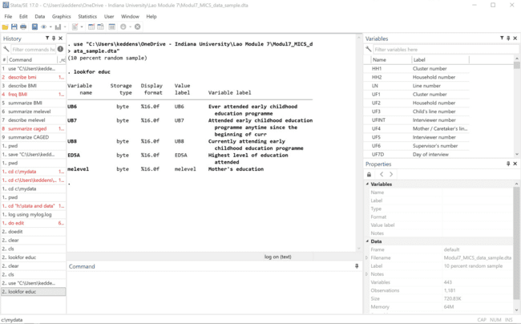
Example of Look For (lookfor)
Notes:
If we use the lookfor command with the stem “educ” for education in the MICS data, we can see that there are five variables that include the word education in their description, including highest level of education attended, mother’s education, and variables measuring attendance at early childhood education programs.

Slide 18
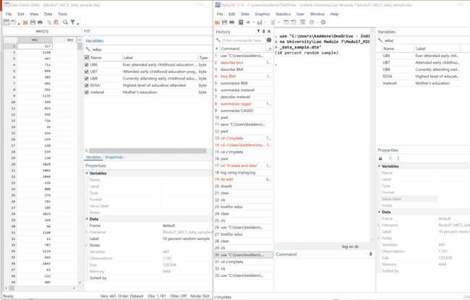
Example of Look For (lookfor)
You can also type your key words into the search bars in the Variables Windows in the Data Editor or on the main Stata page
Notes:
You can also use the “variables” window in both the Data Editor and the main Stata screen and simply type “educ” into the search bar, and you’ll find the same variables are selected. However, this will NOT print your action into the Results window, which you might want to have to save for your log.

Slide 19
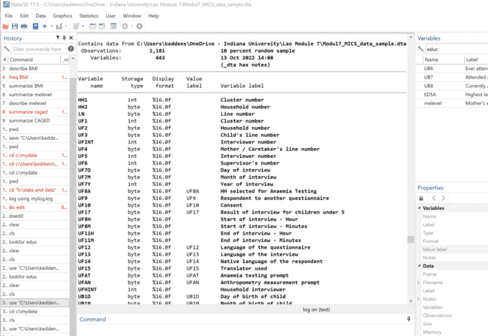
Data Exploration: describe command
To get a general description of the dataset and the format for each variable type: describe
Notes:
The “describe” command provides a general description of the dataset and the format for each variable type. You can type “describe” into the command window and the information will print into the results window. It will tell you both the number of variables and the number of observations, and it will list the variable names, types, value label, and variable label or description.

Slide 20
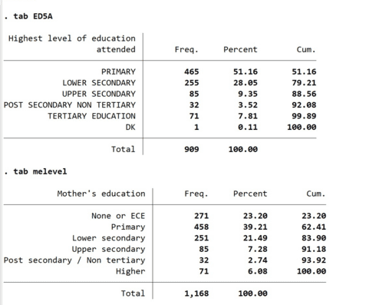
Data Exploration: Frequencies
Name of variable
We can use: tab name of variable
‘Freq.’ provides a raw count of each value. In this case, for example, 465 respondents completed primary school as the highest level of education
‘Percent’ gives the relative frequency for each value. For example, 6.08% of the study participants had mothers who completed higher education
‘Cum.’ is the cumulative frequency in ascending order of the values
Notes:
To calculate frequencies of values of a categorical variable along with their proportions and the cumulative percent, you can use the command “tab” in the command window, and then the name of your variable or variables that you would like to explore. Here, we typed “tab” with the variable “ED5A”, which is the highest level of education attained by the participant, shown in the top table, and in the bottom table, the frequencies for “melevel”, which is the variable representing levels of education of the participant’s mother.

Slide 21
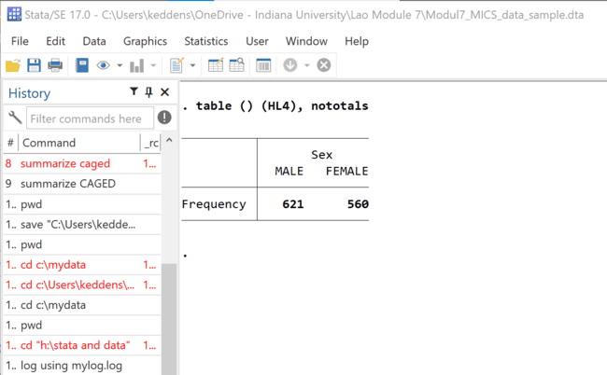
Data Exploration: Using table function
Command table produces frequencies and descriptive statistics per category.
For more info and a list of all statistics type help table.
Here are some examples, type table () (HL4) (), nototals
.
Notes:
You can use the command “table” to produce frequencies and descriptive statistics per category. You can type the command “help table” to get a list of all statistics that you can run with the table command. For a simple example, in the MICS dataset, the variable for sex or gender is HL4. So if we type table and the commands listed above with HL4 as the variable for sex, we get a table of just the frequencies of male and female sex in the MICS sample, and we see we have 621 males and 560 females.

Slide 22
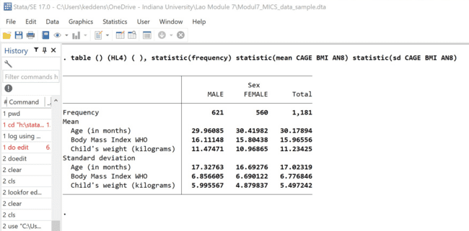
Data Exploration: Using table function
table () (HL4) ( ), statistic(frequency) statistic(mean CAGE BMI AN8) statistic(sd CAGE BMI AN8)
CAGE = child’s age in months
BMI = body mass index
AN8 = child’s weight in kilograms
Notes:
You can see in this example that by adding a few simple commands using the term “statistics,” we can get information about the means and standard deviations of several continuous variables, displayed for each gender and in total. There are many ways you can use the table function to visualize and understand how multiple variables are distributed in your data.

Slide 23
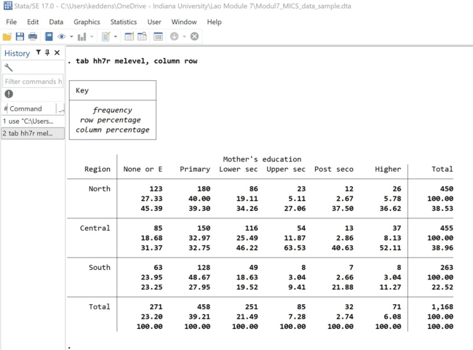
Data Exploration: Using tab function
Variable 1
Variable 2
STATA code: tab hh7r melevel, column row
Notes:
You can use the tab function again to create crosstabs, or a table of categorical variables in both the row and column. By adding the terms “column row” in the command line, you ask Stata to provide the column and row percentages in the data. In this example, we look at how mother’s education level is distributed by region of Lao PDR. This is not testing differences in proportions by region, it is simply looking at how mother’s education level is distributed in each region.

Slide 24
Now, you should be able to: Open and import data in Stata Describe your dataset Find variables in your data Create tables of means and frequencies of variables Evaluate the distribution of variables by other variables
Notes:
Now, you should be able to: Open and import data in Stata, describe your dataset, find variables in your data, create tables of means and frequencies of variables, and evaluate the distribution of variables by other variables. If you have access to Stata and the MICS 10% sample data, see if you can reproduce some of the tables you’ve seen in this presentation.

