Slide 1
Module 8: Food Safety
Leah Thompson
Purdue University
Training by the Applied Nutrition Research Capacity Building (ANRCB) project of the Lao American Nutrition Initiative (LANI)
This work is made possible through support from USAID as a supplement to a USAID Cooperative Agreement #7200AA18CA00009 (LASER-PULSE) to Purdue University. Contents reflect the views of the author(s) and do not necessarily reflect those of USAID.
For more information, please contact Catholic Relief Services Laos.
Notes:
Goal: 30 min

Slide 2
Sickness caused by food
Foodborne illness
=
Notes:
Start out with a definition of foodborne illness

Slide 3
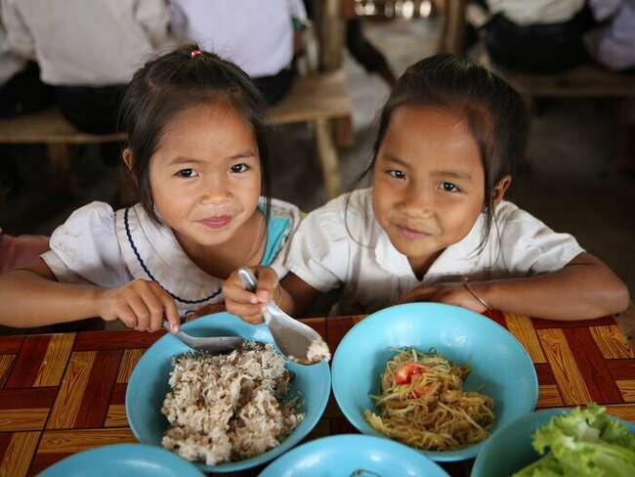
Foodborne Illnesses Greatly Impact Global Health & Nutrition
1 in 10 people become sick from eating unsafe food every year (WHO, 2015)
40% of foodborne illnesses occur in children <5 years (WHO, UNICEF, & WBG, 2020) → 125,000 deaths/year (WHO, 2015)
Diarrheal disease agents = most common cause of foodborne illnesses (WHO, 2015)
WFP/ /Vilakhone Sipaseuth, 2022
Notes:
WHO, 2015 → https://apps.who.int/iris/bitstream/handle/10665/199350/9789241565165_eng.pdf?sequence=1
WHO, UNICEF, & WBG 2020 (from Lao paper) → https://www.who.int/publications/i/item/rs-2018-ge-50-lao
Picture source: https://www.wfp.org/countries/lao-peoples-democratic-republic

Slide 4
Negative Effects of Consuming Unsafe Food
Malnutrition
Poor Productivity
Death
Wasting
Chronic Disease
Stunting
Economic Loss
Acute Disease
Notes:
Stunting, malnutrition, wasting, acute disease, chronic disease, economic loss, poor productivity, death

Slide 5
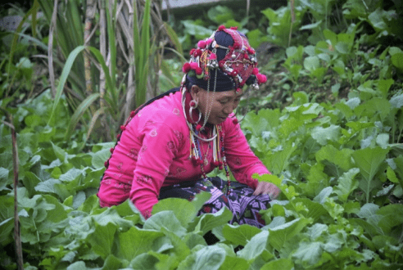
Foodborne Illnesses Greatly Impact Global Health & Nutrition
175,000 deaths/year in Southeast Asia (WHO Regional Office for South-East Asia, 2016)
Consuming unsafe food → difficulty absorbing nutrients
In Lao PDR 33% of children < 5 are stunted (WFP, 2022)
High-risk populations: low-income communities, those who are pregnant, immunocompromised, or elderly
WFP/Vilakhone Sipaseuth, 2020
Notes:
Stunting, where height is low for age, is an indicator of chronic undernutrition. In Lao PDR, 33% of children under 5 are stunted, and the consumption of unsafe foods is a significant contributor to this.
WHO Regional Office for South-East Asia, 2016 (from Lao paper) → https://apps.who.int/iris/rest/bitstreams/1278964/retrieve
WHO, 2015 → https://apps.who.int/iris/bitstream/handle/10665/199350/9789241565165_eng.pdf?sequence=1
WFP, 2022 → https://www.wfp.org/countries/lao-peoples-democratic-republic
Picture: https://docs.wfp.org/api/documents/WFP-0000113995/download/?_ga=2.138281136.1822686870.1661364583-543683521.1661364583

Slide 6
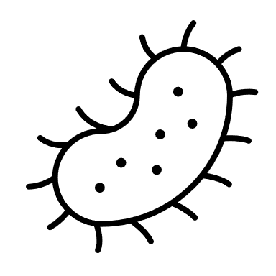
Foodborne Illnesses are Preventable
Notes:
Foodborne illnesses are preventable and there are many actions we can take to prevent illness from unsafe food and improve nutrition

Slide 7
Definitions to Remember
Food Safety = all necessary measures or systems undertaken to guarantee food is safe for consumption
HYGIENE
Personal Hygiene
Bodily cleanliness and care
Environmental Hygiene
Cleanliness in food preparation and living areas
Notes:
Dr. R’s definitions. Do not know the source

Slide 8
Sources of Food Contamination
Raw materials/
ingredients
Manure
Packaging materials
Water
FOOD
Food handlers
Air/dust
Animals and
birds
Soil
Rodents
Garbage and sewage
Insects

Slide 9
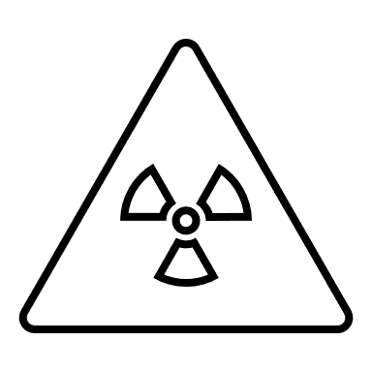
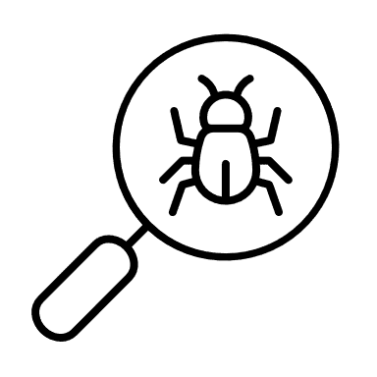
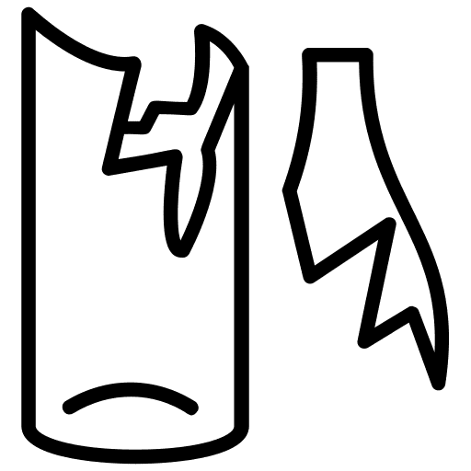
Three Types of Food Contaminants
Chemical
Microbial
Physical

Slide 10
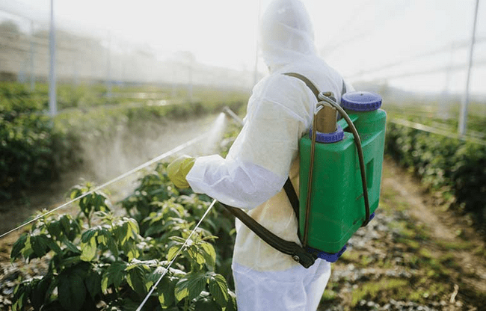
Types of Food Contaminants
Chemical
Chemicals can increase production
Chemicals must be applied at the correct levels + time
Legal pesticide imports increased 3,700% in a decade (Neely, 2022)
Contamination can come from lack of regulation
Safety and Health Magazine, 2019
Notes:
Chemicals are useful in food production because they can promote growth either through fertilizer or can fight pests and diseases
However, chemicals must be applied safely and at the correct levels, otherwise they are dangerous to human health and the environment
Chemicals also occur naturally, such as aflatoxins which come from mold
Legal pesticide imports increased by more than 3,700% between 2009 and 2019 (Neely, 2022; https://www.agrilinks.org/post/sustainable-maize-production-human-health-and-biodiversity-laos)
Picture source: https://www.safetyandhealthmagazine.com/articles/19064-epa-requests-comment-on-health-ecological-risks-of-paraquat
- Industrial runoff, mixing chemicals, unapproved chemicals (Ex: Overuse of pesticides and herbicides made workers sick and contaminated water paraquat for bananas https://www.reuters.com/article/us-china-silkroad-laos/cash-and-chemicals-for-laos-chinese-banana-boom-a-blessing-and-curse-idUSKBN187334)

Slide 11
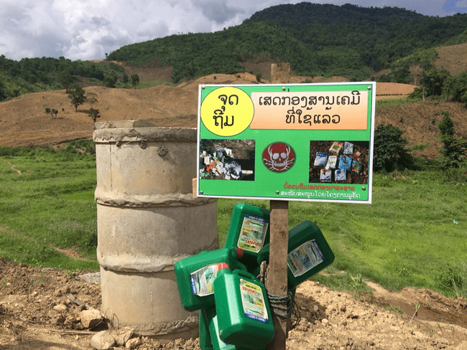
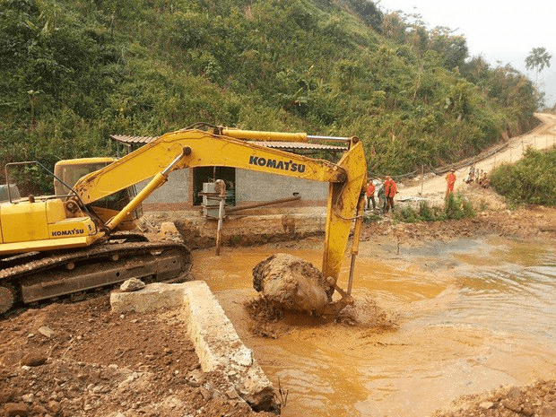
Types of Food Contaminants
Chemical
Contamination Sources:
→ Overuse or mixing
→ Instructions not in Lao
→ Illiteracy
→ Lack of training
→ Industrial runoff
Neely, 2022
Radio Free Asia, 2015
Notes:
Sources of chemical contamination can come from lack of regulation so overuse, instructions not in Lao or user is not literate, never any training in how to store or apply
An estimated 150 million people are vulnerable to arsenic contaminated drinking water, 110 million of which live in 10 countries in South and Southeast Asia, including Lao PDR (Singh et al., 2015)
Less research has been conducted on chemical contaminants in Laos compared to microbial contaminants
Zinc, lead, and chromium in water spinach levels exceeded WHO standards (Vongdala et al., 2019)
Bonylip barn fish in water near mine that had too high levels of nickel, iron, and manganese had altered chromosomes and serum liver aberrations (soulivongsa et al., 2020)
Dangerous chemicals pic: https://www.agrilinks.org/post/sustainable-maize-production-human-health-and-biodiversity-laos
Runoff water pic: https://www.rfa.org/english/news/laos/laos-mining-07242015151423.html

Slide 12
Types of Food Contaminants
Chemical
Examples:
1/3 of public blood samples with “unacceptable” levels of pesticide residues (LURAS)
> 50% of produce in Xiangkhouang contaminated with pesticides and herbicides (LURAS, 2015)
Gold-copper mine runoff contaminated water
→ damaged chromosome + liver in Bonylip Barb fish (Soulivongsa et al., 2020)
Notes:
A study done by the Lao Faciliatated Initiative on Agroecology for ASEAN found that 1/3 of blood public blood samples contained “unacceptable” levels of pesticide residues (https://ali-sea.org/project/luras-lao-upland-advisory-services/)
In a study of 600 samples, more than 50% of fruits and vegetables from markets in Xiangkhouang had pesticide and herbicide residues on them (https://www.asianews.it/news-en/Farmers-in-Xiangkhouang-poisoned-by-pesticides-and-herbicides-in-food-43279.html)
Bonylip barn fish in water near mine that had too high levels of nickel, iron, and manganese had altered chromosomes and serum liver aberrations (soulivongsa et al., 2020)

Slide 13
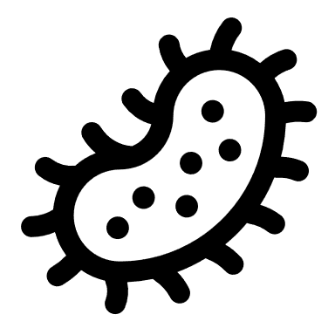
Types of Food Contaminants
Microbial
Parasites + bacteria + viruses
Found in soil, feces, water, etc.
Reside on surfaces of all types of food
Can lead to acute and chronic diseases
Zoonotic disease = diseases that can be transmitted between humans and animals
Notes:
Microogranisms include parasites, bacteria, and viruses.
Can be found on most surfaces and all types of food and can lead to acute and chronic diseases
Diseases that come from animal foods like meat or milk = zoonotic

Slide 14
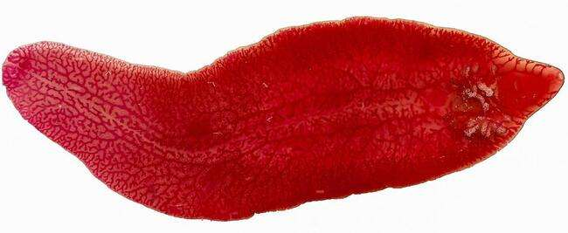
Types of Food Contaminants
Microbial
Most research has been conducted on parasites
Champasack Province → 61% of people tested infected with liver fluke (Forrer et al., 2012)
Associated with consumption of raw fish
Xayaseng et al., 2013
Medical News Today, 2017
Notes:
Of the three types of microbial contaminants, the most available research in Lao has been conducted on parasitic contaminants.
61% of people tested in Champasack Province were infected with liver fluke (O. viverrine), often associated with raw/undercooked fish and can lead to biliary disease and bile duct cancer (Forrer et al., 2012)
Salmonella and enteropathogenic E. coli were the leading foodborne pathogens during the wet season (Houattongkham et al., 2020)

Slide 15
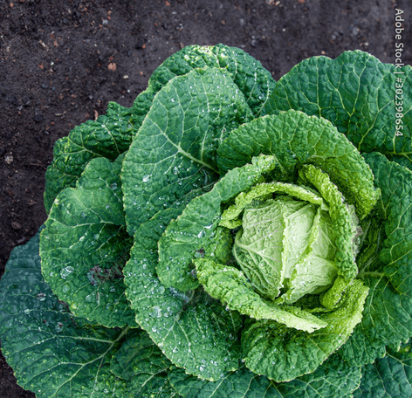
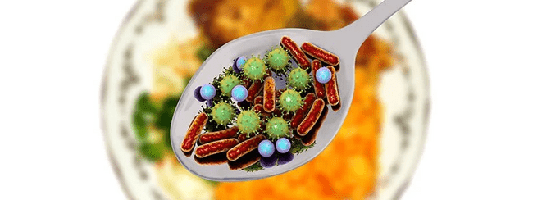
Types of Food Contaminants
Microbial
Salmonella & E. coli were leading foodborne pathogens during wet season (Houattongkham et al., 2020)
Village water in Luang Prabang contained Aeromonas spp., Vibrio spp., and E. coli (Ribas et al., 2017)
→ Lead to diarrheal disease
Wedro, 2022
Notes:
Salmonella and enteropathogenic E. coli were the leading foodborne pathogens during the wet season (Houattongkham et al., 2020)
Another study tested the village water in village in Luang Prabang and found a range of enteric pathogens, such as Aeromonas, Vibrio, and E. coli. These all cause diarrheal disease.
Spoon pic: https://www.medicinenet.com/food_poisoning/article.htm

Slide 16
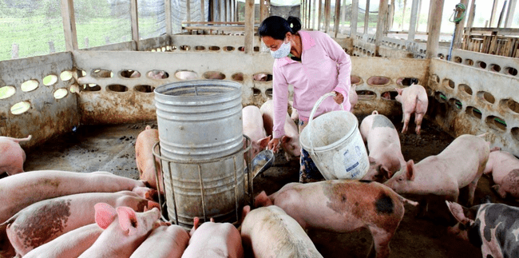
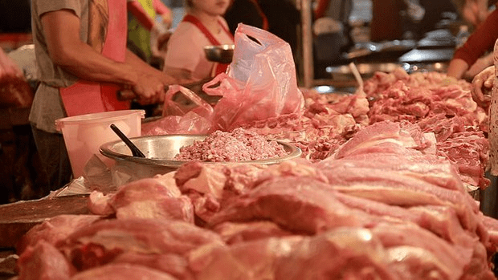
Types of Food Contaminants
Microbial
Pig farmers + slaughterhouse workers = more likely to contract Hepatitis E Virus (HEV)
54% of slaughter pigs had HEV antibodies (Khounvisith et al., 2018)
International Fund for Agricultural Development, 2022
Radio Free Asia, 2019
Notes:
Salmonella and enteropathogenic E. coli were the leading foodborne pathogens during the wet season (Houattongkham et al., 2020)
Pig farmers and slaughterhouse workers were more likely to have contracted hepatitis E virus (HEV) than other farmers (41% vs 18%) and 54% of slaughter pigs had HEV antibodies (Khounvisith et al., 2018)
Pork picture: https://www.rfa.org/english/news/laos/laos-pork-shortage-02142020134745.html
Farmer picture: https://www.ifad.org/en/web/latest/-/take-a-360%C2%B0-tour-of-a-small-thriving-pig-farm-in-the-green-hills-of-lao-pdr?p_l_back_url=%2Fen%2Fweb%2Flatest

Slide 17
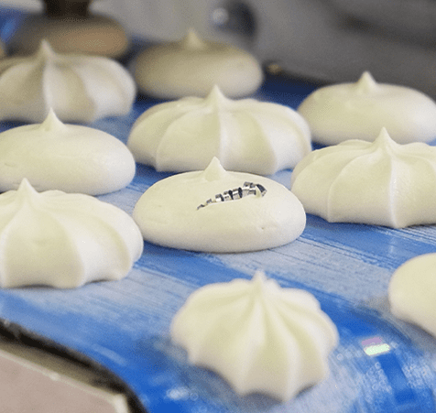
Types of Food Contaminants
Physical
Foreign materials in food that should not be present
Can cause physical harm to consumer such as choking or cutting
Examples: broken glass/metals/plastics during food processing, jewelry, machine grease, hair/nails, etc.
Chilton & Newbold
Moran, 2018
Notes:
Physical contaminants are any objects present in food that are not supposed to be there.
Examples include broken glass during food processing, a bandage from a restaurant worker, or a piece of plastic
Could cause physical harm to consumer such as choking or cuts
Metal picture: https://www.alchemysystems.com/resources/webinars/foreign-material-prevention/
Broken glass picture: https://www.newfoodmagazine.com/article/73775/keeping-the-bad-stuff-out/

Slide 18
Food Value Chain
2.
4.
Processing
Preparation
1.
3.
5.
Transport
Production
Consumption
Notes:
food production, processing, transport, preparation & consumption

Slide 19
Food Value Chain
Includes growing and harvesting of food sources
Includes small- and large-scale farmers
Contamination contributors: Poor soil and water, overuse of chemicals, improper management of animal health, poor waste/manure management
1.
Production
Notes:
Food production involves the growing and harvesting of food sources, from small scale farms to large corporate ones.
Food can be contaminated at the production level from poor soil and water, overuse of chemicals, improper management of animal health, or poor waste management.

Slide 20
Food Value Chain
Includes livestock slaughter, drying, packaging food, value-added products
Can occur at multiple locations
Contamination contributors: broken glass/piece of machinery, packaging materials, improper washing and hygiene, added microbial growth
2.
Processing
Notes:
The processing stage relates to activities such as livestock slaughter, packaging food, making value-added products that improve the shelf life or nutritional value of food. Depending on the operation, processing can happen at the same location as the production site.
Examples of contamination at the processing level include broken glass (such as a broken light or piece of machinery), if packaging materials themselves are not sanitized, improper washing of foods like produce, poor worker hygiene, etc.
Paul: same as comment on previous slide (and the next ones, too). Processing also could include things like drying, etc. That might be relatable. Also, things can become newly contaminated (microbial) during processing or could grow. Milk is a good example.

Slide 21
Food Value Chain
3.
Transport of food occurs between the different steps in the value chain
Contamination contributors: improper sanitation of food containers or vehicles, unhygienic handling, improper storage temperatures
Transport
Notes:
While transportation is illustrated in the middle of the value chain here, transport can occur between any of the value chain steps. This includes personal transport from the market or from farm to processing facility.
Contaminations commonly occur whenever transport vehicles (truck, motorbike, etc.) are not sanitized between trips or likewise when food containers are not sanitized properly. Another significant contributor is poor storage temperatures of food when they are in transport vehicles. If there is no cooling system in a truck and food sits for long periods of time, it fosters an environment for bacterial growth.

Slide 22
Food Value Chain
4.
Includes street food vendors or restaurants
Contamination contributors: poor hygiene, allowing cooked food to touch raw food or surfaces that raw food has touched (cross contamination), undercooking food, improper storage
Preparation
Notes:
The preparation stage does not just apply to preparing a meal at home. It can also mean street food vendors or restaurants.
Contamination at the food preparation stage can come from general lack of hygiene, allowing cooked food to touch raw food or surfaces that raw food has also touched, undercooking food, improper storage prior to eating food.

Slide 23
Food Value Chain
5.
Includes everyone
Contamination contributors: poor transportation and preparation, unwashed hands, improper storage of leftovers, eating expired food
Notes:
While not everyone may be a food producer or processor, everyone is a food consumer.
As previously mentioned, consumers can facilitate contamination during transport and preparation, or from not washing hands before eating, improper storage of leftovers, or eating expired food.

Slide 24
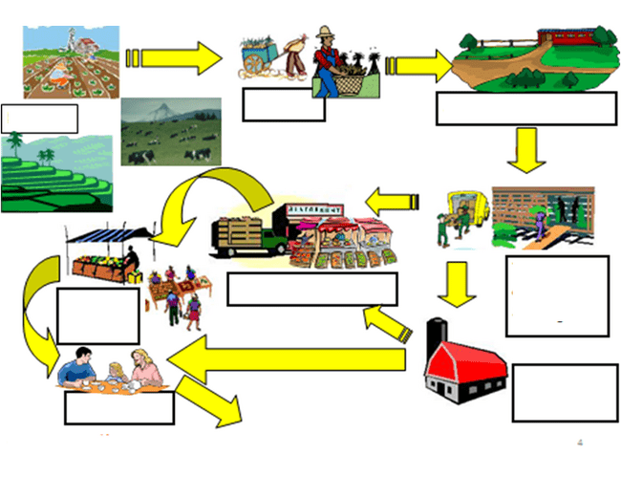
Food Value Chain
Hauling
Processing
Farm
Food Distribution
Transport
and
Storage
Wholesale Market
Retail
Market
Secondary
Processing
Consumers
Nutrient Utilization
Notes:
- This is a more detailed illustration of the different pathways within the food value chain from Dr. R.

Slide 25
Prevention = Eliminating Contaminants at the Source
Raw materials/
ingredients
Manure
Packaging materials
Water
FOOD
Food handlers
Air/dust
Animals and
birds
Soil
Rodents
Garbage and sewage
Insects

Slide 26
Takeaway Messages
Foodborne illnesses are a significant risk to human health, specifically children
Foodborne illnesses are preventable
Three sources of food contamination: chemical, microbial, and physical
The food value chain include production, processing, transportation, preparation, and consumption and there are many opportunities for contamination to occur
Notes:
Does Lao PDR recognize the right to food formally/legally?

Slide 27
Next Session
Practical strategies that reduce the risk of foodborne illnesses
Notes:
Does Lao PDR recognize the right to food formally/legally?

Slide 28
Thank you!

